Slide 1
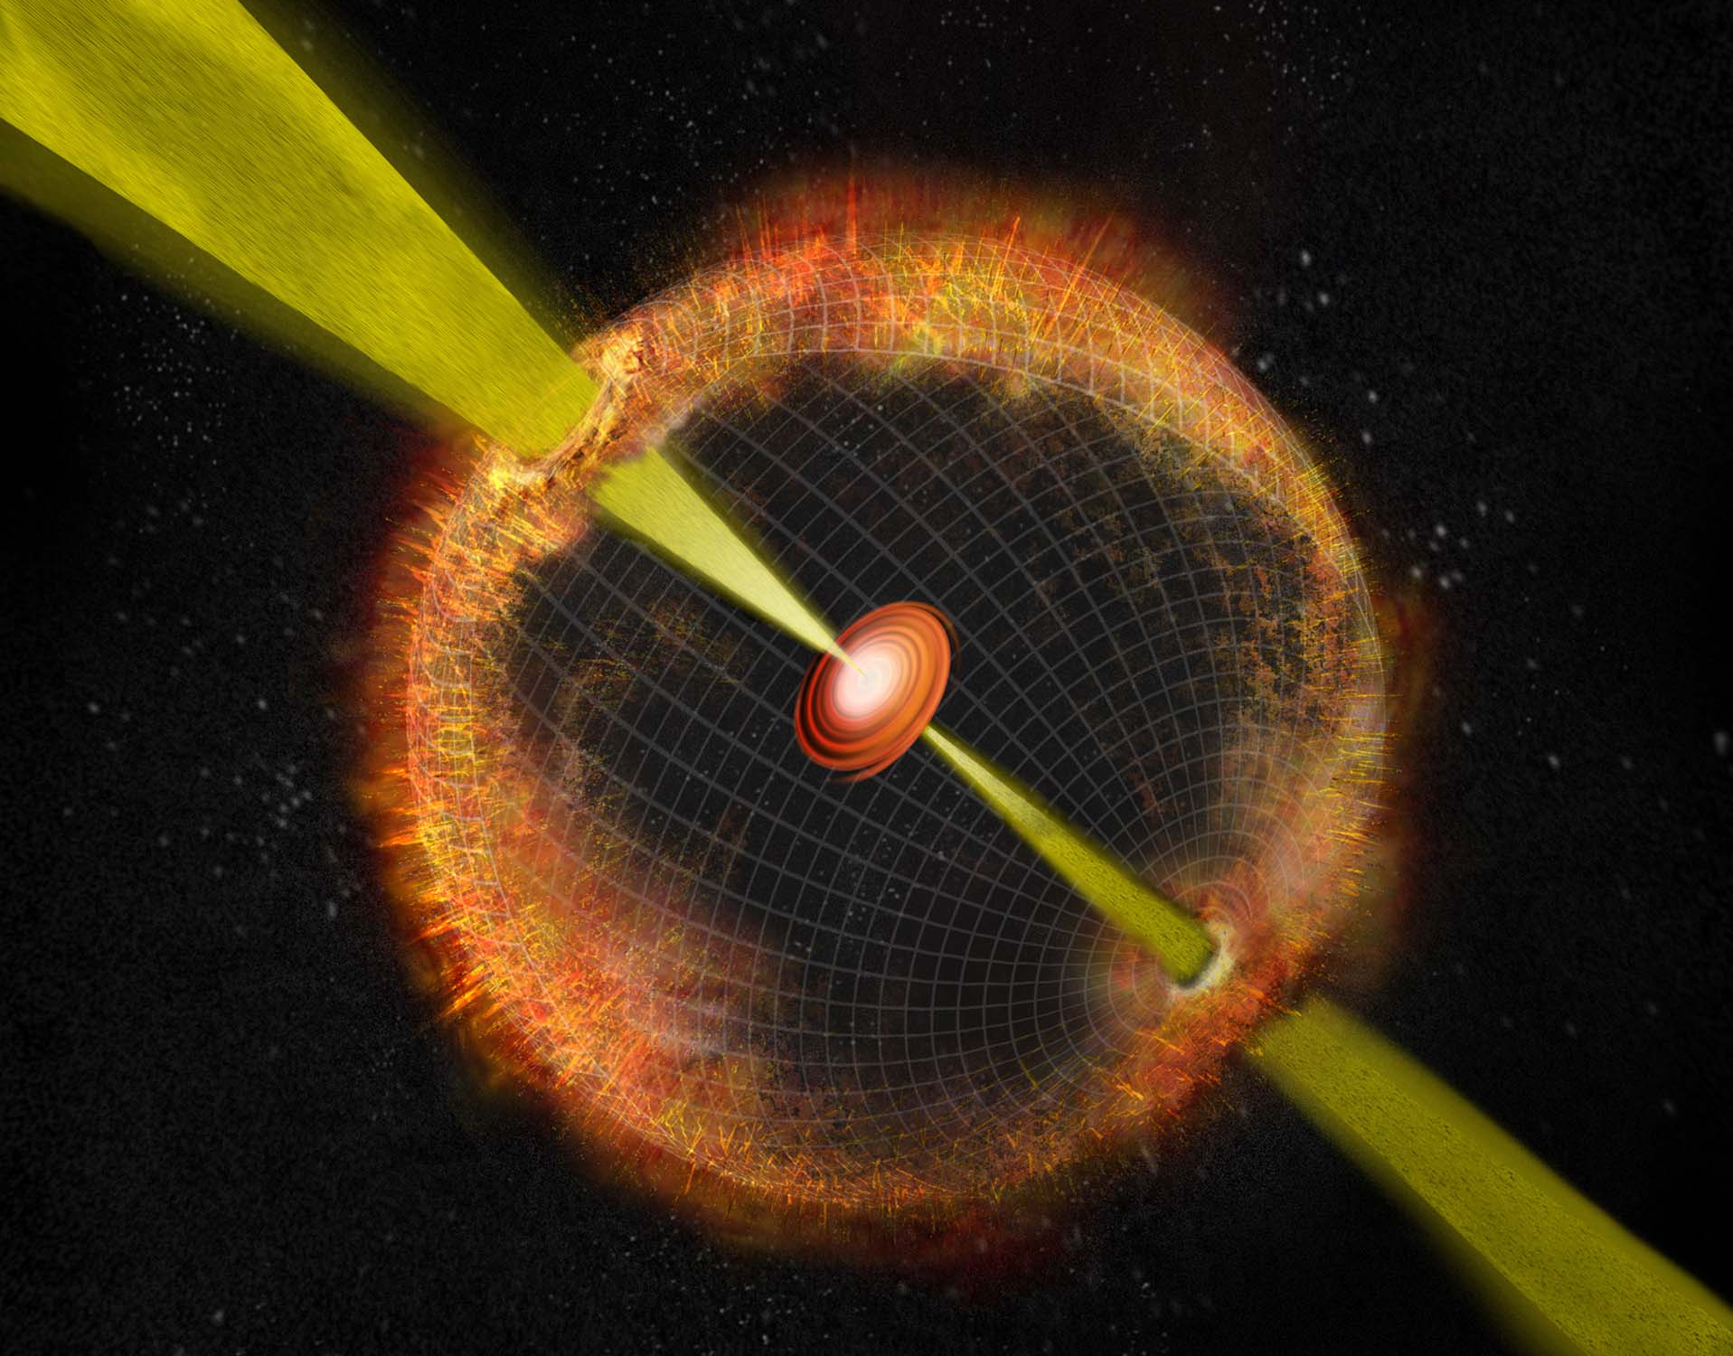
Supernovae shed light on GRBs
Massimo Della Valle
Capodimonte Observatory, INAF-Napoli
Icranet, Pescara

Slide 2
Summary
Supernova Taxonomy
GRB-SN properties
GRB and SN rates
Progenitors Properties
Notes:
I do not have conclusions, rather open questions

Slide 3
Summary
Supernova Taxonomy
GRB-SN properties
GRB and SN rates
Progenitors Properties
Notes:
I do not have conclusions, rather open questions

Slide 4
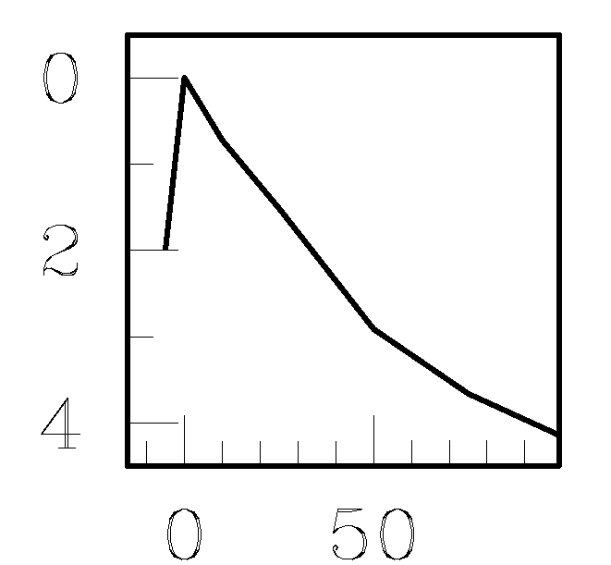
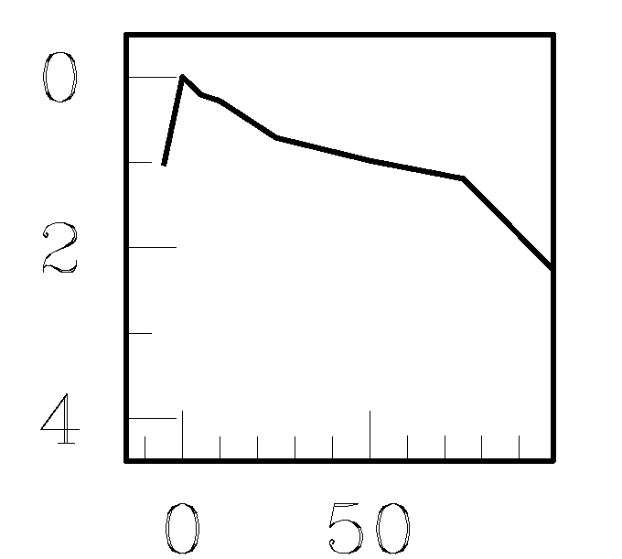
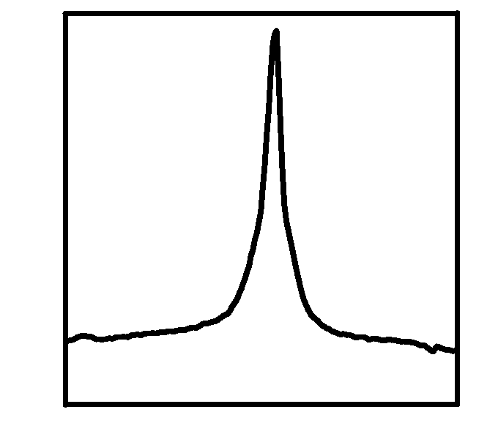
Supernova taxonomy
core-collapse > 8M
thermonuclear < 8M
H
I
II
Si
IIL
IIP
IIn
IIb
He
Ia
Ib
bright
faint
very bright
Ic
→ High KE SNe-Ic → Hypernovae→ GRB-SNe
Notes:
The parameter that divides SNe into two classes is H
In spite of this broad variety, There are only two major explosion mechansims

Slide 5

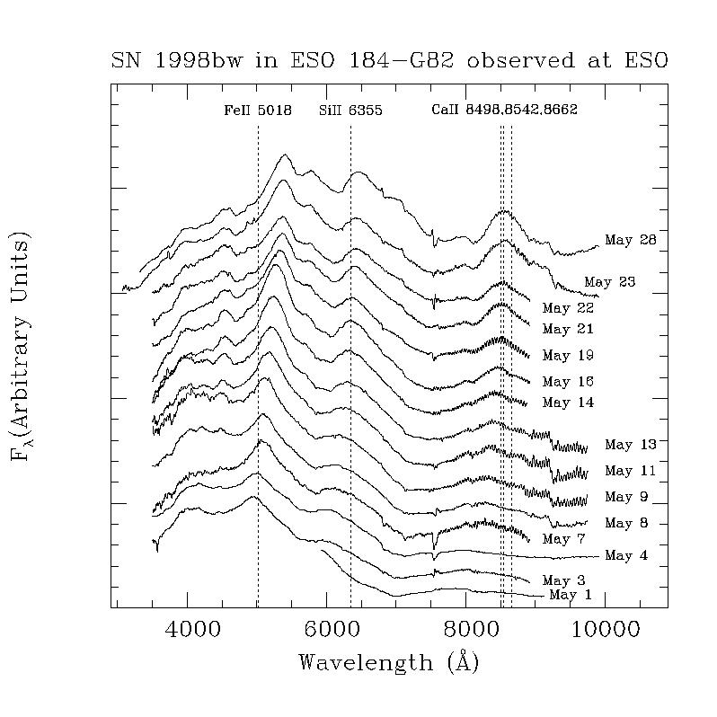
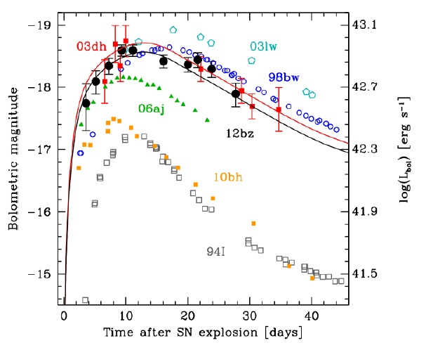
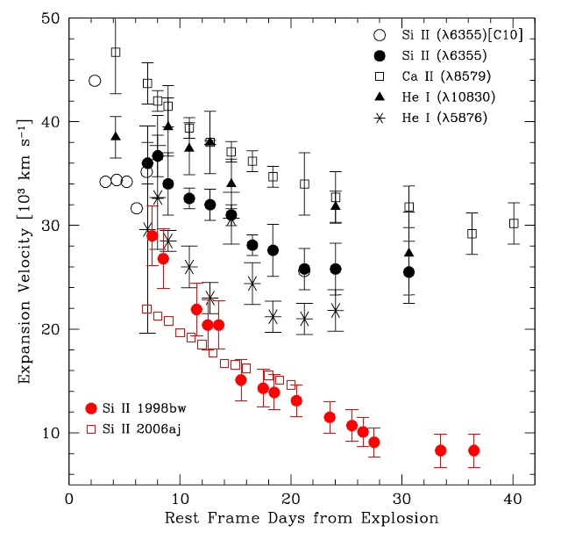
Properties of GRB-SNe (broad-lined SNe-Ic)
Lack of H and He in the ejecta: SNe-Ic
Very broad features: large expansion velocity (0.1c)
Energy (non-relativistic ejecta)
~ 10⁵² erg ≳ 10 larger than usual
CC-SNe
High luminosity: large ⁵⁶Ni mass
( ~ 0.5±0.2 M)
Explosions are aspherical (profiles
of nebular lines O vs. Fe and
Polarization)
Notes:
GRB-Sne are characterized by 5 main properties with respect to NO-GRB CC-Sne.
The last point is particularly important, because makes these objects effective sources of GW radiation

Slide 6
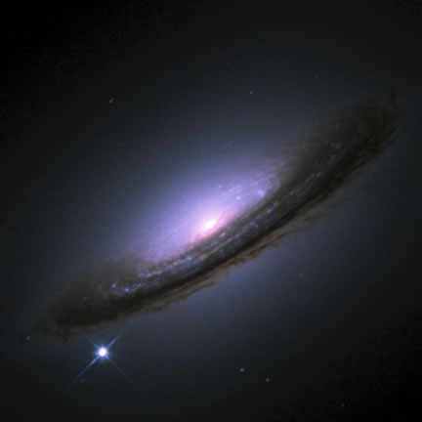
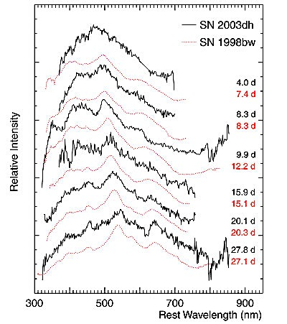

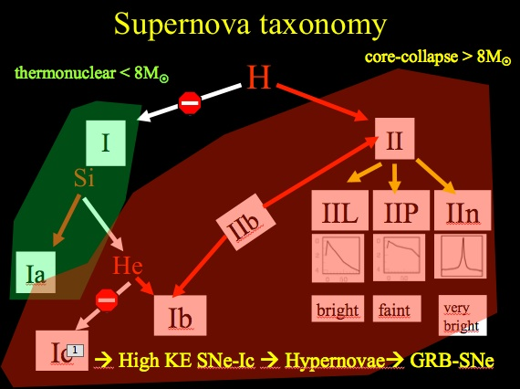
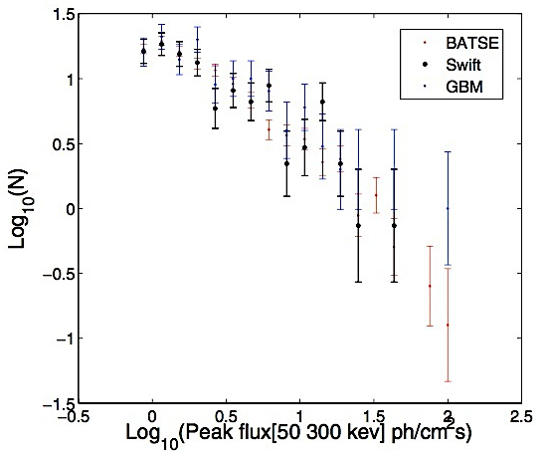
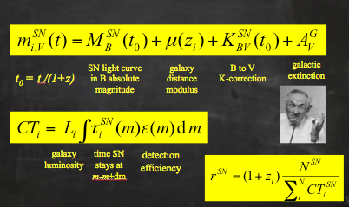
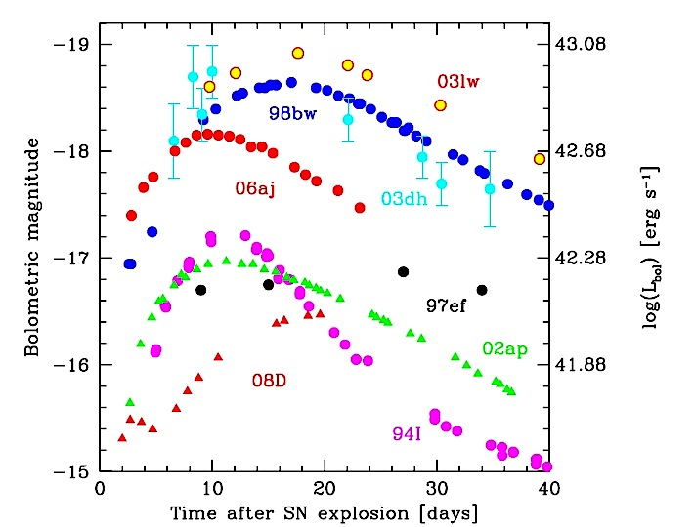
Ingredients for a “healthy”
SN and GRB rates
Notes:
The peak flux distribuition (from BATSE or Swift or Fermi) is the convolution of the Lumiinosity function of GRBs + GRB formation rate (derived from assuming that GRBs trace the star formation rate and therefore derived by assuming a star formation history)

Slide 7
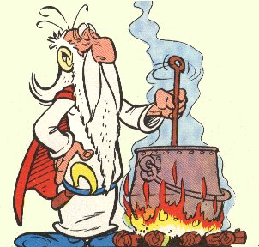
Cooking GRB and SN rates

Slide 8

Main Courses
Rate of SNe-Ibc

Slide 9
Main Courses
Rate of SNe-Ibc
Fraction of SNe-Ib/c which produces (long)GRBs

Slide 10
Main Courses
Rate of SNe-Ibc
Fraction of SNe-Ib/c which produces (long)GRBs
HL-GRB vs LL-GRB rates

Slide 11
Main Courses
Rate of SNe-Ibc
Fraction of SNe-Ib/c which produces (long)GRBs
HL-GRB vs LL-GRB rates
GRB vs. HN rates

Slide 12
Main Courses
Rate of SNe-Ibc
Fraction of SNe-Ib/c which produces (long)GRBs
HL-GRB vs LL-GRB rates
GRB vs. HN rates
“silent” GRB vs GRB rates

Slide 13
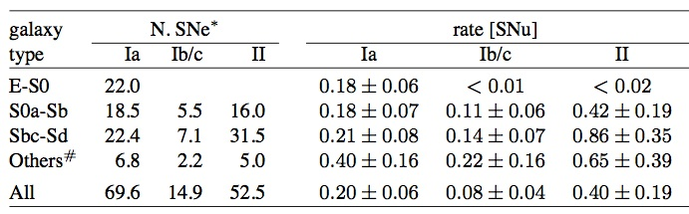
What is the rate of SNe-Ib/c ?
Asiago Survey (Cappellaro et al. 1999)
Rate for Ib/c: 0.152 ± 0.064 SNu Guetta & DV 2007
1.8 x 10⁴ SNe-Ibc Gpc⁻³ yr⁻¹ → 1.1x 10⁴ up to 2.6x 10⁴
Notes:
1.2 x 10⁸ L_{B,} Mpc⁻³ →

Slide 14
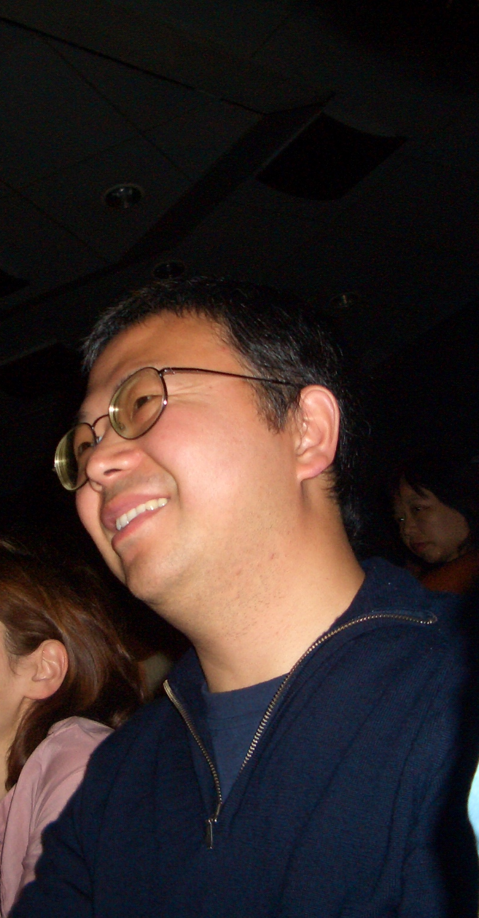
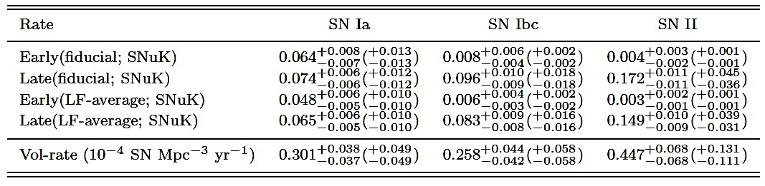
What is the rate of SNe-Ib/c ?
Lick Survey (Li et al. 2011)
Rate for Ib/c: 2.6 x 10⁴ SNe-Ibc Gpc⁻³ yr⁻¹
2.2 x 10⁴ → 3 x 10⁴ SNe-Ibc Gpc⁻³ yr⁻¹
Notes:
Statistical and total

Slide 15
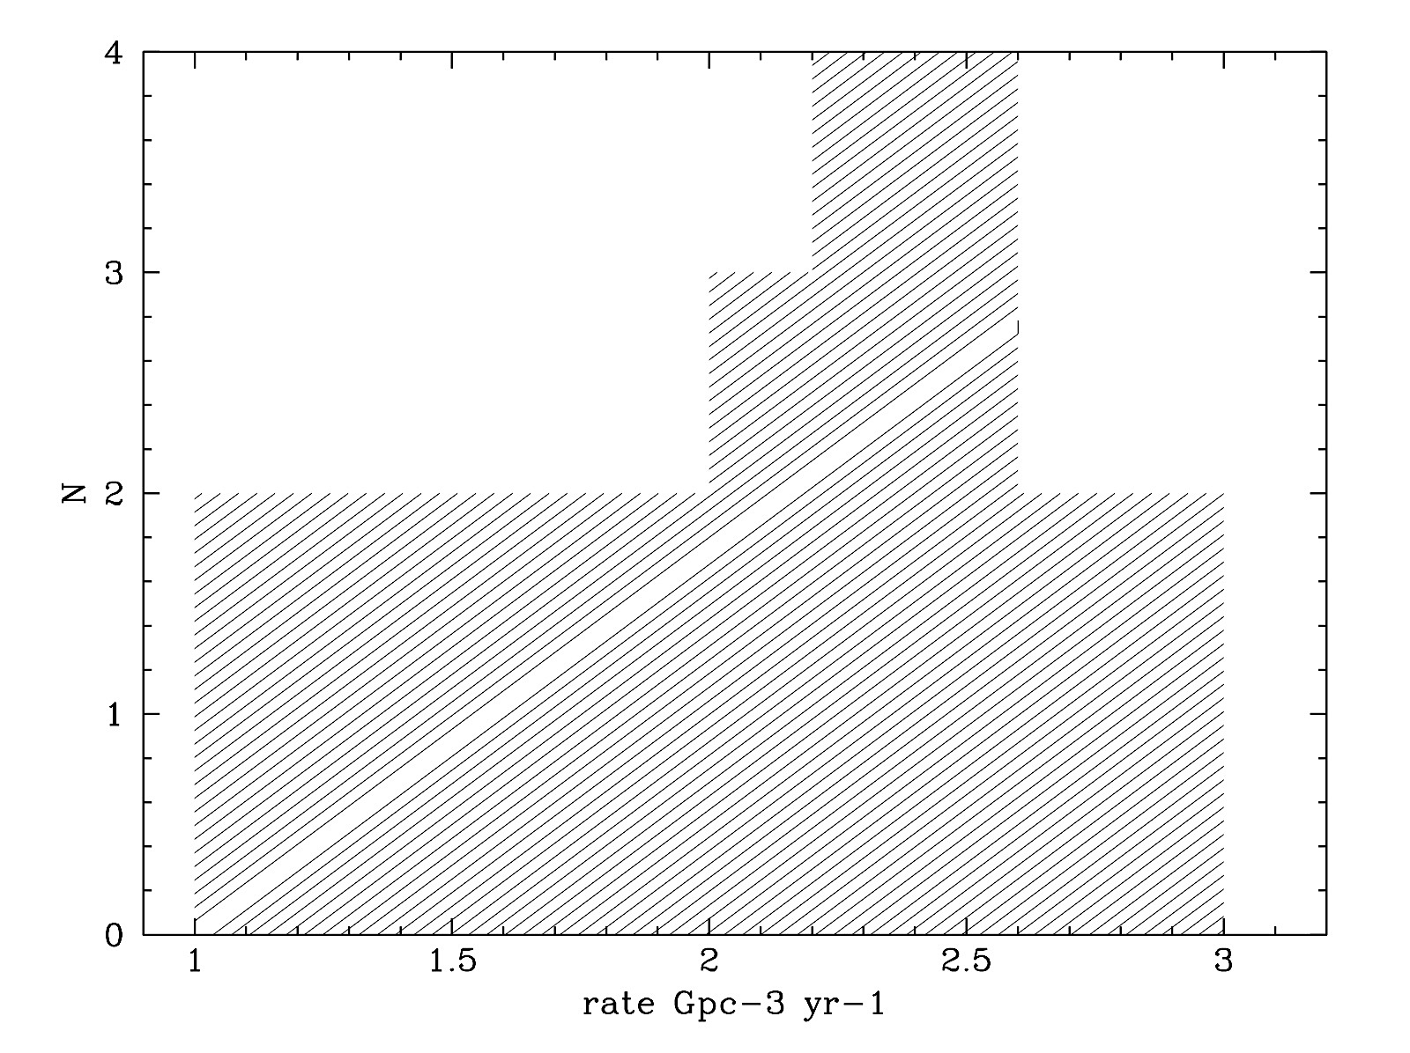
What is the rate of SNe-Ib/c ?
2.4±0.2 x 10⁴ SNe-Ibc Gpc⁻³ yr⁻¹

Slide 16
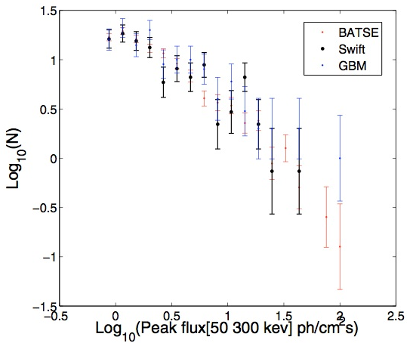
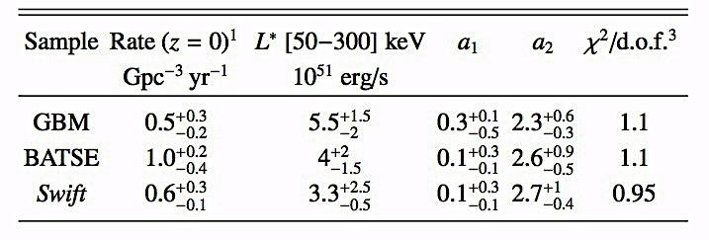
What is the local rate of (long) GRBs ?
GRB Gpc⁻³ yr⁻¹
1.5 Schmidt 1999
0.15 Schmidt 2001
0.5 Guetta et al. 2005
1.1 Guetta & DV 2007
1.1 Liang et al. 2007
> 0.5 Pelangeon et al. 2008
1.3 Wanderman and Piran 2010
(Guetta, Piran & Waxman 2005)
Guetta et al. 2011
Notes:
without beating around the bush
Settle things once and for all

Slide 17
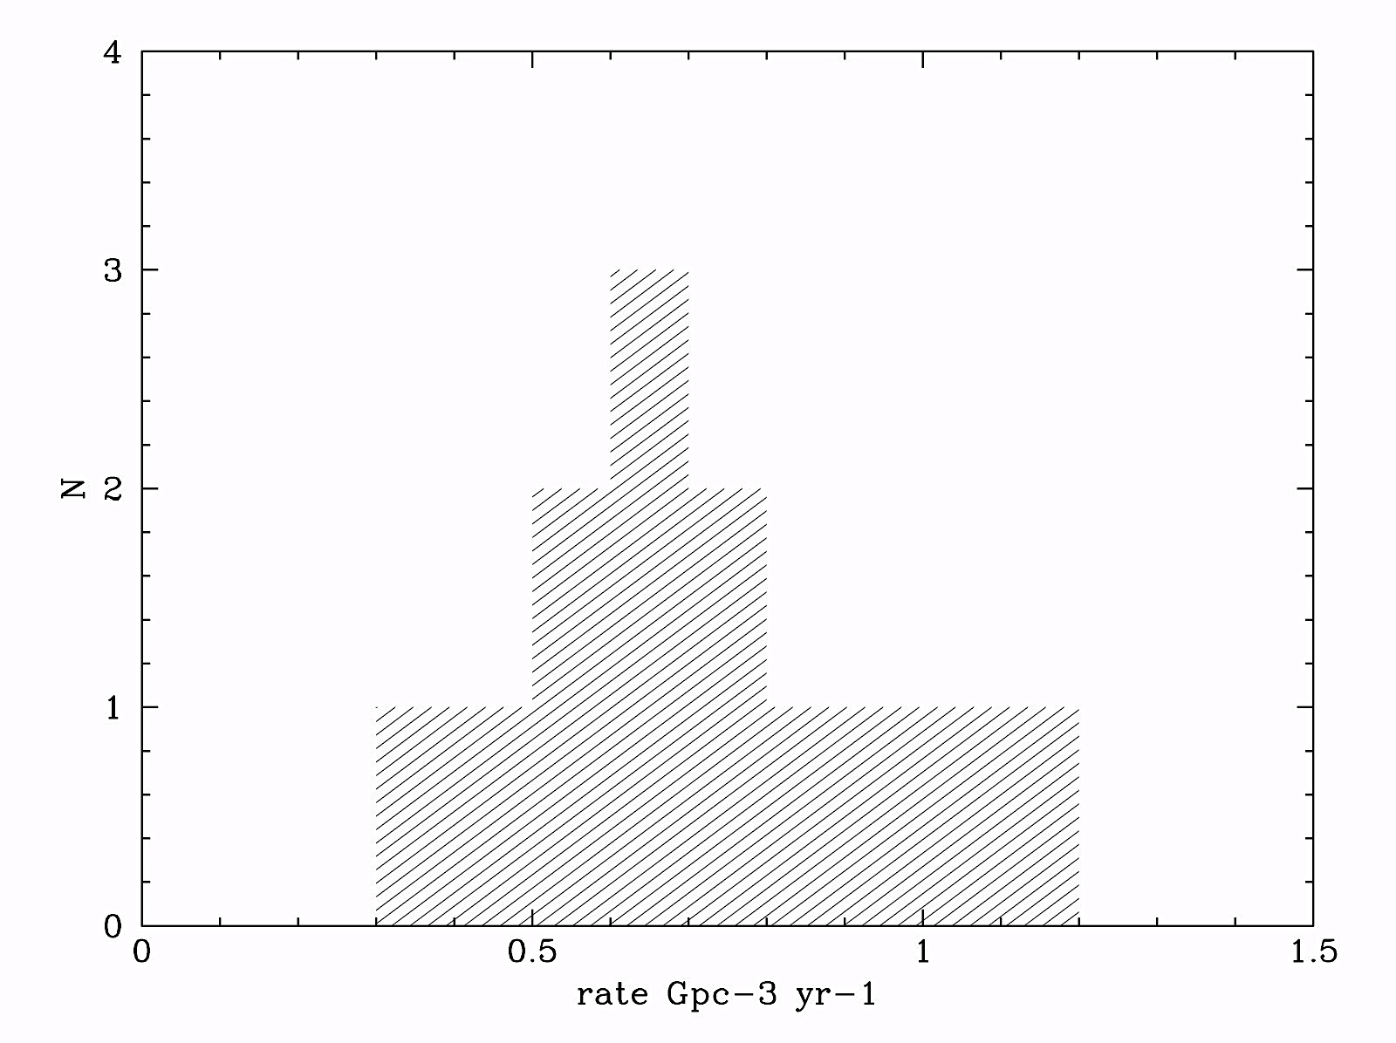
What is the local rate of (long) GRBs ?
0.7 GRB Gpc⁻³ yr⁻¹
(0.5-0.8)

Slide 18
What is the fraction of SNe-Ib/c which produces (long)GRBs ?
Rate for Ibc: 2.4 x 10⁴ SNe-Ibc Gpc⁻³ yr⁻¹
GRB rate: 0.7 GRB Gpc⁻³ yr⁻¹

Slide 19
What is the fraction of SNe-Ib/c which produces (long)GRBs ?
Rate for Ibc: 2.4 x 10⁴ SNe-Ibc Gpc⁻³ yr⁻¹
GRB rate: 0.7 GRB Gpc⁻³ yr⁻¹
<fb⁻¹> ~500 (Frail et al. 2001) (ϑ ~ 4°)
<fb⁻¹> ~75 (Guetta, Piran & Waxman 2004) (ϑ ~ 9°)
<fb⁻¹> < 10 (Guetta & DellaValle 2007 ) (ϑ > 25°) for sub-lum GRBs
<fb⁻¹> ~ 1 (Ruffini et al. 2006) (ϑ ~ 4 π)

Slide 20
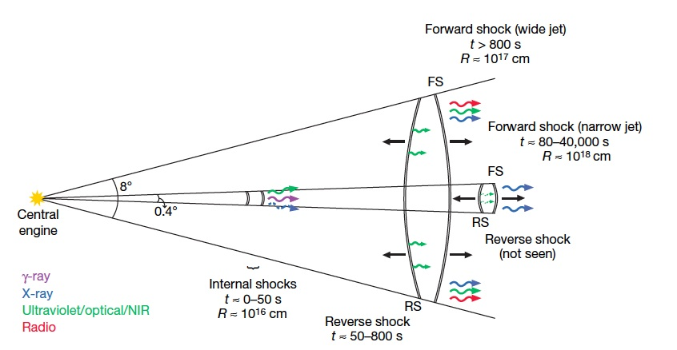
GRB 080319B
Racusin et al. 2008

Slide 21
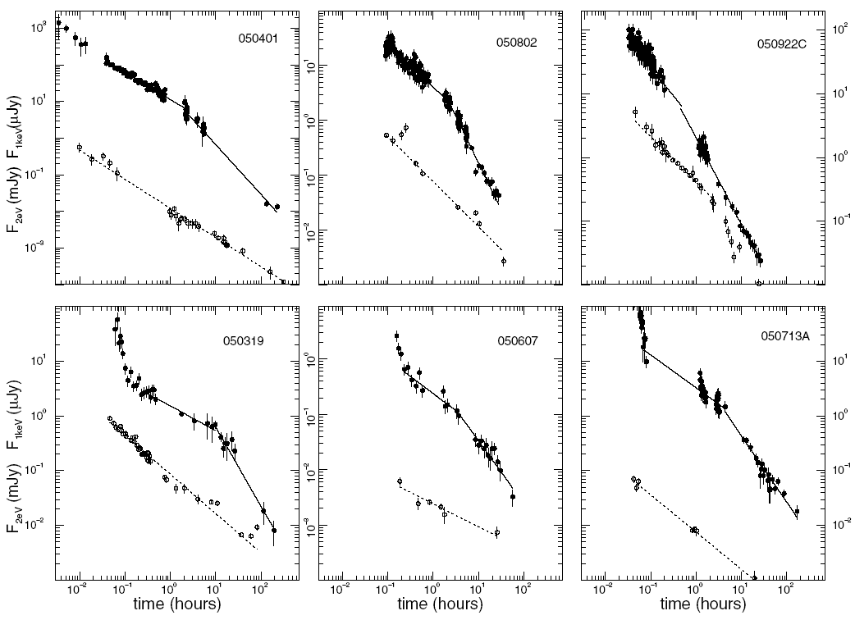
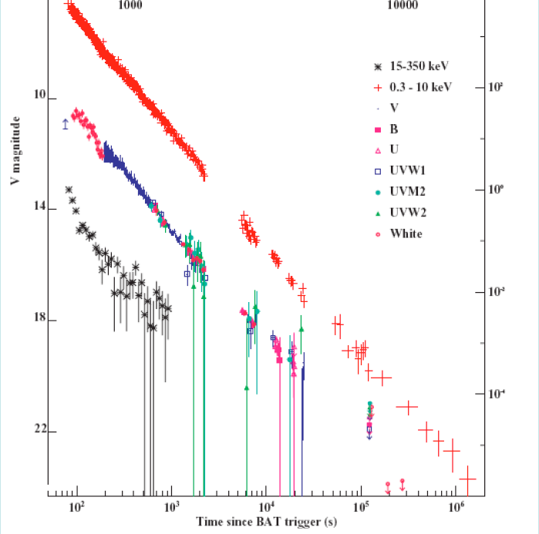
In some cases there is not evidence for beaming, i.e. an achromatic break was not detected (see Campana et al. 2007) .
<fb⁻¹>_{LL-GRBs} ~ 1-2 GRB 060218 θ>80º (Soderberg et al. 2006)
< 7 GRB 031203 θ>30º (Malesani 2006)
< 10 statistic θ>25º (Guetta & Della Valle 2007)
Notes:
So it is possible that there is not a narrow range of beaming factors, but more likely we are dealing with a broad distribution of opening angles.

Slide 22
What is the fraction of SNe-Ib/c which produces (long)GRBs ?
Rate for Ibc: 2.4 x 10⁴ SNe-Ibc Gpc⁻³ yr⁻¹
GRB rate: 0.7 GRB Gpc⁻³ yr⁻¹
<fb⁻¹> ~500 (Frail et al. 2001) (ϑ ~ 4°)
<fb⁻¹> ~75 (Guetta, Piran & Waxman 2004) (ϑ ~ 9°)
<fb⁻¹> < 10 (Guetta & DellaValle 2007 ) (ϑ > 25°) for sub-lum GRBs
<fb⁻¹> ~ 1 (Ruffini et al. 2006) (ϑ ~ 4 π)
GRB/SNe-Ibc: 1.5%-0.003%

Slide 23
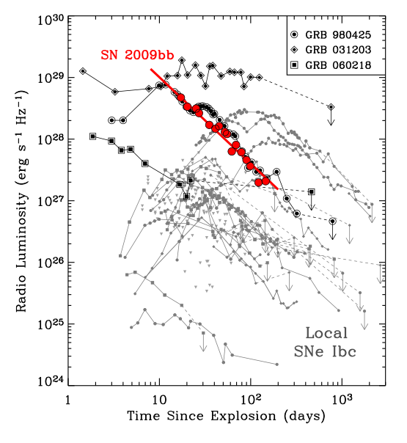
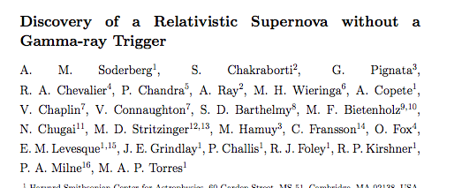
GRB/SNe-Ibc ~ 1/146
GRB/SNe-Ibc ~ 0.7%
GRB/SNe-Ibc: 1.5%-0.003%
< 5% at 99%

Slide 24
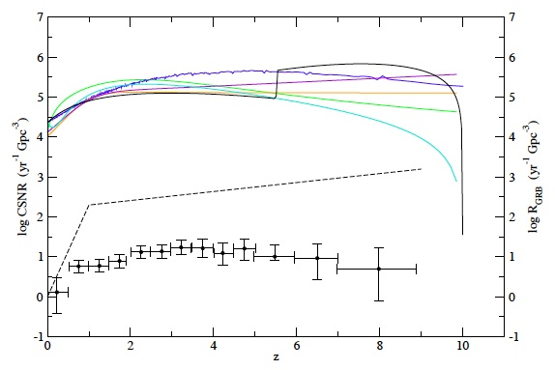
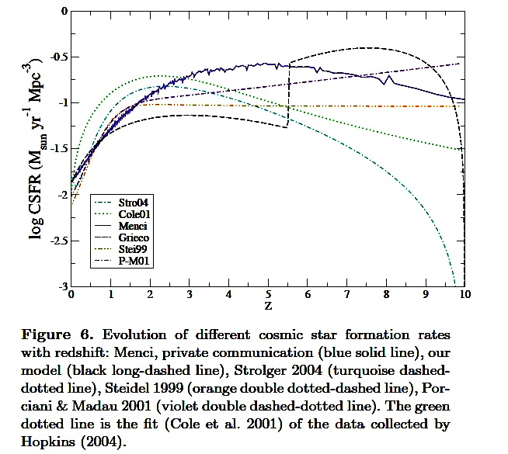
Grieco, Matteucci + 2011
Matsubayashi et al. 2005
Wandeman & Piran 2009
GRB/SNeIbc →0.1-0.01%
(10° < ϑ < 40°)
Notes:
Comparison between the cosmic predicted Type Ib/c SN rates computed by means of all the CSFRs of Figure 5 and the number of observed GRB at different redshift provided by Wanderman & Piran 2010 Swift data, black circle) and Matsubayashi et al. (2005) (black dashed line).
Using the luminosity function and the apparent GRB rate
Most uncertainties are in the GRBs curves.

Slide 25
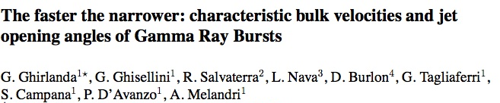
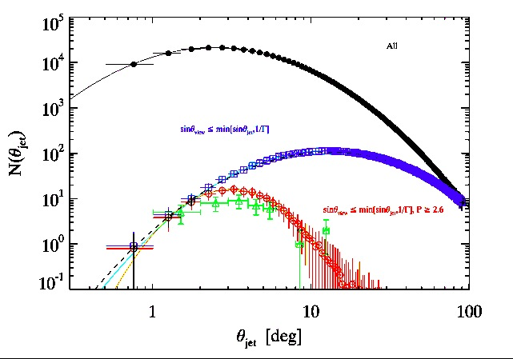
(2013)
1° < ϑ < 30°
Notes:
So it is possible that there is not a narrow range of beaming factors, but more likely we are dealing with a broad distribution of opening angles.

Slide 26
What is the fraction of SNe-Ib/c which produces (long)GRBs ?
Rate for Ibc: 2.4 x 10⁴ SNe-Ibc Gpc⁻³ yr⁻¹
GRB rate: 0.7 GRB Gpc⁻³ yr⁻¹
<fb⁻¹> ~500 (Frail et al. 2001) (ϑ ~ 4°)
<fb⁻¹> ~75 (Guetta, Piran & Waxman 2004) (ϑ ~ 9°)
<fb⁻¹> <10 (Guetta & DellaValle 2007 ) (ϑ > 25°) for sub-lum GRBs
<fb⁻¹> ~ 1 (Ruffini et al. 2006) (ϑ ~ 4 π)
Notes:
Broad opening angles, which are typical of sub-luminous GRBs, are predominant. This may suggest that the main bulk of GRB population is formed by low-lum GRBs rather than bright ones.

Slide 27
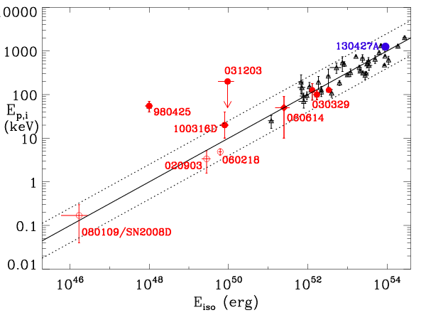
Local GRB-SN census
GRB | SN | z | Ref.
GRB 980425 | SN 1998bw | 0.0085 | Galama et al. 1998
GRB 060218 | SN 2006aj | 0.033 | Campana et al. 2006 Pian et al. 2006
Notes:
In the nearby universe we have recognized 7 cases of connection between GRB and SNe

Slide 28
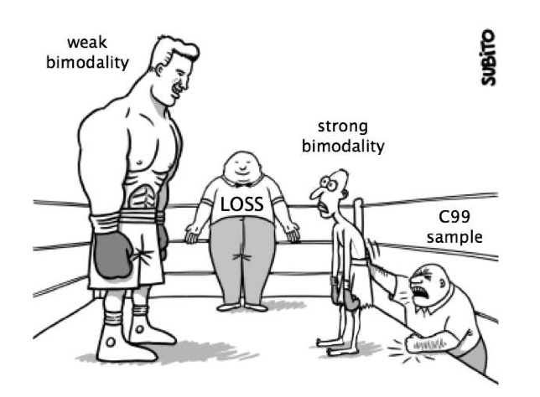
Sampled volume 10⁶ smaller →
Rate LL-GRBs: up to x 10³ Gpc⁻³ yr⁻¹
(Della Valle 2005, Pian et al. 2006, Cobb et al. 2006, Soderberg et al. 2006,
Liang et al. 2006, Guetta & Della Valle 2007, Amati et al. 2007)
LL-GRBs
HL-GRBs
Fermi
Swift

Slide 29
LL-GRBs
GRB | SN | z | D _{max} | Sky Cov. | Δt (yr)
GRB 980425 | SN 1998bw | 0.0085 | 170 Mpc | 0.08 | 7
GRB 060218 | SN 2006aj | 0.033 | 160 Mpc | 0.17 | 9
GRB 080109 | SN 2008D | 0.007 | 200 Mpc | 0.17 | 9
GRB 100316D | SN 2010bh | 0.06 | 268 Mpc | 0.17 | 9

Slide 30
LL-GRBs Rate
LL-GRBs counts (beppo-Sax) ~ 0.2 – 3.3 (1σ) (Gehrels 1986)
SkyCov +V_{max} + Δt → “observed” ~ 90 Gpc⁻³ yr⁻¹ (18 up to
300)

Slide 31
LL-GRBs Rate
LL-GRBs counts (beppo-Sax) ~ 0.2 – 3.3 (1σ) (Gehrels 1986)
SkyCov +V_{max} + Δt → “observed” ~ 90 Gpc⁻³ yr⁻¹ (18 up to
300)
LL-GRBs counts (Swift) ~ 1.3 – 6 (1σ) → SkyCov + V_{max} + Δt→ “observed” ~ 65 Gpc⁻³ yr⁻¹ (48 up to 111)

Slide 32
LL-GRBs Rate
LL-GRBs counts (beppo-Sax) ~ 0.2 – 3.3 (1σ) (Gehrels 1986)
SkyCov +V_{max} + Δt → “observed” ~ 90 Gpc⁻³ yr⁻¹ (18 up to
300)
LL-GRBs counts (Swift) ~ 1.3 – 6 (1σ) → SkyCov + V_{max} + Δt→ “observed” ~ 65 Gpc⁻³ yr⁻¹ (48 up to 111)
LL-GRBs “observed” ~ 71 GRBs Gpc⁻³ yr⁻¹ (51 up to 104)

Slide 33
LL-GRBs Rate
LL-GRBs counts (beppo-Sax) ~ 0.2 – 3.3 (1σ) (Gehrels 1986)
SkyCov +V_{max} + Δt → “observed” ~ 90 Gpc⁻³ yr⁻¹ (18 up to
300)
LL-GRBs counts (Swift) ~ 1.3 – 6 (1σ) → SkyCov + V_{max} + Δt→ “observed” ~ 65 Gpc⁻³ yr⁻¹ (48 up to 111)
LL-GRBs “observed” ~ 71 GRBs Gpc⁻³ yr⁻¹ (51 up to 104)
<fb⁻¹>_{LL-GRBs} ~ 1-2 GRB 060218 θ>80º (Soderberg et al. 2006)
< 7 GRB 031203 θ>30º (Malesani 2006)
< 10 statistic θ>25º (Guetta & Della Valle 2007)

Slide 34
LL-GRBs Rate
LL-GRBs ~ 71 x (1 ÷ 10) ~ 70 ÷ 700 LL-GRBs Gpc⁻³ yr⁻¹
<fb⁻¹>_{HL-GRBs} ~75 (Guetta, Piran & Waxman 2004) ϑ ~ 9°
HL-GRBs ~ 0.7 x 75 ~ 50 Gpc⁻³ yr⁻¹
LL-GRB/HL-GRB ~ 1.4 ÷ 14

Slide 35
What is the fraction of SNe-Ib/c which produces HNe?

Slide 36
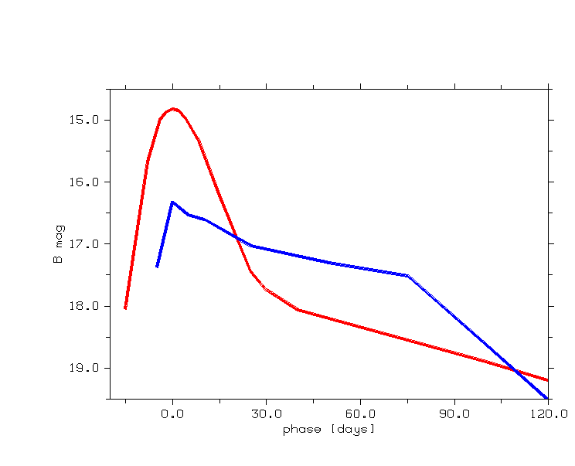
How to compute rates
The observing log: epoch, limiting magnitude
Target apparent light curve: SN type, target distance
Galaxy sample: distance, type, inclination …….
observing
log
JAN
FEB
MAR
APR
MAY
JUN
JUL
AGO
SEP
NOV
DEC

Slide 37
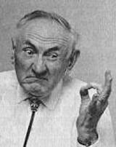
SN light curve in B absolute magnitude
galaxy distance modulus
B to V K-correction
galactic extinction
t₀ = t /(1+z)
galaxy luminosity
time SN stays at m-m+dm
detection efficiency

Slide 38
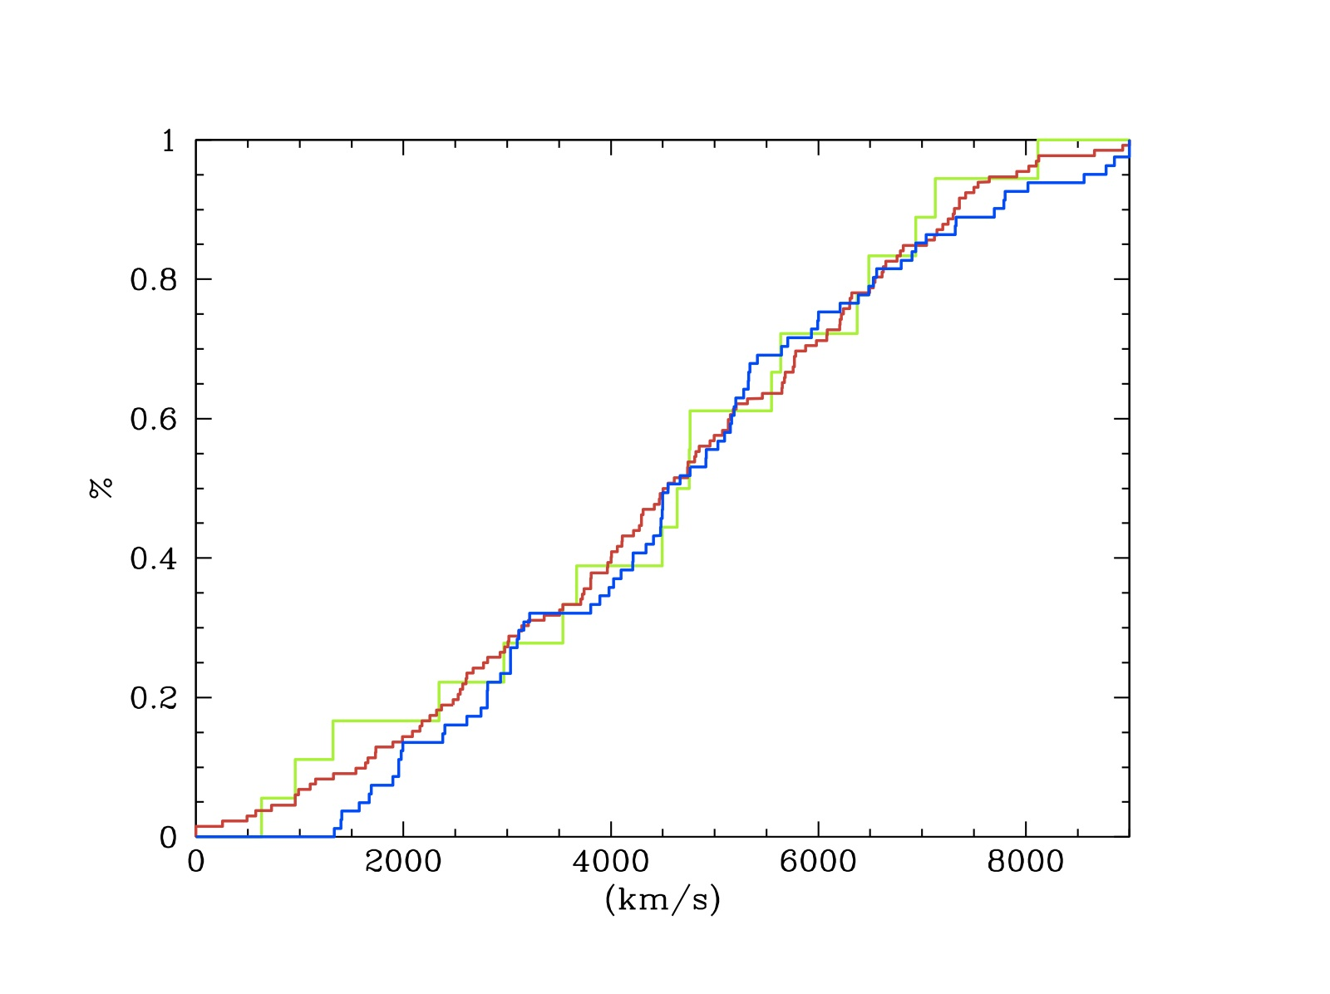
SNe-Ib=81
SNe-Ic=132
SNe-Ibc=50
HNe=18
HNe/SNe-Ibc: ~ 7%
HL-GRBs/HNe: 5%-0.04%
Notes:
~ 3% (for θ ~ 8º-10° )
SNe-Ib/SNe-Ic = 61%

Slide 39
A simplified Scheme for a GRB-SN event
-an almost isotropic component carrying most energy 10⁵² erg and mass (~5-10M)
30,000 km/s
-highly collimated component 4°-10° for HL-GRBs containing a tiny fraction of the mass (10 ^{-4/-5} M) moving at Γ ~ x 10²⁻³
line of sight
HN
HL-GRBs/HNe: 5%-0.04%
line of sight
HN + GRB

Slide 40
SNe-Ib=81
SNe-Ic=132
SNe-Ibc=50
HNe=18
LL-GRBs/HNe: 40%-5%
Notes:
~ 3% (for θ ~ 8º-10° )
SNe-Ib/SNe-Ic = 61%
This ratio increases dramatically after computing the ratio LL/Sne-Ibc

Slide 41
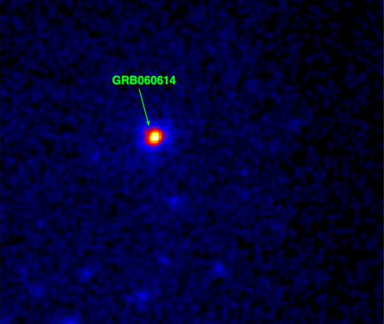
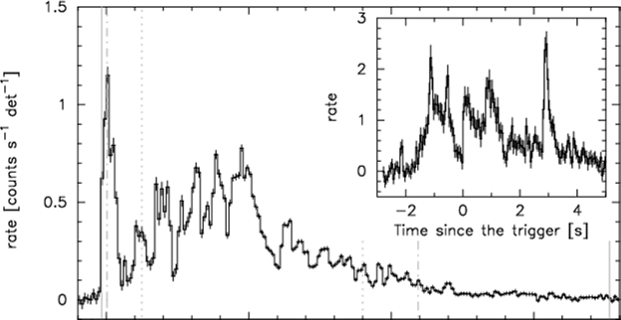
Messing up matters: GRB 060614
Low redshift:
z = 0.125
SN search?
Gehrels et al. 2006
Mangano et al. 2007
0s 50s 100s

Slide 42
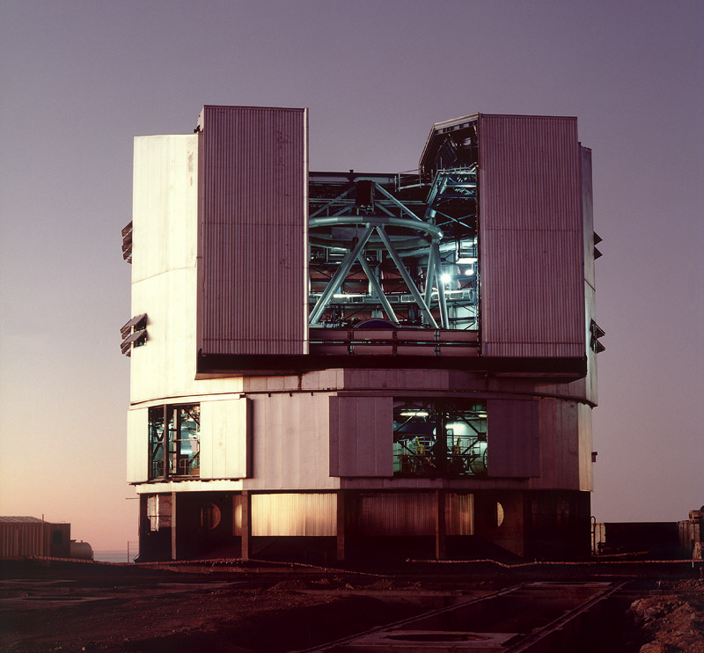
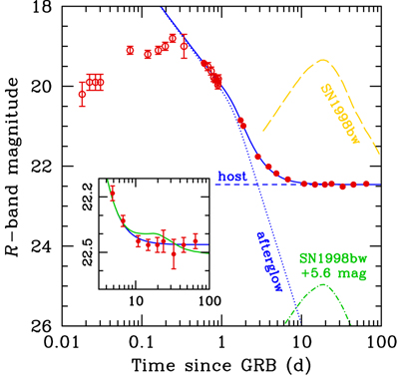
What is the rate of GRB 060614-like events ?
Late time:
host galaxy contribution
(no variation)
Factor >100
Upper limit:
M_{V} > -13.5 (3σ)
Della Valle et al. 2006 (see also Gal-Yam et al. 2006 – Fynbo et al. 2006)

Slide 43
Scenarios without Supernova
1. Supranova → SN occurs (months, years) before the GRB (Vietri & Stella 1998)
2. NS→ QS (Berezhiani et al. 2003)
3. Vacuum Polarization around Kerr-BH (Ruffini 1998; Caito et al. 2008)
4. Binary merging mechanisms similar to those proposed to power short GRBs (Gehrels et al. 2006)

Slide 44
Scenarios with Supernova
-13.5
Notes:
our observations doesn’t exclude a SN – they do exclude a bright SN

Slide 45
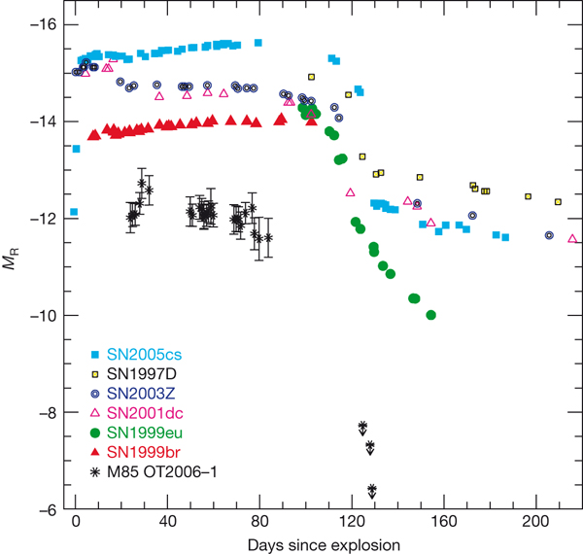
Pastorello et al. 2007

Slide 46
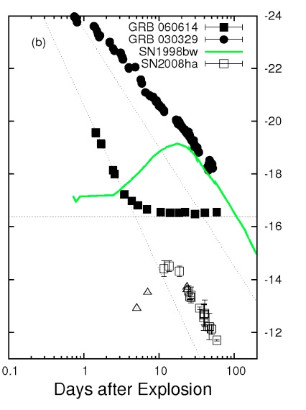
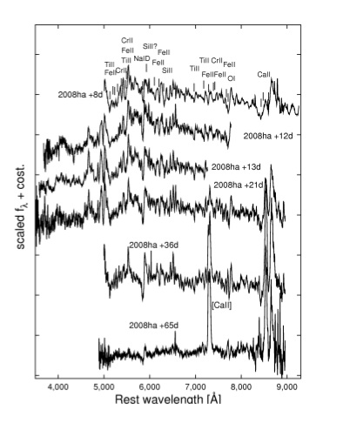
SN 2008ha is the first faint, hydrogen deficient, low-energy core-collapse supernovae ever detected.
Potential “dark SN” (GRB progenitor) ?
Notes:
We do not lack for everything here

Slide 47
GRB-SN census (z > 0.1)
+130427A (Melendri et al. 2014
+130702A (D’Elia et al. 2014)
GRB | SN | z | Ref.
GRB 021202 | SN 2002lt | 1.002 | Della Valle et al. 2003
GRB 050525A | SN 2005nc | 0.606 | Della Valle et al. 2006
GRB 101219B | SN 2010ma | 0.55 | Sparre et al. 2011
GRB 060729 | SN | 0.54 | Cano et al. 2011
GRB 090618 | SN | 0.54 | Cano et al. 2011
GRB 081007 | SN 2008hw | 0.53 | Della Valle et al. 2008
GRB 091127 | SN 2009nz | 0.49 | Cobb et al. 2010 Berger et al. 2011
GRB120714B | SN 2012eb | 0.4 | Klose et al. 2012
GRB 120422A | SN 2012bz | 0.28 | Melandri et al. 2012
GRB 030323 | SN 2003dh | 0.16 | Hjorth et al. 2003 Stanek et al. 2003
GRB 031203 | SN 2003lw | 0.11 | Malesani et al. 2004
Notes:
What about the high-z GRBs?

Slide 48
What is the local rate of 060614-like events ?
GRB-SN counts+SkyCov +V_{max}+Δt → “observed” ~ 0.4 Gpc⁻³ yr⁻¹
(0.3-0.5)
0.7 GRB Gpc⁻³ yr⁻¹
(0.5-0.8)
060614-like ~ 0.3 GRB Gpc⁻³ yr⁻¹
“observed” (060614 & 060505) ~ 0.02-0.55 GRB Gpc⁻³ yr⁻¹

Slide 49
Conclusions
GRB rates vs. SN rates give:
GRB/SNe-Ibc: 1.5%-0.003%
Consistent with the results of Radio surveys:
GRBs/SNeIbc <5%
Observations → 4° < ϑ < 4π
Observations + theory → ϑ < 40°
LL-GRB (<10⁵⁰erg) / HL-GRB (~10^{52÷54}erg) ~ 1.4 ÷ 14
Notes:
It could be that the main bulk of GRB population is formed by LL-GRBs

Slide 50
Conclusions (cont’d)
Most HNe are not able to produce HL-GRBs
HL GRBs/HNe: 5%-0.04%
GRB 130427A

Slide 51
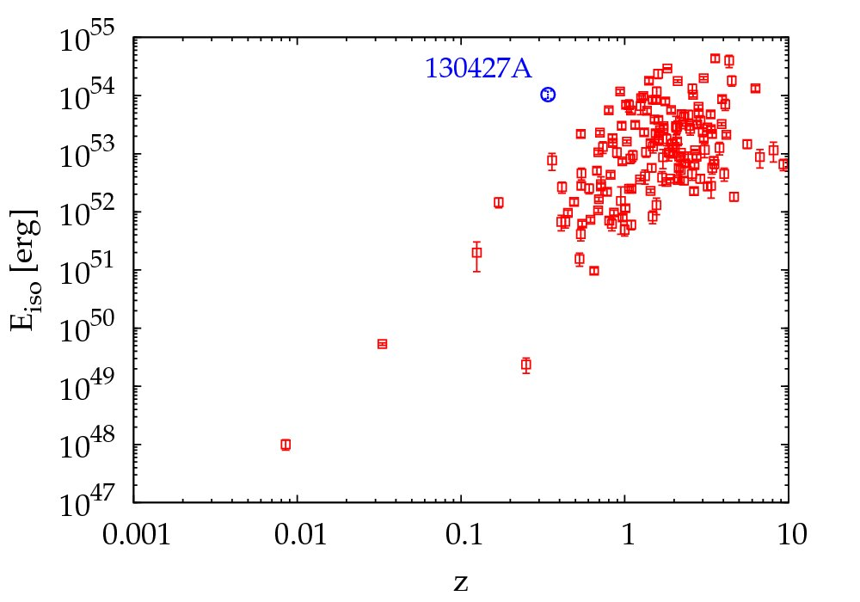
Testing the GRB-SN paradigm with the brightest “close” event; GRB 130427A T90=162s
Recent detection of the very energetic (Eiso = 10⁵⁴ erg) “neraby” (z = 0.34) GRB030427A
Unique occasion to test the GRB-SN connection for “cosmological” GRBs
Melandri et al. 2014

Slide 52
Conclusions (cont’d)
Most HNe are not able to produce HL-GRBs
HL GRBs/HNe: 5%-0.04%
GRB 130427A
This ratio may increase dramatically, up to an order of magnitude for LL-GRBs
LL GRBs/HNe: 40%-4%
GRB 060218
However it still appears that while most GRBs are connected with HNe, the viceversa is not true.
SN 2002ap

Slide 53
Conclusions (cont’d)
observed GRB-SN rate = 0.4 GRB-SNe Gpc⁻³ yr⁻¹
(0.3-0.5)
observed GRB rate = 0.7 GRB Gpc⁻³ yr⁻¹
(0.5-0.8)
The comparison between the GRB rate and the
GRB-SN rate suggests that 060614-like events represent a fraction < 40% or << 40% GRB Gpc⁻³ yr⁻¹ of the long GRBs population.

Slide 54
Conclusions (cont’d)
GRBs are very rare phenomena (compared to SN
explosions)
GRB/SNe-Ibc: 0.003%-1.5%
Ibc/CC ~ 0.30
GRB/CC-SN ~ 10⁻⁵ ÷ 5 x 10⁻³

Slide 55
Conclusions (cont’d)
GRBs are very rare phenomena (compared to SN
explosions)
GRB/SNe-Ibc: 0.003%-1.5%
Ibc/CC ~ 0.30
GRB/CC-SN ~ 10⁻⁵ ÷ 5 x 10⁻³
What causes some small fraction of CC-SNe to produce observable GRBs, while the majority do not?

Slide 56
Special conditions are requested to stars
to be GRB progenitors:
i) to be massive ~ 30-50 M (Maeda et al. 2006; Raskin et al. 2008; Tanaka et al. 2008)
ii) H/He envelopes to be lost before the collapse of the core, i.e. the GRB progenitor is a WR star (Campana et al. 2006)
iii) low metallicity and star forming environments (Modjaz et al. 2008, Fruchter et al. 2006)
iv) binarity (Panagia 1988 and Smartt et al. 2008 → a significant fraction of SNe-Ibc progenitors are binaries)
v) high rotation (Yoon et Langer 2005; Campana et al. 2008,
Yoon et al. 2012)
vi) pair instability mechanisms ? (Gal-Yam 2012; Chardonnet et al. 2010)
Notes:
A detailed study of the absorption pattern in the X-ray spectrum of GRB 060218 reveals evidence of material highly enriched in low-atomic-number metals ejected before the SN/GRB explosion. We find that, within the current scenarios of stellar evolution, only a progenitor star characterized by a fast stellar rotation and subsolar initial metallicity could produce such a metal enrichment in its close surrounding.
So it is possble that a combination of all these requirements is responsible for producing a so tiny fraction of events with respect to the relatively large number of progenitors.
But the role of each of them is not fully understood (yet). If the star rotates fast enough it avoids the RSG phase and it becomes directly a WR (and it retains high angular momentum in the core) because the huge H envelope is not formed.

Slide 57
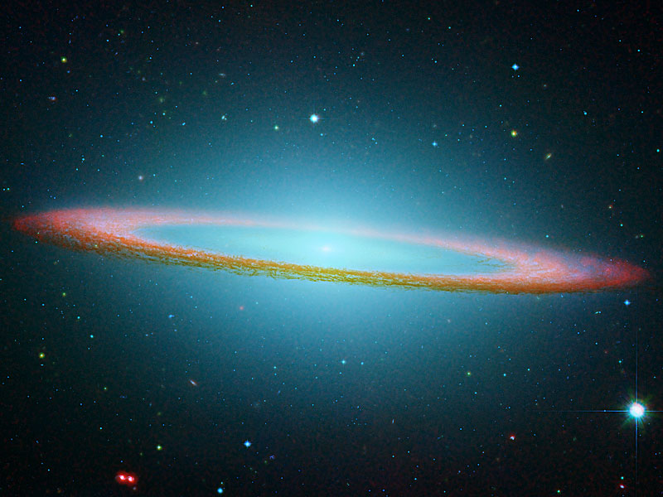
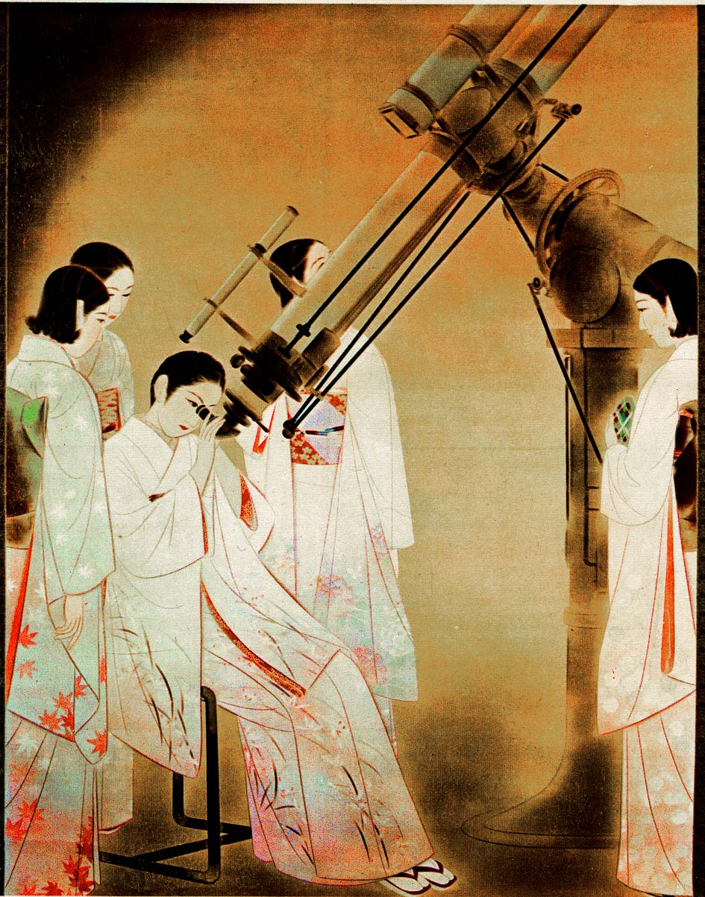
Notes:
Chou Ota

Slide 58


Slide 59
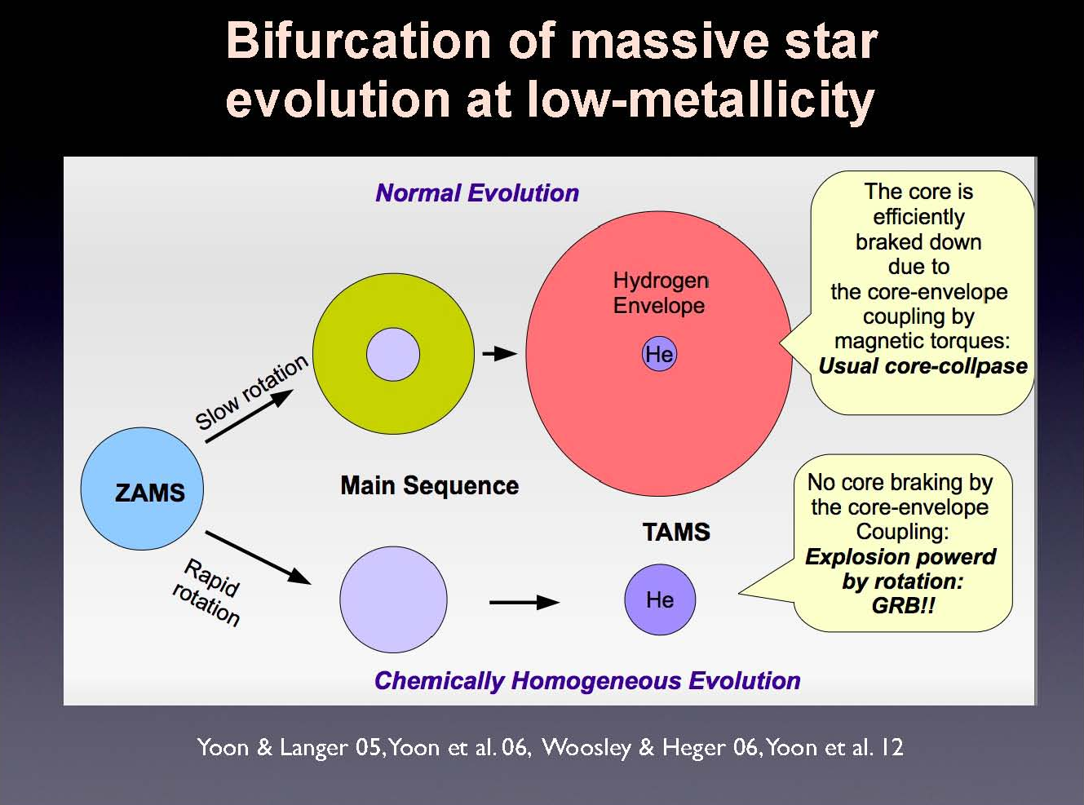

Slide 60
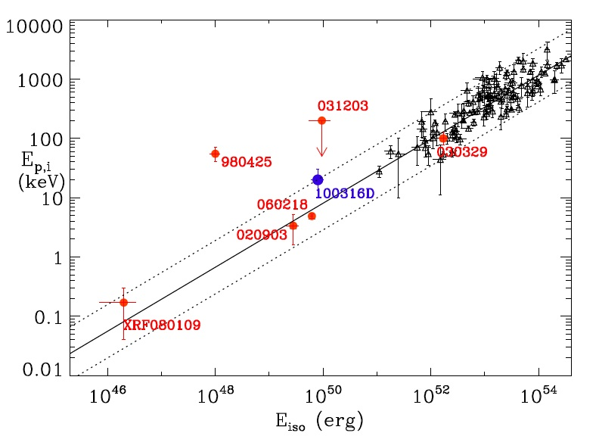
130427A
LL-GRBs
HL-GRBs
Rate x 10
Rate x 1
GRB/HNe ~ 40%
GRB/HNe ~ 5%
HN energy (non-relativistic ejecta) ~ 10⁵² erg
<fb⁻¹>
100
10⁴⁸
10^{52/53}
1
10⁴⁹
10⁵⁰
Notes:
Two points.
The rates increases this way, so the relation do exist although the plane is populated in a biased way
The Gamma-budget is varying by 6 orders of mag while the optical magnitude of the associated SN by a factor of 4
The most powerful GRB events are powered by the spindown of BHs

Slide 61
130427A
d
<fb⁻¹>
100
10⁴⁸
10^{52/53}
1
10⁴⁹
10⁵⁰
Notes:
Two points.
The rates increases this way, so the relation do exist although the plane is populated in a biased way
The Gamma-budget is varying by 6 orders of mag while the optical magnitude of the associated SN by a factor of 4
The most powerful GRB events are powered by the spindown of BHs

Slide 62
Why SN and GRB rates?
Metal Enrichment (Nomoto 2012; Kobayashi 2007)
Energy Injection (von Glasow et al. 2013; Lowenstein 2001)
Cosmic Rays (Blasi 2013; Chakraborti et al. 2011; Ioka & Meszaros 2010)
Neutrinos (Razzaque, Mészáros & Waxman 2004; Fryer & Mészáros 2003)
GWs (van Putten et al. 2011; Birnholtz & Piran 2013)
Reionization (Meiksin & Whalen 2013, Wyithe et al. 2010)
GRB/SN rate vs. redshift (Grieco et al. 2012, Salvaterra 2012, Wanderman & Piran 2010)
Notes:
SNe and GRBs are related to a large number of astrophysical topics, here I have just reported the first ones that come to mind. However it is only through measuring their rates that we can estimate in a quantitative way how SNe and GRBs affect each item
The evolution of the GRB/SN rates with z contains unique information on the star formation history of the universe, the initial mass function (IMF) of stars, all are essential ingredients
for understanding galaxy formation, cosmic chemical evolution, and the mechanisms which determined the efficiency of the conversion of gas
into stars in galaxies at various epochs.

Slide 63
Special conditions are requested to stars
to be GRB progenitors:
Notes:
Two points.
The rates increases this way, so the relation do exist although the plane is populated in a biased way
The Gamma-budget is varying by 6 orders of mag while the optical magnitude of the associated SN by a factor of 4
The most powerful GRB events are powered by the spindown of BHs

Slide 64
GRB-SN census (z > 0.1)
GRB | SN | z | Ref.
GRB 021202 | SN 2002lt | 1.002 | Della Valle et al. 2003
GRB 050525A | SN 2005nc | 0.606 | Della Valle et al. 2006
GRB 101219B | SN 2010ma | 0.55 | Sparre et al. 2011
GRB 060729 | SN | 0.54 | Cano et al. 2011
GRB 090618 | SN | 0.54 | Cano et al. 2011
GRB 081007 | SN 2008hw | 0.53 | Della Valle et al. 2008
GRB 091127 | SN 2009nz | 0.49 | Cobb et al. 2010 Berger et al. 2011
GRB120714B | SN 2012eb | 0.4 | Klose et al. 2012
GRB 120422A | SN 2012bz | 0.28 | Melandri et al. 2012
GRB 030323 | SN 2003dh | 0.16 | Hjorth et al. 2003 Stanek et al. 2003
GRB 031203 | SN 2003lw | 0.11 | Malesani et al. 2004
Notes:
What about the high-z GRBs?

Slide 65
A simplified Scheme for a GRB-SN event
an almost isotropic component carrying most energy 10⁵² erg and mass (~5-10M) → SN event
-almost isotropic, mildly relativistic component θ > 20°
30,000 km/s
line of sight
HN
LL-GRBs/HNe: 40%-4%
line of sight
HN + GRB

Slide 66
Supernova taxonomy
core-collapse > 8M
thermonuclear < 8M
H
I
II
Si
IIL
IIP
IIn
IIb
He
Ia
Ib
bright
faint
very bright
Ic
→ High KE SNe-Ibc → Hypernovae→ GRB-SNe
Notes:
The parameter that divides SNe into two classes is H
In spite of this broad variety, There are only two major explosion mechansims

Slide 67
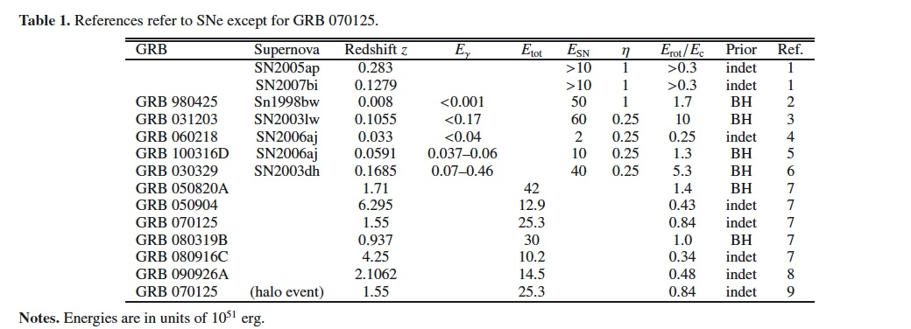
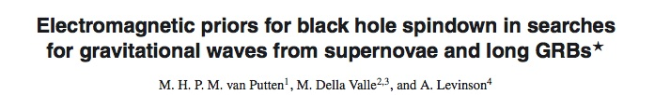
We find that some of the hyper-energetic events cannot be powered by the spindown of rapidly rotating proto-neutron stars by virtue of their limited rotational energy. They can, instead, be produced by the spindown of black holes (→ 70’s Bisnovatyi-Kogan).
Notes:
For reference, we define Ec = 3 x1052 erg to be the maximum of the
rotational energy Erot of a PNS. Ec refers to a PNS mass of
M = 1.45 M and a radius R = 12 km.

Slide 68
In some cases there is not evidence for beaming, i.e. an achromatic break was not detected (see Campana et al. 2007) . It is difficult to figure out a mechanism in which a SN event (E_{K} < 10⁵² erg) can originate a HL-GRB, which may be (in some cases) energetically dominant.
2011

Slide 69
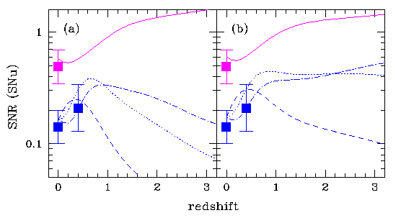

Hold in check what we are doing……
Madau, Della Valle & Panagia 1998
¯
7.1 SNe per sec→ 3.3 SNe per sec
Woosley & mm 2006

Slide 70

What fraction of CC-SNe give rise to Gamma-Ray Bursts ?

Slide 71
What is the rate of SNe-Ib/c ?
Asiago Survey: Cappellaro et al. 1999

Slide 72

Fruchter et al. 2006
Notes:
Thus while the probability of a SN exploding in a particular pixel is roughly proportional to the surface brightness of the galaxy at that pixel,
the probability of a GRB a given location effectively goes as a higher power of the local surface brightness.

Slide 73

Theory 2
Theory 1
Relativistic SN
Radio SN surveys
SN surveys +
LF GRBs
GRBs/SNeIbc < 1.5%
= 0.01% ÷ 0.25%
or 10⁻⁴ ÷ 2.5x10⁻³

Slide 74
High Luminosity GRBs vs Low Luminosity GRBs
LL-GRBs
HL-GRBs
Fermi
Swift

Slide 75
LL-GRBs
GRB | SN | z | D _{max} | Sky Cov. | Δt (yr)
GRB 980425 | SN 1998bw | 0.0085 | 170 Mpc | 0.08 | 7
GRB 060218 | SN 2006aj | 0.033 | 160 Mpc | 0.17 | 9

Slide 76


Slide 77



Slide 78
Modeling lightcurves and spectra
1998bw 40 M | 2003dh 35-40 M | 2003lw 40-50 M | 2006aj ~25 M | 2008D 25-30 M
Maeda et al. 2006 | Mazzali et al. 2003 | Mazzali et al. 2006 | Mazzali et al. 2006 | Tanaka et al. 2008
30-120 M / 8-120 M ~ 0.14
GRB/CC-SN ~ 10⁻⁵ ÷ 5 x 10⁻³
Notes:
So it is possble that a combination of all these requirements is responsible for producing a so tiny fraction of events with respect to the relatively large number of progenitors.
But the role of each of them is not fully understood (yet).

Slide 79


Zampieri et al. 2003
Nomoto et al. 2005
See also Smartt et al. 2008
GRB 060614: SN with small explosion energy → low expansion velocity → most ⁵⁶Ni falls back into the BH → small ⁵⁶Ni mass in the ejecta→ < 10^{-4/-5} M ⁵⁶Ni → “Dark Supernovae” (see DV et al. 2006, Nomoto et al. 2007 and Tominaga et al. 2007)
Notes:
Swallow tail diagram
Small explosion energy:1. Efficiency of the neutrino re-heating 2. rate of infall of the falling material
Onto the proto-NS; 3. Binding Energy of the envelope (i.e. mass of the envelope). If 2 and 3 are large enough only a small amount of energy is made available to accelerate and heat up the ejecta, so the SN explosion can be largely inefficient

Slide 80

Ghirlanda et al. 2013
GRB/SNeIbc →0.4%-0.01%
(6° < ϑ < 45°)
Notes:
GRB rate as a function of redshift. The sample of simulated bursts is shown by the filled black circles and the GRBFR assumed in our
simulation (see Section 2) is shown by the solid grey line. This curve is normalized to the histogram. The GRBFR without density evolution (as
derived by Li 2008 – see equation 1) is shown by the dashed grey line. The rate of bursts PO is shown by the open (blue) squares and that of the PO
bursts with P ≥ 2.6 cm−2 s−1 (i.e. the Swift comparison sample – PO Swift) by the open (red) circles. The rate of Swift GRBs of the complete sample
(rescaled to match the rate of PO Swift rate) is also shown for comparison.
The solid lines reported in the top of the plot are the cosmic rates of SNIb/c
computed by Grieco et al. (2012) for different assumptions on the CSFR.

