Slide 1
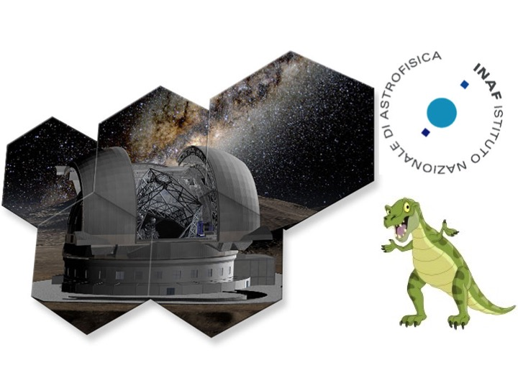
Star-disk interaction in young stars with E-ELT/HIRES
T-REX Meeting – Sesto/Sexten – 23rd July 2015
A preview from X-Shooter spectra
Simone Antoniucci (INAF–OA Roma) and JEDI collaborators
J.Alcalà, K.Biazzo, F.Bacciotti, R.Bonito, C.Codella, E.Covino, F.Fontani, D.Fedele, A.Frasca, T.Giannini, G. Li Causi, D.Lorenzetti, C.Manara, B.Nisini, A.Natta, L.Podio, L.Testi, G.Santangelo, B.Stelzer, M.Tazzari
Jets and Disks
@ Inaf

Slide 2
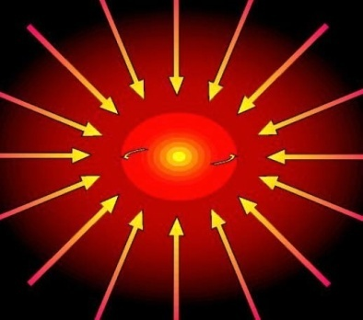
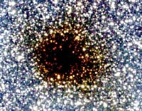
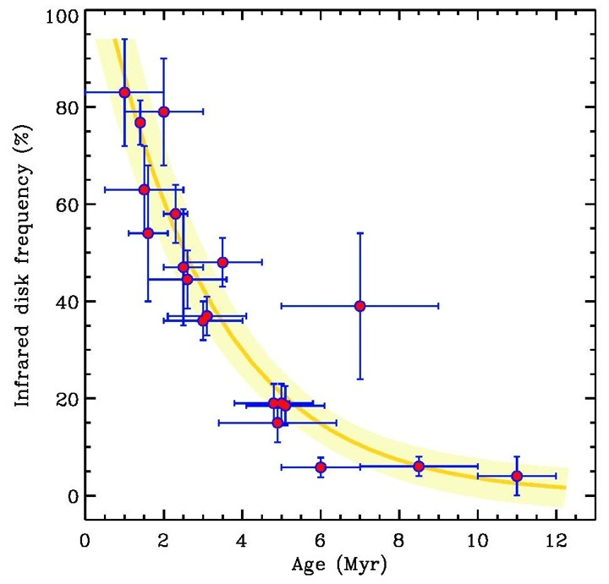
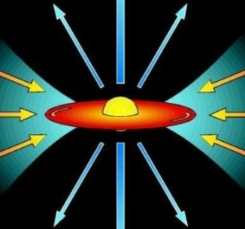
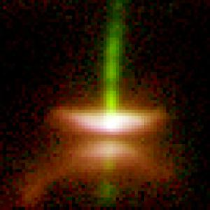
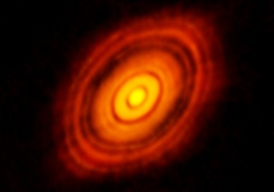
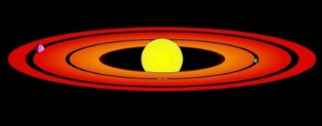
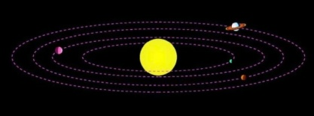
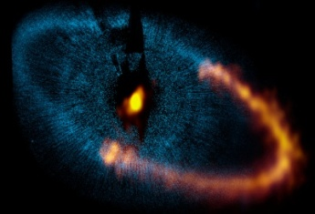
From cores to planetary systems
HH30
HST
core
Hernandez + 2007, Fedele+ 2011
HH30
HST
disk accretion/jets
HL Tau
ALMA
transitional disk/
planet formation
Fomalhaut
HST
debris disk / planetary system
Inner disk accretion/clearing:
e-folding time ~ 2-3 Myr
t
T-REX meeting - Sesto - July 2015 - S. Antoniucci

Slide 3
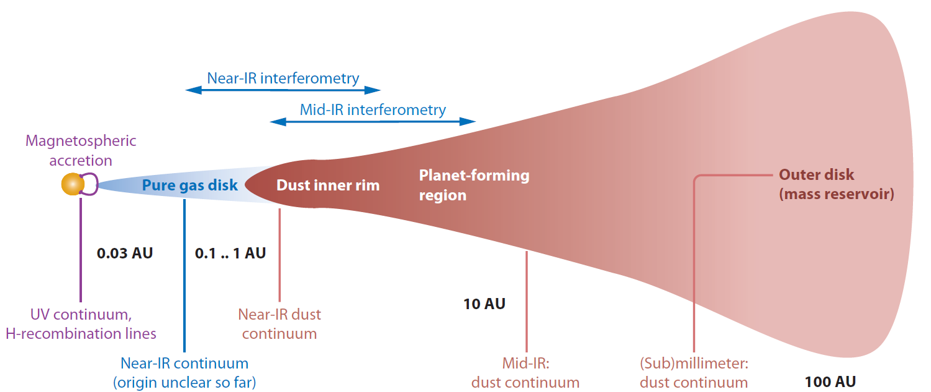
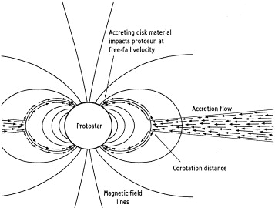
Protostellar system: star-disk interaction
Star + magnetic field + gaseous inner disk (accretion/winds) + dusty disk
adapted from
Dullemond & Monnier 2010
1 AU @150pc = 7 mas
winds/jets
What we know now:
Evolution of star and disk are tightly coupled
We know very little about magnetic fields (but they are extremely important!)
Gas (chemistry) and dust (size distribution) evolve with time and are affected by the star
Structure of the inner disk (and its evolution) is critical for outcome of planet formation (planets in the habitable zone and their characteristics)
inner gas disk
accretion flows
accretion shock
T-REX meeting - Sesto - July 2015 - S. Antoniucci

Slide 4
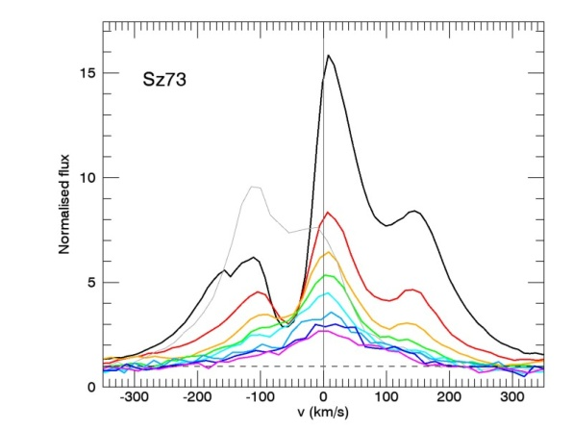
Optical-NIR spectrum of YSOs: X-Shooter
VLT/X-Shooter 0.3-2.5 um spectrum of a young stellar object
Alcalá+ 2014
10⁻¹¹
RU Lup (K7; M∼ 1M)
(R~10000)
F_{λ} (erg/s/cm²/nm)
10⁻¹²
300 400 500 600 700 800 900 1000 2000
λ (nm)
Antoniucci+ 2015
UV excess, IR excess → accretion, veiling
HI lines & other permitted lines (OI, HeI, CaI, CaII, FeI, TiI, NaI, …)
→ probe inner circumstellar structures (accretion, winds)
Forbidden lines ([FeII], [OI], [SII], [NII], …) → wind/jet diagnostics
Molecular lines (H₂, CO, H₂O, OH) → disk, jet diagnostics
HI lines
Emission
v (km/s)
Abs.
Photospheric features → spectral type, luminosity class, magnetic field, veiling
T-REX meeting - Sesto - July 2015 - S. Antoniucci

Slide 5
X-Shooter spectra: accretion & emission lines
X-Shooter → complete characterization of stellar and accretion properties of sources, mostly Classical T Tauri stars (class II obejcts)
Significant effort to perform X-Shooter surveys of several star-forming regions (Cha, Lup, ρ Oph, σ Ori, CrA, …)
JEDI: our italian group working on this subject
JEts and Disks
@ Inaf
OAR, OACN, OAA, OACt, OAPa
http://www.oa-roma.inaf.it/irgroup/JEDI/JEDI/Home.html
Alcalá+ 2014, Manara+ 2015
Multiple photospheric features fitting
Excess continuum fitting
Lacc-line relationships
T-REX meeting - Sesto - July 2015 - S. Antoniucci

Slide 6
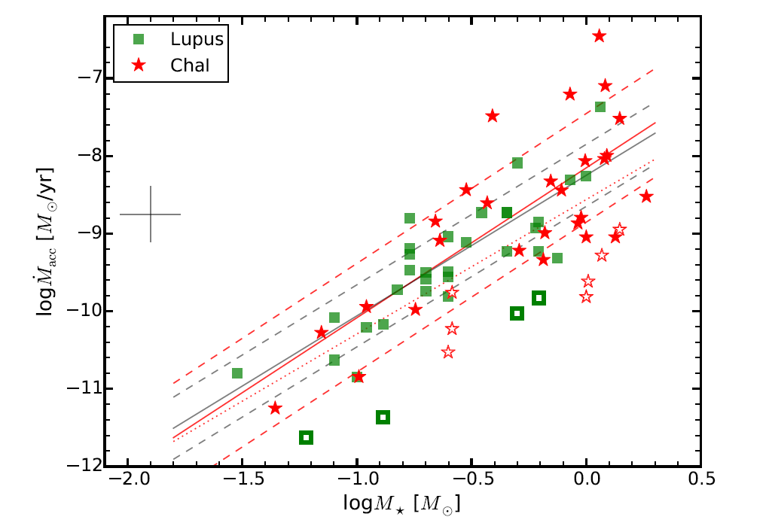
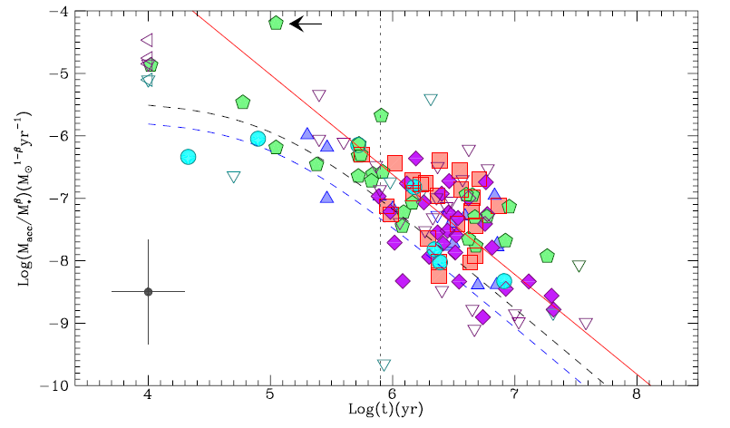
Mass accretion
0.3-2.5 μm coverage → diagnostics for mass accretion rate (UV excess, emission lines)
M_{acc} vs source parameters, M_{acc} vs time evolution
Alcalá+ 2014, Manara+ 2015
Antoniucci+ 2014
embedded/younger sources (Class I)
BDs and below
ELT+HIRES → accretion in brown dwarfs and below (limit is our knowledge of chromospheric activity in stars without disks, Manara+ 2013), accretion in farther star-forming regions (LMC/SMC), accretion dependence on metallicity, accretion in embedded (younger) sources
T-REX meeting - Sesto - July 2015 - S. Antoniucci

Slide 7
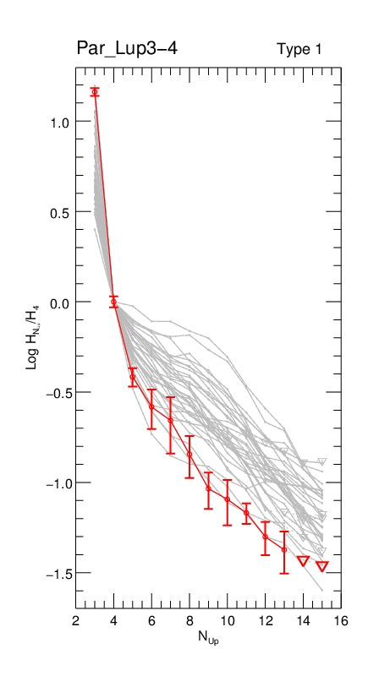
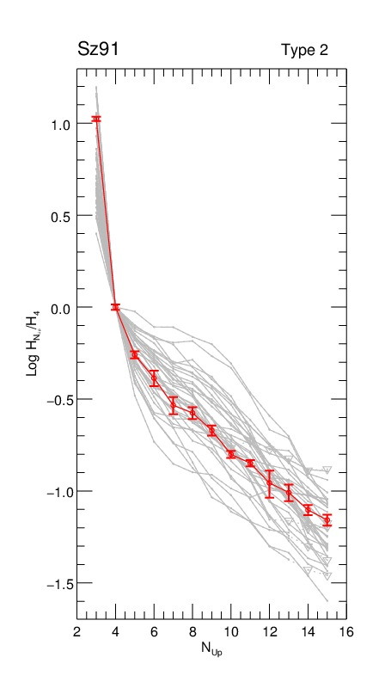
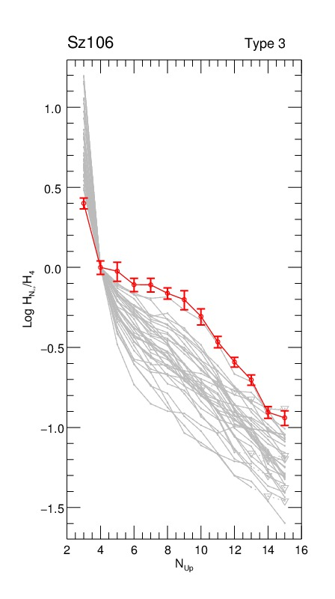
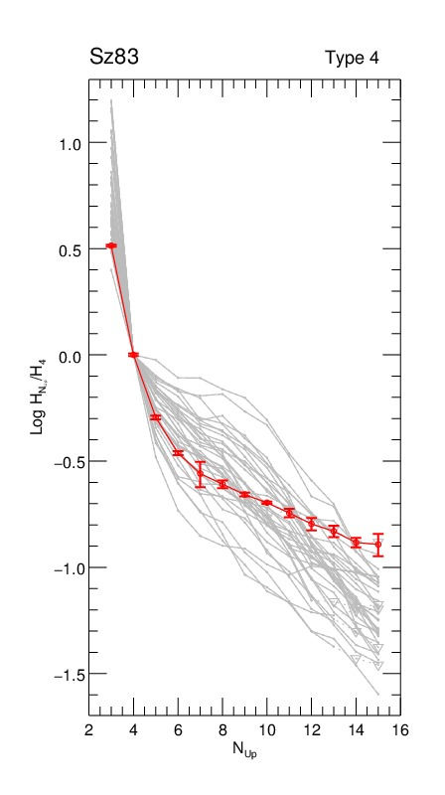
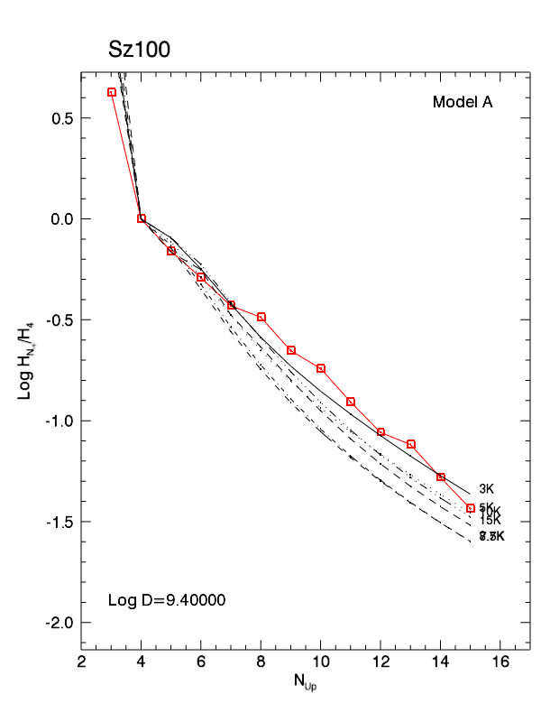
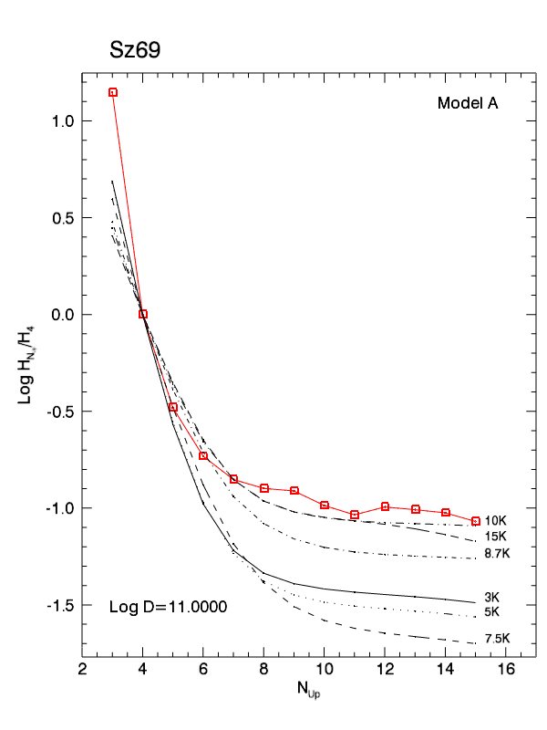
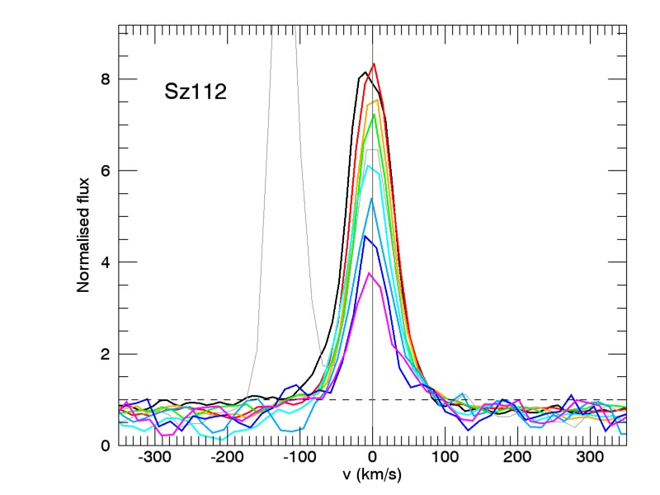
HI lines: info on circumstellar gas
Wide spectral coverage → use multiple lines: HI series decrements
→ properties of hot gas in the inner circumstellar region (accretion/winds/disk)
Balmer decrements
Antoniucci+ 2015 in prep
Kwan & Fischer 2011 emission line models: self-consistent radiative transfer calculations, can manage optically thick emission
Hα
Hβ
Hγ
Hδ
Hε
Normalized Flux
H8
H9
H10
H11
Decrement analysis provides range of gas T (3000-20000 K) and n (10⁸ – 10¹¹ cm⁻³), shape correlates with accretion rate
Refined radiative transfer models are required + line profiles are often difficult to interpret
HIRES → sensitivity to study same gas through other tracers (e.g. [OI],CaII,H₂,H₂O,…), often easier to interpret (optically thin lines)
v (km/s)
T-REX meeting - Sesto - July 2015 - S. Antoniucci

Slide 8
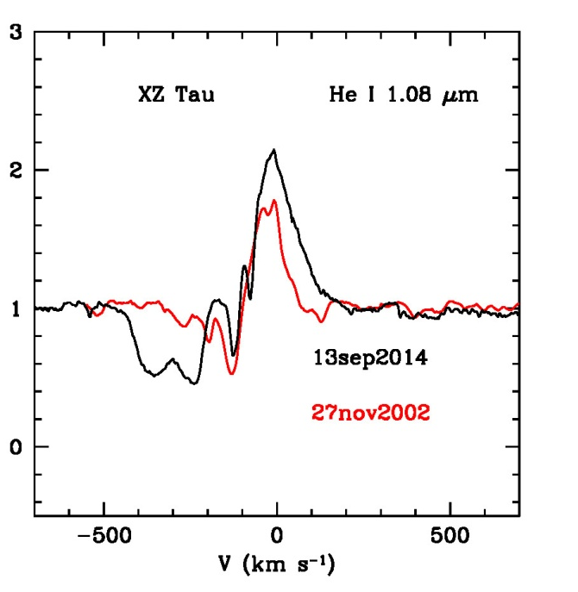
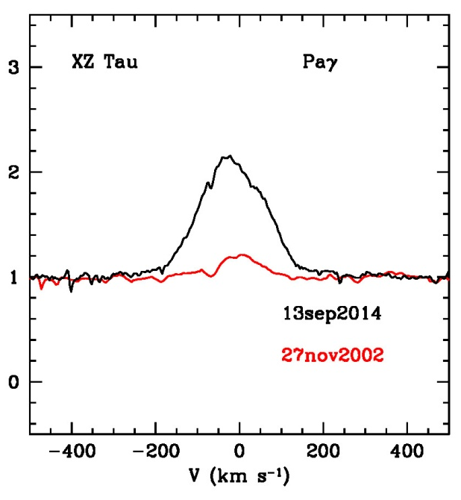
High resolution spectra: profile analysis
TNG/Giano NIR spectra of pre-Main Sequence objects (R~50000)
Nisini, Antoniucci+ in prep
XZ Tau
XZ Tau
Normalized flux
Normalized flux
He I → traces winds
HI → traces accretion flows
HIRES high resolution analysis: study variations of source structures through different tracers (shifts, appearance/disappearance of peaks/dims) revealing modifications in gas geometry and kinematics
T-REX meeting - Sesto - July 2015 - S. Antoniucci

Slide 9
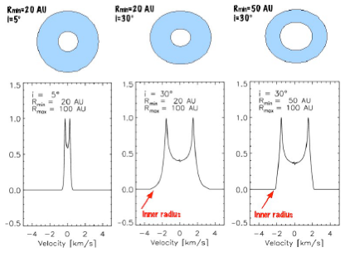
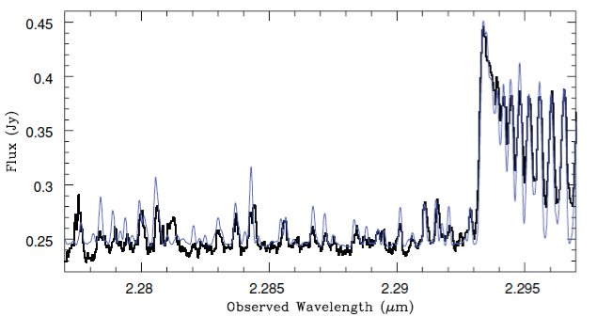
Inner gaseous disk
R_{min}=20AU
i=5°
R_{min}=20AU
i=30°
R_{min}=50AU
i=30°
inner radius
inner radius
HIRES: high sensitivity & high resolution (R > 50000, few km/s)
→ probe the kinematics and gas content of the inner region of the disk
Najita+ 2009, Doppmann+ 2011
CO ν=2-1
[OI] slow winds (photoevaporation?)
X-Shooter spectra, Manara+2013
H₂O
T-REX meeting - Sesto - July 2015 - S. Antoniucci

Slide 10
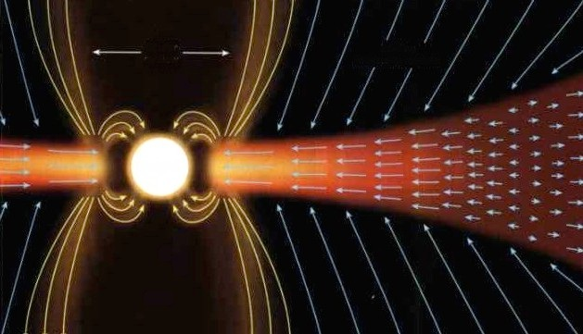
Excitation and dynamics of winds/jets
stellar wind
X-wind
disk-wind
Use large number of lines to probe different excitation layers in the jet
Constraints on physical parameters in the jet → T, n, x_{e}, A_{v}, dust depletion
Estimate mass loss rate, correlation with source properties
Models for nebular emission lines
accretion
Forbidden lines in X-Shooter spectrum of ESO-Ha 574
[SII] 6716
[SII] 6731
Constraints on physical parameters in the jet acceleration region (< 100 AU) → T, n, x_{e}, A_{v}, dust depletion
Accurate measure of the radial (and angular) velocity field → measure M_{wind} and efficiency of angular momentum extraction
Understand effects on disk gas/dust dispersal and evolution → affects formation of planets
Par-Lup 3-4
jet
d (arcsec)
X-Shooter
Whelan+ 2014
LSR Velocity (kms⁻¹)
Giannini+ 2014
T-REX meeting - Sesto - July 2015 - S. Antoniucci

Slide 11
Excitation and dynamics of winds/jets
stellar wind
X-wind
disk-wind
Use large number of lines to probe different excitation layers in the jet
Constraints on physical parameters in the jet → T, n, x_{e}, A_{v}, dust depletion
Estimate mass loss rate, correlation with source properties
Models for nebular emission lines
accretion
Forbidden lines in X-Shooter spectrum of ESO-Ha 574
→ test different jet-launching models from kinematic components (jet acceleration/collimation within 10-100 AU, ~70-700 mas at 150 pc, AO is critical, IFU mode!)
→ find signature of jet rotation (few km/s) and accurately measure the radial (and angular) velocity field → mass loss rate and efficiency of angular momentum extraction
→ understand implications for disk gas dispersal and evolution (affects formation of planets)
Giannini+ 2014
T-REX meeting - Sesto - July 2015 - S. Antoniucci

Slide 12
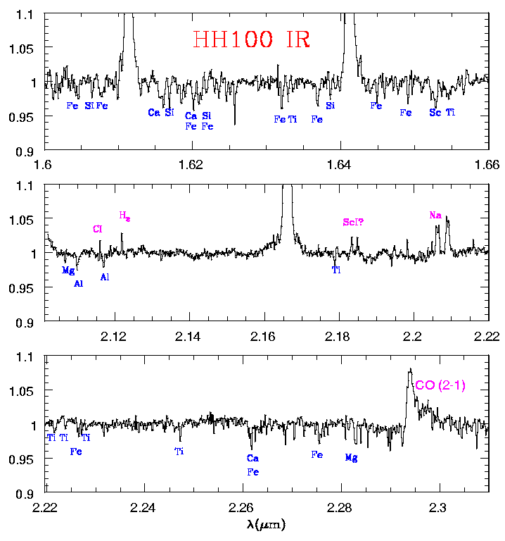
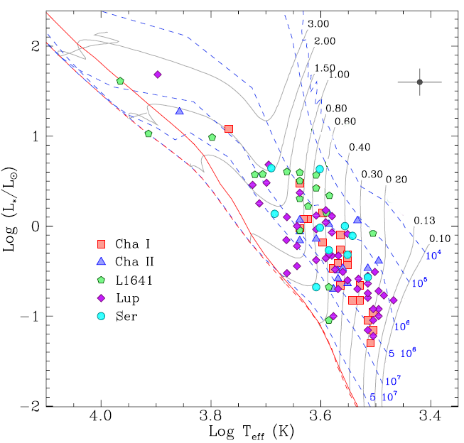
Stellar and accretion properties of embedded protostars
High-sensitivity, high-resolution near-IR spectra are needed to detect the weak photospheric absorption lines in heavily veiled (strong excess continuum) embedded (much younger) sources → source characterization (stellar + accretion parameters)
Br13
Br12
Nisini, Antoniucci+ 2005
Antoniucci+ 2014
Brγ
F_{λ}
T-REX meeting - Sesto - July 2015 - S. Antoniucci

Slide 13
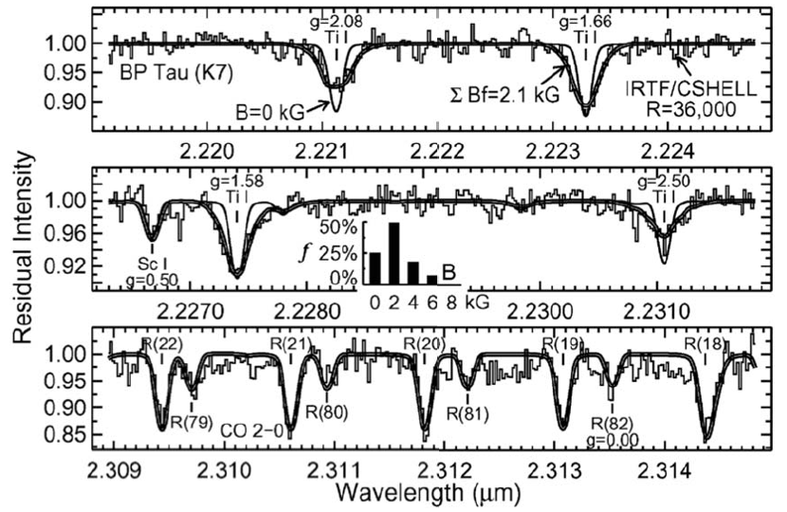
Magnetic fields
Johns-Krull 2009, Gregory+ 2012, Donati+ 2012, Hussain 2012
Very few measurements up to now, only brightest objects
Variations of polarized profiles to reconstruct MF topology
Extension to large number of sources is critical to understand impact on disk+star evolution
Requirements (why HIRES is perfect):
High sensitivity + high spectral resolution (R = 100000), polarimetric mode
Broad spectral coverage
T-REX meeting - Sesto - July 2015 - S. Antoniucci

Slide 14
HIRES for star-disk interaction: a preview
Mass accretion in YSOs
Fully characterize M_{acc} in BDs, younger/embedded sources, farther star-forming regions
Resolution > 5 10⁴ and NIR critical for younger/embedded sources
IFU and AO mode would be good to try to connect to the inner disk/wind
Jets/ouflows
High resolution and AO mode required R~10⁵ to measure jet rotation and disentangle jet-launching models; slit or IFU (would be good!)
Inner gaseous disk
High resolution R~10⁵ for detecting lines through telluric features, profiles
Magnetic fields
High resolution R~10⁵; polarimetry; seeing-limited ok
Important: synergy with ALMA
For all previous points synergy with ALMA is critical to study connection with the outer disk evolution and the large scale outflows
Check the HIRES white paper (http://arxiv.org/abs/1310.3163)
T-REX meeting - Sesto - July 2015 - S. Antoniucci

Slide 15
T-REX meeting – Sesto – July 2015 – Simone Antoniucci
Grazie
“A che tante facelle?” – G. Leopardi

