Slide 1
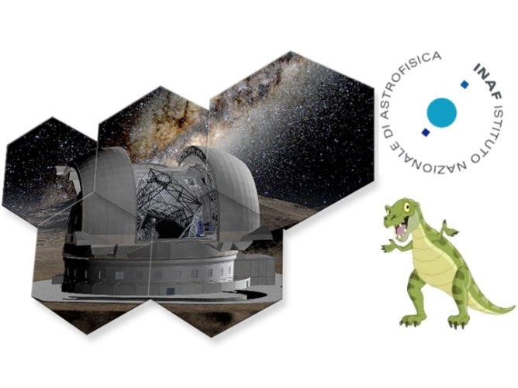
Ion beam figuring technique used as final step in the manufacturing of the mirrors for the E-ELT
Mauro Ghigo
INAF – Astronomical Observatory of Brera - Italy
The outcome of Project T-REX, the Italian Progetto premiale for E-ELT
Sexten Center for Astrophysics – 20 July 2015

Slide 2
Summary
Review of the IBF technique
The large IBF system recently developed in INAF-OAB
Technique useful for the finishing of the M1 segments and MAORY optics
Test figuring of an hexagonal mirror segment 1m corner to corner
Issues encountered and results obtained

Slide 3
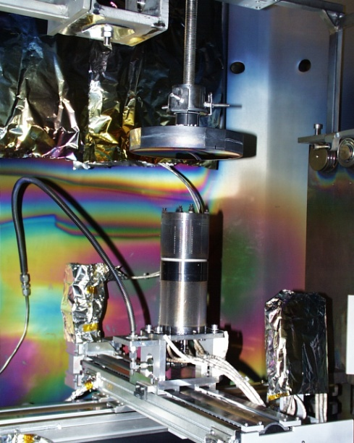
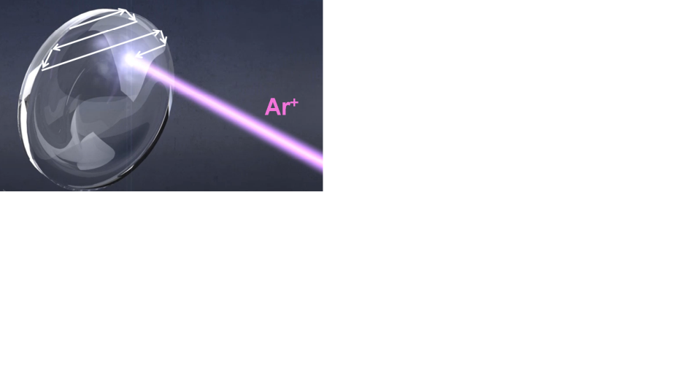
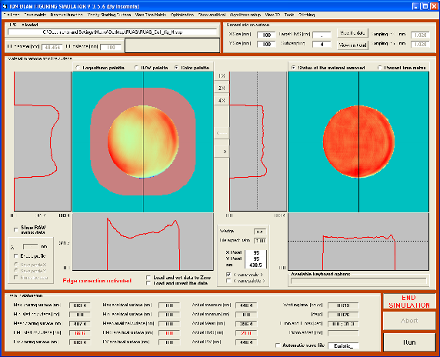
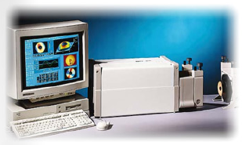
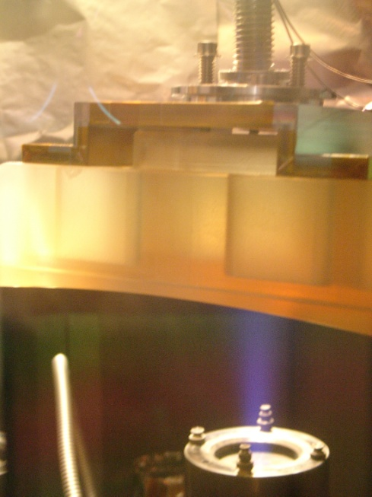
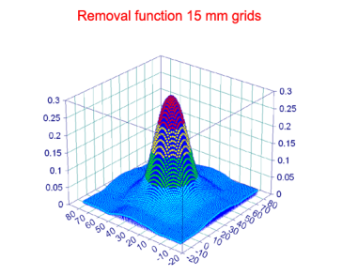
IBF technology
Deterministic process
Pressurless technique (good edges correction)
Optic to be corrected
Interferometric measure
Time matrix computation
Figuring possible on optics already assembled
Stable removal rate (50/100 nm min.)
Removal function

Slide 4
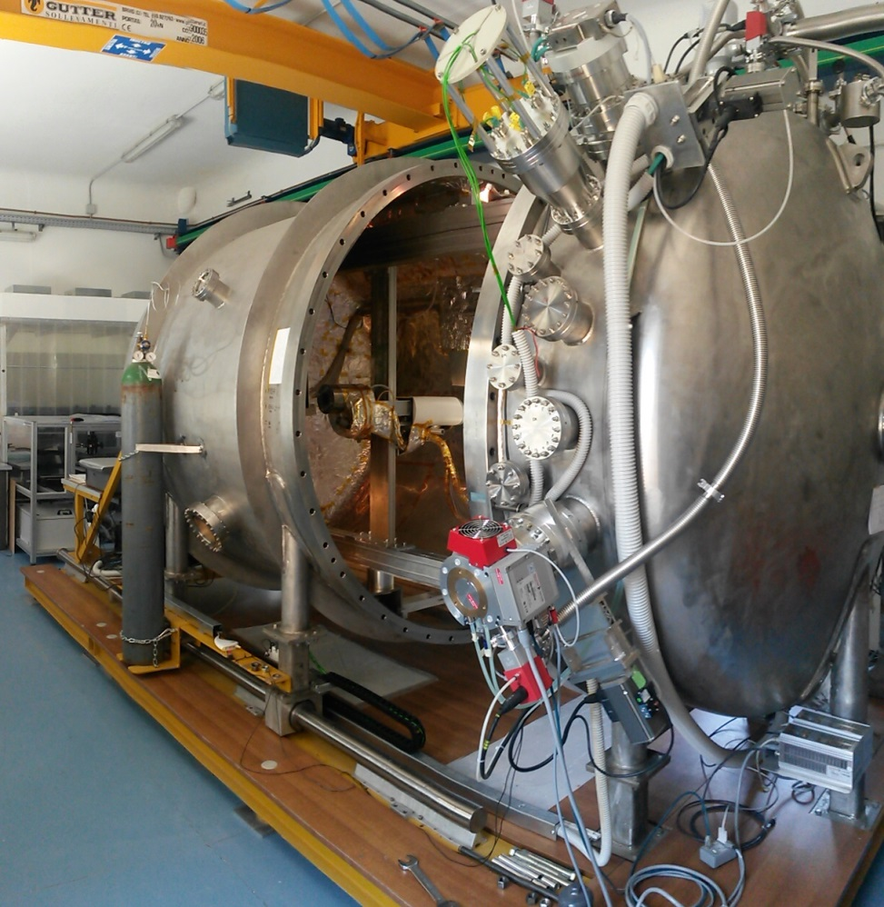
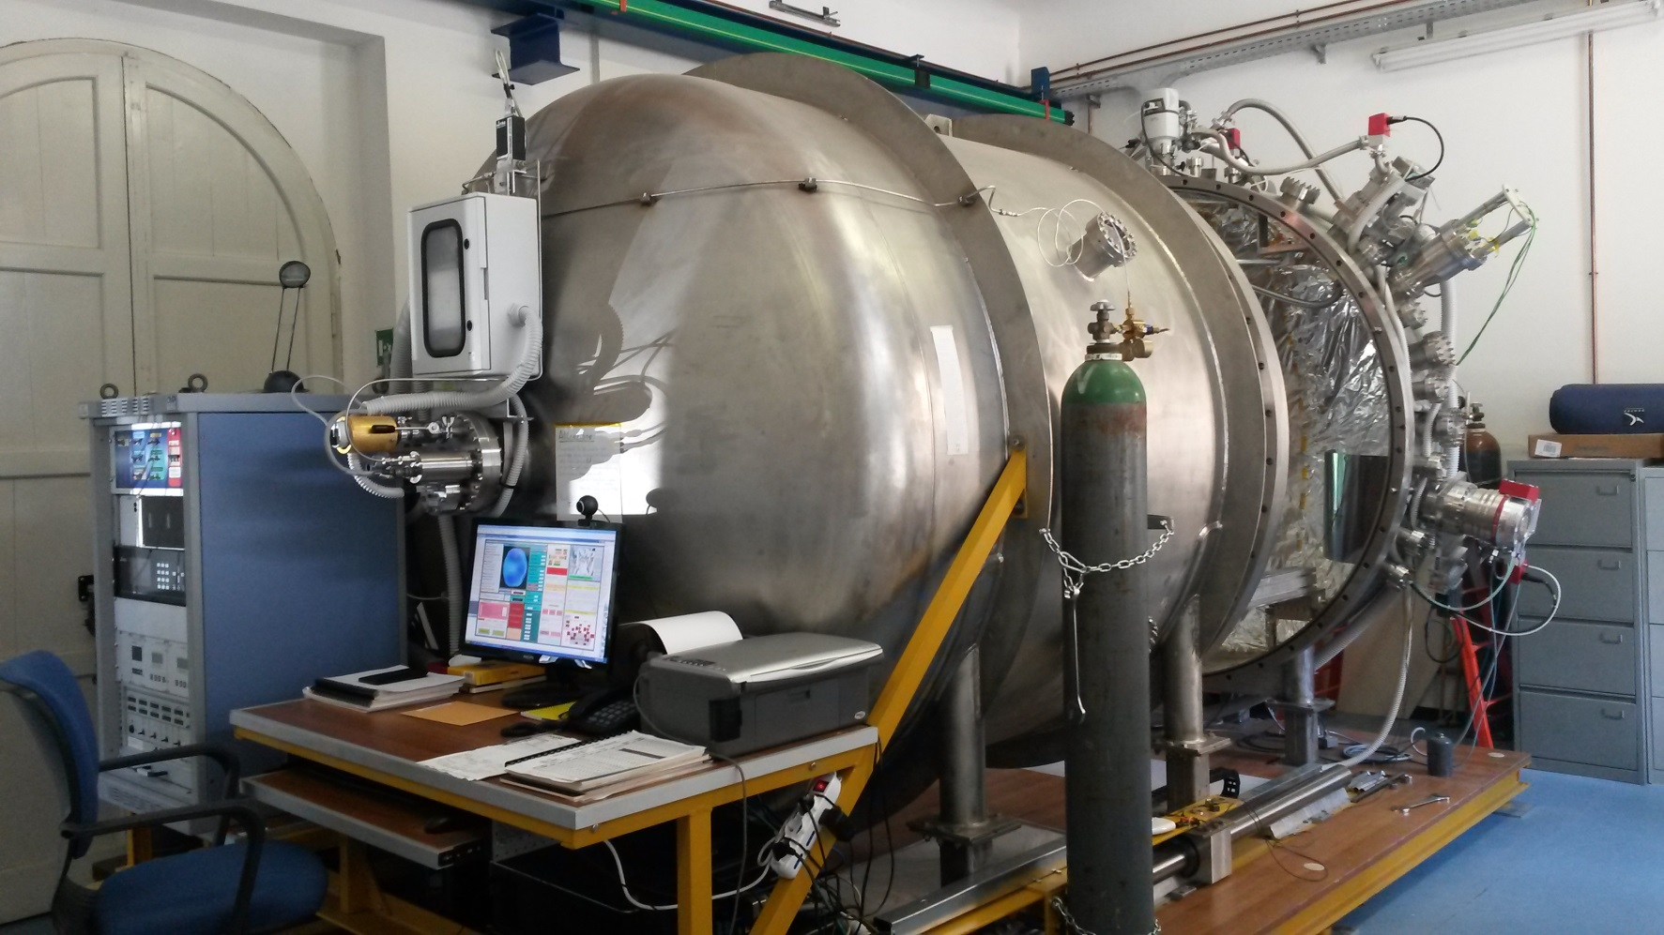
Large IBF facility IN INAF-OAB
One of the largest IBF facilities in Europe. Used mainly (but not only) for R&D studies
Vacuum chamber size 2 m x 3 m. – 2 mech. pumps + 4 turbopumps - IBF working pressure 2*10-4 mBar 4 hours pumping down time – MKS Argon flux controller – Veeco Ion source & Power supply

Slide 5
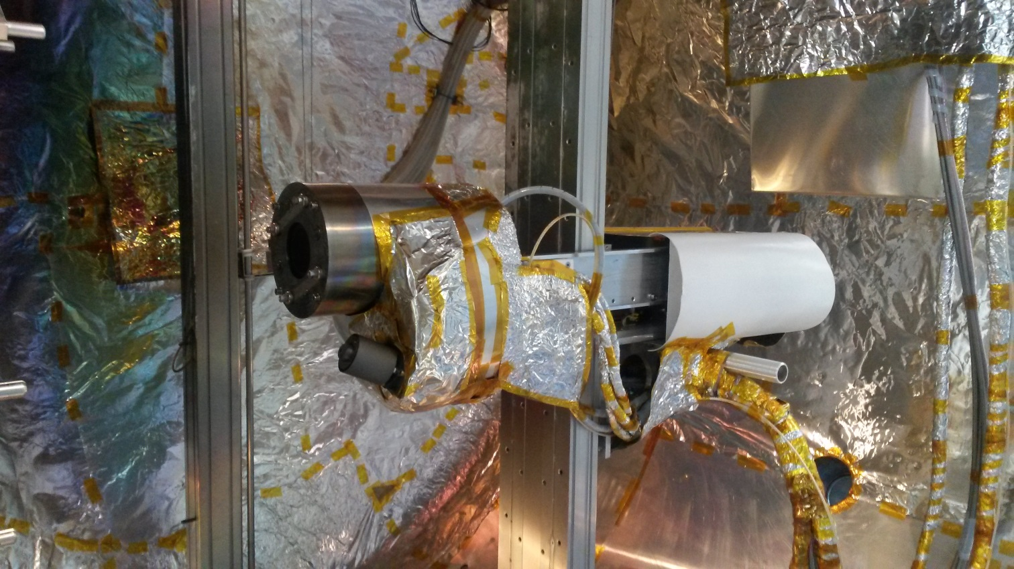
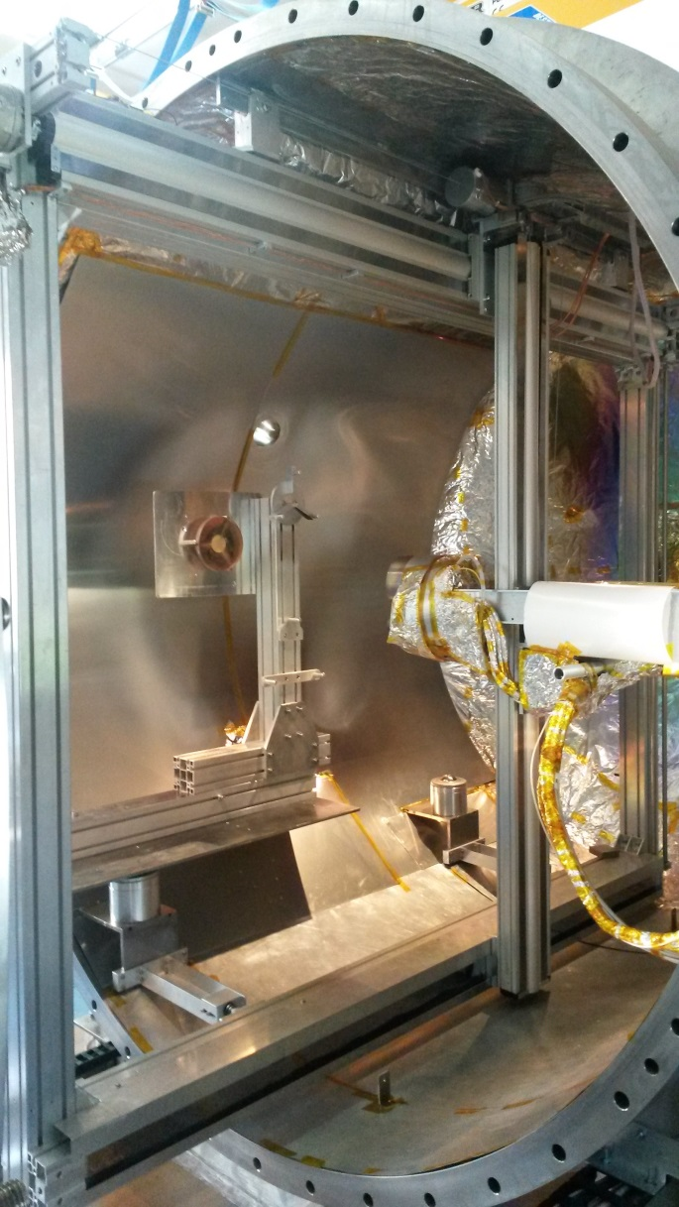
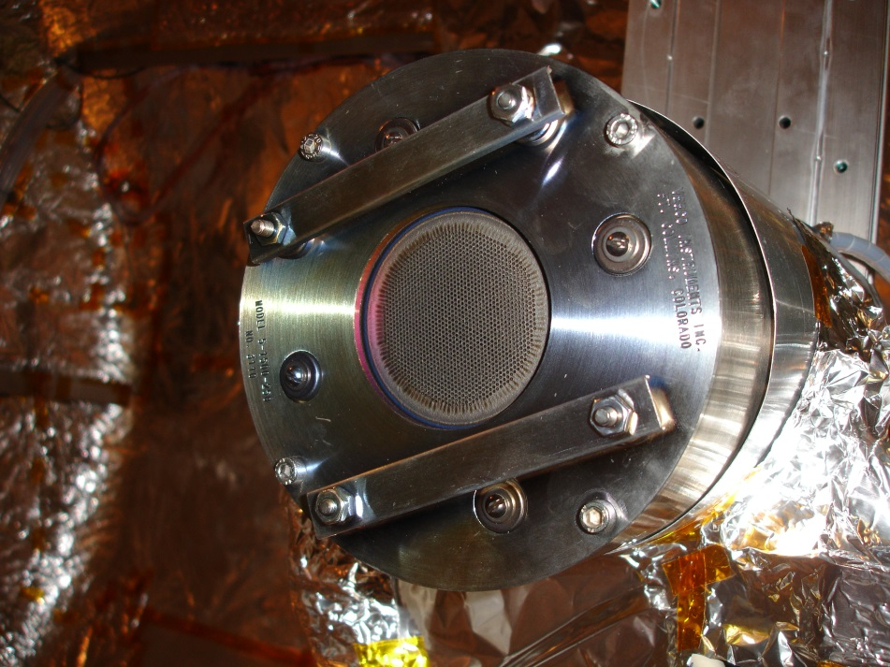
IBF facility IN INAF-OAB
The optic to be figured is mounted in vertical position
1.7 m
1.4 m
Working area of 1.7 x 1.4 m
Three axis system xyz with two gridset
50 mm collimated grids
15 mm focused grids
Hollow cathode ion source
Beam Power from 6 to 240 watts
Figuring made in raster scan path

Slide 6
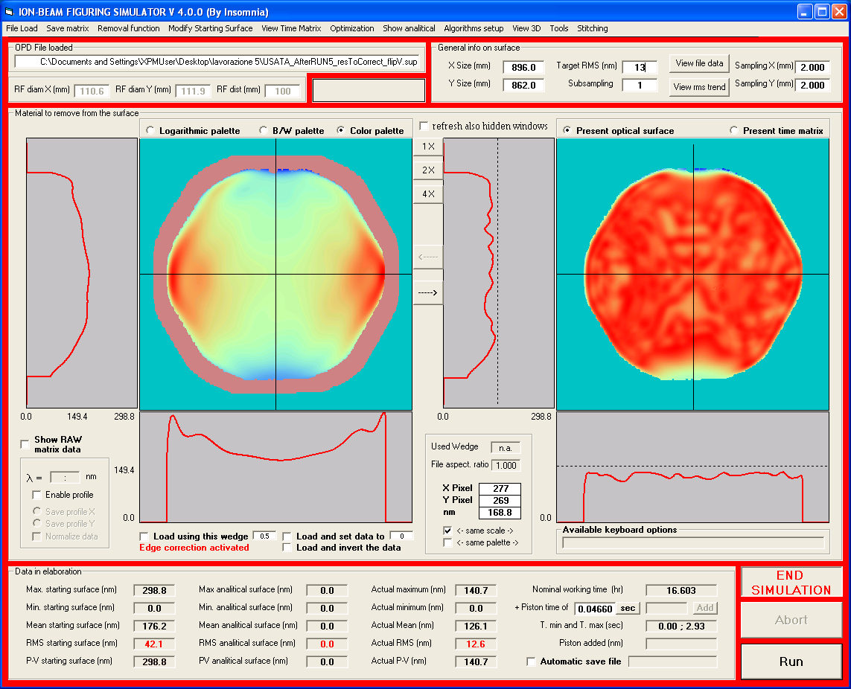
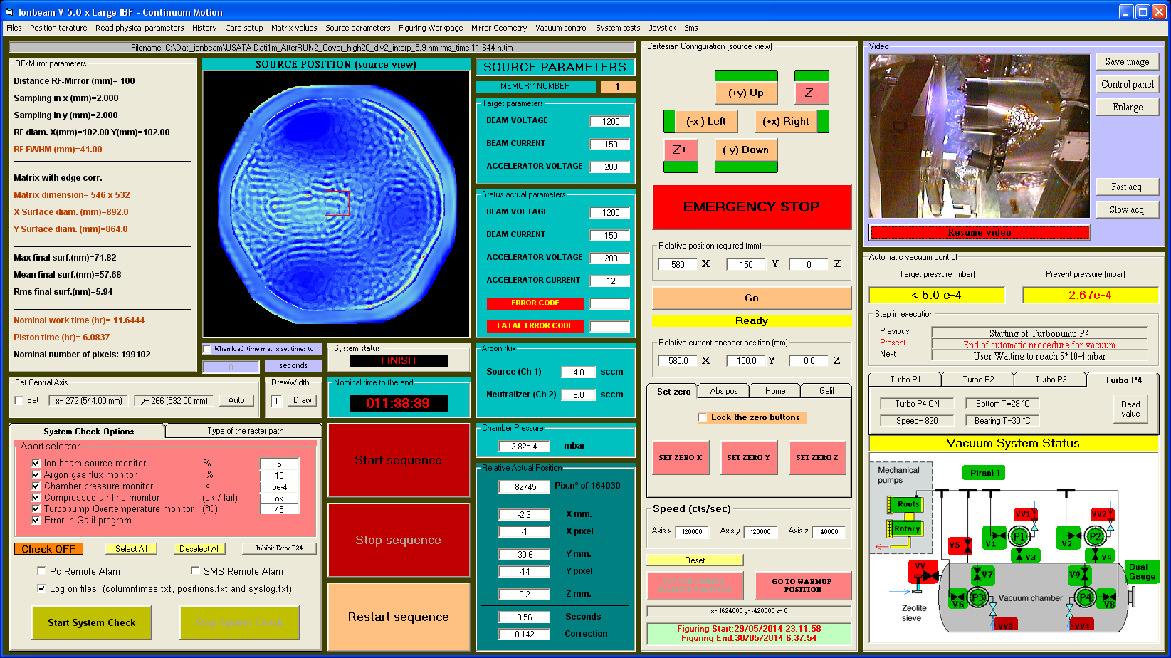
IBF facility IN INAF-OAB
Computational software for Time Matrix determination
IBF facility control software, fully automated process and self monitoring during the figuring
All the software has been developed internally and hence easily adaptable to future needs

Slide 7
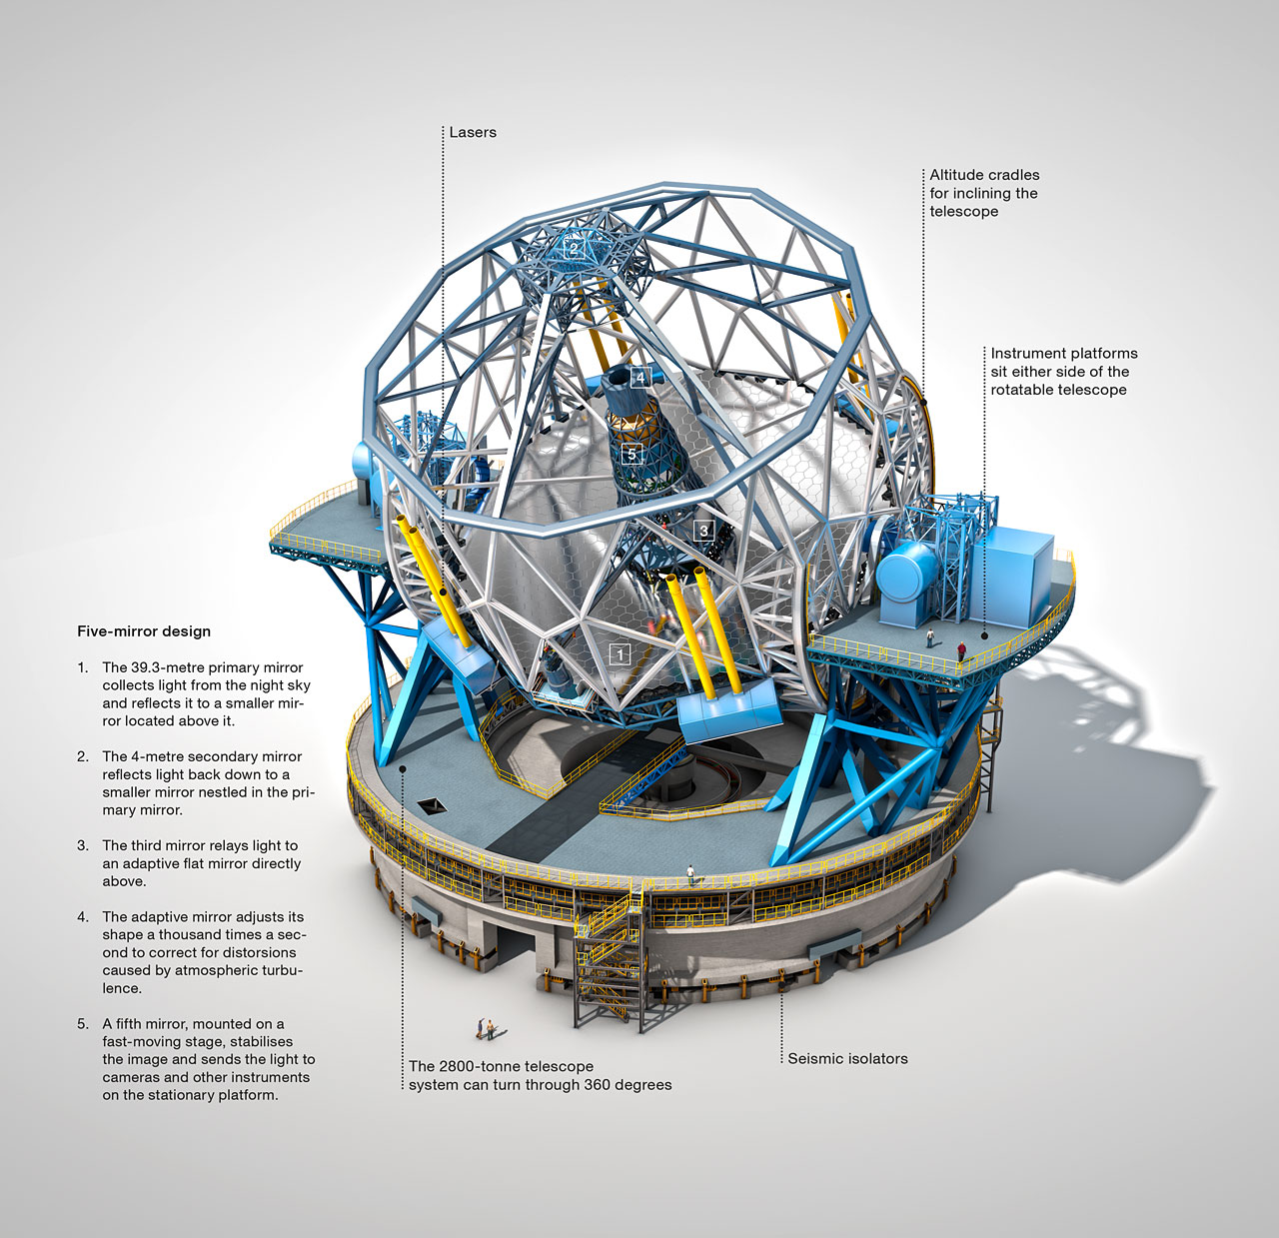
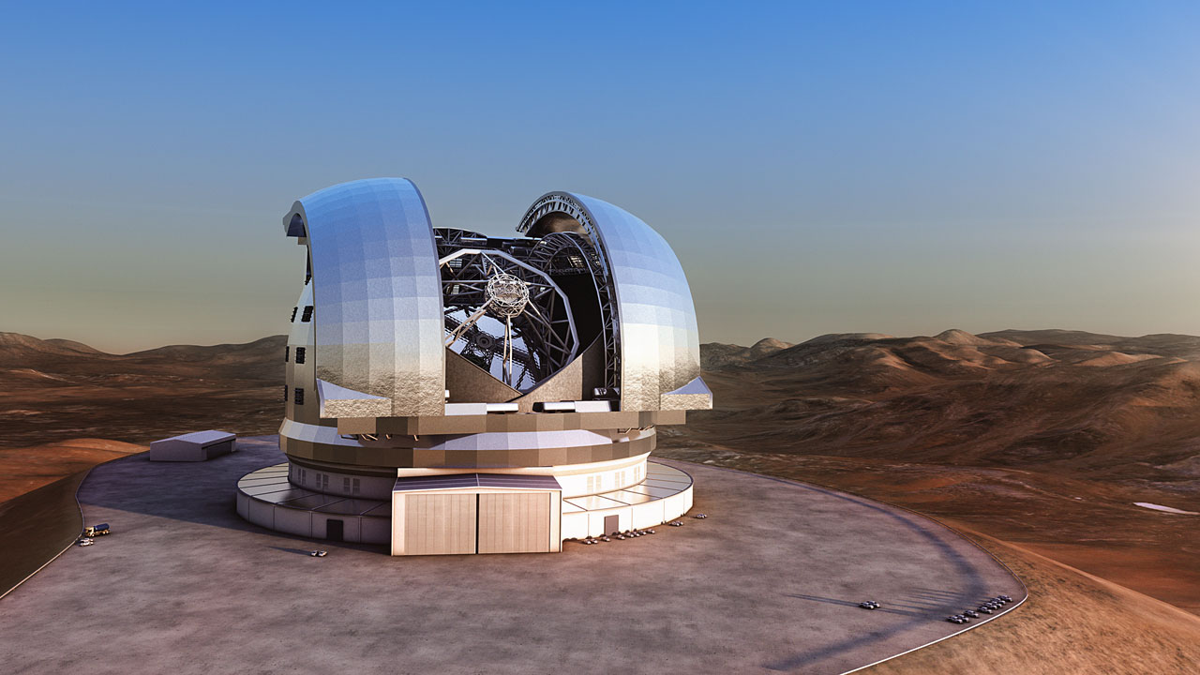
The E-ELT telescope
E-ELT
With its 39 m. main mirror (M1) the E-ELT will be the largest telescope in the world. The mirror will be assembled with 798 hexagonal segments 1.45 m corner to corner, 50 mm thick, and with 69-metre radius of curvature. The IBF is the baseline for the final correction of the segments.

Slide 8
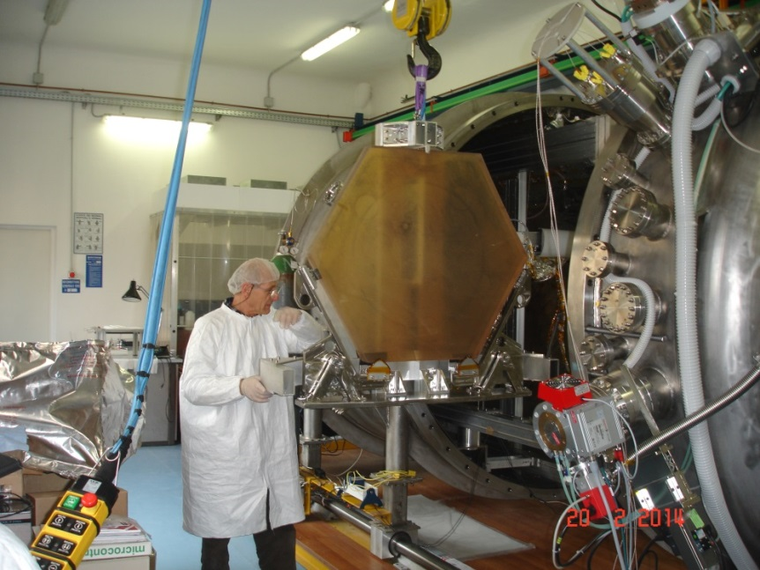
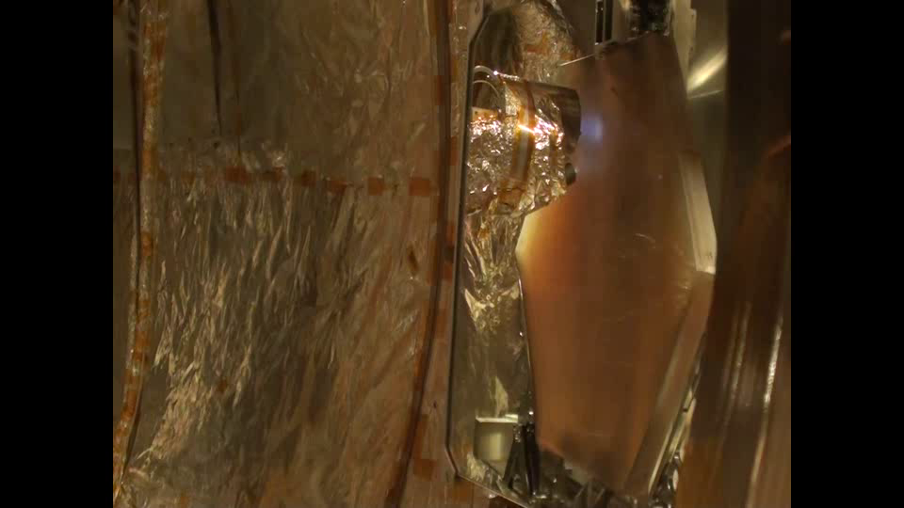
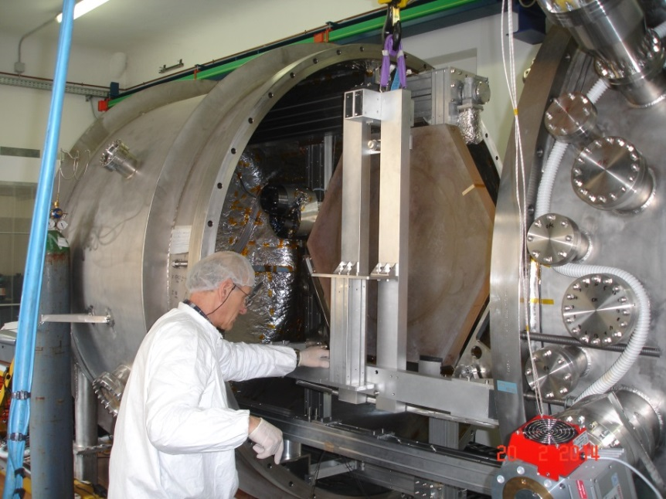
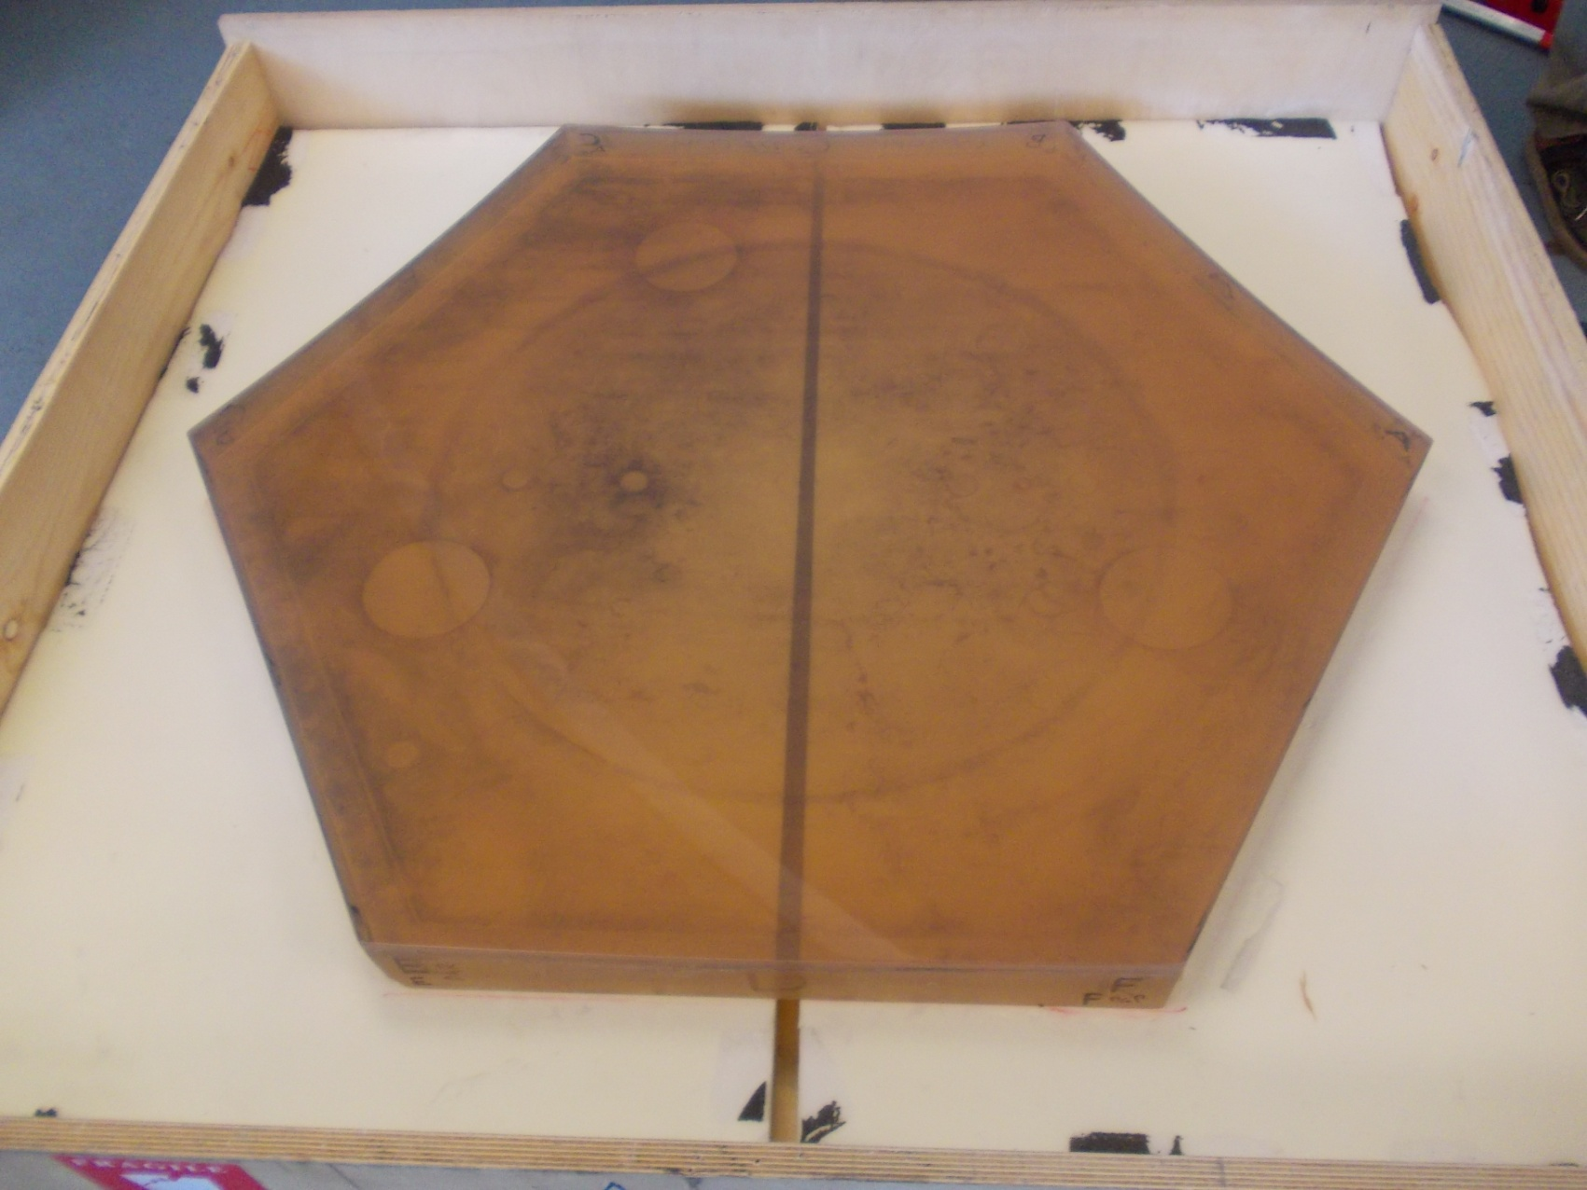
Mirror handling and figuring
Glyndŵr University, N. Wales, has provided to INAF-OAB an hexagonal Zerodur mirror 1m corner to corner for initial test purposes related to the IBF process. It is spherical with a RoC of 3 m so to permit its easy interferometric measure. Previously it was used for polishing and figuring tests on a Zeeko machine, resulting in a textured surface not representative of a true segment but useful for IBF tests.
1 m

Slide 9
The IBF can be also used for MAORY
The Glindwr mirror is representative also of the MAORY optics in terms of size and RoC. The experience done will be useful also for these optics. The sizes are well within the capability of the machine and the material is the same
 | Shape | Radius of curv. | Clear optical diameter | Off-axis distance | F# parent mirror | Conic constant | Material
 |  | (mm) | (mm) | (mm)
M7 | Concave | 32010 | 1170 | 686 | 6.3 | -3.263 | Zerodur
M8 | Flat | - | 1160 | 0 | - | - | Zerodur
M11 | Concave | 5163 | 1120 | 1095 | 0.8 | -0.070 | Zerodur
M12 | Convex | 2045 | 300 | 560 | 0.7 | 0.173 | Zerodur
M13 | Concave | 4823 | 790 | 305 | 1.7 | 0.015 | Zerodur
M14 | Flat | - | 920x660 | 0 | - | - | Zerodur

Slide 10
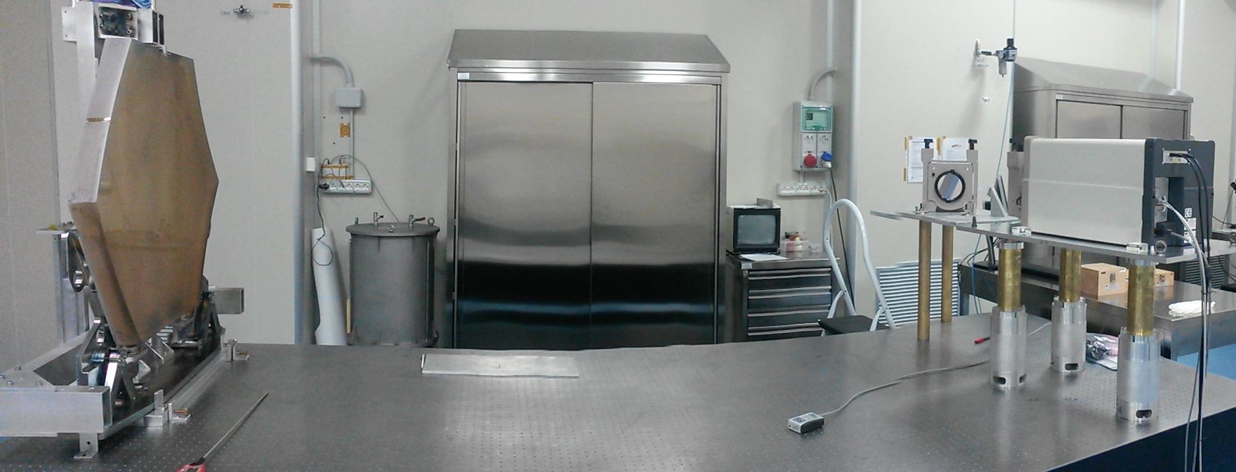
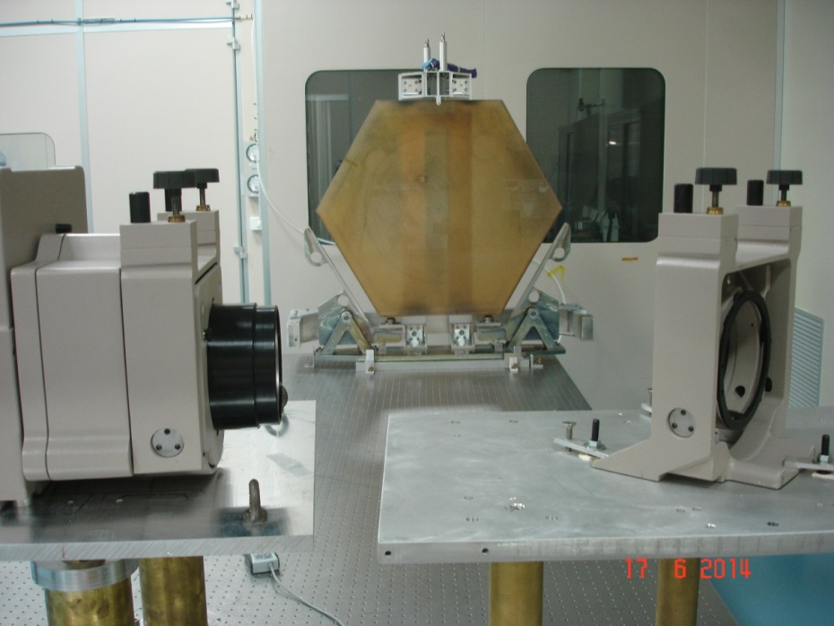
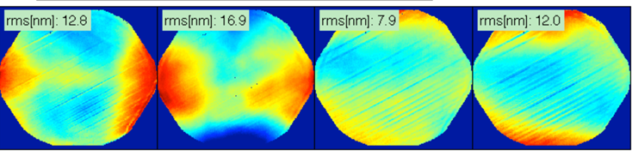
Interferometric setup
A number of set of measurements has been made repositioning the mirror each time. The mean surface for each set has been obtained.
From these mean surfaces a master mean was obtained. In figure are shown the residuals subtracting the means of the sets from the master mean.
Accuracy repeatability ≈12 nm rms

Slide 11
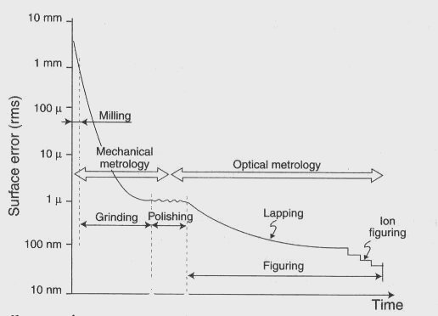
Requested accuracy for M1 segments
Typical manufacturing cycle
Specs from E-ELT Construction Proposal of ESO
The surface accuracy for a typical segment hence needs at least to be of 50 nm rms
The mean of the segments must be corrected at least to 25 nm rms. When removed the focus, astigmatism and trefoil with the active support the overall final figure will be 7.5 nm rms or less.
Notes:
The polishing specification requires that a mounted segment does not exceed 100 nm rms maximum wavefront error and 50 nm rms wavefront averaging over all the segments. After correction of focus, astigmatism and trefoil by active support, the maximum error will reduce to less than 30 nm rms wavefront and 15 nm rms wavefront on average.

Slide 12
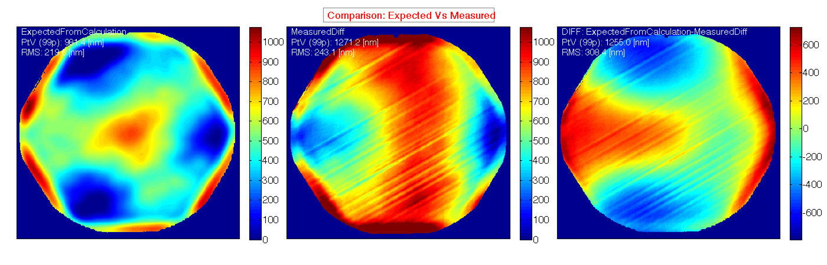
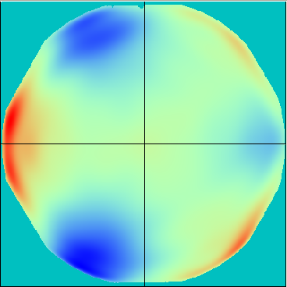
IBF tests on hex segment
Original surface error of the mirror:
PV: 3500 nm, rms: 600 nm
It is also present a high freq. pattern of raster traces, remnant of previous mechanical lapping processes.
We judged the high freq. pattern intractable with ion figuring and therefore we filtered it out before computing the time matrix. To reduce the expected ion figuring time we also removed the low order components to obtain a starting surface of about 200 nm rms.
We ran this first test selecting an high power IBF setting, delivering a 180 Watt beam – 19 hr figuring
Theoretical material to be removed
Measured material removed
Difference
The difference shows a large deformation of 300 nm rms, most likely due to the strong local heating. Post-estimation by FEM of the Temperature indicated values of 180 °C on the Zerodur surface

Slide 13
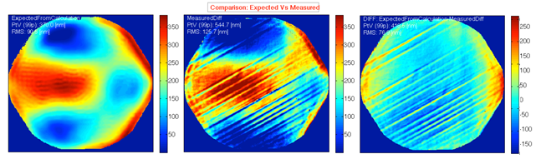
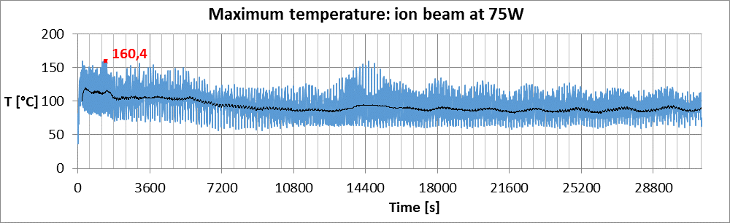
IBF tests on hex segment
Benchmark for the residual error map of the order of 100 nm rms, good finishing value for polishing processes and starting point for ion figuring. Intermediate power, 75 W, to mitigate the thermal issue.
- 17 hours figuring time -
Theoretical material to be removed
Measured material removed
Difference
Temperature evaluation by FEM reached at any time on front surf. Shown only half of the surface, moving from left to center
The highest temperature reached is 160°C. The black curve represents the trend of the running average value, which sets around 100°C and decreases moving toward the center of the surface.
A lower deformation of 75 nm rms was observed, indicating a reduction of the problem

Slide 14
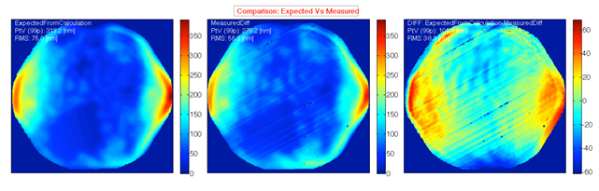
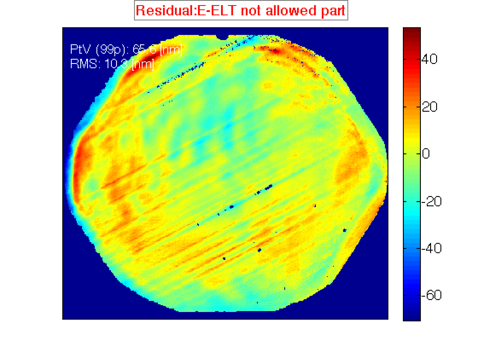
IBF tests on hex segment
The next figuring was done to continue the correction. The same IBF power was used of 75 Watt and figuring time 7 hours. We started from 75 nm rms
Theoretical material to be removed
Measured material removed
Difference
After removal of E-ELT permitted terms
The difference map is limited to ~38 nm rms. After removal of the low frequency terms according to E-ELT specs we obtained a residual error of 10 nm rms, close but not yet within the requirement specification (7.5 nm surface rms) assumed for the mean primary E-ELT segment.

Slide 15
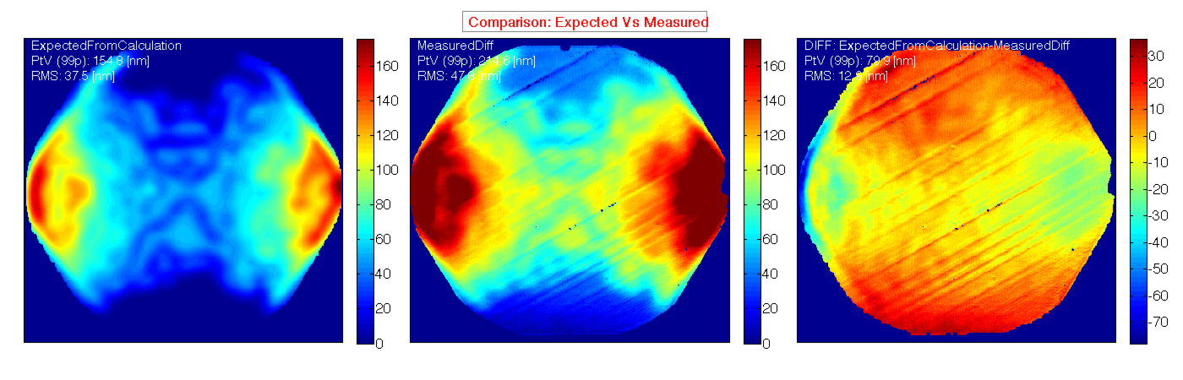
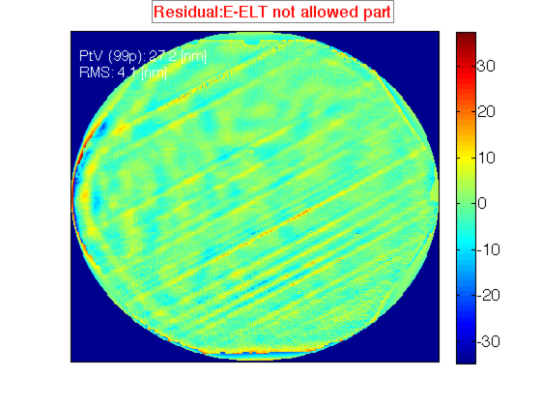
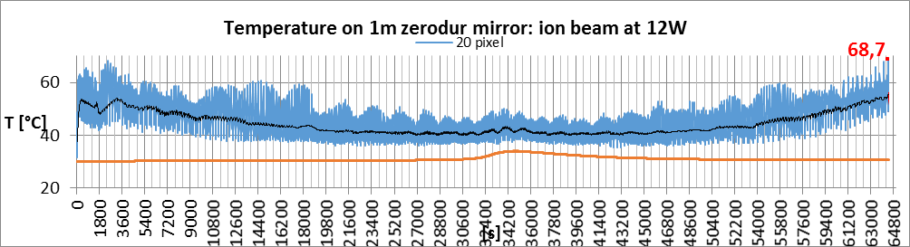
IBF tests on hex segment
Last figuring iteration at low power level, 12,5 W ion source, 19 hours figuring time
Theoretical material to be removed
Measured material removed
Difference
After removal of E-ELT permitted terms
Final residual error of 13 nm rms. No thermal distortions using this power level (T max: 68 °C). After removal of E-ELT permitted terms residual error is 4 nm rms, below the goal specification (5 nm surface rms) assumed for the mean primary E-ELT segment.

Slide 16
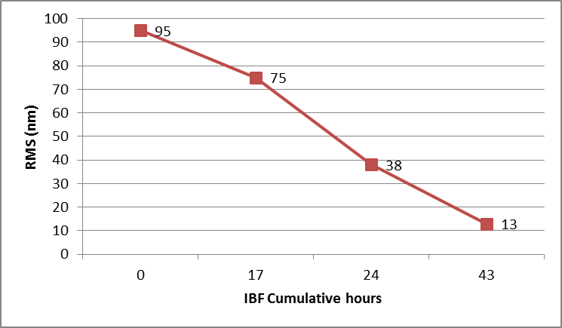
Results of IBF tests
75 watts
Run 1: 17 hr
Run 2: 7 hr
Run 3: 19 hr
-------
43 hr
Run 1
75 watts
Run 2
12 watts
We expect that this cumulative time is not representative of the true figuring runs necessaries for the correction of a real segment because influenced by the issues to understand the thermal problem.
Run 3
A better time estimation will come from the future activities regarding the correction of a real scale hexagonal segment having good surface and initial errors in line with what prescribed after lapping

Slide 17
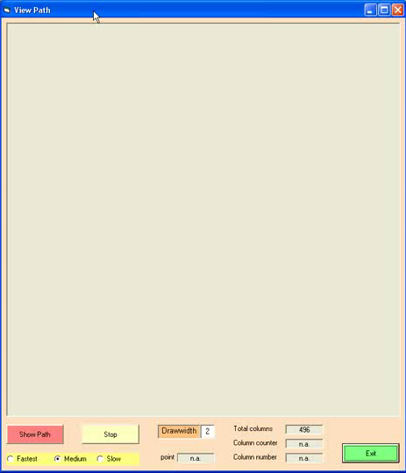

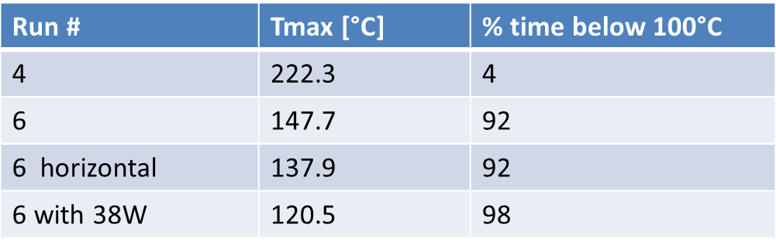
Further Strategy to reduce the heating
Raster scans at 75 Watts. FEM estimation of the frontal temperatures
The raster scan with displaced columns, increase the percentage of time below 100 °C.
This strategy has been already tested in a follow-up run named Run 6. From the data obtained it has been possible to derive that the front max temperature was of 147 °C and that for 92 % of the time the temperature was below 100 °C.
Run 4 Sequential columns
Run 6 Displaced columns

Slide 18
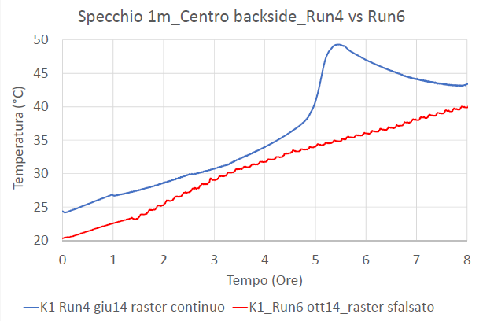
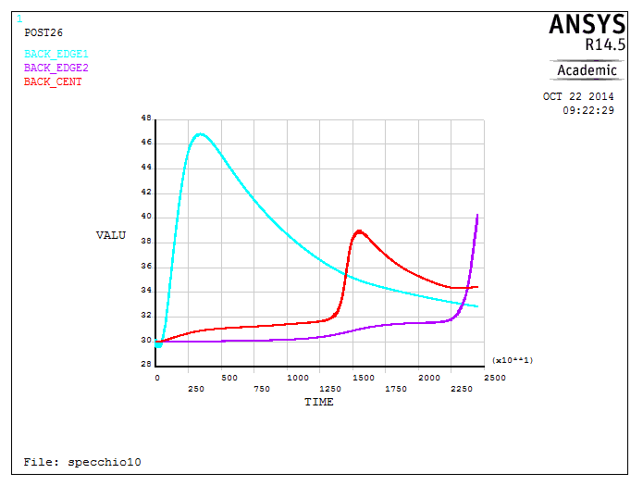
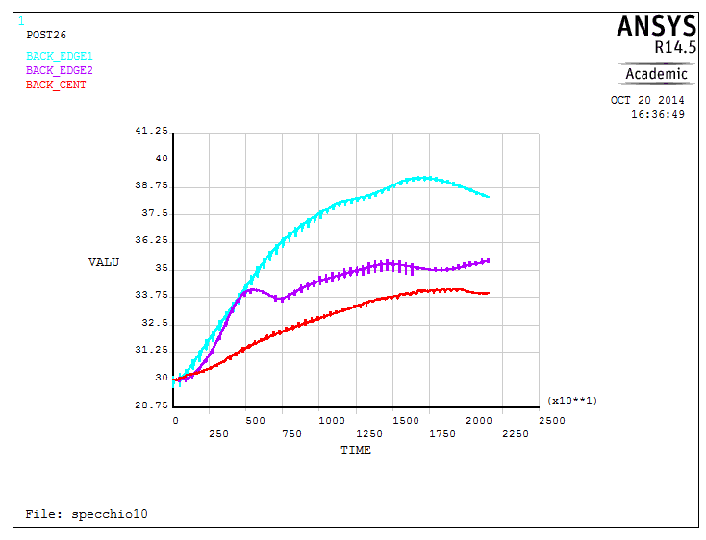
Rear temperature comparison
Comparison between FEM simulations and reality for the back temperature.
The measured rear temperature are in good agreement with the simulated ones assuming a drift in the environment temperature of 2.2°C/hours
Environment temperature:
2.2°C/h
Measured
Run 4 Simulated Run 6 Simulated
Heating time
Run 4
Run 6

Slide 19
Conclusions
INAF-OAB has developed a large IBF facility used for R&D
We are conducting a study concerning the IBF figuring of hexagonal segments in Zerodur for E-ELT. The gained experience will be useful also for the MAORY optics
A preliminary test on a 1 m corner to corner segment has been done and the issue of the thermal heating of the segment during the figuring has been investigated. Solutions has been found and implemented
The test segment has been successfully figured to the goal requested for the ESO segment assembly specs

