Slide 1




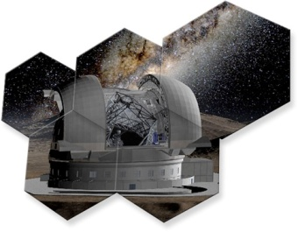
Laboratory measurements of modal noise on optical fiber
M. Iuzzolinoª, A. Tozziª , N. Sannaª, E. Olivaª
The outcome of Project T-REX – Sexten (BZ), 20-23/07/2015
Marcella Iuzzolino
Grant holder @ INAF - Astrophysical Observatory of Florenceª &
Phd student @ Università degli studi di Napoli “Federico II”
iuzzolino@arcetri.astro.it

Slide 2
Contents
Introduction
The real instrument caso – GIANO
What is modal noise
The laboratory set-up
The modal noise measurements
Results

Slide 3
1. Introduction
WHY?
First Team that uses optical fiber in the IR
GIANO
HIRES
No literature
The experimental understanding of MODAL NOISE
To show the evidence of the modal noise
To understand experimentally the influence parameters
Identification of the modal noise in the GIANO spectrums
End in the discovery of a new interpretation of the modal noise : the input induced modal noise

Slide 4
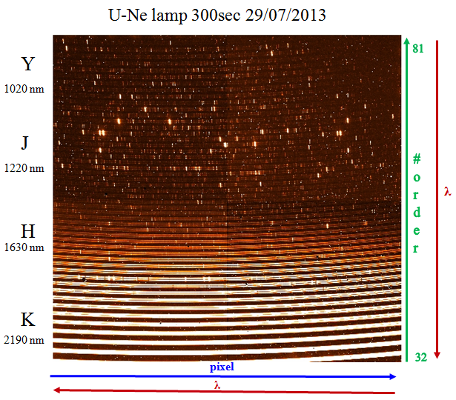
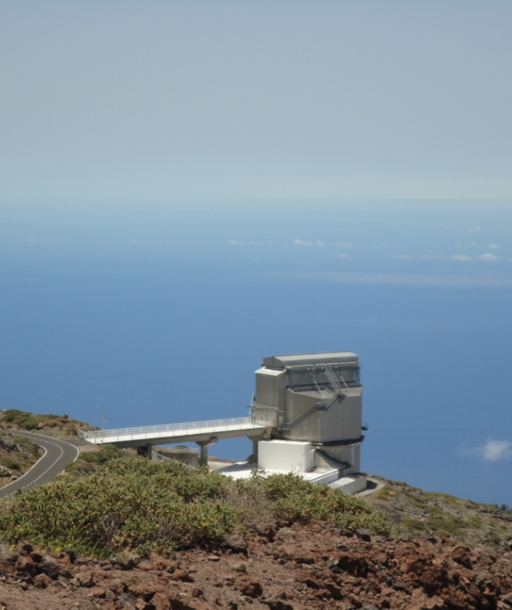
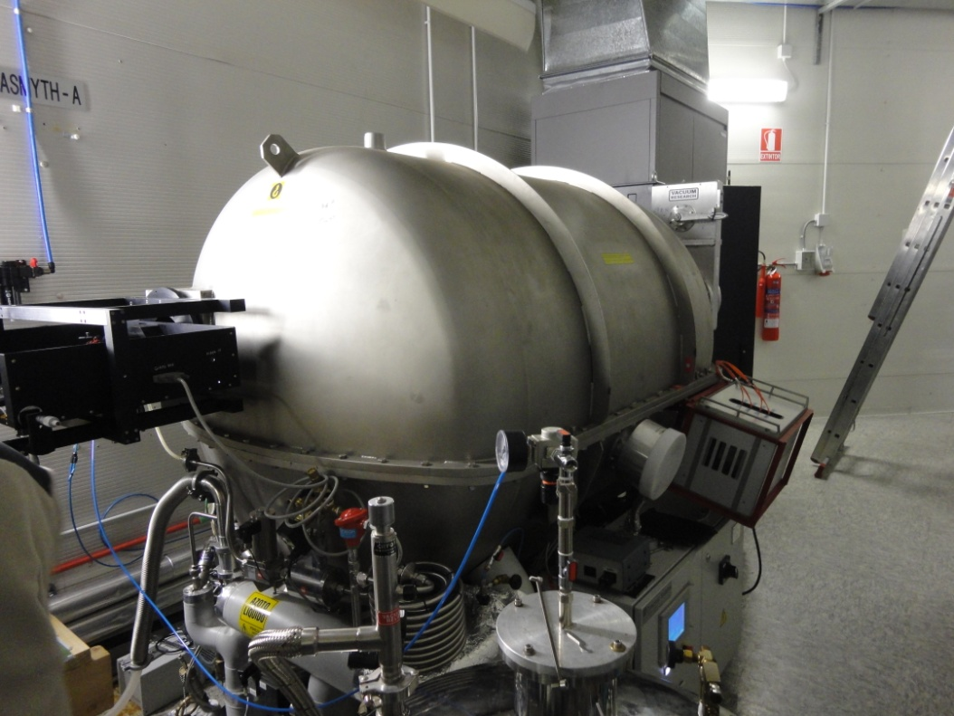
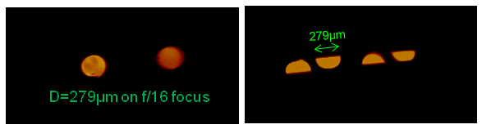
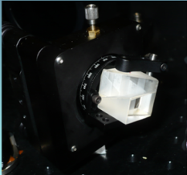
2. The real Instrument case- Giano
3
GIANO¹, the high resolution echelle² spectrograph
@ TNG³ Telescope,
La Palma (Canary Island)
0.95-2.5μm
resolution R=50 000
ZBLAN IR optical fiber :
85μm core,
ZrF4-BaF2-LaF3-AlF3-NaF,
very fragile.
2
1
Small number of excited modes
#Excited Modes (N_{λ}) ~ 1/λ²
HARPS N ~ 0.5 µm ; GIANO ~ 1.6µm → N_{λ} (HARPS) = 10 * N_{λ} (GIANO)
MODAL NOISE – 1%
Fixed in flat exposure – Mechanical Scrambling
Not yet fixed in star observation – 1%
Bowen Wallraven prism

Slide 5
3. What is modal noise \1
What is in literature :
First show (Epworth 1978)
First Prediction of S/N ( Goodman 1981)
Successive studies, that confirmed the first S/N estimation
Studies on astronomical application (till 1.5 μm- Speckle observation) (McCoy 2012)
No papers about fiber used till 2.5 μm or about ZBLAN fiber
What is the modal noise :
Interferences between modes → speckle pattern
Time variation of speckle pattern :
Fiber stress/bendings/defects
Beam truncation
Changes in input illumination ? (New idea)
Spectral variation of speckle pattern
MODAL
NOISE

Slide 6
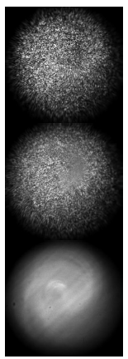
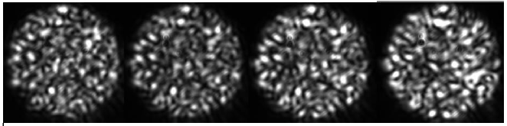
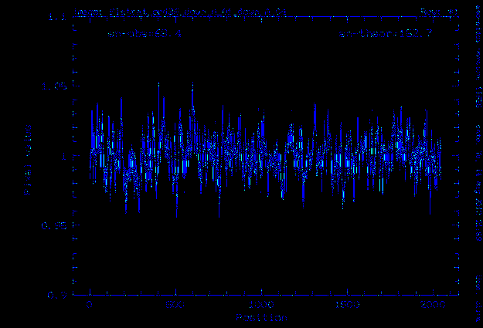
3. What is modal noise \2
Traditional Investigation Strategy – Speckle pattern in the far field and near field
Near field with tilted input source - Corbett
Far field, to test scrambling tecnique efficiency – McCoy
Our New Investigation Strategy :
To observe directly the modal noise in the REAL spectrum IN THE IR
GIANO flat/flat before mechanical scrambling (2012)

Slide 7
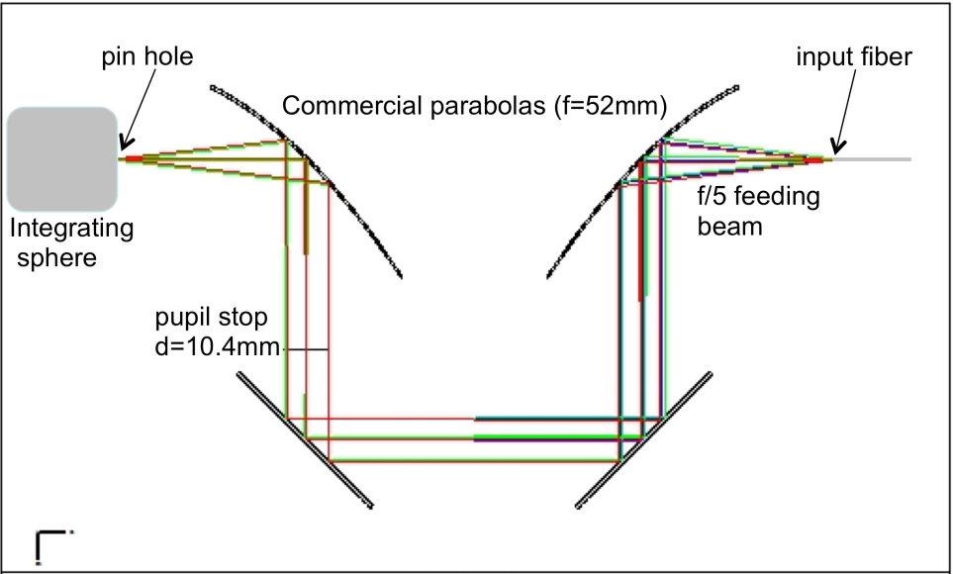
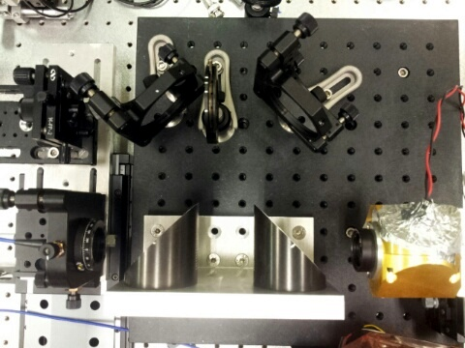
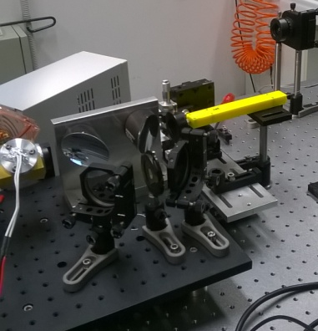
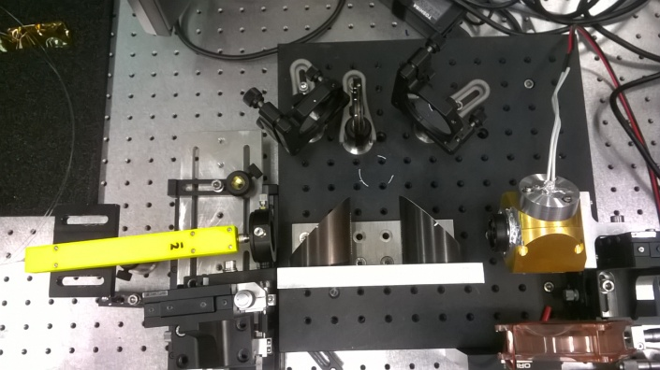
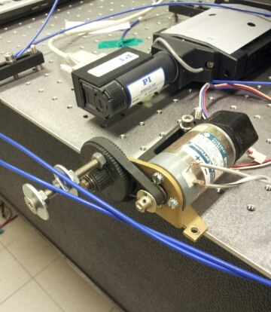
4. The laboratory set-up \1
The scope of the work:
To simulate the telescope-instrument system
To simulate astronomical measurements
To study the modal noise
Fiber input
Image plane illumination
Pupil plane illumination
Photonic Lantern
Pin Hole:
50 µm,
600 µm
T. A. Birks, I. Gris-Sánchez, The Photonic Lantern, Adv. Opt. Photon. 7, 107-167 (2015)
Scrambler :
- Mechanical scrambler
- Optical double scrambler
Optical fiber :
ZBLAN multimode fiber, 85 µm, 8 m
Fused silica, circular core, 85 µm, 8 m
Fused silica, octagonal core, 67 µm, 8 m

Slide 8
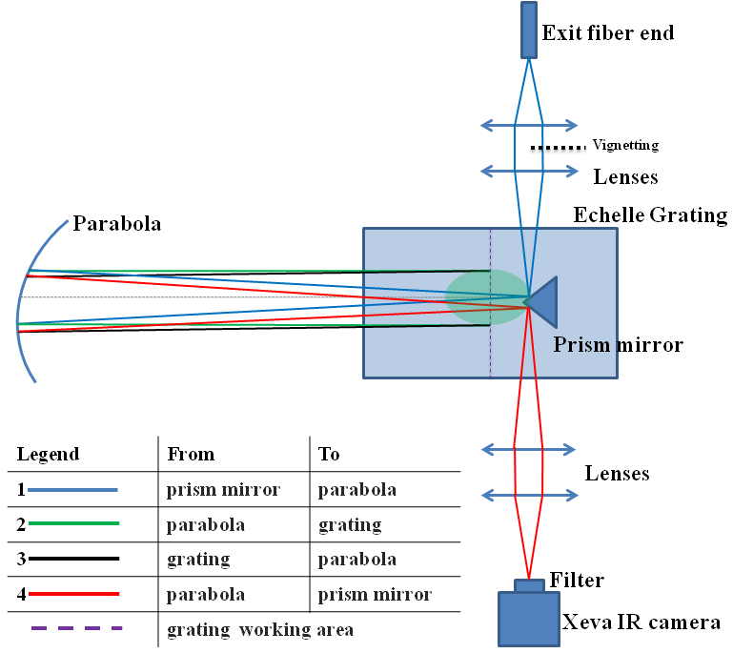
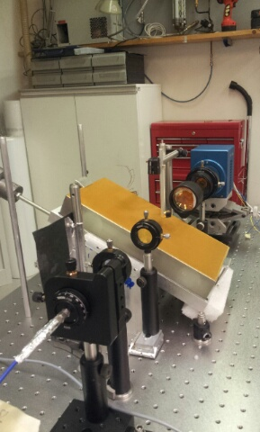
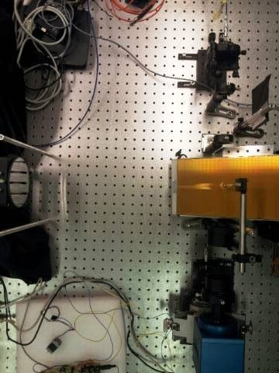
4. The laboratory set-up \2
Optical
fiber
ZBLAN Fiber : core diameter 85 µm
Dispersing element : echelle grating,
23.2 groove/mm,
63° blaze angle
Spectrograph resolving power
(with 85 µm fiber) : R= 20 000
Narrow band filter : center @ 1645 nm, bandwidth 8 nm
Camera : Xenics Xeva-796,
InGaSb detector ,
30x30 µm pixel size,
320x256 pixel
wavelength scale: 0.03 nm/pixel

Slide 9
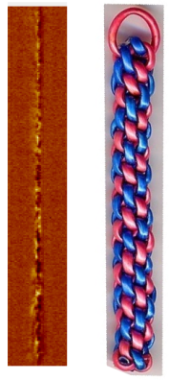
5. The modal noise measurements \1
The scope of the work :
To simulate the telescope-instrument system
To simulate astronomical measurements
To study the modal noise
Modal Noise = 1% rms
Relative measurements
Investigation Strategy :
Computation of mean frames (ex: from 1to 200, and from 201 to 400)
Meanframe 1
Ex :Image # :
from 1 to 200
400 Image Acquisition
Difference between the 2 mean frames
Scooby-doo image
Meanframe 2
Ex: Image # :
from 201 to 400
Exposure time : 500 ms /frame
Light source : Halogen lamp, 4 A
Higher Signal level

Slide 10
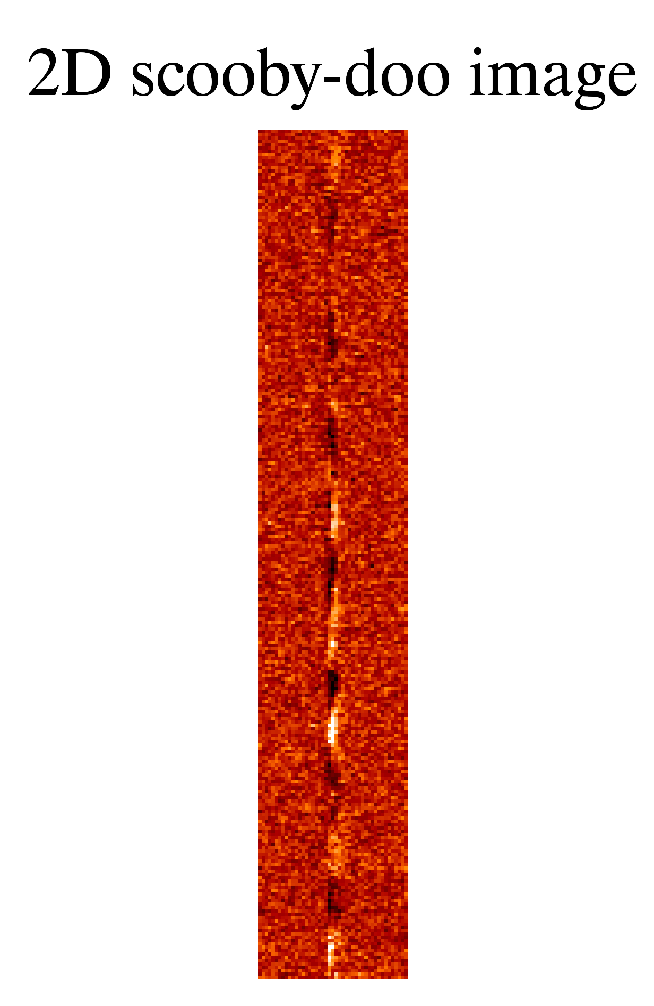
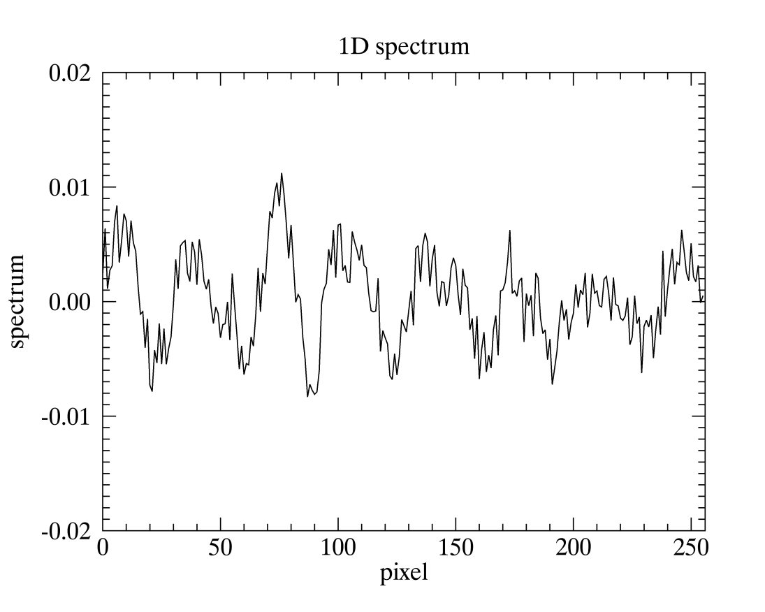
5. The modal noise measurements \2
2D Scooby-doo image
1D Spectrum =
Baseline removal
Example case :
Exposure time : 500 ms
Pin hole: 600 µm
Vignetting: 50% pupil
Static position
RMS : 0.3%
Nframes=400
Plotted spectrum= spectrum -1
RMS as quantitative parameter

Slide 11
5. The modal noise measurements \3
The scope of the work :
To simulate the telescope-instrument system
To simulate astronomical measurements
To study the modal noise
Multiple tests configuration,
cross configurations
- 3 types of fibers
- pupil plane, image
plane illumination,
- optical and mechanical
scrambling
- photonic lanterns
Test 1 - Consideration on input illumination influence
Description : To simulate astronomical measurements
1. Change in the pin hole size (50 µm /600 µm) to simulate the astronomical measurement, i.e. star/flat on a 4m-telescope with good seeing condition.
2. Uniform illumination 600µm /600µm to simulate seeing limited condition on EELT.
Results:
NO MODAL NOISE with uniform input illumination (test case #2) + mechanical scrambling ;
NO MODAL NOISE with photonic lanterns (50 µm)+ mechanical scrambling;
MODAL NOISE (1%) in all the other cases (including octagonal fibers, double optical scrambler).

Slide 12
5. The modal noise measurements \4
The scope :
To simulate the telescope-instrument system
To simulate astronomical measurements
To study the modal noise
Test 2 – Consideration on output fiber exit
Description :
Tests of scrambling tecniques (Mechanical and Optical)
Results:
Only the mechanical scrambling WORKS
Test 3 - Consideration on the fiber material
Description :
ZBLAN fiber, 85 μm circular core size, 8 m length
Fused Silica fiber, 85 μm circular core size, 8 m length
- Fused Silica fiber, 85 μm octagonal core size, 8 m length
Results:
- No difference in term of reduction of modal noise

Slide 13
6. Results
 | Two negative influence parameters
 | “FIBER IN” | “FIBER OUT“
Known Before? | Unknown | Known
Where ? | At the fiber entrance | At the fiber output
What is the cause? | Non uniform input illumination | Along the fiber stress
 |  | Beam spatial filtering (beam truncation)
How to fix it ? | Uniform illumination of th fiber core | Mechanical scrambling @ a frequency higher than the acquisition rate
 | Uniform power distribution among the fiber modes (photonic lantern)

Slide 14
Acknoledgments & references
ACKNOWLEDGEMENT :
This work has been developed thanks to the INAF financial support through the grants
“T-REX-2011” and “T-REX 2012”
REFERENCES
[1] A. Tozzi et alii, "The fiber-fed preslit of GIANO at T.N.G.", SPIE 9147, 360 (2014)
[2] E. Oliva et alii, "The GIANO spectrometer: towards its first light at the TNG", SPIE 2012
[3] E. Oliva, L. Origlia, et alii, "A GIANO-TNG high-resolution infrared spectrum of the airglow emission", Astronomy & Astrophysics
[4] E. Oliva, L. Origlia, et alii, "GIANO-TNG spectroscopy of red supergiants in the young star cluster RSGC2 ", Astronomy & Astrophysics
[6] H. Dutton, "Understanding optical communications", IBM, 1999
[7] T. Wellinger, "White paper-modal noise in fiber links", R&M, 2012, pp.3-6
[8] K. McCoy, L. Ramsey, S. Mahadevana, S. Halversona "Optical fiber modal noise in the 0.8 to 1.5
micron region and implications for near infrared precision radial velocity measurements", 2012
[9] U. Lemke, J. Corbett, J. Allington-Smith, " Modal noise prediction in fibre-spectroscopy: visibility
and the coherent model",2011
[10] B. Daino, G. De Marchis, S. Piazzolla, "Speckle and modal noise in optical fibres. Theory and experiment", 1979
[11] J. Baundrand, H. Walker, "Modal Noise in High-Resolution, Fiber-fed Spectra: A Study and Simple Cure", 2001

