Slide 1
Laboratory prototype for the demonstration of sodium laser guide star wavefront sensing on the E-ELT
Sexten Primary School 20-23 July 2015
THE OUTCOME OF THE T-REX PROJECT,
the Italian Progetto premiale for E-ELT
M. Patti^{1,2}, M. Lombini², L. Schreiber², G. Bregoli², C. Arcidiacono², G. Cosentino¹, E. Diolaiti², I. Foppiani²
¹Universitá di Bologna – Dipartimento di Fisica e Astronomia
²INAF – Osservatorio Astronomico di Bologna

Slide 2
LGS WFS prototype: workplan
Main objectives
Verify performance of LGS Shack Hartmann WFS under different working conditions (sampling, field of view, signal-to-noise ratio, algorithm type, Sodium profile features)
Study low/medium order aberrations induced by Sodium layer coupled with spot truncation and other effects in the LGS WFS
Two phases
Phase 1: LGS WFS prototype upgrade, AIV and preparation of test plan for the next phase
Phase 2: tests run and analysis with the LGS WFS prototype

Slide 3
LGS WFS prototype: requirements
'Seeing limited' source.
Variable Sodium layer density profile.
Spot elongation pattern geometry on a SHWF in case of LGS launcher behind the secondary telescope mirror or on the edge of the primary mirror
Different LGS launcher positions around the primary mirror.
A layered model of atmospheric turbulence and its time evolution.
The footprint position of an LGS on the turbulent layer depending on the layer altitude and on the LGS azimuth and zenith angle.
The spot truncation effect.

Slide 4
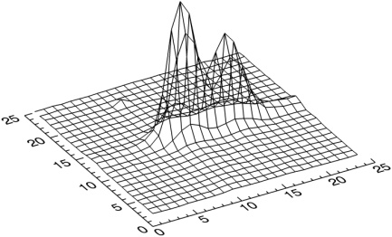
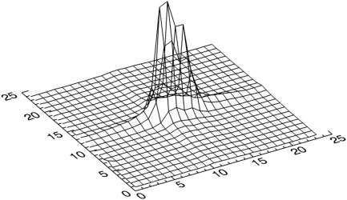
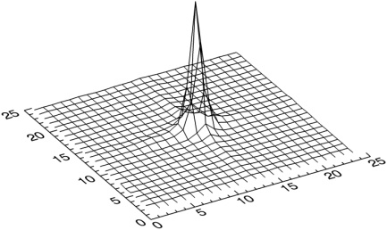
LGS WFS prototype: Data output
SLM modulation

Slide 5
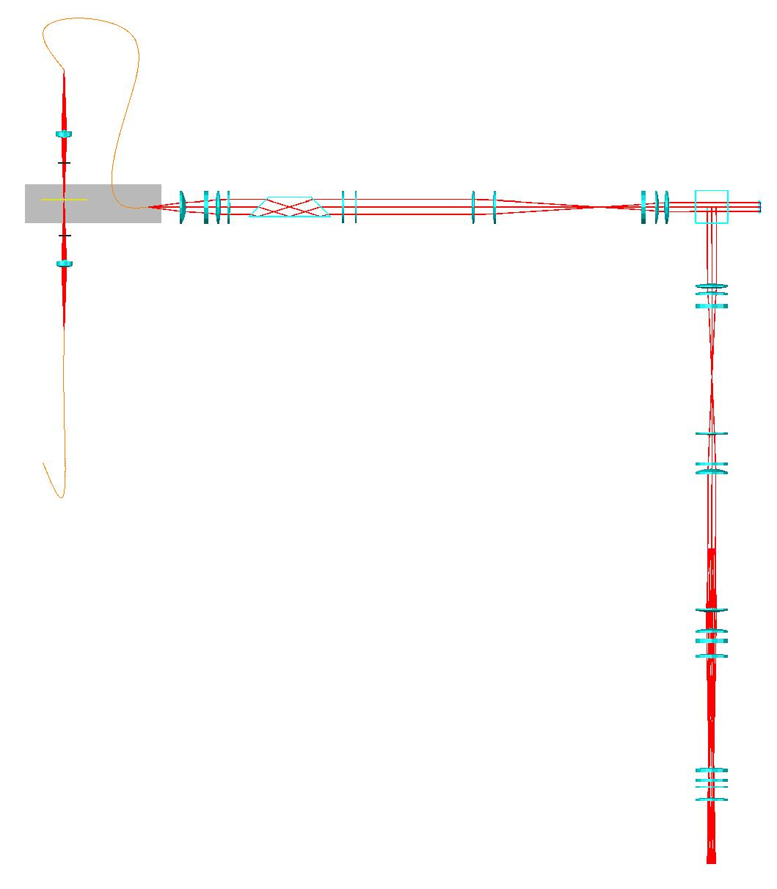
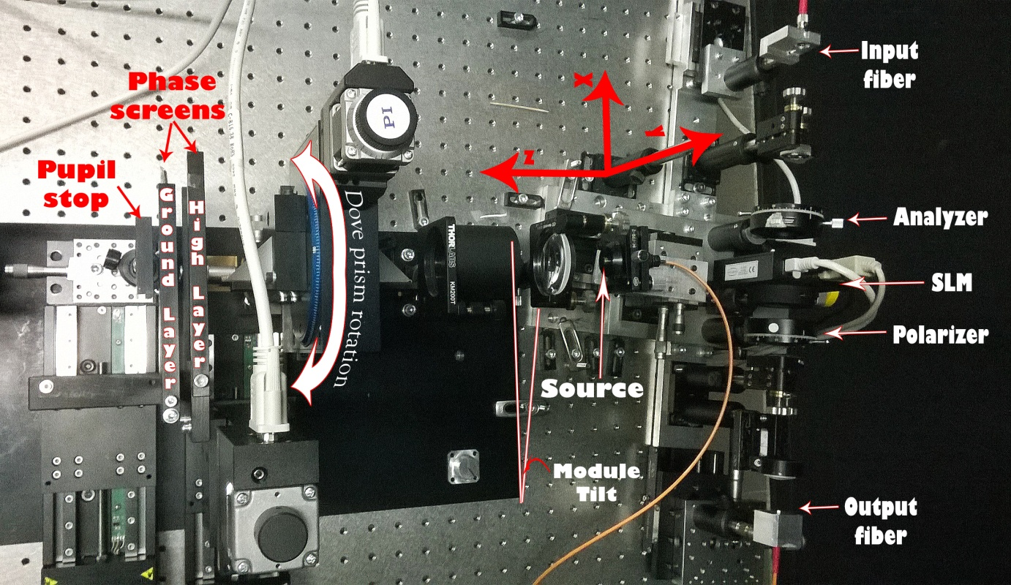
LGS WFS prototype: optical design
Source module
Telescope module
Turbulence module
Spatial light modulator
(on the linear stage)
Dove prism
ALPAO DM52
Field stop
Pupil stop
Deformable mirror module
Linear stage
Source
(on the linear stage)
Lamp
Phase screens
Wavefront sensor module
Lenslet array
40x40
Re-imager module
Image plane (CCD camera)

Slide 6
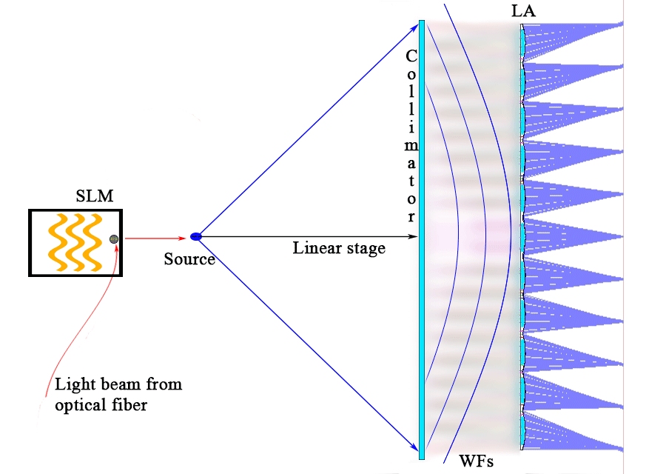
LGS WFS prototype: optical design
Source module
Telescope module
Turbulence module
Spatial light modulator
(on the linear stage)
Dove prism
ALPAO DM52
Field stop
Pupil stop
Deformable mirror module
Linear stage
Source
(on the linear stage)
Lamp
Phase screens
Wavefront sensor module
Lenslet array
40x40
Re-imager module
Image plane (CCD camera)

Slide 7
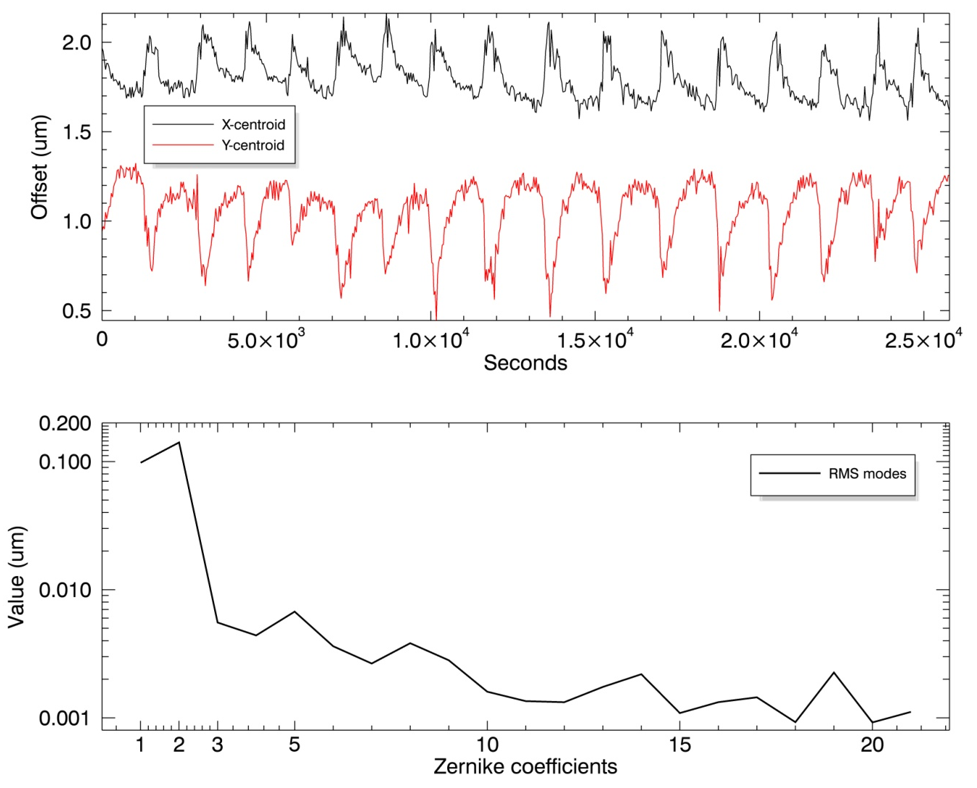
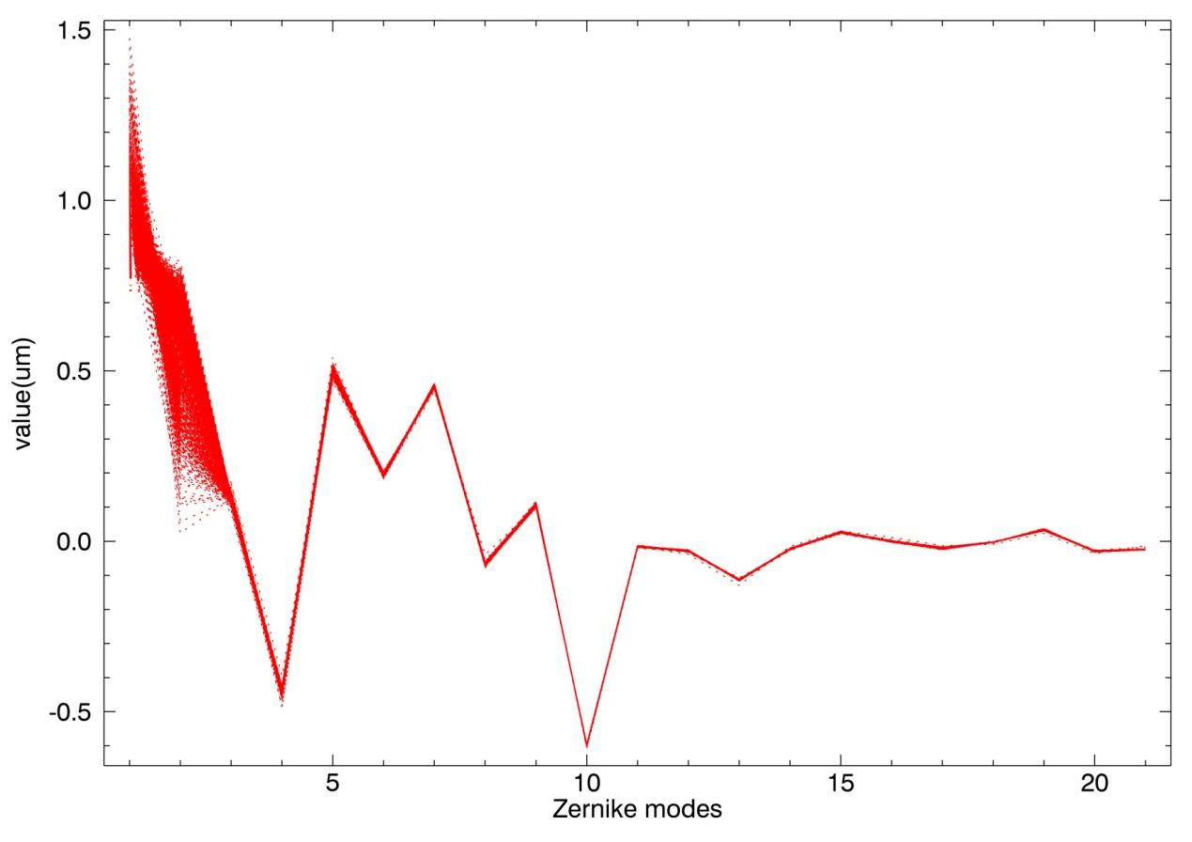
LGS WFS prototype: verification results
1)
3)
2)
1) Mean spot centroids offset, expressed in microns, after the thermal relaxation time
2) RMS of Zernike coefficients due to periodic centroids offset ( Y scale is logarithmic )
3) Overlaid Zernike modes of all measures (1780). The largest variation refers to Tip-Tilt modes whose spread stand out in the figure.

Slide 8
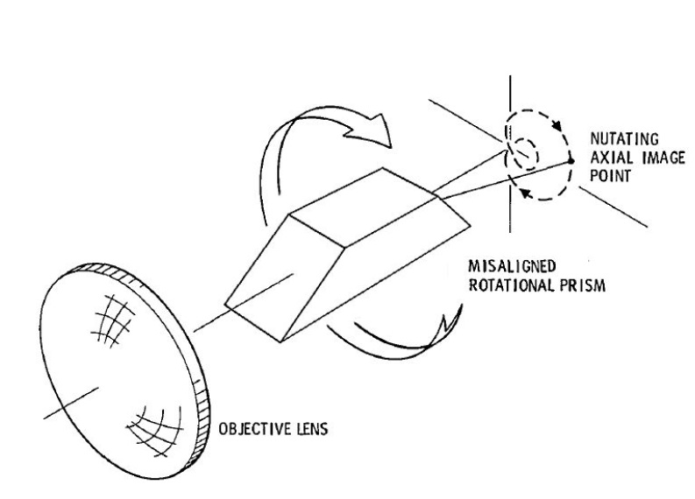
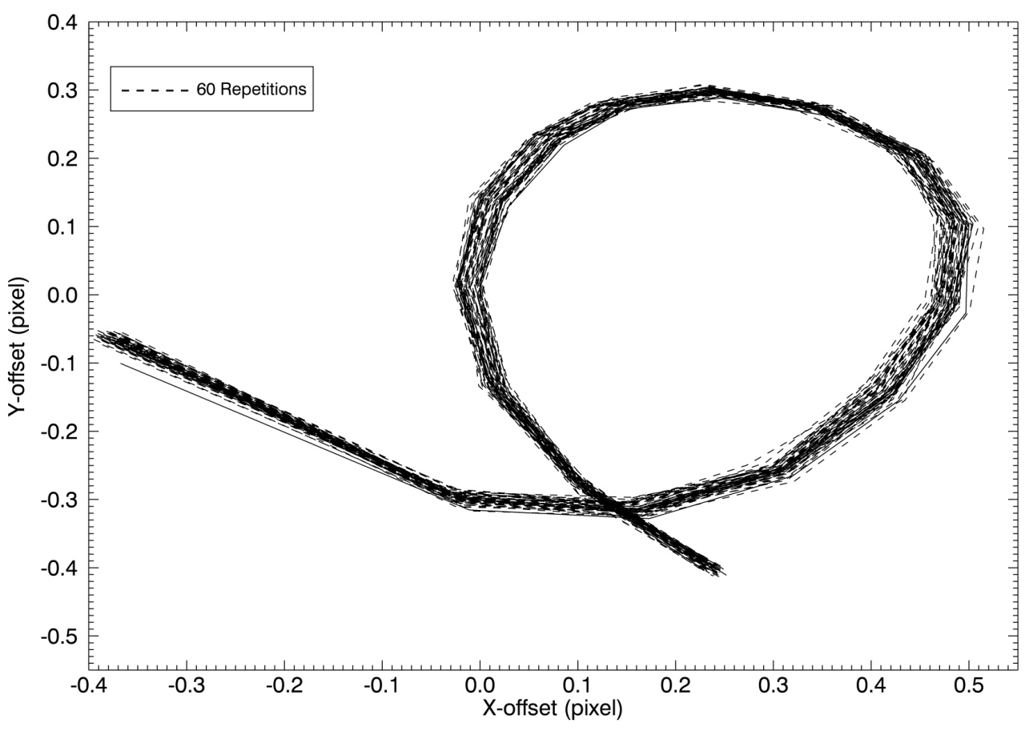
LGS WFS prototype: verification results
- Spot offsets due to prism rotation (mean <12µm); 60 measures were taken for 16 different angles within a 360° pupil image rotation.
The Dove prism causes a rotation of the pupil image that is twice the angular mechanical rotation of the prism. Repeatability test on both direction of prism rotation was performed (clockwise and counterclockwise).

Slide 9
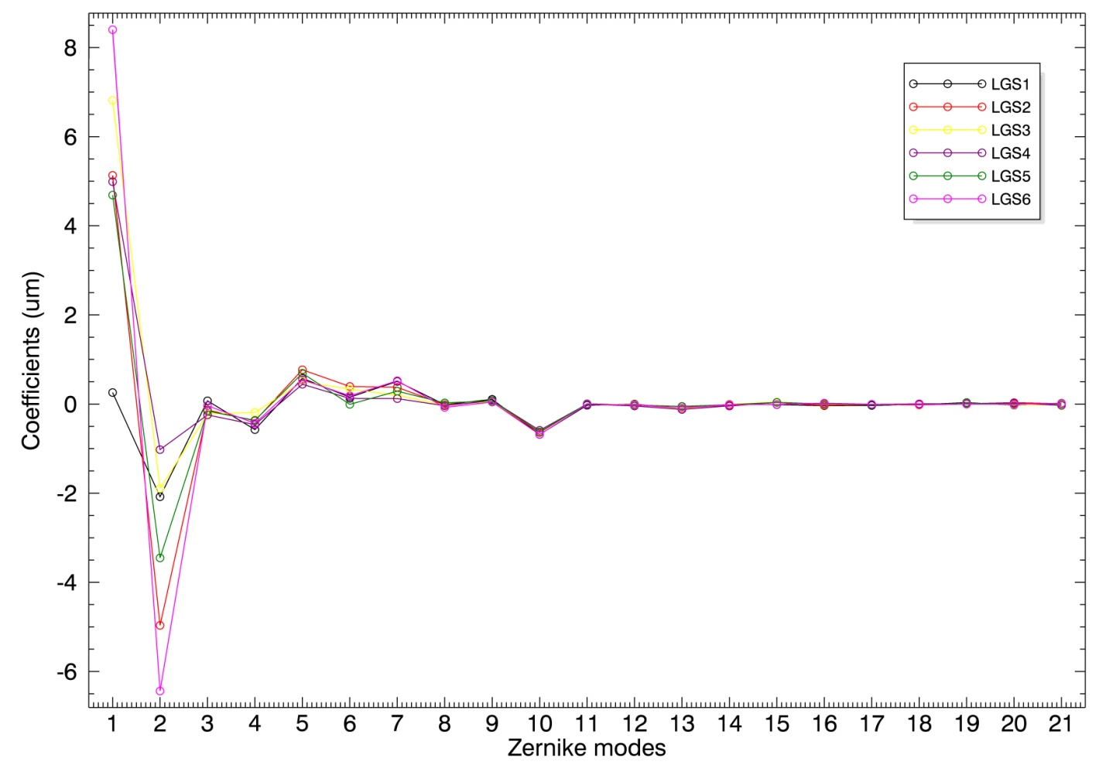
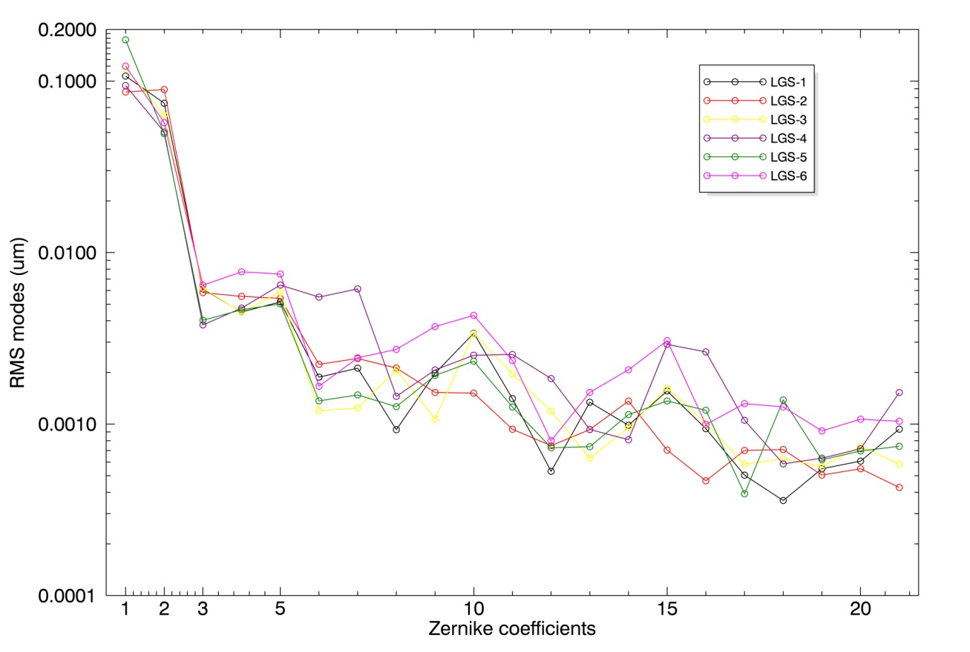
LGS WFS prototype: verification results
1)
2)
1) Zernike modes of 6 simulated LGSs which correspond to 6 prism positions. Except Tip and Tilt, the modes are repeatable due to negligible dependency to thermal effects. Their variations throughout measures are a factor 8 smaller than Tip-Tilt
2) The RMS of repeated measures are inside the accuracy imposed by temperature variation ( Y scale is logarithmic )

Slide 10
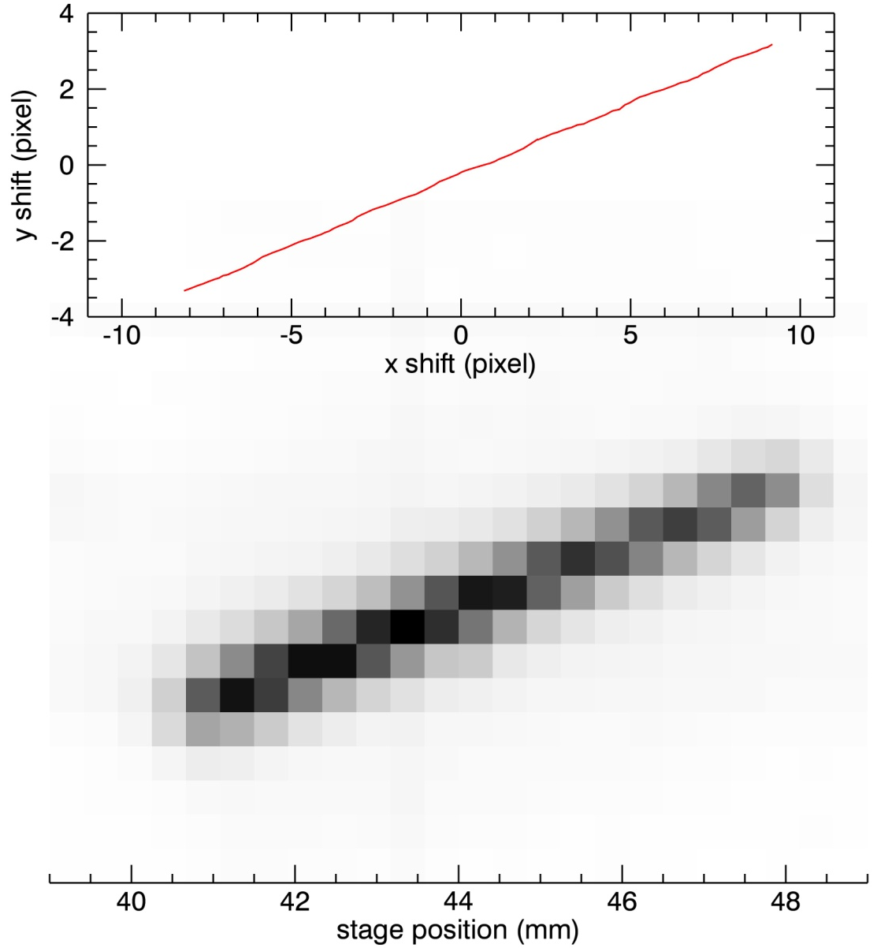
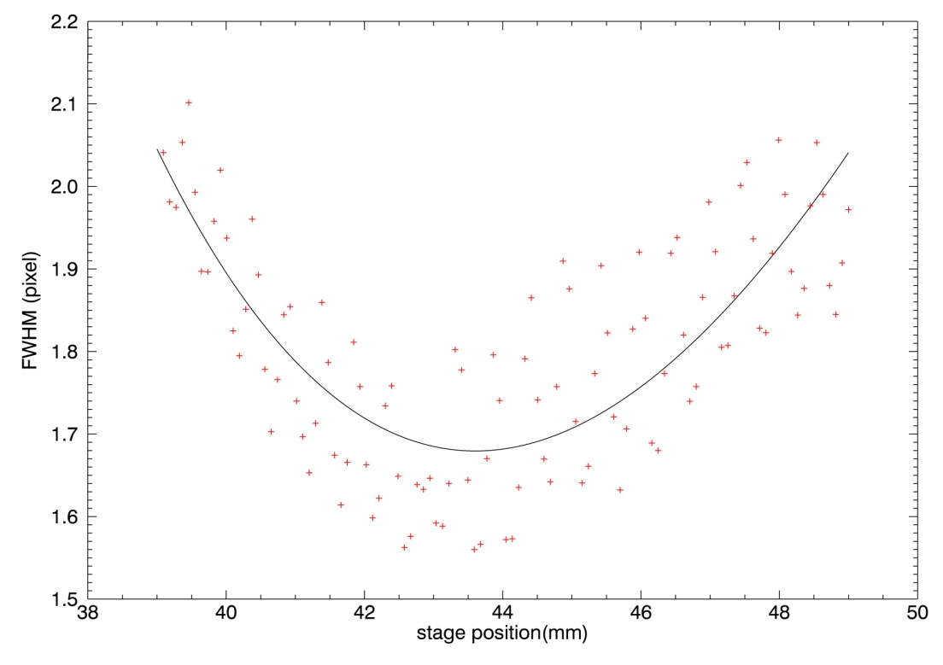
LGS WFS prototype: verification results
1)
2)
2) Spot FWHM in function of linear stage position. Real data are in red while the black line is the best fit curve. The data spread is due to pixel sampling
1) For 1 pixel spot displacement on the detector, the source linear stage has to move by about 0.5mm

Slide 11
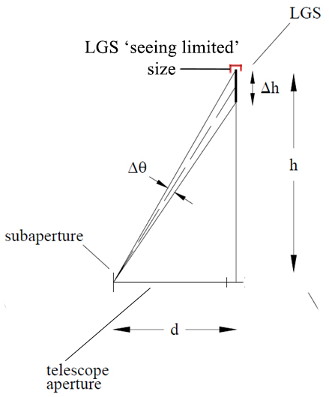
Δθ ~ 1’’ for the most elongated sub-aperture when h = 90Km , d = 39m and Δh = 1Km
LGS WFS Prototype scale
LGS ‘seeing limited’ size ~ 1.5’’
1.8 CCD pixels
24 CCD pixels for the most elongated sub-aperture
Δh ~ 20 Km

Slide 12
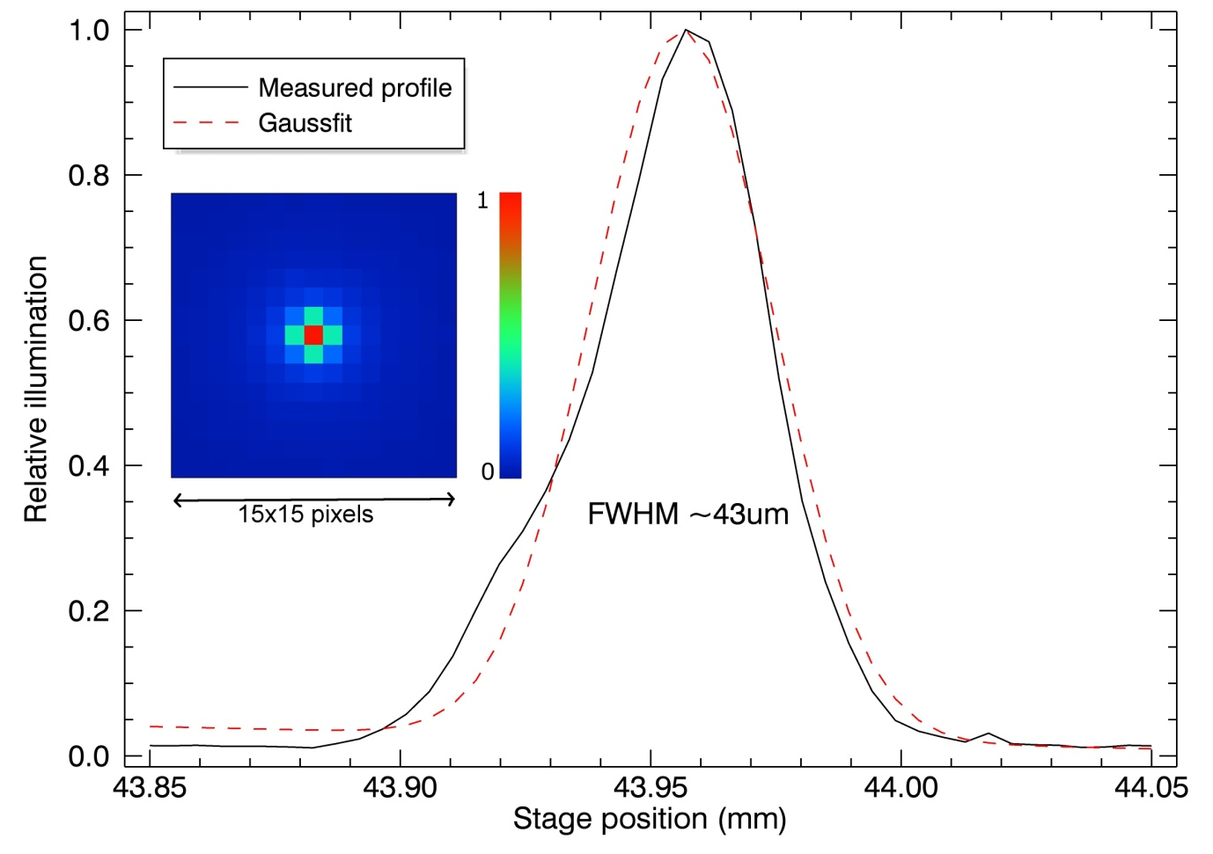
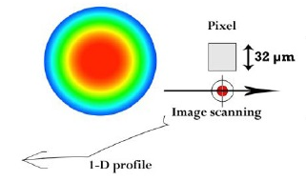
LGS WFS prototype: verification results
Set one SLM column to 255 scale-value and move the linear stage to get an horizontal image scanning. The column of pixel, whose side is 32 μm, trace a one-dimensional profile of the image (~90μm size)
Pixel profile relative to zero defocus SLM column and simulated fiber image on a 15x15 SLM pixel region. The intensity values are well fitted by a Gaussian function (dashed lines) with a FWHM of ~ 43μm
3 SLMpixels ≈ 150m Sodium width

Slide 13
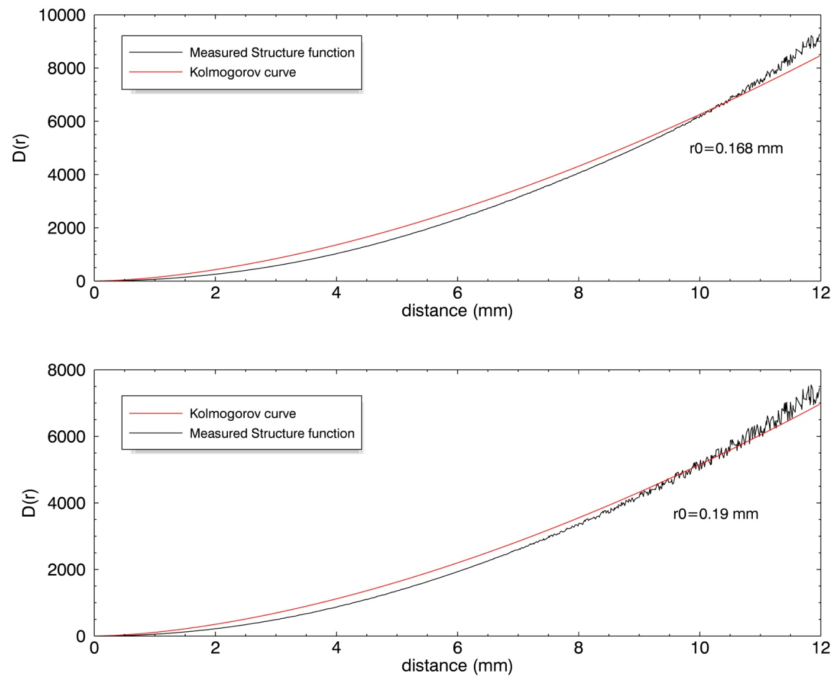
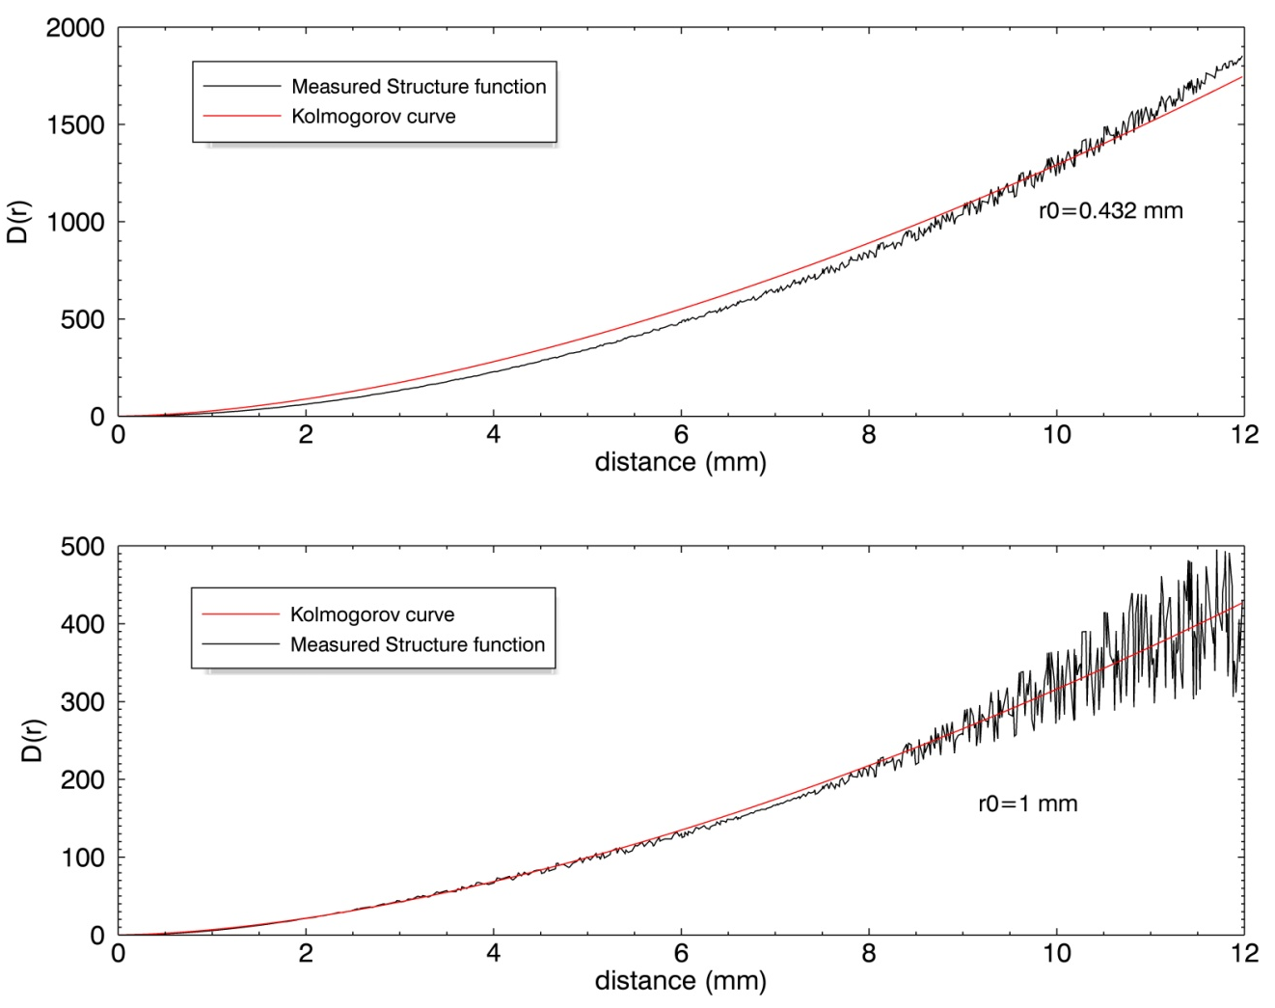
LGS WFS prototype: Atmospheric turbulence characterization
Ground altitude layer
High altitude layer
Minimum (top row) and maximum (bottom row) structure functions of the atmospheric turbulence layer screen (solid line) compared with the theoretical Kolmogorov curve (dashed line)
Fried parameters
Ground altitude layer: ~ 3/5 sub-aperture
High altitude layer: varying between ~ 1.5 and 3.5 sub-apertures

Slide 14
LGS WFS prototype: foreseen tests
Test # | Test goal
T-C01 | Evaluate the spot centroiding accuracy due to influence of sampling
T-C02 | Evaluate the spot centroiding accuracy due to influence of Sodium layer profile and its temporal evolution
T-C03 | Evaluate the spot centroiding accuracy due to influence of spot truncation
T-C04 | Evaluate the spot centroiding accuracy due to different SNR conditions
T-C05 | Repeat the previous tests for different centroiding algorithms
T-LM01 | Evaluate the low order aberrations introduced by the sodium profile variations vs different spot truncations (single LGS)
T-LM02 | Evaluate the Impact of low order aberrations due to sodium profile variations on tomographic recontruction (multiple LGSs)
T-AT | Repeat the previous tests + Temporal evolution of the turbulence

