Slide 1
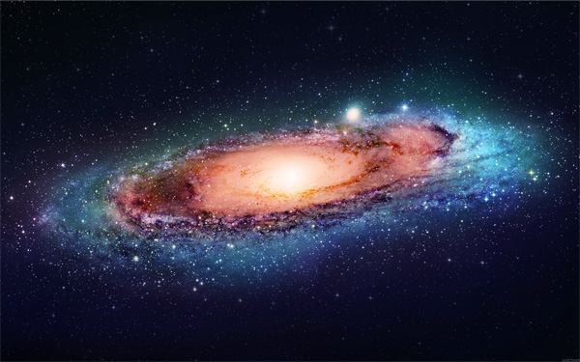
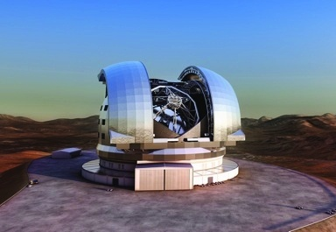
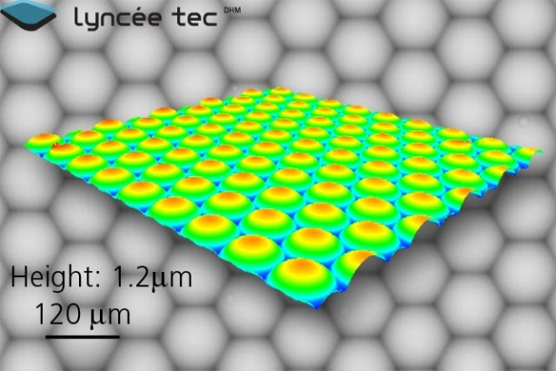
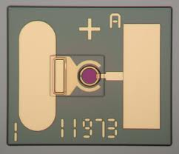
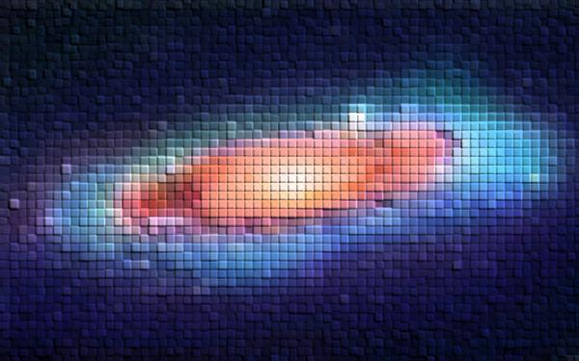

An Introduction to opto-electronic CMOS architectures for ELT’s focal planes and not-only
F. Pedichini
and M. Stangalini (75% TD TRex postdoc )
« The Outcome of Trex » Sesto 2015

Slide 2

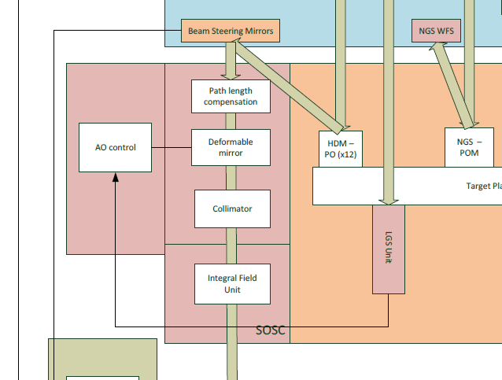
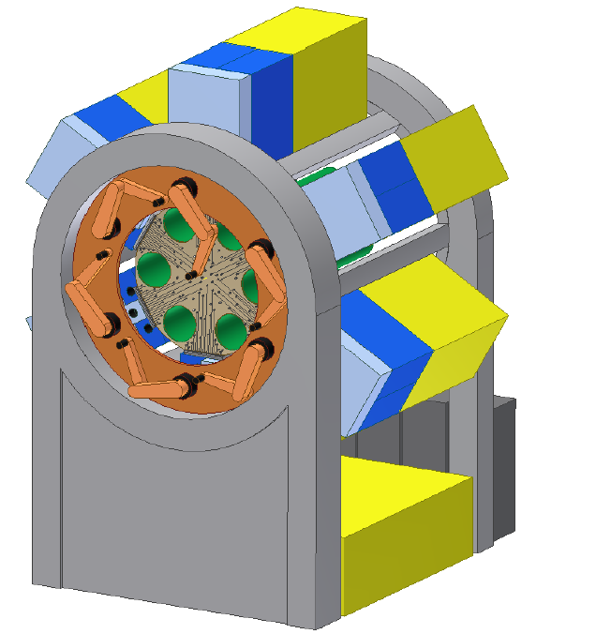
MOSAIC consortium for an E-ELT MOS
MEMS deformable mirror (MOAO open loop)
WF detectors technology
Direct vis. imaging

Slide 3
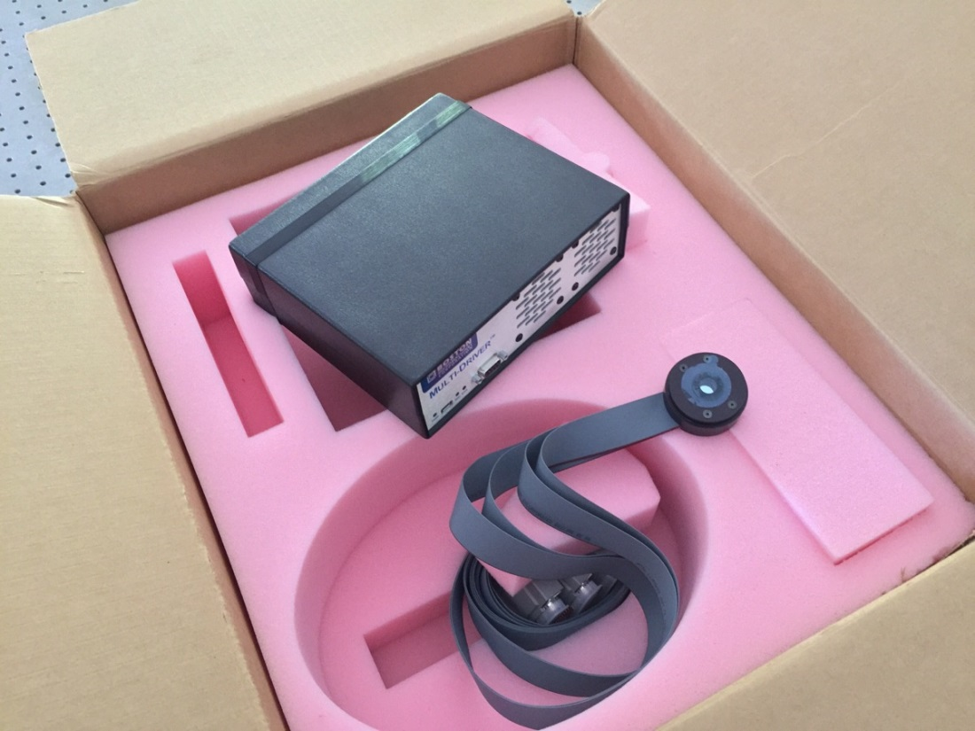
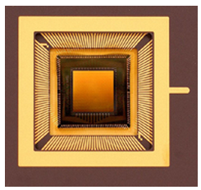
Trex lab@Roma - (M. Stangalini)
Characterization of a 140 actuator MEMS-DM under open loop control for AO local correction in E-ELT MOS
Hardware delivered last week… results soon

Slide 4
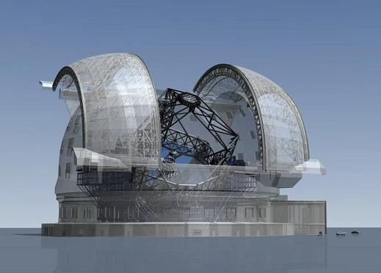
Pixel_One
...a possible technology to exploit
direct seeing limited imaging using
the whole field of ELTs…
…a few years ago at San Diego
SPIE 2010; Pedichini, Di Paola, Testa

Slide 5
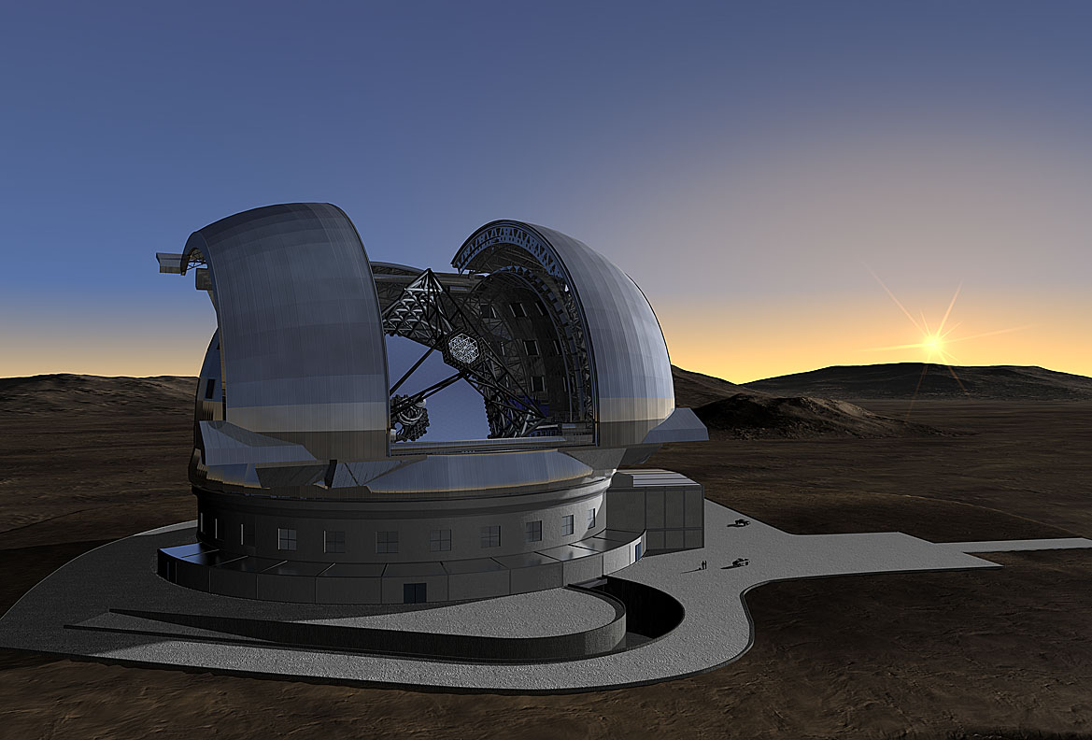
Overview of …
ELT@seeing.limited.it
Important numbers:
Aperture ~ 40 m
Mirror surface > 1000m²
F number 17.7 #
Focal lenght > 700 m
Field of view ~ 5 x 5 arcmin²
Scale 0.2 ÷ 0.3 arcsec/mm
Focal plane surface ~ 1m² (@ 5 arcmin)
Seeing FWHM 0.6-0.8 arcsec

Slide 6
Diffraction limited PSF vs. seeing
The Airy disk diameter at λ=0.5µm is about 4 mas (18 µm) just two CCD pixels at ELT focal plane!
0.36 mm
100 mas

Slide 7
…a different view…. at the seeing scale
0.6 arcsec
seeing FWHM
1000 mm
At a seeing limited ELT
the use of standard detectors
gives a factor thousand of oversampling
Instead we would like a Pixel_One mm wide
0.36 mm
100 mas
1.00 mm
300 mas
5 arcmin
4k x 4k detector
with 15 µm pixels
ESO Omegacam

Slide 8
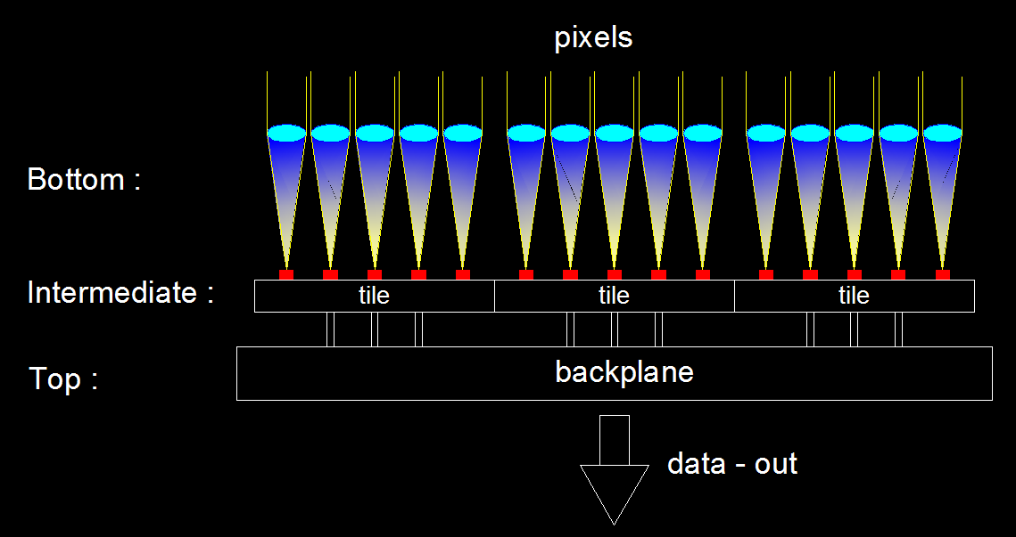
The Pixel_One concept
TLR:
1 pixel camera, ~1mm pitch, >1kHz, replicable

Slide 9
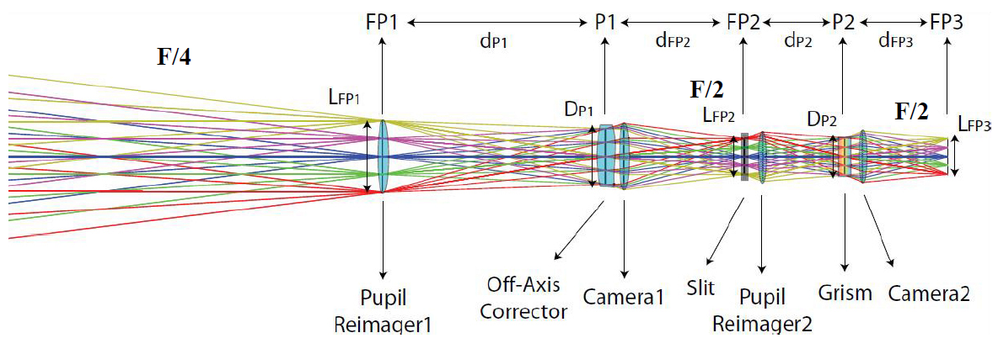
Optical and Silicon pixels… matching
F# 17
Building of a few 100 small focal reducers to F#2÷4 with a binned off the shelf sCMOS detector in a FlyEye approach
F# 17
F#1 F#1 F#1…
One Million of tiny focal reducers microlenses
&
One Million of Pixel_One cameras
a replicable CMOS process may be not expensive
Need to develop it
&
1m² of silicon
F# 1…
One Big focal reducer
&
One standard detector
3x3 binned
very expensive glass
very demanding optics
detector cost is worth
(SPIE 2006 Gentile et al.)
(SPIE 2010 Magrin et al.)
(SPIE 2010 Ragazzoni et al.)

Slide 10
µ-lenses…!
r 20µm
Ø 1mm
Ø 40µm

Slide 11
Bottom level: the Pixel
1000 µm
Ø 30÷40 µm
A micro lens about 1 mm wide sample the focal plane.
A “small” cmos-pixel converts photons to electrons and integrates the charge.
A local A/D digitizes at 8-12 bit and adds/stores the result.
The ASIC manages the self-reset, the control signals, the data transfer on the local busses and the integration time.
I/O data bus
A/D
register
State machine
I/O data bus

Slide 12
Pixel features:
The local A/D samples at kHz rates and digital integrates yelding an infinite dinamic not limited by the pixel “fullwell”
The state machine manages all the processes and transfer data to host.
Current CMOS tecnology provides pixels with low RON. Less than 1 e- expected for Pixel_One
(Ybin Bay et al. SPIE 2008, Downing et Al. SPIE 2012, Fairchild sCMOS and others)

Slide 13
UMC CIS 180 IMAGE SENSOR ULTra (4T) diode Technology (D.I.Y.)
NODE -> 180 nm
Interconnect -> 2P4M
VDD -> 1.8V core / 3.3V I/O
Min Pixel Size -> 2.6 um
Capacitor -> Poly-Insulator-Poly, Metal-Insulator-Metal
Digital design
  IP library
  Cadence & Sysnopsys design flow
Analog design
  Cadence FDK available
Pixel Design
  Optical simulation support
Technology evolution -> 130 nm , 110 nm , 90 nm ready .. 65 nm planned (2011-12)
Exist a MPW path at Europractice for a cheap early prototyping

Slide 14
Intermediate level: The Tile
We can mosaic an array of 32 x 32 Pixel_One on a single substrate and interconnect the data bus and control lines by means of an I/O digital circuit to PINS.
This is a very sparse CMOS on chip camera made of only 1024 pixel on a surface of about 32 x 32 mm² .
The I/O logic must allow the independent control of each single Pixel_One (vital on an ELT’s imager)
I/O logic
…and fill ONE squared meter of
(curved..?) focal plane !

Slide 15
Backplane: Instructions for use
At an ELT a 32 bit equivalent photometric dynamic means to expose a 5 magV star for 500 ms with a gain of 1adu/e- without saturation of the full well.
Sky background
21 magV/arcsec²
2000 e-/s
fast variable Star
22magV+sky
4000 e-/s
Bright field
Star
<15magV+sky
90%
10%
<1%
transfer data at
end of the exposure
saturation time 2E6 sec!
transfer data at
each sample you
need for science
transfer data before
digital saturation of
32+ bit storage register
Pixel_One Backplane is a real parallel array of “smart” imagers and each “pixel” of them can be programmed to accomplish different exposure times. This approach reduces the data rate and leave the fast sampling only where or when is really needed.
(pre-imaging required)

Slide 16
(D.I.Y.) a LABORATORY ON A die
Pixel / die = 5x5 (different)
Total Pixels area 2500 µm2
Die area 5x5 mm2
Sampling at 250 Kfps SAR ADC (12 bit)
I/O (slave mode) -> about 10 Kbit/s
I/O (master mode) -> about 1 Mbit/s
Multiplexing
ADCs
Memory RF
32 bit
Adder & comp
Control Logic
IO LVDS

Slide 17
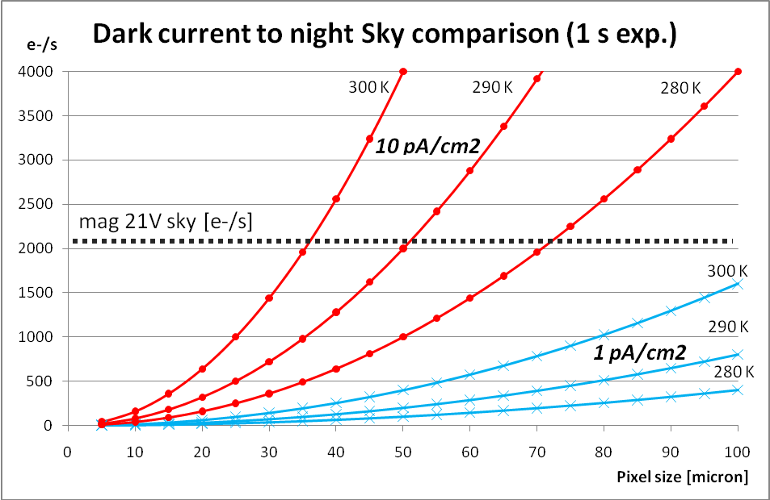
S/N optimization
No Cryo!
Optical pixel size 1x1 mm, 4T pixel architecture, global Q.E. 50% (optics+silicon) RON 4e-.

Slide 18
Conclusion
EUROPRACTICE allows research institution to develop CMOS pixels at 30€ / mm² (minimum fee is 30k€)
Mass production can be less 5€ / mm² (to be investigated)
400 well engineered cameras with focal reducers and lenses diameter of 70mm are about 400 x 10K = 4 M€ !
1 Million of Pixel_One may be only 2 M€ ? (work in progress)
A LAST SLIDE >>>>

Slide 19
Not only imaging… Pixel_One for W.F.S.
@ 1kHz WFS detector may saturate if magR < 7÷5
Oversampling (> 1kHz) using autoregressive prediction of turbulence on a few ms timescale may increase the Strehl by 50% factor (see: Stangalini, Arcidiacono AO4ELT 2013)
…not more pixels but
slopes parallell computed

Slide 20
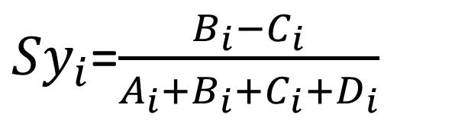
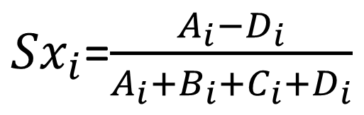
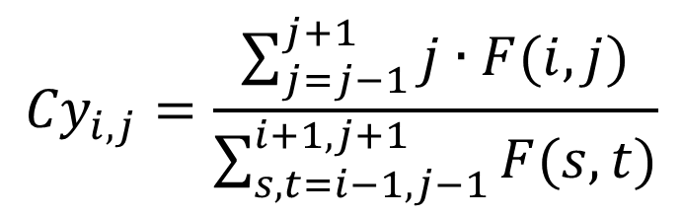
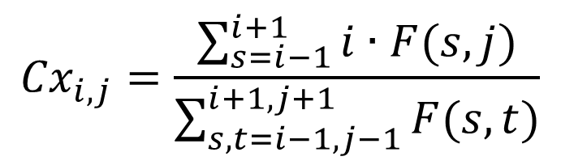
…not more pixels but
Slopes or Centroids computed in parallell
A
B
${Sx}_{i}$=$\frac{A_{i}−D_{i}}{A_{i}+B_{i}+C_{i}+D_{i}}$
C
D
${Sy}_{i}$=$\frac{B_{i}−C_{i}}{A_{i}+B_{i}+C_{i}+D_{i}}$
…
i,j-1
…
$${Cx}_{i,j}=\frac{\sum_{s=i−1}^{i+1}{i∙F(s,j)}}{\sum_{s,t=i−1,j−1}^{i+1,j+1}{F(s,t)}}$$
i-1,j
i,j
i+1,j
$${Cy}_{i,j}=\frac{\sum_{j=j−1}^{j+1}{j∙F(i,j)}}{\sum_{s,t=i−1,j−1}^{i+1,j+1}{F(s,t)}}$$
…
i,j+1
…

Slide 21
In X.A.O. Shack Hartmann or Pyramid uses several pixels (4x4+) to provide 2 slopes/ap…
Parallel acquisition and computing allow
slow quiet and simpler architecture
3kHz
detector
200 x 200
Preprocessor
Bias & Flat
1 Gflops
Slope computing
20+ Gflops
1.5 Gb/s
6 Mfloat/s
3kHz Pixel_One
detector
200 x 200
6 Mfloat/s

Slide 22
If a new Trex funding or something else….
EUROPRACTICE allows research institution to develop CMOS cameras using 180 micron-litography at low cost sharing the project
45 prototipes with 5x5 pixel_one = 30 k€ (VAT inc.)
UMC CIS180 Image sensor 2P4M ULTRA diode
Samples |  |  | > 45
Matrix Chip | 2x2 | 4x4 | 5x5 | 10x10
Area Chip (mm2) | 4 | 16 | 25 | 100
APS x batch | 720 | 720 | 1125 | 4500
Chips x batch | 180 | 45 | 45 | 45
Blocks x design | 1 | 1 | 1 | 4
Cost (die) | 20400 | 20400 | 20400 | 81760
Packaging | 3000 | 3000 | 3000 | 3000
2012 costs estimate by courtesy of A. Bartoloni (INFN, CERN)

Slide 23
No evident showstopper in PixelOne
Thank you for your attention…
any question?

Slide 24
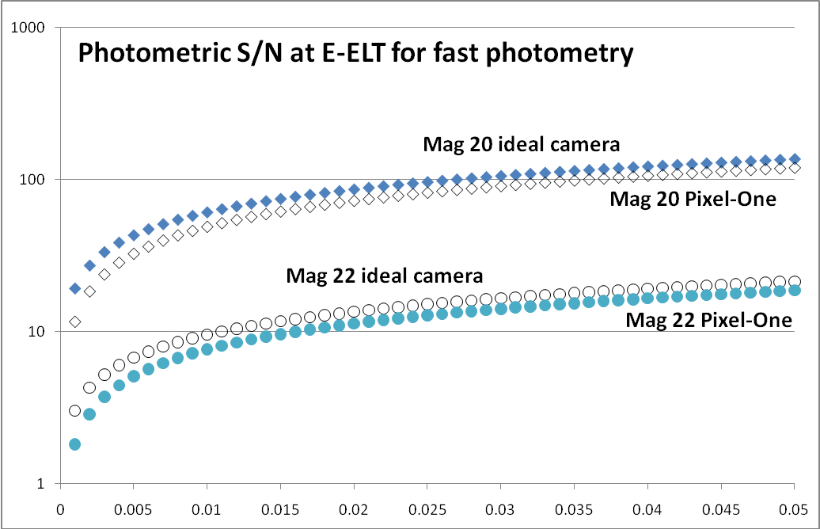
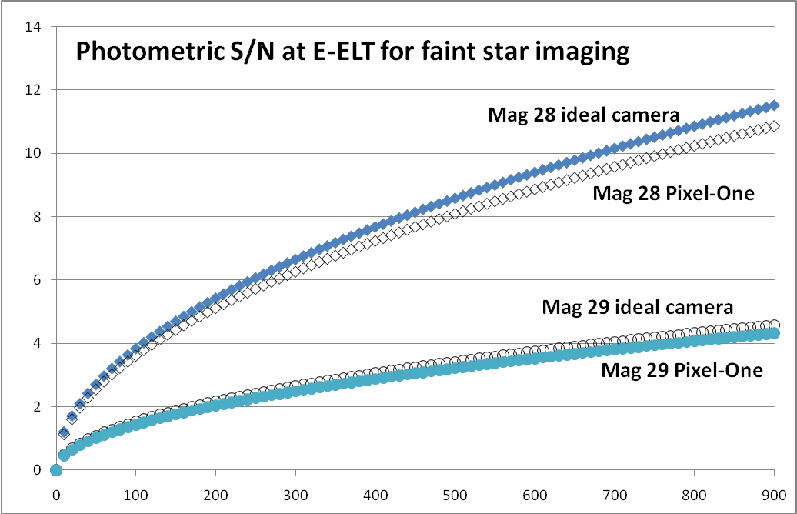
PixelOne*@ E.ELT
Photometric S/N vs integration time in seconds for Pixel-One used as a fast photometer and for Pixel-One used as a faint sources imager at the Nasmith focus of the future E-ELT in V band with 0.8” seeing, sky mag. = V 21.
*In the “Italian slang” PixelOne sounds like “a big pixel”.

Slide 25
Science cases for Pixel_One… (finally)
High-frequency time sampling of compact objects: like pulsars, magnetars, etc, can be observed with a time sampling of the order of 10⁻³-10⁻² , Vmag~20 (10σ), while in 1s the 10σ limiting magnitude is V~24.3
Faint galactic halo objects: e.g. brown dwarfs.
Faint objects around brighter sources: imaging big galaxies concentrating on spiral arms avoiding the bright bulges saturation
Rapidly variable phenomena: it is possible to follow rapidly variable phenomena with high efficiency. Typical targets are contact binaries and short period variables.
Other targets: in general any program that requires seeing-limited conditions can be carried out with Pixel_One. Even moderately crowded fields can be observed with a special attention to faint objects without “bleeding and saturation”
“It is worth stressing that the relatively large field-of-view makes it possible to execute surveys, thus conjugating speed of acquisition with sky coverage.”

