Slide 1


A Bonnet and Fluid Jet Polishing Facility for Optics related to E-ELT
Gabriele Vecchi
INAF-Osservatorio Astronomico di Brera
Review of the polishing methods
Manufacturing optics related to E-ELT: MAORY and M1 (R&D)
Results of the acceptance test
Conclusions
The outcome of the T-REX project – Sexten - July 2015

Slide 2
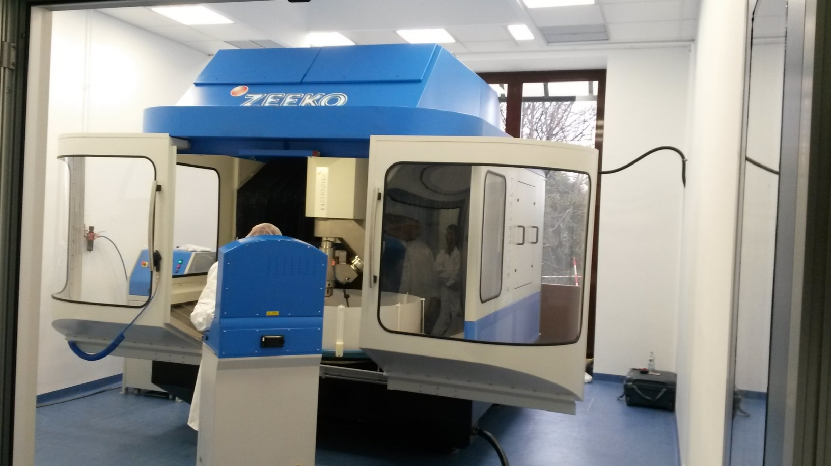
IRP Machine by Zeeko Ltd.
The IRP is a 7 axis CNC optical polishing/forming machine capable of producing ultra-precise surfaces on a variety of materials and shapes.
IRP1200 model. Nominal max part size = 1200 mm.
Three machines of this kind in Italy (two are in Media Lario).
Footprint: 4,3m x 4,3m x 3m (including console, chiller and abrasive slurry unit).
Load capacity = 500 Kg.
Clean room ISO7, 49m² area.
Required temperature variations within 2°C over 24h.
~4meters

Slide 3
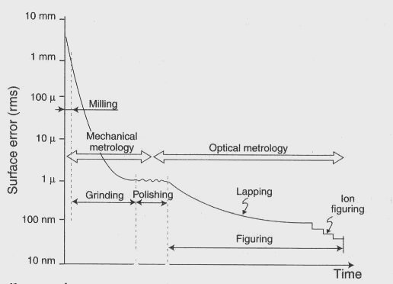
Manufacturing Chain
Surface error vs time
Polishing with Zeeko machine brings the workpiece from mechanical to optical quality.
In traditional optical polishing the tool is forced against the workpiece in presence of abrasive fluid. There is no active control on tool-workpiece distance.
In CNC polishing the tool position is actively controlled to follow the surface of the workpiece.
ZEEKO POLISHING

Slide 4
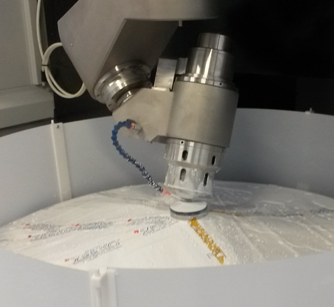
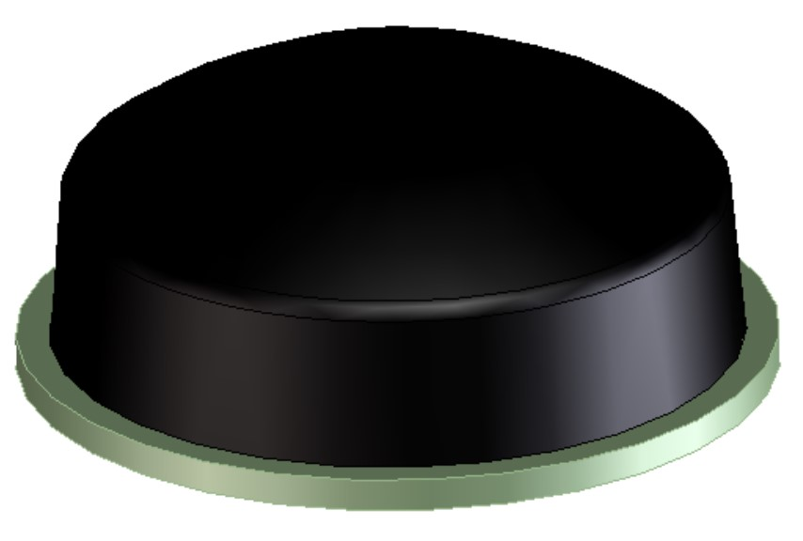
7-axis Robotic System
Axes: X, Y, Z, C table, H tool spindle, A, B rotations.
  The tool is a spherical and inflated rubber membrane, named bonnet.
  H axis is inclined to the surface’s local normal (by A, B rotations), defining the precess angle.
  A, B axes cross H axis at the center of curvature of the bonnet.
H
B
A
z
y
Bonnet tool
x
C
Virtual pivot
Credit: A. Beaucamp et al. (2013)

Slide 5
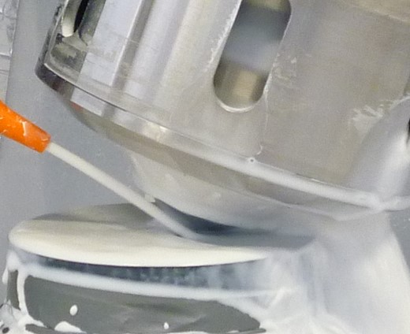
Bonnet Polishing
The bonnet is pressed against (offset) the part defining the spot size.
Removal is proportional to dwell time, and to the product of relative surface speed and pressure (Preston model). Removal depends also on the type of tool, abrasive slurry and material.
In form-corrective polishing the dwell time of the tool at each position is set according to the removal required to correct the measured local form error.
The min spot size sets the shortest form wavelength correctable.
Credit: A. Beaucamp et al. (2013)
Virtual pivot

Slide 6
Fluid Jet Polishing (FJP)
  A slurry of abrasive particles is pressurized and projected through a nozzle towards the surface. Removal rate is directly proportional to specific gravity of the slurry.
  FJP resembles ion beam figuring [(IBF), see next talk by Mauro Ghigo] as both are kinetic machining techniques with no tool contact.
  It holds the potential to address mid-spatials and edges.
Credit: A. Beaucamp et al. SPIE 8838 (2013)

Slide 7
Outline
Review of the polishing methods
Manufacturing optics related to E-ELT: MAORY and M1 (R&D)
Results of the acceptance test
Conclusions

Slide 8
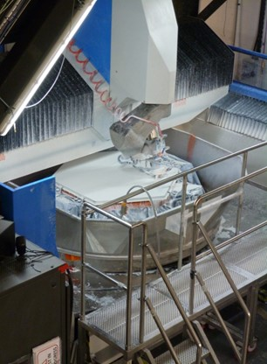
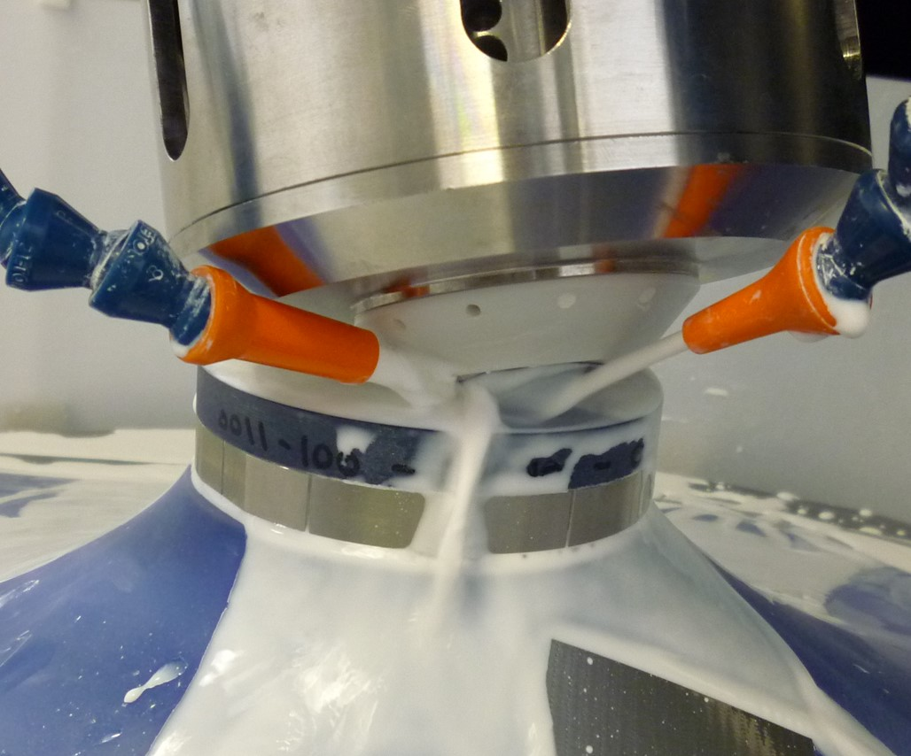
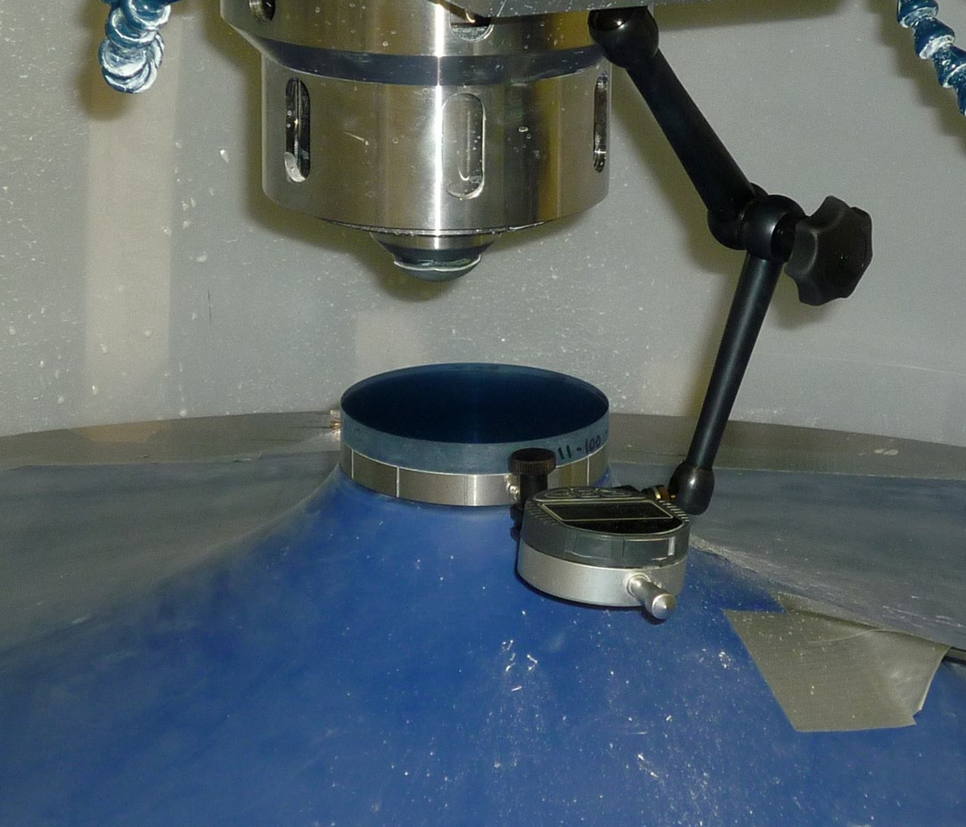
Manufacturing optics related to E-ELT
The UK consortium of Glyndŵr Innovations, University College London and Zeeko Ltd. has made segment prototype for M1-EELT fulfilling ESO’s specs (25 nm RMS).
They applied bonnet polishing and pitch smoothing on a customized Zeeko 1600 machine. No final IBF.
C. Gray et al., Proc. of SPIE 88380K (2013) “Fast manufacturing of E-ELT mirror segments using CNC polishing”
Image credit: opTIC Glindwr University
Several challenges to overcome:
    Polishing near the edges
    Optimize the slurry management
    Accurate alignment and input data mapping
    Minimize/avoid mid spatials
    Cleanliness

Slide 9
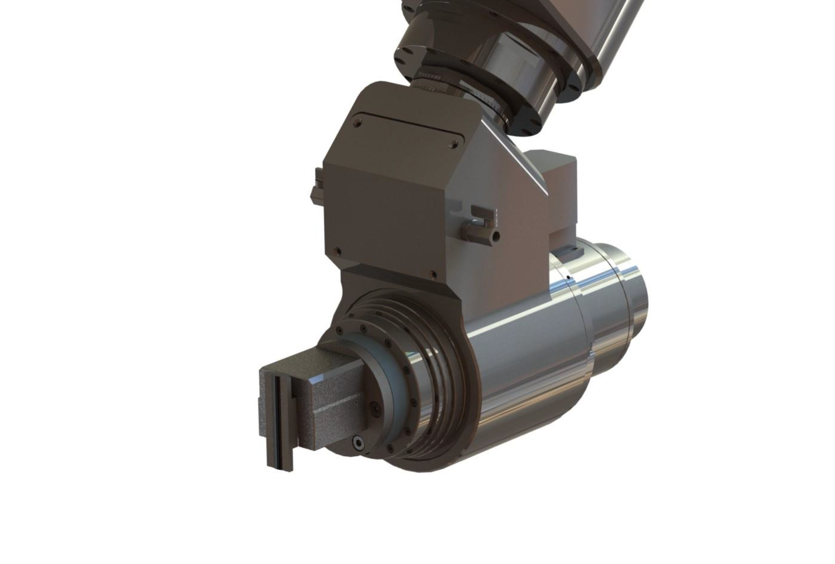
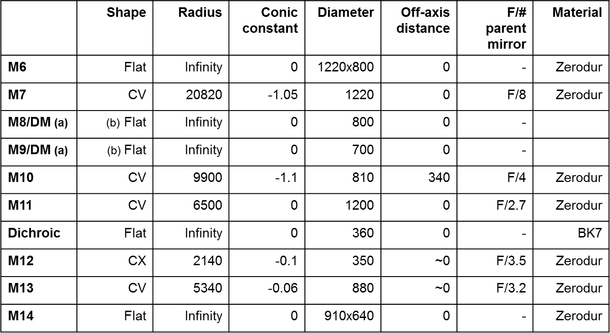
Manufacturing optics related to E-ELT
A manufacturing plan feasible at OABr combines the Zeeko1200 polishing and the IBF as final step.
It would be similar to the baseline plan for M1 segments.
www.eso.org/sci/facilities/eelt/docs/e-elt_constrproposal.pdf
Grinding: get form accuracy ∼ 1µm RMS
Bonnet Pre-Polishing: remove subsurface damage (SSD) and lower the roughness
Bonnet Corrective Polishing: get form accuracy < 1µm RMS, roughness @ nm level
Pitch smoothing : remove mid-spatials not correctable by bonnet.
Support Integration
IBF: get form accuracy in spec., keep roughness in spec.
Bonnet tool
MAORY
Credit: Matteo Lombini
Pitch smoothing tool

Slide 10
Outline
Review of the polishing methods
Manufacturing optics related to E-ELT: MAORY and M1 (R&D)
Results of the acceptance test
Conclusions

Slide 11
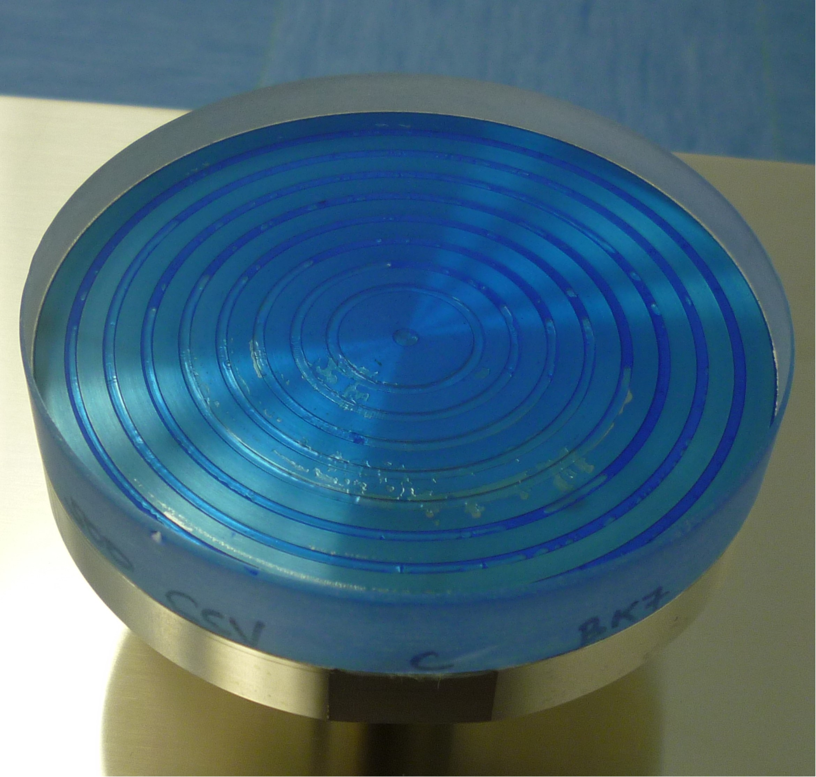
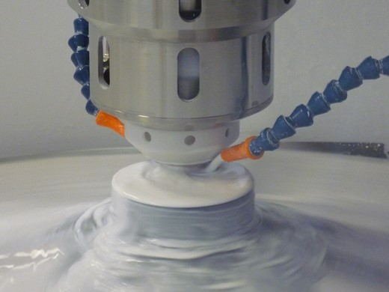
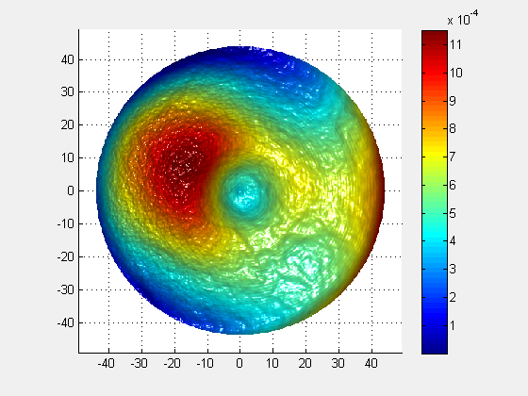
Results of the Acceptance Test
BK7 test sample
100 mm
Flat 100mm BK7 part, lapped (to a form error less than 2 µm)
Pre-Polishing by Synchro-Spiral mode, intended to:
    remove the SSD caused by the grinding phase
    reduce the surface roughness (enabling interferometry)
    provide larger removal rate (than form corrective polishing) to get quicker processing.
mm
Error map after one pre-polishing run (144 min):
1152 nm PV, 228 nm PV over 88mm clear aperture.
mm
mm

Slide 12
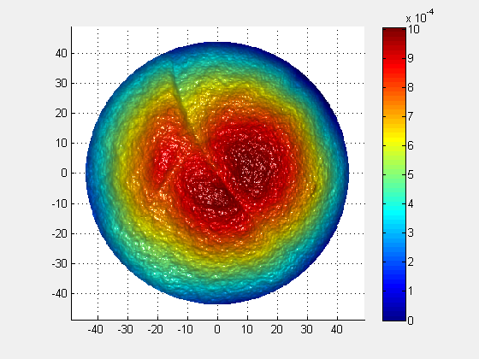
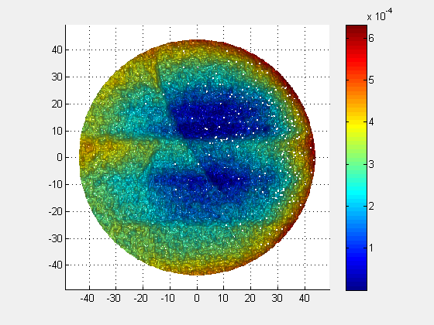
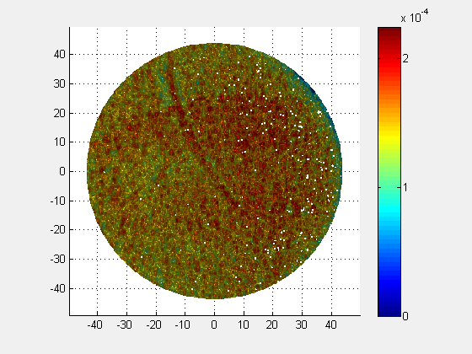
Results of the Acceptance Test
100mm flat BK7 part, previously pre-polished, Corrective Polishing
Form error maps acquired by interferometry
Goal: < λ/40 RMS (<16 nm RMS) over 88mm clear aperture
Flat pre-polished sample, 1008 nm PV, 233 nm RMS.
After correction 1 632 nm PV, 110 nm RMS.
After correction 5 224 nm PV, 19 nm RMS.
mm
mm
mm
mm
mm
mm
mm
mm
mm
19 nm RMS reached after 5 runs (459 min).

Slide 13
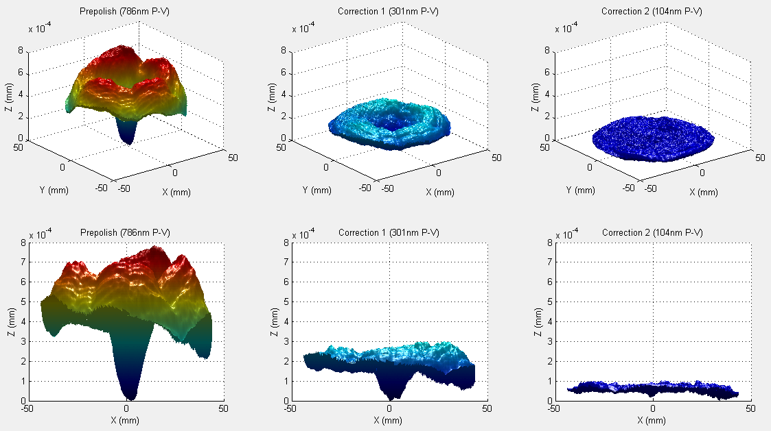
Results of the Acceptance Test
100mm concave BK7 part, previously pre-polished, Corrective Polishing
Starting conditions: 786 nm PV, 136 nm RMS
After Correction 2: 104 nm PV, 12 nm RMS.
Two corrective runs (180 min) brought the part within spec, < λ/40 RMS.
Better convergence factor is obtained once the removal rate has been made constant and known.
Images courtesy of P. Messelink, 2015

Slide 14
Conclusions
A Zeeko 1200 polishing/forming robotic machine has been implemented within the T-REX program at INAF-Brera Astronomical Observatory.
  Bonnet Polishing acceptance test has been performed successfully.
  Fluid Jet Polishing acceptance test is being scheduled in short term.
Future activities:
  Develop and practice the process on test pieces.
  Establish the process aiming to MAORY optics and providing technological development to E-ELT-M1.
  Exploit the synergy between the two systems for polishing and IBF hosted at Brera Observatory.
The outcome of the T-REX project – Sexten - July 2015

