Slide 1
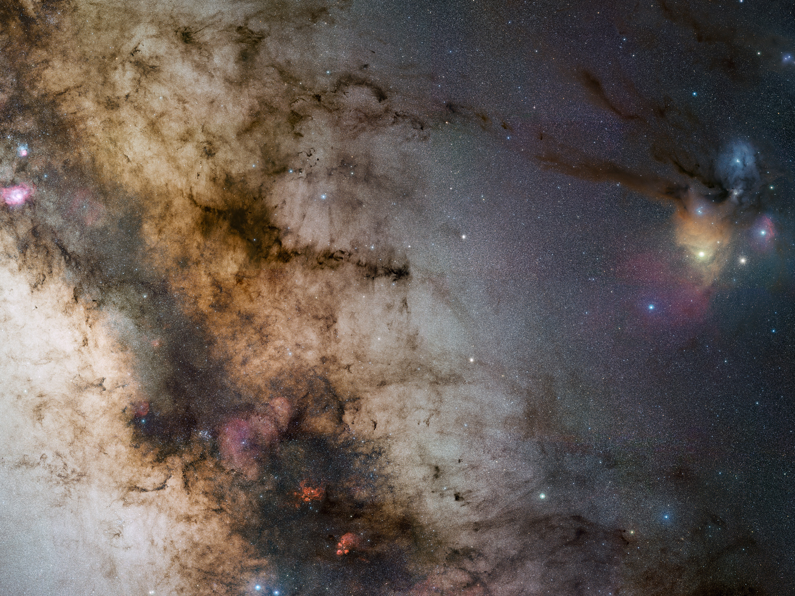



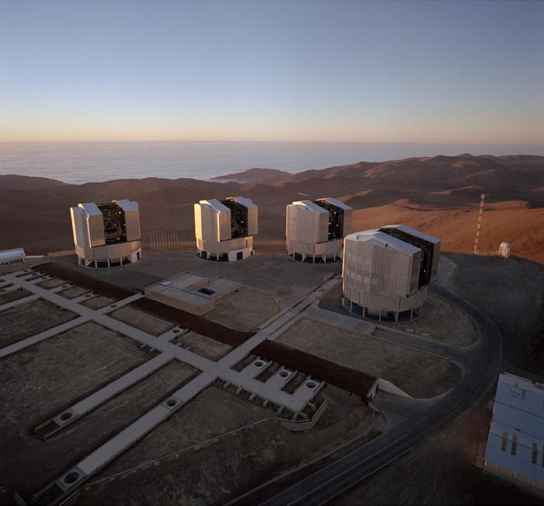
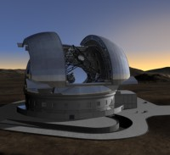
MOSE
Operational optical turbulence forecast for
the E-ELT flexible scheduling
VLT
E-ELT
Elena Masciadri⁽¹⁾
Franck Lascaux⁽¹⁾, Alessio Turchi⁽¹⁾, Luca Fini⁽¹⁾
INAF – Osservatorio Astrofisico di Arcetri, Italy⁽¹⁾
Cerro Paranal
Cerro Armazones
Credit: ESO/S.Guisard

Slide 2
OUTLINE
- MOSE: scientific goals
- Benefits in terms of astronomical observations
(AO efficiency and optimization of the scientific exploitation of the
ground-based facilities)
- Principle of the optical turbulence forecast performed with a mesoscale
atmospherical model
- Selection of the most relevant results achieved on the model performances
in forecasting atmospherical parameters and optical turbulence
- Conclusions & Perspectives
The outcome of the T-REX project - 20-24 July 2015, Sexten, Italy

Slide 3
MOSE: MOdelling Sites ESO
VLT
SCIENTIFIC GOALS
E-ELT
Feasibility study to evaluate the opportunity for the set-up of an automatic system for the forecast of:
All classical atmospherical parameters:
Temperature
Wind Speed and Direction
Relative humidity
★ Optical Turbulence: C_{N}², ε, θ₀, τ₀
Cerro Paranal
Cerro Armazones
Tool/method: mesoscale atmospherical model Meso-NH and Astro-Meso-NH
Masciadri et al. 1999
wind speed
ε: seeing
θ₀: isoplanatic angle
τ₀: wavefront coherence time
σ² : scintillation rate
L₀: spatial coherence outer scale
θ_{M} : isoplanatic angle for the MCAO
2D
(x,y)
F(hª,V^{b},L₀^{c})C_{N}²dh
heigth
dynamic outer scale
The outcome of the T-REX project - 20-24 July 2015, Sexten, Italy

Slide 4
BENEFITS in TERMS OF ASTRONOMICAL OBSERVATIONS
★Surface temperature: fundamental to eliminate the thermal gradient air/mirror and eliminate the ‘mirror seeing’ contribution.
★Surface wind speed: it is the main source of vibrations of critical structures: adaptive secondary, primary mirror.
★Surface wind direction: the atmospheric parameter more easily correlated to the seeing conditions.
★Vertical stratification atm. parameters on [0,20km]:
- Particularly wind speed, main ingredient for the wavefront coherence time (τ₀).
- There are not monitors that can routinely measure the wind speed stratification.
★Optical Turbulence: mesoscale models represents the unique method that is able to provide 3D maps of the C_{N}² from which we can retrieve all the astroclimatic parameters integrated along whatever line of sight.
Lascaux et al., MNRAS, 2015
BIAS_{med} and RMSE_{med} < 1 °C
BIAS_{med} < 0.93 ms⁻¹; RMSE_{med} ≤ 2.3ms⁻¹
BIAS_{med} < - 7°; RMSE_{med} ~ [32-35]°; RMSE_{REL} ~ [17-19]%
Masciadri et al., 2013, MNRAS
Practical examples of optimization of the AO observations that we can obtain:
1) Identification of temporal windows in which AO can not work at all (ε > 1.5” or τ₀ < τ_{0,threshold})
2) Identification of temporal windows in which the total seeing is extremely weak (ε < 0.8”) for high-contrast imaging
3) Identification of temporal windows in which the turbulence in the free atmosphere is weak ➔ GLAO, MCAO and WFAO
(extra-solar planets)
Just one tool for a huge number of benefits in different contexts !
The outcome of the T-REX project - 20-24 July 2015, Sexten, Italy

Slide 5
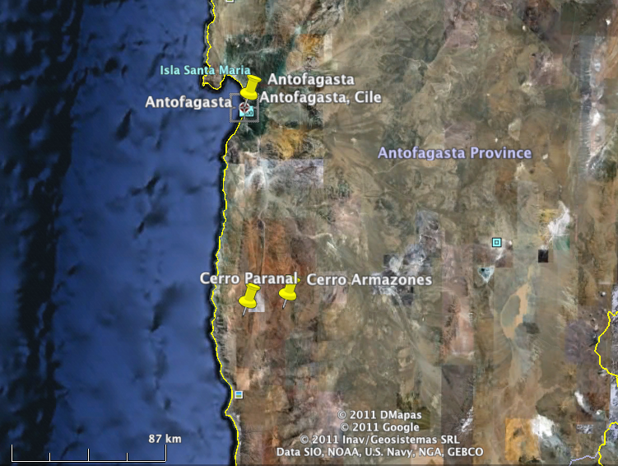
MODEL CONFIGURATION - GRID NESTING
- Paranal-Armazones: ~22km
800 km
- Paranal-Antofagasta: ~110km
- Paranal-coast: ~16km
160 km
- Armazones-coast: ~36km
75 km
10 km
Grid-nesting TWO WAY:
mutual interaction between each father and son domain
★ Standard configuration: 3 domains (with innermost domain resolution ΔX=500m)
★ High-resolution configuration: 5 domains (with innermost domain resolution ΔX=100m)
The outcome of the T-REX project - 20-24 July 2015, Sexten, Italy

Slide 6
OT FORECAST: PRINCIPLE
★ Simulations are forced each six hours (00:00, 06:00, 12:00, 18:00)
with forecasts from the ECMWF available in the meanwhile
★ Simulations are performed with grid-nesting technique that permits
to increase the resolution in a region around the telescope with a set
of imbricated models
TOY MODEL
OPTICAL TURBULENCE
FORECAST
ECMWF forecast at 18h
with meso-scale model
ECMWF forecast at 12h
local time
12:00
00:00
06:00
Present Time
ECMWF
OROG.
ECMWF
OROG.
TEMPORAL INTERPOLATION
Day J-1
Day J
The outcome of the T-REX project - 20-24 July 2015, Sexten, Italy

Slide 7
FORECAST SCHEME for PARANAL & ARMAZONES
DAY (J-2)
DAY (J-1)
DAY J
simulated time ΔT=15-18h
00:00
06:00
12:00
18:00
00:00
06:00
12:00
18:00
00:00
06:00
12:00
18:00
UT
30 h
36 h
42 h
48 h
17:00
10:00
14:00
20:00
02:00
08:00
14:00
20:00
02:00
08:00
14:00
20:00
02:00
08:00
14:00
LT
★
NIGHT
NIGHT
effective
post-processing
ΔT** = 4h
NIGHT
effective simulation time
ΔT* = 17h
starting
simul.
ending
simul.
display
results
21:00
15:00
Florence
Time
01:00
07:00
13:00
19:00
01:00
07:00
13:00
19:00
01:00
07:00
13:00
19:00
LT=UT – 4;
LT=UT - 3 (legal)
The outcome of the T-REX project - 20-24 July 2015, Sexten, Italy

Slide 8
WIND SPEED VERTICAL DISTRIBUTION (0-20km)
Masciadri et al., 2013, MNRAS
INDIVIDUAL NIGHTS
MODEL VALIDATION
00:00 UT
06:15 UT
12:00 UT
1) GCMs data are not reliable in the
low part of the atmosphere
max relative error on 50 obs.
2) GCMs data are available only at
synoptic hours i.e. each 6 hours
(V_{MNH}-V_{OBS}/V_{OBS})_{max} x 100 ~14%
obs.
model
Wind speed temporal sampling: 2 minutes
It is possible to arrive to a few seconds !!
2/8/2009
2/8/2009
DAY
NIGHT
DAY
NIGHT
Time (simulation hours from t₀)
Time (simulation hours from t₀)
The outcome of the T-REX project - 20-24 July 2015, Sexten, Italy

Slide 9
ATMOSPHERICAL PARAMETERS CLOSE TO THE GROUND [0-30m]
CERRO PARANAL: 129 nights
BIAS=-0.12
RMSE=0.99
σ=0.99
BIAS=-0.37
RMSE=1.02
σ=0.94
BIAS=-0.12
RMSE=0.99
σ=0.99
BIAS=-0.37
RMSE=1.02
σ=0.94
Lascaux et al., MNRAS, 2015
TEMPERATURE
2m
30m
high hor. resolution (100m) necessary for the wind speed
BIAS=-2.90
RMSE=4.03
σ=2.79
BIAS=-1.39
RMSE=3.04
σ=2.71
BIAS=-1.16
RMSE=2.73
σ=2.47
BIAS=-0.24
RMSE=2.70
σ=2.65
BIAS=-2.90
RMSE=4.03
σ=2.79
BIAS=-2.90
RMSE=4.03
σ=2.79
BIAS=-1.16
RMSE=2.73
σ=2.47
BIAS=-0.24
RMSE=2.70
σ=2.65
WIND
SPEED
10m
30m
10m
30m
10m
30m
WIND
DIRECTION
RMSE_{REL}= RMSE/180°=20%
WS_{th}= 3ms⁻¹
BIAS=3.4°
RMSE=36.7°
σ=36.6°
WS_{th}= 3ms⁻¹
BIAS=-0.2°
RMSE=35.7°
σ=35.7°
WS_{th}=3m s⁻¹
BIAS=3.4°
RMSE=36.7°
σ=36.6°
WS_{th}=3m s⁻¹
BIAS=-0.2°
RMSE=35.7°
σ=35.7°
The outcome of the T-REX project - 20-24 July 2015, Sexten, Italy

Slide 10
ATMOSPHERICAL PARAMETERS CLOSE TO THE GROUND [0-30m]
RANDOM CASE
a=b=….=n/9
PC=33.33%
POD_{1,2,3}=33.33%
CONTINGENCY TABLES
- Proportion of correct detection
- Probability of detection of an event
Proportion of Correct detection
PC=(a+e+i)/n]x100; 0 ≤ PC ≤ 100%
3x3 contingency table
Probability of Detection of event 1
POD₁=[a/(a+d+g)]x100; 0 ≤ POD ≤ 100%
Probability of Detection of event 2
POD₂=[e/(b+e+h)]x100; 0 ≤ POD ≤ 100%
Probability of Detection of event 3
POD₃=[i/(c+f+i)]x100; 0 ≤ POD ≤ 100%
Extremely bad detection
EBD=[(c+g)/n]x100; 0 ≤ POD ≤ 100%
A table 3x3 is identified by two threshold limits
The outcome of the T-REX project - 20-24 July 2015, Sexten, Italy

Slide 11
ATMOSPHERICAL PARAMETERS CLOSE TO THE GROUND [0-30m]
CERRO PARANAL: 129 nights
1st tertile
3rd tertile
TEMPERATURE
2m
30m
Lascaux et al., MNRAS, 2015
Total points = 3483; PC = 75.5%; EBD=0.2%
POD1= 91.8%; POD2= 66.3%; POD3=65.9%
Total points = 3483; PC = 73.7%; EBD=0.5%
POD1= 93.7%; POD2= 55.2%; POD3=69.0%
WIND SPEED
10m
30m
Total points = 3456; PC = 60.6%; EBD=4.4%
POD1= 56.2%; POD2= 47.5%; POD3=74.3%
Total points = 3456; PC = 60.6%; EBD=3.7%
POD1= 52.5%; POD2= 48.2%; POD3=79.0%
The outcome of the T-REX project - 20-24 July 2015, Sexten, Italy

Slide 12
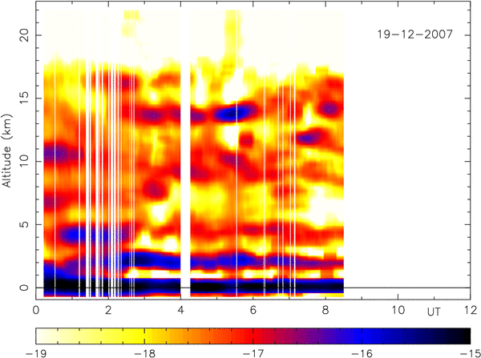
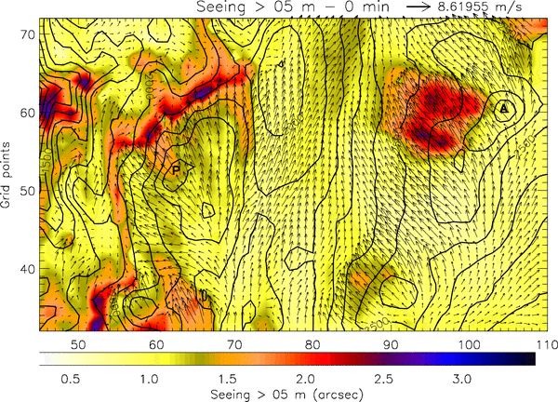
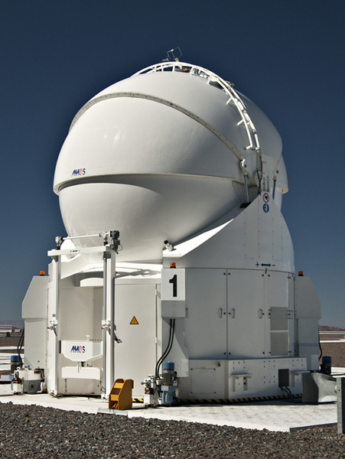
PARANAL – Night of 19/12/2007
C_{N}² : GENERALIZED SCIDAR
GS
MODEL
GS
DIMM
MODEL
32.5 km x 20 km; Δx=500m; seeing > 5m + wind @ 10m
AT
High-temporal frequencies filtered
5m
SIMULATIONS with the non-hydrostatic atmospherical meso-scale model + Astro package (Astro-Meso-Nh)
ΔT=9 hours - night ; (00:00 - 9:00) UT; sampling=5 min

Slide 13
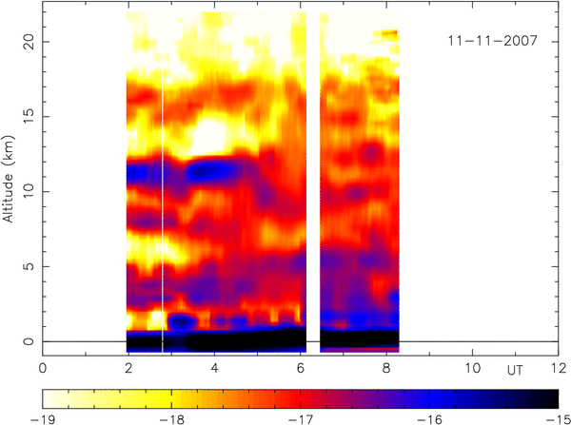
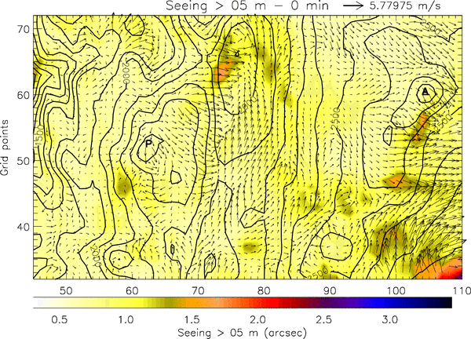
PARANAL– Night of 11/11/2007
C_{N}² : GENERALIZED SCIDAR
GS
MNH
GS
DIMM
MNH
32.5 km x 20 km; Δx=500m; seeing > 5m + wind @ 10m
AT
5m
SIMULATIONS with the non-hydrostatic atmospherical meso-scale model + Astro package (Astro-Meso-Nh)
ΔT=9 hours - night; (00:00 - 9:00) UT; sampling=5 min

Slide 14
GS
DIMM
MODEL
TOTAL SEEING – MOVING AVERAGE 1 h + RESAMPLING 20 min
Astrobigne’, Firenze, 5 May 2015

Slide 15
GS
DIMM
MODEL
TOTAL SEEING – MOVING AVERAGE 1 h + RESAMPLING 20 min
The outcome of the T-REX project - 20-24 July 2015, Sexten, Italy

Slide 16
ASTROCLIMATIC PARAMETERS
OBS. vs. OBS.
MODEL vs. OBS.
1st tertile
3rd tertile
Total points=504; PC=62.90%; EBD=5.16%
POD1=64.29%; POD2=35.71%; POD3=88.69%
Total points=504; PC=55.16%; EBD=5.36%
POD1=84.12%; POD2=20.84%; POD3=62.50%
Total points=504; PC=59.72%; EBD=2.58%
POD1=71.43%; POD2=61.31%; POD3=46.43%
Total points=529; PC=55.76%; EBD=5.86%
POD1=88.13%; POD2=34.10%; POD3=44.89%
The outcome of the T-REX project - 20-24 July 2015, Sexten, Italy

Slide 17
IMPACT of OT forecast
RED: model
BLACK: DIMM
GREEN: DIMM previous night
The outcome of the T-REX project - 20-24 July 2015, Sexten, Italy

Slide 18
CONCLUSIONS & PERSPECTIVES
CONCLUSIONS
■ We proved that we are able to forecasts the atmospherical parameters and the OT
with a score of success that is already sufficiently high to definitely guarantee a benefic impact
on the service mode of top-class telescopes and the E-ELT.
■ The MOSE final review is planned for autumn 2015 (Phase A: 2 years; Phase B: 1 year).
Negotiation with ESO for the implementation of the automatic operational system
for Paranal and Armazones.
■ We are already involved in a similar project for LBT (ALTA project).
Milestones:
- June 2016: automatic operation of atmospherical parameters (commissioning)
- December 2016: automatic operation of OT (commissioning)
PERSPECTIVES
It should be our intention to extend this application to other top-class ground-based
facilities in addition to LBT, VLT, E-ELT ➔ STARMET project (Arcetri/LAMMA)
The outcome of the T-REX project - 20-24 July 2015, Sexten, Italy

