Slide 1
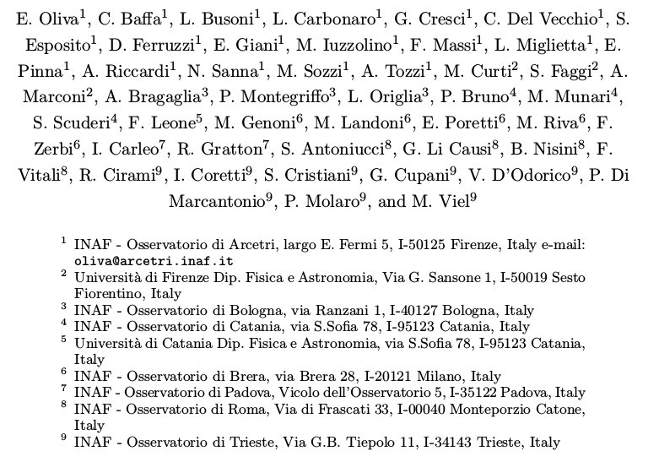
T-REX OU4 HIRES The high resolution spectrograph for E-ELT

Slide 2
T-REX OU4 HIRES
Main goal
Consolidate the project for the construction of the high resolution spectrograph for the E-ELT.
Main tasks
Development of scientific cases and tools to predict the instrument performances.
Detailed design of a highly modular instrument.
R&D activities to increase technical readiness and optimize performances.
Creation of an international consortium that includes most of the European and ESO-related institutes interested in high resolution spectroscopy.

Slide 3
T-REX OU4 HIRES
Historical background
Two instruments were studied in the early phase-A (2007-2010)
CODEX: natural seeing, R=120,000, optical (0.37-0.72μm)
SIMPLE: AO assisted, R=130,000, NIR (0.84-2.5μm)
INAF deeply involved in both instruments.
ESO road-map after re-organization of E-ELT project in 2011
→ HIRES single instrument with full-range
Extract from ESO roadmap document of 2011

Slide 4
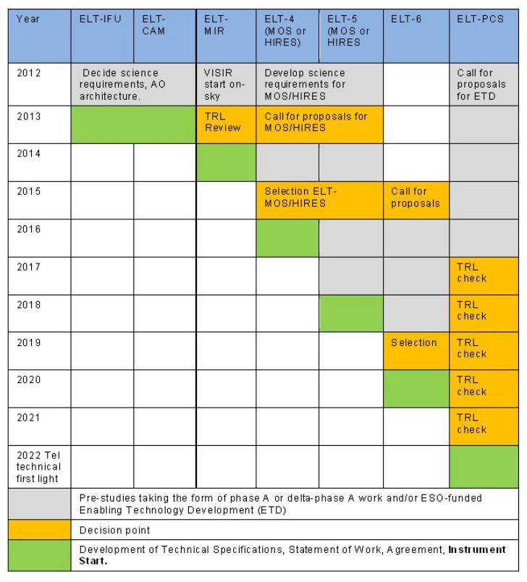
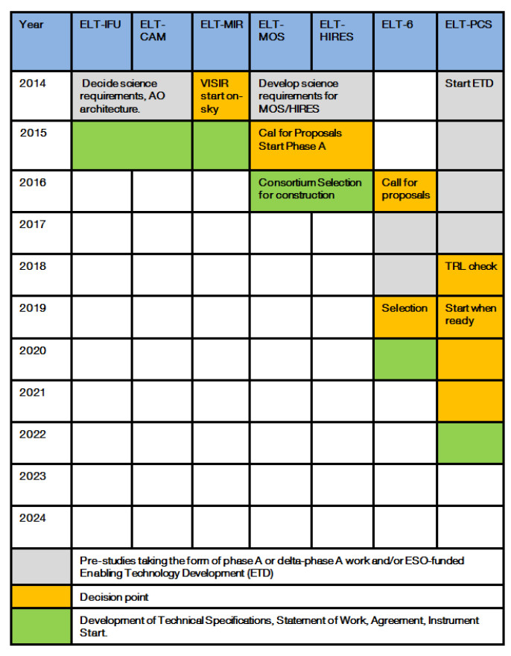
T-REX OU4 HIRES
January 2012 ESO roadmap July 2015

Slide 5
T-REX OU4 HIRES
Scientific cases and data simulation
Expanded science cases for at high spectral and spatial resolution observations (HR² mode): proto-planetary disks, comets and exo-planets atmospheres (synergy with OU6-PCS)
Exposure time calculator (http://tirgo.astro.it/hires_calc)
HIRES and AO correction
HIRES includes visual and blue wavelengths
→ HIRES is a seeing limited instrument at short wavelengths.
HIRES seeing-limited in the near-IR? A seeing limited instrument is more efficient for very high S/N spectroscopy of bright targets, e.g. studies of exo-planets atmospheres.
→ HIRES needs both seeing limited and AO modes in the IR.
A SCAO module is being studied also for HIRES (synergy with OU3-CAM).

Slide 6
T-REX OU4 HIRES
Instrument design
Highly modular instrument.
Four fiber-bed spectrometer modules split in wavelengths.
Observing modes are selected at the telescope interface.
Fixed fiber bundles define the observing modes.
Nothing change in the spectrometer when mode is changed.
Simultaneous calibration always available for main HR modes.
A MOS (~10 objects) MR (R~15,000) is also included.
All modes have full spectral coverage, i.e. HIRES=super X-shooter

Slide 7
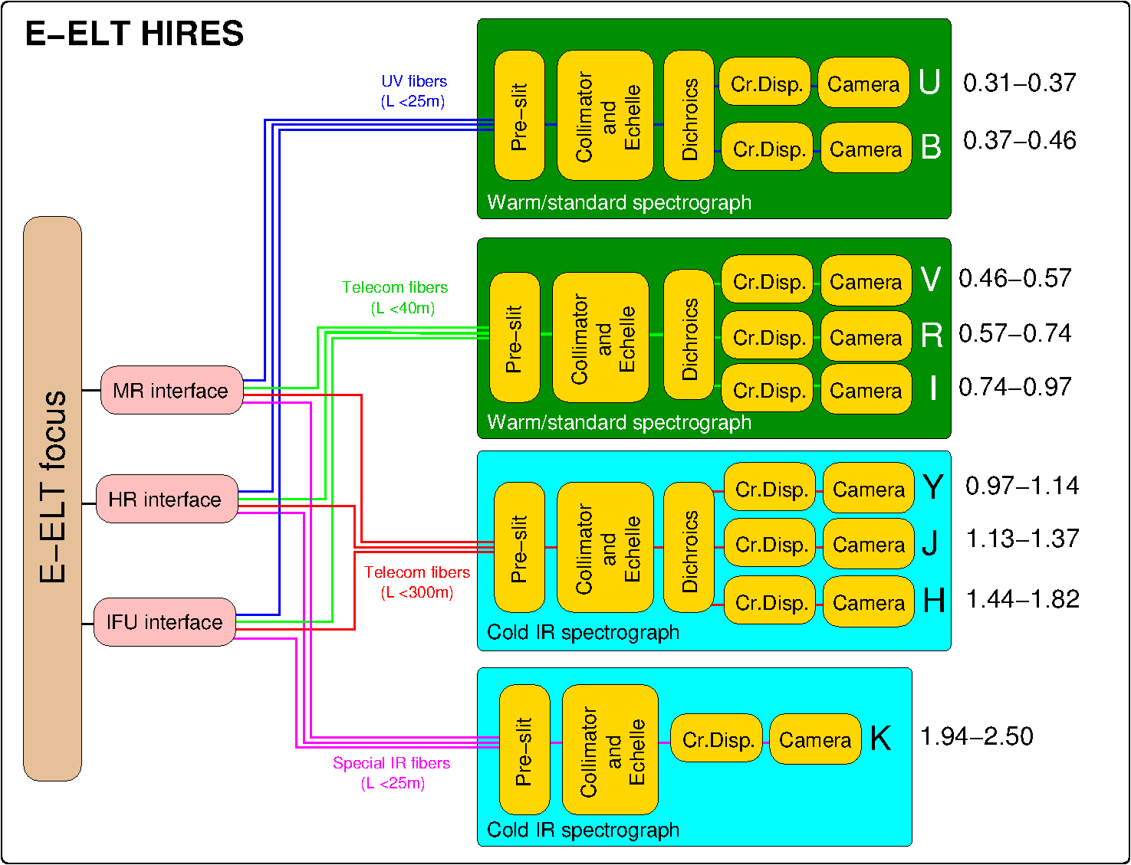
T-REX OU4 HIRES
Four fiber-bed spectrometer modules split in wavelengths.

Slide 8
T-REX OU4 HIRES
Observing modes are selected at the telescope interface.

Slide 9
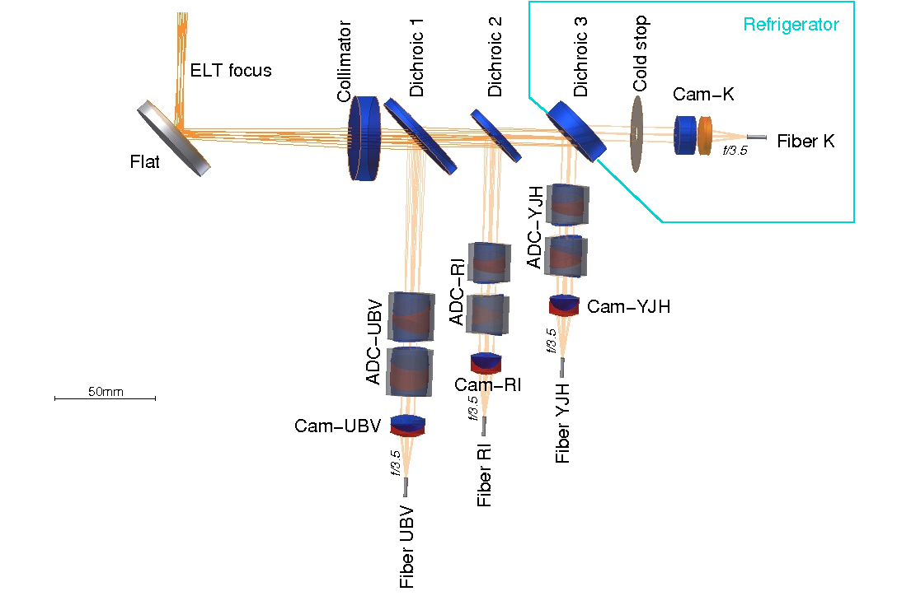
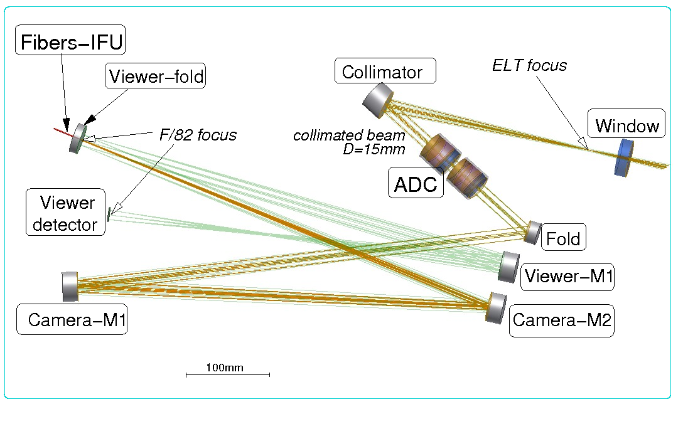
T-REX OU4 HIRES
Observing modes are selected at the telescope interface.
HR²-IFU mode
HR-mode

Slide 10
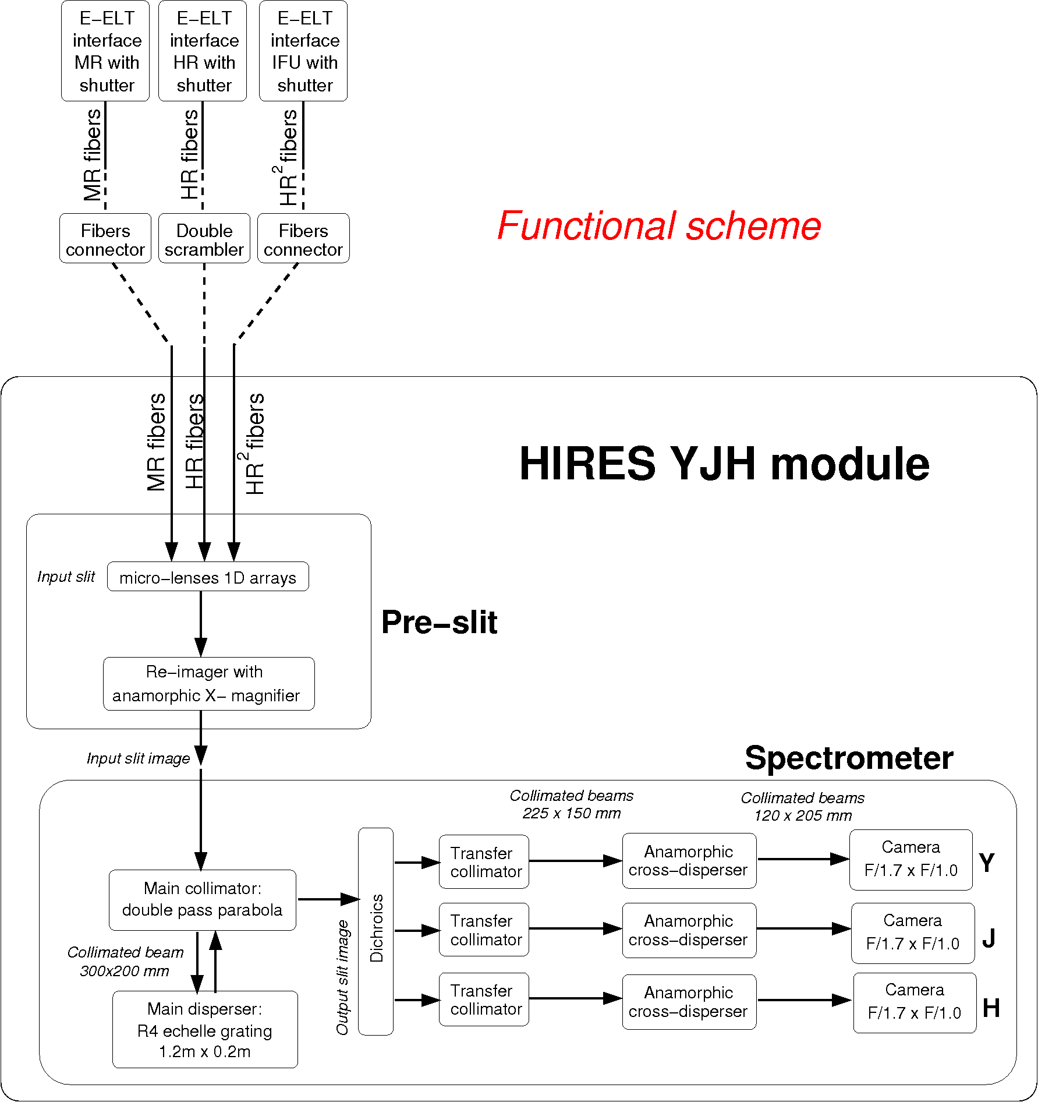
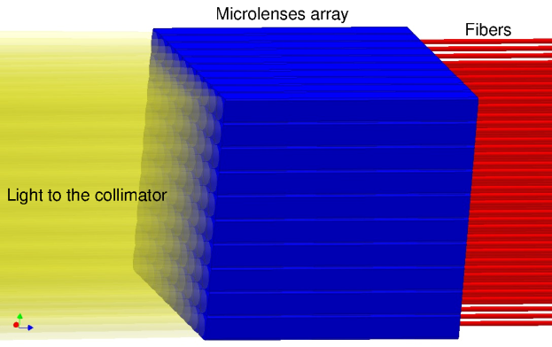
T-REX OU4 HIRES
Fixed fiber bundles define the observing modes.
HR
MR
HIRES module

Slide 11
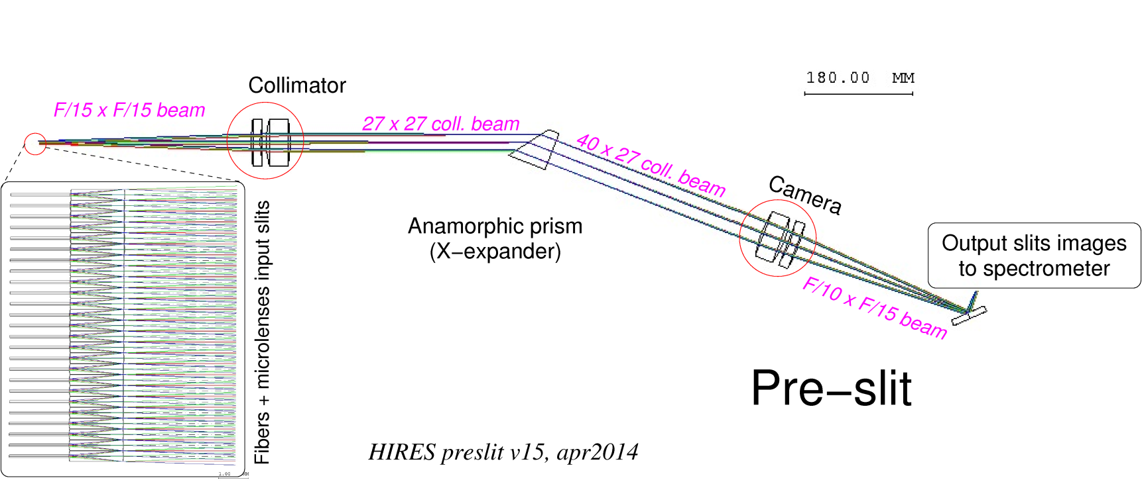
T-REX OU4 HIRES
Fixed fiber bundles define the observing modes.
HR
IFU

Slide 12
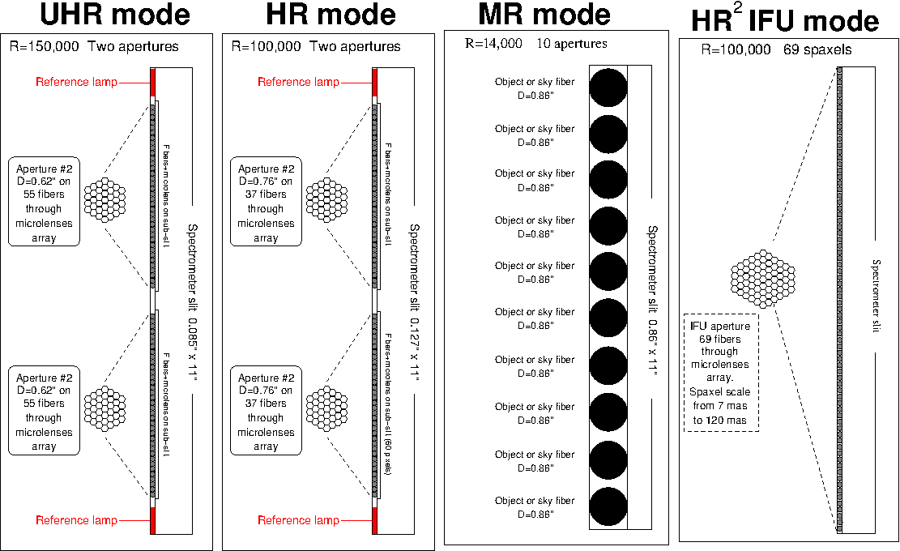
T-REX OU4 HIRES
Fixed fiber bundles define the observing modes.

Slide 13
T-REX OU4 HIRES
If AO works the fiber bundles become IFU’s.

Slide 14
T-REX OU4 HIRES
Main parameters of the observing modes.
Parameter | UHR mode | HR mode | MR mode | HR² IFU mode
Resolving power | 150,000 | 100,000 | 14,000 | 100,000
# of simultaneous objects | 2 + cal.lamp | 2 + cal.lamp | 10 | 69 spaxels
Aperture on sky | D=0.62” per object | D=0.76” per object | D=0.86” per object | 7 to 120 mas/spaxel 58 to 1000 mas f.o.v.
Slicing/dicing | 55 fibers/obj | 37 fibers/obj | 1 fiber/obj | 1 fiber/spaxel
Physical size of each fiber core | 0.057 mm | 0.085 mm | 0.570 mm | 0.085 mm
Sampling on IR array | 2 x 1.3 pixels | 3 x 2 pixels | 20 x 11 pixels | 3 x 2 pixels
Sampling on CCD | 3.3 x 2 pixels | 5 x 3 pixels | 37 x 20 pixels | 5 x 3 pixels

Slide 15
T-REX OU4 HIRES
Nothing changes in the spectrometer when mode is changed. Simultaneous calibration always available for main HR modes.

Slide 16
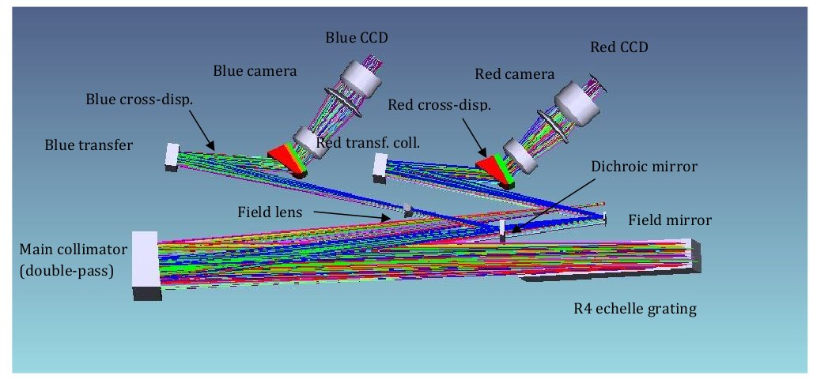
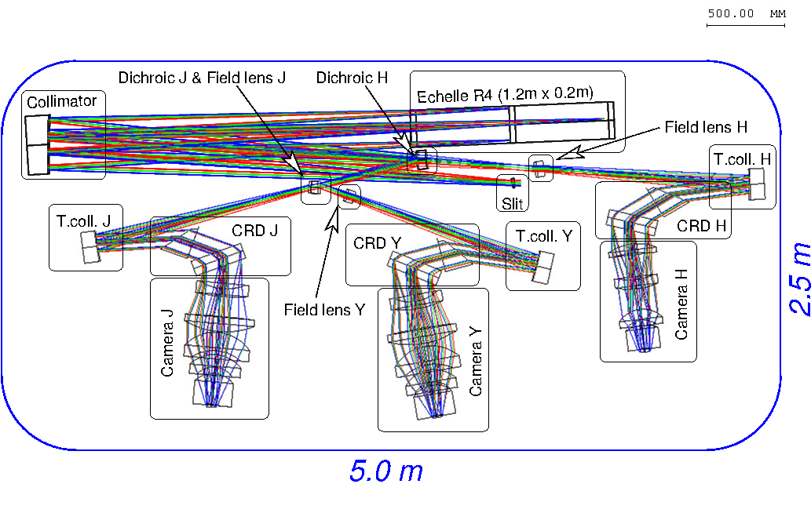
T-REX OU4 HIRES
Each spectrometer module is similar to ESPRESSO
ESPRESSO
Collimators are identical
4m
HIRES

Slide 17
T-REX OU4 HIRES
Each spectrometer module is similar to ESPRESSO

Slide 18
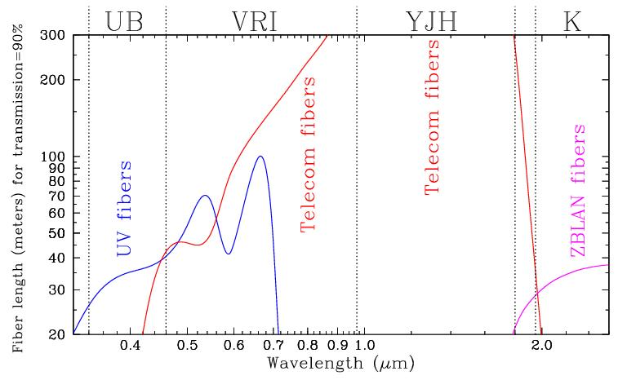
T-REX OU4 HIRES
Positioning of spectrometer modules dictated by fibers technology

Slide 19
T-REX OU4 HIRES
Spectrometer modules can be positioned in different places
YJH can use 300m fibers, can go anywhere (e.g. Coude room)
VRI has a limit of 40m, UB/K even shorter → close to Nasmyth
A Coude optical train is a possible alternative

Slide 20
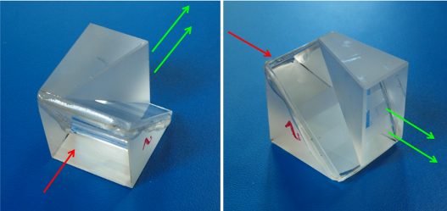
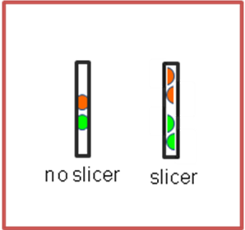
T-REX OU4 HIRES
R&D Activities
Development of image slicers with high efficiency (with Pecchioli Research company), 1st prototype operative at TNG.
Development of large-size ultra-stable cryostats (with Criotec Impianti): learning and improving from GIANO experience.
Clever systems for doing polarimetry at the Nasmyth.

Slide 21
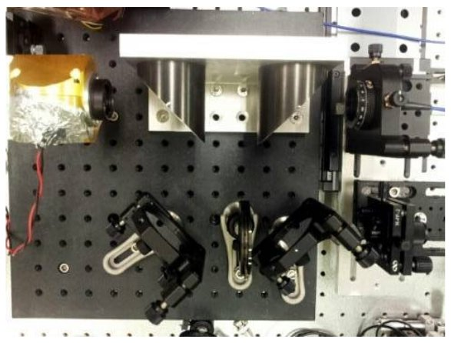
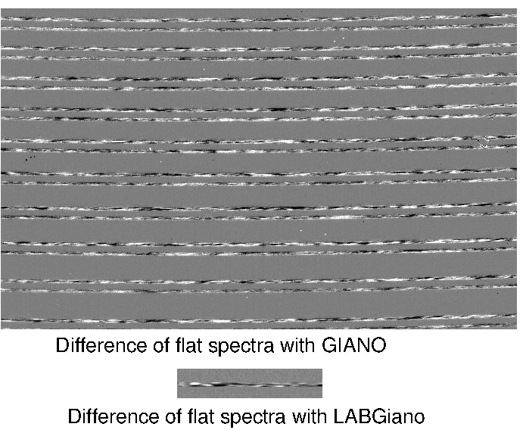
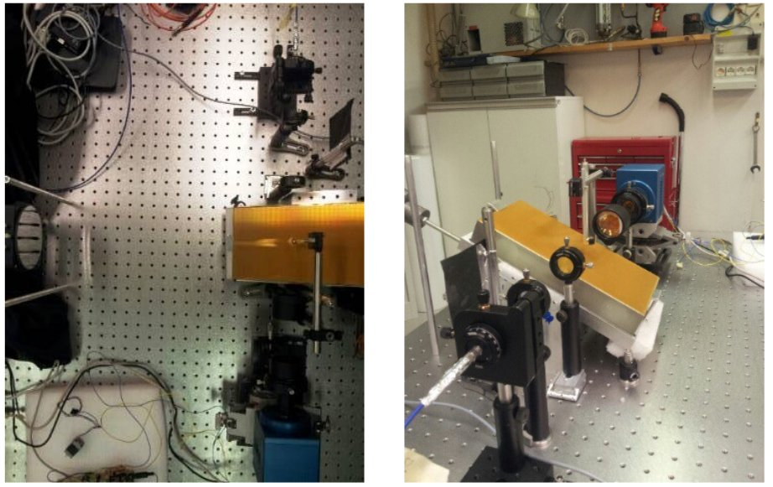
T-REX OU4 HIRES
R&D Activities
End-to-end characterization of fibers in the IR with dedicated fiber-fed spectrometer in Arcetri labs. Unexplored field, many surprises with modal noise, much to learn still.

Slide 22
T-REX OU4 HIRES
HIRES initiative
Gathers any expressed interests on HR spectroscopy on ELT
Includes institutes from Chile, Brazil, Denmark, France, Germany, Italy, Poland, Portugal, Spain, Sweden, Switzerland and UK.
Acts toward agencies to secure FTE’s and funding
Set up a consortium responding to formal call by ESO
INAF has a major role in consortium (PI and Project Office)

Slide 23
Thank you

Slide 24
Extra slides

Slide 25
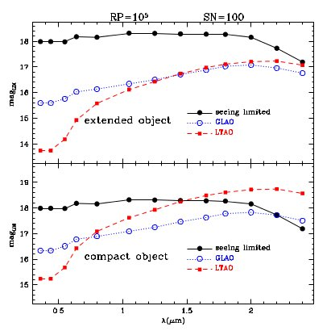
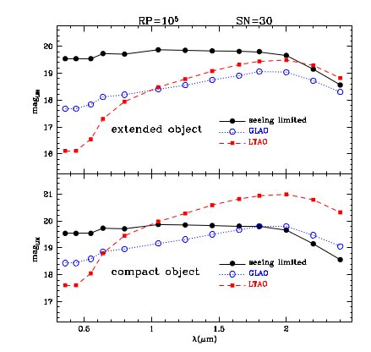
T-REX OU4 HIRES
HIRES and AO correction
Sanna et al. this conference

