Slide 1
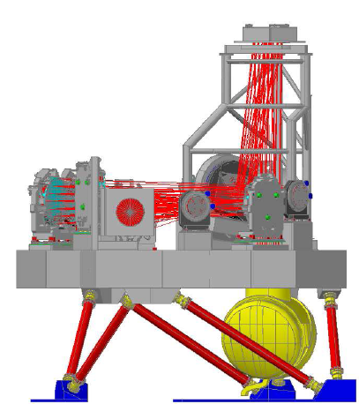
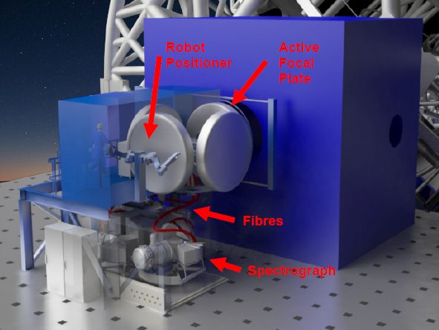
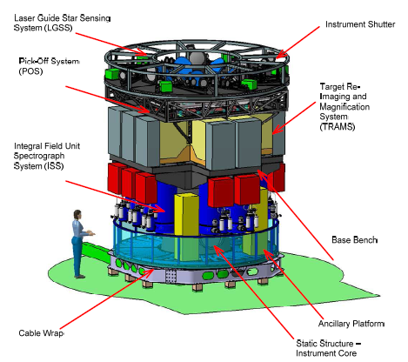
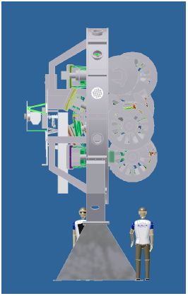
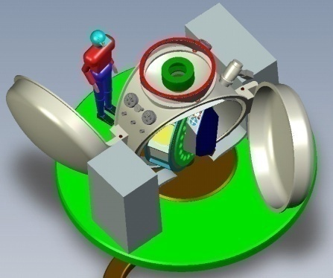
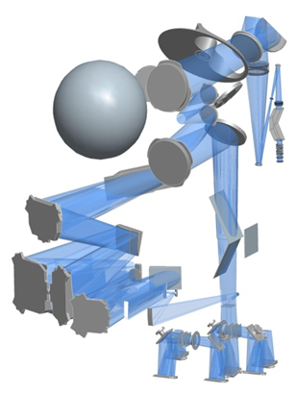
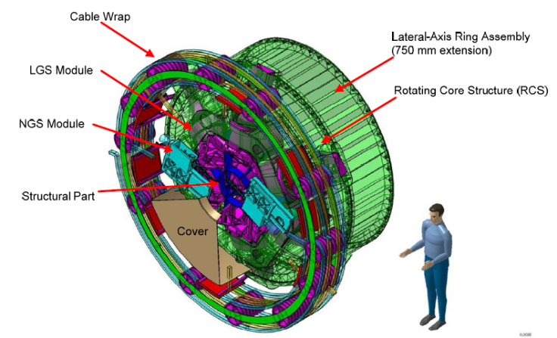
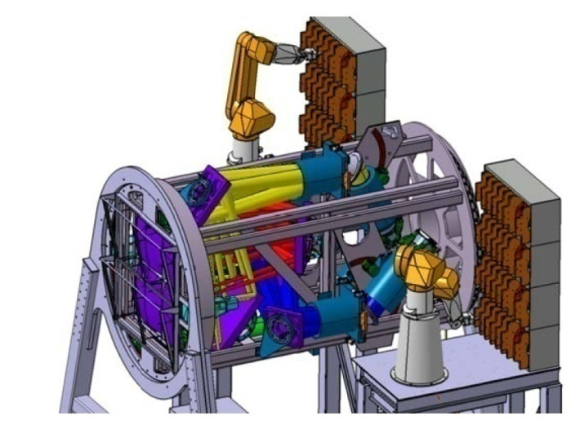
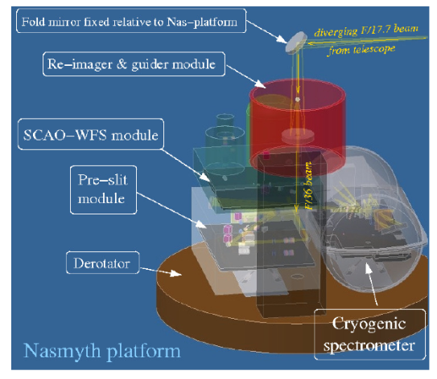
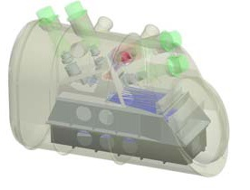
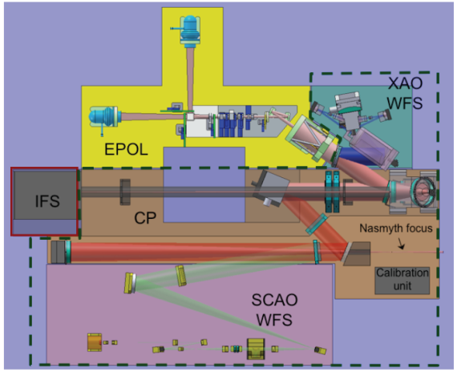
ELT Instrumentation Development Mark Casali
1
Notes:
1

Slide 2
contents
Status of Instrument Roadmap and Instrument information
Technology Development programme
Procurement Framework

Slide 3
Instrument interfaces
Pre-Focal Station
M6
Phasing
Windshake
Multiple concepts
Extensive discussion
Draft ICD now available

Slide 4
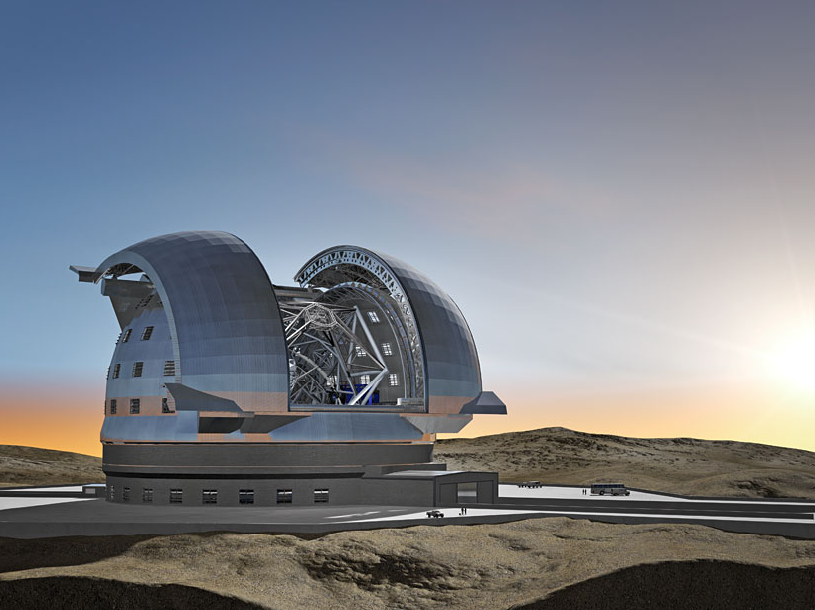
Instrument Status and information
Notes:
4

Slide 5
The Baseline Roadmap
Instrument | Status
MICADO | For recommendation/approval by Committees
MAORY | For recommendation/approval by Committees
HARMONI/LTAO | For recommendation/approval by Committees
METIS | For recommendation/approval by Committees
ELT-MOS | Call for Proposals to be issued July 2015
ELT-HIRES | Call for Proposals to be issued July 2015
ELT-6 | Call for proposals in 2016
ELT-PCS | To proceed when technology is ready (2019)
Constr. budget
Ops budget

Slide 6
Establishing Instrument Technical Specs
HARMONI
TLR
METIS
TLR
MICADO
TLR
Budget,
Tech considerations,
Risks
HARMONI
Tech Spec
METIS
Tech Spec
MICADO *
Tech Spec
MAORY *
Tech Spec
Tech Spec preparation in final stages.
* In addition there will be an ESO-owned interface control document between MICADO & MAORY

Slide 7
HARMONI (+LTAO)
IFS spectrometer. PI : Niranjan Thatte
Univ of Oxford | UK
UK ATC | UK
CRAL | France
ONERA | France
Obs Marseille | France
IAC | Spain
CSIC | Spain
ESO

Slide 8
HARMONI & LTAO
IFU spectrograph from 0.5 to 2.4 μm
3 spatial pixel scales
From diffraction limited to coarse ”seeing limited” scale
Low (3000) medium (7000) high (20000) spectral resolution
Includes
Non-sidereal tracking
Single Conjugate AO mode
Statement of Work includes LTAO study to PDR. Led by LAM & ONERA. Draft technical specifications are part of deliverables
Will go to construction when Phase II funding is confirmed

Slide 9
MICADO
MCAO-corrected camera. PI: Ric Davies
MPIE | Germany
USM | Germany
MPIA | Germany
IoA Gőttingen | Germany
Nova | Netherlands
LESIA | France
Univ of Vienna & Linz | Austria
INAF (Padova) | Italy
ESO

Slide 10
MICADO
Precision Imager with 2 pixel scales and >30 filters
1-2 mas & 3-4mas
Includes fixed-format spectroscopy mode
Includes
SCAO module (shared with MAORY)
Non-sidereal tracking

Slide 11
MAORY
Multi-Conjugate AO module. PI: E.Diolaiti
INAF | Italy
INSU-IPAG | France
ESO

Slide 12
MAORY
Multi-Conjugate 6-laser AO system for MICADO + 1 auxiliary port
Corrected field of 70” for MICADO and 2.5’ at Aux port
Designed for 2 internal DMs + M4 (3-layer correction)
Includes
non-sidereal tracking
SCAO module (shared with MICADO)

Slide 13
First instruments AO-ready
MICADO
HARMONI
MAORY
LTAO

Slide 14
First instruments poor seeing
MICADO
HARMONI
MAORY
LTAO
1’ field of view
Has coarse pixel scale
giving fov ~ 6x6”

Slide 15
METIS
Mid-IR imager & spectrometer. PI: B Brandl
NOVA | Netherlands
CEA Saclay | France
ETH | Switzerland
KU Leuven | Belgium
MPIA | Germany
UKATC | UK
Univ of Vienna | Austria
ESO

Slide 16
METIS
L,M,N,Qshort Imager and spectrometer
Imaging
Minimum of 10 filters. 10x10” [20x20] field
Coronagraphy
L,M Spectroscopy
Low, medium, IFU/x-dispersed high resolution
N Spectroscopy
Low and medium resolution
Includes
SCAO and non-sidereal tracking

Slide 17
Instrument schedule
Scope/cost/options discussed with ELT management, instrument teams, advisory committees, STC and ESC
STC reviewed/recommended proposal in April
FC approved expenditures in May
Council approved GTO in June
Agreement signatures expected in Sept/Oct

Slide 18
First-light Construction phase
Preliminary design (2017)
Followed by cost/scope review
Final design (2019)
Preliminary acceptance – Europe (2024)
Commissioning (2024)
Provisional acceptance – Chile (2026)
Warranty period follows
Final acceptance (2028)

Slide 19
Multi-Object Spectrograph and High Resolution Spectrograph
Equal priority. Will start when ready.
Top-Level Requirements prepared
RFI was issued
Enabled ESO to confirm interest in community
Enabled ESO to understand proposed scope
Discussions with STC, Council and internal management have refined strategy
Go ahead with open call for proposals, including GTO allocation
Set cash budgets to what is available in long term planning
Adjust scope to fit
Very limited possibilities for additional GTO

Slide 20
Multi-Object Spectrograph and High Resolution Spectrograph
Current schedule
Preparation of Call for Proposals for Phase A studies
Includes cash total for instruments + GTO awards
Cash flow limited by ESO financial position
Competitive proposals welcome
Call issued, July 2015
Phase A start in 2016
1-2 year studies finishing with review
Then decision on construction

Slide 21
Technology Development Programme
Notes:
21

Slide 22
Instrument Science Detectors
Instrument | Number of Det | Pixel format | Wavelength um
MICADO | 13-16* | 4kx4k | 0.8-2.5
HARMONI | 8* | 4kx4k | 0.95-2.45
 | 8 | 4kx4k | 0.47-0.95
METIS | 1 | 1kx1k | 5-14(28)
 | 6 | 2kx2k | 3-5
ELT-MOS | 6* | 4kx4k | 0.6-1.7
 | 6-8 | 4kx4k or 6kx6k | 0.37-1
ELT-HIRES | 3* | 4kx4k | 0.8-2.45
 | 5 | 9kx9k | 0.3-0.8
ELT-PCS | 4* | 4kx4k | 0.95-1.65
 | 8 | 4kx2k | 0.6-0.9

Slide 23
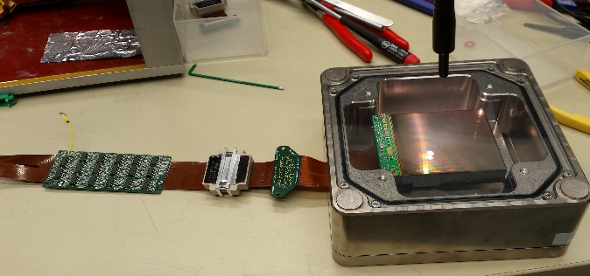
Instrument science detectors
Visits/discussions with manufacturers ongoing
Selex, Raytheon, Teledyne, Sofradir have been visited.
It is likely that single bulk order ($20-30M) for the 30+ detectors will give us best price/performance
Call for tender in late 2016
Crucial that we work on specifications closely with instrument teams
Unified science-driven specifications if possible
First light with the H4RG bare mux

Slide 24
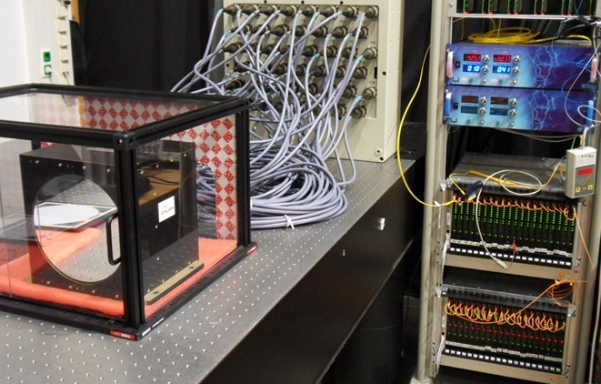
HO deformable mirror systems
crucial for ELT instrumentation
Currently in a very difficult situation
MCAO
PCS (Epics). >20,000 actuators
Open-loop DMs
VLT AO instruments envisioned
MCAO
Extension to optical range
SPHERE DM

Slide 25
WFS Detectors
eAPD HgCdTe devices (Selex)
Major steps forward to very low read noise high-speed infrared detectors.
For wavefront sensors, fringe trackers, possibly science observations
High speed CMOS (E2V)
NGSD evaluation in lab at ESO
Further revisions planned

Slide 26
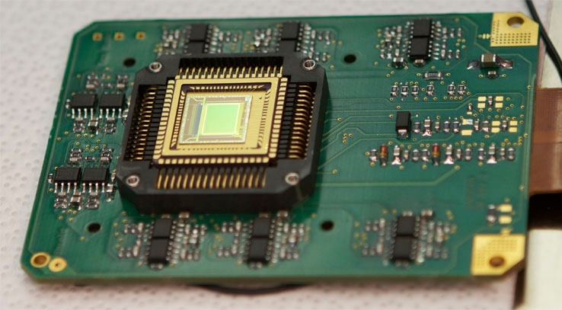
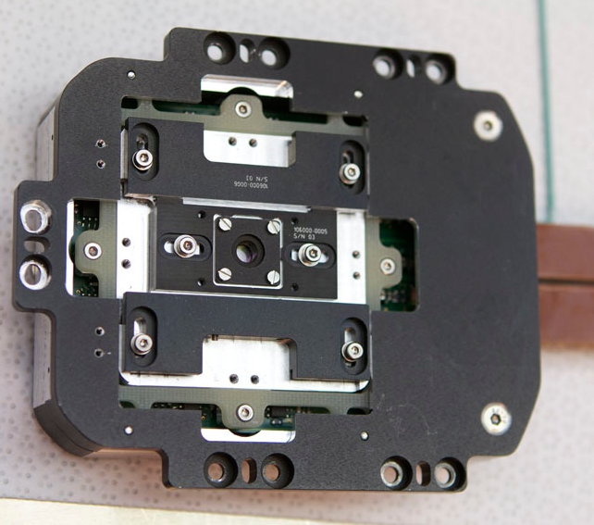
WFS Detectors
NGSD / LGSD CMOS
Pixel array (Refn pixels - 40 columns) | 1760x1680 (880x840 pixels in NGSD) - 5x6cm requiring stitched design (>> max. reticle 25.5x32.5mm)
Technology | Thinned backside illuminated CMOS 0.18µm – TowerJazz; APD5; 6 metal layers; MIM capacitor
Pixel pitch | 24µm
Pixel topology | 4T pinned photodiode pixel
Array architecture | 84x84 time coherent “sub arrays” of 20x20 (8x8 NGSD) pixels
Saphira
320x256
eAPD
HgCdTe
Gravity WFS

Slide 27
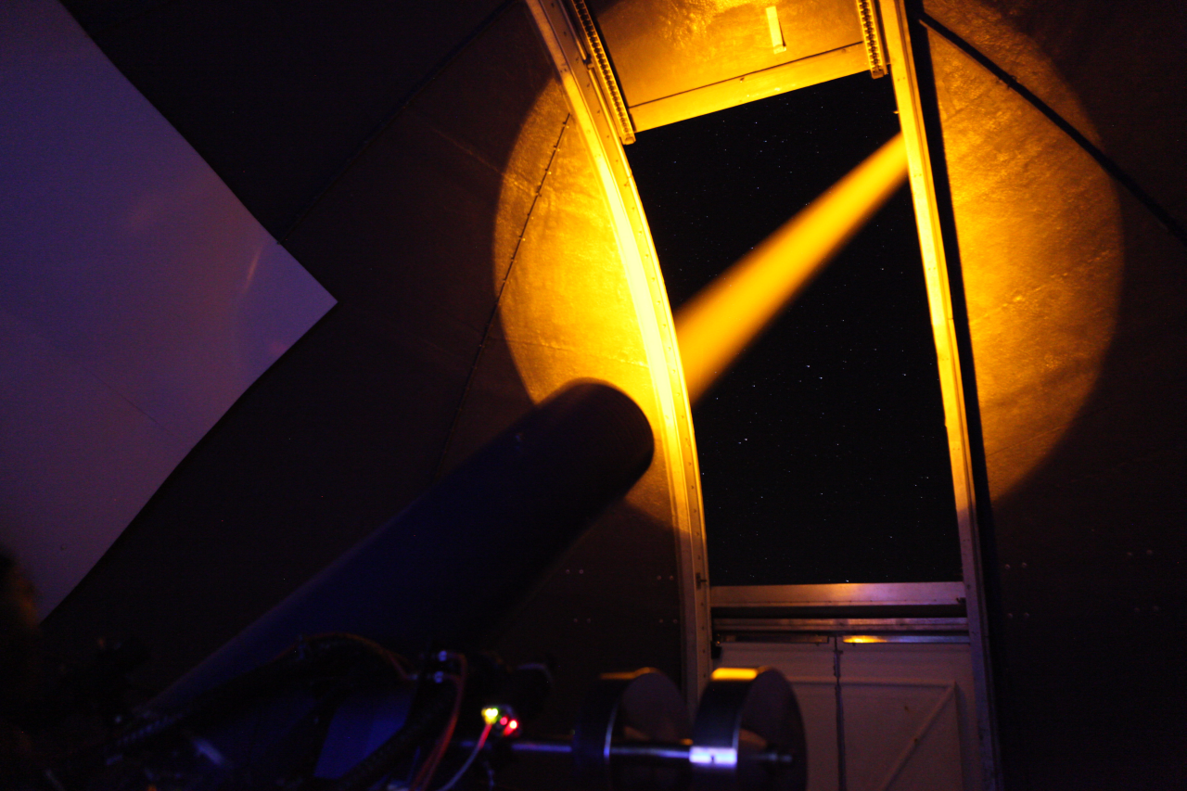
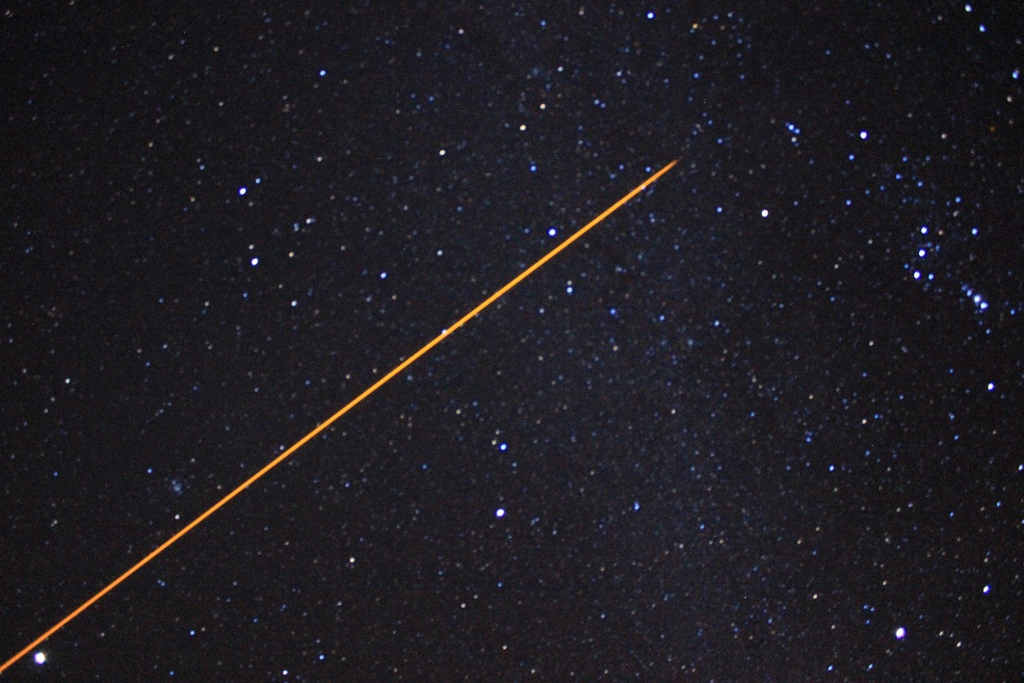
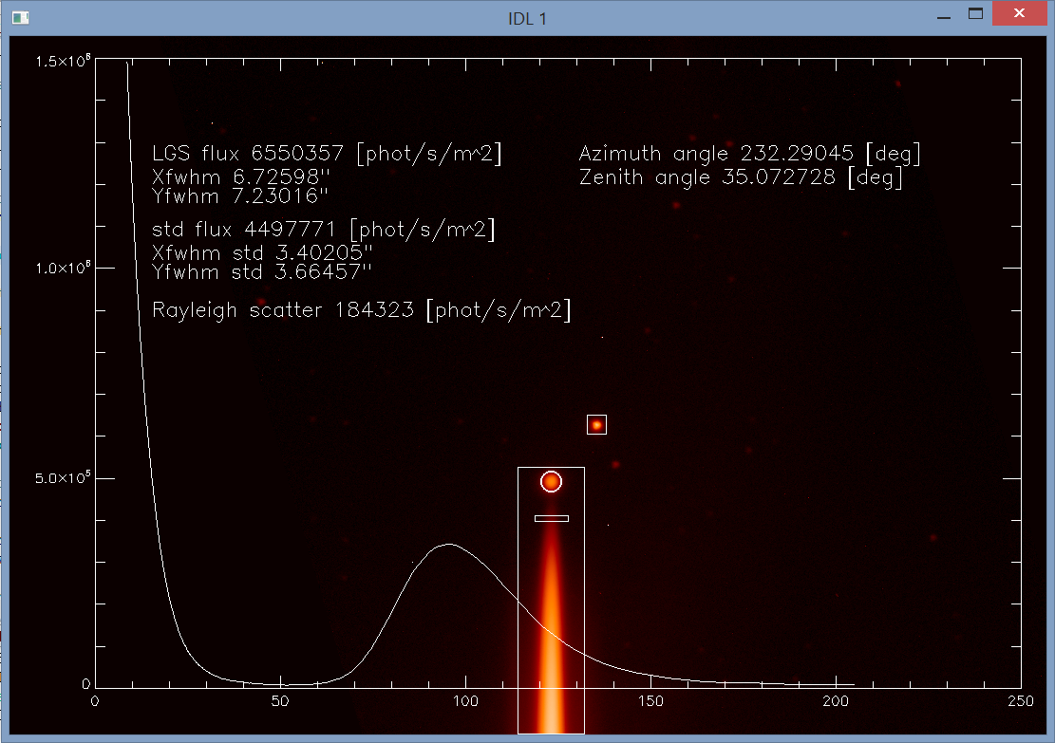
Na Laser testing and performance
Tests of return flux as function of
Bandwidth
Polarisation
Auxiliary line strength
Annual variations
Collaboration with IAC on Obs.Teide

Slide 28
Common Instrument Systems
Realtime computing
WFS cameras (focal plane, detectors, boards)
Science detector controllers
Attention must be paid to obsolescence and maintenance, and customisation.

Slide 29
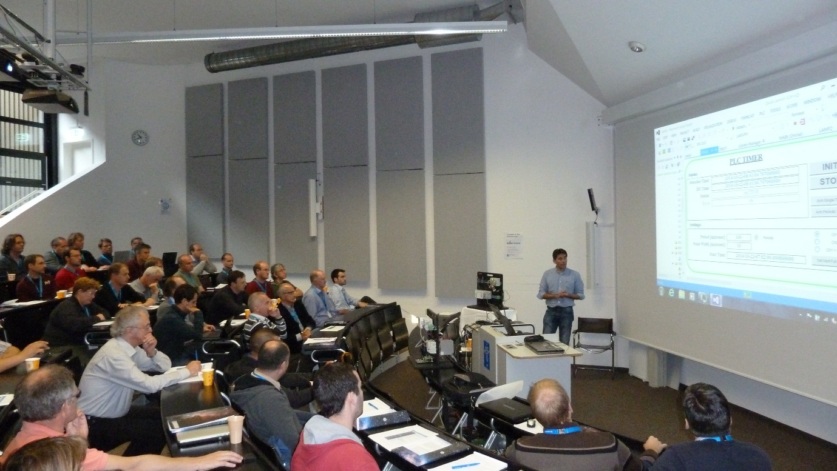
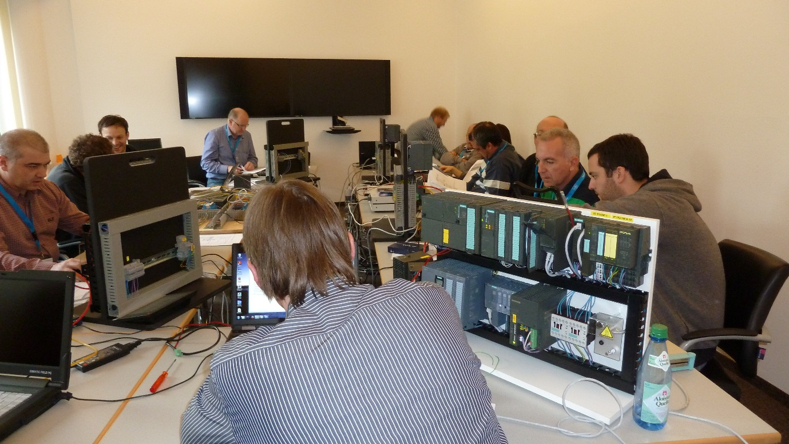
Infrastructure and Standards
PLC projects hosted within TecDev
VLT PLC based instrument control. Workshop.

Slide 30
Procurement Framework
Notes:
30

Slide 31
New Guaranteed Time Policy for ELT
VLT policy was successful but GTO awards large and losing community support in recent years.
GTO-FTE swap wrong incentive
New policy approved for ELT by Council on Dec 2014.
GT allocation fixed at time of call for proposals (65 nights for normal instrument)
GT return for cash contributions to be limited to exceptional circumstances. ELT at 300k/night.
Up to 25% may be taken on another instrument

Slide 32
Handling interface and design uncertainties
Recognising that much design and cost evaluation still needs to be done, that is..
Interfaces still being finalized
Design uncertainty remains
Eg. MAORY design at early stage
LTAO operation with HARMONI
Cost estimation difficult (VLT not good guide)
ESO will conduct a review of cost and scope for all instruments following PDR. Revisions to cost and scope may result (under change control).

Slide 33
“just in time” payments from ESO
ESO cash payments for instruments have increased substantially from 5M (VLT) -> 18M (ELT)
Improvements to smoothing cash flow and governance
Cash payments to consortia for industrial procurements will be made close to calls for tender
ESO will require regular reports on expenditure and will track cumulative expenditure

Slide 34
ESO Project Participation
ESO participates as an associate member of each instrument team.
Key responsibility is for detector and controller procurement and delivery
AO system design and engineering support
Setting of standards for Instrument technology
Eg Instrument Control
Common Instrument Systems

Slide 35
Common Requirements and interfaces
First version of common instrument requirements has been released with input from teams and under final revision.
Interface document in final revision
Provides clear interface description for instruments, role of telescope WF sensing, space envelopes, etc.
Strong involvement of inst. teams
No ideal solution. Compromise required. High-level decision taken. Further iteration planned in a version 2.

Slide 36
summary
First three instrument agreements to be signed soon. Preliminary design starting early 2016.
Call for Proposals for Phase A studies for HIRES and MOS out soon.
Technology development under way to support the instrument programme

Slide 37
End and questions

