Slide 1
Gaia Science Alerts
Giuseppe Altavilla, INAF-Osservatorio Astronomico di Bologna
giuseppe.altavilla@oabo.inaf.it

Slide 2
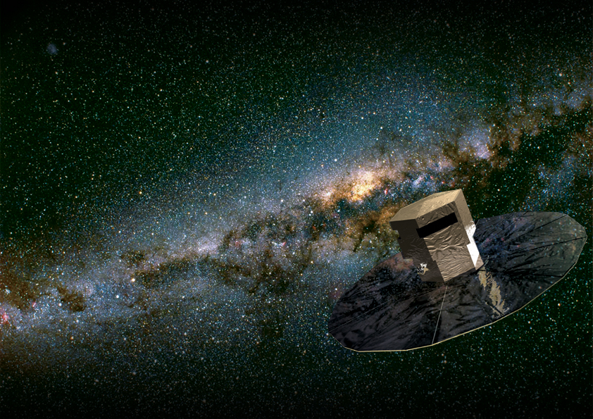
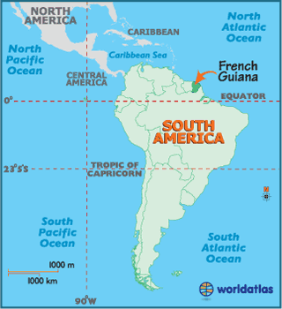
Gaia in a nutshell
ESA Cornerstone mission. Gaia was adopted within the scientific programme “Horizon 2000) of the European Space Agency (ESA) in October 2000
Launch date: 19 December 2013
Lifetime: 5 yr (+ 1yr possible extension + …)
Launcher: Soyuz–Fregat, from Kourou (French Guiana)

Slide 3
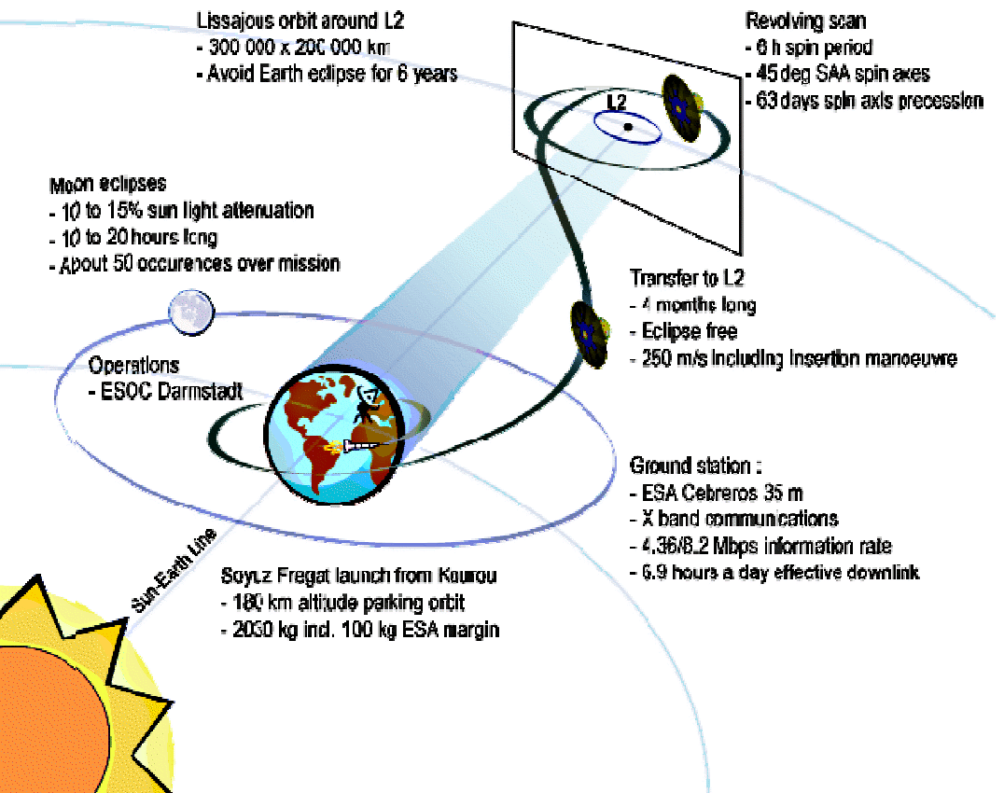
Gaia in a nutshell
L2, 1.5 million km from the Earth (~2 months cruise)
stable thermal environment,
high observing efficiency,
moderate radiation environment (launch worst phase).
Ground Based Optical Tracking (GBOT needed for solar system only (accuracy 20mas, 150m in L2)
Notes:
Questa se non fai vedere il filmato…

Slide 4
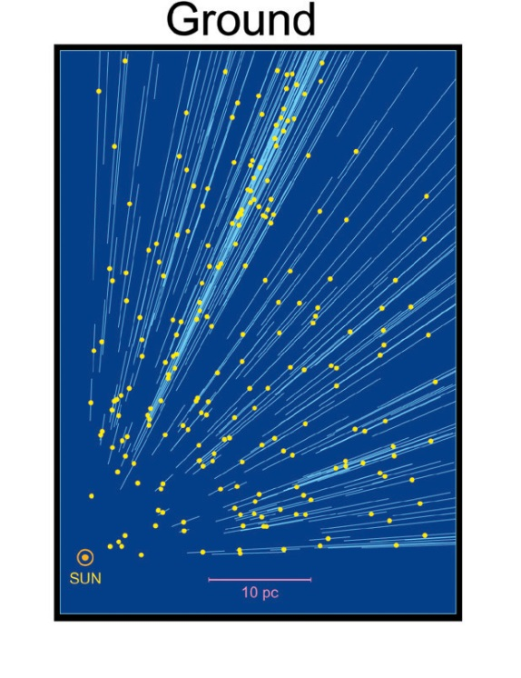
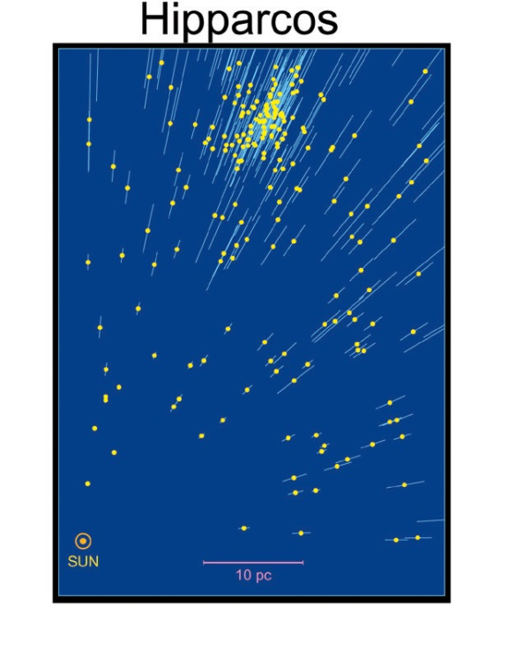
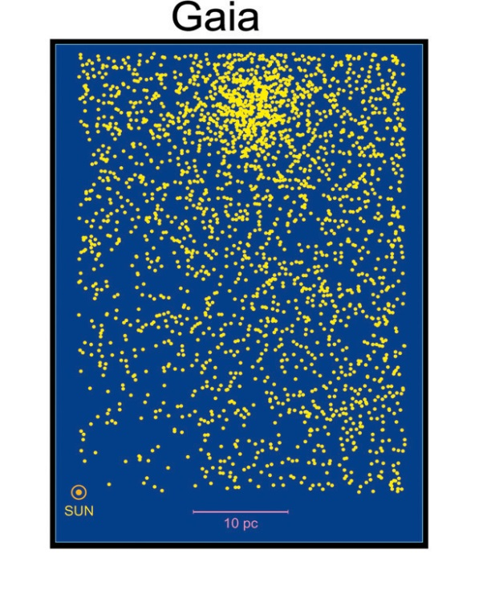
Gaia objectives
The largest and most precise 3D chart of our Galaxy (6D space survey: α, δ, π, μ_{α}, μ_{δ} + complementary radial velocities) + astrophysical parameters
Composition, Formation and Evolution of our Galaxy, unraveling the chemical and dynamical history of our Galaxy... And much more!
Astrometric accuracy:
the Hyades D ̴47 pc

Slide 5
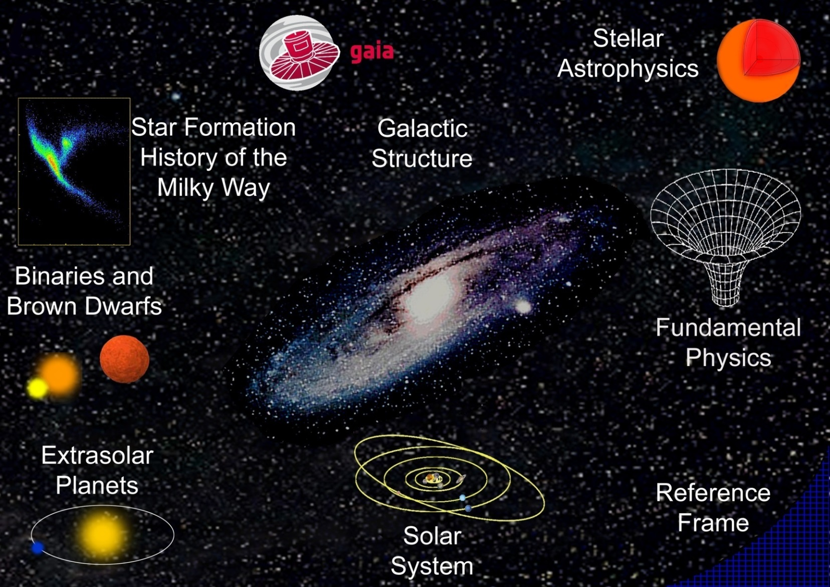
Gaia will provide
The Cosmic
Distance
Scale

Slide 6
Inside Gaia billion-pixel camera

Slide 7
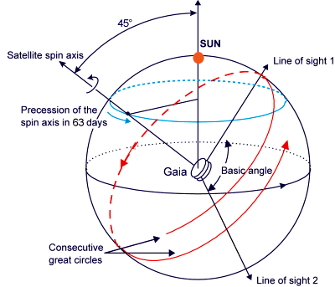
Gaia scanning law
Each object observed 10-250 times (average ≈70-80)
Maximum number of passages around ±45° from EP
© B. Holl
Notes:
http://www.cosmos.esa.int/web/gaia/media-gallery/videos
This movie shows the number of field transits (for both fields of view). The coordinates are in ICRS, longitude increasing to the left.
The ecliptic plane in this system is given by the blue warped line.
The sun is represented by a yellow dot.
The spin axis of Gaia is represented with a black dot
The movie has three intervals, interesting features to note are:
1) From 0 to 2 days:
The two fields of view scan great circles.
Due to slow precession of the spin axis, different great circles are scanned.
The 'holes' between the great circles are real, since the across scan rate is too high there to overlap everywhere with the previous great circle. You will see that these holes are observed at later times.
2) From 2 to 183 days: The 63 day precession period of the spin axis can clearly be seen, and the spin axis is obviously in the middle of the great circles that are being scanned.
The spin axis is always at an angle of 45 degrees with the sun.
It shows that after half a year we have covered the whole sky at least once.
3) From 183 days to 5 years: It shows how the particular NSL (Nominal Scanning Law) scan pattern is being built up.
It shows that the overabundant regions at +/- 45 deg latitude in ecliptic co-ordinates are caused by the 45 deg angle between the spin axis and the sun (remember that the ecliptic plane is indicated by the blue line).
The movie was made by scanning the central positions of each pixel of a healpix map of depth 8 (3.1 million pixels) with the scanner in AGISLab and taking the number of SM-observations (of which there is just 1 per field transit). Then the map was projected into a Hammer-Aitoff plot using the graphics library in GaiaTools. The picture, in particular, shows the number of field transits in ICRS after 5 years.

Slide 8
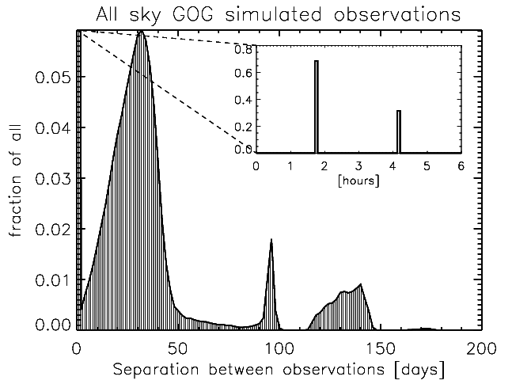
The Gaia Science Alerts programme
The very early data products released to the astronomical community
Gaia will cover 1230 sq. deg. / day with high spatial resolution and well known (but non-optimal) cadence.
106.5m
4h 13.5m
On average each patch of the sky is observed again after ̴30 days
Maximum number of passages around ±45° from EP
Notes:
1230 sq deg per day from https://project.lsst.org/meetings/lsst-europe-2013/sites/default/files/lsstcam13-hodgkin.pdf

Slide 9
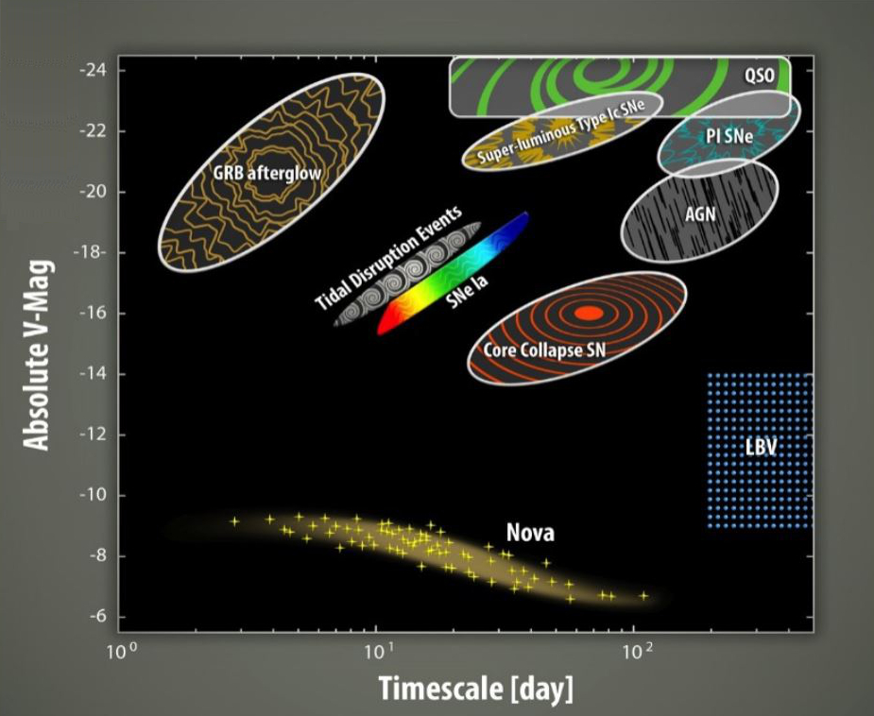
The Gaia Science Alerts programme
Repeated observations of the same patches of the sky allow transients detections (G≤19).
Gaia Photometric science alerts:
appearance of a new source, or a change in flux (possibly including spectral variation -
independent or combined with flux variation - but NO periodic variable stars and moving objects)
?
?
?
?
?
?
?

Slide 10
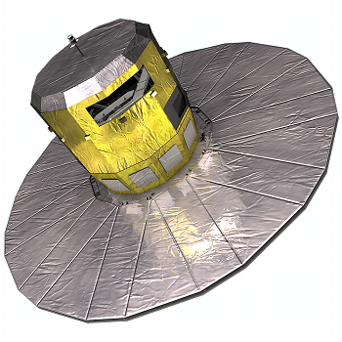
The Gaia Science Alerts programme
CU3
Initial Data Treatment (IDT) - ESAC
Telemetry - ESOC
CU5
Photometric processing Cambridge – IoA
Alertpipe
Alerts candidate detection, calibration, classification, cross match
Gaia Science Alerts
Follow-up:
Gaia Marshall
Calibration Server
Notes:
CU3 core processing
ESOC : European Space Operations Centre (ESA)
ESAC : European Space Astronomy Centre (VilSpa)

Slide 11
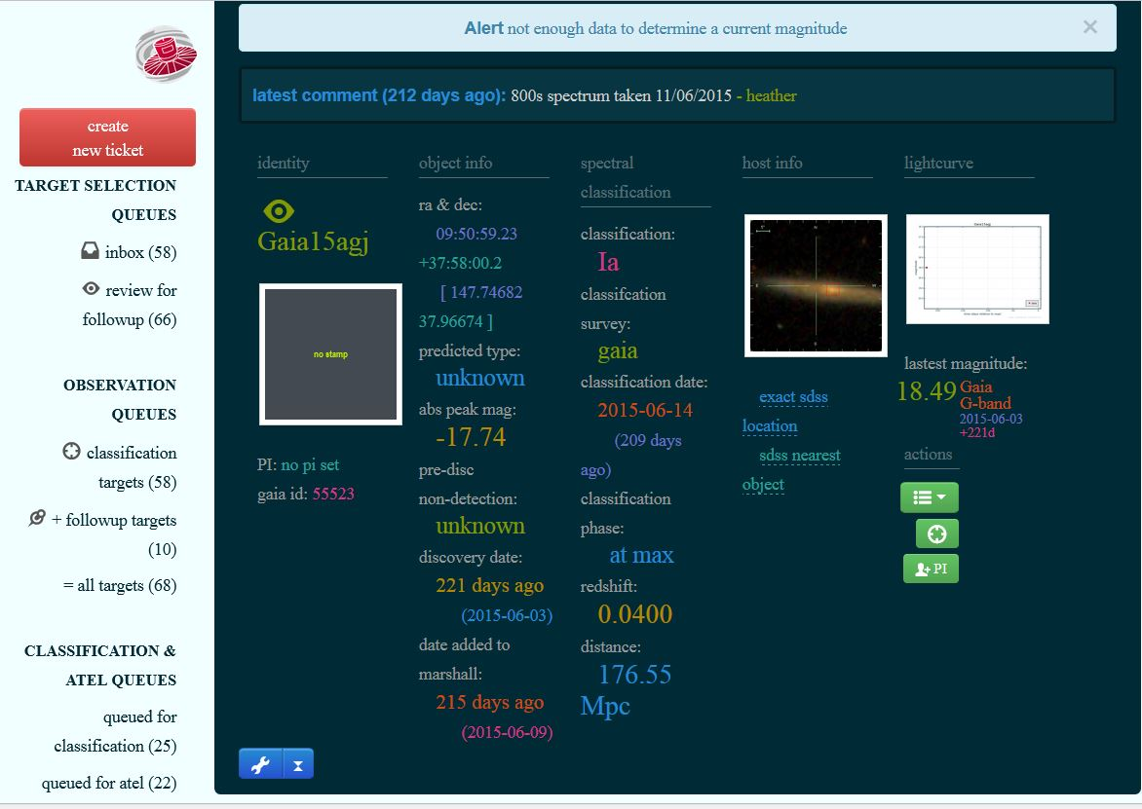
Gaia Marshall
Provides a visual workflow of the status of alerts follow-up
‣Developed at Queen’s University Belfast for Pessto Survey
‣Customised by GSA group to meet our requirements
‣With David Young (Queen’s Univ.) support
https://gaiamarshall.ast.cam.ac.uk/marshall

Slide 12
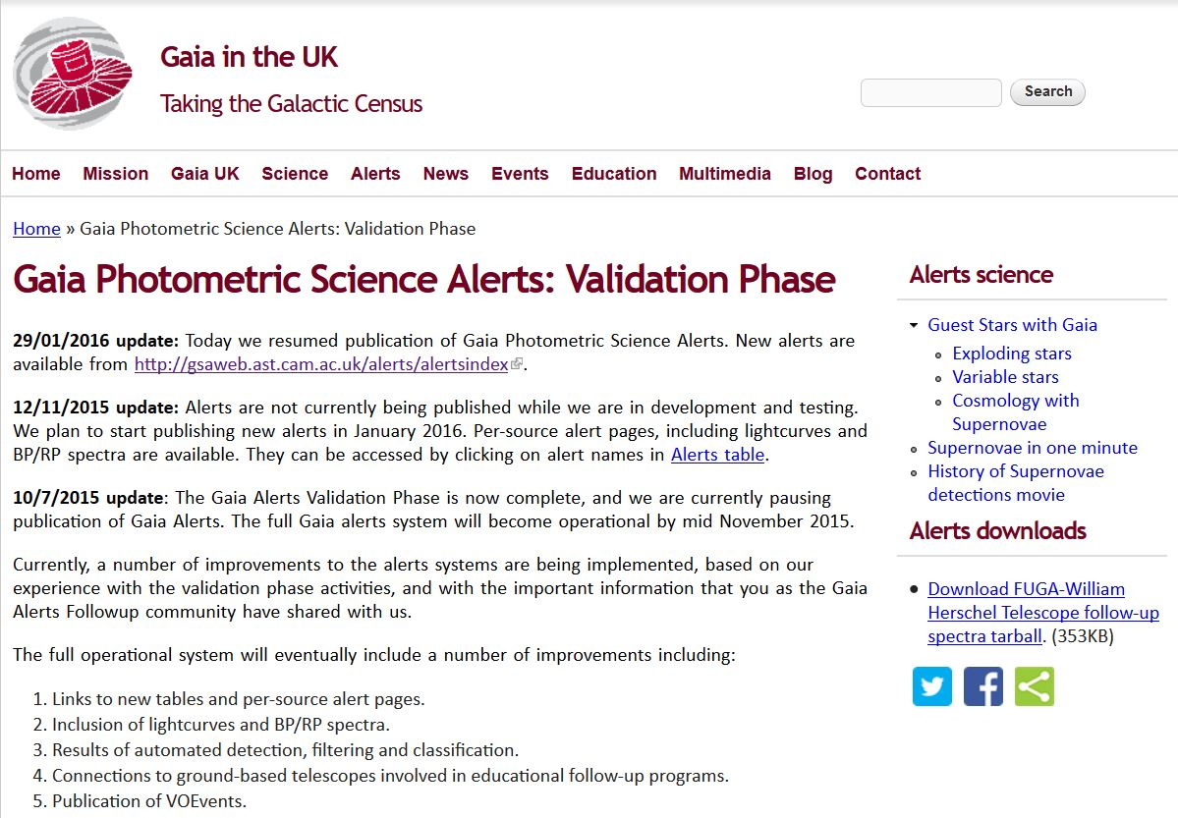
Gaia Photometric Science Alerts
https://gaia.ac.uk/selected-gaia-science-alerts
see also https://www.ast.cam.ac.uk/ioa/wikis/gsawgwiki/

Slide 13
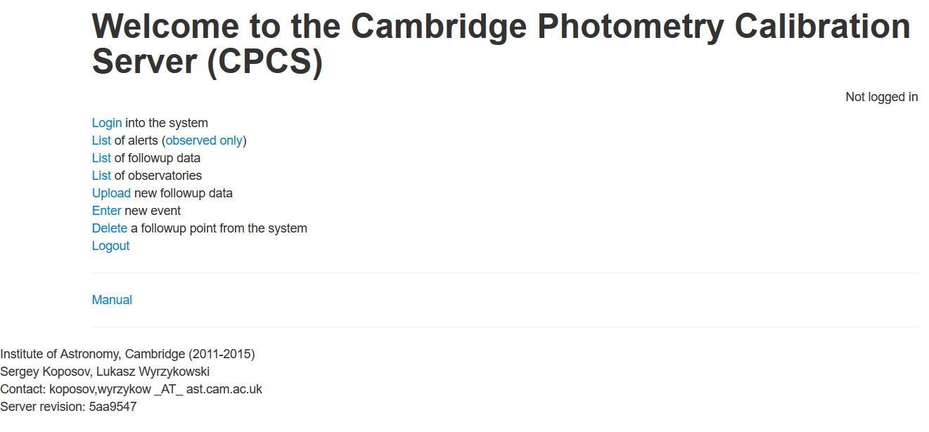
Gaia Calibration Server
The main purpose of the Cambridge Photometry Calibration Server (CPCS) is to provide a uniform calibrations of photometric follow-up observations of transient targets to be reported by Gaia Science Alerts team.
https://www.ast.cam.ac.uk/ioa/wikis/gsawgwiki/index.php/Calibration_Server

Slide 14
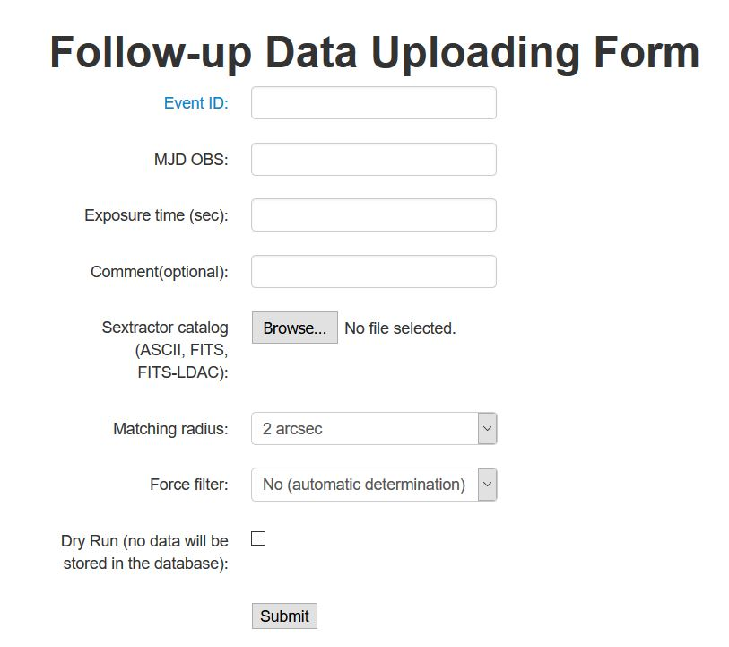
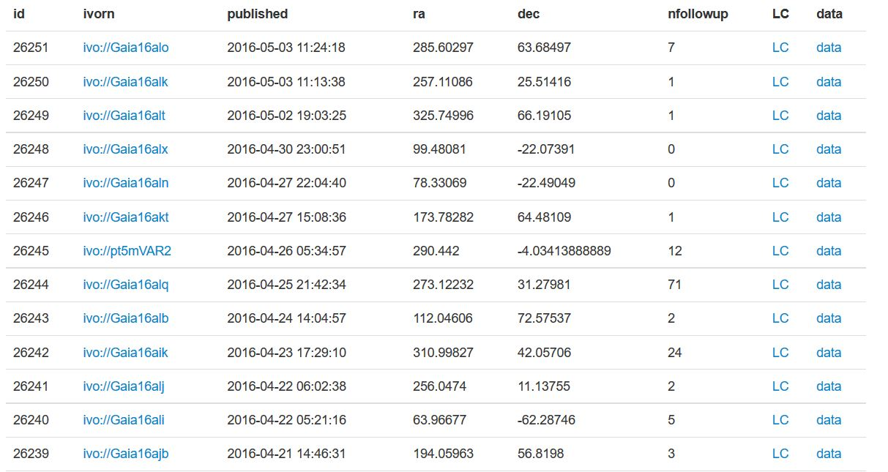
Gaia Calibration Server
ivo://Gaia16alo
57507.8988532
300
Upload the SExtractor output catalogue
See https://www.ast.cam.ac.uk/ioa/wikis/gsawgwiki/index.php/Calibration_Server for details
comment
Only alerts present in the database can be calibrated
If the event is not there it can be added manually
The main purpose of the Cambridge Photometry Calibration Server (CPCS) is to provide a uniform calibrations of photometric follow-up observations of transient targets to be reported by Gaia Science Alerts team.

Slide 15
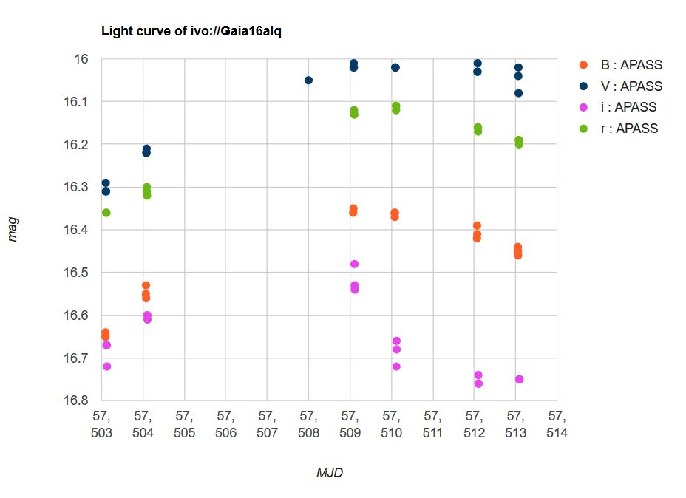
Gaia Calibration Server
The calibration Server tags the data points in the light curve for accreditation. 76 registered users, 43 of whom have contributed almost 18000 data points in total so far for 269 Alerts
Notes:
Dati from Hodgkin CU5M16 https://wiki.cosmos.esa.int/gaia-dpac/images/a/a1/CU5M16_sth.pdf

Slide 16
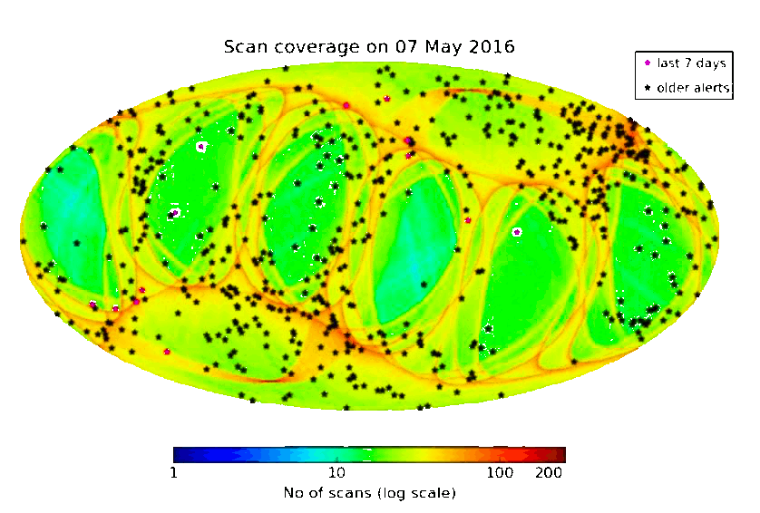
The Gaia Science Alerts Programme
Detections are from mid-January onwards.
http://gsaweb.ast.cam.ac.uk/alerts/home

Slide 17
The Gaia Science Alerts Programme
Detections are from mid-January onwards.
From August 2014 to May 7 2016: 600 published alerts
Notes:
The map shows locations of Gaia Science Alerts (black stars), superimposed on the scan density map of the sky. The background colour indicates how many times each area, of approximately 0.05 square degrees, of the sky was seen by the Gaia Photometric Science Alerts up to date

Slide 18
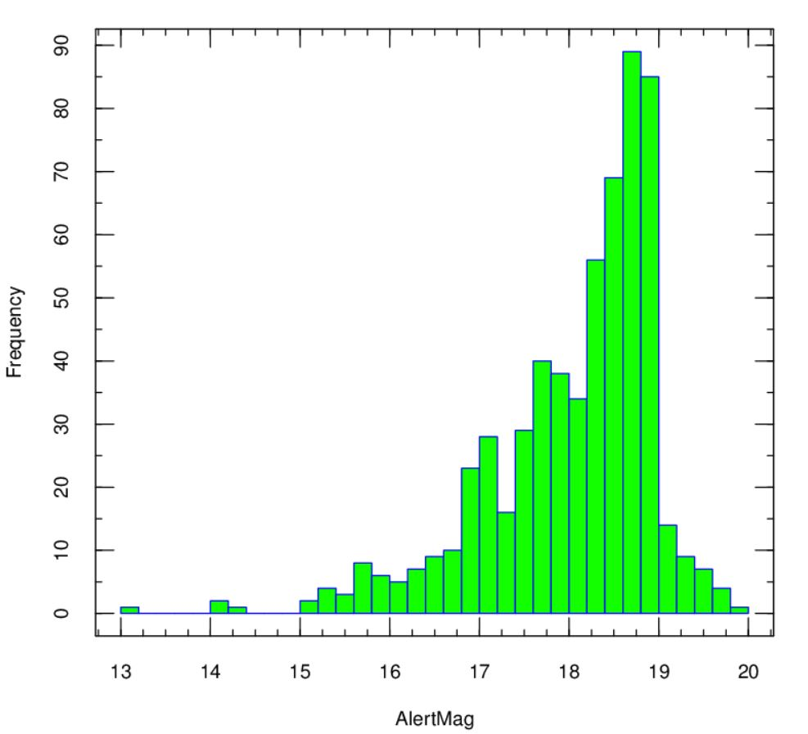
The Gaia Science Alerts Programme
 | 08/2016→ 07/05/2016
unknown | 452
SNIa | 59 +2pec
SN CC | 27 (13II,9IIP,2Ib,2Ic,1Ib/c)
SN | 5
CV | 11
AGN | 6
QSO | 6
YSO | 6
other | 26
alertmagmin | 13.03
alertmagmedian | 18.33
alertmagmean | 18.05
alertmagmax | 19.98
published | 600
unknown type SNe not included

Slide 19
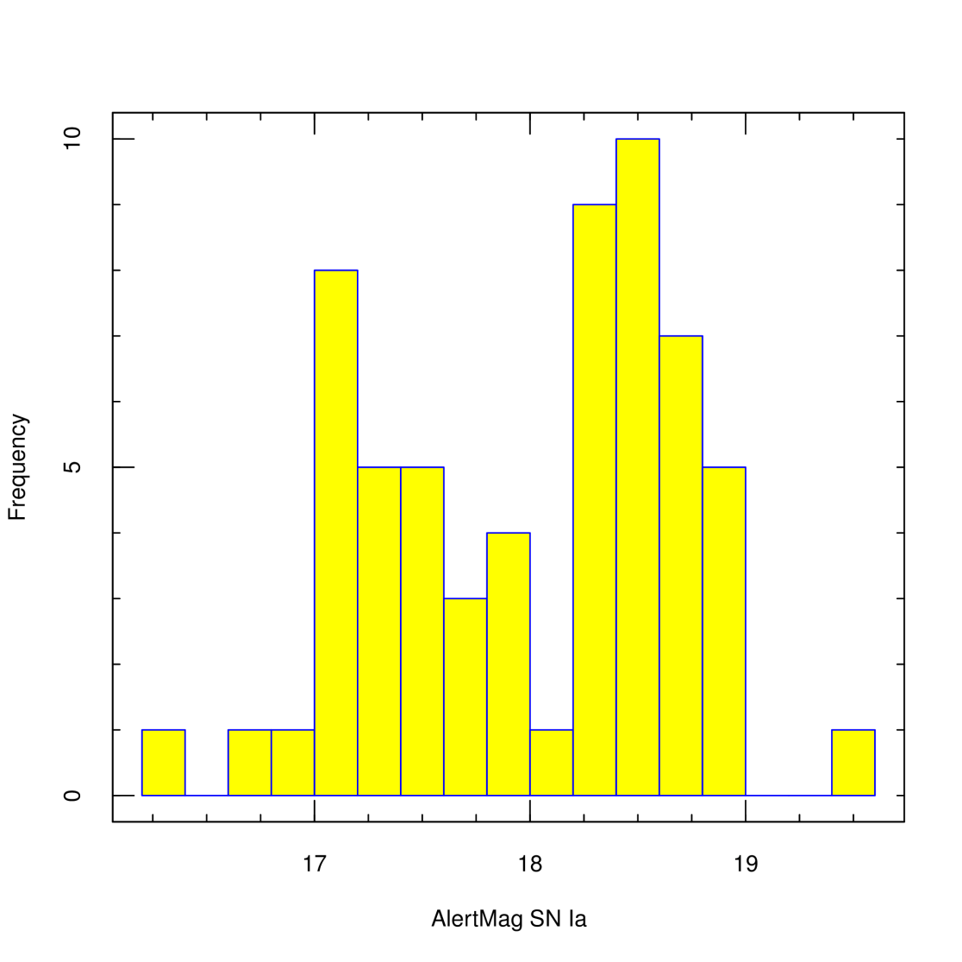
The Gaia Science Alerts Programme
 | 08/2016→ 07/05/2016
unknown | 452
SNIa | 59 +2pec
SN CC | 27 (13II,9IIP,2Ib,1Ic,1Ib/c)
SN | 5
CV | 11
AGN | 6
QSO | 6
YSO | 6
other | 26
alertmagmin | 13.03
alertmagmedian | 18.33
alertmagmean | 18.05
alertmagmax | 19.98
published | 600

Slide 20
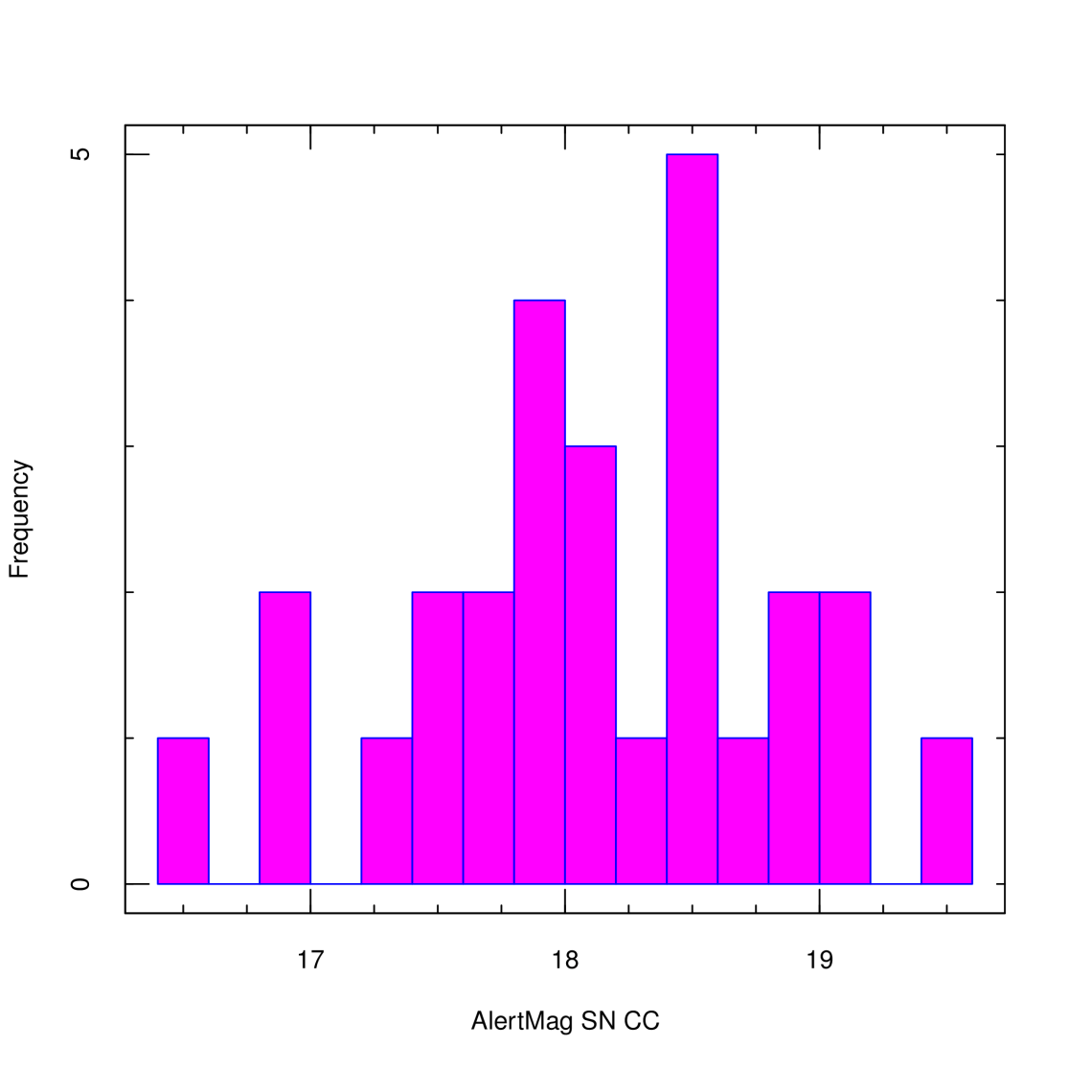
The Gaia Science Alerts Programme
 | 08/2016→ 07/05/2016
unknown | 452
SNIa | 59 +2pec
SN CC | 27 (13II,9IIP,2Ib,1Ic,1Ib/c)
SN | 5
CV | 11
AGN | 6
QSO | 6
YSO | 6
other | 26
alertmagmin | 13.03
alertmagmedian | 18.33
alertmagmean | 18.05
alertmagmax | 19.98
published | 600

Slide 21
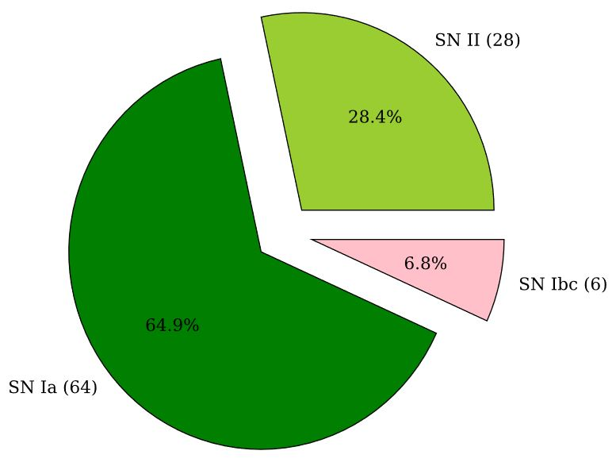
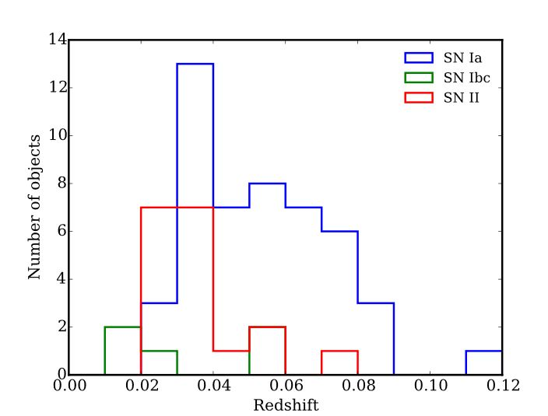
The Gaia Science Alerts Programme
Credits: N. Blagorodnova
Efficient spectroscopy requires ≥2m Telescopes
Smaller telescopes can contribute to photometry
Up to the beginning of 2016:
275 published alerts, 55 in common with other surveys, 217 NEW
41% spectroscopically observed (NTT, LT, INT, WHT, AAT,…)
53% followed up photometrically ( for a total of $\sim$15000 data points)
98 SNe (the first: Gaia14aaa Ia, z:0.036)
Notes:
NTT 3.58m LT 2m INT 2.54 WHT 4.2 AAT 3.9

Slide 22
The Gaia Science Alerts Programme
2015 (http://www.rochesterastronomy.org/sn2015/snstats.html) - Gaia and other SN surveys :
1986 objects were discovered by PS1 (prof)
266 objects were discovered by CRTS (prof)
240 objects were discovered by OGLE-IV wide field survey (prof)
180 objects were discovered by All Sky Automated Survey for SuperNovae (ASAS-SN) (prof)
127 objects were discovered by PTF (prof)
112 objects were discovered by Gaia Photometric Science Alerts programme (prof)
94 objects were discovered by Dark Energy Survey (prof)
87 objects were discovered by High Cadence Transient Survey (HiTS) (prof)
61 objects were discovered by MASTER (prof)
60 objects were discovered by Subaru/Hyper Suprime-Cam (prof)
49 objects were discovered by La Silla-QUEST (prof)
26 objects were discovered by Kamil Hornoch et al.
22 objects were discovered by THU-NAOC Transient Survey (TNTS) (prof)
20 objects were discovered by Italian Supernovae Search Project
19 objects were discovered by SPitzer InfraRed Intensive Transients Survey (prof)
17 objects were discovered by Tim Puckett, Jack Newton, et al.
13 objects were discovered by LOSS (prof)
Including unknown type SNe

Slide 23
The Gaia Science Alerts Programme
2016 (up to Apr. 9 http://www.rochesterastronomy.org/sn2016/snstats.html)
Gaia and other SN surveys :
2030 objects were discovered by PS1 (prof)
182 objects were discovered by Gaia Photometric Science Alerts programme (prof)
130 objects were discovered by CRTS (prof)
53 objects were discovered by All Sky Automated Survey for SuperNovae (ASAS-SN) (prof)
44 objects were discovered by OGLE-IV wide field survey (prof)
34 objects were discovered by La Silla-QUEST (prof)
29 objects were discovered by PTF (prof)
23 objects were discovered by ATLAS (prof)
15 objects were discovered by MASTER (prof)
14 objects were discovered by PMO-Tsinghua Supernova Survey (PTSS) (prof)
Including unknown type SNe

Slide 24
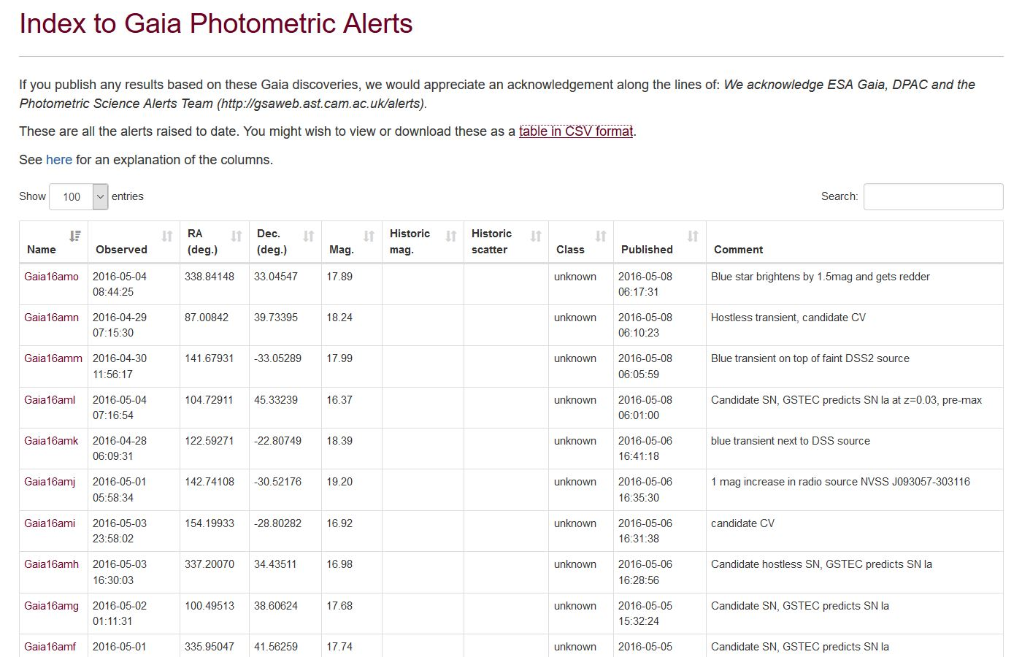
The Gaia Science Alerts Programme
http://gsaweb.ast.cam.ac.uk/alerts/alertsindex

Slide 25
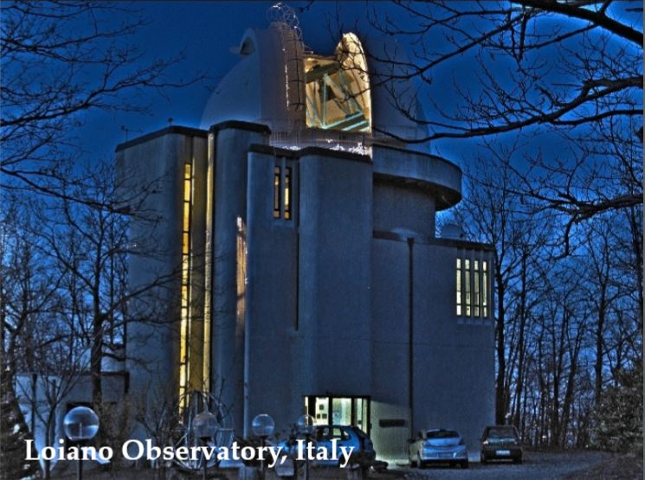
The Gaia Science Alerts Programme
We contribute to this effort with the Cassini 1.5m Telescope at Loiano.
Bologna-Warsaw joint proposals

Slide 26
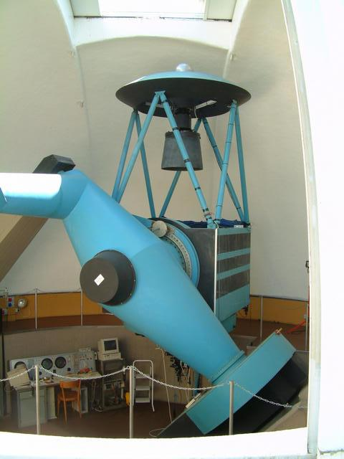
The Gaia Science Alerts Programme
BFOSC@1.52m Cassini Telescope
Field of View: 13'x12.6'
Pixel scale: 0.58 arsec/pixel
Lat. 44 15 33 N, Long. 11 20 02E,
785m asl
UBVRI,Gunn
V~22 in 30min, V~6-7 in ̴1sec;
(in spectroscopy V~18 in 30min, V~5-6 in 10sec)
See here the comparison with other telescopes
1.5m, imaging ok,
“wide” field useful for relative photometry

Slide 27
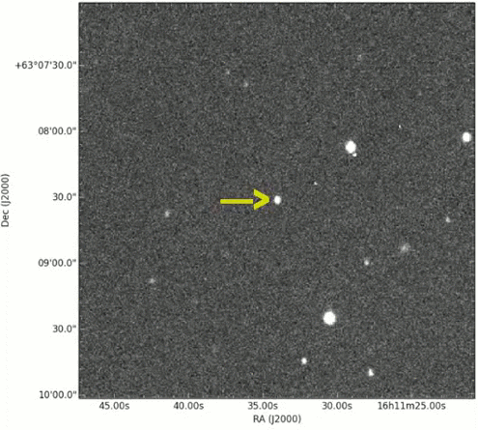
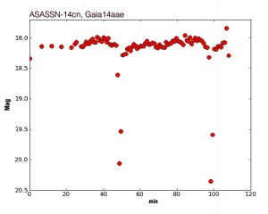
The Gaia Science Alerts Programme
“Total eclipse of the heart: The AM CVn Gaia14aae / ASSASN-14cn”, Campbell et al. 2015
INAF-OABO researchers (G. Altavilla, G. Clementini, R. Gualandi) as well as INAF researchers at OAPD and OACT coauthor this paper which is based on images taken also at the Cassini Telescope of the Bologna Observatory
The observations span 88 min. The movie has been sped up by a factor 250, so that the whole clip lasts only 21 seconds. The data were taken at Loiano Observatory on 2014/10/24
Notes:
Gaia14aae was identified independently by the All-Sky Automated Survey for Supernovae (ASAS-SN; Shappee et al.) and by the Gaia Science Alerts project, during two separate outbursts.

Slide 28
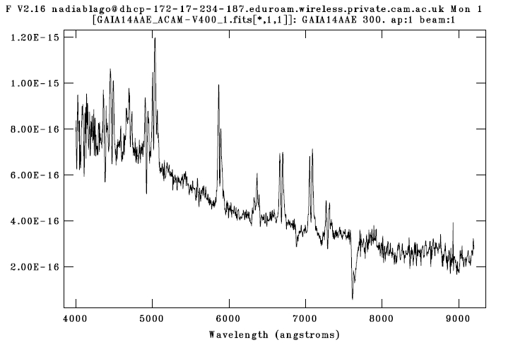
The Gaia Science Alerts Programme
“Total eclipse of the heart: The AM CVn Gaia14aae / ASSASN-14cn”, Campbell et al. 2015
Bursts up to mag 14,
but spectrum obtained while quiescent again (i = 18.7) with the 4.2m William Herschel Telescope on La Palma

Slide 29
Requirements for spectrophotometric
follow-up of Gaia Alerts
Photometry:
availability of flux measurements within ̴ 1 day for prompt classification & adaptive scheduling
multi-band photometry, at least two bands (e.g. V,I), Sloan ugriz preferred - flux calibration no worse than 10% (0.1 mag)
WCS and fluxes (from, e.g., SExtractor) submitted to the Calibration Server
Spectroscopy:
low-intermediate-resolution spectroscopy R > 150
spectral range: minimal 4500-7000Å with S/N > 20, wavecalib better than ±3Å
relative flux calibration better 10%, absolute flux calibration not crucial
reduced spectra within ̴ 1day

Slide 30
Gaia Alerts Conclusions
Small telescopes (also < 1m) suitable for photometric monitoring & follow-up and (not so small – e.g. Cassini 1.5m) spectroscopy of the brightest alerts
Larger telescopes (≥2m – e.g. Copernico 1.8m) needed for spectroscopic confirmation & follow-up
Small telescopes: more numerous, usually more flexible & adaptive scheduling with respect to bigger telescopes.
Robotic telescopes are preferred.

Slide 31
Thanks for your attention

Slide 32
