Slide 1
The Spectrophotometric Standard Stars Grid for the Gaia absolute calibration
Giuseppe Altavilla
&
G. Cocozza, S. Galleti, S. Ragaini
E. Pancino, M. Bellazzini, A. Bragaglia, C. Cacciari, L. Federici,
P. Montegriffo, S. Marinoni, G. Tessicini, G. Valentini

Slide 2
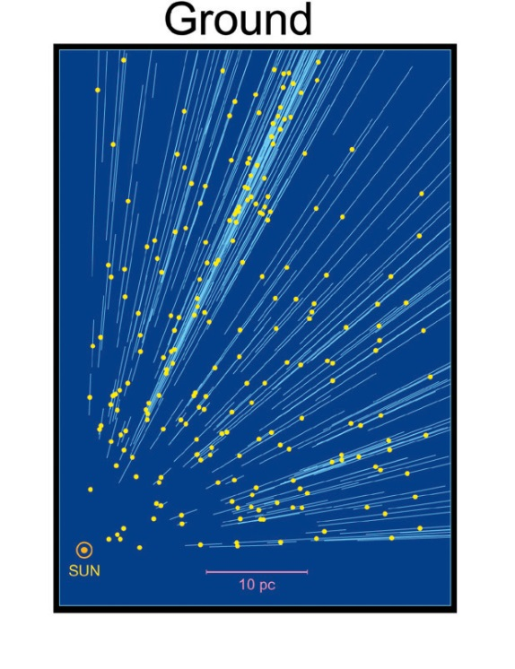
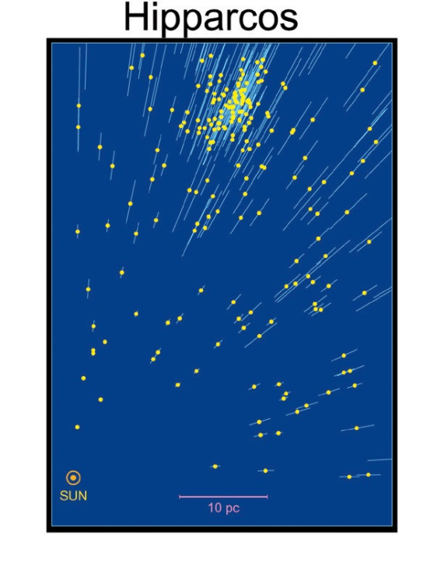
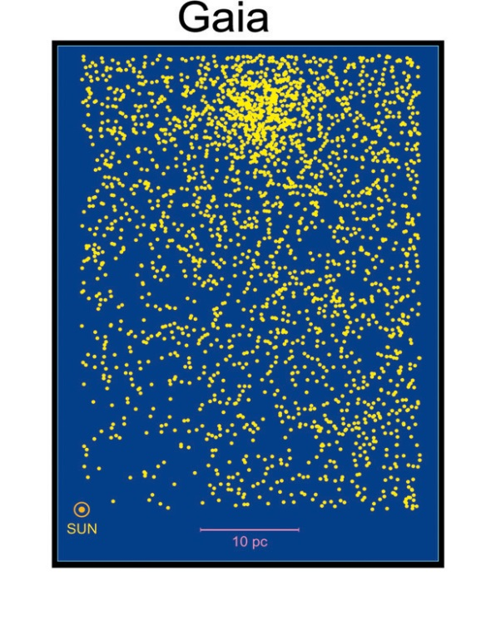
Gaia objectives
The largest and most precise 3D chart of our Galaxy (6D space survey: α, δ, π, μα, μδ + complementary radial velocities) + astrophysical parameters
Composition, Formation and Evolution of our Galaxy, unraveling the chemical and dynamical history of our Galaxy... And much more!
Astrometric accuracy:
the Hyades D ̴47 pc
1960
1993
2022
Notes:
10² piu’ precisa, 10³ piu’ profonda, 10⁴ più oggetti di Hipparcos
Astrometry and SpectroPhotometry (R ̴100) for at least one billion stars (1% of the stars in the Milky Way)
Spectroscopy (R=11500) for about 150 million stars

Slide 3
Gaia will provide…
in our Galaxy …
the distance and velocity distributions of all stellar populations
a rigorous framework for stellar structure and evolution theories
a large-scale survey of extra-solar planets a large-scale survey of Solar System bodies … and beyond
definitive distance standards out to the LMC/SMC
rapid reaction alerts for supernovae and burst sources QSO detection, redshifts, microlensing structure fundamental quantities to unprecedented accuracy: γ to 10-7 (10-5 present)

Slide 4
Gaia DPAC
DPAC: Data Processing and Analysis Consortium
CU1: System Architecture
CU2: Data Simulations
CU3: Core Processing
CU4: Object Processing
CU5: Photometric Processing
CU6: Spectroscopic Processing
CU7: Variability Processing
CU8: Astrophysical Parameters
CU9: Catalogue Access
Notes:
The DPAC consists of about 450 persons, spread over academic institutes and space agencies throughout Europe and beyond
Scientific community:
organised in Data Processing and Analysis Consortium (DPAC)
450+ scientists in 20+ countries active at some level

Slide 5
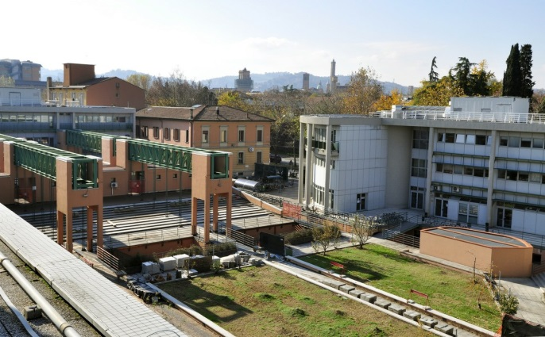
Gaia DPAC
DPAC: Data Processing and Analysis Consortium
CU1: System Architecture
CU2: Data Simulations
CU3: Core Processing
CU4: Object Processing
CU5: Photometric Processing
CU6: Spectroscopic Processing
CU7: Variability Processing
CU8: Astrophysical Parameters
CU9: Catalogue Access
Notes:
The DPAC consists of about 450 persons, spread over academic institutes and space agencies throughout Europe and beyond
Scientific community:
organised in Data Processing and Analysis Consortium (DPAC)
450+ scientists in 20+ countries active at some level

Slide 6
Gaia@Bologna
CU5 - photometric processing
DU13: Instrument absolute response characterization: ground-based preparation (E. Pancino, G. Altavilla deputy)
DU14: Instrument absolute response characterisation: definition and application (C. Cacciari)
G. Cocozza, S. Galleti, S. Ragaini,
M. Bellazzini, A. Bragaglia, L. Federici, P. Montegriffo, E. Rossetti
DU17: Flux and classification-based science alerts
CU7 - variability processing (G. Clementini)
Notes:
Two Development units (DU) within CU5 (Photometric processing), are dedicated to the
external calibration of Gaia photometry. They are DU13: “Instrument absolute response
characterisation: ground-based preparation” coordinated by E. Pancino and DU14” “In-
strument absolute response characterisation: definition and application” coordinated by
C. Cacciari (provide an absolute calibration model).
They are both based in Bologna, Italy, in collaboration with the Bologna,
Barcelona, and Groningen Universities.

Slide 7
The Bologna CU5DU13 goal
Provide a grid of ̴200 Spectro-Photometric Standard Stars (SPSS) for the absolute spectro-photometric calibration of the Gaia G-band and low resolution (BP/RP) spectrophotometry
Existing grids are not sufficient, we need:
Spectral type coverage (all spectral types)
Well distributed in the sky
Precision and accuracy of 1-3%
Good statistics (100-200)
Full coverage of Gaia range (330-1100 nm)
See Pancino et al., 2012, MNRAS, 426, 1767, Altavilla et al. 2015, AN, 336, 515

Slide 8
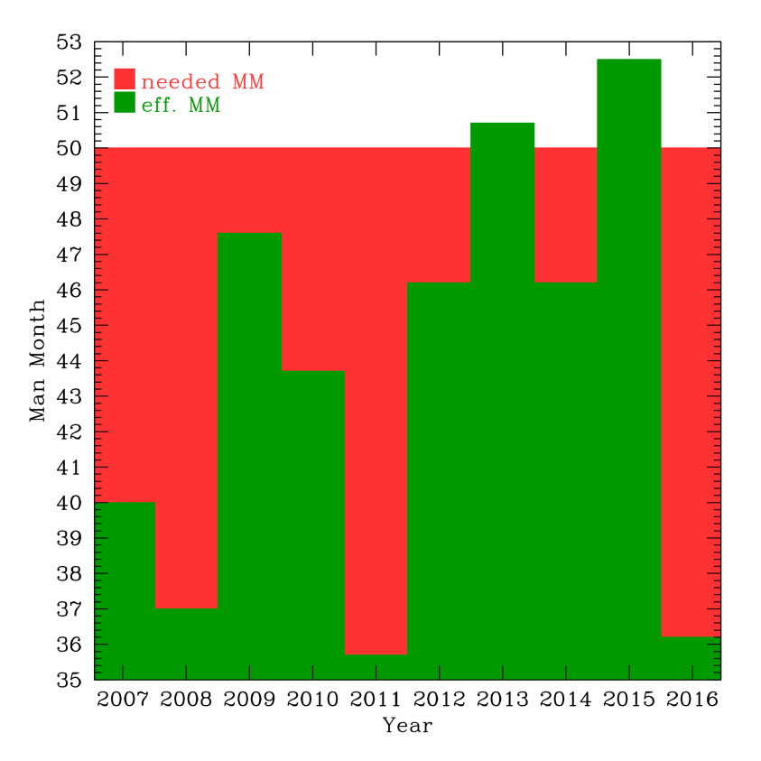
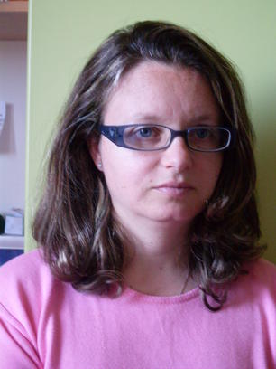
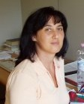
The Bologna CU5 ASI funded Team
All 3 AR contracts renewed for 2016
TD renewed (-> July 2016)
̴3 FTE in contracts + 0.6 FTE OABo staff + outside personnel

Slide 9
Gaia focal plane
0.93m
~4.4 sec
Blue/Red Photometer
Astrometric field
Radial Velocity
Spectrometer
Skymapper
0.42m
Credits ESA
FoV: 0.7 deg x 0.7 deg, pixel (10 µm x 30 µm): 0.059”(AL) x 0.177”(AC)
106 CCD 4500x1966 px (TDI)
Notes:
106 CCD 102 scientifici

Slide 10
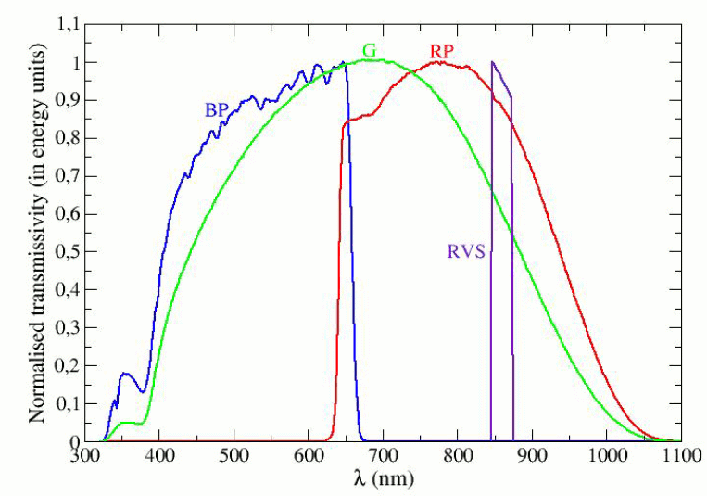
Gaia passbands
BP 3300-6800Å, R=80-20
G 3300-10500Å
RP 6400-10500Å, R=90-70
RVS 8470-8740Å, R=11500

Slide 11
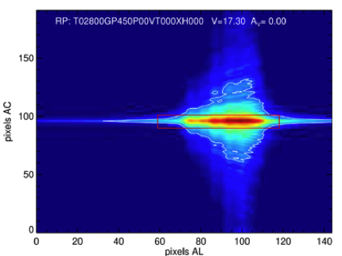
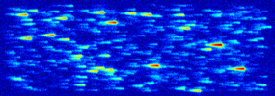
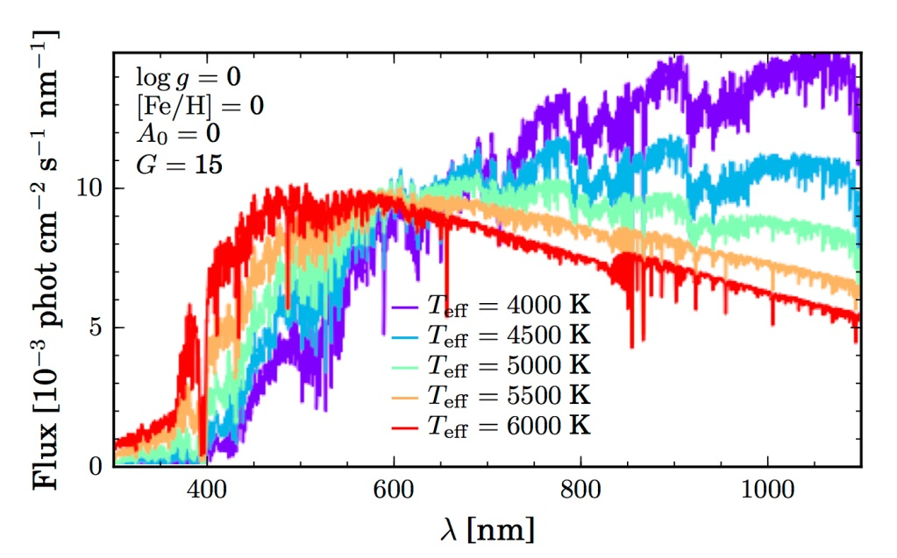
Gaia absolute calibration
Detection
Extraction
Internal Calibration
External Calibration
Extraction
Astraatmadja, 2015, GAIA-C8-TN-MPIA-TLA-001

Slide 12
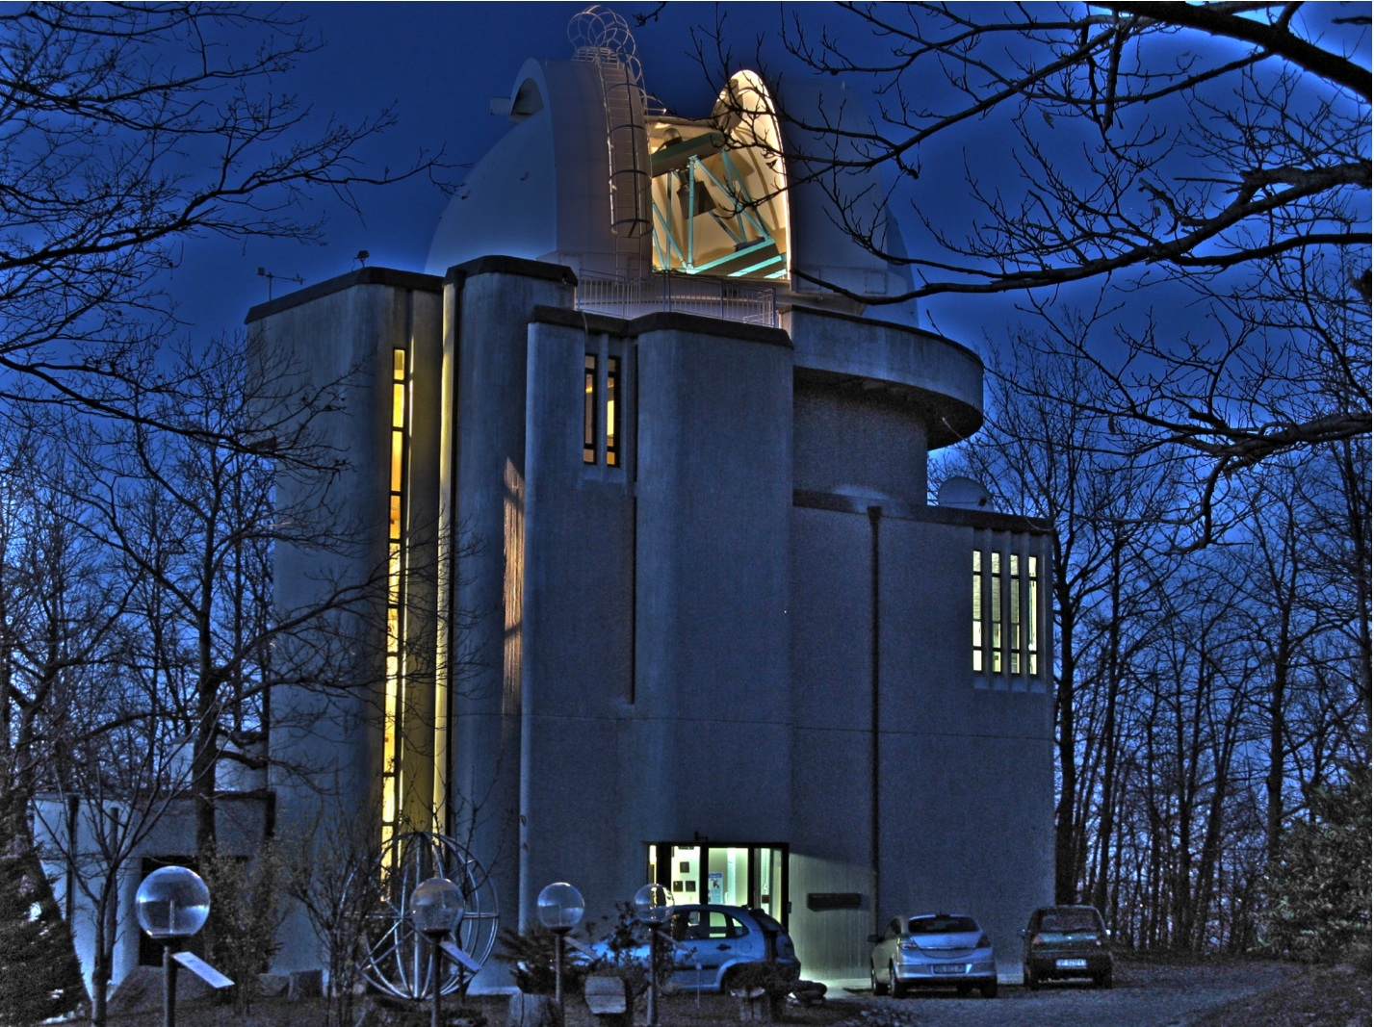
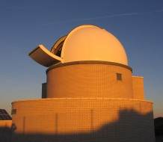
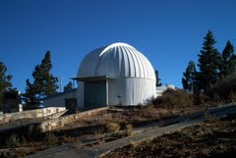
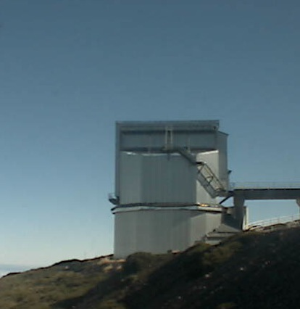
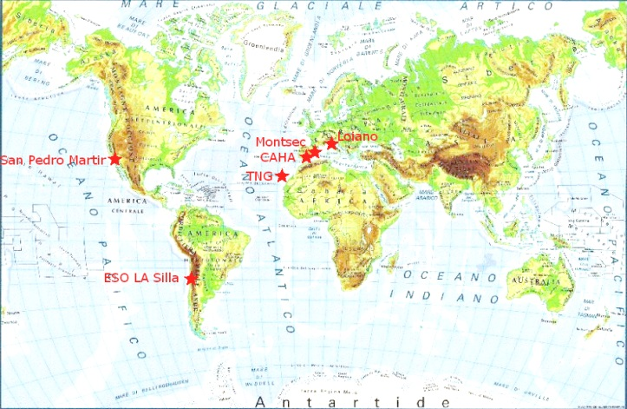
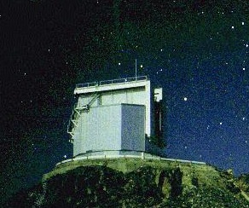
Gaia SPSS
CAHA 2.2m
TJO 0.8m
Cassini 1.5m
A large observational effort to collect the required data started in 2006, completed in 2015.
Almost 5000 hours (the equivalent of 500 nights)
>900 different nights, 66 observing runs from 2006 to 2015
6(+1) telescopes and instruments
Comparable to one of the large modern surveys (GES)
San Pedro
Mártir
1.5m
NTT 3.58m
TNG 3.58m
REM 0.6m

Slide 13
Gaia SPSS
CAHA 2.2m
TJO 0.8m
Cassini 1.5m
̴200 calibrators (SPSS), ̴1% internal and a few % external accuracy, to model the instruments response
San Pedro
Mártir
1.5m
NTT 3.58m
TNG 3.58m
REM 0.6m

Slide 14
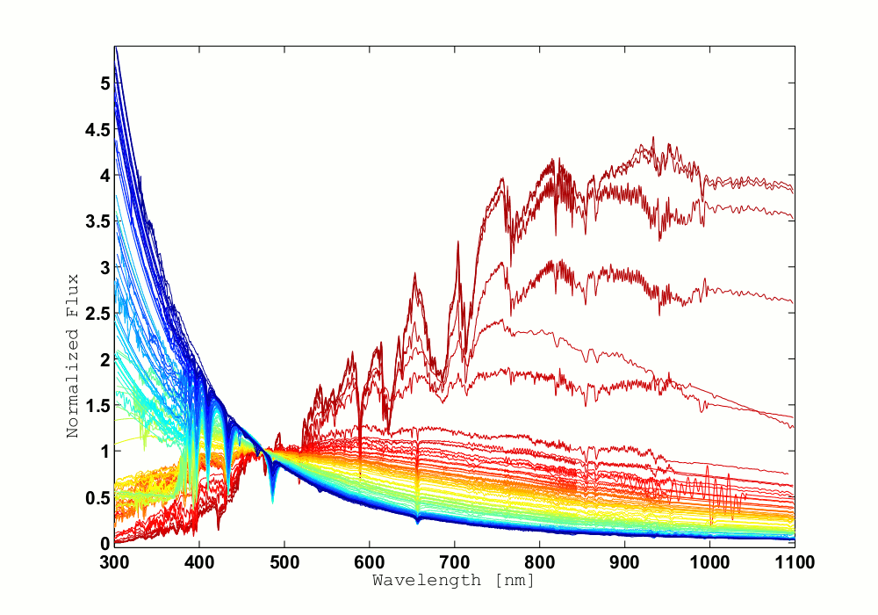
SPSS V1 release
July 2015
94 SPSS
Extended with theoretical or empirical template spectra (CALSPEC,
Gaia spectral libraries,
Public libraries)
Can calibrate 1st Gaia release (end summer 2016), G band only
Already exceeding DPAC requirements
Notes:
Vo release October 2013 for pipeline testing

Slide 15
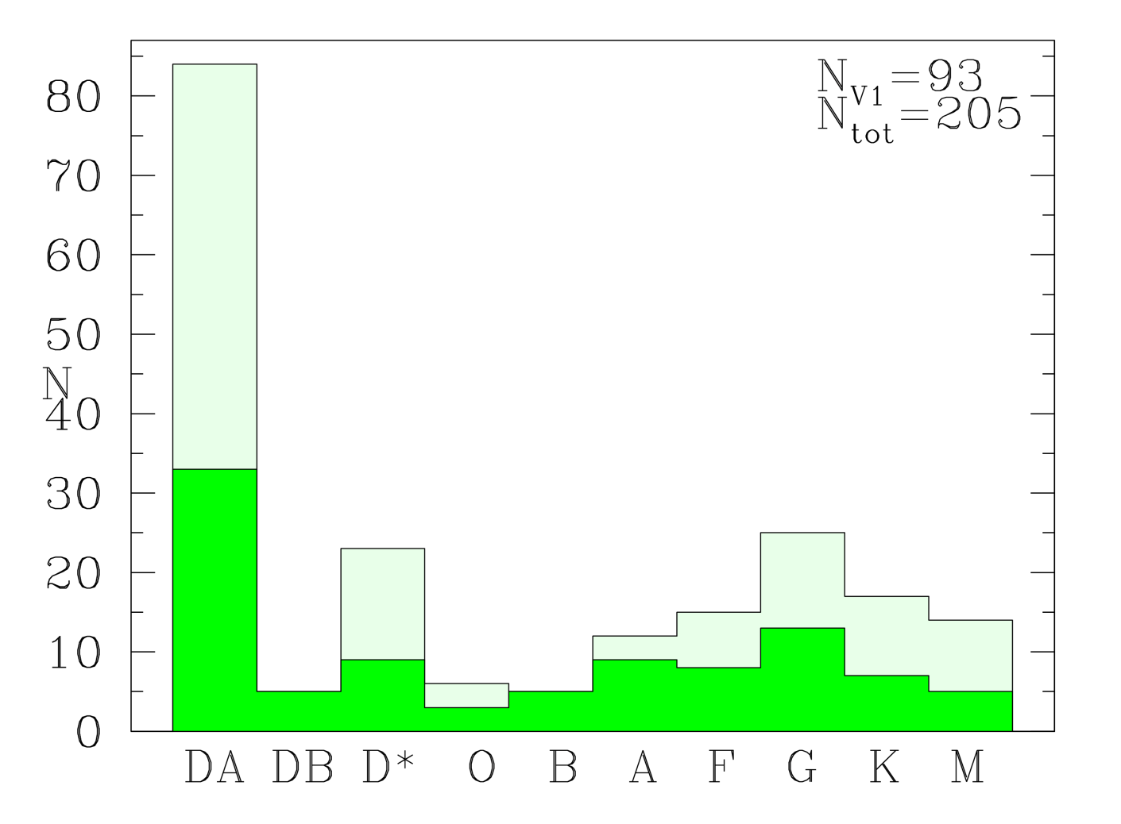
SPSS V1 release
July 2015
94 SPSS
Extended with theoretical or empirical template spectra (CALSPEC,
Gaia spectral libraries,
Public libraries)
Can calibrate 1st Gaia release (end summer 2016), G band only
Already exceeding DPAC requirements

Slide 16
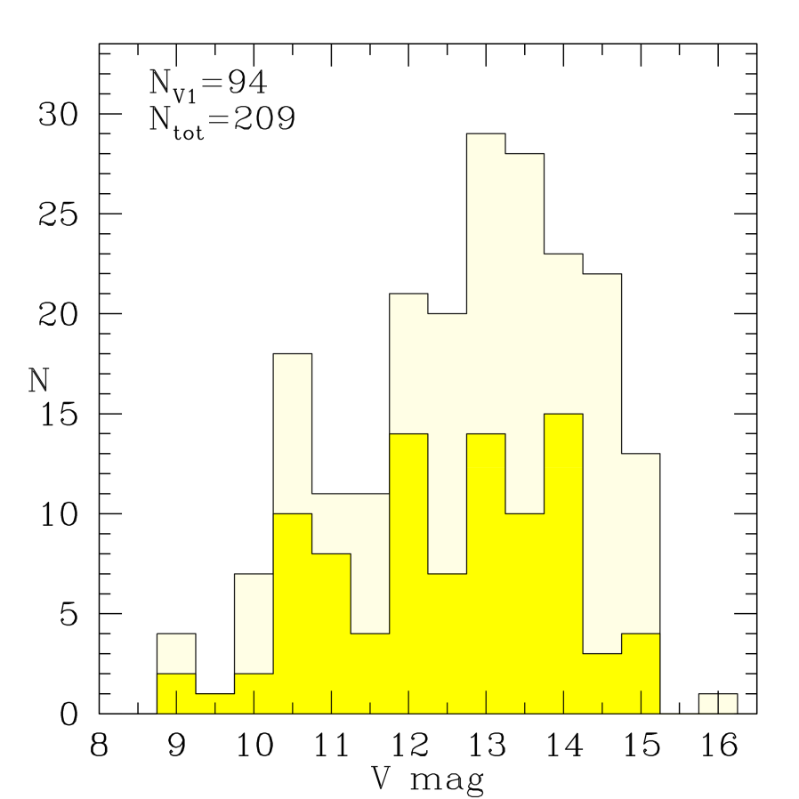
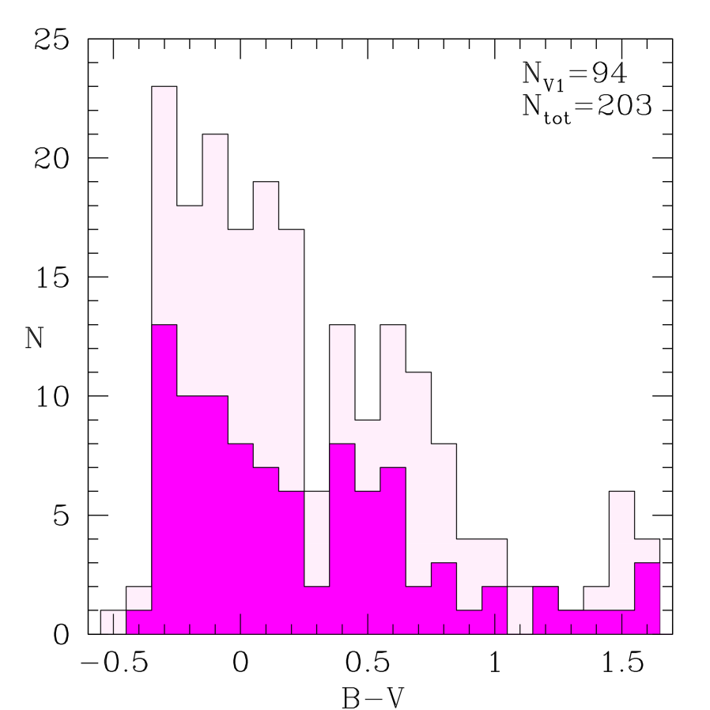
SPSS V1 release

Slide 17
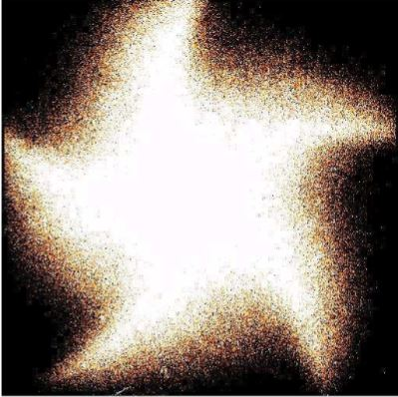
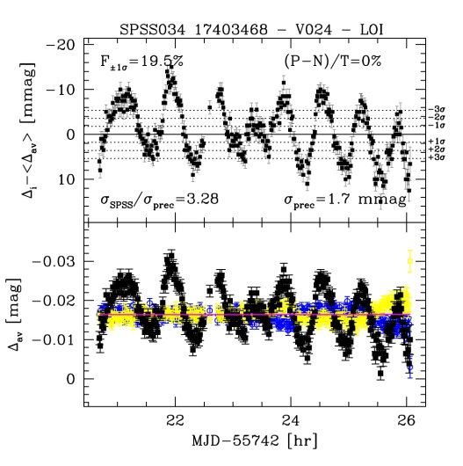
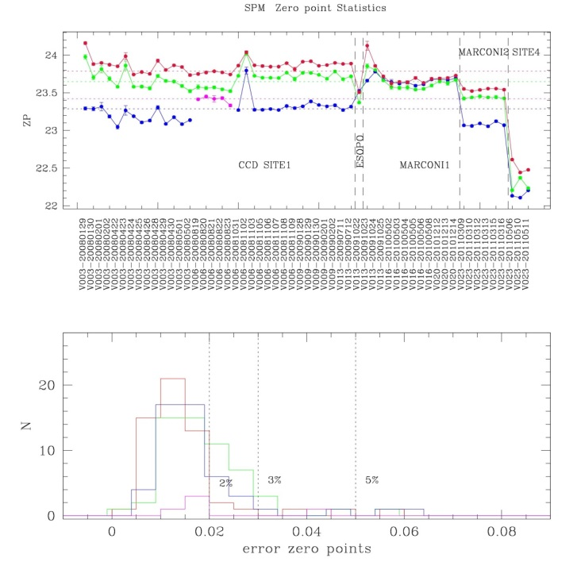
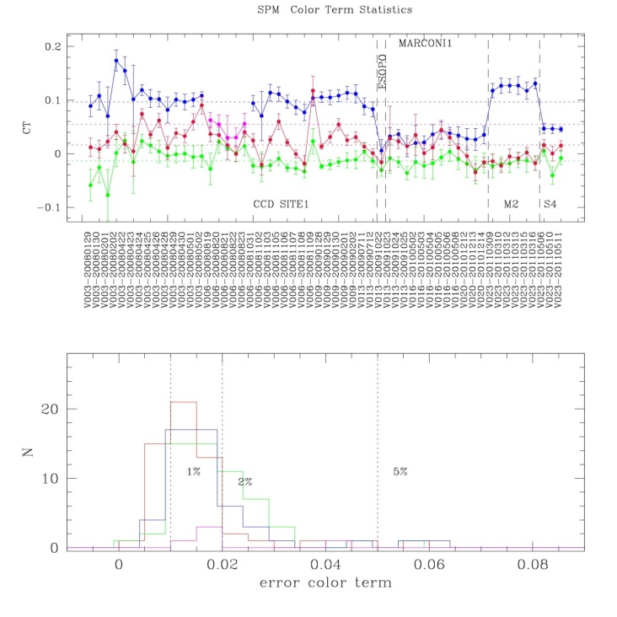
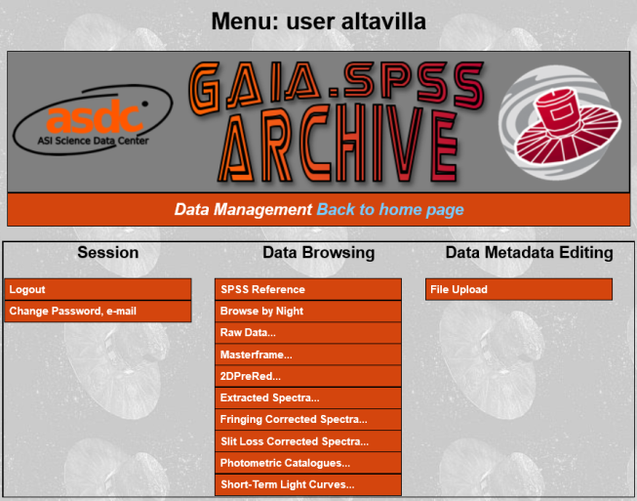
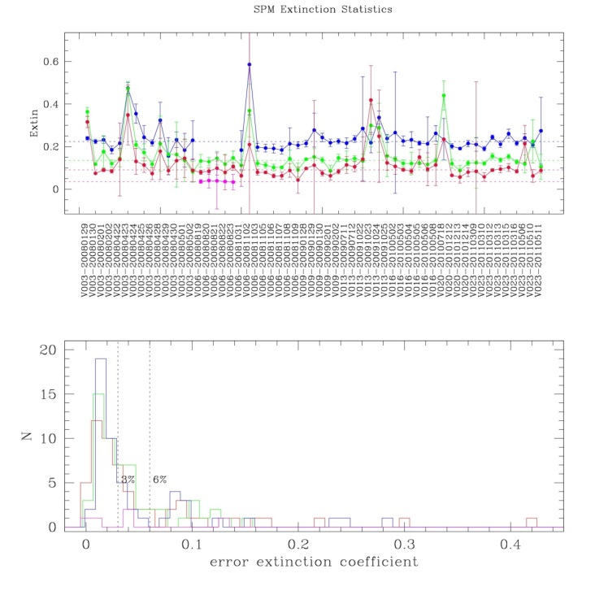
SPSS… not only spectroscopy
Instruments
characterization
Altavilla et al.
2015AN.336.515A
Constancy assessment:
Marinoni et al, in prep.
Absolute Photometry
The ASDC
Gaia SPSS archive
gaiaextra.asdc.asi.it:8900

Slide 18
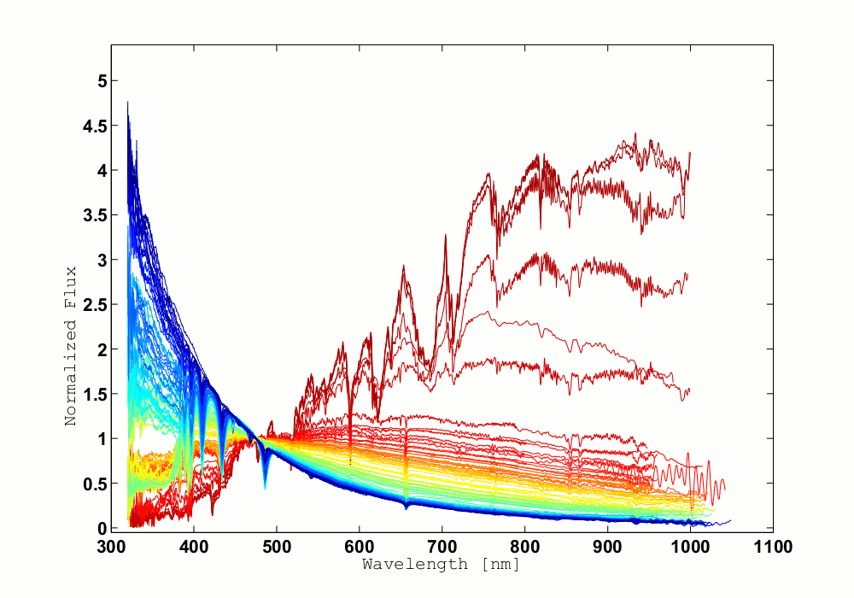
SPSS V2 release
mid 2016 for Gaia 2nd release
Including
constancy assessment
absolute photometry
Improving the SPSS grid:
more spectra, fringing corr. …
more SPSS
V0 - October 2013
V1 - July 2015
Summer 2016
V2

Slide 19
First release: end summer 2016 | Positions (α, δ) and G magnitudes (single-star and good astrometric behaviour). Photometric data of Ecliptic Poles Scanning RR Lyrae and Cepheid variable stars. The five-parameter astrometric solution - positions, parallaxes, and proper motions - for stars in common with the Tycho-2 Catalogue. The catalogue is based on the Tycho-Gaia Astrometric Solution
Second release: summer 2017 | Five-parameter astrometric solutions (single-star). Integrated BP/RP photometry. Mean radial (no radial-velocity variation).
Third release: summer 2018 (TBC) | Orbital solutions, system radial velocity and five-parameter astrometric solutions, for binaries having periods between 2 months and 75% of the observing time will be released. Object classification and astrophysical parameters, together with BP/RP spectra and/or RVS spectra they are based on (well-behaved objects). Mean radial velocities (no radial-velocity and with available atmospheric-parameter estimates).
Fourth release: summer 2019 (TBC) | Variable-star classifications will be released together with the epoch photometry used for the stars. Solar-system results will be released with preliminary orbital solutions and individual epoch observations. Non-single star catalogues.
Final release: 2022 (TBC) | Full astrometric, photometric, and radial-velocity catalogues. All available variable-star and non-single-star solutions. Source classifications, astrophysical for stars, unresolved binaries, galaxies, and quasars. An exo-planet list. All epoch and transit data for all sources.All ground-based observations made for data-processing purposes.

Slide 20
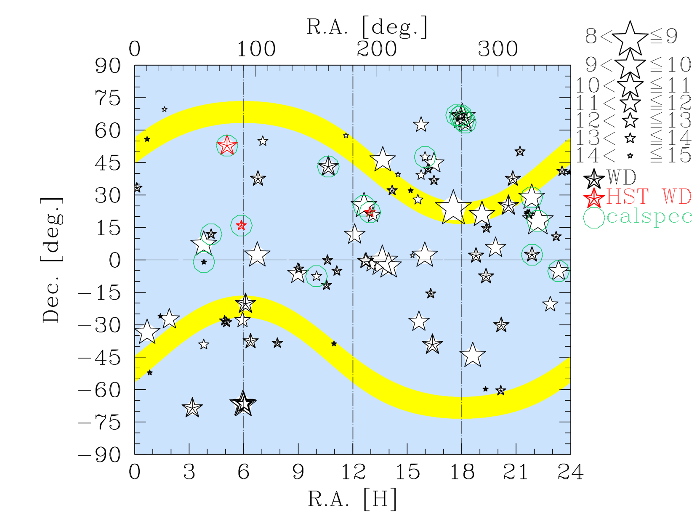
SPSS V1 release

