Slide 1



Chemical evolution modeling: the role of star formation histories and gas flows
Monica Tosi
INAF – Osservatorio Astronomico di Bologna
Castiglione della Pescaia September 16th 2013

Slide 2
Chemical evolution modelling: the role of star formation histories and gas flows
or:
Francesca and I
over the years
Castiglione della Pescaia September 16th 2013

Slide 3


Once upon the time ...
In pre-history,
Francesca and I
lived in the same city (Rome),
were students at the same University (La Sapienza),
graduated roughly at the same time (1976 and 78),
but
didn’t know each other and
didn’t work on chemical evolution models
We first met in 1978

Slide 4

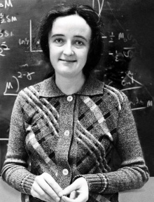
Then, roughly at the same time, we moved,
… and found our way to astrophysics
She got a fellowship to go to Padova
and work with Cesare Chiosi on
Galactic chemical evolution models,
I got a fellowship to go to Yale
and work with Beatrice Tinsley on
Galactic chemical evolution models

Slide 5
SF and gas flows (in and out), and their rates ratio are the key ingredients in chemical evolution models
One of the first basic lessons we learnt is that
They govern element production and dilution, hence:
Time scales of galaxy active life
metallicity, and abundance gradients
age-metallicity relations
Etc…

Slide 6
Infall history: MW models (the 80s)
Tinsley (1980 and references therein): continuous metal poor infall needed to solve G-dwarf problem and explain radial metallicity gradients
Chiosi (1980): continuous slow infall [τ_{ιnf} ≈ (2-3) × 10⁹ yr] after first rapid collapse to account for G-dwarfs and radial distribution of gas and SFR in the disk
Twarog (1980): infall rate ≈ 1/2 SFR (with <SFR>/SFR_{now} ≈ 2.5) needed to explain AMR => long lasting infall
Tosi (1982 and 1988): almost constant infall of extragalactic metal poor gas (Z_{inf} ≤ 0.2 Z ) after disk formation to account for AMR and radial distribution of element abundances and abundance ratios, gas, SFR, etc. Current total rate 1-2 M yr⁻¹.
Lacey & Fall (1985): radial gas flows make the observed gradients, but infall of metal-free gas is still needed to reproduce solar neighbourhood properties, with current total rate 0.1-1 M yr⁻¹.
Matteucci & Francois (1989): infall of extragalactic metal poor gas, with e-folding time proportional to galactocentric distance (i.e. the more distant, the longer) to account for abundance gradient of several elements.

Slide 7
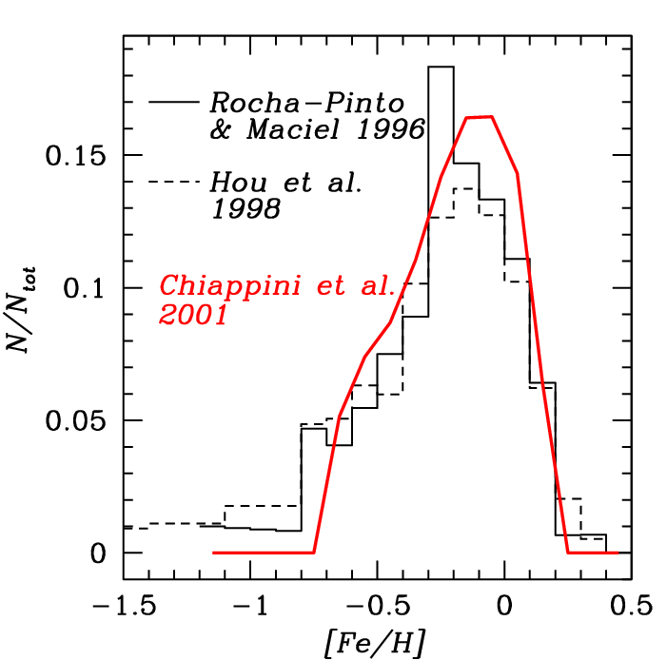
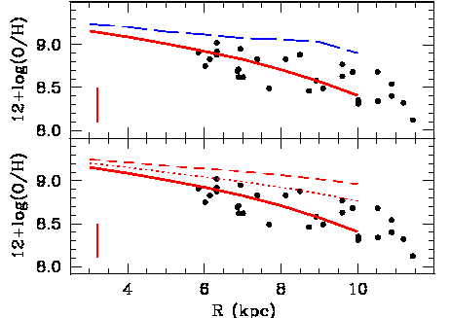
infall to reproduce properties of stellar populations
models with no infall
models with metal free infall
local G-dwarfs
abundance gradients (HII regions)
dots: F stars
1
0.5
Z_{infall/}Z_{sun}=0
data Shaver et al 83, models Tosi 88

Slide 8
Infall history: MW models (2)
Then, people started arguing that HVCs were not sufficient evidence of significant persisting infall and, for more than a decade, only very few of us kept insisting on its need. Until …
Chiappini, Matteucci & Gratton (1997): proposed the two-infall model, with a rapid halo collapse, followed by a slow gas accretion from outside the Galaxy to explain both disk and halo observed properties. Inside-out disk formation.

Slide 9
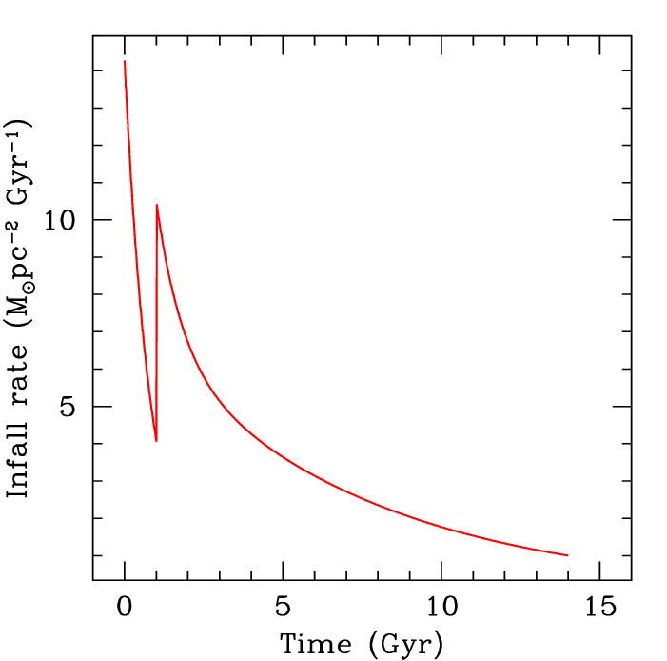
two-infall model: infall rate in  neighbourhood
Halo and thick disk formation
thin disk formation
Chiappini, Matteucci & Gratton (1997)

Slide 10
Infall history: MW models (2)
Then, people started arguing that HVCs were not sufficient evidence of significant persisting infall and, for more than a decade, only very few of us kept insisting on its need. Until …
Chiappini, Matteucci & Gratton (1997): proposed the two-infall model, with a rapid halo collapse, followed by a slow gas accretion from outside the Galaxy to explain both disk and halo observed properties. Inside-out disk formation.
Boissier & Prantzos (1999): inside-out disk formation; infall time-scale radially varying [t_{inf,} ≈ 7 × 10⁹ yr]

Slide 11
Infall summary
from chemical evolution models, infall of metal poor gas appears to be necessary in most spirals, even when radial flows exist (and help with the gradients …)
infall is observed in HI in many spirals (see Sancisi et al 2008 for a review). In MW evidence is from HVCs (e.g. Mirabel 1981, DeBoer & Savage 1983-4, Songaila et al 1988); derived metallicity ~0.2 Z_{sun}, rate ~0.4 M_{o}yr ⁻¹ (Wakker et al 2008). Is 1 M_{o}yr ⁻¹ available ?
gas infall is predicted as residual of proto-galaxy collapse, accretion from surrounding halo, merging of gas rich satellites, intergalactic gas trapped during galaxy motion (e.g. Songaila et al 1998, Blitz et al 1999). In MW Magellanic Stream will eventually fall in too (e.g. Sofue 1994, Fox et al 2010).

Slide 12
galactic winds
from chemical evolution models of galaxies, winds appear to be necessary in low mass starburst dwarfs, not in spirals
winds are observed in H_{α} and X-rays in some Irrs and BCDs, like NGC1569, NGC1705 (e.g. Waller 1991, Meurer et al. 1992, Della Ceca et al. 1997), not in spirals
Winds are predicted by hydrodynamics of SN ejecta in starburst dwarfs (e.g. DeYoung & Gallagher 1990, MacLow & Ferrara 1998, D’Ercole & Brighenti 1999, Recchi et al. 2002), with low mass and intense star formation. In massive galaxies, like spirals, SN ejecta fail to escape.

Slide 13
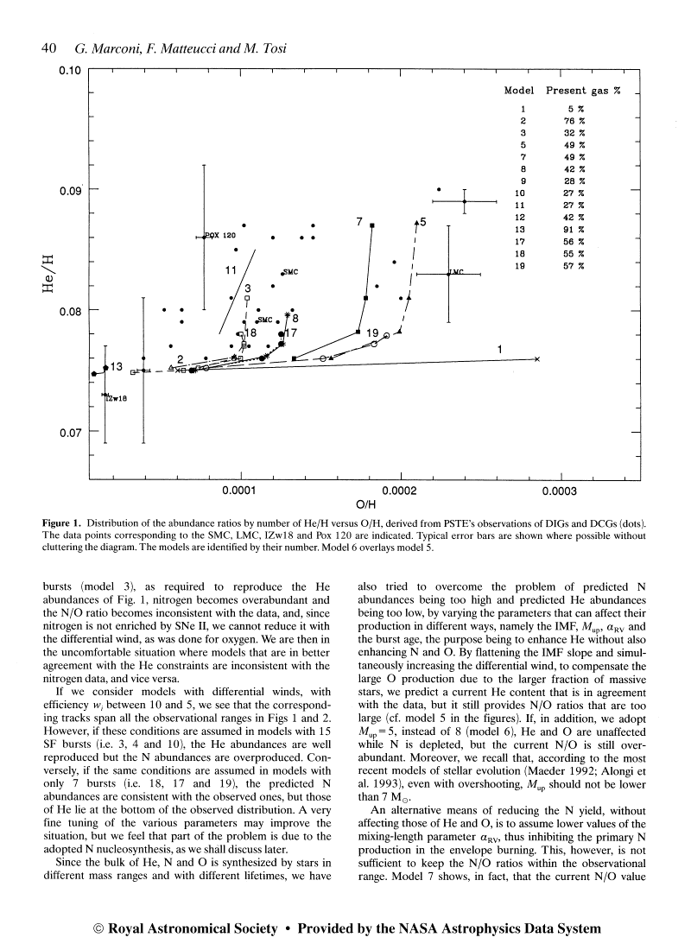
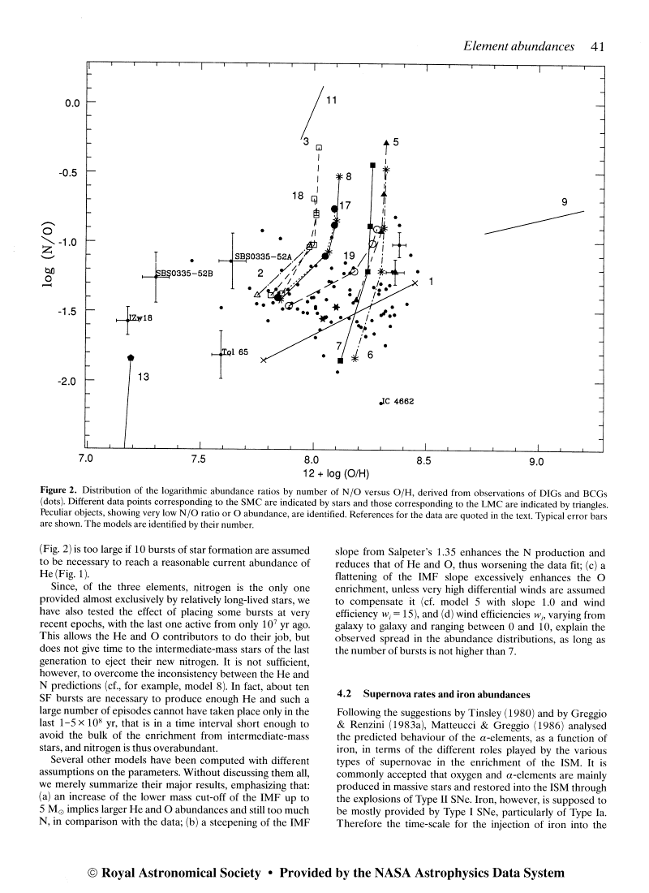
first wind models: Matteucci & Tosi 85, Pilyugin 93, Marconi et al 94
Marconi, Matteucci, Tosi 94
no winds
to reproduce observed abundances in starburst dwarfs
differential galactic winds
are necessary
non selective winds
differential winds

Slide 14
gas flows comparison
chemical evolution of spirals and dwarfs:
spirals
dwarfs
RESULTS:
Long-term infall of metal poor gas needed to dilute metals and favor gradients. Fountains possible. Winds unlikely.
RESULTS:
Winds very likely in lower mass active galaxies. Infall present. Fountains unlikely.
QUESTIONS:
Can the accretion rate resulting from sum of discrete events be treated as continuous ?
What is the effect on chemical evolution of its discontinuity ?
QUESTIONS:
What is the wind efficiency of SNe Ia and II ?
What is the final fate of the ejected gas ?

Slide 15
Star formation history

Slide 16
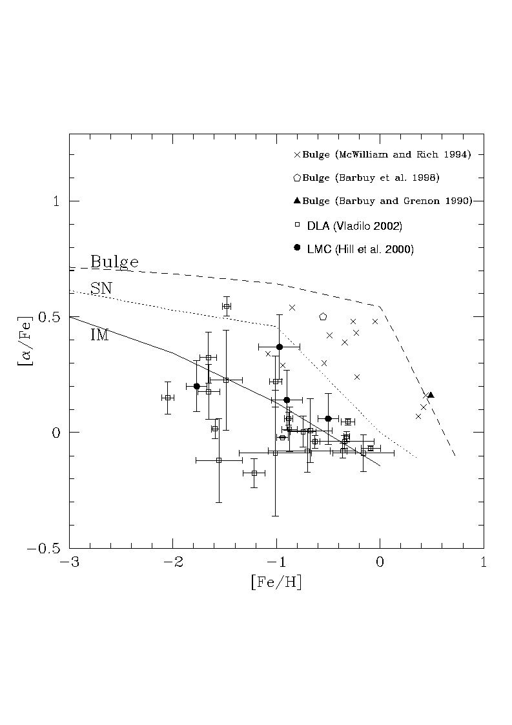
Trend of [α/Fe] vs [Fe/H] depends on relative timescales of Sne II and Ia, hence on SF history
α-elements produced by massive stars;
Fe mostly by SNeIa
Matteucci (1992, 2003)
Stars born before the onset of the bulk SNIa explosions have high [α/Fe].
When SNeIa start yielding their large Fe, stars form with lower and lower [α/Fe].

Slide 17
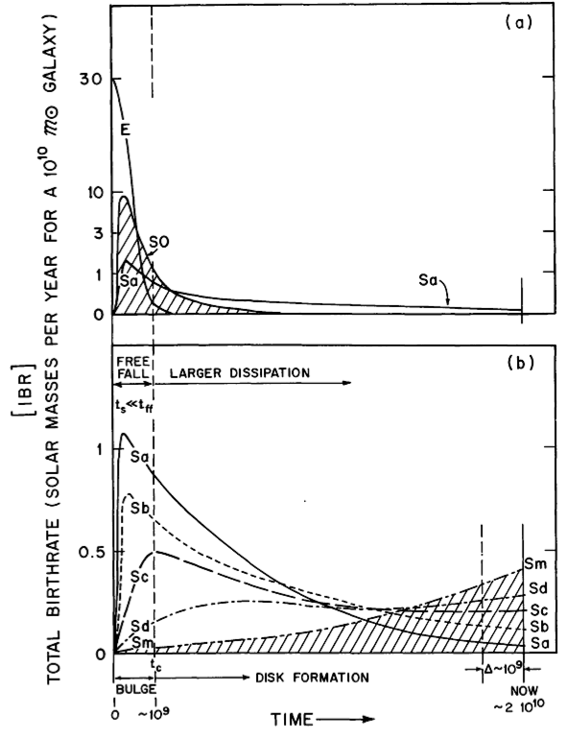
Star Formation
Sandage 1986
Valid as climate, but
what about weather ?
Schmidt – Kennicutt law: SFR = a Σ_{gas}^{~1.4} (Kennicutt 2008)

Slide 18
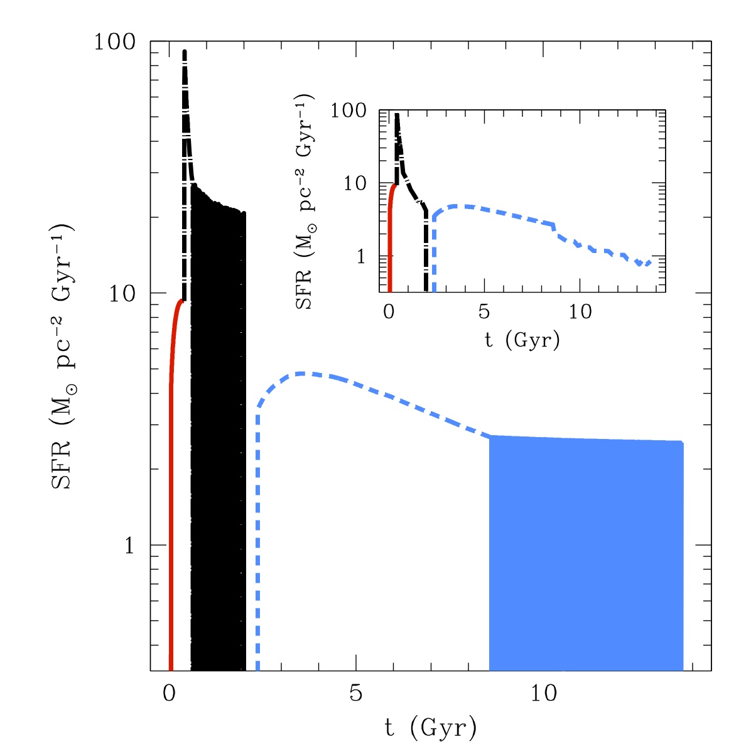
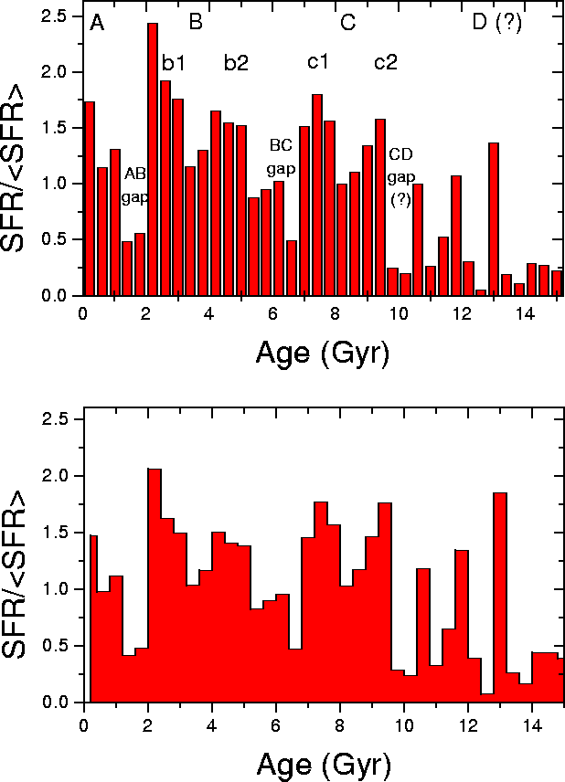
SF in the Milky Way
solar neighbourhood
radial distribution
from chemev models (Micali, Matteucci, Romano 13)
solar neighbourhood
Inside-Out formation and radially varying SFR efficiency required to reproduce observed SFR, gas and colour profiles (Boissier and Prantzos 1999)
from chromospheric age of dwarfs
(Rocha-Pinto et al 2000)

Slide 19
We need robust SFHs
Thanks to HST stellar populations have been resolved in several galaxies, both of early and late type, both in the Local Group and beyond.
From their CMDs, with synthetic CMD method, we infer SF history, IMF and distance.
These are inputs for new generation of chemical evolution models of individual galaxies, where SFH is not a free parameter any more.

Slide 20
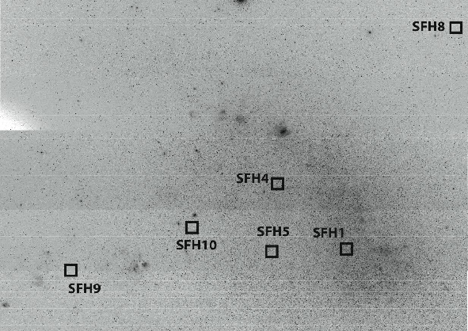
SFH5
Model
SFH10
Model
6 HST/ACS fields in SMC
SFH9
Model
SFH8
Model
Cignoni et al (2013)

Slide 21
6 HST/ACS fields in SMC
now
now
now
now
Cignoni et al 2012, 2013
now
now

Slide 22
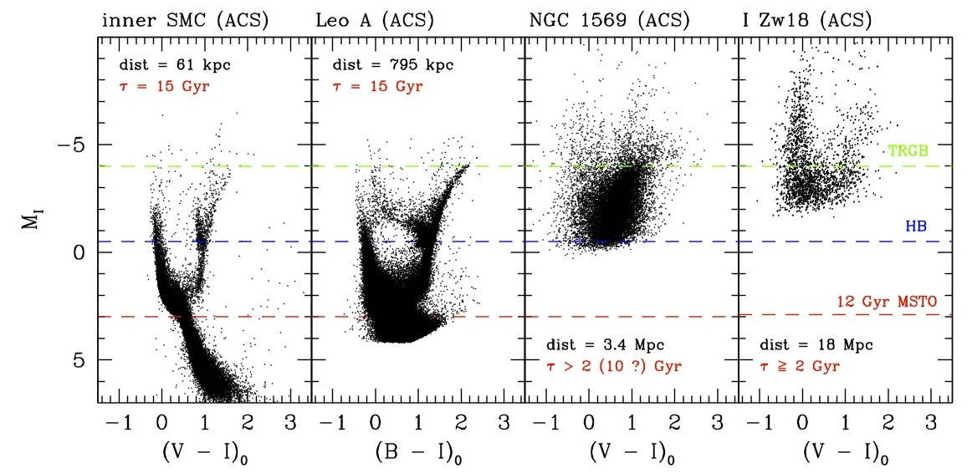
Effect of distance on star resolution on reachable lookback times / stellar ages

Slide 23
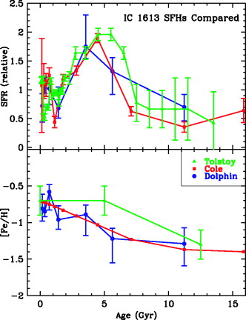
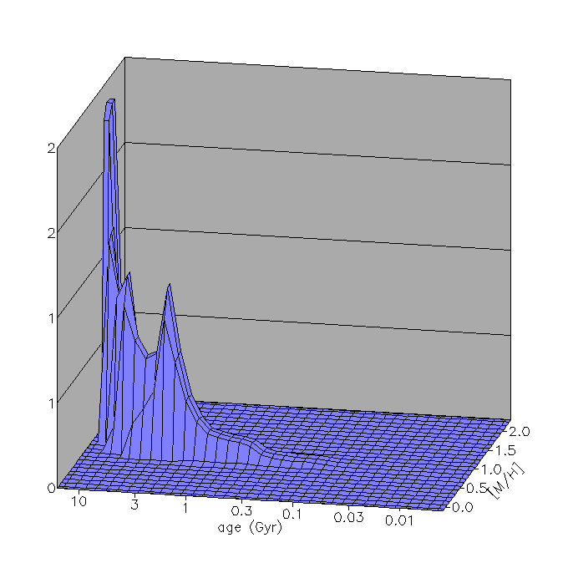
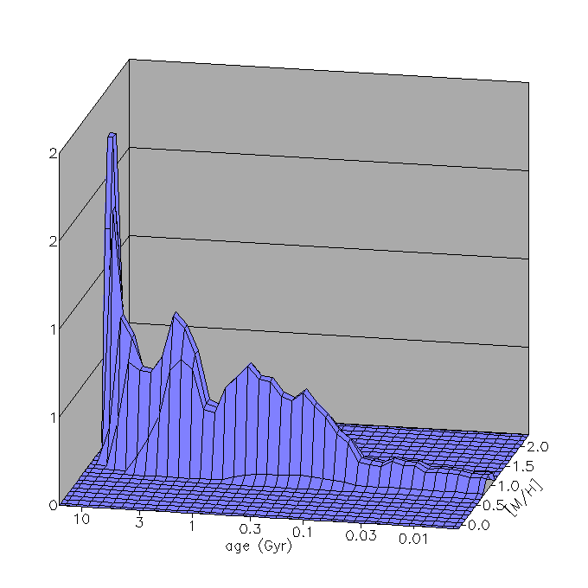
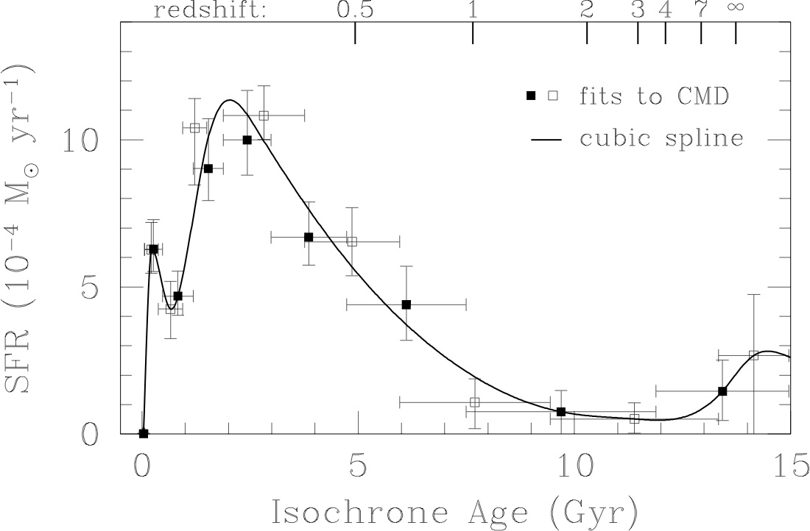
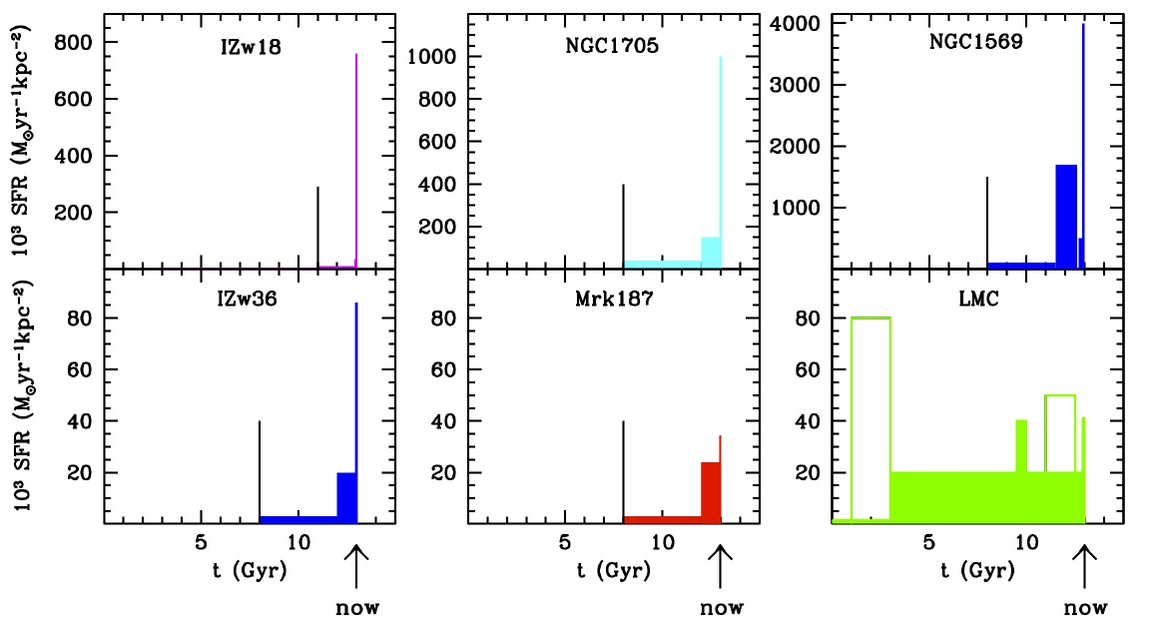
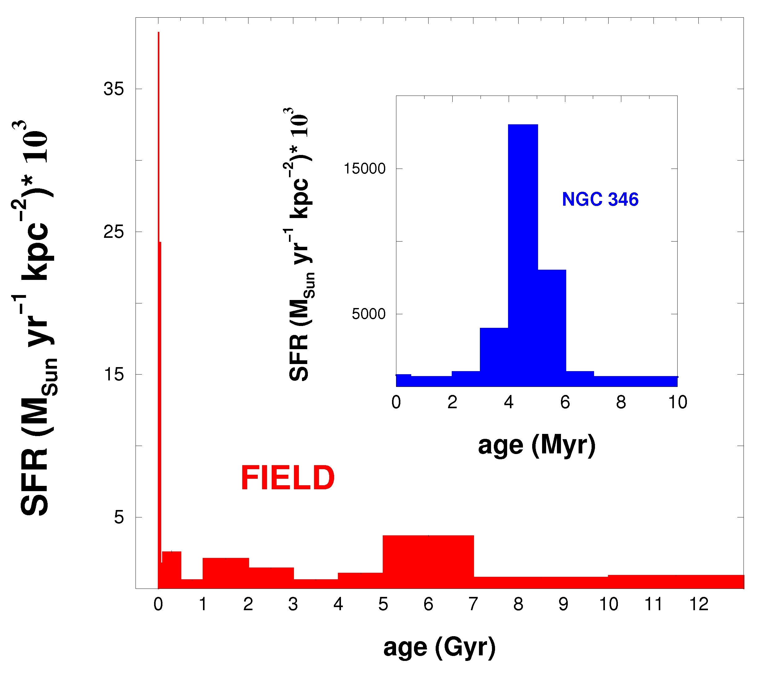
SFHs in dwarf galaxies
dIrr
dSph
dTrans
now
now
now
Skillman et al 03
Dolphin 03
Leo A
dIrr
BCD
BCD
dIrr
lookback time
now
BCD
BCD
Irr
Cole et al 07
NGC346 in SMC
dIrr
Notice the similarity between SFH in starburst dwarfs and in SMC region with young cluster (where involved area is much smaller, though)
now
Cignoni et al 08

Slide 24
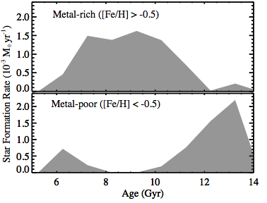
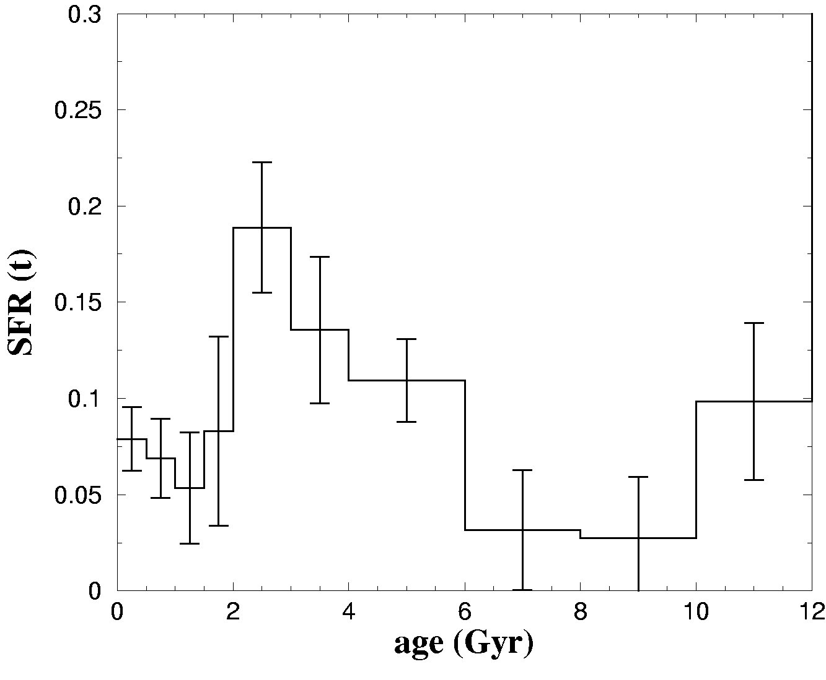
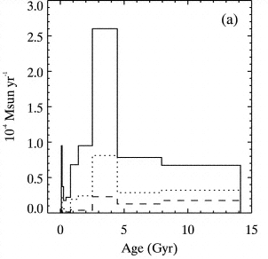
SFHs in Spirals
M31
SAB bc II
◉ neighb
SA b I-II
from Hypparcos
now
Cignoni et al 06
now
M33
Barker et al 07
Brown 03
SA cd II-III
The later the type and
the lower the luminosity class, the more similar to dwarfs’ SFHs
Leo A
now

Slide 25
comparison
chemical evolution of spirals and dwarfs:
spirals
dwarfs
Continuous but as average of many contiguous episodes. On average slowly decreasing with time (the later the type, the slower the decrease). Varying with galactocentric distance.
Fairly continuous, but less than in spirals. Gasping more than bursting. Peaked at early or recent epochs depending on morphological type. No dwarf currently at first SF episode ever found yet.
SF:
infall of metal poor gas needed to dilute metals and favor gradient. Fountains possible. Winds unlikely.
winds very likely in lower mass galaxies; infall present, fountains unlikely.
flows:

Slide 26


THANKS !
Francesca:
since 1978,
35 years of great fun together.
I’m looking forward to the next 35 …

Slide 27
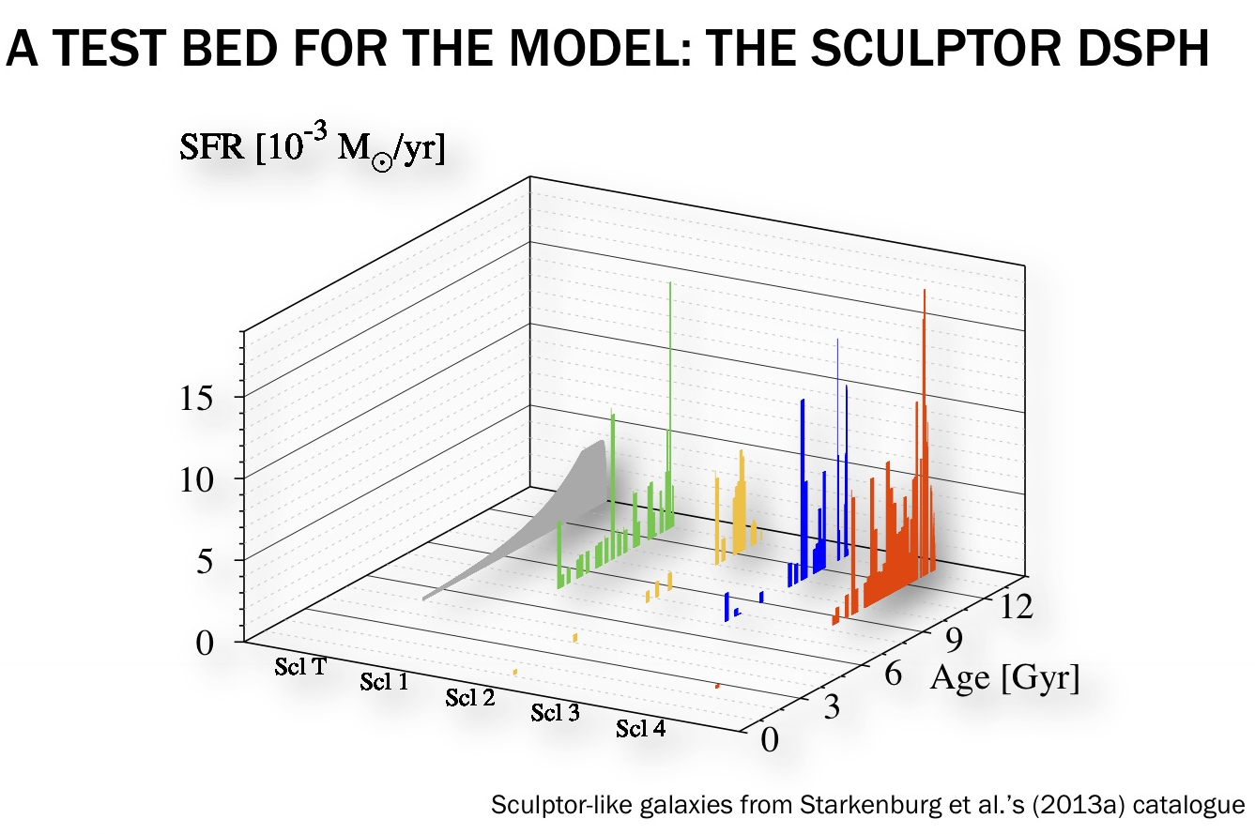
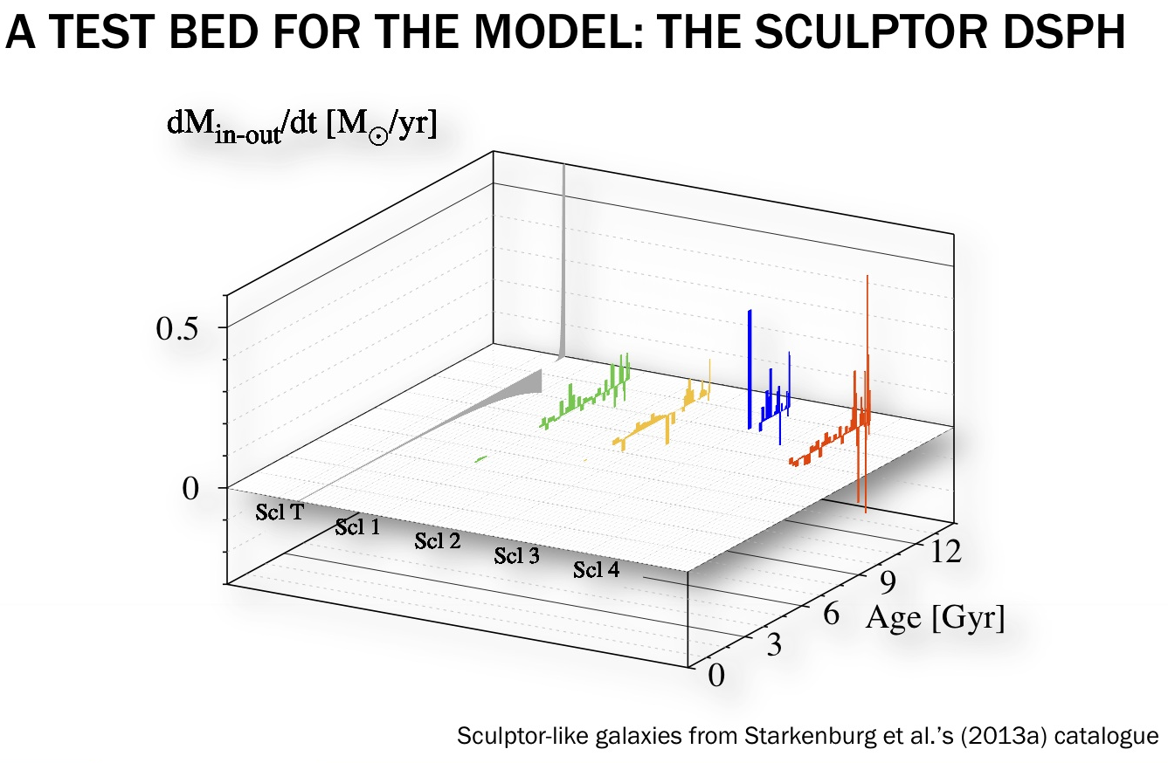
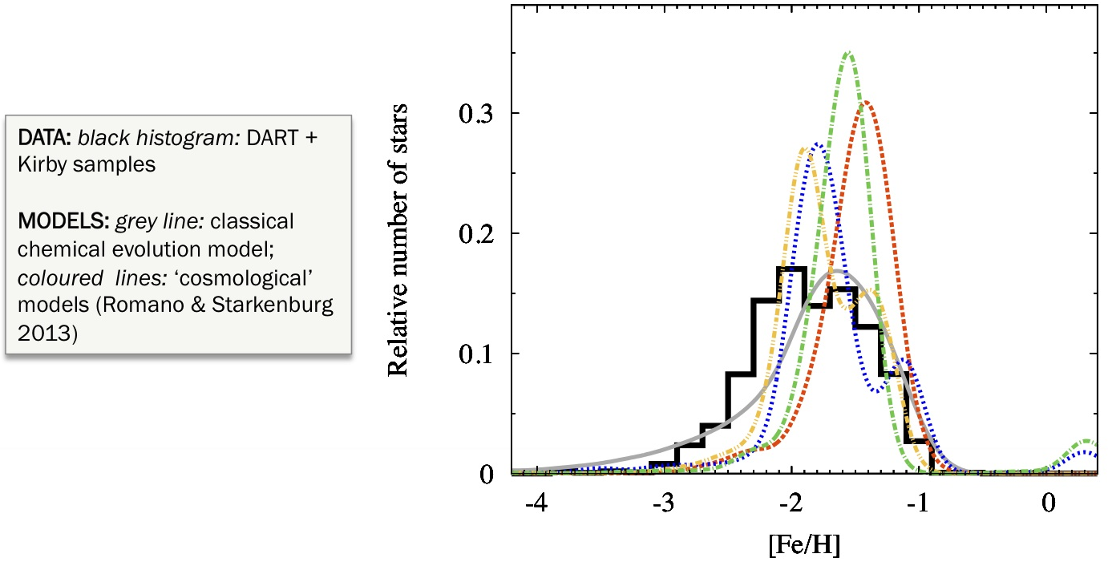
Models in cosmological context are the new frontier, but still far from satisfactory
Courtesy D. Romano 2013

Slide 28
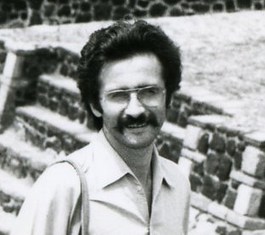

And, by the way,
We met our future husbands in the same place (Erice):
they are both astronomers
and sleeping lions (i.e. born in August)

Slide 29
SFHs from CMDs of resolved stellar populations
Local Group galaxies:
Photometric resolution of individual stars is possible down to fainter/older objects in all galactic regions
long lookback time (up to Hubble time) for SFH is reachable and space distribution of SF is derivable
More distant galaxies:
Distance makes crowding much more severe and even HST has not resolved yet stars as faint as the MS-TO
lookback time ranges from a few tens of Myr to several Gyr (reached only in outer, less crowded regions) and space distribution is derivable only in a few cases

