Slide 1
Metallicity and the control of star-formation*
Simon Lilly
ETH Zurich
* based on Lilly, Carollo, Renzini, Pipino & Peng (2013) ApJ 772 119

Slide 2
Goal is to understand galaxies at their simplest level in their cosmological context and especially to illuminate connections between disparate aspects of galaxy evolution.
Based on analysis of the evolving population of galaxies as revealed in the large imaging and spectroscopic surveys at z = 0 (SDSS) and at 0.1 < z < 4 (e.g. (z)COSMOS, GOODS, AEGIS etc).
Two important qualifications
Will be talking about typical fairly massive star-forming galaxies (9 < log m_{star} < 11).
Will be talking about approximations to a (simple) big picture, not constructing detailed physical models.

Slide 3
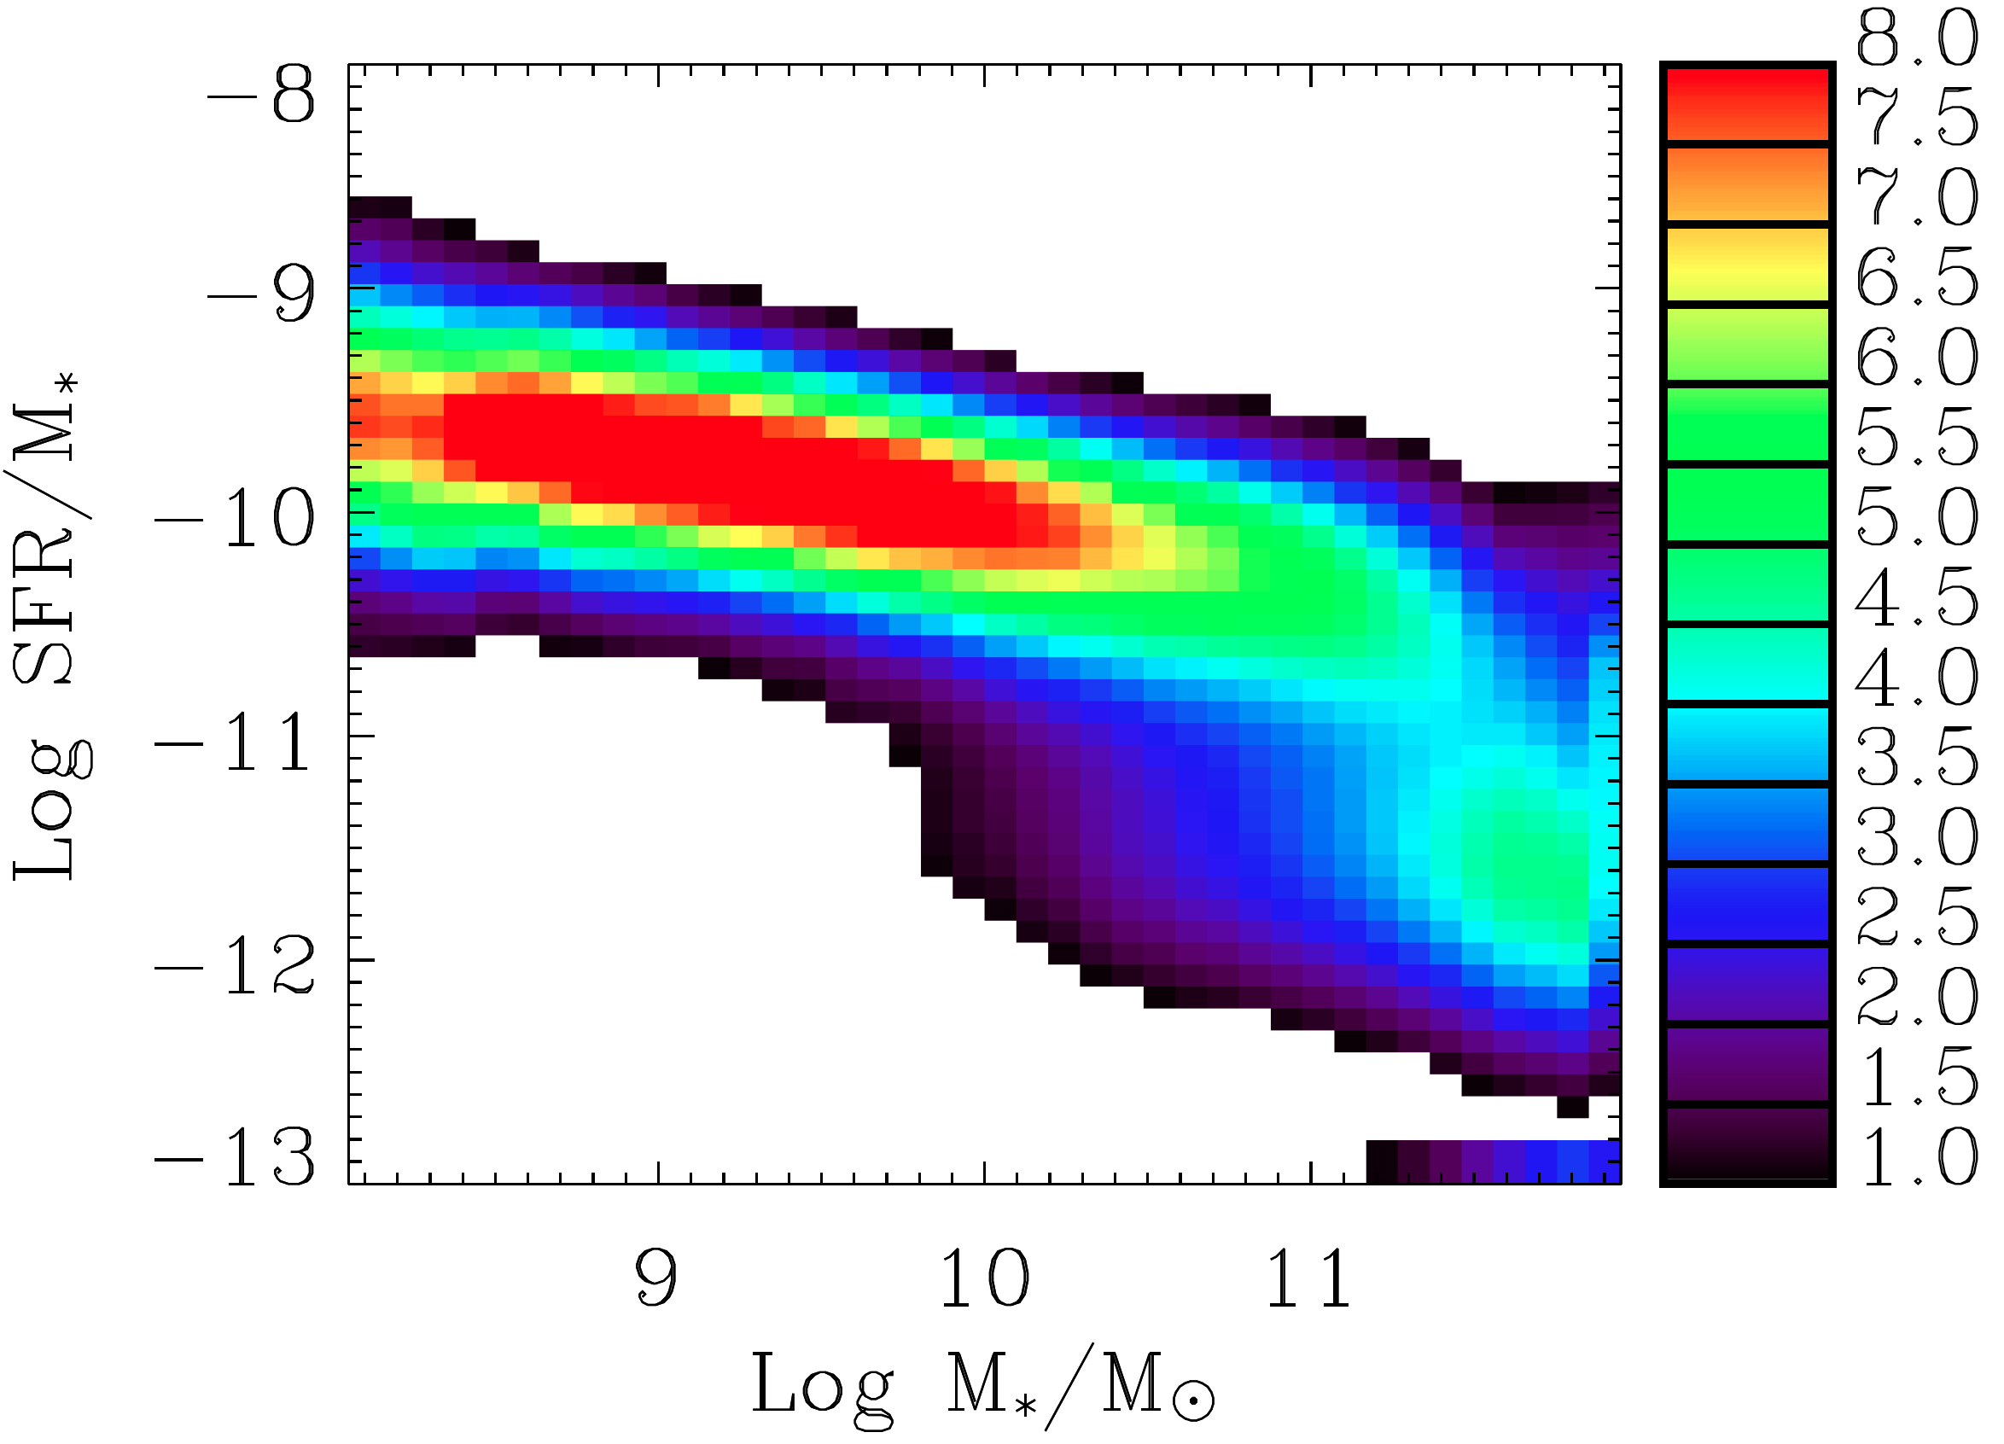
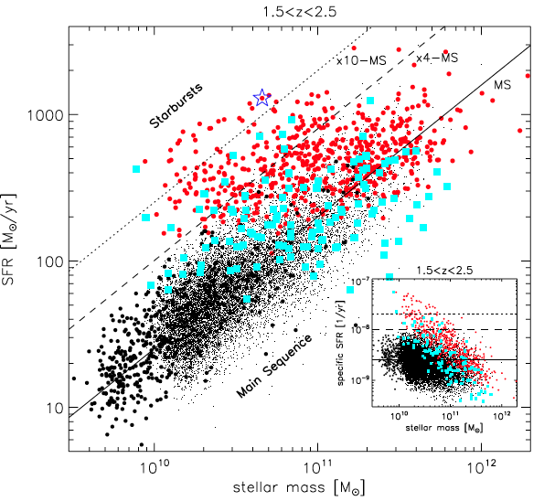
What controls SFR
The Main Sequence of star-forming galaxies
The sSFR of most SF galaxies has a small dispersion (± 0.3 dex) and is more or less constant over a wide range of mass
Brinchmann et al (2004)
Rodighiero et al (2012)
Main Sequence also seen out to z ~ 2.
Daddi et al (2007), Elbaz et al (2007).
“Outliers” with significantly elevated SFR comprise ~ 2% of population and ~ 10% of total SFR Rodighiero et al (2012)
This ratio changes little with redshift. Sargent et al (2012)

Slide 4
Questions
A cartoon of galaxy evolution (at least since z ~ 3)
Some key questions in galaxy evolution:
What quenches star-formation in some galaxies?
What controls the evolution of sSFR on the Main Sequence?
What is relative contribution of mass increase due to mergers? i.e. sMMR vs sSFR
What is the link with central black holes?
What is the link to structure and morphology
1% outliers
Factor of 20 decline since z = 2
SFR
“main sequence”
“quenched” passive
Stellar mass

Slide 5
What controls SFR
Aside: implied SFR(t) of Main Sequence galaxies

Slide 6
What controls SFR
What controls the SFR of Main Sequence galaxies?
Lilly et al (2013) using
Data compilation from Stark et al (2012)
Dark Matter sMIR from Neistein&Dekel (2008)
The observed (r)sSFR(t) is closely related to the theoretical specific accretion rate of dark matter haloes, sMIR_{DM}(t). But note:
sSFR systematically higher than sMIR by factor of a few
Reversed weak dependence on mass

Slide 7
Self-regulation
A classical regulator system regulated by the gas content
Star-formation
Outflow
inflow
change in reservoir (cf Dave+2012, Bouche 2010)
Key feature of this regulator is that it sets sSFR = specific accretion rate (sMIR_{B})
independent of values of ε and λ (if they are constant)
Why? Because a constant fraction of the inflow goes into stars
Lilly et al (2013), c.f.
Bouché et al (2010), Dave et al (2012)

Slide 8
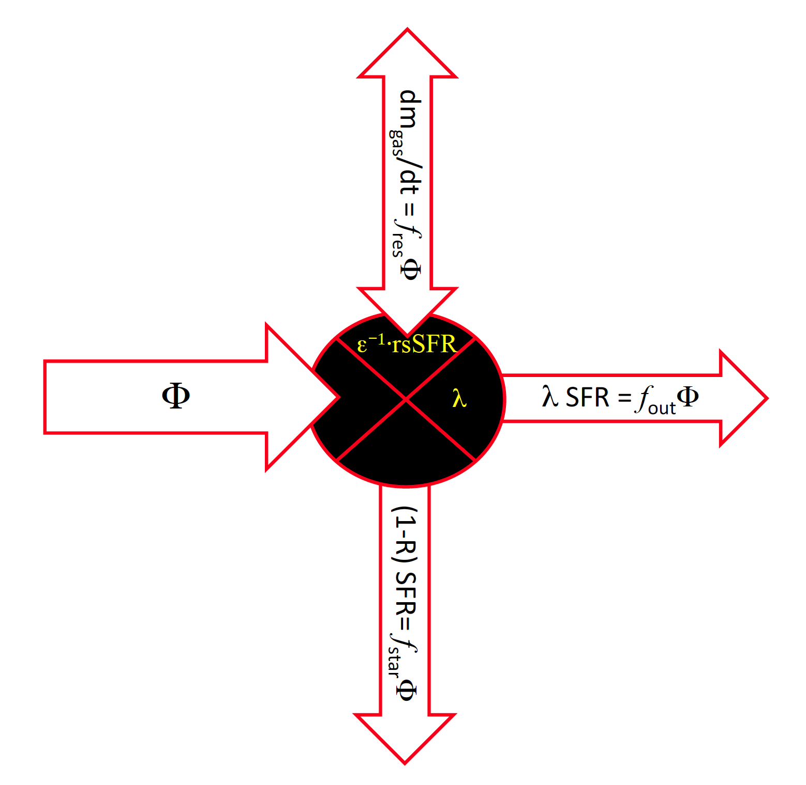
Self-regulation
A classical regulator system regulated by the gas content
Star-formation
f_{res}
Outflow
Two-way flow
Note: High z galaxies are gas rich because they must have a high sSFR because they have a high sMIR
f_{out}
Key feature of this regulator is that it sets sSFR = specific accretion rate (sMIR_{B})
independent of values of ε and λ (if they are constant)
Why? Because a constant fraction of the inflow goes into stars
Gas stays in system for only a short time τ_{gas} ~ ε⁻¹
f_{star}

Slide 9
Timescales in galaxy evolution
Will the regulator regulate in practice?
The gas regulator requires
τ_{gas} < timescale on which external conditions (i.e. sMIR_{B}) are changing
τ_{gas} < timescale on which internal parameters ε and λ are changing: If ε and λ depend strongly on m_{star}, this will be ~ rsSFR⁻¹
OK!
No longer OK at z ≥ 2 ?
Changes in rsSFR(z)?
Clumpy disks
Lilly et al (2013)
Matteucci Meeting, September 2013

Slide 10
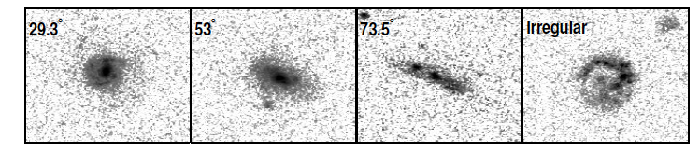
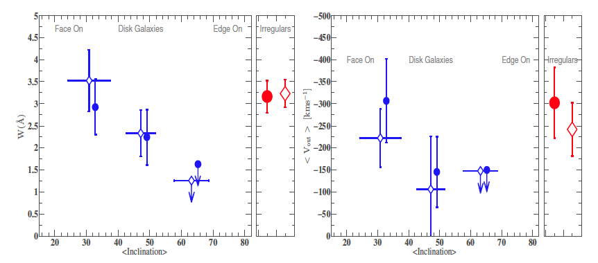
Mapping MgII at intermediate redshift
Aside: Mapping MgII in outflows at intermediate redshift
A. Radial and azimuthal <W>_{MgII} behind 4000 0.5 < z < 0.9 zCOSMOS galaxies
Bordoloi+ 2011, ApJ 743
B. Outflow EW and <v> of outflow MgII as f(i) in ~500 stacked “down the barrel” zCOSMOS spectra
Bordoloi et al 2013 arXiv1307.6553
C. Also evidence for magnetization of wind from excess Faraday Rotation of background quasars
Bernet+ 2007, Nature, and Bernet+ 2013, ApJL

Slide 11
Metallicity as a diagnostic
Metallicity as a diagnostic of the regulator
c.f. closed box
Generally small, only term that depends on history of system
This term from dm_{gas}/dt ≠ 0
Key idea: Metallicity is set “instantaneously” by the parameters of the regulator, ε and λ and by the sSFR (which is set by specific accretion rate), and not by the previous history of the galaxy, which enters only via the (small) dlnμ/dt term, i.e. extreme flow-through solution. This is because τ_{gas} is short
Matteucci Meeting, September 2013

Slide 12
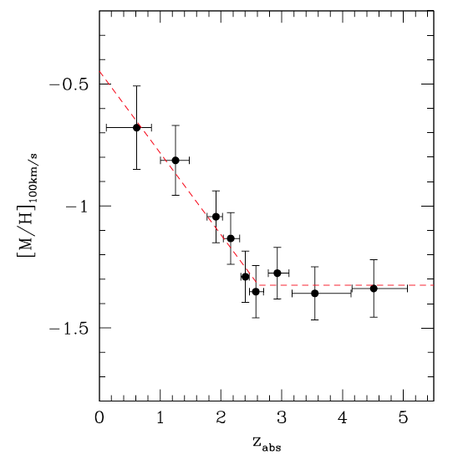
Metallicity as a diagnostic of the regulator
x
Note the following:
Global link between cosmic sSFR(t) and typical Z(t) in the Universe
Møller et al 2013
DLA metallicities
Note also: link with α/Fe which follows from sSFR: Expect knee in α/Fe vs. Z to migrate to lower Z in lower mass galaxies
Requires a Z(m_{star}, SFR) relation ….
…. that will only change with time to the extent that ε and λ do: so we expect a “fundamental metallicity relation”
We can get f_{star}(m_{star}) directly from Z(m_{star}), without needing to know ε or λ (assume y, Z₀ are ~ independent of m_{star})
x

Slide 13
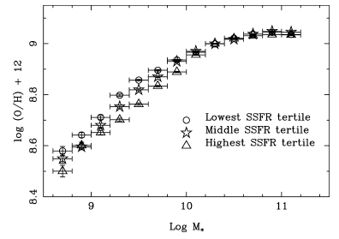
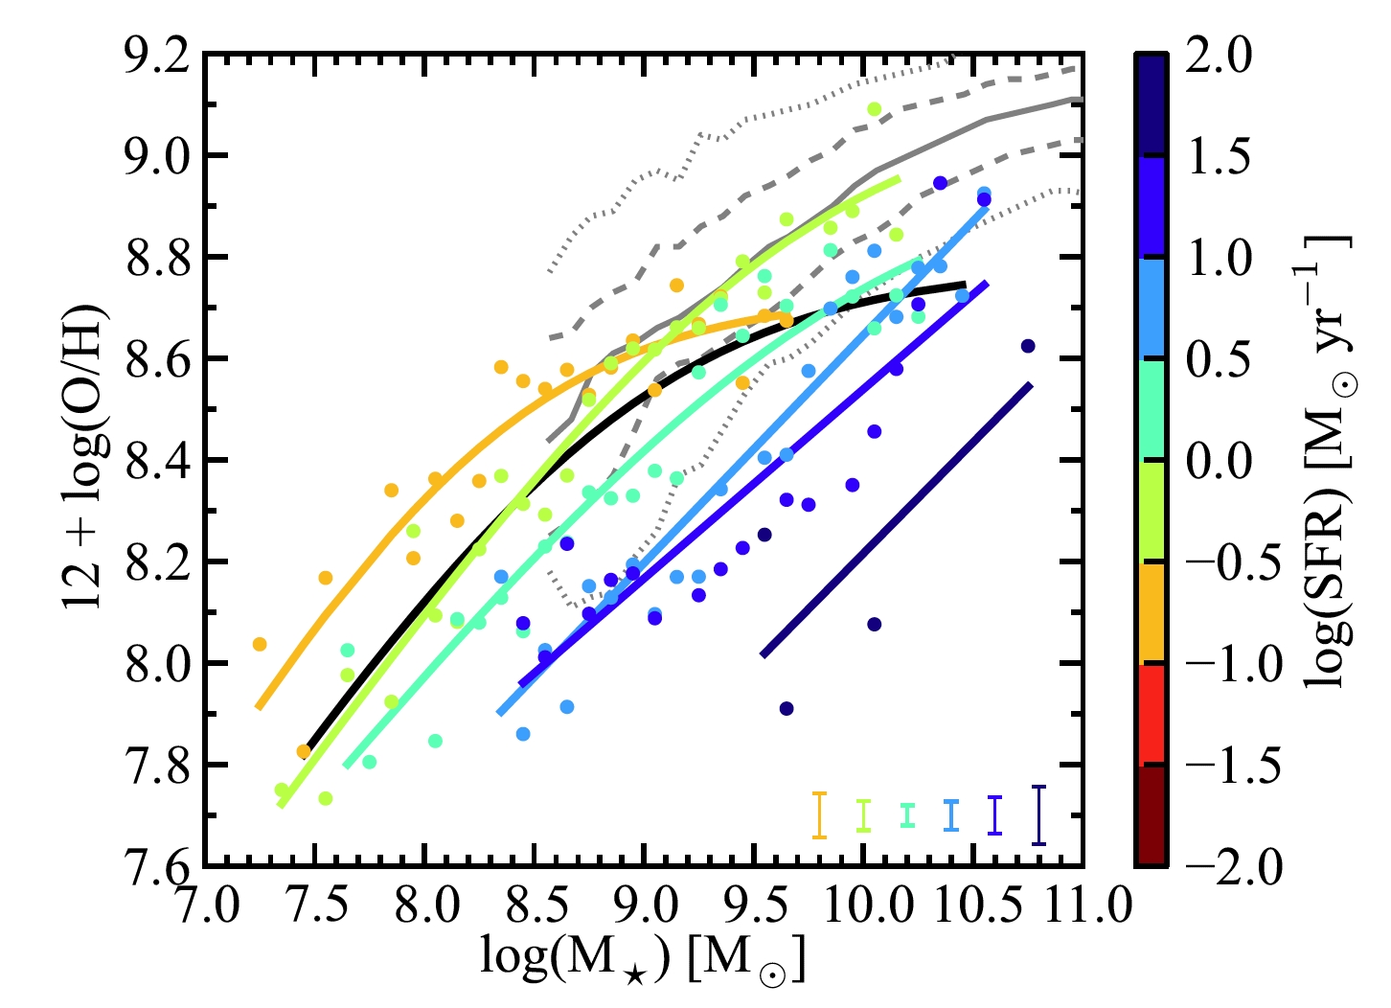
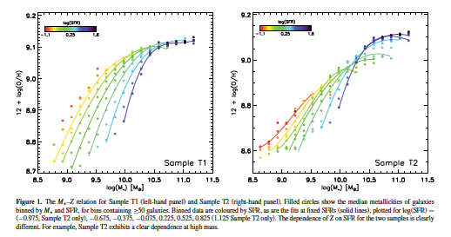
Z(m_{star},SFR) is observationally a mess.
Ellison et al 2008
Mannucci et al 2010
Andrews & Martini 2012
Yates et al 2012

Slide 14
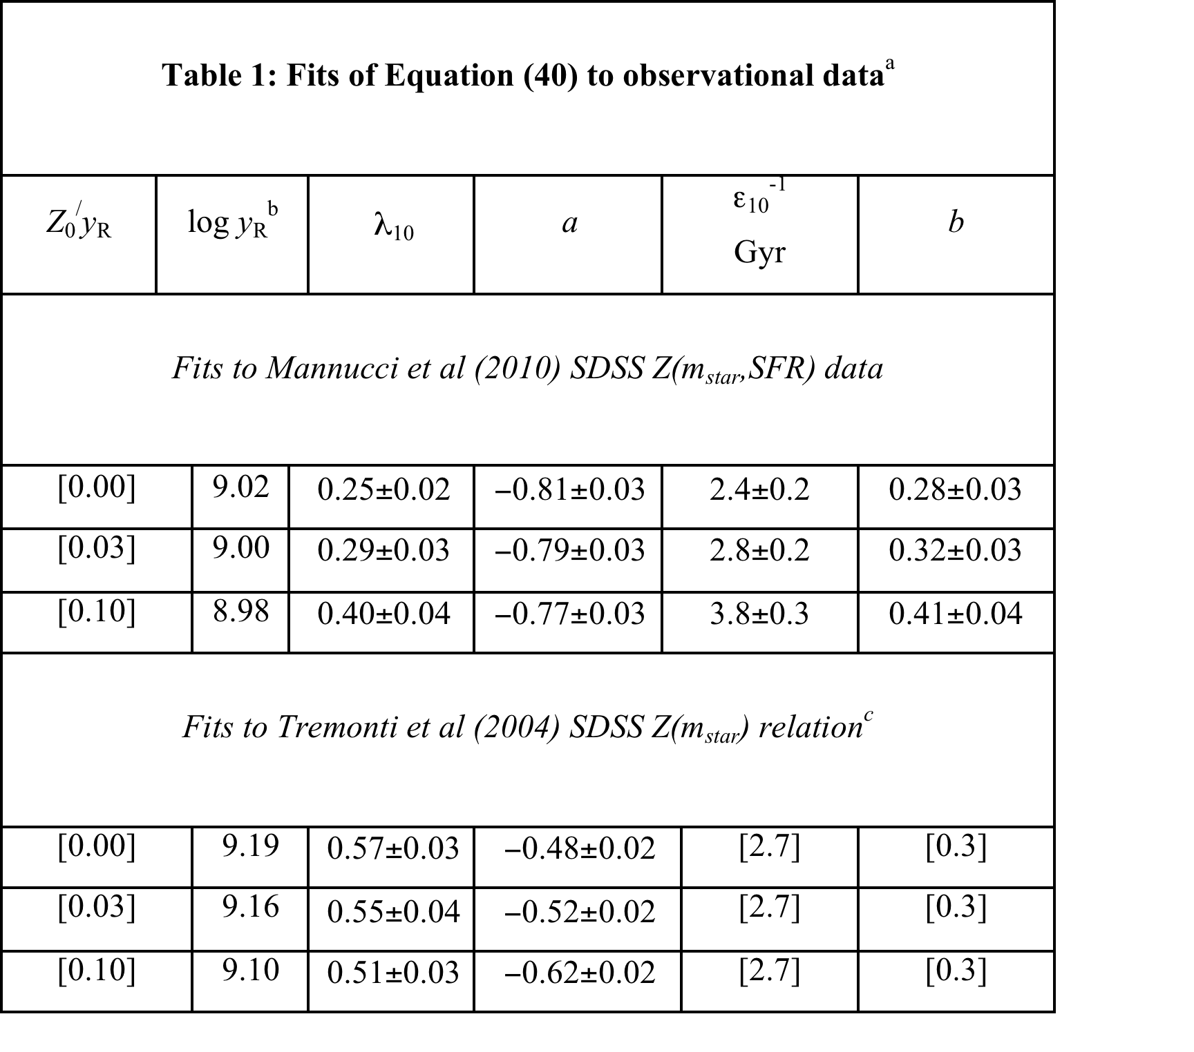
The FMR
Reproducing the Mannucci et al Z(m,SFR) data
Data from Mannucci et al 2010 at z = 0
σ ~ 0.07
log(SFR)
log(m_{star})
Metallicity Z_{gas}
Also, note that the fact that the relation for individual regulator is seen in the population, implies ε and λ are uniform.
Recovered values of ε and λ are astrophysically plausible:
ε⁻¹ = τ_{gas} ~ 2 m₁₀^{-0.3} Gyr
λ ~ 0.5 m₁₀^{-0.8}
Matteucci Meeting, September 2013

Slide 15
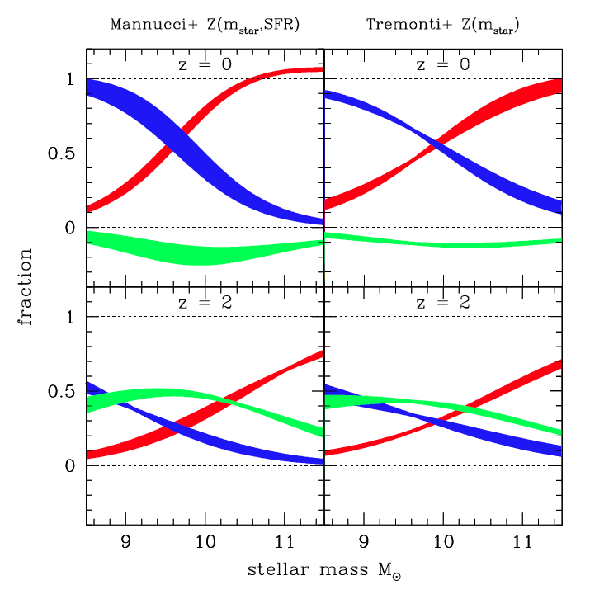
Three-way split into stars, outflow and into or out of the reservoir
Most baryons entering the galaxy system end up in stars at high masses. Most are re-ejected at low masses
z = 0
Change in the reservoir size is significant at high redshift (marginally dominant at some masses)i.e.
Flow normalised to inflow
Reservoir is depleting at present epoch (i.e. negative f_{res}), but at rate that is still small compared with the flow through the system
z = 2
log stellar mass

Slide 16
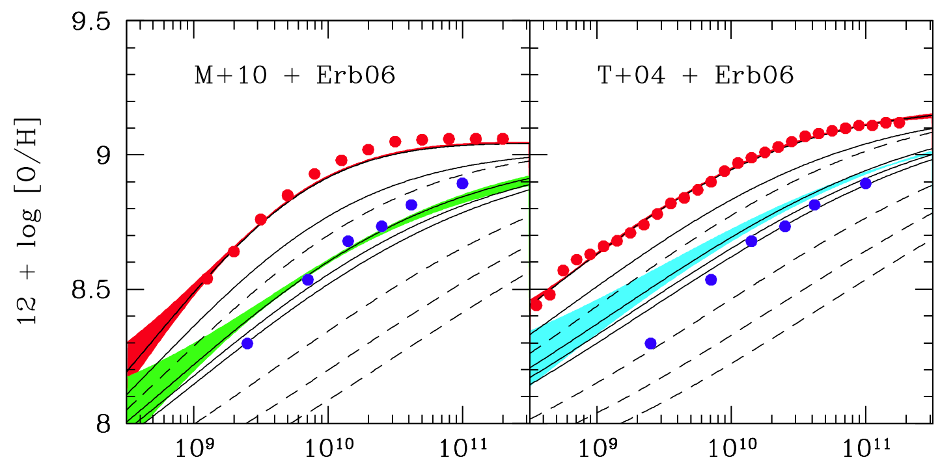
Chemical evolution
Chemical “evolution” is just the changing operation of the regulator
Qualitatively reproduces observed “evolution” in the mean Z(m_{star}) relation to z ~ 2+
z = 0 data from Mannucci+ 2010
Predicted change of Z(m) at z = 0,1,2,3,4 for ε ∝ (1+z) (solid lines) and for constant ε (dashed lines)
12+log[O/H]
z = 2 data from Erb+2008
Stellar mass
Lilly et al (2013)
Matteucci Meeting, September 2013

Slide 17
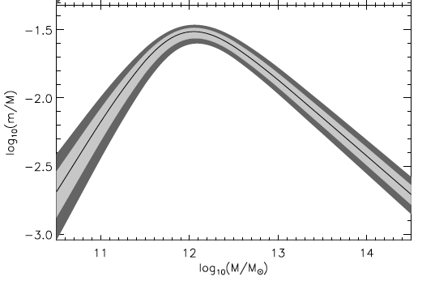
Stellar content of haloes
The stellar content of dark matter haloes
Z(m_{star}) gives f_{star}(m_{star}) without need to know regulator parameters ε or λ.
“Abundance matching” of galaxies and dark matter haloes (e.g. Moster et al 2010)
Low mass slope of Z(m) gives
with 0.4 < η < 0.5
f_{star}(m_{star}) x f_{gal} determines m_{star} as f(m_{halo}). If f_{gal} ∝ m_{halo}^{ξ}
m_{star}= 10⁹-10¹¹
η ~ 0.45 exactly what is required to match the mass functions of galaxies and dark matter haloes, with ξ ~ 0, i.e.
Matteucci Meeting, September 2013

Slide 18
The FMR
The boost of the sSFR relative to the specific accretion rate
Fact that f_{star}(m_{star}) increases with mass also implies that sSFR > sMIR_{DM}
small
Taken at face value, the last two slides suggest that baryonic processes within galaxies, as sampled by the metallicity, produce the differences between stellar and dark matter build-up.
Matteucci Meeting, September 2013

Slide 19
Concluding points to take away
The regulator picture implies that high redshift galaxies are gas-rich because they must have a high sSFR because their haloes have a high specific accretion rate (and not the other way around).
Metallicity and chemical “evolution” reflect the quasi-instantaneous operation of the regulator. Provides natural explanations for SFR as “second parameter” in Z(m) and for a more or less epoch independent “FMR”.
Fact that Z(m,SFR) relation for individual regulators appears to apply to the population (with σ at each point << range across the population), indicates that the regulator parameters (ε and λ) are uniform across the population of galaxies. Implications for “feedback”?
A very simple “no-free-parameter SAM” consisting of DM haloes, regulators as described here plus phenomenological models of mass- and satellite-quenching channels, does very well in reproducing galaxy population.
There is good convergence between quite independent phenomenological approaches (e.g. Behroozi et al epoch dependent abundance matching).

Slide 20
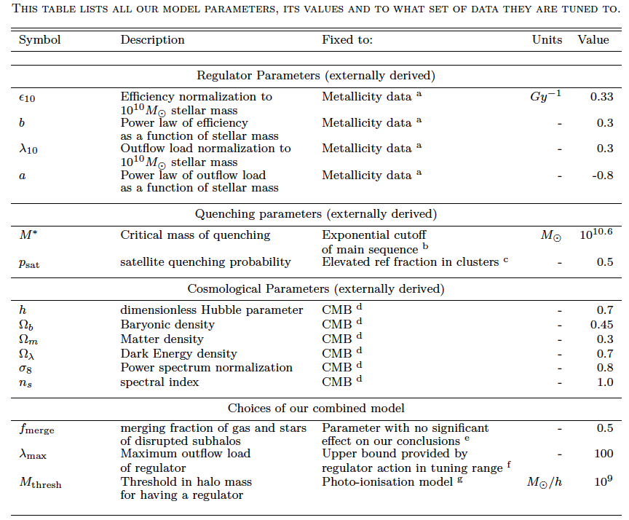
The FMR
A semi-analytic model with “no free parameters” **
Birrer et al (2013, to be submitted soon)
DM haloes and subhaloes from excursion set (from Parkinson et al (2008)
Populate (sub-)haloes with gas-regulator systems with ε(m), λ(m) taken from gas-regulator (Lilly+13) based on Z(SFR,m) from Manucci et al (2010)
All gas entering halo is divided amongst regulators (+ central gets gas and half stars from mergers).
Prescription for merging of some
regulators into central
Quench galaxies with empirical
quenching “laws” ε_{m} and ε_{sat}
taken from Peng+10+12
ε and λ of regulator
M* and ε_{sat} of quenching
** i.e. the (relatively few) parameters are inserted a priori from independent data and are not adjusted to match the output to observations
Cosmology
Three other practical parameters with little sensitivity
Matteucci Meeting, September 2013

Slide 21
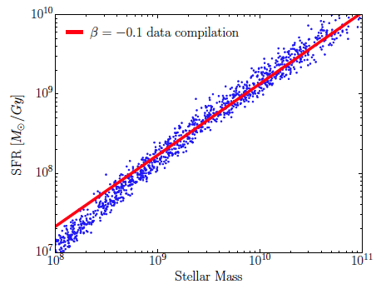
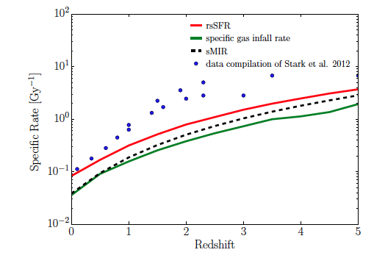
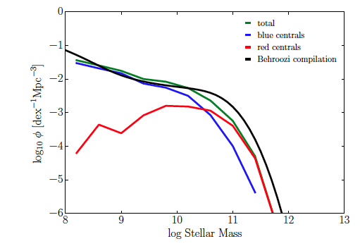
The FMR
Some successes
Model
Data compilation from Stark+12
Model
Good SFR(m) relation @ z = 0
sSFR(z) is low at z ~ 2 (common problem)
Good faint end slope to φ(m)
Model
Data compilation from B13
z = 0
z = 2
Evolution of φ* and M* for SF galaxies to z = 3
z = 4
Matteucci Meeting, September 2013

Slide 22
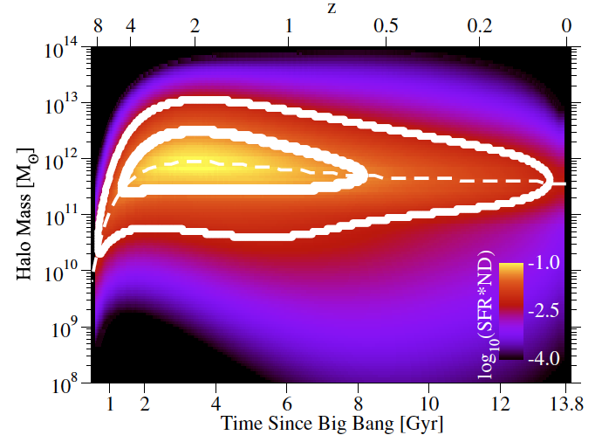
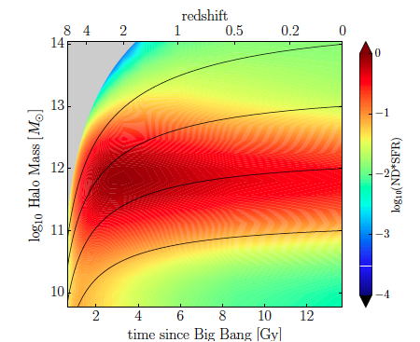
Comparison with Behroozi
An orthogonal phenomenological approach (Behroozi et al 2013)
Start with φ(m) for DM haloes and galaxies:
Abundance-match galaxies and haloes at all redshifts to fix m_{star}(m_{halo},z)
Differentiate m_{star} to get the SFR
Global fit to observational data sSFR, SFRD etc.
No-parameter SAM
(Birrer et al 2013)
From Behroozi et al 2013
Matteucci Meeting, September 2013

