Slide 1
Obscured AGN and the synthesis of the cosmic X-ray background
R. Gilli
INAF – Oss. Bologna

Slide 2
The discovery of the cosmic X-ray background (XRB)
2-6 keV data
Counts > 0 from all directions ➔ diffuse background radiation
Giacconi et al. (1962). Nobel prize in 2002
It is the first cosmic background discovered (CMB in 1964)

Slide 3
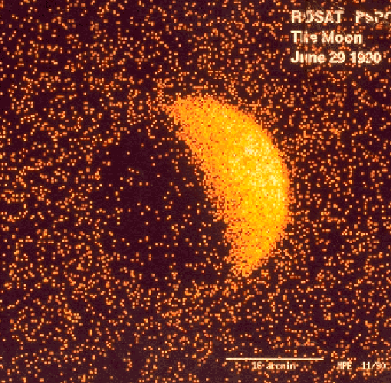
ROSAT image of the moon (0.5-2 keV)
The moon casts a
shadow on the
XRB

Slide 4
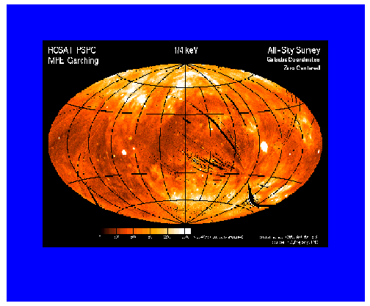
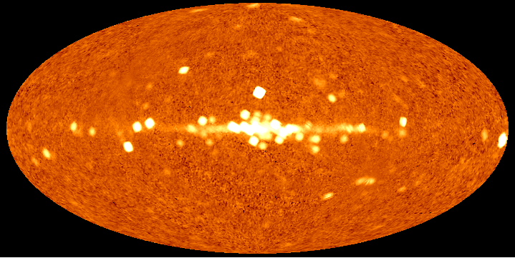
All sky X-ray maps
ROSAT
E ~ 0.25 keV
G a l a c t i c p l a n e
HEAO-1 E ~ 10 keV:
Galaxy transparent at these energies
XRB isotropy:
~3% on deg² scales
- isotropy suggests an
extragalactic origin
G a l a c t i c p l a n e

Slide 5
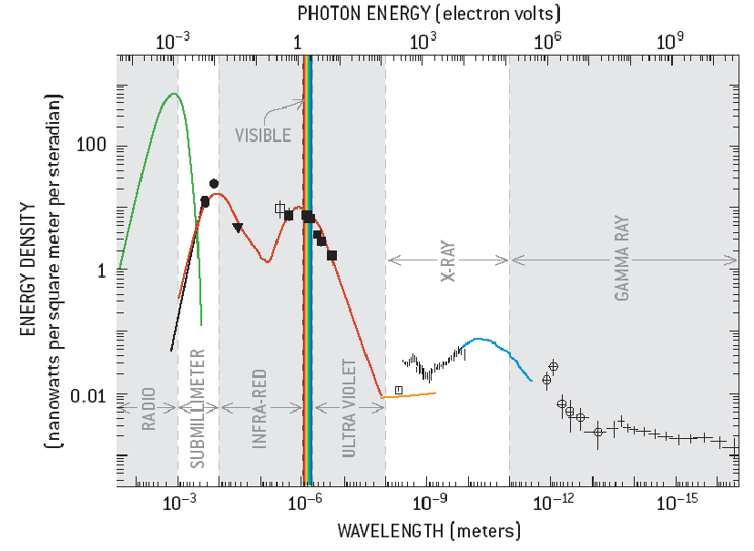
Cosmic backgrounds at different wavelengths
CMB
Optical =
stars
νΙν
Infrared=
Stars
(+AGN?)
X-ray Background = AGN
soft hard
2 keV

Slide 6
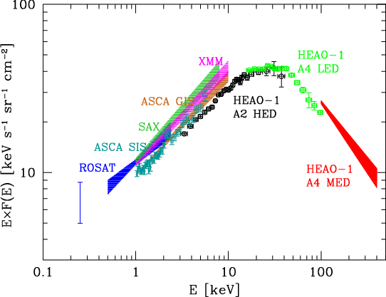
The spectrum of the cosmic XRB
The first spectral data (1980) in the 3-60 keV band could be reproduced accurately by thermal emission from an optically thin plasma:
F(E)~ E^{-0.29}e^{-E/41keV} (bremsstrahlung)

Slide 7
Can diffuse plasma explain the XRB spectrum??
No!
1) subtracting AGN no more bremsstrahlung
2) CMB perfect blackbody; hot gas (T~40 keV ~ 4 10⁸ K) would produce
distortions by inverse Compton effect
➔ Emission by unresolved faint individual sources ➔ AGN

Slide 8
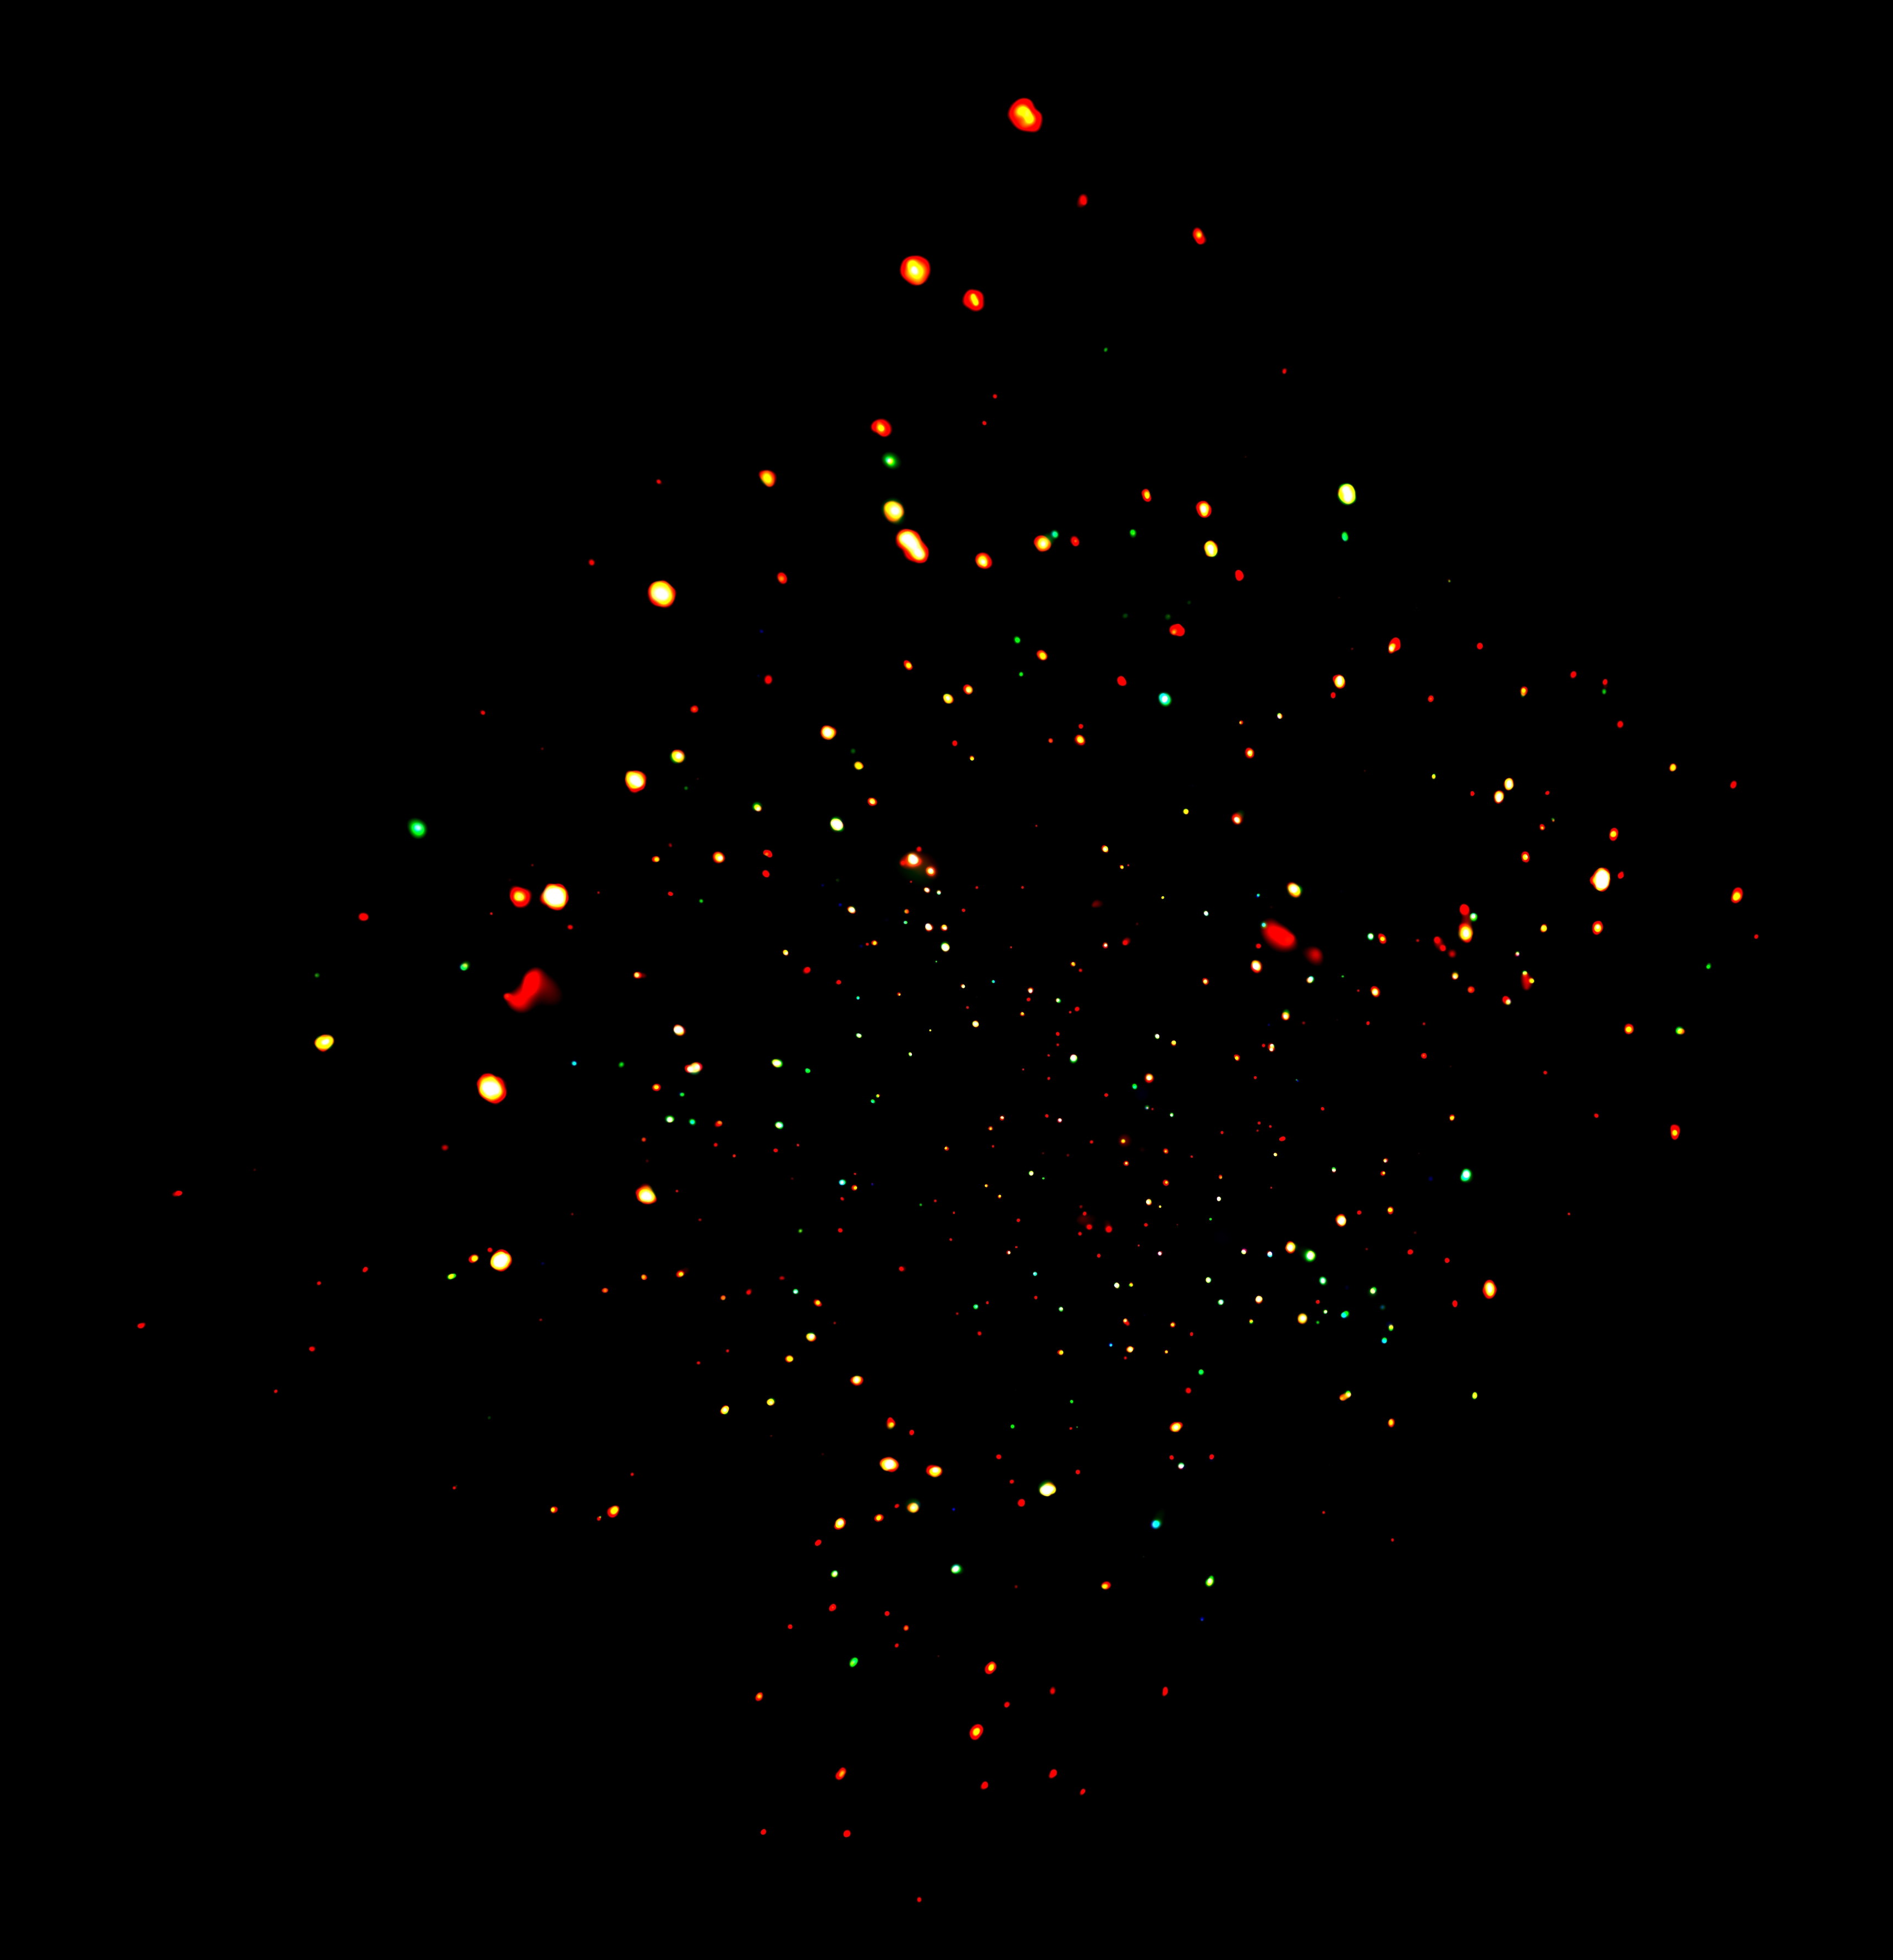
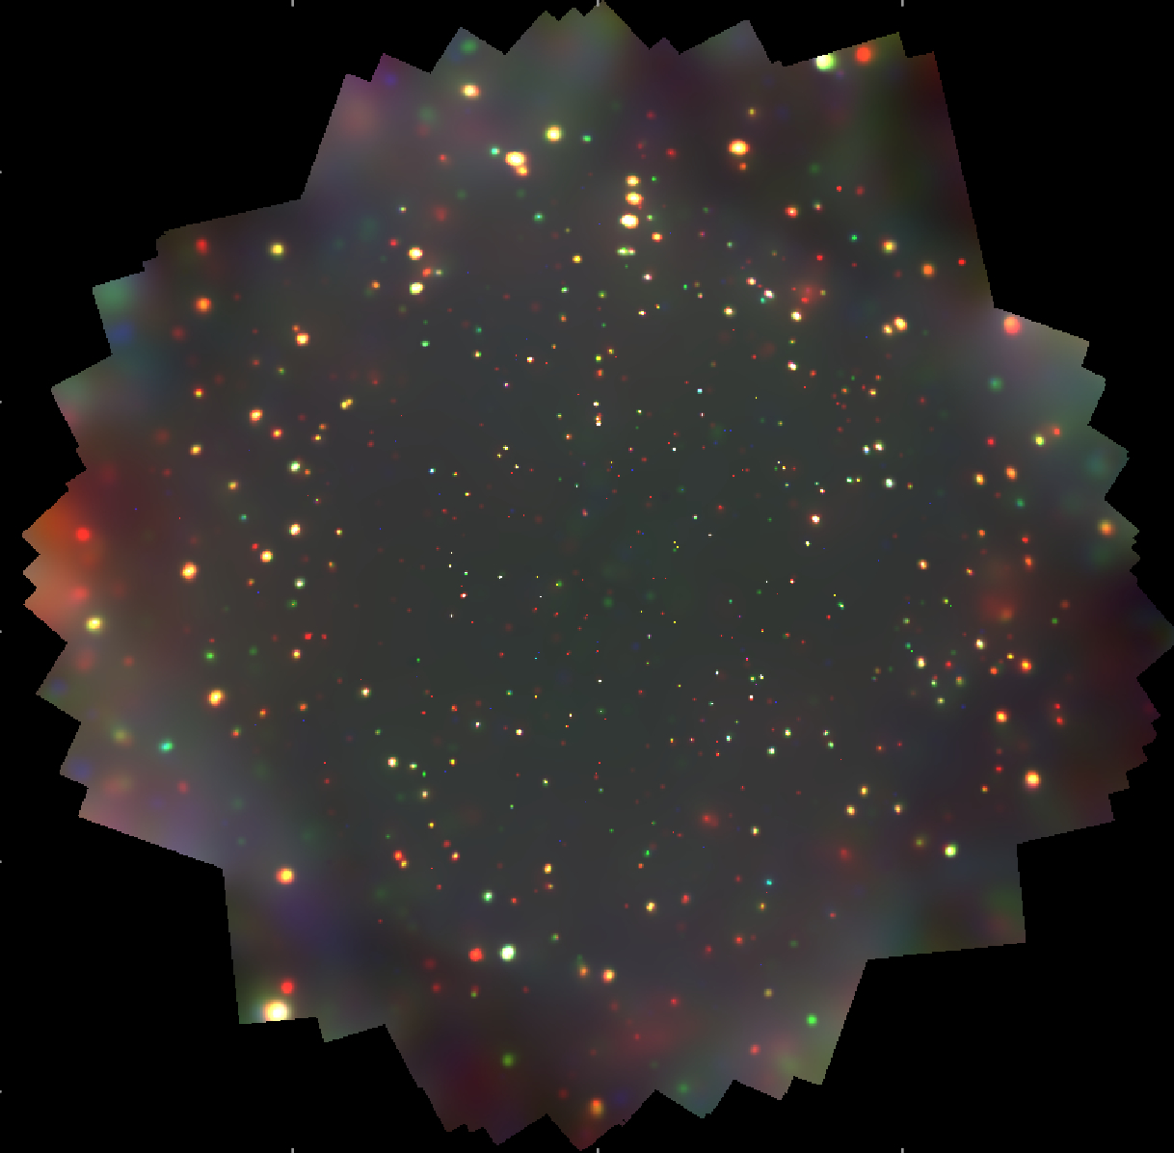
The deepest X-ray fields and the resolved XRB fraction
2Ms Chandra Deep Field North
2Ms Chandra Deep Field South
~0.1 deg² each ~ 0,00025% of whole sky
red = 0.3 -1 keV
green = 1 - 2 keV
blue = 2 -7 keV
Limiting flux ~2 10⁻¹⁷ erg/cm²/s
in the 0.5-2 keV band
2Ms Chandra ~ 20 days integration time

Slide 9
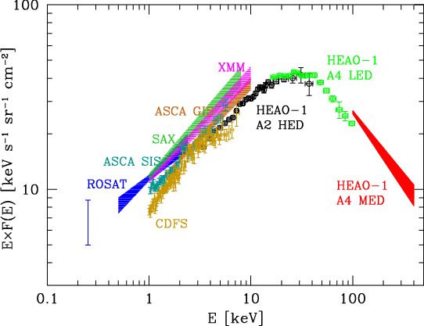
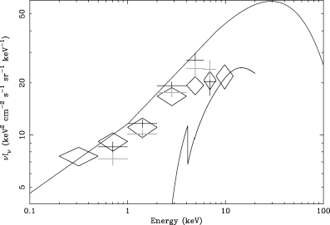
Most (50-80%) of the E < 10 keV XRB is resolved into single sources
From Worsley et al. (2005)
Resolved XRB in the
Chandra Deep Fields
Resolved fraction decreases
with increasing energy

Slide 10
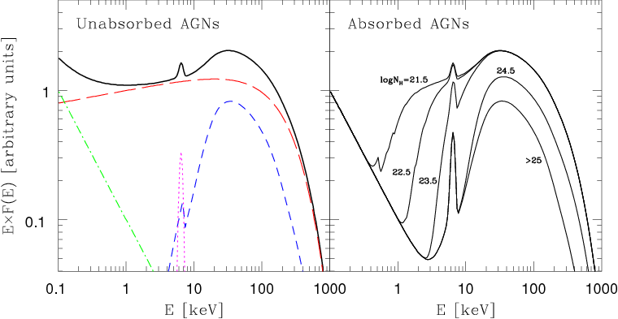
Do bright (unobscured) AGN have the right spectrum to produce the XRB?
observer
α ∼ 0.9
Hot electrons
Black hole
Accretion disk
Primary powerlaw
Soft excess
Compton reflection continuum
Iron Kα line
F(E) = C E^{-α} e^{(-E/Ec)} [1+ A(E) ] + BB(E) + G(E)

Slide 11
AGN X-ray spectra: indices and units
Primary component of AGN X-ray spectra: power law
with a high energy cutoff.
Energy spectrum
F(E) = E^{-α} e^{-(E/Ec)} in keV/cm²/s/keV
Photon spectrum:
N(E) = E^{-Γ} e^{-(E/Ec)} in photons/cm²/s/keV
F(E) = E x N(E)
➔E^{-α} = E x E^{-Γ} = ^{-(Γ-1)} ➔ Γ = α+1
α= spectral index; α ~ 0.7 - 1.0
Γ= photon index; Γ ~ 1.7 - 2.0
E_{c}=high energy cut off; E_{c} ~ 100 – 500 keV (highly uncertain)

Slide 12
Spectral paradox: the X-ray spectra of bright, unobscured AGN is too steep
(α~0.9) to produce the XRB spectrum in the 2-10 keV band (α~0.4) ➔
The contribution from harder sources is fundamental ➔ obscured AGN
XRB spectrum: α=0.4
Spectrum of unobscured AGN: α=0.9
Original idea by Setti&Woltjer1989 subsequently developed by many others
(e.g. Madau+94,Comastri+95,Ballantyne+06,Gilli+07,Treister+09,…)

Slide 13
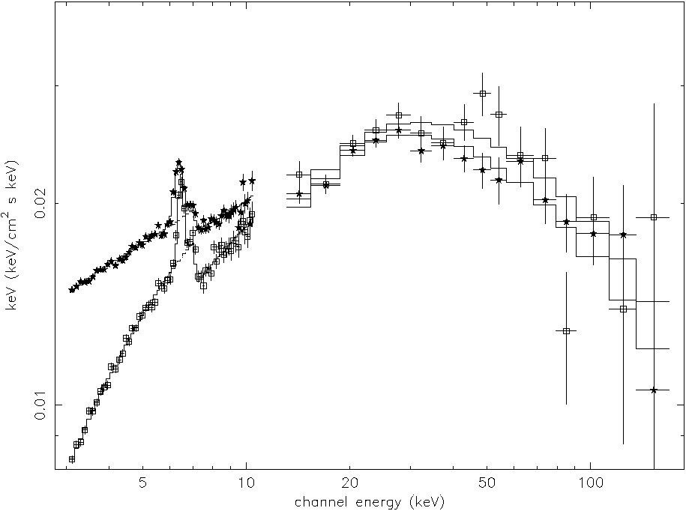
Examples of obscured and unobscured X-ray spectra
Seyfert 1
Absorption cut-off: it mimics
a hard (α<0.7) power law
Seyfert 2

Slide 14
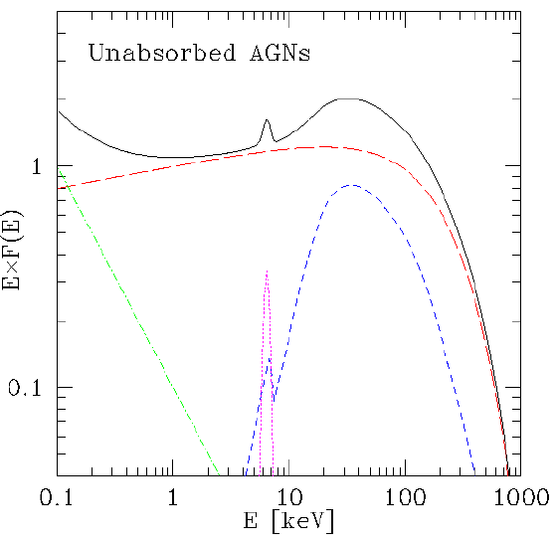
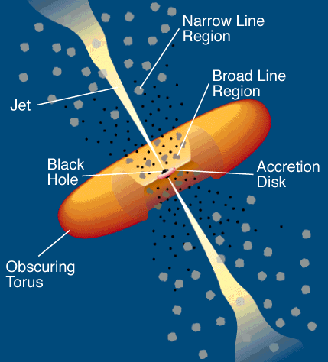
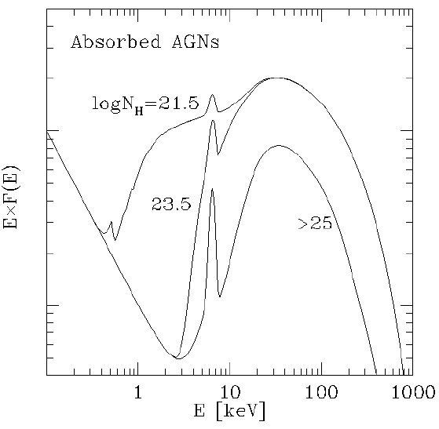
The unified model
Antonucci & Miller (1985)
Figure by Urry & Padovani (1995)

Slide 15
Obscured AGN
Compton reflected
component
observer
T<10⁵ K
Transmitted
component
N_{H}=10²¹-10²⁵ cm⁻²
1-100 pc
F_{abs}(E) ~ F_{unabs} e^{-NHσE} + F_{unabs} A_{torus}(E)

Slide 16
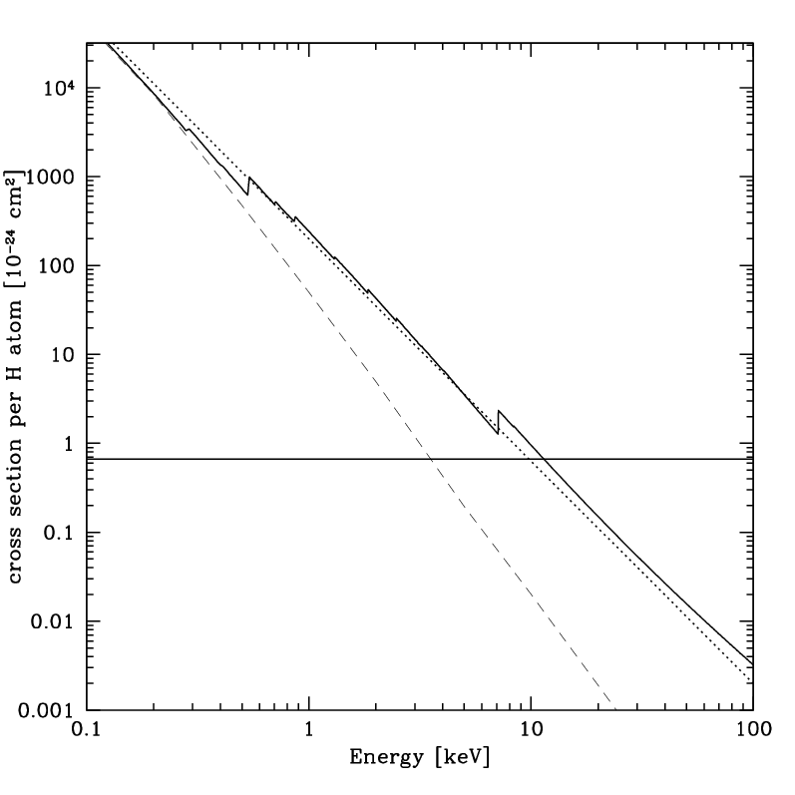
Cross sections
σ_{E} = cross section for
photoelectric absorption
σ_{T} = cross section for
Thomson scattering
N_{H} = hydrogen equivalent
column density
units : cm⁻²
Cosmic abundances
σ_{E} ~ E^{-2.5}
I_{obs}(E)/I_{int}(E) ≈e^{-τ}
τ=N_{H}σ_{E}
σ_{E} ≈E^{-2.5} ➔
Nuclear emission
is transparent at
high energies
Iron edge
at 7.1 keV
σ_{T}
H + He only
σ_{T}>σ_{E} at E> 10 keV
Absorption of X-ray photons is produced by metals

Slide 17
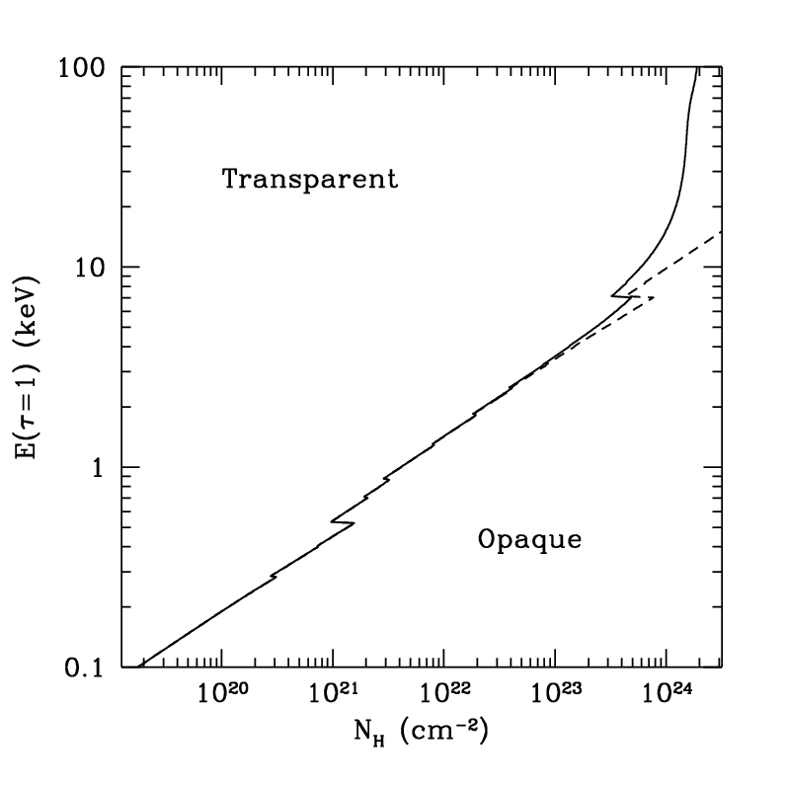
Photoelectric absorption + scattering
I_{obs}(E)/I_{int}(E) ≈e^{-τ}
τ = N_{H}σ
Dashed line = photoelectric absorption only
Solid line = absorption + scattering
For N_{H}>σ_{T}⁻¹~1.5 10²⁴ cm⁻² even
high-energy radiation, which would
escape photo-electric absorption,
is depressed because of scattering.
These objects are called Compton-thick.

Slide 18
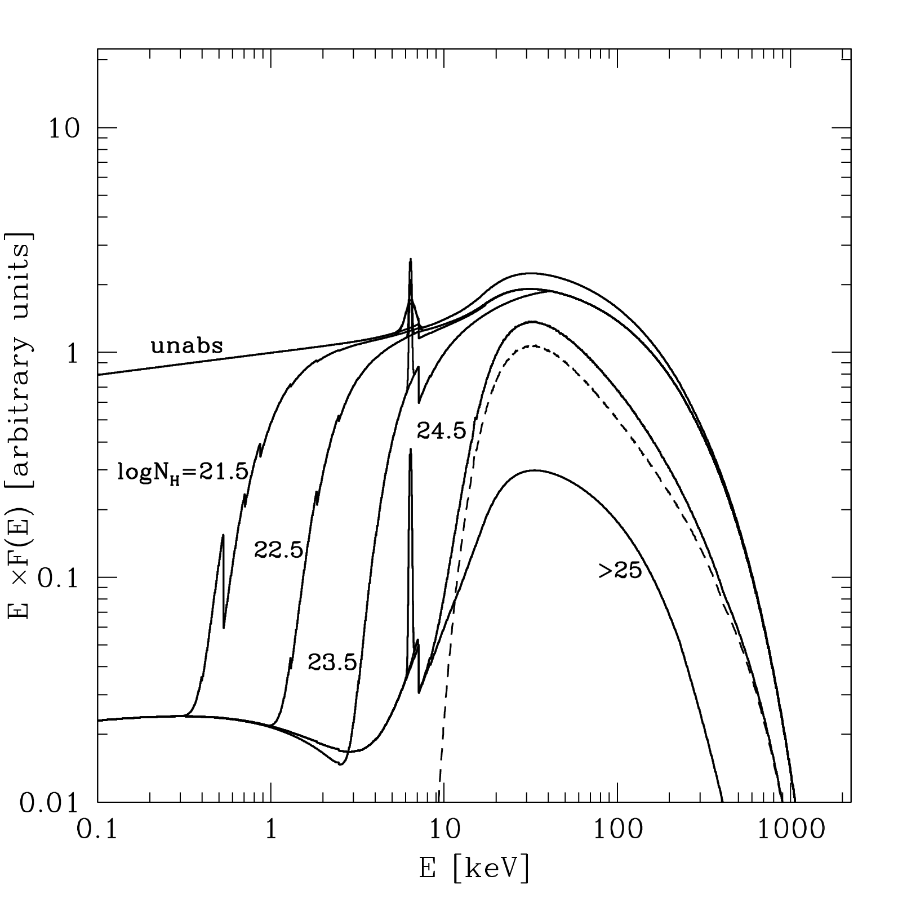
AGN X-ray spectral templates with different N_{H}
Unabsorbed:
logN_{H}<21
Compton-Thin:
21<logN_{H}<24
Compton-Thick:
Mildly (log N_{H} =24-25)
Heavily (log N_{H} >25)
Reflected
component
observer
Transmitted
component
The cold gas in the torus contributes to the iron Kα line emission.
Only about 40 “certified” C-thick AGN
known so far, mostly in the local Universe (z<0.1)
As N_{H} increases, the spectrum is absorbed towards higher and higher energies.

Slide 19
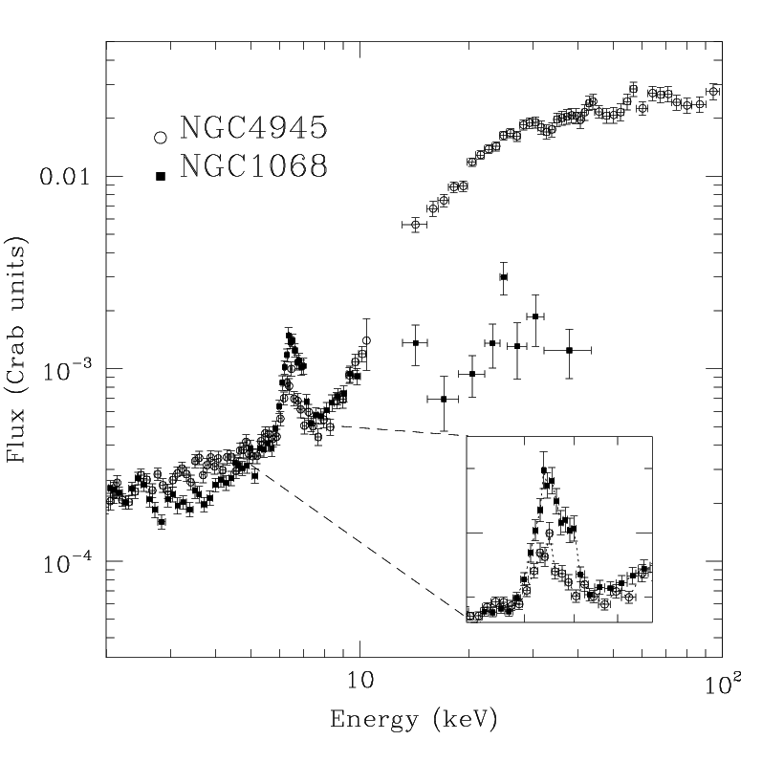
Examples of local Compton-thick AGN
logN_{H}~24
Mildly thick
heavily thick
logN_{H}>25
Seyfert 2 NGC4595 : logN_{H}~24 ➔ reflection + transmission
Seyfert 2 NGC1068 : logN_{H}>25 ➔ only reflection

Slide 20
The number of obscured AGN and relative NH distribution is known with some accuracy only in the local Universe: the cosmological evolution of the NH distribution and of the abs/unabs AGN ratio are still debated (La Franca+05, Treister+06, and others)
How many AGN are obscured?
Risaliti et al. (1999)
frazione
22 23 24 25
logN_{H}
In the local Universe it is estimated that absorbed AGN outnumber unobscured
ones by a factor of >4, and that half of them are Compton-thick (N thick ~ N thin): therefore, more than 80% of the local AGN population is obscured.

Slide 21
Synthesis of the XRB
I
X-ray spectrum
X-ray luminosity function
I(E)=cosmic XRB intensity . Usually in units of keV/cm²/s/sr/keV

Slide 22
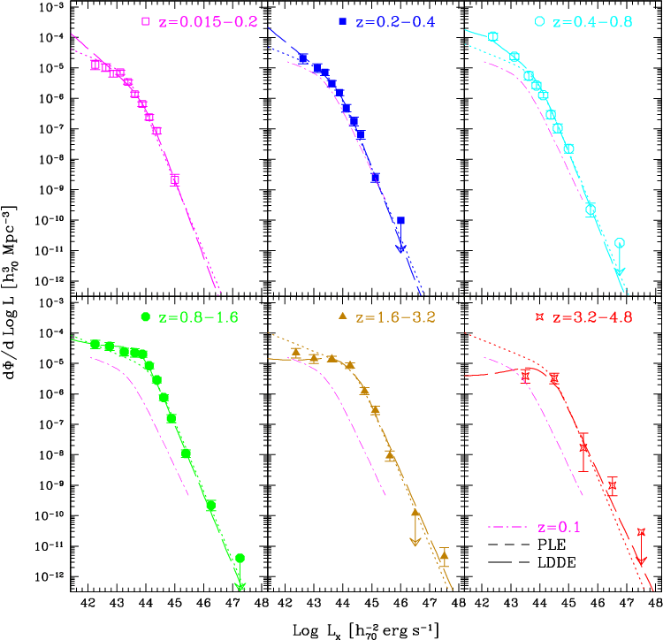
AGN luminosity function in the soft band (unobscured AGN only)
Luminosity dependent
density evolution
(LDDE):
evolution rate is
higher for high
luminosity objects
From
Hasinger, Miyaji & Schmidt (2005)

Slide 23
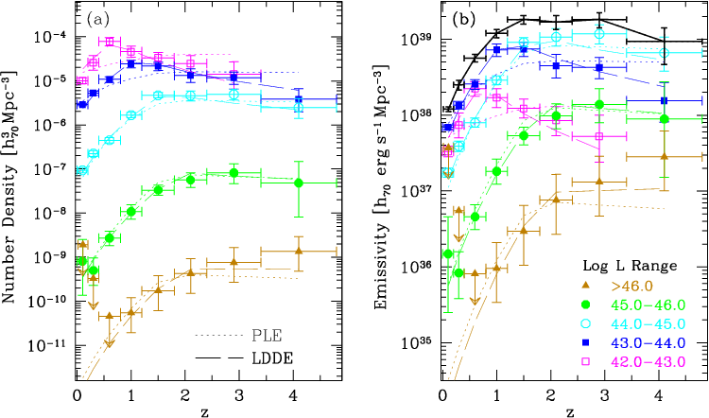
AGN cosmological evolution
Number density Luminosity density
Objects with lower luminosity peak at lower redshift,
similar to what observed for SFR in galaxies: downsizing

Slide 24
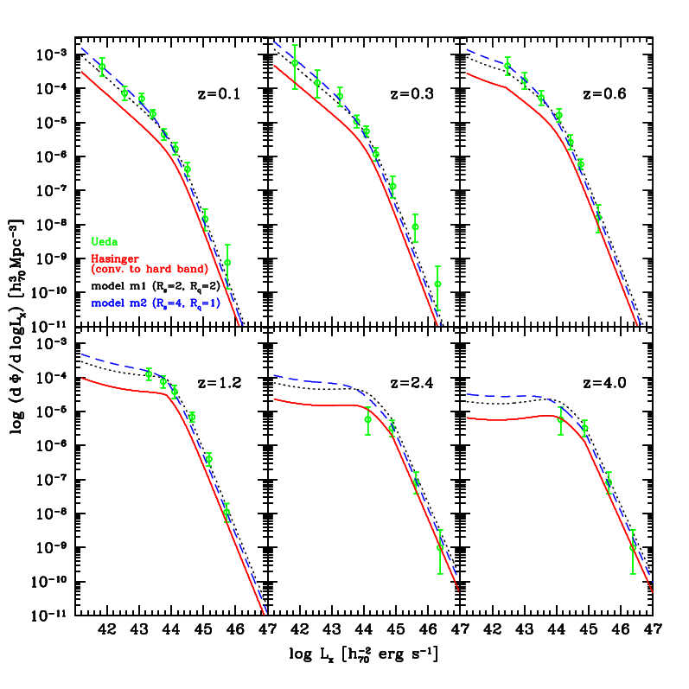
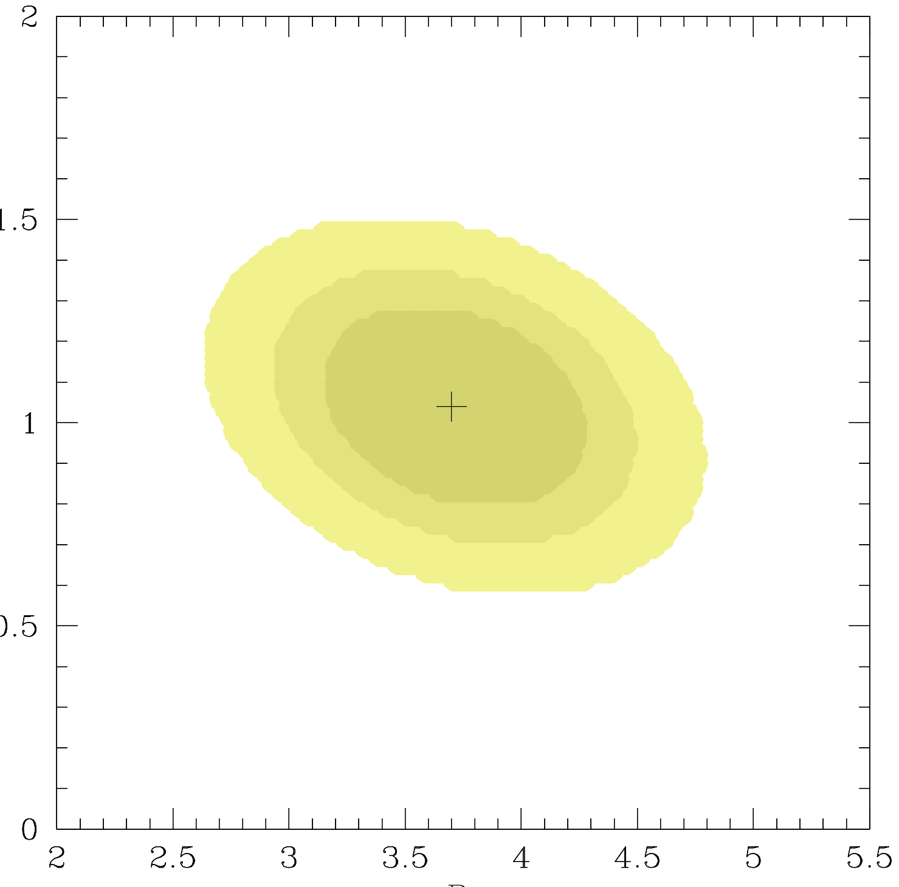
Hard band (2-10 keV) LF: unabs + Compton-thin AGN
Unabsorbed AGN
(from soft XLF)
Total Compton-thin AGN (abs/unabs ratio decreasing with increasing Lx)
Total Compton-thin AGN
(constant abs/unabs ratio)
R ( high lum )
R ( low lum )
Best fit thin/unabs ratios: ~ 4 for Log Lx ~ 42 erg/s
~ 1 for Log Lx ~ 45 erg/s

Slide 25
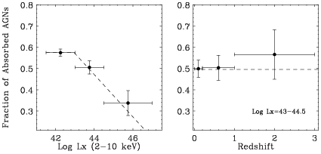
Dependence of the obscured AGN fraction on X-ray luminosity and redshift
From Ueda et al. (2003)
Broad consensus for an obscured AGN fraction declining
towards high intrinsic luminosities ➔ receding torus model
(Lawrence 1991, Simpson 2005)
Behavior with z still debated (e.g. La Franca+2005,Treister+06,Gilli+09)

Slide 26
How about the evolution of C-thick AGN?
We essentially do not know
In XRB models they are usually assumed to evolve like less obscured AGN, but this has still to be proven
What is the relative fraction
of mildly vs heavily C-thick AGN?
We essentially do not know
In XRB models they are usually assumed to be equally abundant

Slide 27
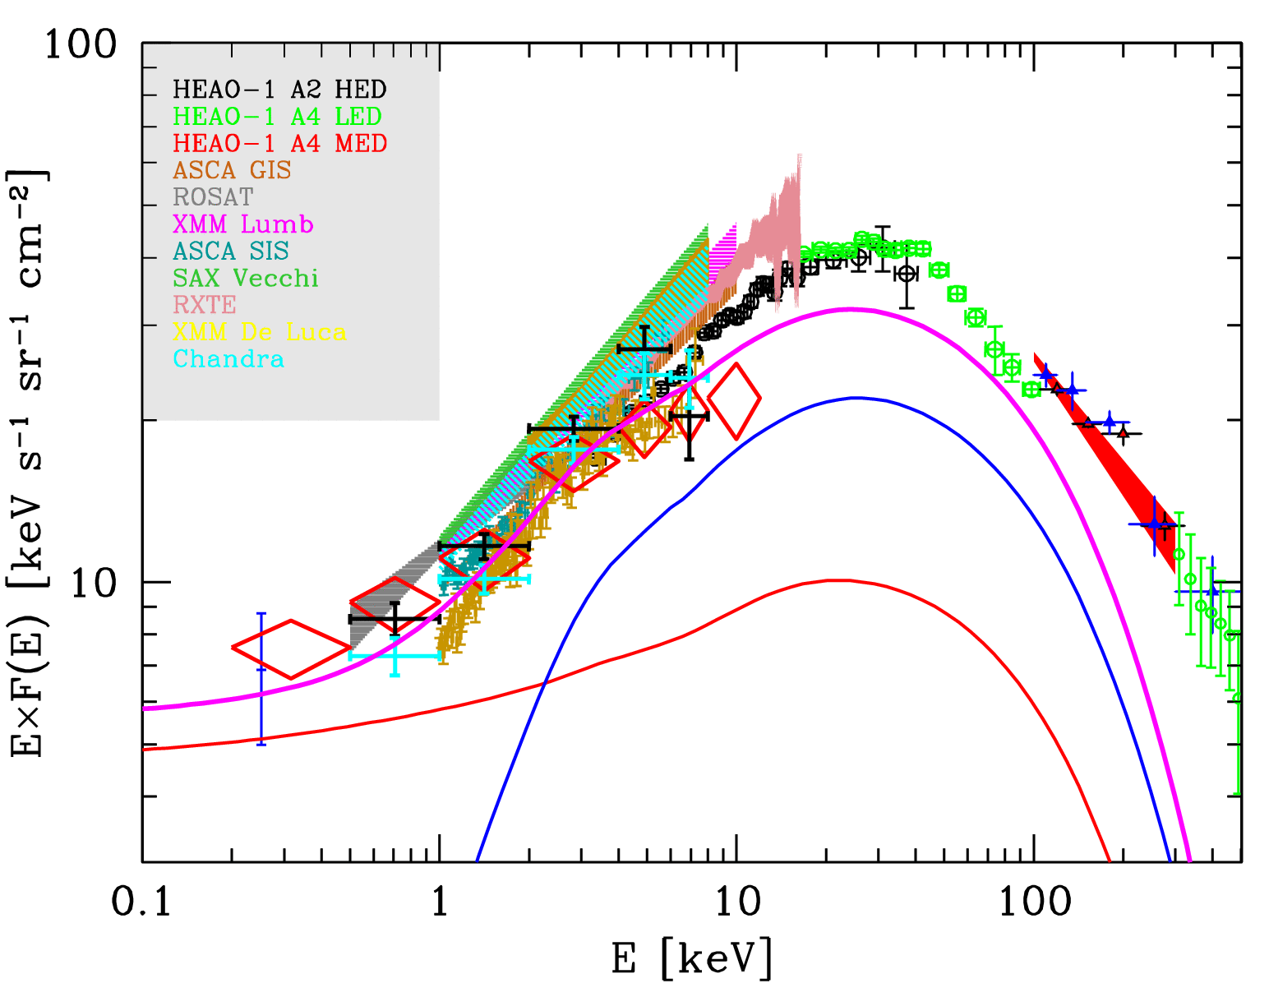
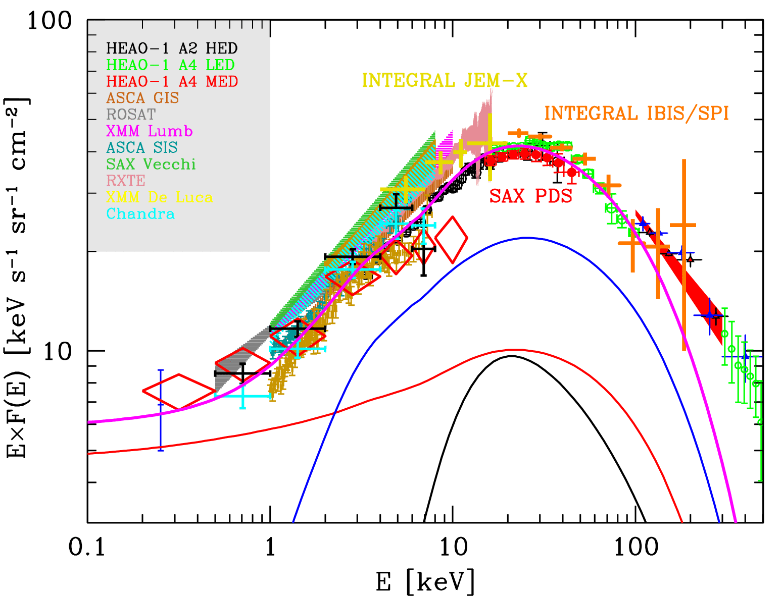
The fit to the XRB spectrum
N thick
=
N thin
COMPTON-THICK AGN NECESSARY TO FILL THE 30 KEV GAP:
their contribution varies from 10 to 30% depending on model assumptions
Many models in the literature.

Slide 28
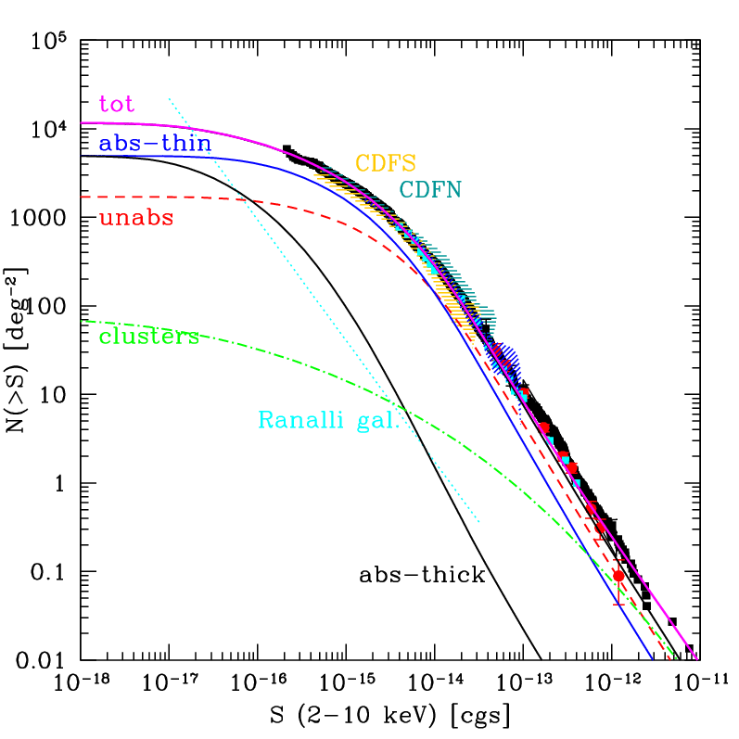
AGN number counts logN-logS relation: source counts above a given flux S. At bright fluxes unobscured AGN dominates, while the contribution from obscured sources increases towards fainter fluxes.
For a Euclidean
Universe:
N(>S) ~ S^{-1.5}
[cgs] = erg/cm²/s

Slide 29
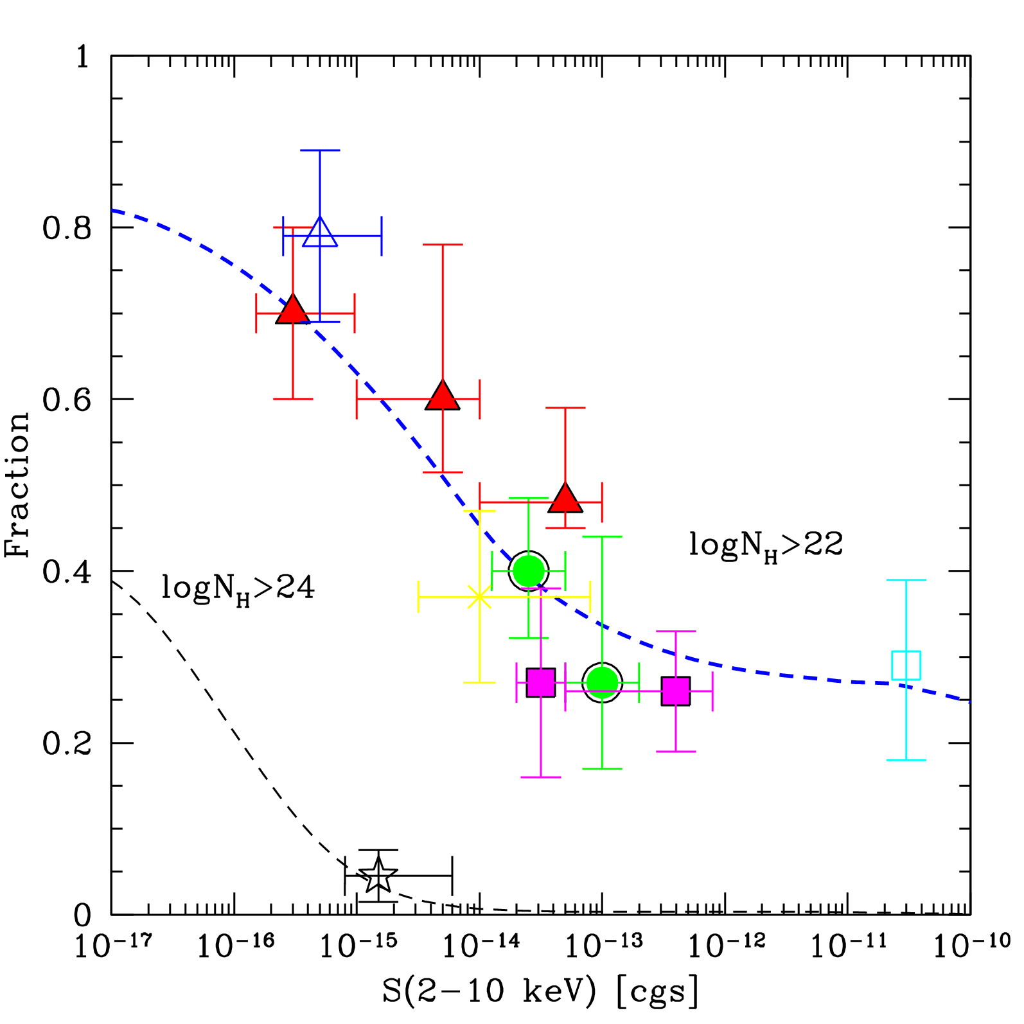
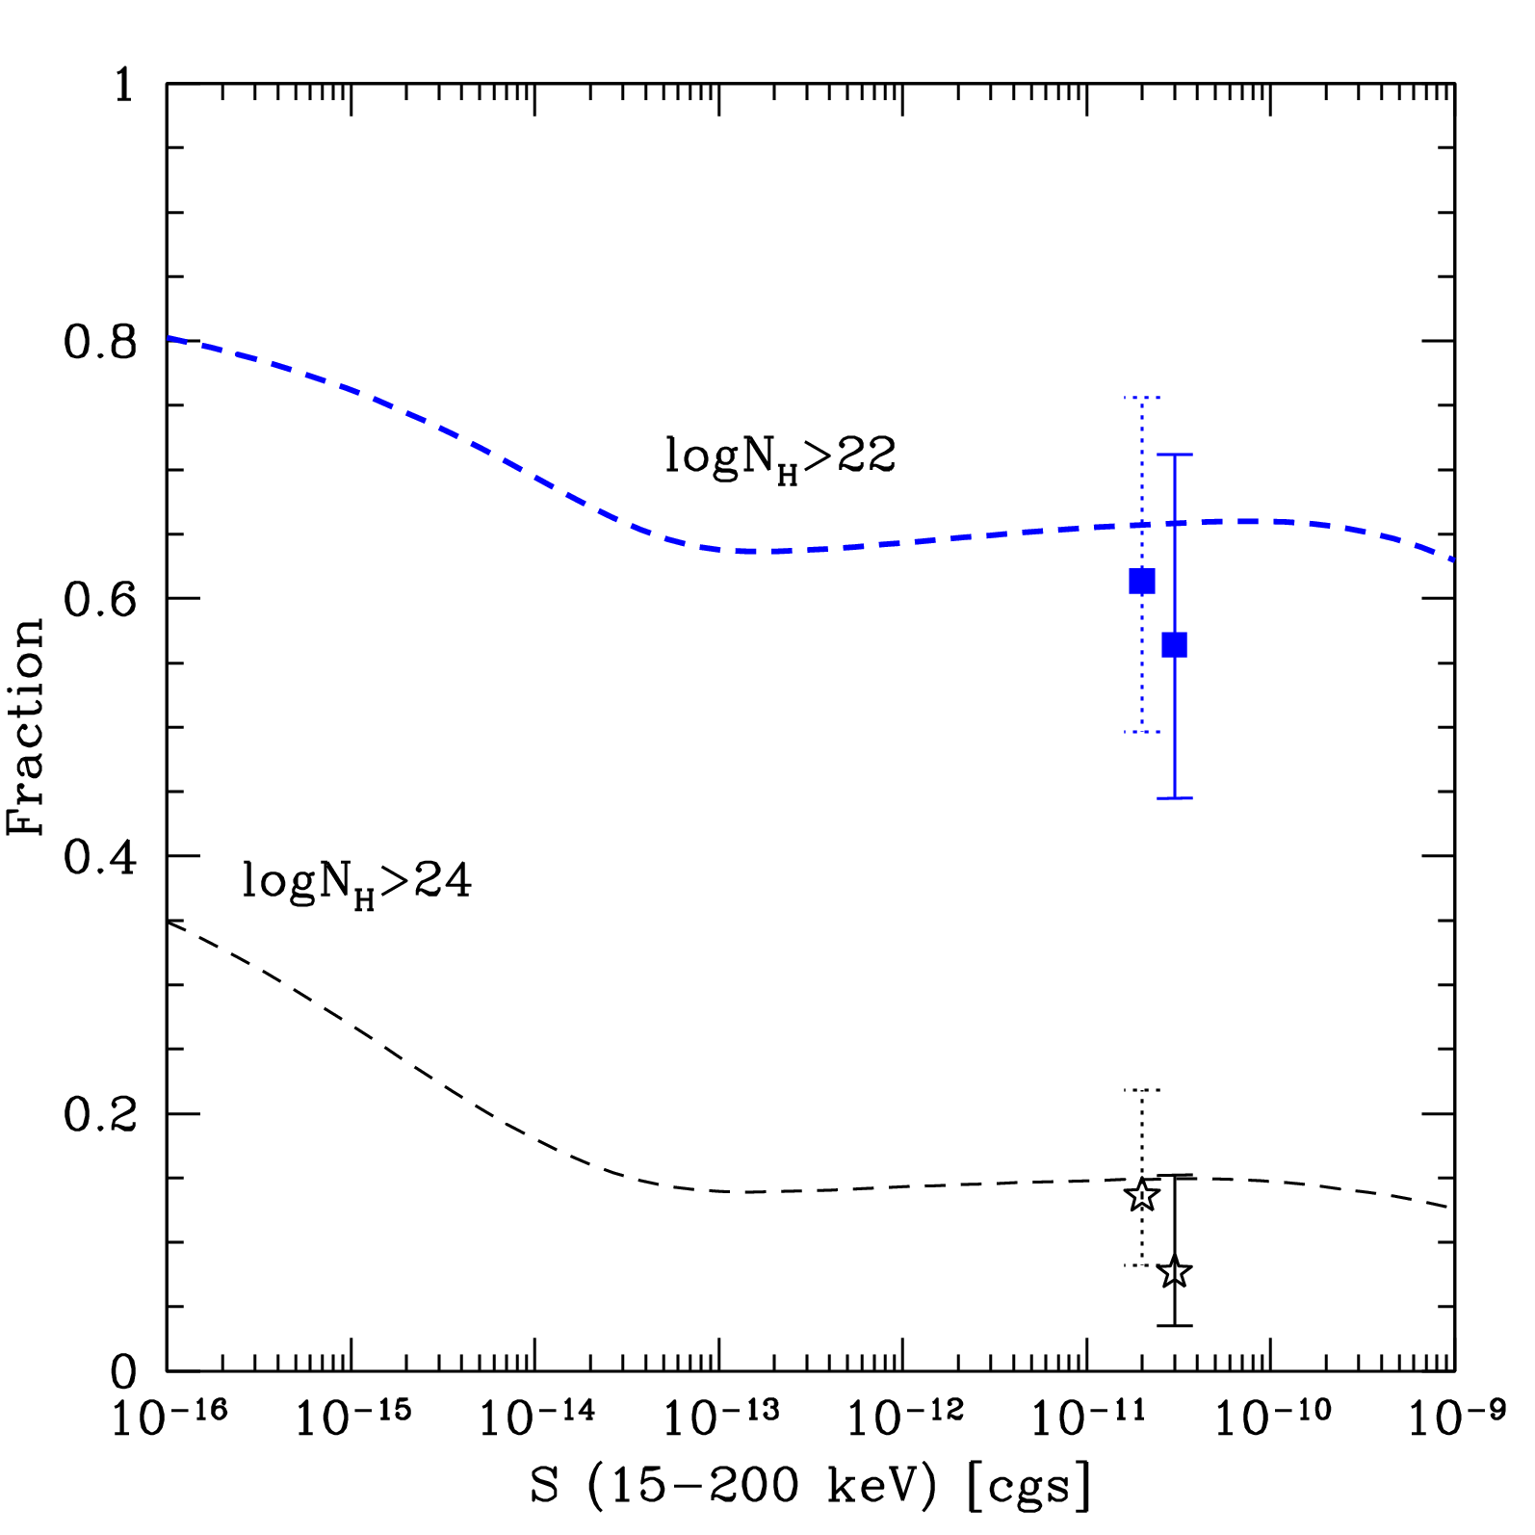
Obscured AGN fraction vs sample limiting flux
2-10 keV samples
Swift/BAT (> 10 keV) sample
All abs.
All abs.
Thick
Thick
Compton-thick candidates in the CDFS (Tozzi et al. 2006)
Compton-thick AGN are present in very small numbers in current samples

Slide 30
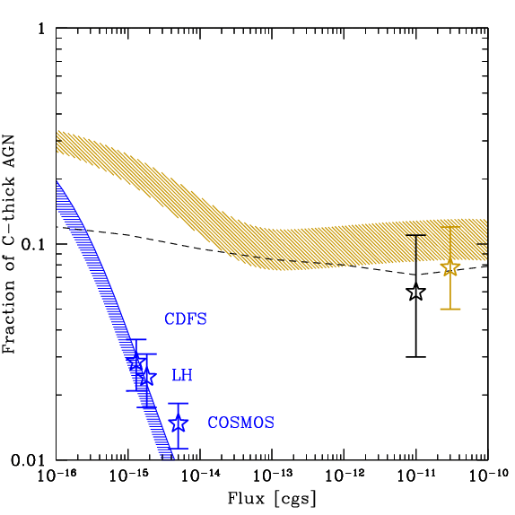
The fraction of C-thick AGN
> 10 keV
2-10 keV

Slide 31
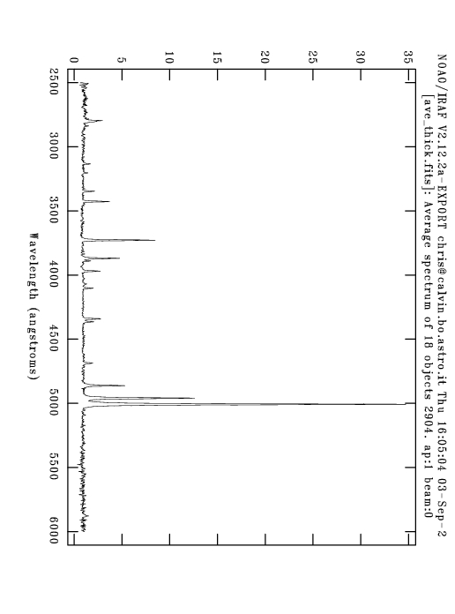
How to select C-thick AGN?
OBSERVER
Narrow Line
Region
Optical emission lines of photo-ionized
elements: e.g. [O III]5007, [NeV]3427
[OIII]5007
[NeV]3427
IR emission
from heated dust
torus
Objects with unusually weak
X-ray emission wrt to
IR (e.g. at 6μm) or line emission
are candidate C-thick AGN

Slide 32
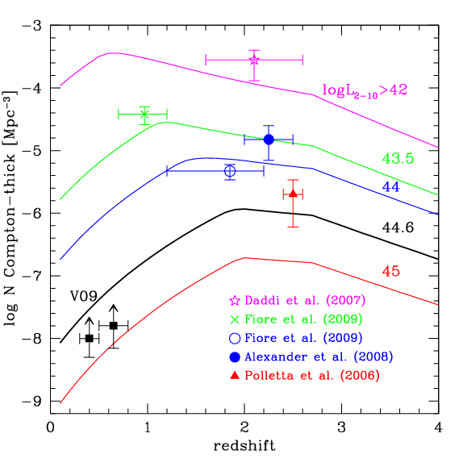
Space density of C-thick AGN
But these are indirect estimates: one needs X-ray spectra to unambiguously select C-thick AGN

Slide 33
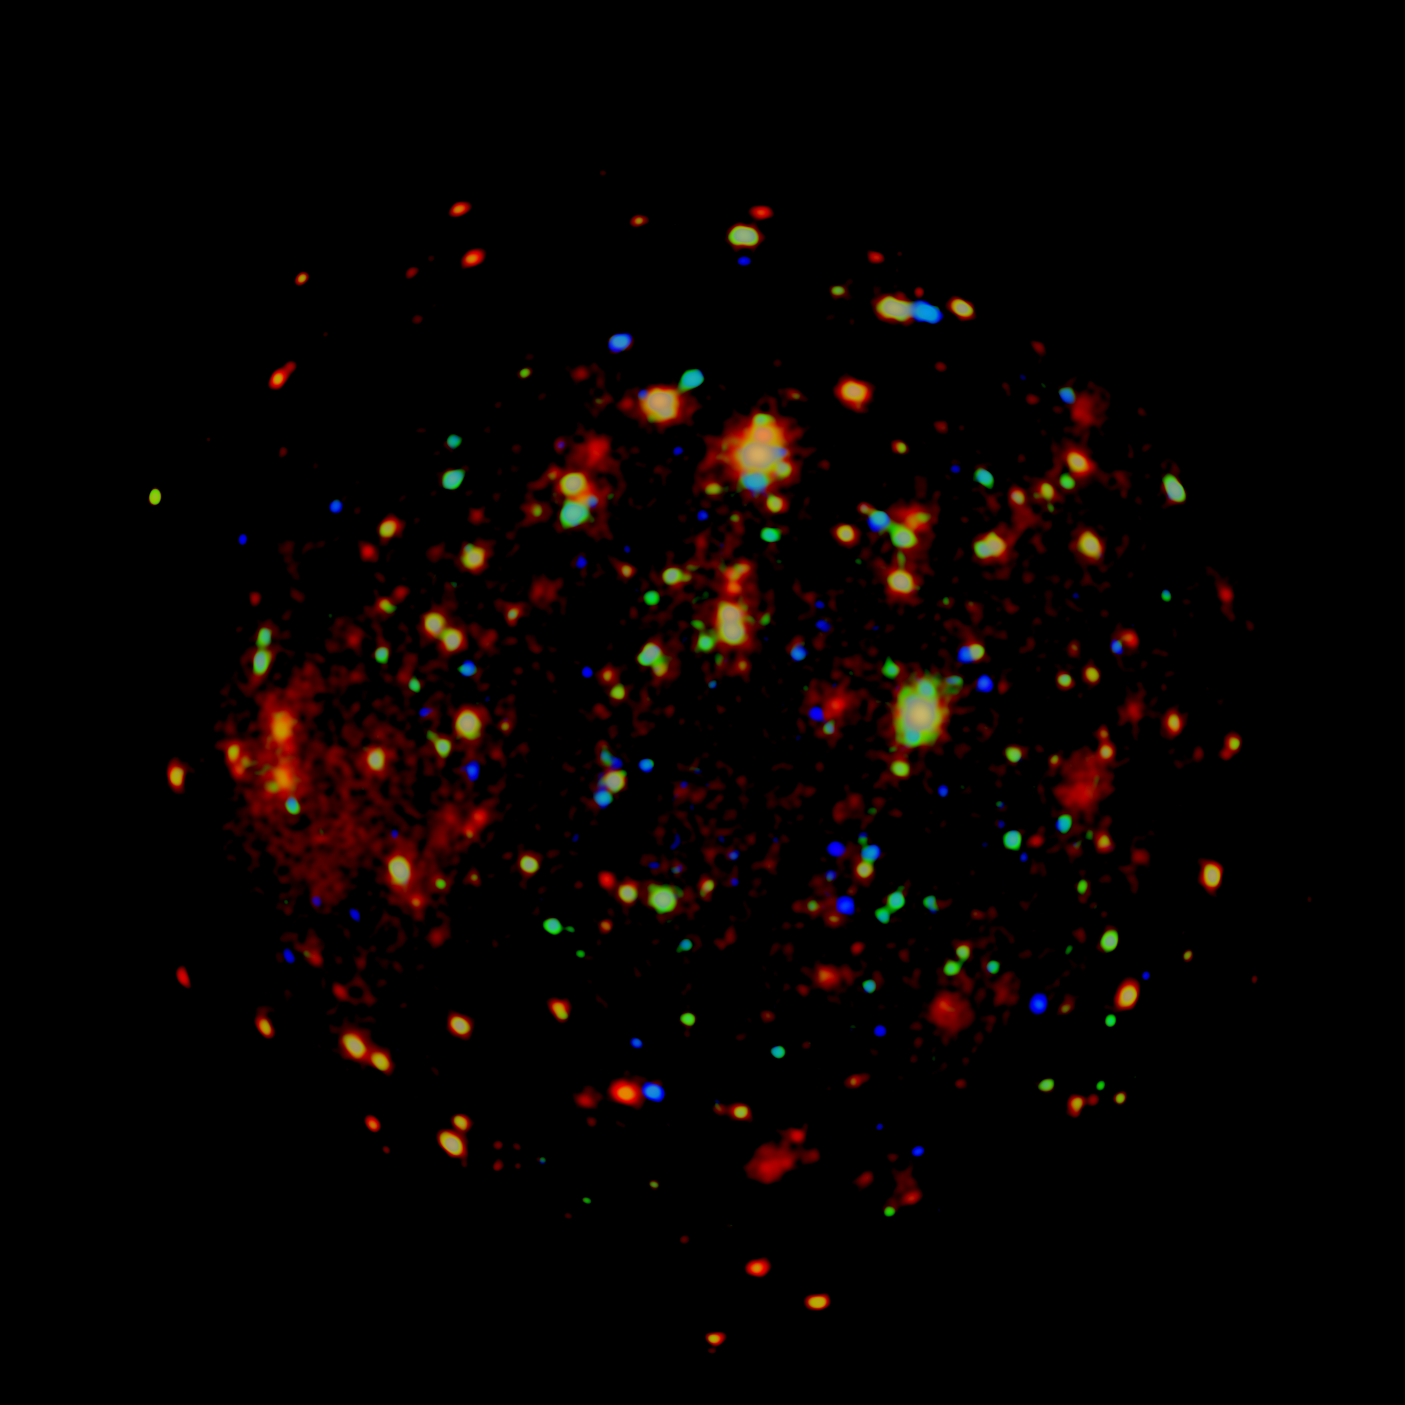
2.5Ms XMM image of the Chandra Deep Field South
~0.3 deg²
red = 0.4 -1 keV
green = 1 - 2 keV
blue = 2 -8 keV
Goals:
resolve the XRB in the 5-10 keV band
get spectra of distant heavily obscured AGN
PI A. Comastri

Slide 34
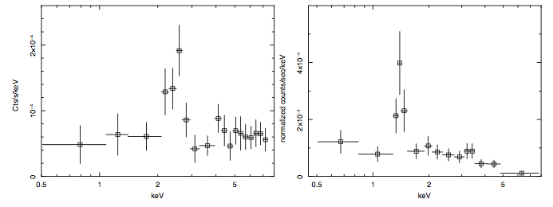
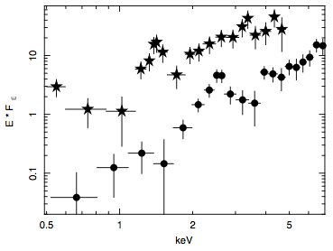
Two clear examples of distant C-thick AGN found in the XMM-CDFS
XID 153
z=1.53
XID 202
z=3.70
XID 202
XID 153
Detection of significant samples of distant C-thick AGN
will allow to determine their cosmological evolution

