Slide 1
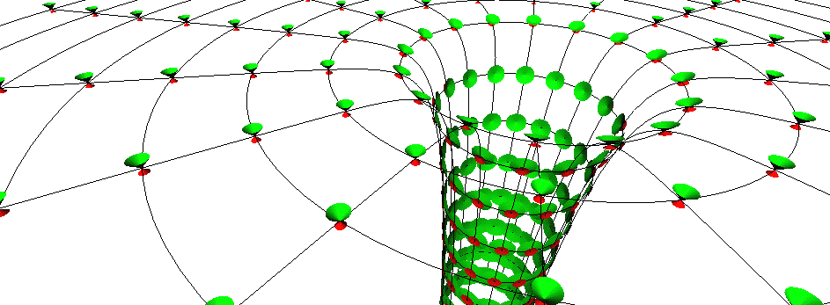
Black holes in Einstein
General Relativity
Prof Chris Done, University of Durham

Slide 2


Slide 3
Special relativity
t
Towering achievement
Throw away ideas about fixed space and fixed time!!!
NOT that everything is relative!
Fixed spacetime interval
1D + time,
ds²=c²dτ²=c²dt² - dx²
P
dt
ds
dx
x

Slide 4

Special relativity
ds²=c²dτ²=c²dt² - dx²
Travelling at fixed speed c through spacetime….
Generally all through time
If put some of the motion through space then takes
longer to move through time (time dilation)
BUT only does inertial frames – not acceleration

Slide 5
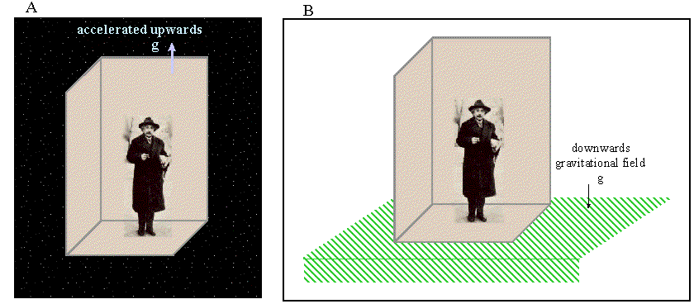
Gravity = acceleration
difference between gravity and acceleration ?
Look the same, behave the same…
Maybe they ARE the same - ‘happiest thought’
Principle of equivalence: acceleration=gravity

Slide 6
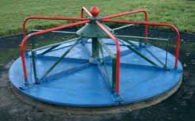
Acceleration: special relativity
Circular motion easiest to think about
Measure roundabout circumference (CL) and radius (rL) by crawling around with ruler of length L
Get ratio C/r=2π
Now rotate ….

Slide 7
Acceleration: special relativity
Length contracts along direction of motion so need more ruler lengths to go round c’ > c!! But radius unaffected
Ratio c’/r > 2π
Can’t happen!! …in flat space

Slide 8
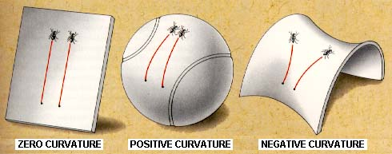
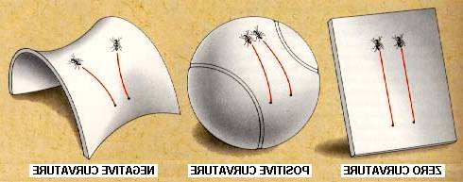
Curved spaces
Can happen in curved spaces!!
eg sphere. Circle round equator. Circumference is 2πr, diameter is πr so ratio is 2 < π!!!
Can get ratio > π only in negatively curved space – curves towards in one direction and away in another (saddle)

Slide 9
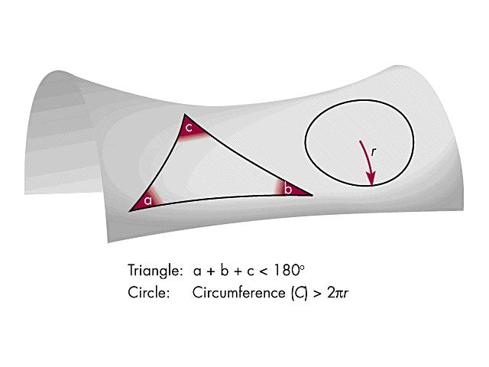
Curved spaces
If we want to do acceleration then we have to
do curved spaces. ie curved spacetime!!
So do we REALLY want to do acceleration ?

Slide 10
Acceleration = Curvature (SR)
Gravity = Acceleration (EP)
hence
Gravity = Curvature

Slide 11
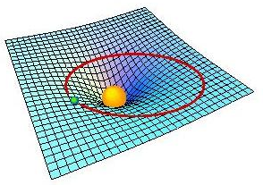
Gravity: warped spacetime
Gravity IS curvature
Natural paths (no forces acting ie inertial frames) are ‘straight lines’ on curved space - geodesics

Slide 12
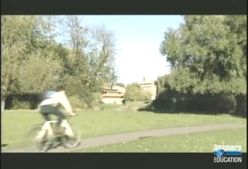

Slide 13
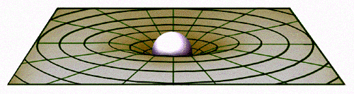
Toolkit for GR
How to describe curvature ?
How does mass(energy) curve space(time) ?

Slide 14
Toolkit for GR
How to describe curvature ?
How does mass(energy) curve space(time) ?
How to describe these ‘straight line’ natural paths?
True position
Apparent position

Slide 15
Toolkit for GR
How to describe curvature ?
How does mass(energy) curve space(time) ?
How to describe these ‘straight line’ natural paths?
Tensors
True position
Apparent position

Slide 16
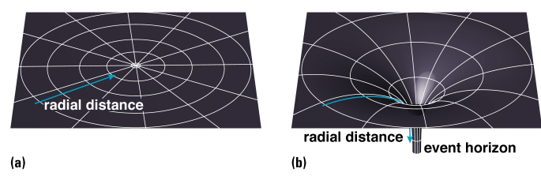
Curved spacetime: general relativity
ds²=(1-2GM/c²r) c²dt² - (1-2GM/c²r)⁻¹ dr² - r²dθ² - r²sin²dφ²
Schwarszchild metric – R_{s}=2GM/c² get stationary paths with ds²=(1-2GM/c²r) c²dt² <0 so don’t exist! HAVE to fall down, spacetime itself is falling down – EVENT HORIZON

Slide 17
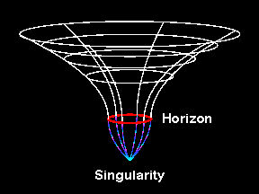
Gravity: warped spacetime
No change in curvature at Earths orbit – black holes don’t suck inexorably! (Unlike bad SF movies… but there is something very odd close to the event horizon…..)
But what happens at horizon? And below??

Slide 18
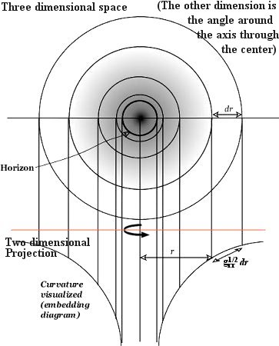
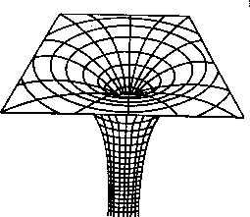
Embedding diagram
dR = (1-2GM/c²r)^{-1/2} dr
dR > dr so tilt
dR →∞ as r → R_{s}

Slide 19
Event horizon
Embedding diagram has infinite throat at r=2R_{g}=2GM/c²
BUT this assumed you can measure a length dR
ds²=(1-2GM/c²r) c²dt² - (1-2GM/c²r)⁻¹ dr² - r²dθ² - r²sin²dφ²
Below 2GM/c² real paths MUST have a spatial term (now +ve) to offset the dt (now –ve) term. So no such thing as stationary observers at or below horizon.
Depends on BH spin – its at 2Rg for a=0, 1Rg for a=1 (maximal spin, event horizon rotating at c)

Slide 20
Event horizon
Embedding diagram shows dR not spacetime (Riemann) curvature. True curvature → ∞ at r=0 and is finite (though large) at r=R_{s}
r=0
r=Rs
r
t
t
t
r
r
r
And principle of equivalence – in free fall so is inertial frame and no difference between this and no gravity at all!
until you hit r=0 or rather when tidal forces rip you apart.
t
r

Slide 21
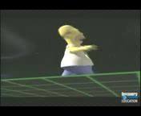

Slide 22
Particle orbits
Newtonian orbits
Gravity attractive – wants to be closer in.
but if closer then rotate faster due to angular momentum conservation
Bigger outward centrifugal force!
Balance inward gravity with outward angular momentum to get stable orbit
Can always orbit closer
energy
Angular momentum, barrier ∝1/r²
r
Newtonian gravity ∝ -1/r

Slide 23
Particle orbits
Extra terms in GR potential
(Rest mass energy)
Term which is –ve so adds to gravitational potential and makes it stronger
Gravity will always dominate if get to small enough r!
energy
Angular momentum, barrier ∝1/r²
Rest mass energy
r
Newtonian gravity ∝ -1/r
Extra GR ∝-1/r³

Slide 24
Behaviour of maximum…
Last stable orbit – gravity so strong that no friendly angular momentum barrier to stop you falling down……6Rg for a=0
1Rg for a=1 (horizon rotating at speed of light)
9Rg for a=-1 – disc rotates in opposite direction to BH
energy
Angular momentum, barrier ∝1/r²
Rest mass energy
r
Newtonian gravity ∝ -1/r
Extra GR ∝-1/r³

Slide 25
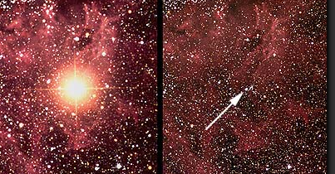
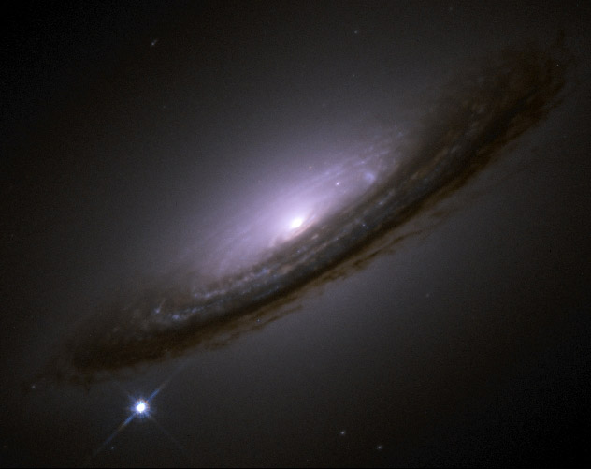
Supernovae
Stellar mass black holes
Core collapse of massive star
Supernovae!
Core: neutron star or black hole depending on initial mass

Slide 26

Black hole vs neutron star
Neutron star held up by quantum state of neutrons
But no known state of matter can hold up complete collapse if M>3xSun
Event horizon only factor of 3 smaller than a neutron star – Rns~Risco
Accretion flow sees same gravity – then hits surface

Slide 27
Observing black holes?
How to test this ?
The thing about a black hole, its main distinguishing feature is its black! And the thing about space, your basic space colour is its black! So how are you supposed to see them ? Red Dwarf

Slide 28
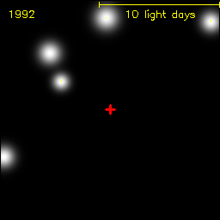
By gravity – all they possess!
Gravitational effect on nearby stars
Stars in GC get to within a lightday, but this is 2000x event horizon. Not probing the REALLY curved BH spacetime.
Hard to detect

Slide 29
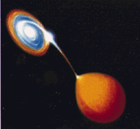
Disc Accretion
Single particles orbit
Gravitational orbits - inner ones faster
Continuous ring of gas - Frictional viscosity dissipates energy as material can fall inwards
BRIGHT accretion discs glowing X-ray hot

Slide 30
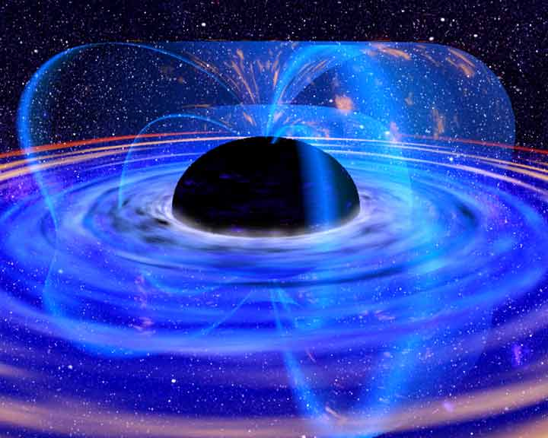
Accretion
Accreting BH: huge X-ray luminosity close to event horizon R_{s}
Emission from region of strong spacetime curvature
Observational constraints on strong gravity if we can understand accretion!

Slide 31
Accretion
Accreting BH: huge X-ray luminosity close to event horizon R_{s}
Emission from region of strong spacetime curvature
Observational constraints on strong gravity if we can understand accretion!
Neutron star size ~ Risco so accretion flow sees same gravity and similar mass as in BHB- then hits surface - test of event horizon!

Slide 32
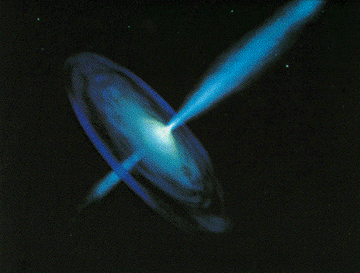

Black holes
Stellar mass BHB
Observational template of how accretion flows (spectra and variability) and their associated jet behave
Build a working physical model of accretion flows

Slide 33
Black holes
Scale up to AGN – what works and what doesn’t
Need to understand accretion flow and jet feedback in order to understand galaxy formation

Slide 34
Spectra
Plot νf(ν) as this peaks at energy where power output of source peaks.
N(E)=AE ^{−Γ}
F(E)=EN(E)= AE^{−Γ+1}=AE^{-α}
α=Γ−1
Log Εf(Ε)
Soft spectrum
Most power at low E
α>1 Γ>2
Log Ε
dL= F(E) dE = EF(E) dE/E = EF(E) dlog E

Slide 35
Spectra
Plot νf(ν) as this peaks at energy where power output of source peaks.
N(E)=AE ^{−Γ}
F(E)=EN(E)= AE^{−Γ+1}=AE^{-α}
α=Γ−1
Log Εf(Ε)
hard spectrum
Most power at high E
α<1 Γ<2
Log Ε
dL= F(E) dE = EF(E) dE/E = EF(E) dlog E

Slide 36
Spectra
Plot νf(ν) as this peaks at energy where power output of source peaks.
N(E)=AE ^{−Γ}
F(E)=EN(E)= AE^{−Γ+1}=AE^{-α}
α=Γ−1
Log Εf(Ε)
flat spectrum
Equal power per decade
α=1 Γ=2
Log Ε
dL= F(E) dE = EF(E) dE/E = EF(E) dlog E

Slide 37
Spectra of accretion flow: disc
Differential Keplerian rotation
Viscosity B: gravity → heat
Thermal emission: L = AσT⁴
Temperature increases inwards until minimum radius R_{lso}(a*) For a*=0 and L~L_{Edd} T_{max} is
  1 keV (10⁷ K) for 10 M
  10 eV (10⁵ K) for 10⁸ M
Log ν f(ν)
Log ν
Notes:
Accretion discs are the most well known form of the accretion flow. Inner radii rotate faster so there is viscous friction (a magnetic dynamo) which converts gravitational energy to heat. If this thermalises then at large radii there is not much gravitational energy and a lot of area, so producing low temperature, while at small radii there is lots of energy and not much area, so high temperature. There is a minimum radius – the last stable orbit which is a GR prediction – so there is a maximum temperature. At LEdd this is of order 1keV, or 10 million degrees for GBH, or 10eV, a hundred thousand degrees for a supermassive BH.

Slide 38
Spectra of accretion flow: disc
Differential Keplerian rotation
Viscosity B: gravity → heat
Thermal emission: L = AσT⁴
Temperature increases inwards until minimum radius R_{lso}(a*) For a*=0 and L~L_{Edd} T_{max} is
  1 keV (10⁷ K) for 10 M
  10 eV (10⁵ K) for 10⁸ M
Log ν f(ν)
Log ν
Notes:
Accretion discs are the most well known form of the accretion flow. Inner radii rotate faster so there is viscous friction (a magnetic dynamo) which converts gravitational energy to heat. If this thermalises then at large radii there is not much gravitational energy and a lot of area, so producing low temperature, while at small radii there is lots of energy and not much area, so high temperature. There is a minimum radius – the last stable orbit which is a GR prediction – so there is a maximum temperature. At LEdd this is of order 1keV, or 10 million degrees for GBH, or 10eV, a hundred thousand degrees for a supermassive BH.

Slide 39
Spectra of accretion flow: disc
Differential Keplerian rotation
Viscosity B: gravity → heat
Thermal emission: L = AσT⁴
Temperature increases inwards until minimum radius R_{lso}(a*) For a*=0 and L~L_{Edd} T_{max} is
  1 keV (10⁷ K) for 10 M
  10 eV (10⁵ K) for 10⁸ M
Log ν f(ν)
Log ν
Notes:
Accretion discs are the most well known form of the accretion flow. Inner radii rotate faster so there is viscous friction (a magnetic dynamo) which converts gravitational energy to heat. If this thermalises then at large radii there is not much gravitational energy and a lot of area, so producing low temperature, while at small radii there is lots of energy and not much area, so high temperature. There is a minimum radius – the last stable orbit which is a GR prediction – so there is a maximum temperature. At LEdd this is of order 1keV, or 10 million degrees for GBH, or 10eV, a hundred thousand degrees for a supermassive BH.

Slide 40
Spectra of accretion flow: disc
Differential Keplerian rotation
Viscosity B: gravity → heat
Thermal emission: L = AσT⁴
Temperature increases inwards until minimum radius R_{lso}(a*) For a*=0 and L~L_{Edd} T_{max} is
  1 keV (10⁷ K) for 10 M
  10 eV (10⁵ K) for 10⁸ M
Maximum spin T_{max} is 3x higher at same total luminosity
Log ν f(ν)
Log ν
Notes:
Accretion discs are the most well known form of the accretion flow. Inner radii rotate faster so there is viscous friction (a magnetic dynamo) which converts gravitational energy to heat. If this thermalises then at large radii there is not much gravitational energy and a lot of area, so producing low temperature, while at small radii there is lots of energy and not much area, so high temperature. There is a minimum radius – the last stable orbit which is a GR prediction – so there is a maximum temperature. At LEdd this is of order 1keV, or 10 million degrees for GBH, or 10eV, a hundred thousand degrees for a supermassive BH.

Slide 41
Spectra of accretion flow: disc
Differential Keplerian rotation
Viscosity B: gravity → heat
Thermal emission: L = AσT⁴
Temperature increases inwards until minimum radius R_{lso}(a*) For a*=0 and L~L_{Edd} T_{max} is
  1 keV (10⁷ K) for 10 M
  10 eV (10⁵ K) for 10⁸ M
Maximum spin T_{max} is 3x higher at same total luminosity
Log ν f(ν)
Log ν
Notes:
Accretion discs are the most well known form of the accretion flow. Inner radii rotate faster so there is viscous friction (a magnetic dynamo) which converts gravitational energy to heat. If this thermalises then at large radii there is not much gravitational energy and a lot of area, so producing low temperature, while at small radii there is lots of energy and not much area, so high temperature. There is a minimum radius – the last stable orbit which is a GR prediction – so there is a maximum temperature. At LEdd this is of order 1keV, or 10 million degrees for GBH, or 10eV, a hundred thousand degrees for a supermassive BH.

Slide 42
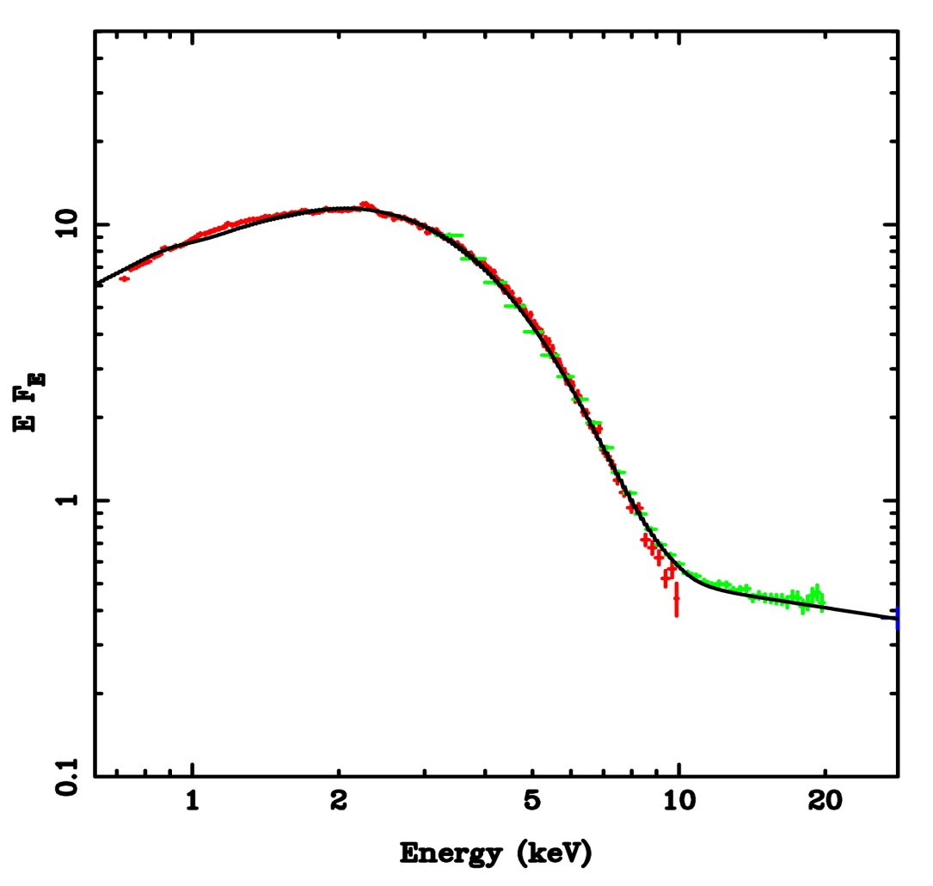
Observed disc spectra in BHB!!
Fit disc models to get maximum temperature and flux in the disc
L=2πD² F /cos i = A T⁴
A=2πr_{in}² R_{g}² (R_{g}=GM/c²)
Get one measure of inner radius IF we know the system parameters!
GX-339-4
Kolehmainen et al 2010

Slide 43
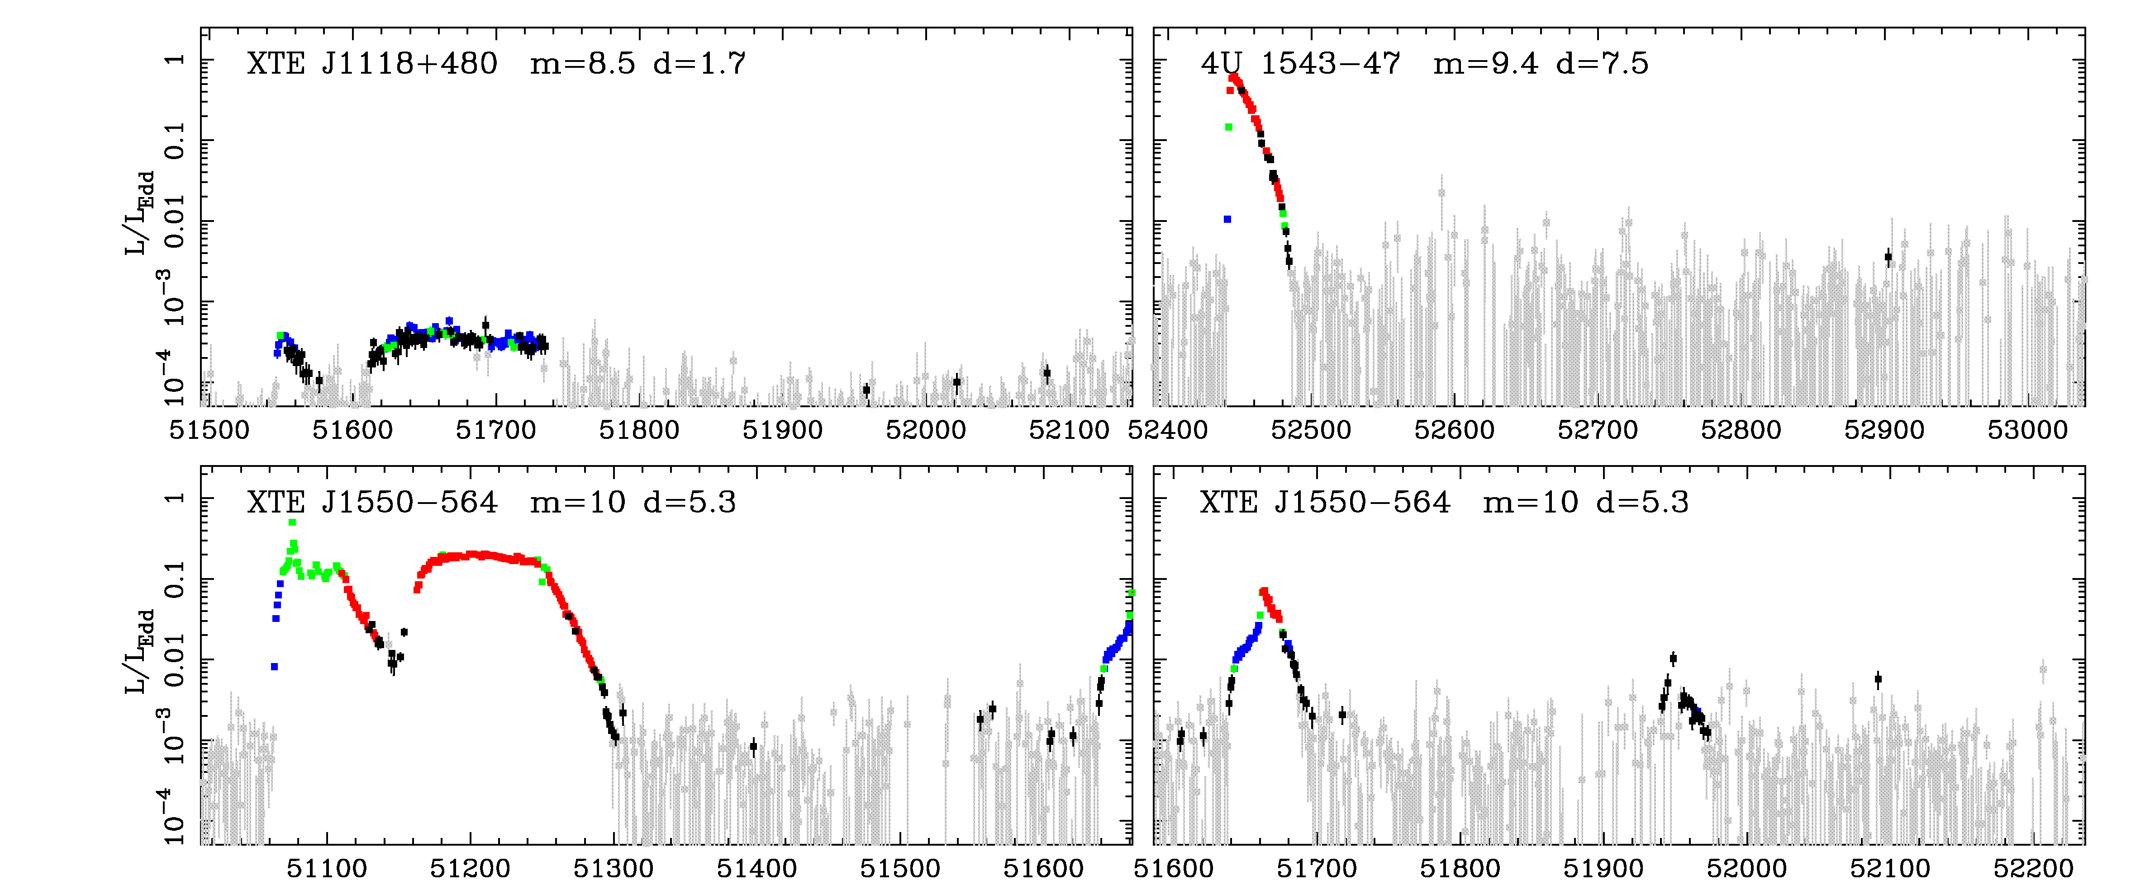
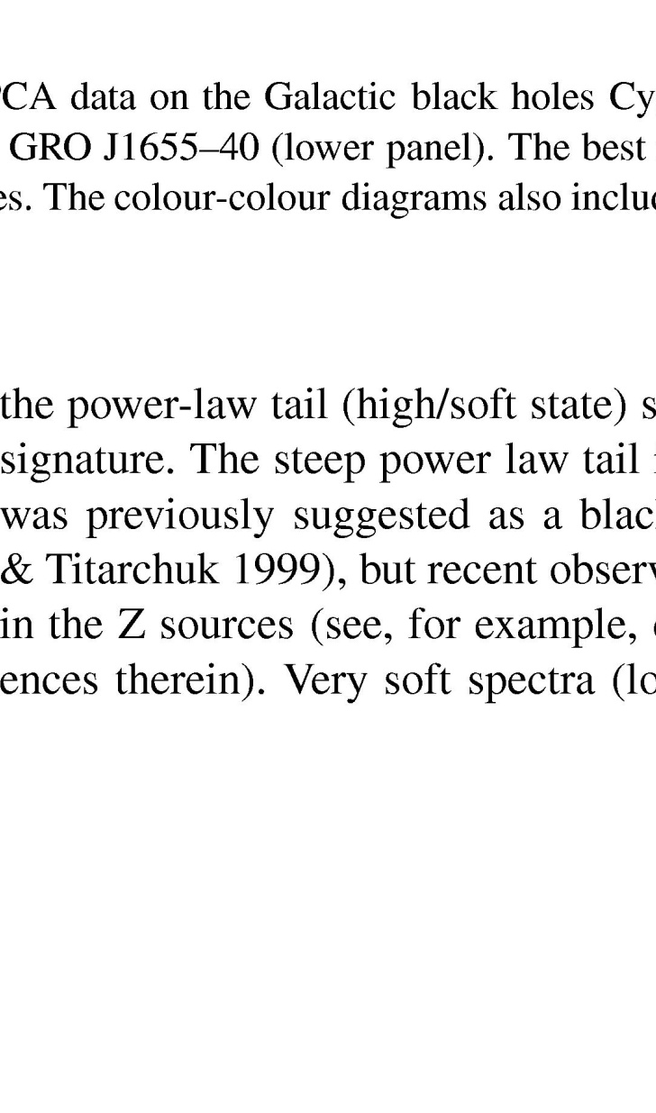
BHB – Quasars for the impatient
BRIGHT! Huge amounts of data, long term variability (days –years) in mass accretion rate (due to H ionisation instability in disc)
Observational template of accretion flow as a function of L/L_{Edd} onto ~10 M BH (very homogeneous!)
2 years
DGK07

Slide 44
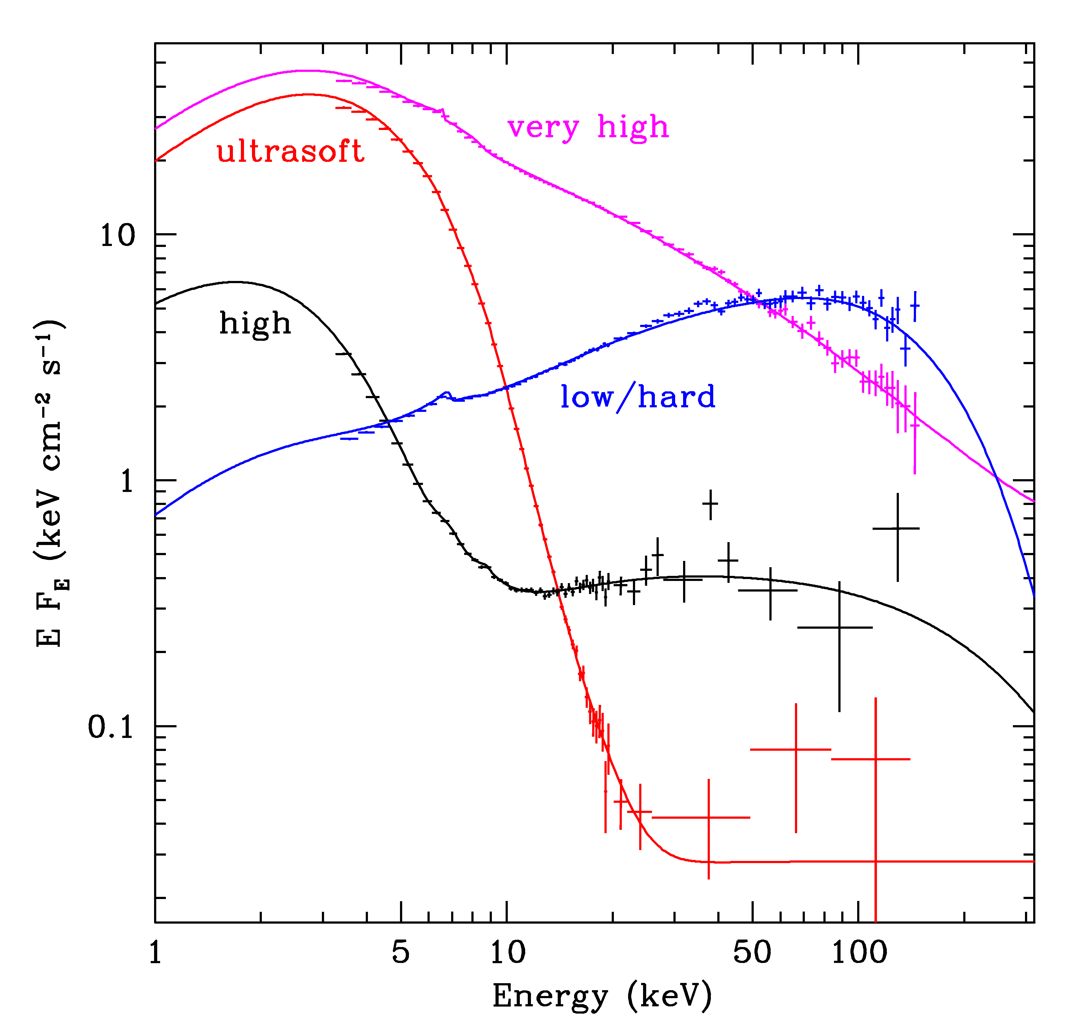
Spectral states
very high
Disc dominated - look like a disc but small tail to high energies
Very high/intermediate states at least know something about a disc
Low/hard state look really different, not at all like a disc!
disk dominated
high/soft
Gierlinski & Done 2003

Slide 45
BHB – Quasars for the impatient
BRIGHT! Huge amounts of data, long term variability (days –years) in mass accretion rate (due to H ionisation instability in disc)
Observational template of accretion flow as a function of L/L_{Edd} onto ~10 M BH (very homogeneous!)
2 years
DGK07

Slide 46
Spectral states
very high
Disc dominated - look like a disc but small tail to high energies
Very high/intermediate states at least know something about a disc
Low/hard state look really different, not at all like a disc!
disk dominated
high/soft
Gierlinski & Done 2003

Slide 47
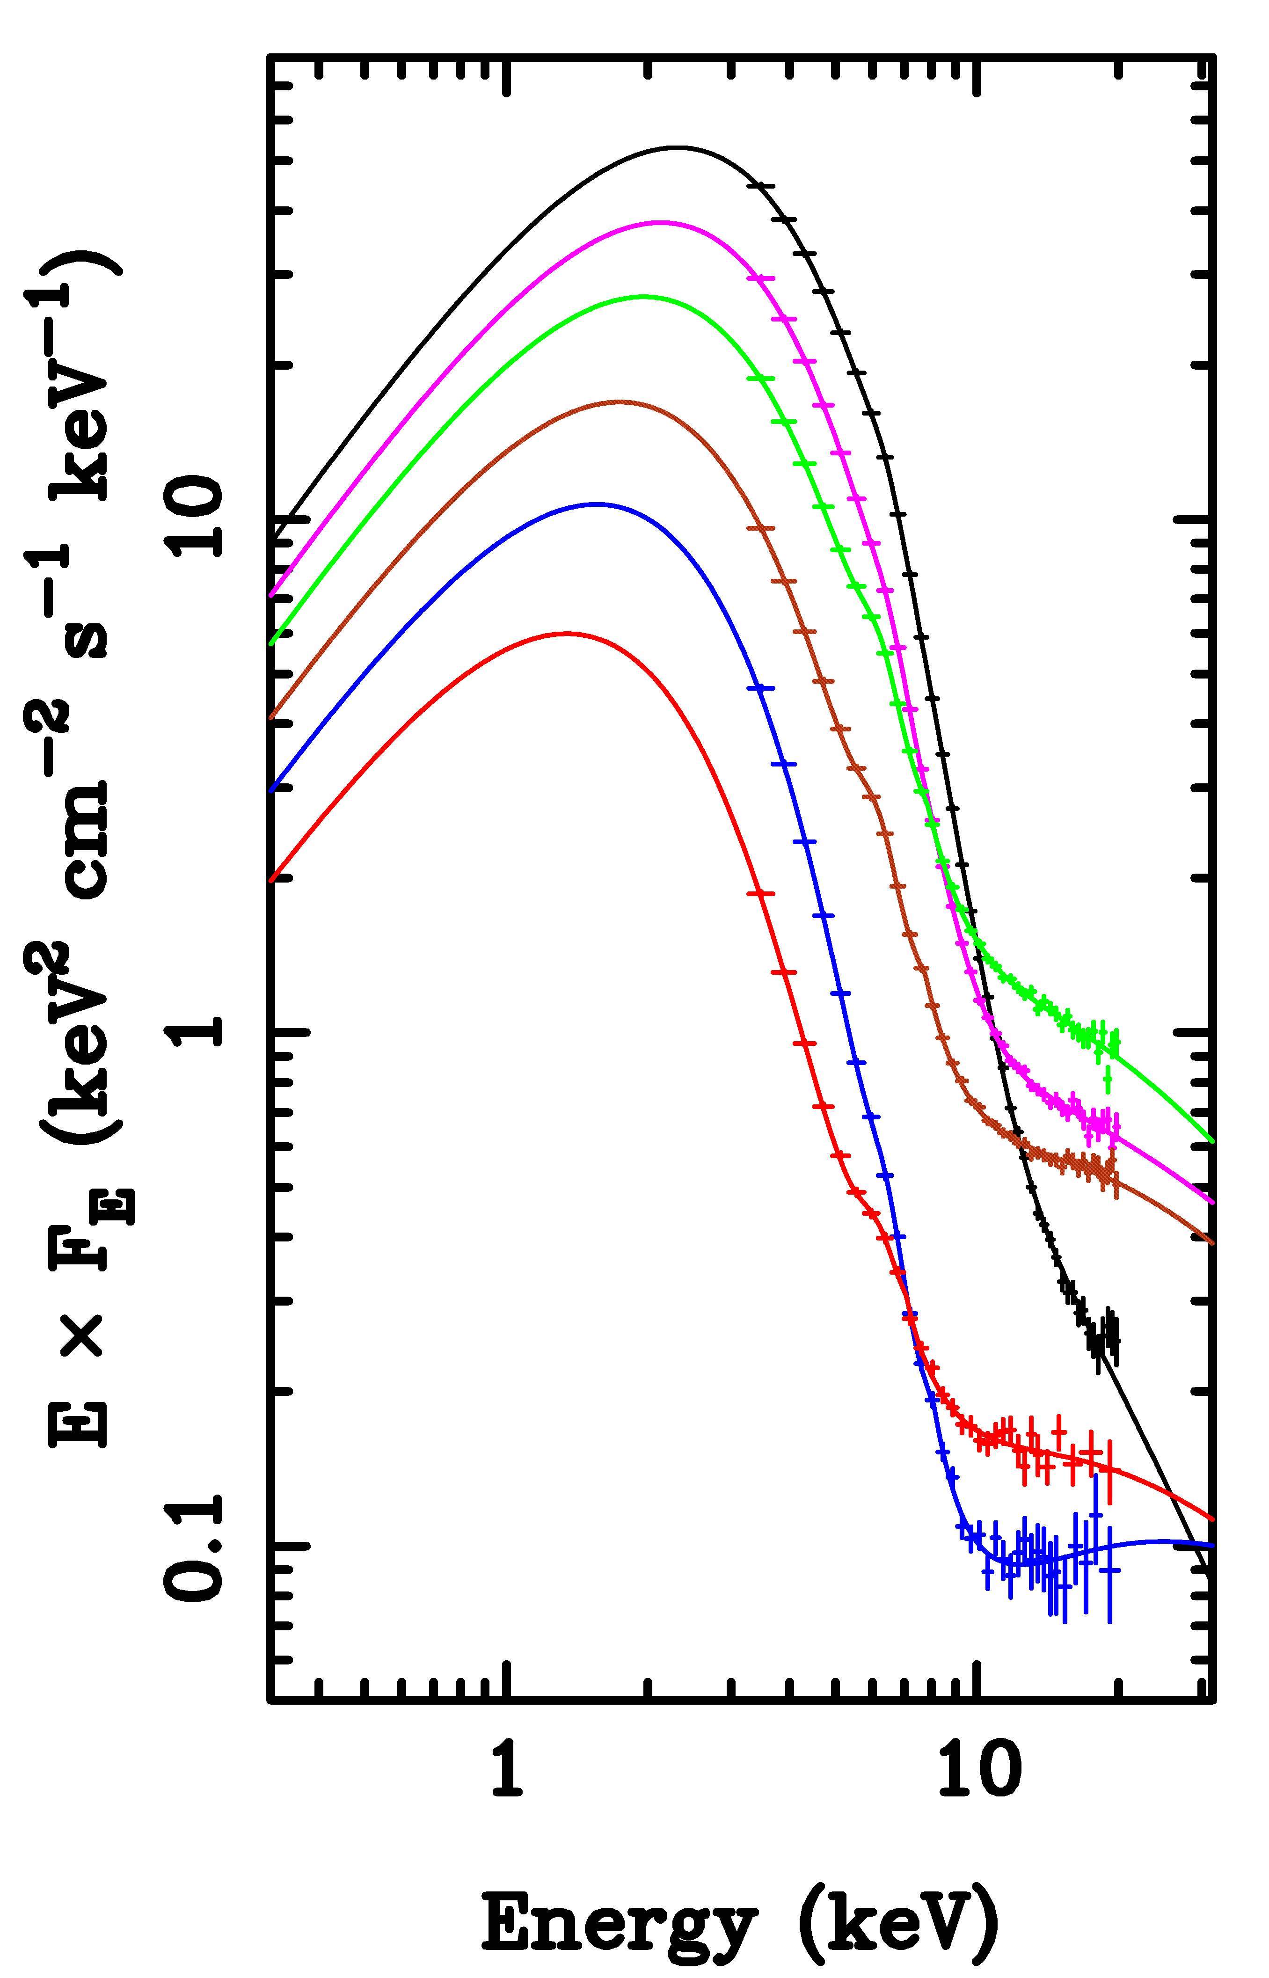
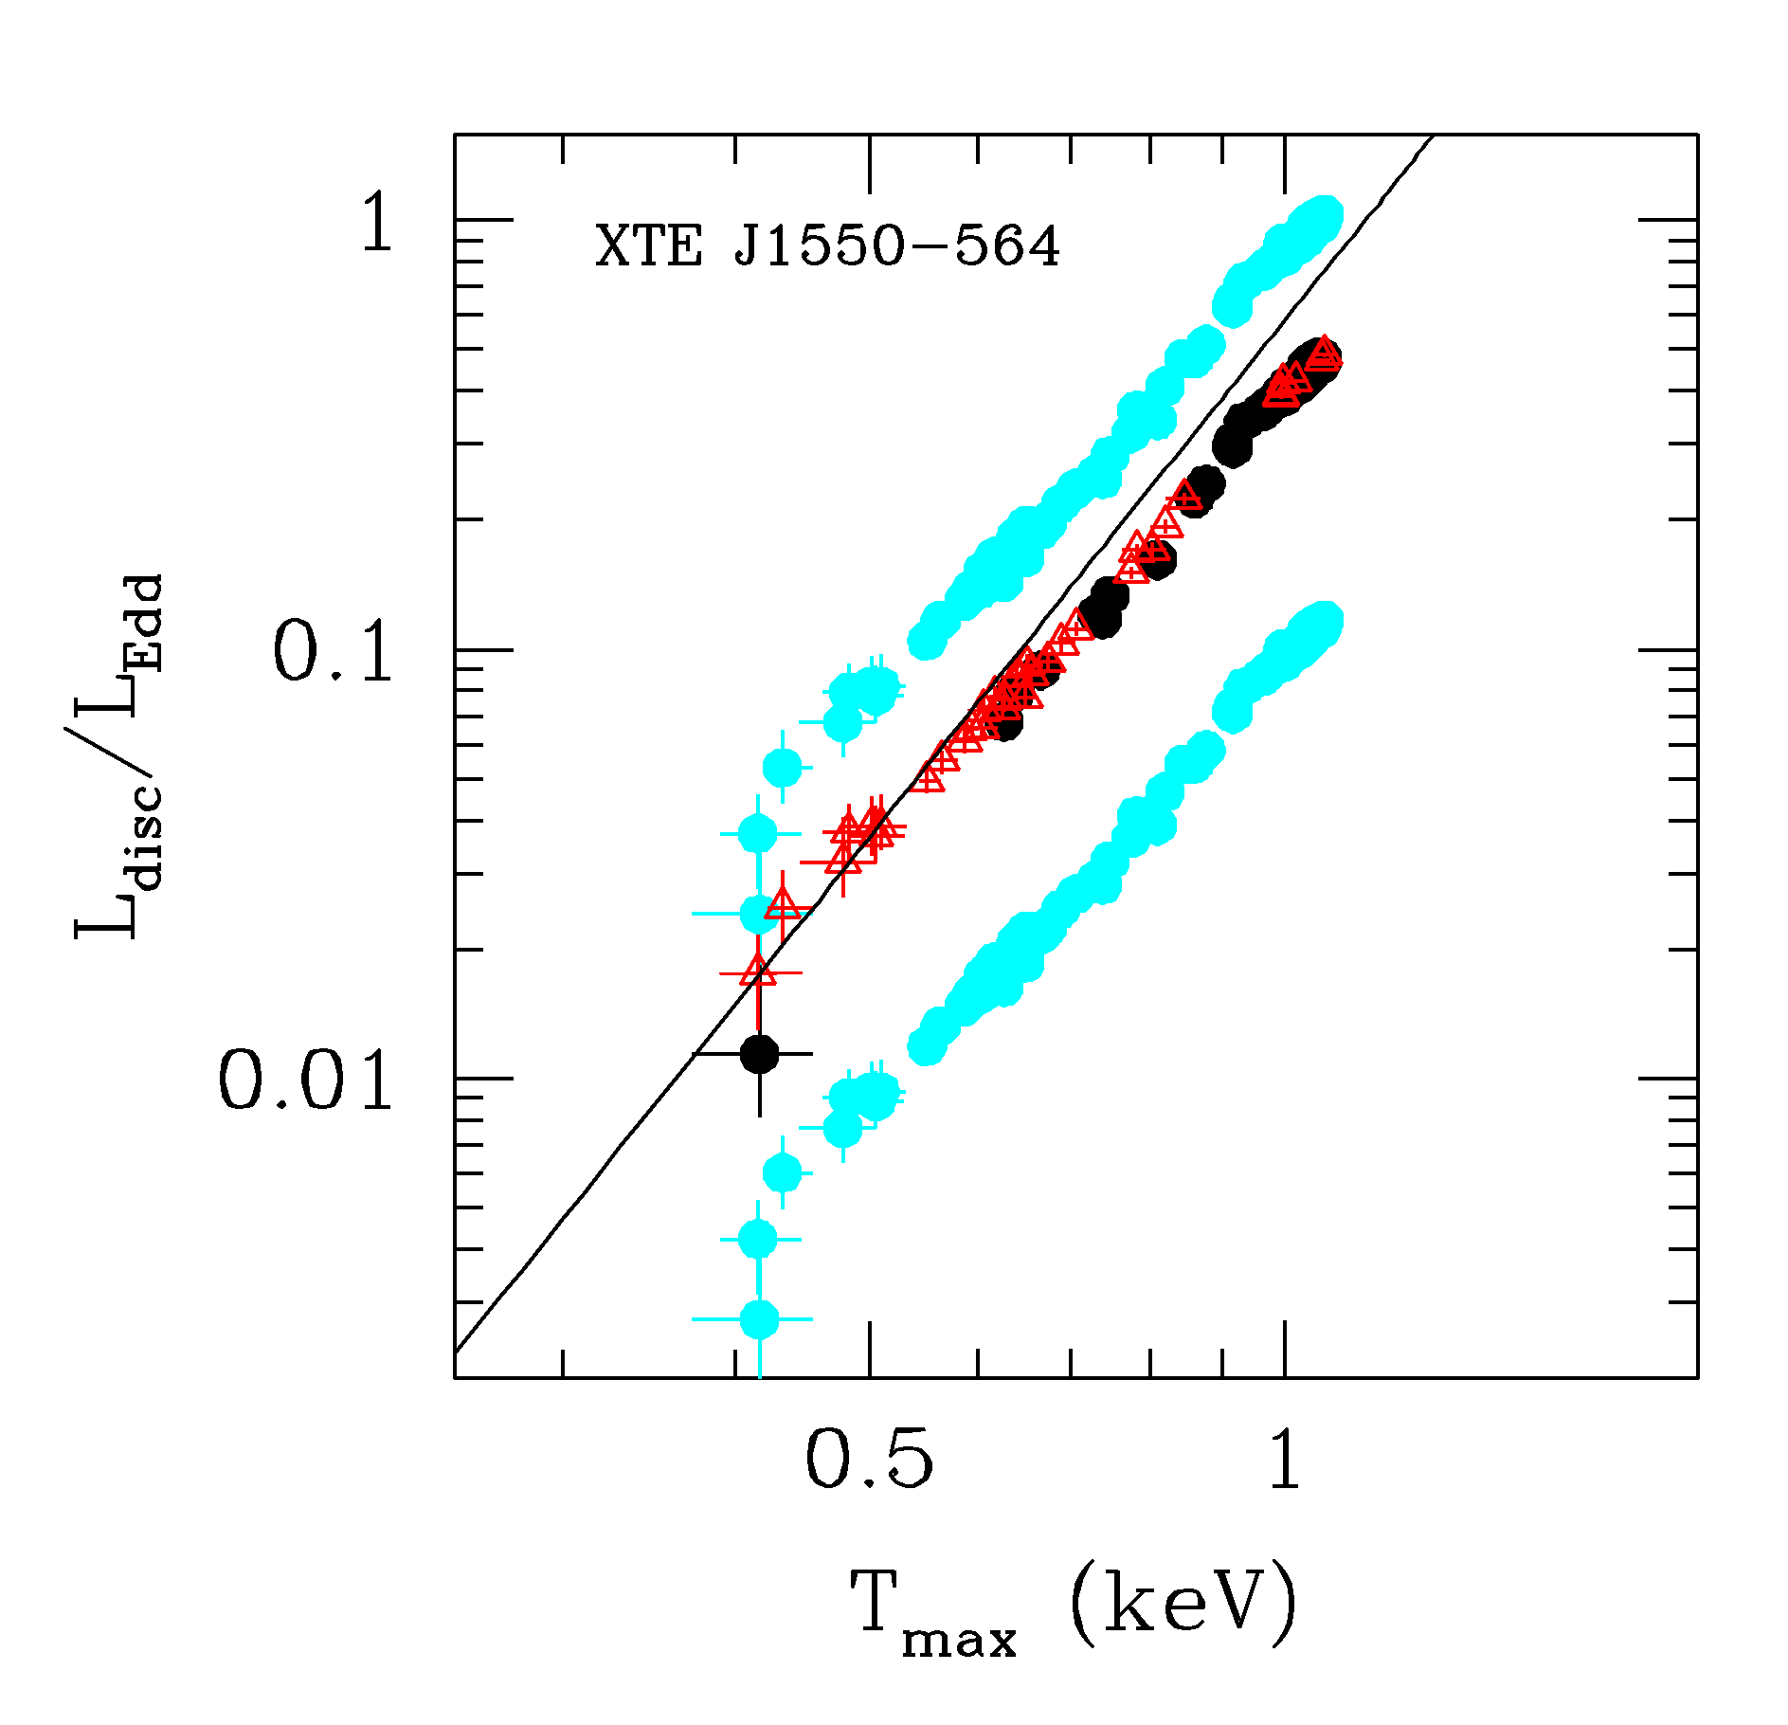
Variability of disc:long timescale
L/L_{Edd} ∝AT⁴_{max} (Ebisawa et al 1993; Kubota et al 1999; 2001)
Constant size scale – last stable orbit!! BH spin

Slide 48
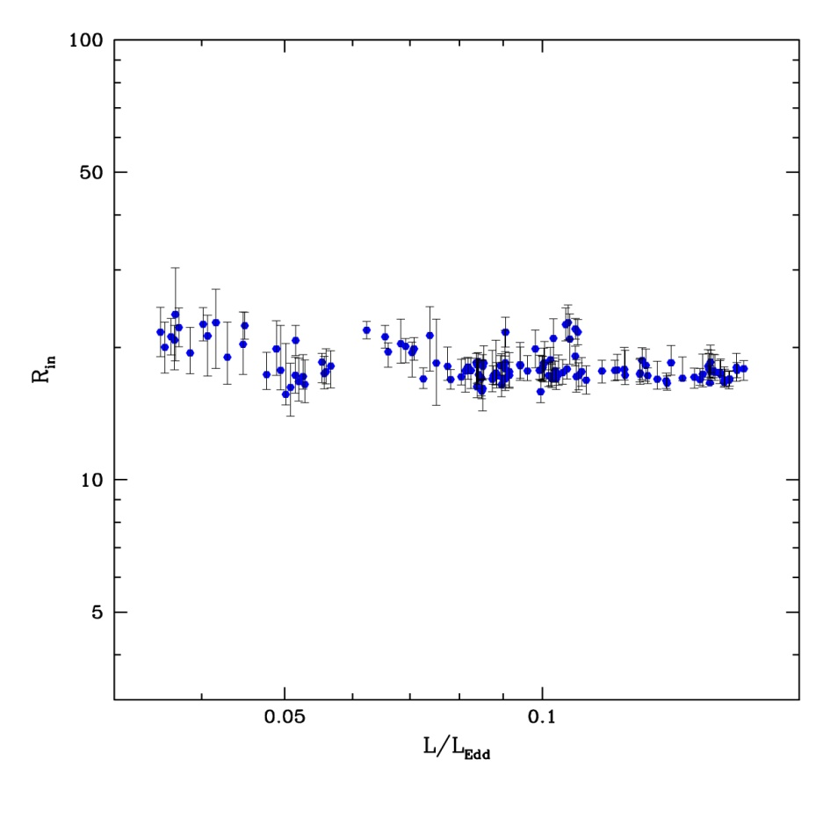
Disc spectra: last stable orbit
L/L_{Edd} ∝T⁴_{max} (Ebisawa et al 1993; Kubota et al 1999; 2001)
Constant size scale – last stable orbit!!
Proportionality constant gives a measure R_{lso} i.e. spin as L=σ R² T⁴
Not quite as simple as this
Proper relativistic emissivity (Novikov-Thorne)
corrections for spectrum not being blackbody (fcol)
Corrections for relativistic propagation effects
Gierlinski & Done 2003

Slide 49
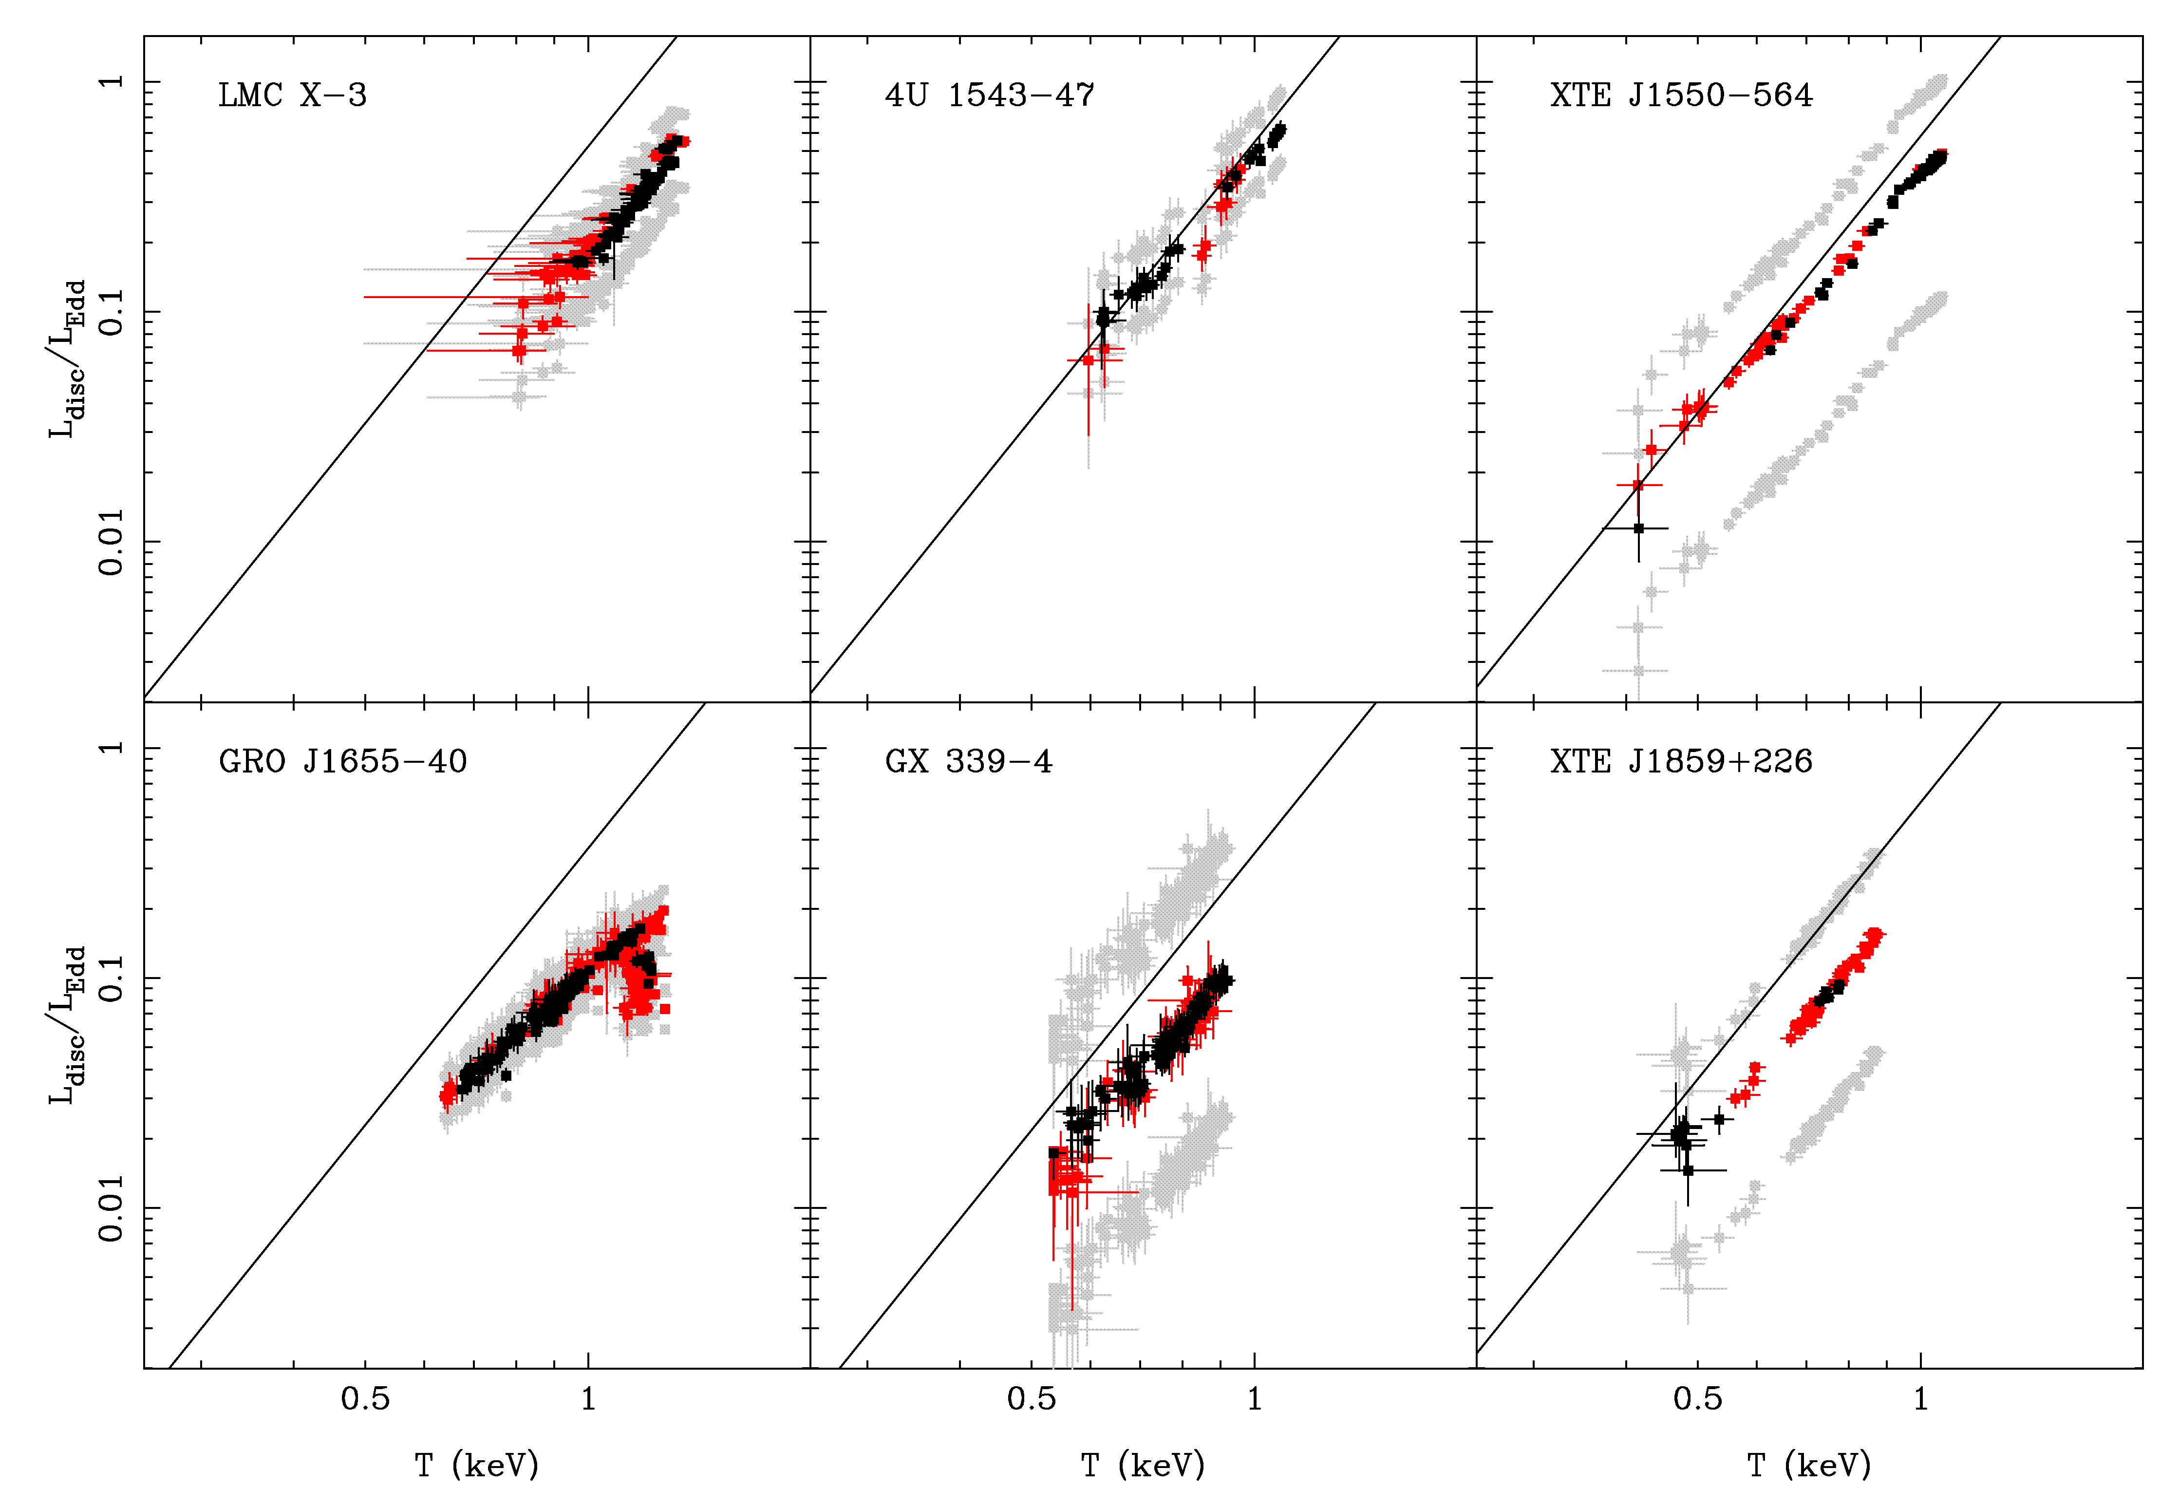
Observed disc spectra
a=0-0.7
a=0-0.8
a<0.7
a~0.65
a<0.9
Davis, Done & Blaes 2006, Shaffee et al 2006, Kohlemainen & Done 2009, Kubota et al 2009

Slide 50
Theoretical disc spectra
Surely even disc spectra aren’t this simple!!!!
Disc annuli not blackbody – too hot, so little true opacity. Compton scattering important.
Modified blackbody Shakura & Sunyaev 1973
Describe by colour temperature fcol
And relativistic smearing effects on the spectra at each radius
kTeff
f_{col} kT
Log ν f(ν)
Log ν

Slide 51
Relativistic effects
Relativistic effects (special and general) affect all emission (Cunningham 1975)
Emission from the side of the disc coming towards us is blueshifted and boosted by Doppler effects, while opposite side is redshifted and suppressed.
Also time dilation and gravitational redshift
Broadens spectrum at a give radius from a narrow blackbody
flux
Energy (keV)
Fabian et al. 1989
Notes:
Another area where Astro e2 will give major progress in an independent test of the accretion flow models. The accretion disc moves fast in a strong gravitational field, so both special and general relativistic effects modify its spectrum. Doppler shifts and length contraction mean that the emission from the disc moving towards us is blueshifted and boosted, while that moving away is redshifted and suppressed. Then time dilation and gravitational redshift drag everything redwards. The strength of these all effects decrease with radius. All emission from the disc is affected, but its much easier to see on intrinsically narrow features – lines. X-ray illumination of the disc gives iron Kalpha line. Moving inner disc models predict broader line in softer spectra. But the measured line profile can be distorted by narrow absorption features superimposed on the emission. The high spectral resolution of Astro e2 will unambiguously show these, enabling the intrinsic line profile to be measured.

Slide 52
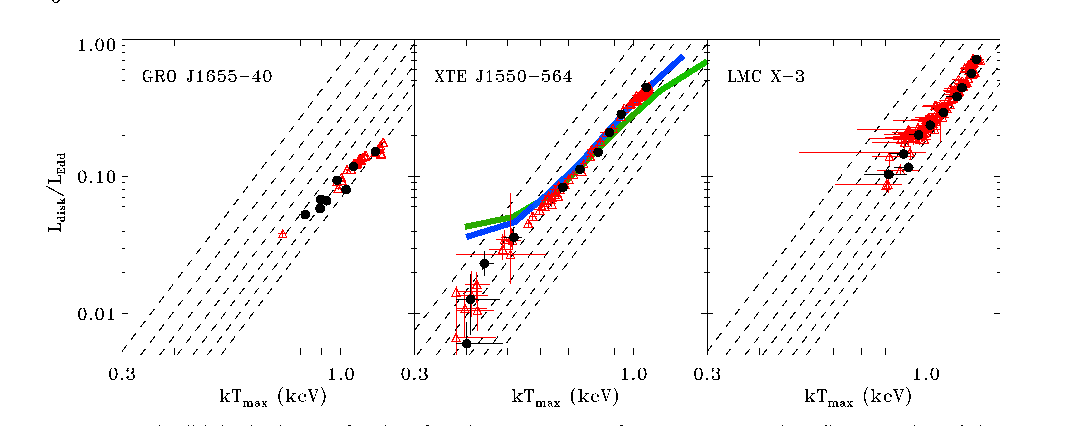
Disc vertical structure + GR
a*~0.6
a*~0.1
a*~0.3
Davies, Done & Blaes 2005
Full models rather than post-hoc corrections
calculate disc emission from detailed models of the vertical and radial structure of the disc then propagate out in full GR spacetime
Get moderate spin a* - supernovae collapse (Gammie et al 2006)

Slide 53
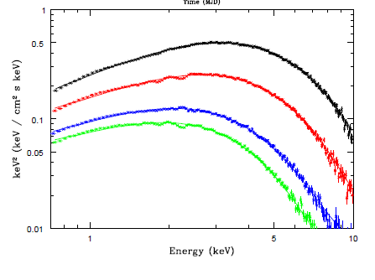
And at lower energies…
RXTE misses peak of disc..
XMM-Newton can see it directly still get good fits to constant radius disc models, though some residuals at the 5% level even with BHSPEC.
Best disc models are not quite up to describing real data at the <5% level
And still a few dirty things in the calibration
Kolehmainen et al 2012

Slide 54
And at lower energies…
RXTE misses peak of disc..
XMM-Newton can see it directly still get good fits to constant radius disc models, though some residuals at the 5% level even with BHSPEC.
Best disc models are not quite up to describing real data at the <5% level
And still a few dirty things in the calibration
Kolehmainen et al 2012

Slide 55
But not all spectra look like a disc
Disc dominated look like a disc and vary like a disc L – T⁴ so get spin (moderate?)
States where spectra don’t look like a disc don’t behave like discs!!
These are the spectra with a JET seen in radio
very high
disk dominated
high/soft
Gierlinski & Done 2003

Slide 56
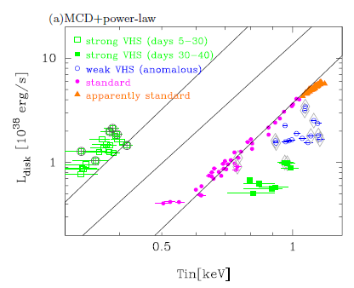
and then they don’t give spin
Disc dominated look like a disc and vary like a disc L – T⁴
States where spectra don’t look like a disc don’t behave like discs!! Radius can be higher or lower – not constant, ie not reliable indicator of spin!!!
Don’t do this!!
very high
disk dominated
high/soft
Kubota & Done 2004

Slide 57
Observed disc spectra in BHB!!
L=GM mdot/(2R_{isco})
Only radiate half of available gravitational potential energy as half in KE of orbital motion of material at Risco (Virial theorem)
L ∝mdot so just keep on increasing mdot to get bigger L?
GX-339-4
Kolehmainen et al 2010

Slide 58
Eddington limit
Ionised H gas falling in
Generates flux of radiation outwards F=L/4πr²
Pressure=F/c=Force/area
Outwards radiation interacts with electrons! Cross-section area σ
Outwards force is F=Lσ/4cπr²
Inwards force is gravity.
Balance at Eddington limit
L_{Edd}σ/4cπr² = GM/r²
L_{Edd}= 4cπGM/σ = 1.3x10³⁸ M ergs/s

Slide 59
BHB – Quasars for the impatient
Peak luminosity generally L<LEdd due to size of binary orbit
Limits mass which can build up in quiescence
2 years
DGK07

Slide 60
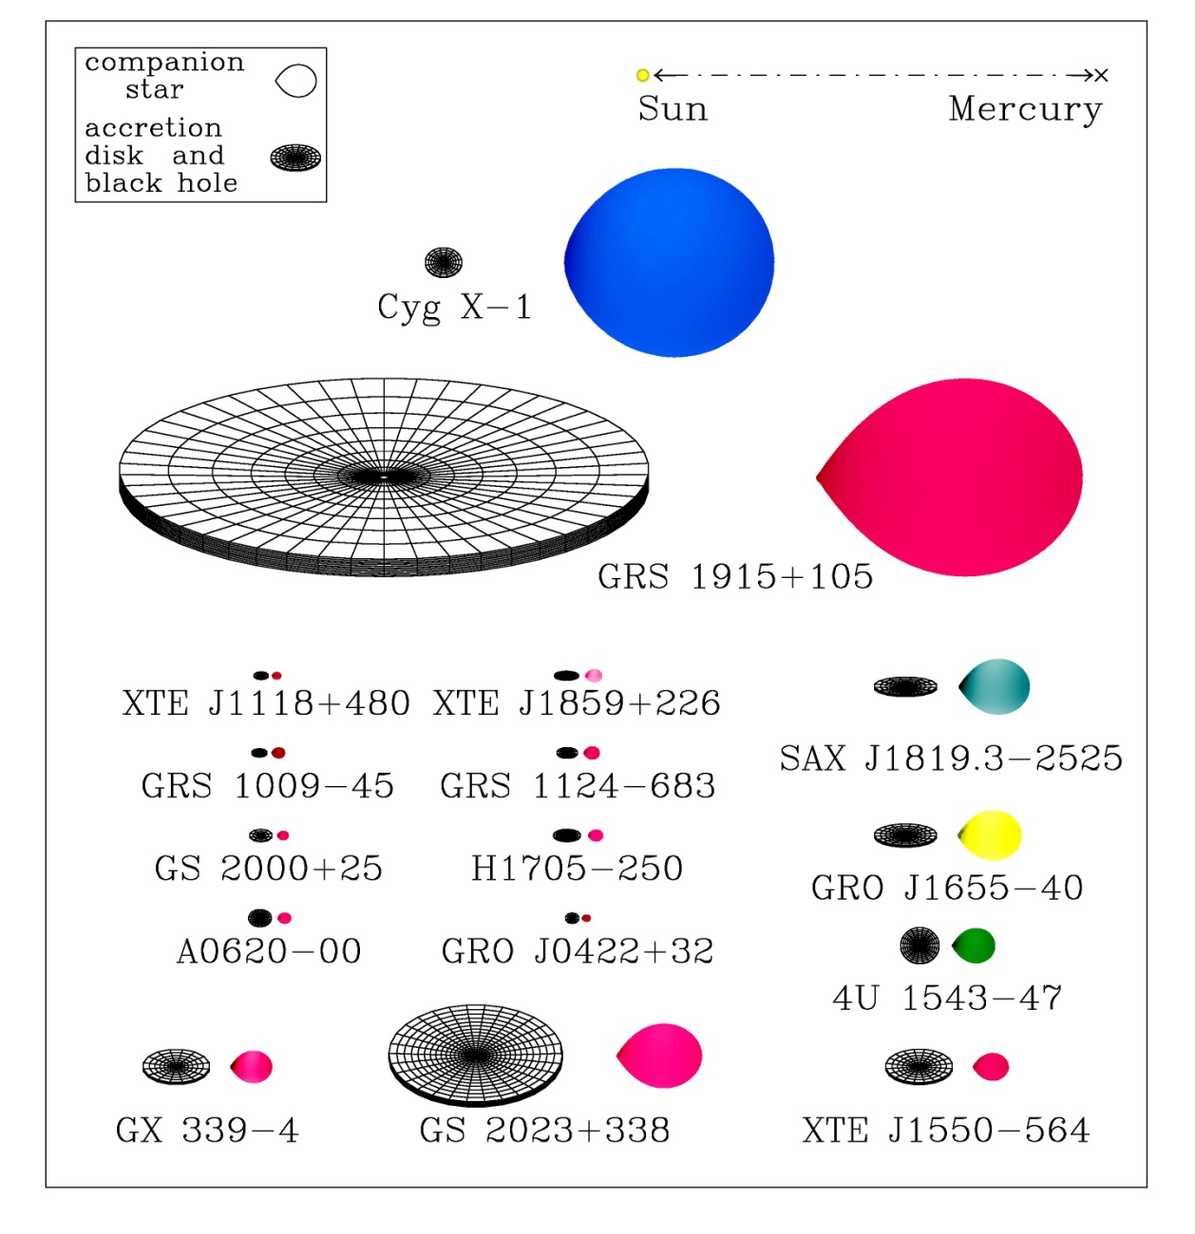
As seen in most BH in our galaxy
J. Orosz
Need high mass accretion rate to get to LEdd
Transient – need outer disc kT < 4000K (H ionisation)
Persistent – need large mdot

Slide 61
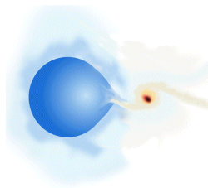
HMXRB
wind accretion from high mass companion
Overflows roche lobe only if close enough
If not quite close enough then wind gets focussed onto blakc hole (like Cyg X-1)

Slide 62
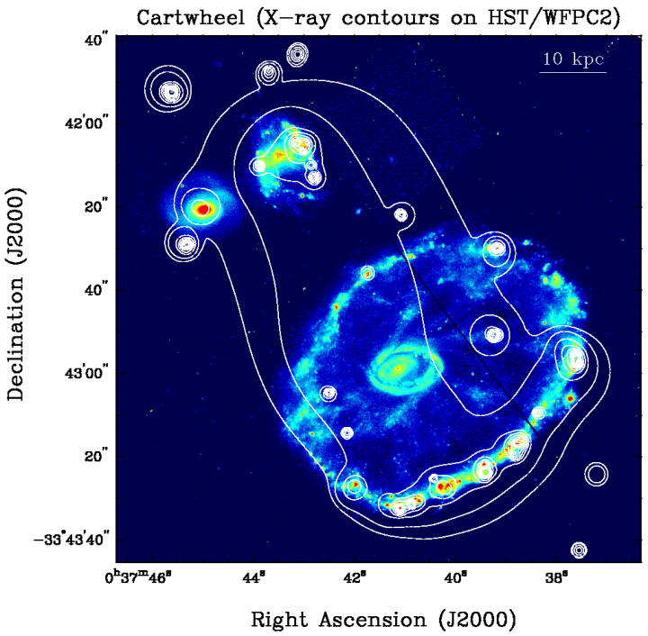
Intermediate mass BH?
Ultra - Luminous X-ray sources in spiral arms of nearby starforming galaxies – ULX
L~10³⁹⁻⁴⁰ ergs s⁻¹ so M~10-100 M for L <L_{Edd}
Hard for stellar evolution to make BH > 50 M
Either IMBH (hard to make) or (majority) L/LEdd > 1 from HMXRB
Gao et al 2003

Slide 63
Luminosity > LEdd ?
Standard disc assumes that energy liberated locally through mass accretion is radiated locally
Not necessarily true – can be carried radially along with the flow is accretion timescale < radiated timescale
Optically thick advection – slim discs (Abramowicz et al 1988) only different L>LEdd
Heats next ring in – but can advect that also. Then lose does the black hole!
L=LEdd log(1+mdot/mdotEdd)
Log ν f(ν)
Log ν

Slide 64
Luminosity > LEdd ?
Standard disc assumes that energy liberated locally through mass accretion is radiated locally
Not necessarily true – can be carried radially along with the flow is accretion timescale < radiated timescale
Optically thick advection – slim discs (Abramowicz et al 1988) only different L>LEdd
Heats next ring in – but can advect that also. Then lose does the black hole!
L=LEdd log(1+mdot/mdotEdd)
Log ν f(ν)
Log ν

Slide 65
Luminosity > LEdd ?
Standard disc assumes that mdoty constant with R
Not necessarily true – can lose mass in a wind is L>LEdd (Shakura & Sunyaev 1973)
L=LEdd log(1+mdot/mdotEdd) i.e. same as before but for different reason
Log ν f(ν)
Log ν

Slide 66
Luminosity > LEdd ?
Standard disc assumes that mdoty constant with R
Not necessarily true – can lose mass in a wind is L>LEdd (Shakura & Sunyaev 1973)
L=LEdd log(1+mdot/mdotEdd) i.e. same as before but for different reason – local flux at disc surface has to be <LEdd
Two possible responses – so disc probably does both as seen in numerical simulations
Log ν f(ν)
Log ν

Slide 67
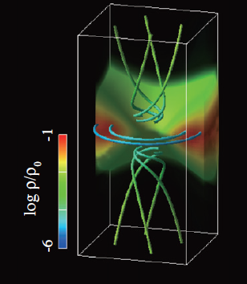
Luminosity > LEdd ?
Standard disc assumes that mdoty constant with R
Not necessarily true – can lose mass in a wind is L>LEdd (Shakura & Sunyaev 1973)
L=LEdd log(1+mdot/mdotEdd) i.e. same as before but for different reason – local flux at disc surface has to be <LEdd
Two possible responses – so disc probably does both as seen in numerical simulations

Slide 68
Intermediate mass BH?
Ultra - Luminous X-ray sources in spiral arms of nearby starforming galaxies – ULX
L~10³⁹⁻⁴⁰ ergs s⁻¹ so M~10-100 M for L <L_{Edd}
Hard for stellar evolution to make BH > 50 M
Either IMBH (hard to make) or (majority) L/LEdd > 1 from HMXRB
Gao et al 2003

Slide 69
Conclusions
Einstein GR – predicts black hole event horizon and last stable orbit which depends on spin
Can only see the effect of these if have material close to black hole. ie accretion. Classic solution of the accretion flow equations is cool, geometrically thin, optically thick disc (Shakura & Sunyaev 1973)
At high mass accretion rates, spectra seen from BHB look like a simple disc and varies on long timescales like a simple disc WITH FIXED inner edge. Consistent with last stable orbit! Moderate spin
But spectra at lower L/Ledd can look very different – much hotter! Thermal comptonisation rather than blackbody…
…..to be continued….

