Slide 1
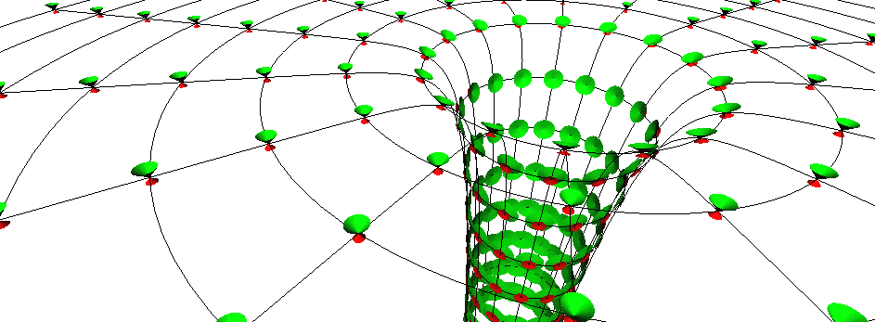
Compton scattering
Prof Chris Done, University of Durham

Slide 2
Spectra not all dominated by disc
All spectra accompanied by tail to high energies
Tail carries very little fraction of bolometric power in disc dominated high/soft state
Lower L/L_{Edd}:low/ hard spectrum, peaks at high energies, not like a disc
Intermediate spectra (HIMS/SIMS)
High L/LEdd very high state
Gierlinski & Done 2003

Slide 3
Compton scattering theory
ε_{out}
ε_{in}
Collision – redistribute energy
If photon has more energy than electron then it loses energy – downscattering
If photon has less energy than electron then it gains energy – upscattering
Easiest to talk about if scale energies to mc² so electron energy γmc² just denoted γ while photon energy becomes ε=hν/mc²=E/511 for E (keV)
θ_{ie}
θ_{oe}
γ
θ_{io}
ε_{out} = ε_{in}(1 - βcos θ_{ei})
1- βcos θ_{eo}+ (ε_{in}/γ) (1- cosθ_{io})

Slide 4
How much scattering ?
Compton scattering seed photons from accretion disk. Photon energy boosted by factor Δε/ε ~ 4Θ+16Θ² if thermal in each scattering.

Slide 5
Optical depth
Process cross-section σ. Sweep out volume σ R
Number of particles in that volume is n σ R = τ
σ cm²

Slide 6
How much scattering ?
Number of times scattered given by optical depth, τ=σnR
Scattering probability exp(-τ)
Optically thin τ << 1 prob ~ τ average number ~ τ
Optically thick τ>>1 prob~1
and average number ~ τ²
Total fractional energy gain = frac.gain in 1 scatt x no.scatt
Compton y = (4Θ+16Θ²) (τ+τ²)
~ 4Θτ² for Θ<1 τ>1
R

Slide 7
Spectra
Plot νf(ν) as this peaks at energy where power output of source peaks.
N(E)=AE ^{−Γ}
F(E)=EN(E)= AE^{−Γ+1}=AE^{-α}
α=Γ−1
Log Εf(Ε)
hard spectrum
Most power at high E
α<1 Γ<2
Log Ε
dL= F(E) dE = EF(E) dE/E = EF(E) dlog E
dN= N(E) dE = EN(E)dE/E = F(E) dlogE

Slide 8
Optically thin thermal compton
power law by multiple scattering of thermal electrons
Number of photons dN/dE dE = E dN/dE dLog E = f (ε) dlog ε ∝ ε^{−α}
For τ<1 scatter τ photons each time to energy ε_{out}=(1+4Θ+16Θ²)ε_{in}
index α=log(prob)/log(energy boost) ~ -log τ/log (1+4Θ+16Θ²)
Log N(γ)
Log f_{ν}
Log γ
Log ν

Slide 9
Optically thin thermal compton
power law by multiple scattering of thermal electrons
Number of photons dN/dE dE = E dN/dE dLog E = f (ε) dlog ε ∝ ε^{−α}
For τ<1 scatter τ photons each time to energy ε_{out}=(1+4Θ+16Θ²)ε_{in}
index α=log(prob)/log(energy boost) ~ -log τ/log (1+4Θ+16Θ²)
Log N(γ)
Log f_{ν}
Log γ
Log ν

Slide 10
Optically thin thermal compton
power law by multiple scattering of thermal electrons
Number of photons dN/dE dE = E dN/dE dLog E = f (ε) dlog ε ∝ ε^{−α}
For τ<1 scatter τ photons each time to energy ε_{out}=(1+4Θ+16Θ²)ε_{in}
index α=log(prob)/log(energy boost) ~ -log τ/log (1+4Θ+16Θ²)
Log N(γ)
Log f_{ν}
Log γ
Log ν

Slide 11
Optically thin thermal compton
power law by multiple scattering of thermal electrons
Number of photons dN/dE dE = E dN/dE dLog E = f (ε) dlog ε ∝ ε^{−α}
For τ<1 scatter τ photons each time to energy ε_{out}=(1+4Θ+16Θ²)ε_{in}
index α=log(prob)/log(energy boost) ~ -log τ/log (1+4Θ+16Θ²)
Log N(γ)
Log f_{ν}
Log γ
Log ν

Slide 12
Practice!! Mystery object
Estimate Θ and τ

Slide 13
Seed photons
Need more soft emission than exp(- τ)
Not all disc comptonised! Patchy corona or truncated disc

Slide 14
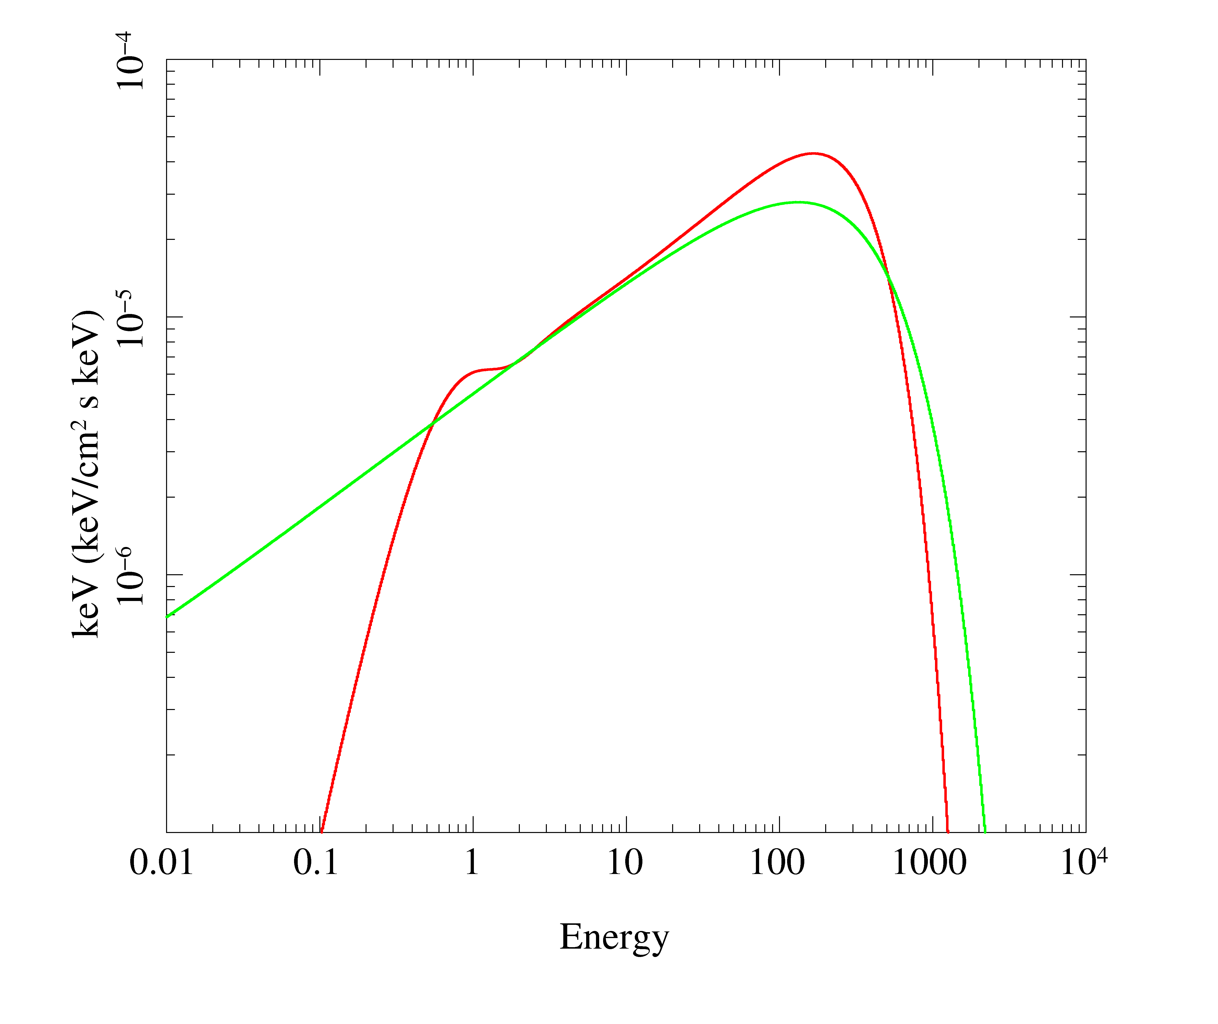
Compton spectra are NOT power law
Exponentially cutoff power law is not a good approximation to real Comptonisation models!!
Differ by factor of 2 at the peak

Slide 15
Energetics!
Seed photon power illuminating flow Ls
Heating of electrons gives comptonisation power Lh
y axis τ Ls to Lh, x axis from ε_{in} to 3Θ
Get self consistent Θ from energetics

Slide 16
Energetics!
Seed photon power illuminating flow Ls
Heating of electrons gives comptonisation power Lh
Lh >> Ls to get hard spectrum
Easy to see how in truncated disc. Less easy in isotropic corona as reprocessing ties Ls ~ 1/2 Lh

Slide 17
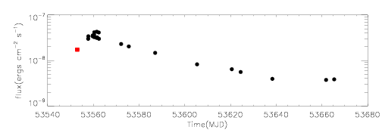
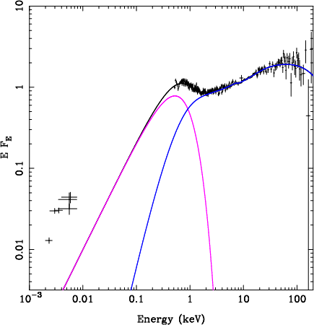
Seed photons in low/hard state
Low/hard state outburst
Swift optical/UV/X-ray plus RXTE 3-200 keV
Low Nh (2x10²¹ cm⁻²)
Factor 10 ↓ in 3 months
Seed photons disc at peak
Probably cyclo-sync later
3 months
x10
Chiang & Done 2009

Slide 18
Seed photons in low/hard state
Most photons from disc don’t intercept hot flow
So Ls << Lh and predict very HARD spectra
Never see this!
So need another source of seed photons
Got B field and hot electrons – the thermal electrons can spiral around the B field lines and give cyclo-synchrotron in the flow itself so it makes it own seed photons!
x10
Chiang & Done 2009

Slide 19
Comptonisation in high/soft state
Bewildering variety of spectra from single object
Underlying pattern
High L/L_{Edd}: soft spectrum, peaks at kT_{max} often disc-like, plus tail
Lower L/L_{Edd}: hard spectrum, peaks at high energies, not like a disc
Gierlinski & Done 2003

Slide 20
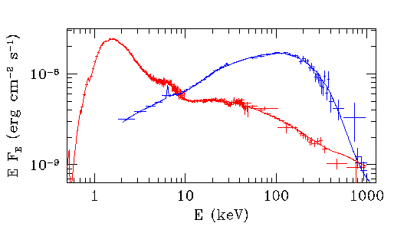
Observations
Cyg X-1: Gierlinski et al 1999
Low state spectra peak at 100 keV. Well modelled by thermal electrons Θ∼0.1−0.2 τ~1
High state spectra need predominantly non-thermal electron distribution

Slide 21
Non-thermal compton upscattering:
ε_{out}
ε_{in}
If ε_{in} << γ then electron has most energy so loses it to photon
Average over angle for isotropic electron and photon distribution.
Output photons beamed into angle 1/γ from electrons
Nonthermal ε_{out} ~ γ² ε_{in}
Limit is ε_{out} < γ
θ_{ie}
θ_{oe}
γ
θ_{io}
ε_{out} ~ ε_{in}(1 - βcos θ_{ei})
1- βcos θ_{eo}

Slide 22
Optically thin nonthermal compton
power law by single scattering of nonthermal electrons N (γ) ∝ γ^{−p}
index α = (p-1)/2 (p >2 so α > 0.5 – monoenergetic injection)
Starts a factor τ down from seed photons, extends to γ_{max}² ε_{in}
f(ε) ∝ ε^{−(p-1)/2}
Log N(γ)
Log fν
N (γ) ∝ γ^{−p}
Log γ
γ_{max}
ε_{in}
Log ν
γ_{max}² ε_{in}

Slide 23
Optically thin nonthermal compton
Again, can do by energy
Lh in electron power, Ls in seed photons
Y axis τ Ls to Lh, x axis from ε_{in} to γ_{max}² ε_{in}
εf(ε) ∝ ε^{−(p-3)/2}
Log N(γ)
Log νfν
N (γ) ∝ γ^{−p}
Log γ
γ_{max}
ε_{in}
Log ν
γ_{max}² ε_{in}

Slide 24
Energetics: nonthermal
nonthermal need shape of injected electrons as well as Lh and τ
Q(γ) ∝ γ^{−s} between γ_{min} and γ_{max}
Illuminate region with seed photons Ls
Heating (inject) = cooling (coulomb, comp) ⇒ self consistent N(γ) rate leaving γ = rate injected
Where compton dominates dγ/dt ∝ γ² integrate N(γ) ∝ γ⁻² ∫ Q(γ) dγ
= γ⁻² [ γ^{-(s-1) -} γmax^{-(s-1)} ] / (s-1) so can’t be flatter than γ⁻² hence spectrum can’t be flatter than α=0.5
But could have separate thermal component plus hybrid!!

Slide 25
Observations
Cyg X-1: Gierlinski et al 1999
Low state spectra peak at 100 keV. Well modelled by thermal electrons Θ∼0.1−0.2 τ~1
High state spectra need predominantly non-thermal electron distribution

Slide 26
Comptonisation in high/soft state
Bewildering variety of spectra from single object
Underlying pattern
High L/L_{Edd}: soft spectrum, peaks at kT_{max} often disc-like, plus tail
Lower L/L_{Edd}: hard spectrum, peaks at high energies, not like a disc
Gierlinski & Done 2003

Slide 27
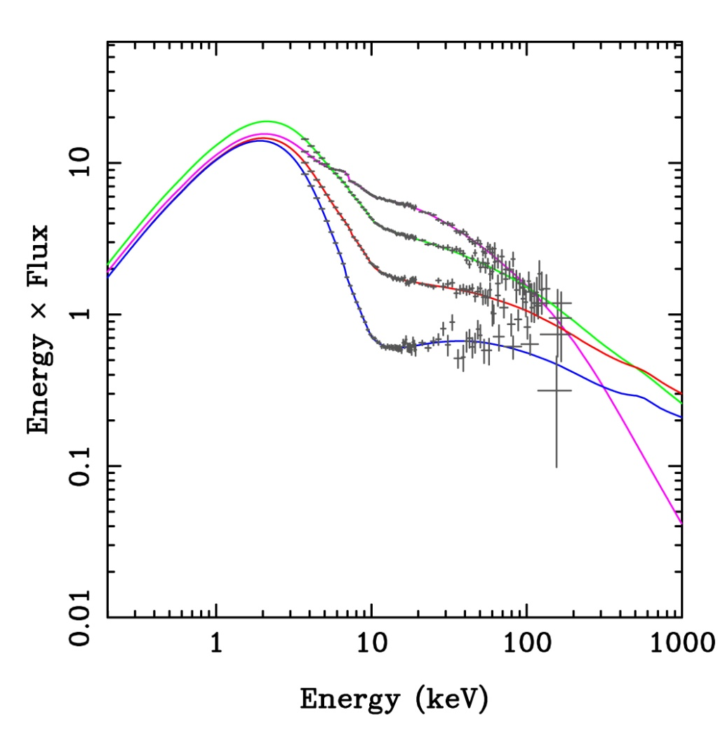
X-ray spectra at high L/L_{Edd} are not always disc dominated
Disc dominated spectra tail – either small t or small covering fraction
Merge smoothly onto VHS
Most extreme show no clear disc rise – high optical depth AND high covering fraction
DGK07

Slide 28
X-ray spectra at high L/L_{Edd} are not always disc dominated
Disc dominated spectra tail – either small t or small covering fraction
Merge smoothly onto VHS
Most extreme show no clear disc rise – high optical depth AND high covering fraction
DGK07

Slide 29
X-ray spectra at high L/L_{Edd} are not always disc dominated
Disc dominated spectra tail – either small t or small covering fraction
Merge smoothly onto VHS
Most extreme show no clear disc rise – high optical depth AND high covering fraction
DGK07

Slide 30
Hybrid plasma
Very high states in GBH look like this
NOT POWER LAW CONTINUUM Kubota & Makashima 2004
thermal doesn’t fit , nonthermal doesn’t fit either as steep
XTE J1550-564
XTE J1550-564
Log γ
Log ν
Gierlinski & Done 2002

Slide 31
Optically thick nonthermal
Multiple scattering τ>1 Ghisellini 1989
If steep power law non-thermal electrons then <γ> ~ 1 so get small energy boost each time – similar to thermal.
But max energy is <γ> ~ 1 ie mc², 511 keV
Log N(γ)
Log νfν
N (γ) ∝ γ^{−p}
Log γ
Log ν
Log γ
γ_{max}
ε_{in}
Log ν

Slide 32
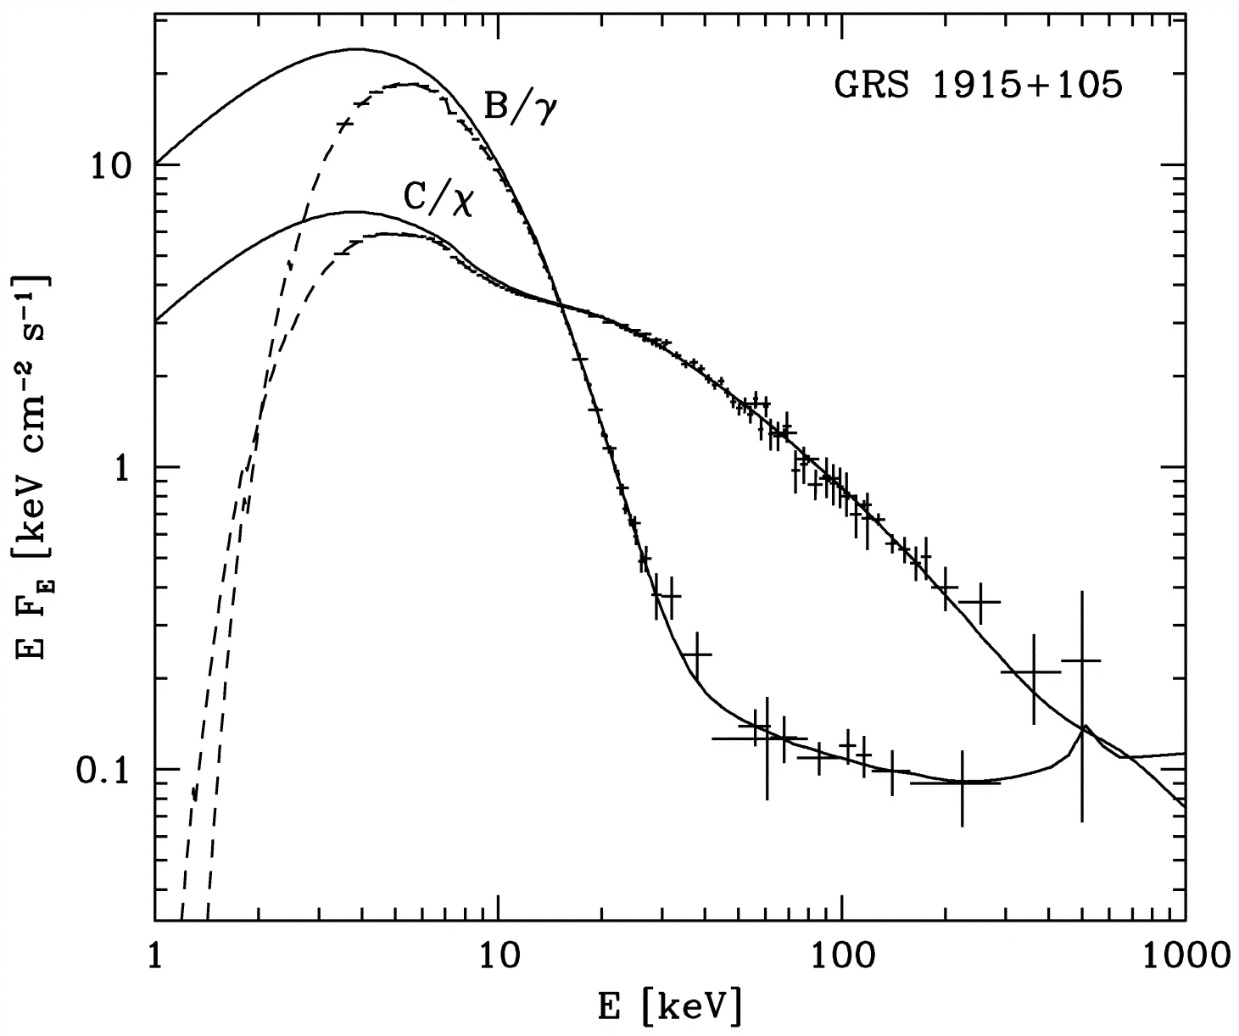
Hybrid plasma
Very high states in GBH look like this
NOT POWER LAW CONTINUUM Kubota & Makashima 2004
thermal doesn’t fit , nonthermal doesn’t fit either as steep
XTE J1550-564
Log γ
Log ν
Zdziarski et al 2001
Gierlinski & Done 2002

Slide 33
Hybrid plasma
Optically thick nonthermal ? Contradiction?
Multiple scattering τ>1 implies electron thermalise
Coulomb collisions –between electrons. Most efficient at low γ
Compton collisions – cooling γ² so most efficient at high γ
Log N(γ)
Log νfν
N (γ) ∝ γ^{−p}
Log γ
Log ν
Log γ
γ_{max}
ε_{in}
Log ν

Slide 34
Very high state
Complex curvature – 2 electron dist, one thermal, one nonthermal ?
Or hybrid - single electron dist, low E thermal, high E nonthermal
Gierlinski & Done 2003

Slide 35
Conclusions
Hard X-rays can be made from Compton scattering – some plasma with very energetic electrons
Plasma is thermal (BUT NOT BLACKBODY!) in low/hard state kT~100keV, tau~1 power Lh. Seed photons from disc and/or self generated cyclo-synchrotron Ls
Lh>>Ls, and not all seed photons we see are seen by X-ray source - constraints on geometry
Plasma is (mostly) nonthermal in high/soft state. Seed photons from disc
Spectra require both both thermal and nonthermal components in intermediate /very high states – hybrid plasma or two components?

Slide 36
Photons and matter: absorption
Chris Done
University of Durham

Slide 37
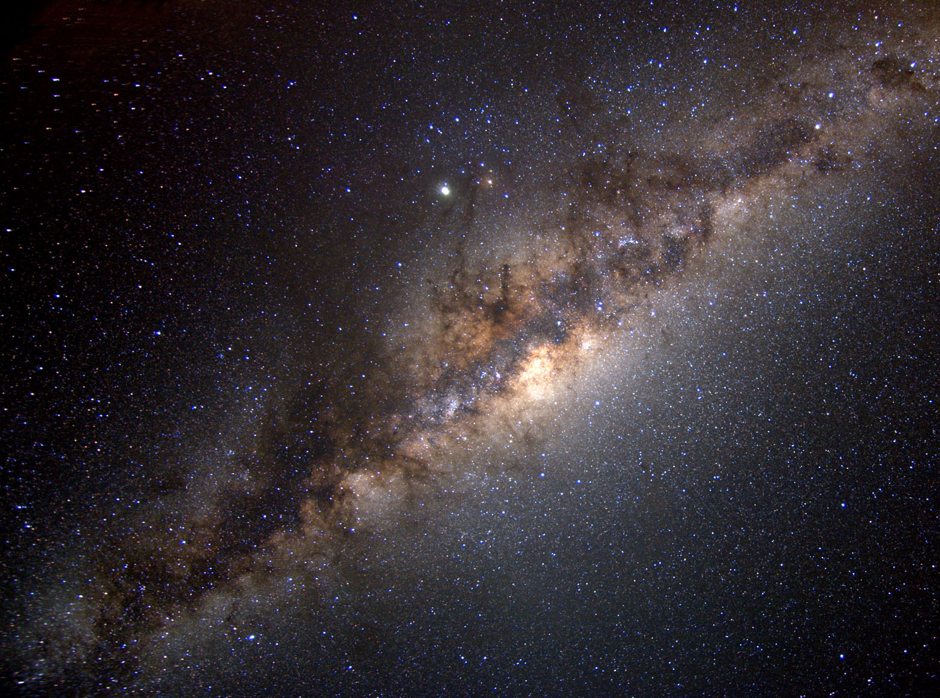
Gas in our galaxy

Slide 38
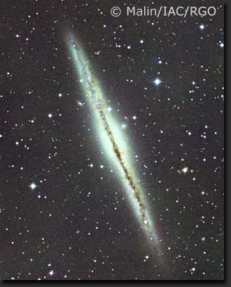
Gas in other galaxies
Look through host galaxy when looking at AGN or x-ray sources in other galaxies

Slide 39
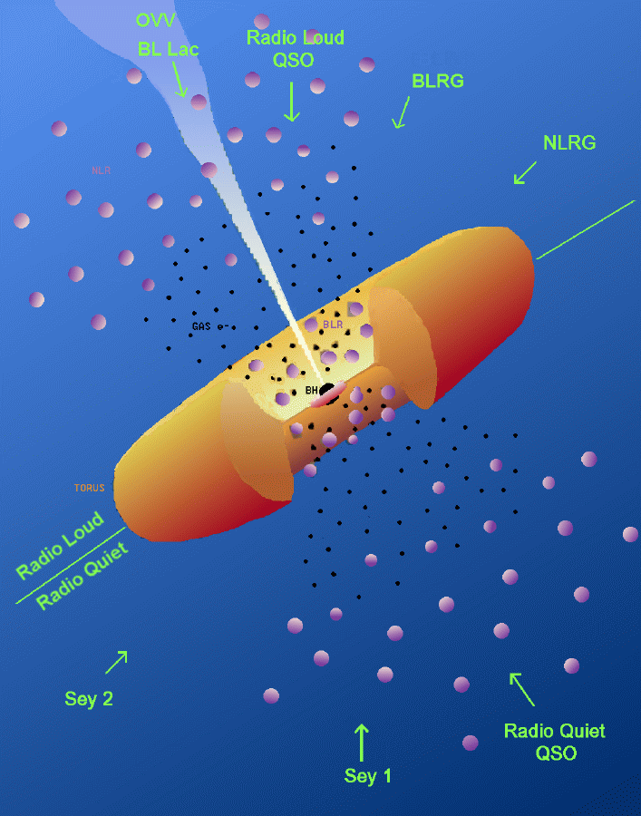
Gas close to AGN
Cold gas associated with nucleus: torus
Ionised gas BLR/NLR clouds
Ionised gas as scattering region where see polarised BLR in some Seyfert 2’s

Slide 40
Winds from accretion disc
Proga 2003

Slide 41
Disc and accretion curtain
Intermediate polars (DQ Hers) for white dwarf accretion
Accreting millisecond pulsars (LMXB) and accretion powered pulsars (HMXRB) for neutron stars (probably highly ionised)

Slide 42
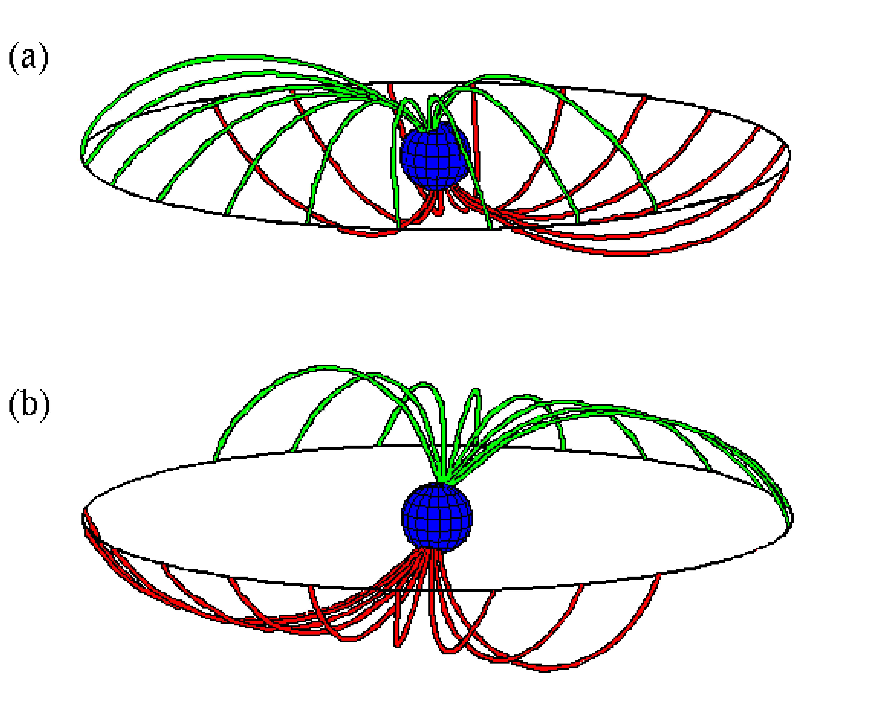
Disk and accretion curtain

Slide 43
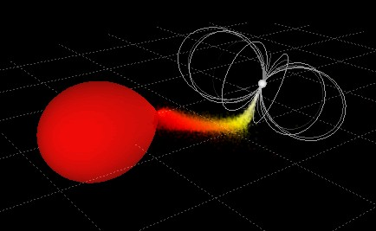
Polars (WD only)

Slide 44
Accretion column
Magdziarz & Done 1999

Slide 45
X-ray absorption: neutral
Characterised by N_{H} – number of hydrogen atoms along a tube of area 1 cm² between us and source
1cm²

Slide 46
X-ray absorption: neutral
Characterised by N_{H} – number of hydrogen atoms along a tube of area 1 cm² between us and source τ= σ n R = σ Ν_{H}
σ cm²

Slide 47
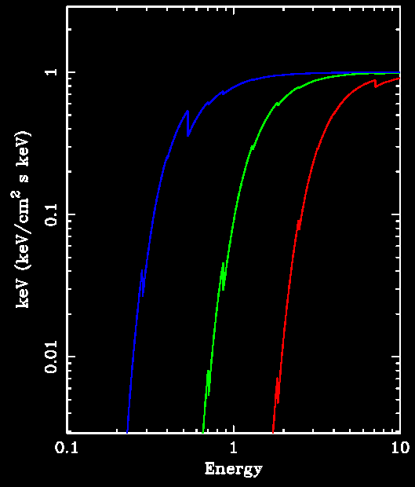
X-ray absorption: neutral
Characterised by NH – number of hydrogen atoms along a tube of area 1 cm² between us and source
But abundances of other elements matter in X-ray
10²¹
10²²
10²³

Slide 48
X-ray absorption: neutral
H edge 13.6 eV = 0.013keV
Higher Z elements have higher edge energy for K shell electron as higher charge means inner electrons more tightly bound
Outer electrons shielded so ionisation energy is less
CNO K 0.28, 0.40, 0.53 keV
ionisation 9, 11 and 14 eV
Fe K & L edges at 7.1 and 0.7 keV
n=1 K shell
n=2 L shell
n=3 M shell…etc

Slide 49
X-ray absorption: neutral
Higher Z elements less abundant so total absorption cross section decreases with energy
H
He
Log σ
C
N
O
Log Ε

Slide 50
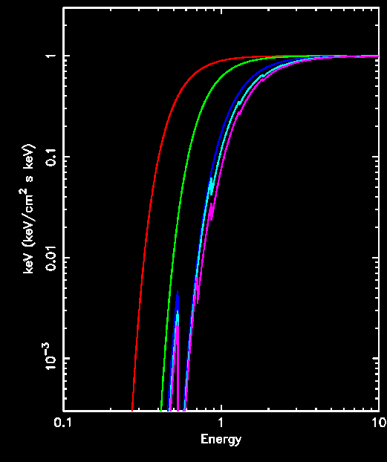
X-ray absorption: neutral
Higher Z elements have higher edge energies as inner electrons more tightly bound
CNO K 0.28, 0.40, 0.53 keV
mid Z K shells Ne, Mg Si, S 0.9, 1.30, 1.8, 2.5 keV
Fe K edges at 7.1 keV and L shell edge at 0.7
Higher Z elements less abundant so total absorption cross section decreases with energy
N_{H}=10²² cm⁻²
H
+CNO
H+He
+Ne,Si,S
+Fe

Slide 51
X-ray absorption: ionisation
Leaves ion!
Ion can recombine if more free electrons than X-ray photons
Then its back to neutral before the next X-ray comes. So X-rays only see neutral material
BUT what if the X-ray comes before the electron. Ion is not neutral and all edge energies are higher as unbalanced charge
n=1 K shell
n=2 L shell
n=3 M shell…etc

Slide 52
X-ray absorption: ionised
Higher Z elements less abundant so total absorption cross section decreases with energy
H
He
Log σ
C
N
O
Log Ε

Slide 53
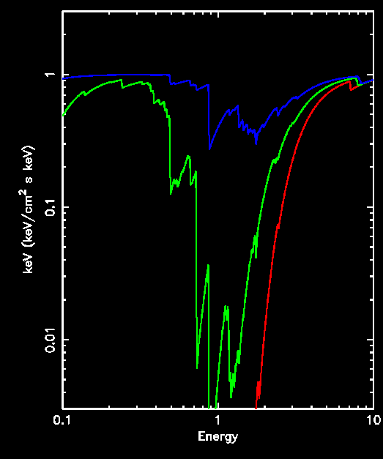
Photoionised absorption: edges
if completely ionised then no edges left!! Just power law
ionised edges are higher energy net charge so more tightly bound
H like edge at 0.0136 Z² keV (energy ∝ charge/r) so high Z elements need more energy to completely ionise.
Fe K He, H-like 8.7, 9.2 keV (XXV and XXVI). if dominant then everything else is ionised!
ξ=10³
ξ=10²
ξ=1
N_{h}=10²³

Slide 54
Photoionisation: populations
which ions? Balance photoionisation (heating) with recombination (cooling)
Depends mostly on ratio of photon to electron density!
n_{γ}/Ν_{e} = L/(hν 4π r² c N_{e})
= ξ / (hν 4π c)
ξ = L/ (N_{e}r²)
Nh, ξ, AND spectral shape
N^{i} + γ ⇔ N^{i+1} + e
N^{i} n_{γ} σ = N^{i+1} N_{e}α(T)
N^{i+1} = n_{γ} σ
N^{i} N_{e}α(T)

Slide 55
Photoionisation: populations
N^{i} + γ ⇔ N^{i+1} + e
N^{i} n_{γ} σ = N^{i+1} N_{e}α(T)
N^{i+1} = n_{γ} σ
N^{i} N_{e}α(T)
Another way to define is ratio of photon pressure to gas pressure
Prad = Ξ = L 1
Pgas 4πr²c nkT = ξ / (4πckT)

Slide 56
Photoionised absorption: edges
if completely ionised then no edges left!! Just power law
ionised edges are higher energy net charge so more tightly bound
H like edge at 0.0136 Z² keV (energy ∝ charge/r) so high Z elements need more energy to completely ionise.
Fe K He, H-like 8.7, 9.2 keV (XXV and XXVI). if dominant then everything else is ionised!
ξ=10³
ξ=10²
ξ=1
N_{h}=10²³

Slide 57
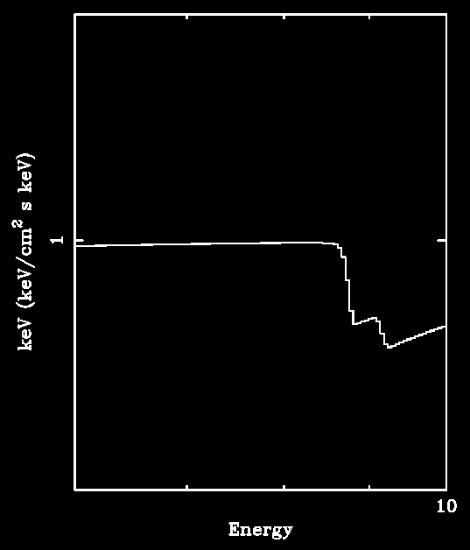
Photoionised absorption: edges
ξ=10³
Multiple edges as generally multiple ion states not just one
ξ=10²
ξ=1
N_{h}=10²³

Slide 58
Lines: even neutral material!
K edge energy is 1s - ∞
generally not that much bigger than 1s-2p Kα line eg H edge at 13.6, Lyα 10.2 eV
can see (just) for C N O with good resolution data but EW is generally small compared to edge
don’t see this from neutral high Z elements as L shells filled for Z> Ne (Si, S Fe…)
but can when ionise! Which also means hotter material
1-2 Kα
1-3 Kβ
1-4 Kγ
1-∞ K

Slide 59
Lines: ionised!
See 1s-2p if got hole in L shell
One electron less than filled 2p shell ie one electron less than neon like
Still need at least 1 electron so F-like to H-like has LOTS of lines
He like generally biggest cross-section
O: 0.6keV Fe: 6.7 keV
1-2 Kα
1-3 Kβ
1-4 Kγ
1-∞ K

Slide 60
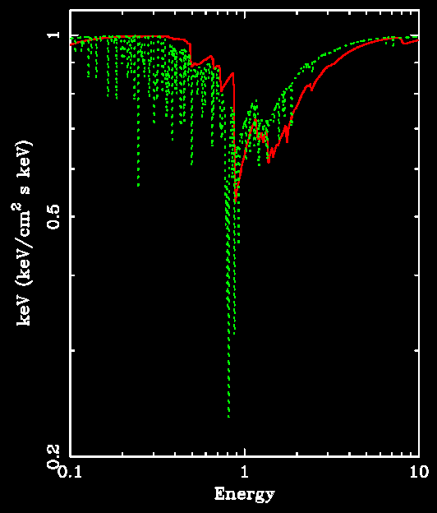
Ionised absorption: lines!!!
BIG difference: LINES
absori does ionisation balance and corresponding edge absorption
xion does ionisation balance (better as balances heat/cooling) and line + edge absorption
Use this where material close enough to X-rays to be ionised!!

Slide 61
Evidence for Winds in AGN: X-ray absorption
See ionised absorption lines in soft X-ray spectra of around 50% of nearby AGN Reynolds et al 1997
‘warm absorbers’ ie ionised material
With good grating spectra see its multiphase Blustin et al 2005 – eg NGC3783 has at least 3 different ξ
V~500 km/s outflow
NGC3783 Netzer et al 2003

Slide 62
Compton temperature
X-ray heating of material from compton up and downscattering Δε/ε=4Θ − ε
Integrate over number of photons N(ε) at each energy
∫ N(ε) Δε = 0 = ∫ N(ε) (4Θ −ε) ε dε
Compton temperature T_{IC}=511 Θ_{IC}
4Θ_{IC}= ∫ N(ε) ε² dε / ∫ N(ε) εdε
Log νfν
Log ν

Slide 63
Compton temperature
X-ray heating of material from compton up and downscattering Δε/ε=4Θ − ε
Integrate over number of photons N(ε) at each energy
∫ N(ε) Δε = 0 = ∫ N(ε) (4Θ −ε) ε dε
Compton temperature T_{IC}=511 Θ_{IC}
4Θ_{IC}= ∫ N(ε) ε² dε / ∫ N(ε) εdε
Log νfν
Log ν

Slide 64
Thermally driven Winds
Direct illumination or scattering from wind…
X-ray source irradiates top of disc, heating it to Compton temperature
T_{IC} depends only on spectrum - L_{irr} only controls depth of layer
Begelman McKee Shields 1983

Slide 65
Thermally driven Winds
Hot so expands as pressure gradient – corona bound if
v² =3kT_{IC}/m <v_{esc}² = GM/R
Wind for R > R_{IC} driven by pressure gradient so expands on c_{s} with v∞=√(3kT_{IC}/m_{p})
= √(GM/R)
Wind velocity typically that of gravitational potential from where it is launched
R=R_{IC}
Begelman McKee Shields 1983

Slide 66
Absorption lines in BHB
Kubota et al 2007
Neutral ISM absorption
Ionised absorption

Slide 67
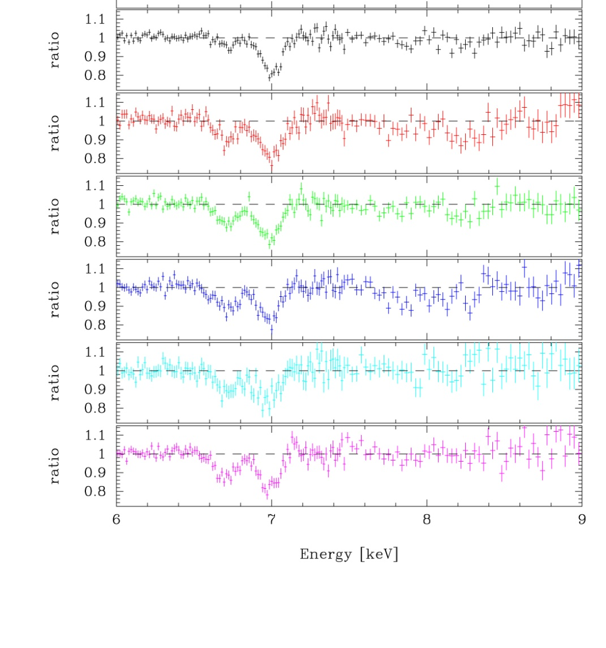
Absorption lines in BHB
He–like Fe 6.7 keV
H-like Fe at 7.0 keV
Ratio 6.7/7.0 gives ξ
Increasing so ionisation state decreasing with L as expect for photoionsed material
To get column need width of line < 4000 km/s
Guess a ‘reasonable’ number and get Nh
ξ=L/nr² = L Δr/(Nh r²) Assume Δr/r~1 to get r= ξ Nh /L distance of material from X-ray source

Slide 68
Continuum radiation driven Winds
But any material above disc is also illuminated by the continuum source
Effective gravity is
(1- τ/τ_{es} L/L_{Edd}) GM/R NOT simply GM/R
If just electron scattering = (1- L/L_{Edd}) GM/R continuum driven winds from all radii at L>L_{Edd}

Slide 69
Continuum radiation driven Winds
But any material above disc is also illuminated by the continuum source
Effective gravity is
(1- τ/τ_{es} L/L_{Edd}) GM/R NOT simply GM/R
If just electron scattering = (1- L/L_{Edd}) GM/R continuum driven winds from all radii at L>L_{Edd}
Absorb momentum of radiation so they are faster v ~ 0.1-0.3c Everett & Ballantyne 2004, Ohsuga 2007
L_{KE}~L_{rad} >L_{Edd} Ohsuga 2007
Ohsuga 2006

Slide 70
UV line driven Winds
If substantial opacity: τ>>τ_{es} so gravity (1- τ/τ_{es} L/L_{Edd}) GM/R
Most opacity in UV resonance lines
Momentum absorbed in line accelerates wind so more momentum absorbed in line - UV line driving at L<<L_{Edd}
Log νfν
Log E

Slide 71
UV line driven Winds
If substantial opacity: τ>>τ_{es} so gravity (1- τ/τ_{es} L/L_{Edd}) GM/R
Most opacity in UV resonance lines
Momentum absorbed in line accelerates wind so more momentum absorbed in line - UV line driving at L<<L_{Edd}
Log νfν
Log E

Slide 72
UV line driven Winds in AGN?
Surprisingly hard to do as X-ray source as well !
UV bright disc launches vertical wind. Rises up but then illuminated by central X-ray source which overionises it so that no UV transitions! Only X-ray lines and these don’t absorb as much momentum L_{x} << L_{UV}
AGN and CV discs are bright UV sources so power big winds especially when not much X-ray emission
Proga 2003

Slide 73
X-ray absorption: high ionisation/column/v
BUT also beginning to see absorbers which are much more highly ionised. And have higher column and velocity
PDS456 even more extreme Pair of blue-shifted absorption lines observed with Suzaku at 9.08/9.66 keV (rest frame) or 7.68/8.15 keV (observed) 0.26/0.32c L_{KE}~L_{rad}

Slide 74
X-ray absorption: high ionisation/column/v
BUT also beginning to see absorbers which are much more highly ionised. And have higher column and velocity
IC4329a see He and H-like Fe Kα! H-like is 7.68 keV (rest-frame), 7.5 keV (observed) so outflow v~0.1c Markowicz et al 2006
↓
↓

Slide 75
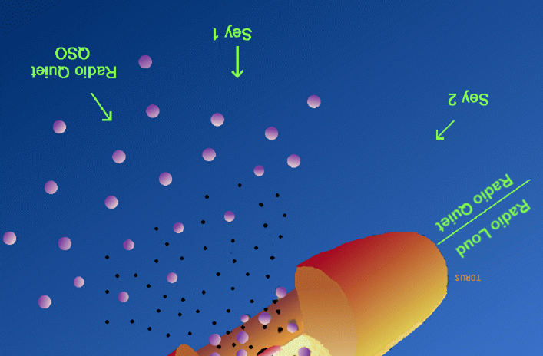
Gas close to AGN
Also irradiate torus
Same TIC, but much further out so very easy to launch wind from torus
Probable origin for some/most of the ‘warm absorbers’ seen in AGN Krolik & Kris 2001, Blustin et al 2005..

Slide 76
Evidence for Winds in AGN: X-ray absorption
See ionised absorption lines in soft X-ray spectra of around 50% of nearby AGN Reynolds et al 1997
‘warm absorbers’ ie ionised material
With good grating spectra see its multiphase Blustin et al 2005 – eg NGC3783 has at least 3 different ξ
V~500 km/s outflow
NGC3783 Netzer et al 2003

Slide 77
Reflection from a slab
Reflection by electron scattering where ever X-rays illuminate optically thick material e.g. accretion disk Lightman & White 1988, George & Fabian 1991, Matt, Perola & Piro 1991, Matt et al 1991,1993,1996, Ross et al 1993,1996, Zycki & Czerny 1994….
Electrons ~ at rest so mostly downscattering – angles!! Get range of ε_{out} (i) for given i, ε_{in}
Not just compton – also got photoelectric absorption (and associated fluorescence lines)
θ_{io}
ε_{out}
ε_{in}
ε_{out} ~ ε_{in}
1 + ε_{in} (1- cosθ_{io})

Slide 78
Reflection from a slab: pexriv
XSPEC: pexrav
Low E: reflection probability set by relative importance of scattering and photoelectric abs.
High E: Compton downscattering so depends on spectral shape above bandpass Magdziarz & Zdziarski 1995
Makes peak 20-50 keV
Photoelectric absorption edges
Log σ
Electron scattering
Incident spectrum
Reflected spectrum

Slide 79
Reflection from a slab: pexriv
XSPEC: pexriv
Depends on ionisation ξ=L/nr². fewer bound electrons so smaller photoabs. So higher reflection Done et al 1992
High E: Compton downscattering stays constant

Slide 80
Reflection from a slab
XSPEC: reflionx
Depends on ionisation ξ=L/nr². fewer bound electrons so smaller photoabs. So higher reflection Done et al 1992
High E: Compton downscattering stays constant

Slide 81
Relativistic smearing: spin
Relativistic effects (special and general) affect all emission
Emission from side of disc coming towards us:
Doppler blueshifted
Beamed from length contraction
Time dilation as fast moving (SR)
Gravitational redshift (GR)
Fe Kα line from irradiated disc should be broad and skewed, and shape depends on R_{in} (and spin)
flux
Energy (keV)
Fabian et al. 1989
Notes:
Another area where Astro e2 will give major progress in an independent test of the accretion flow models. The accretion disc moves fast in a strong gravitational field, so both special and general relativistic effects modify its spectrum. Doppler shifts and length contraction mean that the emission from the disc moving towards us is blueshifted and boosted, while that moving away is redshifted and suppressed. Then time dilation and gravitational redshift drag everything redwards. The strength of these all effects decrease with radius. All emission from the disc is affected, but its much easier to see on intrinsically narrow features – lines. X-ray illumination of the disc gives iron Kalpha line. Moving inner disc models predict broader line in softer spectra. But the measured line profile can be distorted by narrow absorption features superimposed on the emission. The high spectral resolution of Astro e2 will unambiguously show these, enabling the intrinsic line profile to be measured.

Slide 82
Conclusions
Continuum source gets absorbed if intersects material
photoelectric absorption edges and lines
Material can be just line of sight – unrelated, generally neutral
But continuum source illuminating disc/torus gives rise to absorbing material in line of sight via winds - photoionised
Equatorial disc wind
thermal in BHB
thermal/radiation pressure/UV line driven in AGN
B field always helps!
AGN also have wind from torus – warm absorbers

