Slide 1
Spectra and variability of BHB (1) and AGN (2)
Chris Done,
Chichun Jin, Martin Ward, Mari Kolehmainen
University of Durham

Slide 2
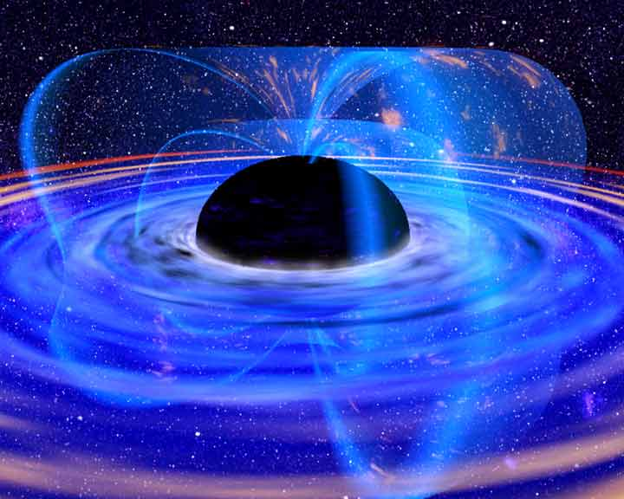
Accretion
Accreting BH: huge X-ray luminosity close to event horizon R_{s}
Emission from region of strong spacetime curvature
Observational constraints on strong gravity if we can understand accretion!

Slide 3
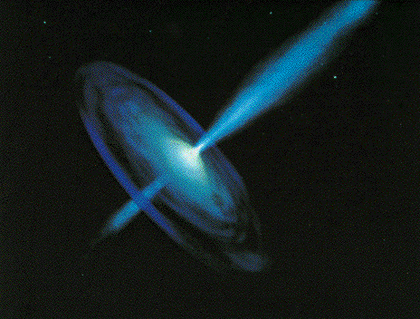
Black holes
Black hole binaries –
Observational template of how accretion flows (spectra and variability) and their associated jet behave
Build a working physical model of accretion flows
Black hole spin

Slide 4
Black holes
Scale up to AGN – what works and what doesn’t

Slide 5
BHB – Quasars for the impatient
BRIGHT! Huge amounts of data, long term variability (days –years) in mass accretion rate (due to H ionisation instability in disc)
Observational template of accretion flow as a function of L/L_{Edd} onto ~10 M BH (very homogeneous!)
2 years
DGK07

Slide 6
Spectral states
very high
Disc dominated - look like a disc but small tail to high energies
Very high/intermediate states at least know something about a disc
Low/hard state look really different, not at all like a disc!
disk dominated
high/soft
Gierlinski & Done 2003

Slide 7
Variability of disc:long timescale
L/L_{Edd} ∝AT⁴_{max} (Ebisawa et al 1993; Kubota et al 1999; 2001)
Constant size scale – last stable orbit!! BH spin

Slide 8
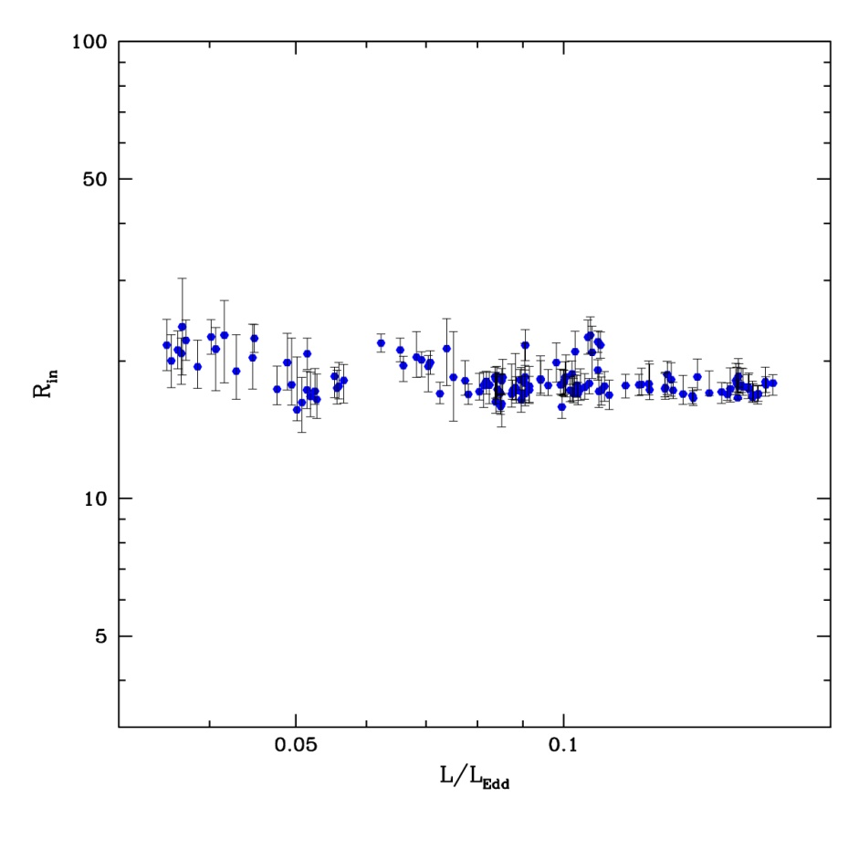
Disc spectra: last stable orbit
L/L_{Edd} ∝T⁴_{max} (Ebisawa et al 1993; Kubota et al 1999; 2001)
Constant size scale – last stable orbit!!
Proportionality constant gives a measure R_{lso} i.e. spin as L=σ R² T⁴
Not quite as simple as this
Proper relativistic emissivity (Novikov-Thorne)
corrections for spectrum not being blackbody (fcol)
Corrections for relativistic propagation effects
Gierlinski & Done 2003

Slide 9
Disc dominated spectra
Disc models assumed energy thermalises in optically thick disc structure
A few energetic (nonthermal-hybrid) electrons Compton upscatter photons from disc Lh<<Ls
Maybe B field (MRI) bubbling up (buoyant) an reconnecting (dissipating energy) above the disc patchy and/or τ<<1
Log ν f(ν)
Log ν
Notes:
The disc models assumed that the emission thermalised. That’s not necessarily true at low L/Ledd where the flow is not very dense. If its not thermalising then its not cooling as efficiently so the flow heats up. This can lead to a hot, optically thin, geometrically thick inner flow replacing the inner disc. The hot electrons in this flow can compton upscatter any low energy photons from a residual outer disc, but there are not many of these, so the spectrum is hard

Slide 10
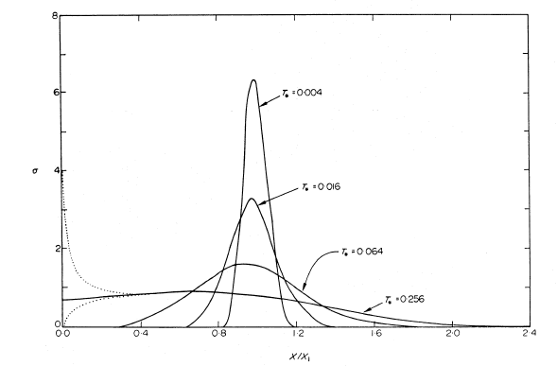
Variability of disc:short timescale
Accretion rate through disc changes on timescales of days
tvisc= α⁻¹ (H/R)⁻² torb
=5 α⁻¹ (H/R)⁻² (r/6) ^{-3/2} ms ~ 500s
~ 500s at last stable orbit for 10M
No rapid variability of disc in disc dominated states!

Slide 11
Variability of disc:short timescale
Accretion rate through disc changes on timescales of days
tvisc= α⁻¹ (H/R)⁻² torb
=5 α⁻¹ (H/R)⁻² (r/6) ^{-3/2} ms ~ 500s
~ 500s at last stable orbit for 10M
No rapid variability of disc in disc dominated states!
0.5 1.0 2.0

Slide 12
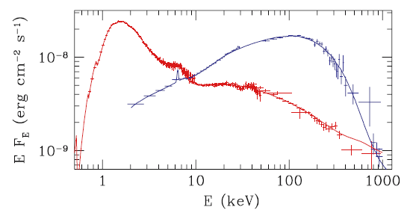
Spectra which don’t look like a disc
Gierlinski et al 1999

Slide 13
Low/hard state variability
Hard X-rays show much more dramatic change on short timescales down to few 10s of ms
tvisc= α⁻¹ (H/R)⁻² tdyn = 5 α⁻¹ (H/R)⁻² (r/6) ^{-3/2} ms
IF viscous timescale then H/R~1
0.5 1.0 2.0

Slide 14
Variability of disc:short timescale
Accretion rate through disc changes on timescales of days
tvisc= α⁻¹ (H/R)⁻² torb
=5 α⁻¹ (H/R)⁻² (r/6) ^{-3/2} ms ~ 500s
~ 500s at last stable orbit for 10M
No rapid variability of disc in disc dominated states!
0.5 1.0 2.0

Slide 15
Accretion flows without discs
Disc models assumed thermal plasma – not true at low L/L_{Edd}
Instead: hot, optically thin, geometrically thick inner flow replacing the inner disc (Shapiro et al. 1976; Narayan & Yi 1995)
Hot electrons Compton upscatter photons from cyclo-sync? Typically optical energies for P_{B}~0.1Pgas
But see some disc as well in bright low/hard states
Log ν fv(ν)
Log ν
Notes:
The disc models assumed that the emission thermalised. That’s not necessarily true at low L/Ledd where the flow is not very dense. If its not thermalising then its not cooling as efficiently so the flow heats up. This can lead to a hot, optically thin, geometrically thick inner flow replacing the inner disc. The hot electrons in this flow can compton upscatter any low energy photons from a residual outer disc, but there are not many of these, so the spectrum is hard

Slide 16
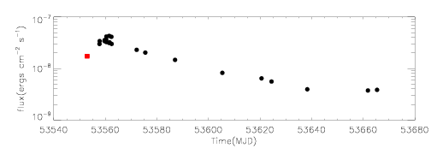
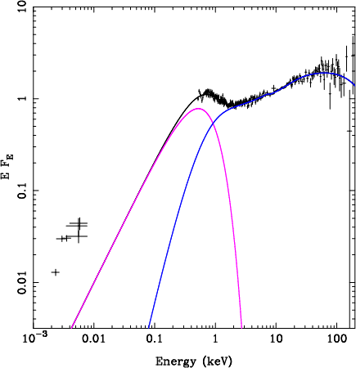
Seed photons in low/hard state
Low/hard state outburst
Swift optical/UV/X-ray plus RXTE 3-200 keV
Low Nh (2x10²¹ cm⁻²)
Factor 10 ↓ in 3 months
Seed photons disc at peak
Probably cyclo-sync later
3 months
x10
Chiang & Done 2009

Slide 17
Accretion flows without discs
Disc models assumed thermal plasma – not true at low L/L_{Edd}
Instead: hot, optically thin, geometrically thick inner flow replacing the inner disc (Shapiro et al. 1976; Narayan & Yi 1995)
Hot electrons Compton upscatter photons from cyclo-sync? Typically optical energies for P_{B}~0.1Pgas
But see some disc as well in bright low/hard states
Log ν fv(ν)
Log ν
Notes:
The disc models assumed that the emission thermalised. That’s not necessarily true at low L/Ledd where the flow is not very dense. If its not thermalising then its not cooling as efficiently so the flow heats up. This can lead to a hot, optically thin, geometrically thick inner flow replacing the inner disc. The hot electrons in this flow can compton upscatter any low energy photons from a residual outer disc, but there are not many of these, so the spectrum is hard

Slide 18
Accretion flows without discs
Disc models assumed thermal plasma – not true at low L/L_{Edd}
Instead: hot, optically thin, geometrically thick inner flow replacing the inner disc (Shapiro et al. 1976; Narayan & Yi 1995)
Hot electrons Compton upscatter photons from cyclo-sync? Typically optical energies for P_{B}~0.1Pgas
But see some disc as well in bright low/hard states
But not easy to put it under flow as Ls<<Lh – so truncate
Log ν fv(ν)
Log ν
Notes:
The disc models assumed that the emission thermalised. That’s not necessarily true at low L/Ledd where the flow is not very dense. If its not thermalising then its not cooling as efficiently so the flow heats up. This can lead to a hot, optically thin, geometrically thick inner flow replacing the inner disc. The hot electrons in this flow can compton upscatter any low energy photons from a residual outer disc, but there are not many of these, so the spectrum is hard

Slide 19
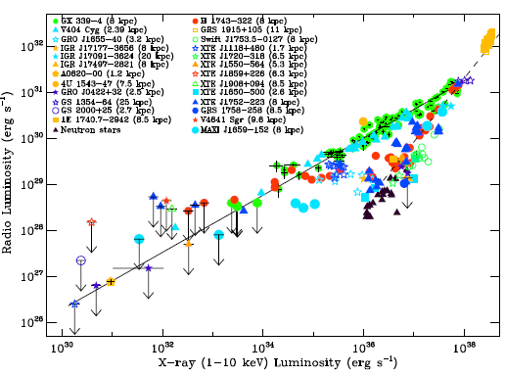
Accretion flows – Jet
Low/hard
High/soft
Very high
Corbel et al 2012
Notes:
The disc models assumed that the emission thermalised. That’s not necessarily true at low L/Ledd where the flow is not very dense. If its not thermalising then its not cooling as efficiently so the flow heats up. This can lead to a hot, optically thin, geometrically thick inner flow replacing the inner disc. The hot electrons in this flow can compton upscatter any low energy photons from a residual outer disc, but there are not many of these, so the spectrum is hard

Slide 20
Accretion flows without discs
Disc models assumed thermal plasma – not true at low L/L_{Edd}
Instead: hot, optically thin, geometrically thick inner flow replacing the inner disc (Shapiro et al. 1976; Narayan & Yi 1995)
Hot electrons Compton upscatter photons from outer cool disc
Few seed photons, so spectrum is hard
Jet from large scale height flow
Log ν fv(ν)
Log ν
Notes:
The disc models assumed that the emission thermalised. That’s not necessarily true at low L/Ledd where the flow is not very dense. If its not thermalising then its not cooling as efficiently so the flow heats up. This can lead to a hot, optically thin, geometrically thick inner flow replacing the inner disc. The hot electrons in this flow can compton upscatter any low energy photons from a residual outer disc, but there are not many of these, so the spectrum is hard

Slide 21
Accretion flows without discs
Disc models assumed thermal plasma – not true at low L/L_{Edd}
Instead: hot, optically thin, geometrically thick inner flow replacing the inner disc (Shapiro et al. 1976; Narayan & Yi 1995)
Hot electrons Compton upscatter photons from outer cool disc
Few seed photons, so spectrum is hard
Jet from large scale height flow
Log ν fv(ν)
Log ν
Notes:
The disc models assumed that the emission thermalised. That’s not necessarily true at low L/Ledd where the flow is not very dense. If its not thermalising then its not cooling as efficiently so the flow heats up. This can lead to a hot, optically thin, geometrically thick inner flow replacing the inner disc. The hot electrons in this flow can compton upscatter any low energy photons from a residual outer disc, but there are not many of these, so the spectrum is hard

Slide 22
Moving disc
Disc closer in, more soft photons from disc so softer spectra
Especially when overlaps with hot flow. Decrease radius, increase overlap, increases seed photons dramatically
Disc down to last stable orbit and collapse of hot flow gives physical mechanism for hard/soft transition + jet collapse
Restarts at very high L/LEdd? Where radiation pressure truncates?

Slide 23
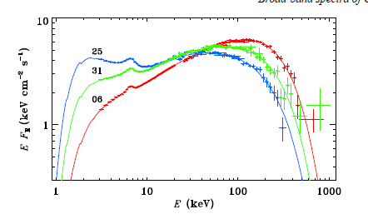
Compton spectrum softens
Ibragimov et al 2005

Slide 24
Observed GBH spectra
RXTE archive of many GBH
Same spectral evolution 10⁻³ < L/L_{Edd} < 1
Truncated disc → R_{ms} qualitative and quantitative
Done & Gierliński 2003
Γ (3-6.4)
4.5
3.0
1.5
1.5
1.5
3.0
3.0
4.5
4.5
Γ (6.4-16)
Γ (6.4-16)

Slide 25
Event horizon – compare to NS
BH event horizon: 2-0.5 R_{s}, last stable orbit: 3-0.5 R_{s}
Neutron stars. R~3R_{s} so gravitational potential for accretion flow the same.
Look at same M/M_{Edd} for accretion flow – difference reveals presence/absence of surface!
. .

Slide 26
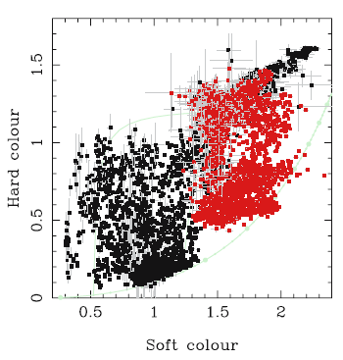
L_{h}/L_{s}
LS
Hard (low L/L_{Edd})
Soft (high L/L_{Edd})
1
VHS
HS
US

Slide 27
Moving disc
Disc closer in, more soft photons from disc so softer spectra
Especially when overlaps with hot flow. Decrease radius, increase overlap, increases seed photons dramatically
Disc down to last stable orbit and collapse of hot flow gives physical mechanism for hard/soft transition + jet collapse
Restarts at very high L/LEdd?

Slide 28
Hardness – intensity diagram
Outburst starts hard, source stays hard as source brightens
Then softens to intermediate/very high state/steep power law state major hard-soft state transition
Then disc dominated, then hardens to make transition back to low/hard state – hysteresis as generally at lower L
Fender Belloni & Gallo 2004

Slide 29
BHB – show hysteresis
See in outbursts. Not in persistent sources (Cyg X-1)
But Cyg x-1 also HMXRB so maybe accreting from wind ?
But see NO large scale hysteresis in persistent NS LMXRB
So hysteresis is out of equilibrium flow (Gladstone et al 2007)
2 years
DGK07

Slide 30
Low/hard state variability
Hard X-rays show much more dramatic change on short timescales down to few ms
tvisc= α⁻¹ (H/R)⁻² tdyn = 5 α⁻¹ (H/R)⁻² (r/6) ^{-3/2} ms
IF viscous timescale then H/R~1
0.5 1.0 2.0

Slide 31
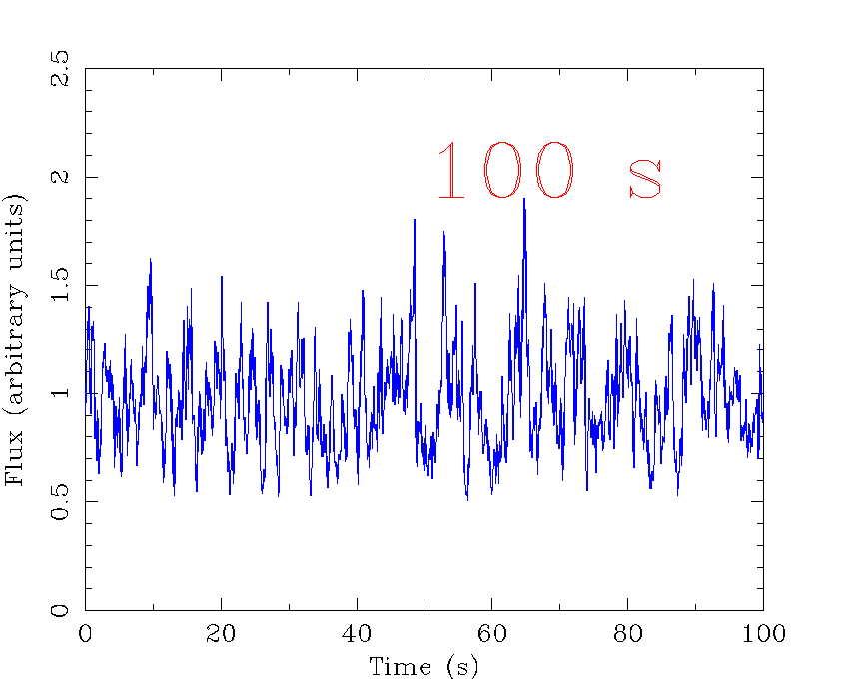
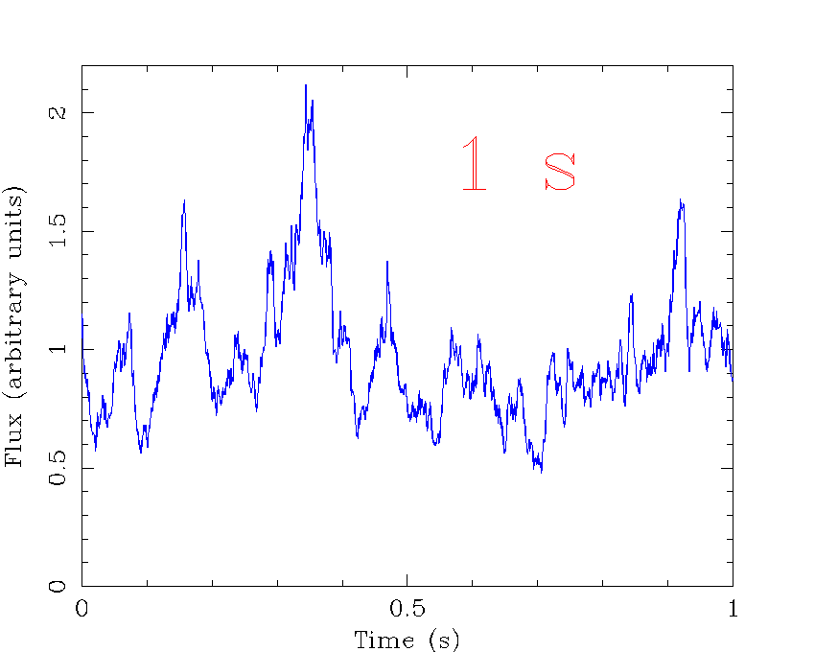
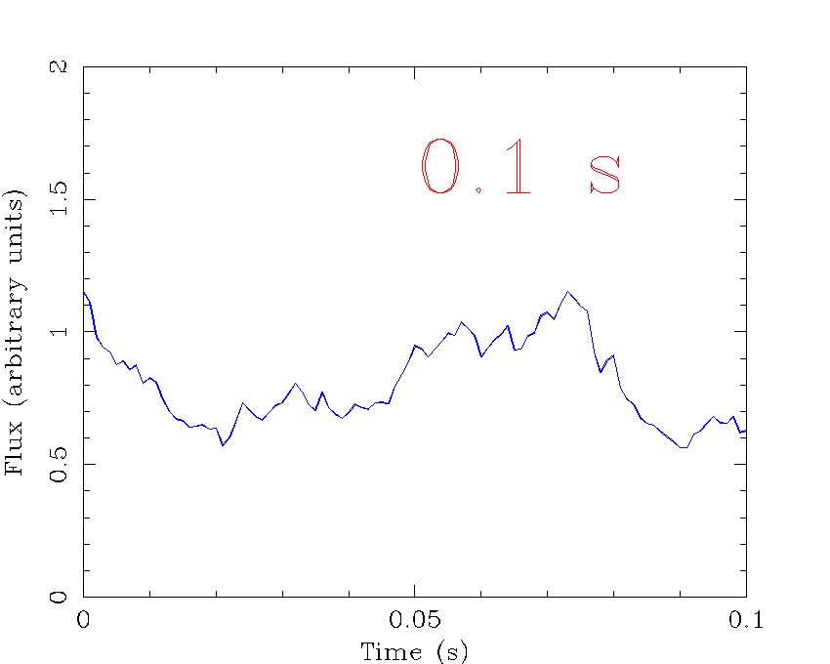
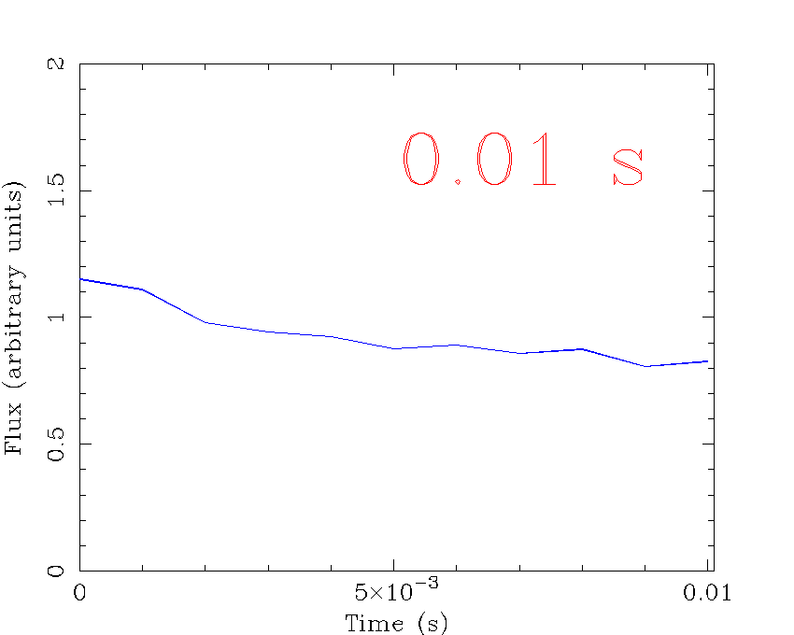
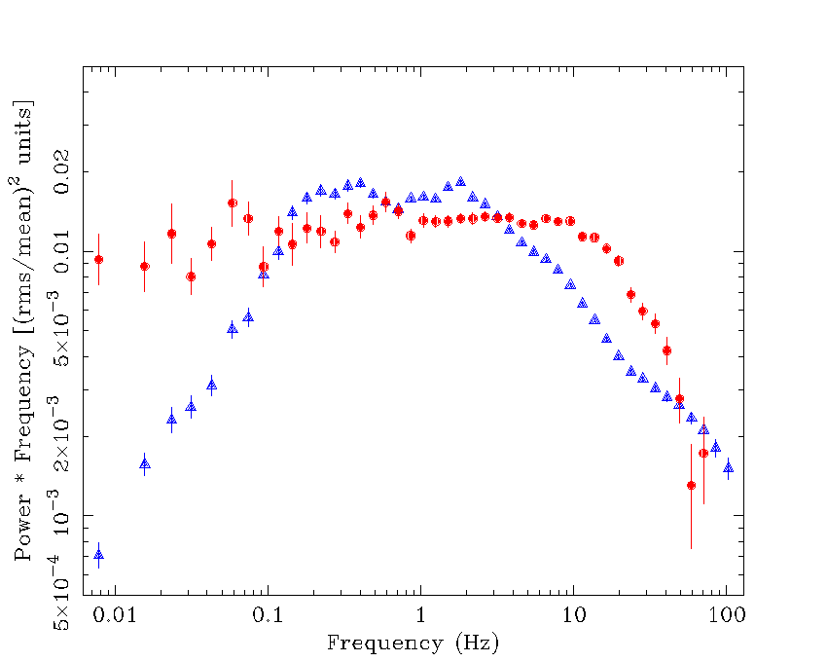
Quantifying variability: the power spectral density (PSD) of Cyg X-1
P(f)∝f⁻¹
P(f)∝f⁰
P(f)∝f⁻²
Phil Uttley

Slide 32
XTE J1550-564

Slide 33
f_{b}
f_{h}
XTE J1550-564

Slide 34
f_{QPO}
XTE J1550-564

Slide 35
Moving disc – moving QPO
Energy spectra need disc to move from 50-6ish Rg as make transition
Power spectra: low frequency break moves, high frequency power more or less constant! Large radius moves, Small radii constant
Low frequency QPO moves with low frequency break
QPO big, must be fundamental
DGK07

Slide 36
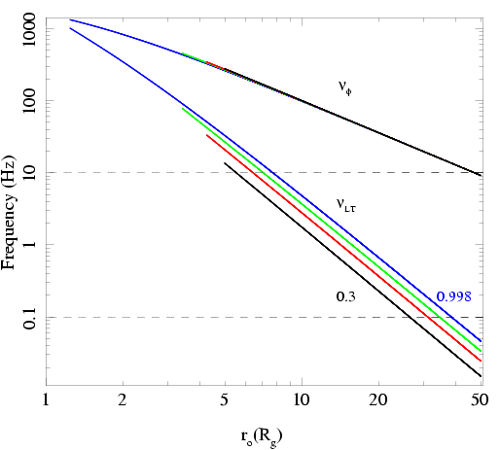
Low frequency QPO
Spectra need disc to move from R_{tr} = 50-6ish R_{g} as make transition
Observed QPO frequencies go from ~0.1-10 Hz
See similar range in ALL BHB – so either all BHB have same spin or not much spin dependence on QPO
Not ν(ϕ) as too fast!
Ingram, Done & Fragile 2009

Slide 37
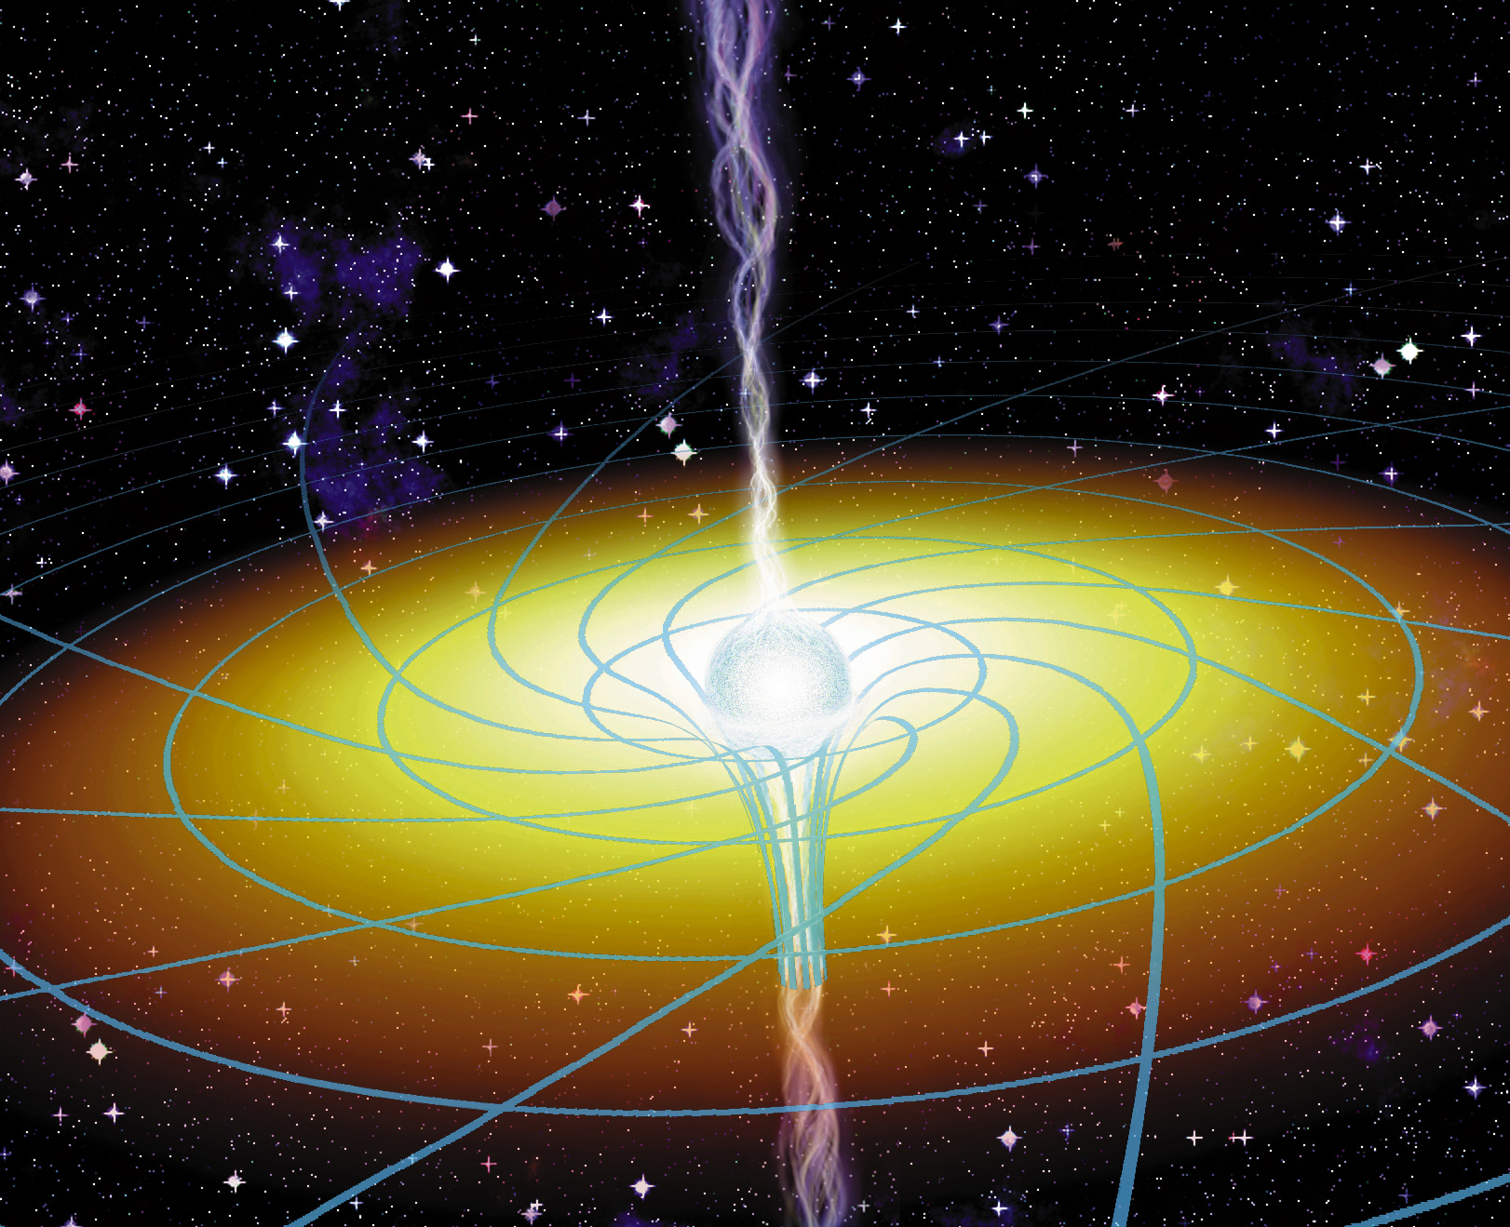
Frame dragging
Spacetime rotating
Asymmetric potential
Orbits get dragged around
So any orbit which crosses the equatorial plane will precess
Lense-Thirring precession
www.phys.ncku.edu.tw/.../ apod/ap971107.html

Slide 38
Low frequency QPO
Stella & Vietri 1998 – GR potential not spherically symmetric so vertically offset circular orbit has ν(θ) ≠ ν(ϕ)
Lense-Thirring precession ν_{LT} = ν(θ) - ν(ϕ)
Lamb & Markovic

Slide 39
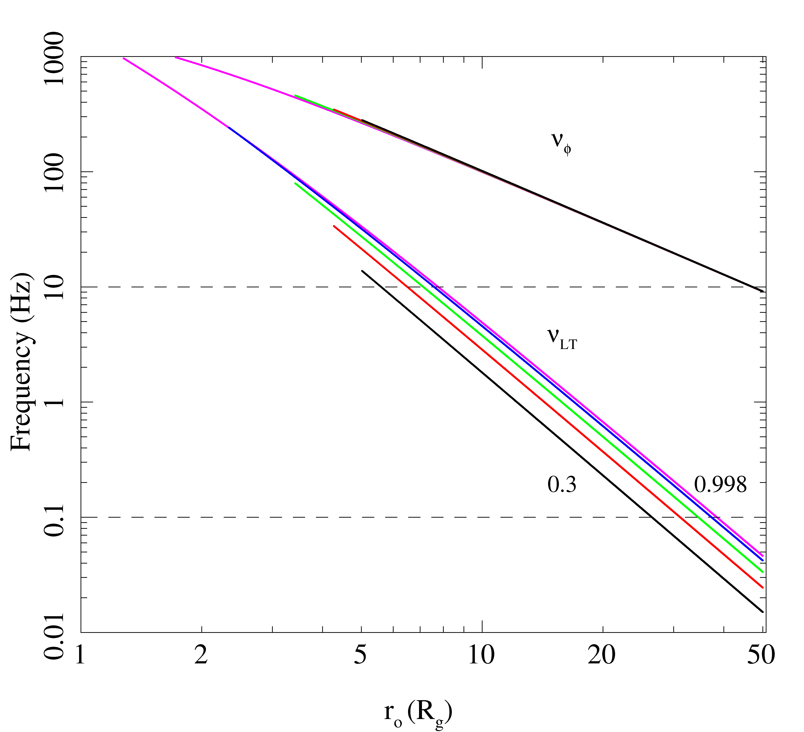
Does it work ?
Not really
Any moderate spin gives QPO much faster than observed as r → lso
And edge of disc would have blackbody spectrum. QPO has spectrum of hot inner flow
Ingram, Done & Fragile 2009

Slide 40
How does it modulate?
Spectrum of LF QPO is same as Comptonisation to zeroth order
NOT the disc - most obvious close to transition
Zycki & Sobolewska 2005; 2006
DGK07
Ingram, Done & Fragile 2009

Slide 41
< H/R
precession
> H/R
Warped disc
Ingram, Done & Fragile 2009

Slide 42
Chris Fragile 2007

Slide 43
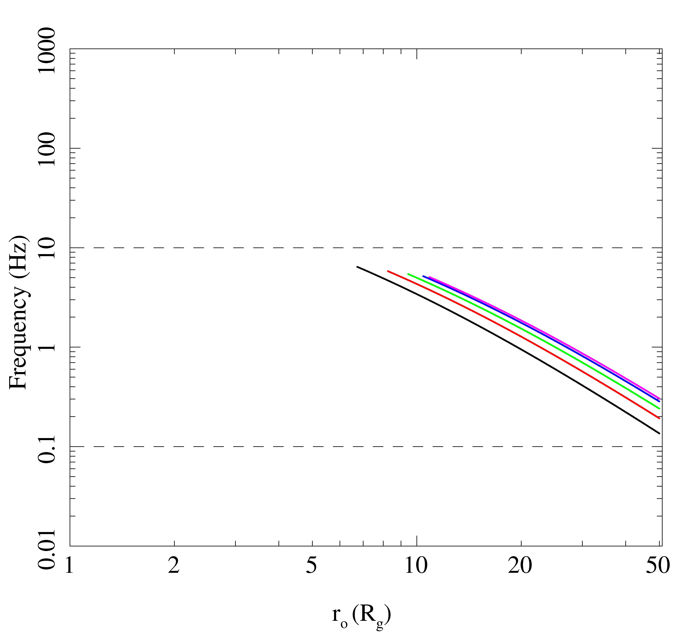
LT precession of hot flow?
Truncates at ~ bending wave radius
QPO frequency given by weighted average of LT precession frequency over all radii in hot flow
Gets the frequencies correct!!
Modulates Compton region so gets spectrum
Ingram, Done & Fragile 2009

Slide 44
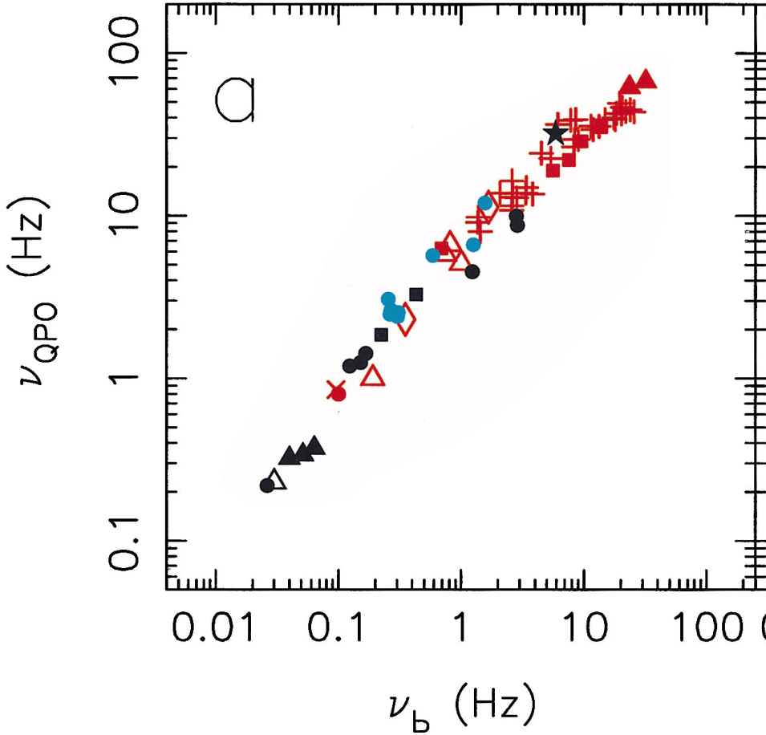
QPO and broadband noise
Low frequency QPO moves with low frequency break
Wijnands & van der Klis 1989

Slide 45
Origin of variability: MRI
Krolik, de Villiers, Hawley

Slide 46
Propagating fluctuations
But emission depends on Mdot
Mdot can’t vary on shorter timescales than the local viscous timescale, t_{visc}(r)
P_{f}
MRI
f
Notes:
variability in Mdot peaks at local viscous frequency

Slide 47
Propagating fluctuations
But emission depends on Mdot
Mdot can’t vary on shorter timescales than the local viscous timescale, t_{visc}(r)
P_{f}
Mdot
f
Notes:
variability in Mdot peaks at local viscous frequency

Slide 48
Propagating fluctuations
But emission depends on Mdot
Mdot can’t vary on shorter timescales than the local viscous timescale, t_{visc}(r)
f P_{f}
f
Notes:
variability in Mdot peaks at local viscous frequency

Slide 49
Propagating fluctuations
But emission depends on Mdot
Mdot can’t vary on shorter timescales than the local viscous timescale, t_{visc}(r)
f P_{f}
f
Notes:
variability in Mdot peaks at local viscous frequency

Slide 50
Propagating fluctuations
But emission depends on Mdot
Mdot can’t vary on shorter timescales than the local viscous timescale, t_{visc}(r)
f P_{f}
f
Notes:
variability in Mdot peaks at local viscous frequency

Slide 51
Propagating fluctuations
But emission depends on Mdot
Mdot can’t vary on shorter timescales than the local viscous timescale, t_{visc}(r)
f P_{f}
f
Notes:
variability in Mdot peaks at local viscous frequency

Slide 52
f_{b}
f_{h}
log[fP(v)]
log[f]
Notes:
52

Slide 53
f_{b}
f_{h}
log[fP(v)]
log[f]
Notes:
53

Slide 54
f_{b}
f_{h}
log[fP(v)]
log[f]
Notes:
54

Slide 55
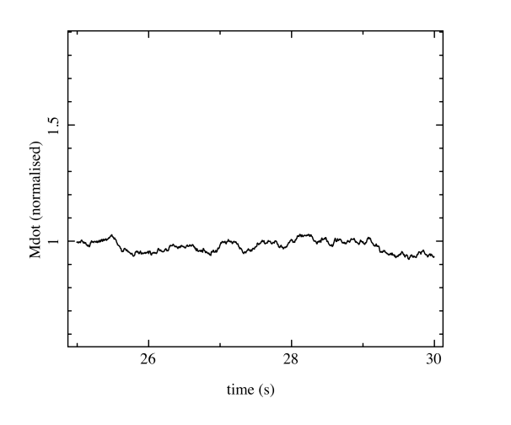
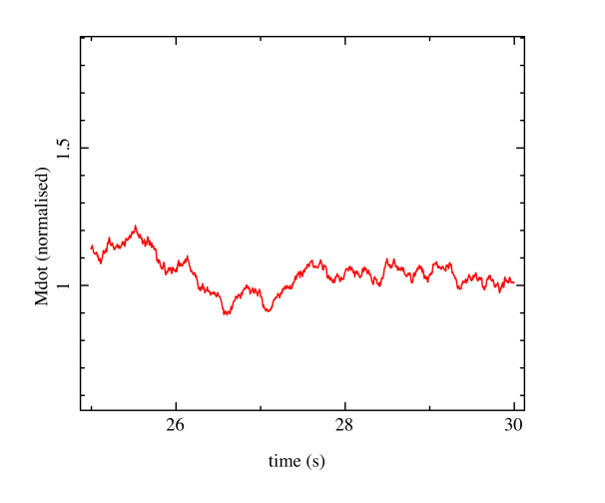
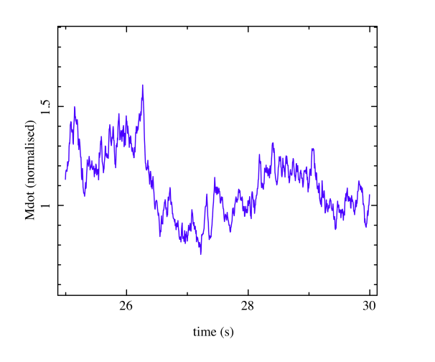
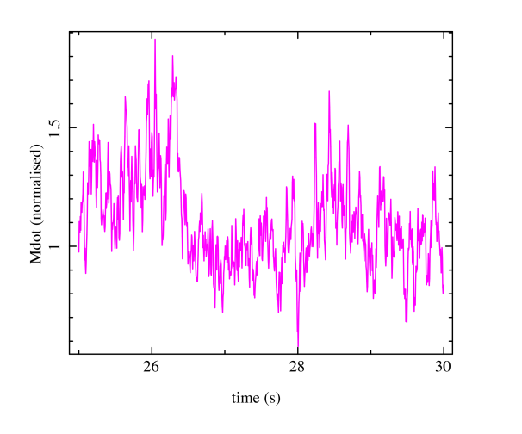
Propagating fluctuations
This gives the noise spectrum EMMITED at each annulus
Lyubarskii 1997; Arevalo & Uttley 2006, Kotov et al 2001

Slide 56
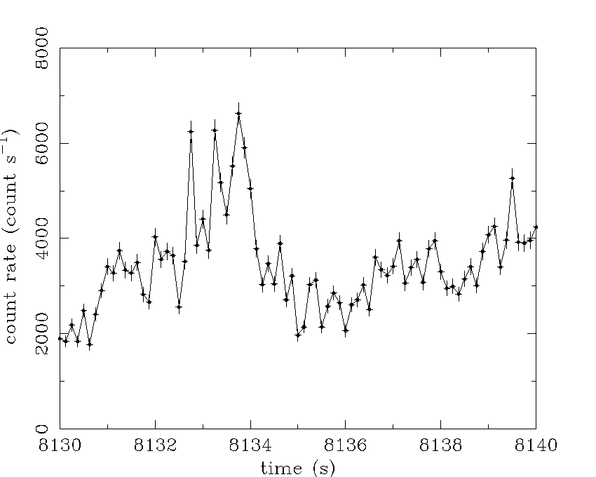
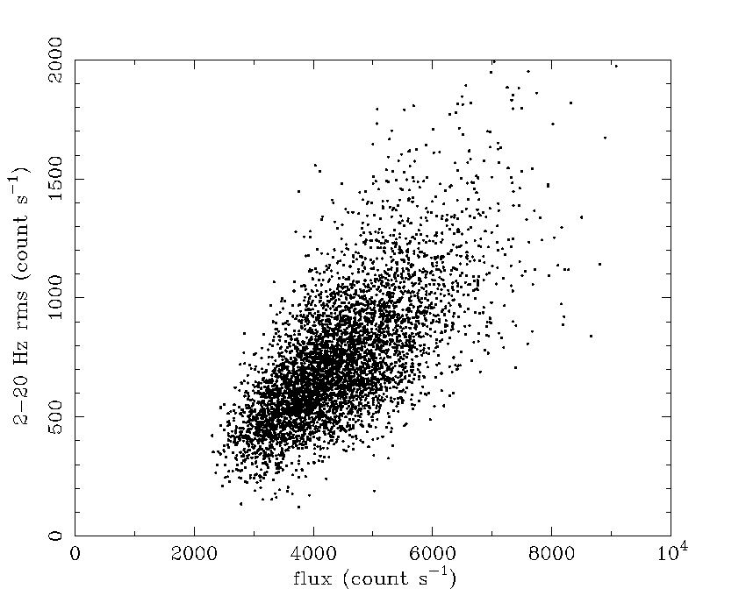
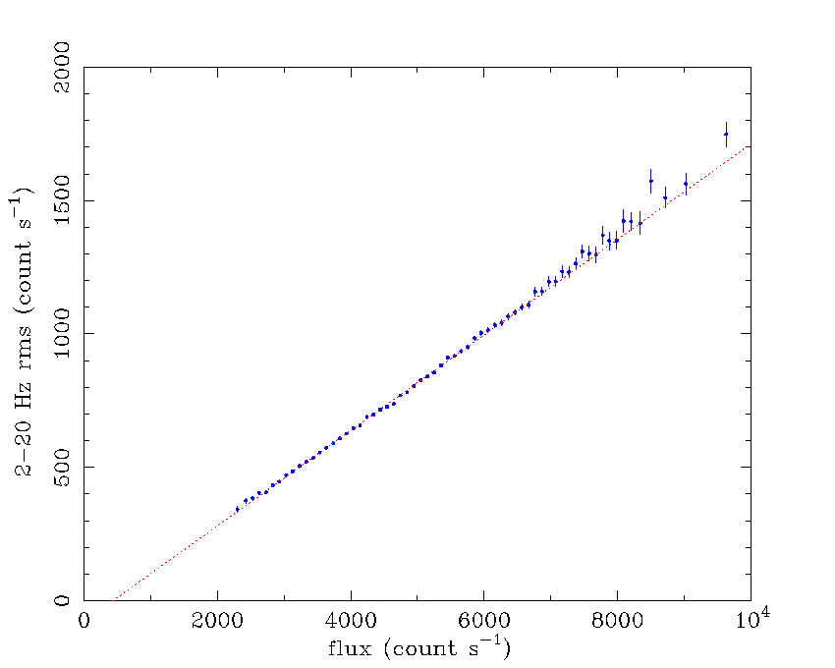
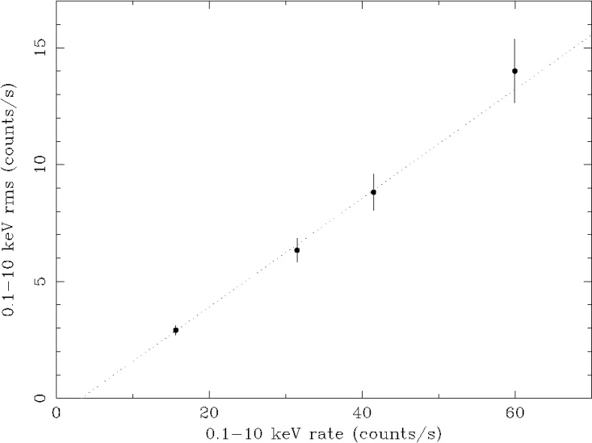
The rms-flux relation
rms-flux relation of Cygnus X-1 [Uttley & M^{c}Hardy 2001 (UM01)]
1 s segments
Unbinned 2-20 Hz
rms vs flux
Binned 2-20 Hz
rms vs. flux
0 1 2 3 4 5 6 7 8 9 10
NGC 4051
rms-flux
rms = sqrt [ (1/N) ∑_{i=1,N} (flux_{i} - mean)² ]
Linear rms-flux relations are
also seen in AGN, e.g.
NGC 4051
(UM01, M^{c}Hardy et al. 2004)

Slide 57
Flux distribution of variability
Has very characteristic shape – not symmetric. Skewed to higher flux levels. Lightcurve is ‘flare-y’
Uttley, McHardy & Vaughan 2005

Slide 58
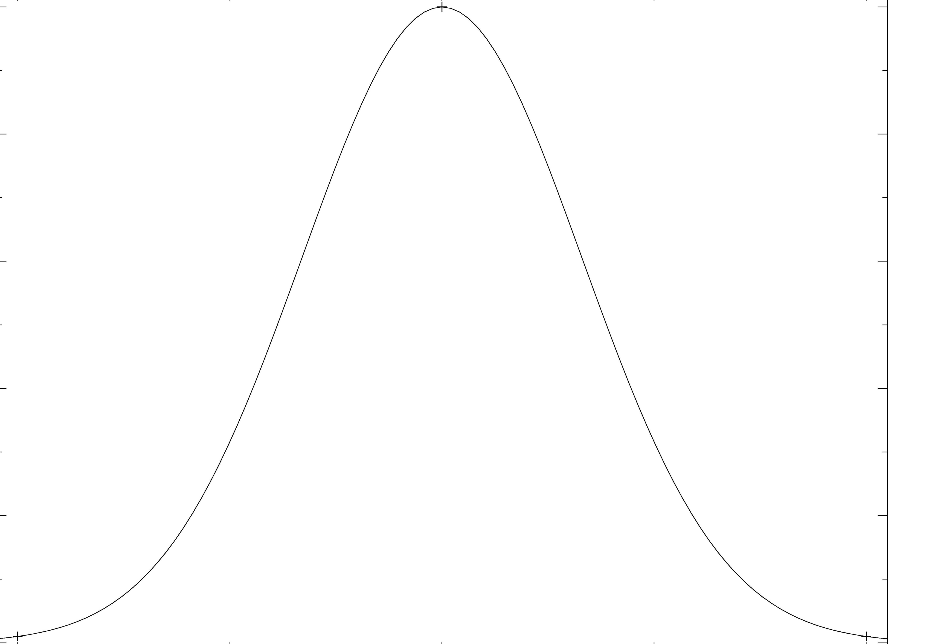
Implies log normal flux distribution
Normalised flux
-0.2 0 0.2
log (flux)
Cannot get this from SHOTS, or any SUM of independent events
Or from self organised criticality (wait till critical value to trigger)
Uttley, McHardy & Vaughan 2005

Slide 59
Propagating fluctuations
This gives the noise spectrum EMMITED at each annulus
Lyubarskii 1997; Arevalo & Uttley 2006, Kotov et al 2001

Slide 60
Fitting to XTE J1550-564
r_{o}=68.0

Slide 61
Fitting to XTE J1550-564
r_{o}=45.7

Slide 62
Fitting to XTE J1550-564
r_{o}=25.0

Slide 63
Fitting to XTE J1550-564
r_{o}=16.3

Slide 64
Fitting to XTE J1550-564
r_{o}=12.8
Ingram & Done 2011

Slide 65
Black holes
Black hole binaries –
Observational template of how accretion flows (spectra and variability) and their associated jet behave
Build a working physical model of accretion flows
Black hole spin

Slide 66
Black holes
Scale up to AGN
Bigger mass! L =AT⁴ -L goes with M but A goes with R² so M² so area wins and disc temp lower!
Larger RANGE in mass – all BHB within factor 2 of 10M whereas AGN from 10⁵-10¹⁰M disc in UV
Larger range of SPIN?? Can grow by accreting gas (like BHB) but can also grow via BH-BH mergers in major galaxy mergers

Slide 67
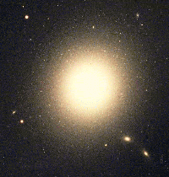
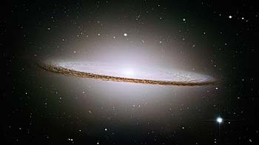
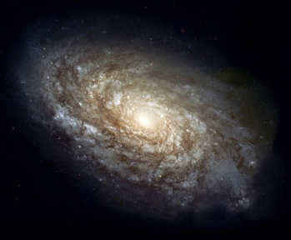
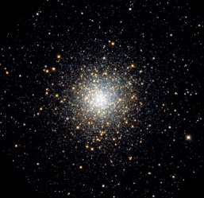
Mass of AGN??
Magorrian-Gebhardt relation gives BH mass!! Big black holes live in host galaxies with big bulges! Either measured by bulge luminosity or bulge mass (stellar velocity dispersion) or BLR
10⁵⁻¹⁰M
10⁹
Black hole mass
10³
10⁶
Stellar system mass
10¹²
Notes:
Scaling these models up to the supermassive black holes in quasars, the only change should be that the disc emission is in the UV rather than X-ray region. The problem is knowing how far to scale them for an individual qso, knowing the BH mass. This has only recently become possible with the discovery of the relationships between the BH mass and the properties of the galaxy as a whole. Big BH live in big galaxies, little BH live in small ones. Also, only recently that enough high s/n data has become available to test these models – xmm-newton database

Slide 68
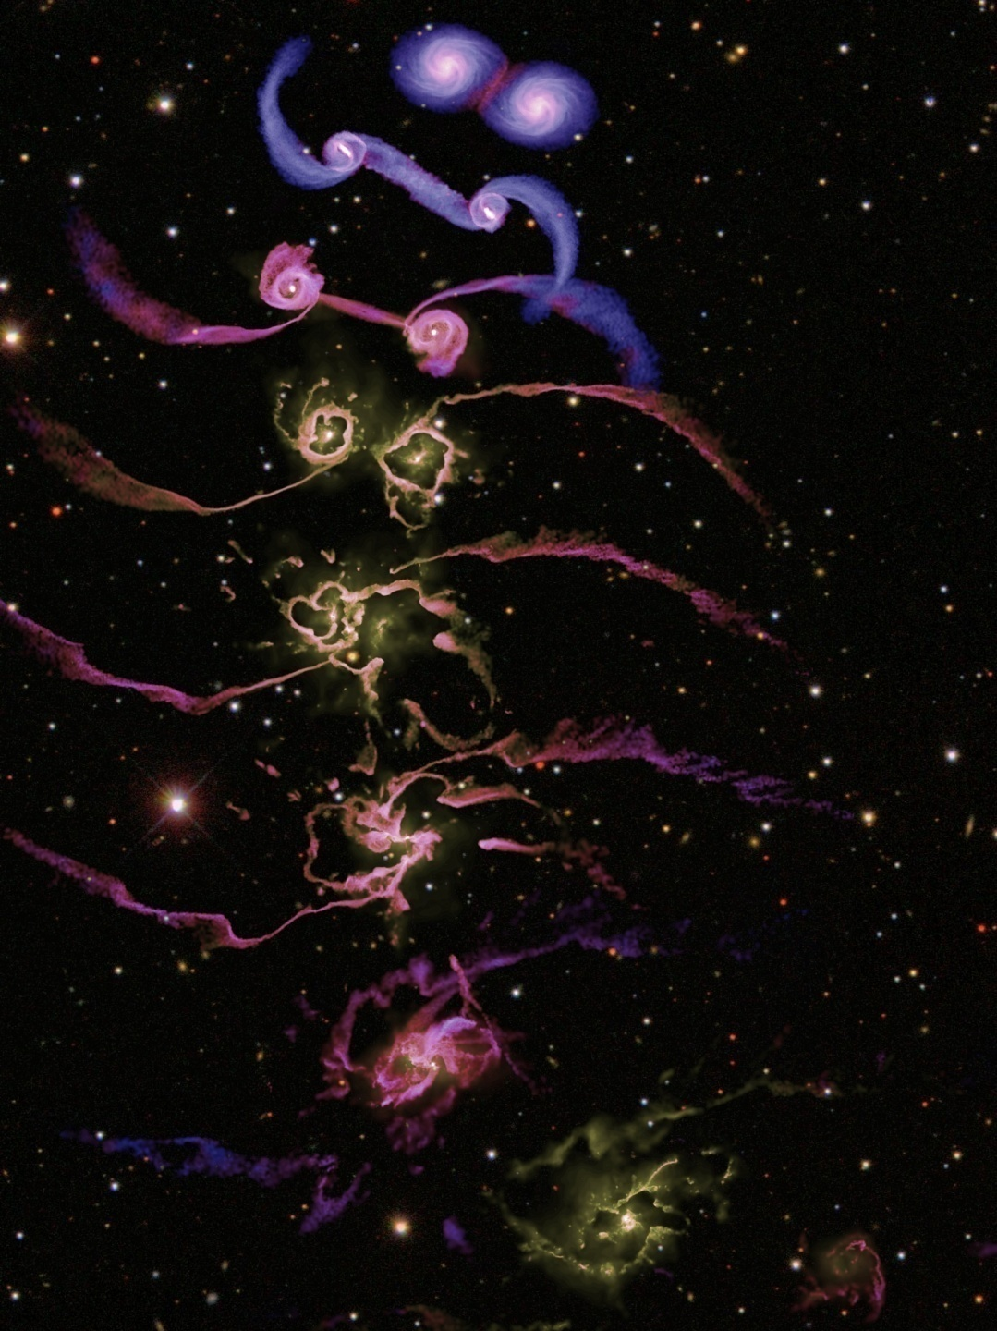
Black holes in AGN grow by accretion
Gas supply to nucleus
Galaxy disc instabilities
Major mergers
Minor mergers
Cooling flow of hot gas from halo
Regulated by feedback
Supernovae
Kinetic energy from jet
Momentum from wind and/or radiation
Need to understand accretion to understand feedback
Di Matteo et al 2005

Slide 69
UV disc seen in Quasars!
Bright, blue/UV continuum from disc.
Gas close to nucleus irradiated and photo-ionised – lines!
Broad permitted lines ~ 5000 km/s (BLR)
Narrow forbidden lines ~ 200 km/s (NLR)
Forbidden lines suppressed if collisions so NLR is less dense than BLR
Francis et al 1991
Notes:
Scaling these models up to the supermassive black holes in quasars, the only change should be that the disc emission is in the UV rather than X-ray region. The problem is knowing how far to scale them for an individual qso, knowing the BH mass. This has only recently become possible with the discovery of the relationships between the BH mass and the properties of the galaxy as a whole. Big BH live in big galaxies, little BH live in small ones. Also, only recently that enough high s/n data has become available to test these models – xmm-newton database

Slide 70
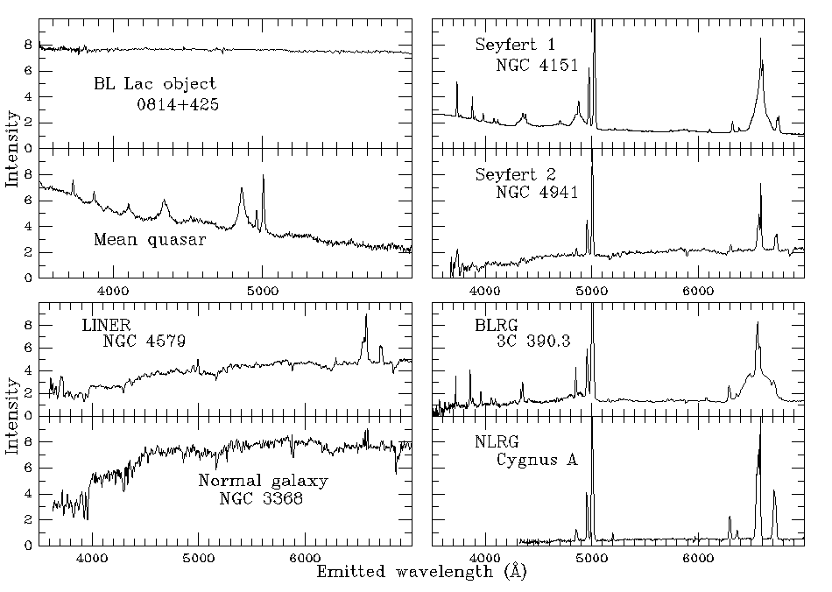
AGN/QSO Zoo!!! Optical

Slide 71
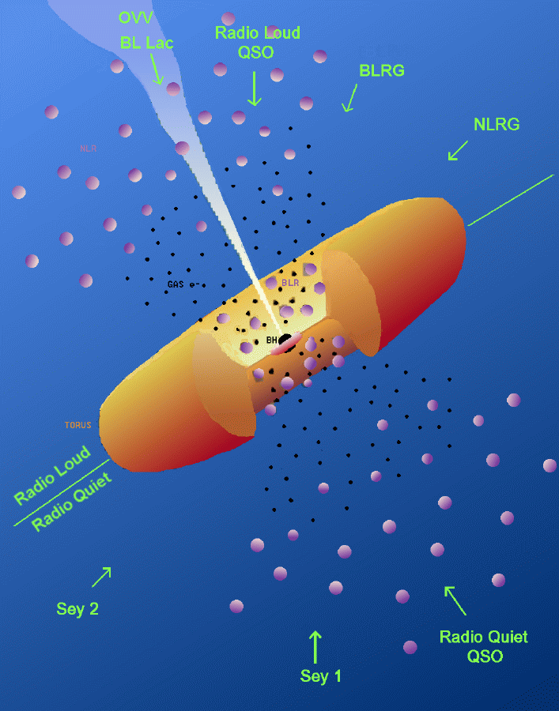
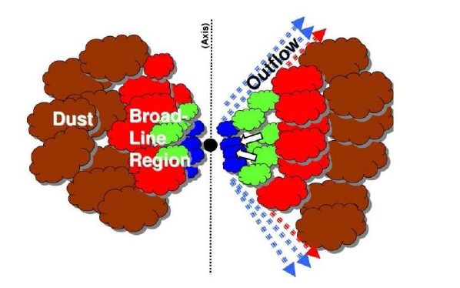
Seyfert 1 – Seyfert 2
Intrinsically same except for obscuration ?
So now take only unobscured objects!

Slide 72
Seyfert 1 - Quasars
Similar spectra and line ratios,
strong UV flux to excite lines,
probably similar L/L_{Edd} ~ 0.1-0.3
Increasing L
Increasing M

Slide 73
Spectral states - BHB
Dramatic changes in continuum – single object, different days
Underlying pattern in all systems
High L/L_{Edd}: soft spectrum, peaks at kT_{max} often disc-like, plus tail
Lower L/L_{Edd}: hard spectrum, peaks at high energies, not like a disc (McClintock & Remillard 2006)
very high
Gierlinski & Done 2003

Slide 74
‘Spectral states in AGN’
Disc BELOW X-ray bandpass. Only see tail.
0.01
0.1
1
10
100
But spectra should still change from disc dominated to tail dominated

Slide 75
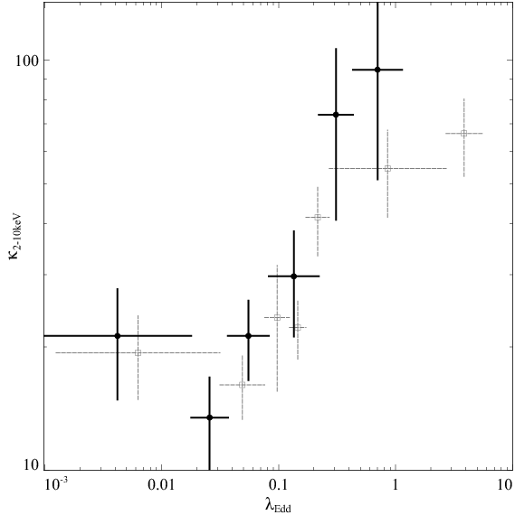
AGN spectral states
Vasuvaden & Fabian 2008
Big change in ratio of Lbol/L(2-10 keV) with Eddington ratio L/LEdd
Looks good!!
Lbol/L(2-10 keV)
Lbol/LEdd

Slide 76
LINERS-S1-NLS1 ?
Similar mass.
Different L/L_{Edd}
Different ionisation
NLS1
Increasing L/L_{Edd}
S1/QSO
disc
Hot inner flow, no UV bright disc – true type 2 Seyferts
LINER
Jester 2005; Leighy 2005; kording et al 2007

Slide 77
LINERS-S1-NLS1 - radio???
Similar mass.
Different L/L_{Edd}
Different ionisation
NLS1
Increasing L/L_{Edd}
S1/QSO
disc
Hot inner flow, no UV bright disc – true type 2 Seyferts
LINER
Jester 2005; Leighy 2005; kording et al 2007

Slide 78
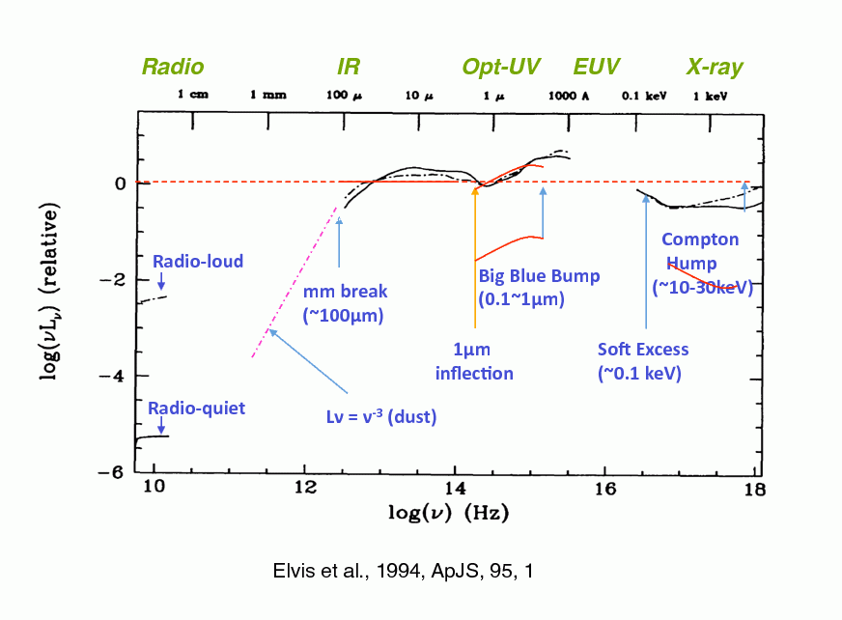
What do AGN look like?
Mass not well known 10 years ago…
Big! So disc peak somewhere in unobservable UV/EUV !!
Spectra generally not dominated by the disc – hard tail often carries a large fraction of Lbol and puzzling soft excess also can carry large fraction of Lbol
Richards et al 2006, Elvis et al 2004

Slide 79
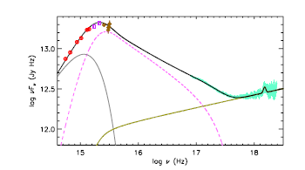
Classic QSO?
Mkn 509 XMM-Newton OM + FUSE +EPIC
10⁸M L/LEdd~0.1
Not low/hard as no jet and too bright! AGN are (should be!) high soft state. But disc turnover far too soon. Plus strange soft X-ray excess….What is this????
Medhipour et al 2011

Slide 80
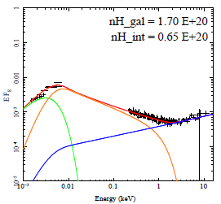
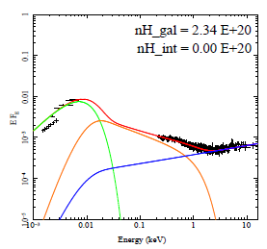
So what do AGN look like?
51 objects with SDSS-2XMM with high s/n and low absorption
High M, low L/LEdd, disc far from SX
Jin et al 2011

Slide 81
Classic QSO?
Mkn 509 XMM-Newton OM + FUSE +EPIC
10⁸M L/LEdd~0.1
Not low/hard as no jet and too bright! AGN are (should be!) high soft state. But disc turnover far too soon. Plus strange soft X-ray excess….What is this????
Medhipour et al 2011

Slide 82
Classic QSO?
Mkn 509 XMM-Newton OM + FUSE +EPIC
10⁸M L/LEdd~0.1
Not low/hard as no jet and too bright! AGN are (should be!) high soft state. But disc turnover far too soon. Plus strange soft X-ray excess….What is this????
Medhipour et al 2011

Slide 83
Classic QSO?
Mkn 509 XMM-Newton OM + FUSE +EPIC
10⁸M L/LEdd~0.1
Not low/hard as no jet and too bright! Plus strange soft X-ray excess….What is this????
Medhipour et al 2011

Slide 84
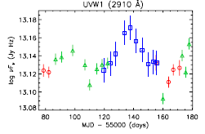
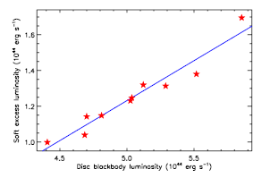
Variability on ~month
Mkn 509 XMM-Newton OM + FUSE +EPIC
Soft excess correlates with UV NOT X-ray on long timescales
Medhipour et al 2011

Slide 85
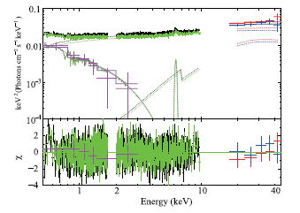
Variability on < day
Short timescale. Soft excess does NOT vary, hard power law does
It’s a separate component!!!! Noda et al 2011; 2012
Noda et al 2011

Slide 86
So what do AGN look like?
51 objects with SDSS-2XMM with high s/n and low absorption
High M, low L/LEdd, disc far from SX
Jin et al 2011

Slide 87
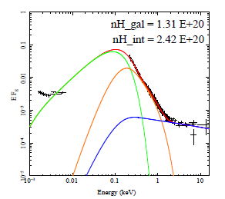
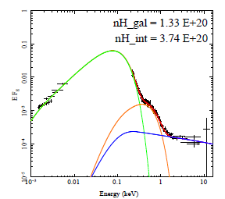
So what do AGN look like?
51 objects with SDSS-2XMM with HIGH S/N AND LOW NH
Low M, high L/LEdd disc makes most of Soft Xrays
Jin et al 2011

Slide 88
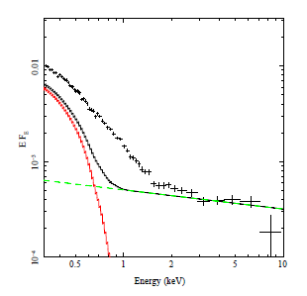
Disc spectra from 10⁶ M L/L_{Edd} ~1
Done, Davis, Jin, Blaes Ward 2011
Enormous soft excess in REJ1034
But actually a lot of it should be the bare disc!
Plus a little bit of soft comptonisation !
Again variability says it’s a separate component to the power law (Middleton et al 2010)
More like disc dominated black holes

Slide 89
Disc spectra from 10⁶ M L/L_{Edd} ~1
Done, Davis, Jin, Blaes Ward 2011
Enormous soft excess in REJ1034
But actually a lot of it should be the bare disc!
Plus a little bit of soft comptonisation !
Again variability says it’s a separate component to the power law (Middleton et al 2010)
More like disc dominated black holes

Slide 90
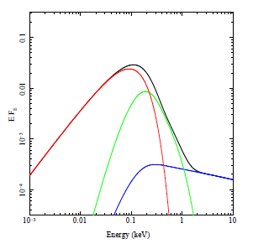
Models conserving energy!!
Lopt ∝M Mdot
Know M from optical and Hβ
Measure Mdot from L opt. Lbol = η Mdot c²
Schwarzchild a=0 η=0.0572
If powered by accretion of material through the outer disc then this also makes soft excess and power law tail
Thermal down to R_{corona} with colour temp correction
Comptonised/power law after this – XSPEC optxagn Done et al 2011 cf dkbbfth Done & Kubota 2006
R_{corona}
Mdot
M
Done et al 2011

Slide 91
Theoretical disc spectra
Surely even disc spectra aren’t this simple!!!!
Disc annuli not blackbody – too hot, so little true opacity. Compton scattering important.
Modified blackbody Shakura & Sunyaev 1973
Describe by colour temperature fcol
And relativistic smearing effects on the spectra at each radius
kTeff
f_{col} kT
Log ν f(ν)
Log ν

Slide 92
AGN spectral states
Jin, Ward, Done Gelbord 2011

Slide 93
AGN spectral states
Jin, Ward, Done Gelbord 2011

Slide 94
AGN spectral states
Jin, Ward, Done Gelbord 2011

Slide 95
AGN spectral states
L/L_{Edd}~10⁻⁵
M/M_{Edd}~10^{-2.5}
Nemmen et al 2012
M=2x10⁸

Slide 96
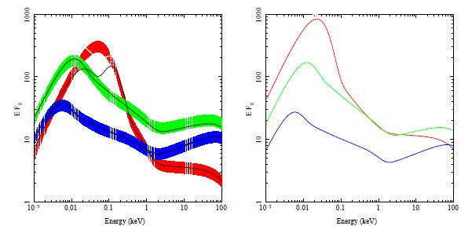
INTRINSIC changes in SED
Co-add models in 3 bins of L/L_{Edd}
Correlates with M due to galaxy formation. high mass objects have low L/L_{Edd} in local Universe – downsizing
Physical model so shift to same mass M=10⁸ to compare with BHB
M=10⁷ L/L_{Edd}~1
L/L_{Edd}~1
M=10⁸
L/L_{Edd}~0.2
L/L_{Edd}~0.2
L/L_{Edd}~0.06
M=2x10⁸ L/L_{Edd}~0.06
Done et al 2011

Slide 97
Low/hard to high/soft ?
Looks good to zeroth order… but….
Transition at L/LEdd=0.02 in steady state accretion - 0.2 in AGN
LINERS are low/hard state (strong radio)
Green/blue are classic QSO – not low/hard state – what are they?
M=10⁷ L/L_{Edd}~1
BHB 10 M
L/L_{Edd}~1
M=10⁸
L/L_{Edd}~0.2
L/L_{Edd}~0.2
AGN 10⁸ M
L/L_{Edd}~0.06
M=2x10⁸ L/L_{Edd}~0.06
Done et al 2011

Slide 98
AGN spin?
Classic QSO don’t really look like ANY state in BHB
So what are they??
Not dominated by disc so can’t use L-T of disc to get size scale robustly (BHB)
Jin et al 2012

Slide 99
AGN spin?
LOWEST MASS, HIGHEST L/LEdd - NLS1
LOOK LIKE DISC DOMINATED BHB
highest disc temperatures – pushed even high by colour temperature correction
Disk peaks in EUV (close to observable soft X-rays!)
This assumed zero spin!!
Jin et al 2012

Slide 100
Relativistic effects
Relativistic effects (special and general) affect all emission (Cunningham 1975)
Emission from the side of the disc coming towards us is blueshifted and boosted by Doppler effects, while opposite side is redshifted and suppressed.
Also time dilation and gravitational redshift
Broadens spectrum at a give radius from a narrow blackbody
flux
Energy (keV)
Fabian et al. 1989
Notes:
Another area where Astro e2 will give major progress in an independent test of the accretion flow models. The accretion disc moves fast in a strong gravitational field, so both special and general relativistic effects modify its spectrum. Doppler shifts and length contraction mean that the emission from the disc moving towards us is blueshifted and boosted, while that moving away is redshifted and suppressed. Then time dilation and gravitational redshift drag everything redwards. The strength of these all effects decrease with radius. All emission from the disc is affected, but its much easier to see on intrinsically narrow features – lines. X-ray illumination of the disc gives iron Kalpha line. Moving inner disc models predict broader line in softer spectra. But the measured line profile can be distorted by narrow absorption features superimposed on the emission. The high spectral resolution of Astro e2 will unambiguously show these, enabling the intrinsic line profile to be measured.

Slide 101
Black Hole spin!
PG1244
Pure disc at this mass and mass accretion rate - a=0
Already goes VERY close to soft X-rays – constrains SPIN
Done,, Jin, Middleton Ward 2012

Slide 102
Black Hole spin!
Relativisitic effects and advection
Set M at maximum 2x10⁷ M and i=30 a<0.8
If this really has a=0.998 either mass very wrong (>10⁸M), or disc model wrong !!
But the disc is really just a disc!
Done,, Jin, Middleton Ward 2012

Slide 103
Conclusions:
Range of SED’s with shape changing with mostly L/LEdd but some change with M also.
Downsizing in local universe – see high activity only on low mass BH as high mass BH already run out of gas
LINERS look like low/hard state 2x10⁸ M, L/LEdd <0.01
Standard Quasars (10⁸ M, L/LEdd ~0.1) don’t look like any BHB state ! Soft excess, hard spectra, (mostly) radio quiet…
NLS1 (10⁷ M, L/LEdd ~1) – largest fraction of power dissipated in disc – disc dominated, so can get spin from disc continuum fitting
PG1244+026 gives low spin but should do this for a range of NLS1 to get spin distribution

