Slide 1
Formation and cosmic evolution of massive black holes
Andrea Merloni
MPE, Garching
PhD School, Bologna, 04/2013

Slide 2
Syllabus
Monday:
Observational evidence of Supermassive Black Holes
AGN surveys
Tuesday:
The evolution of SMBH mass function and spin distributions
The first black holes
Thursday:
Accretion in a cosmological context: AGN feedback models
The fundamental plane of active black holes
Friday:
AGN-galaxy co-evolution: theoretical issues and observational evidences
Shedding light onto AGN/galaxy evolution issues with next-generation of multi-wavelength survey facilities

Slide 3
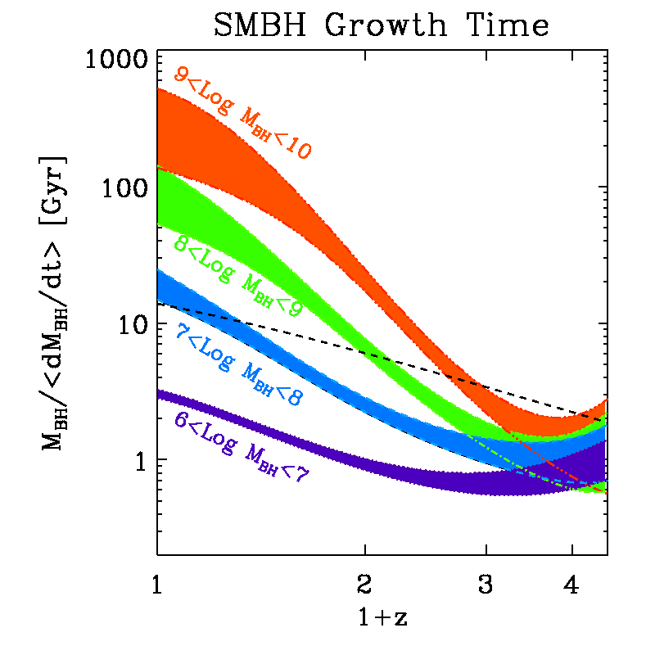
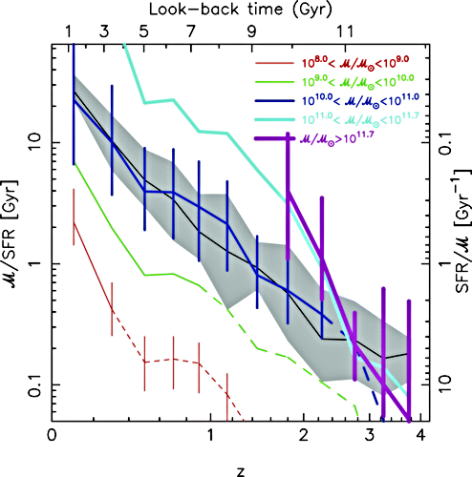
AGN/galaxy evolution: anti-hierarchical growth
Merloni+ ‘08, ‘09
BH growth times [Gyr]
Gal. growth times [Gyr]
Perez-Gonzalez et al. 2008
What (if any) is the physical link between these two apparently related evolutionary paths? What the evolution at z>2?
Further progress requires:
Estimates of M_{BH}, M*, and their rate of change for large, complete samples: mapping the “flow dynamics” in M_{BH}-M* planes
“Mass-matched” samples crucial
Notes:
As I mentioned, the founding stone of our research will be on the field of AGN surveys.
Let me try now to summarize in a slide and a few words the most important result in the field in the last few years.
The theory of relativistic accretion allows us to associate, via an efficiency parameter, the observed luminosity of a growing black hole with its growth rate. By following the evolution of SMBH mass function via a simple continuity equation, we can plot, as a function of redshift, the average ratio of BH mass to growth rate, a timescale defining the mass doubling time of an object. Different tracks, each corresponding to a specific black hole mass range, indicate that the growth times were shorter in the past: black holes grew more rapidly at redshift 1-3. More interestingly, at redshift lower than 1, 1.5, we see that the lower the mass of a black holes, the faster it grows. This is, in a nutshell, the definition of anti-hierarchical growth, sometimes called downsizing: larger black holes must have grown earlier than smaller ones. Unfortunately, the quality of the AGN survey data at z larger than 2 do not allow yet to reach firmer conclusions on the evolutionary paths in the distant past.
If you do the same plot for galaxies, a very similar trend is revealed, with the largest galaxies always having longer growth times than smaller ones (up to z=3).
What, if any, is the physical link between these two apparently related evolutionary paths?

Slide 4
Simultaneous growth of BH and galaxies: integral constraints
We have used SMBH as tracers of the spheroid stellar mass
Fractional stellar mass loss (~30% in 13 Gyr)
A 3 parameters (ε, α, β) joint fit to stellar mass and SFR densities evolution

Slide 5
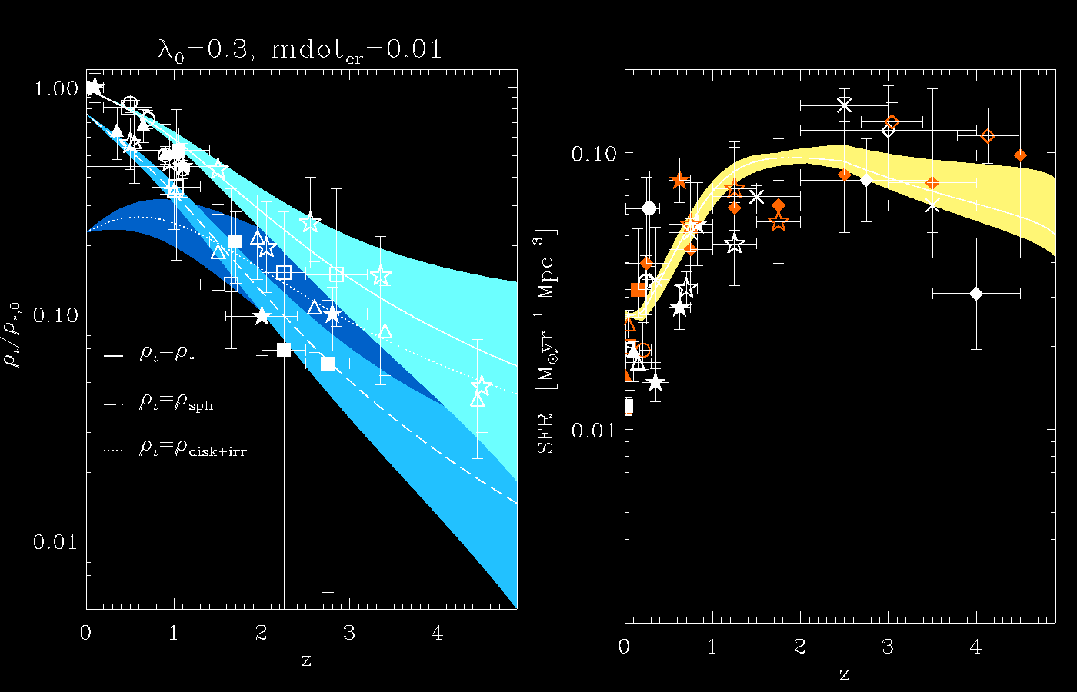
Parallel lives
Merloni, Rudnick and Di Matteo 2004

Slide 6
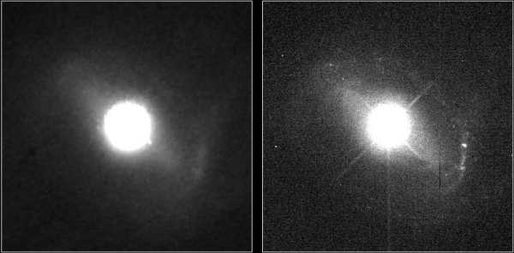
The REAL problem: How to obtain reliable host galaxy masses in QSO?
HST image of PG 1229+204 (z=0.064)
Credit: Dr. John Hutchings,Dominion Astrophysical Observatory, NASA

Slide 7
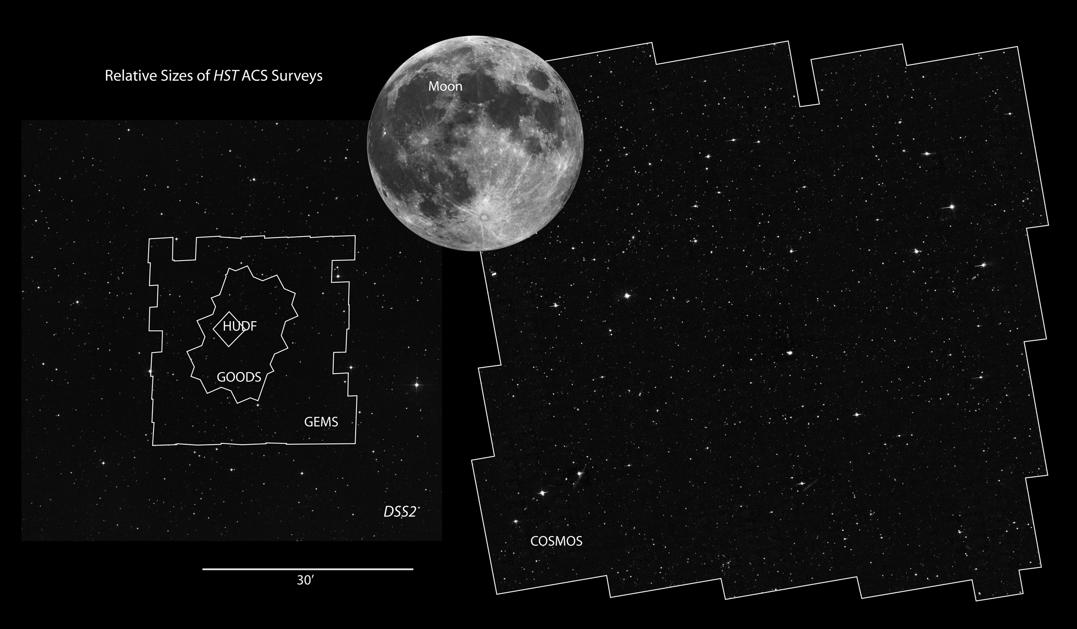
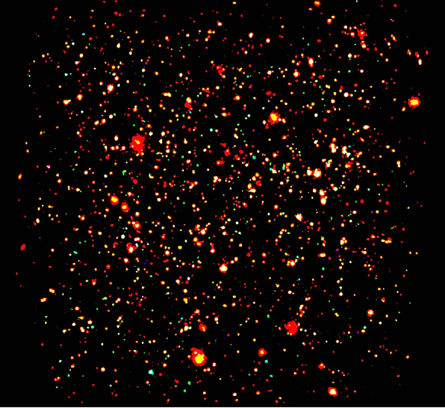
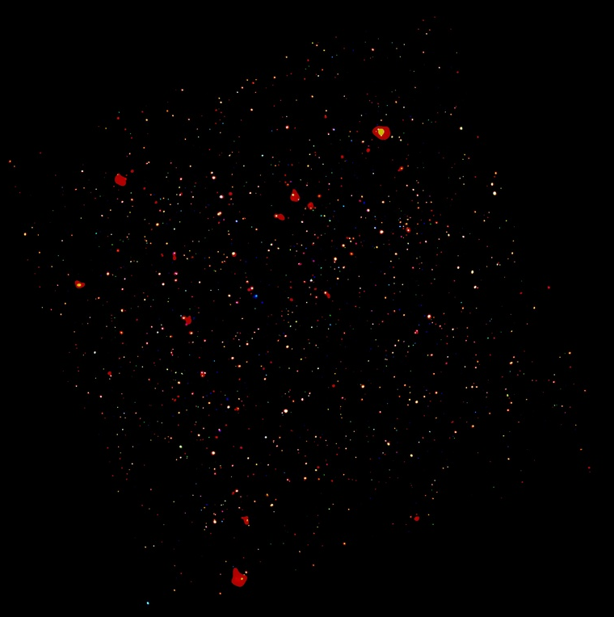
COSMOS survey
2 deg² equatorial
HST treasury project
Deep: ACS i_{AB} < 27
Similar volume as SDSS, but fainter and higher z
HST/XMM/Chandra COSMOS
[Scoville, Hasinger, Elvis]

Slide 8
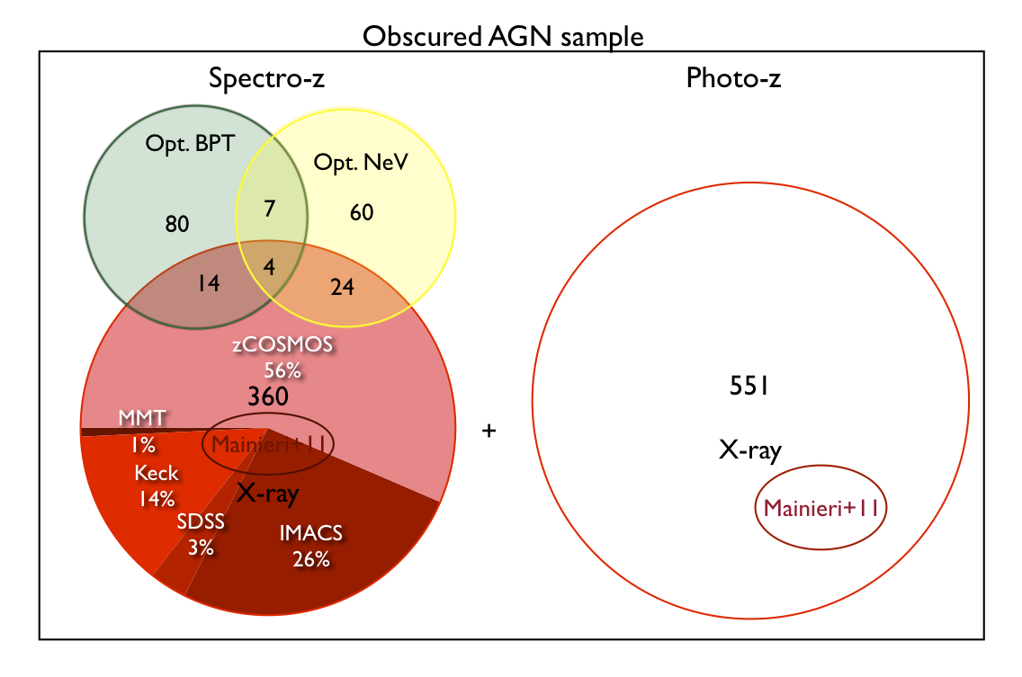
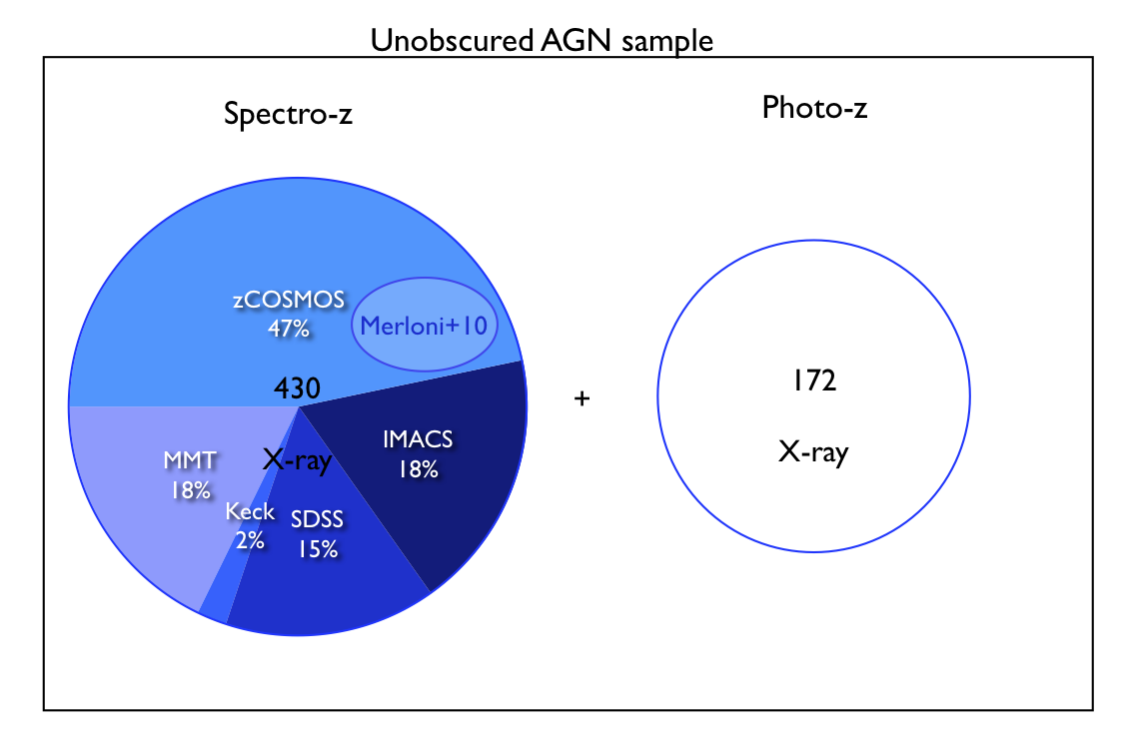
A complete, X-ray selected, AGN sample
1555 X-ray selected AGN (XMM; f_{lim}~ 5×10⁻¹⁶[0.5-2]; 3×10⁻¹⁵[2-10])
100% redshift complete (54% specz; 46% photoz)
602 Unobscured (71% specz; 29% photoz)
953 Obscured (42% specz; 58% photoz)
Parent sample of ~200k IRAC galaxies (photoz, M*; Ilbert et al. 2010)
Bongiorno et al. 2012
See also Brusa et al. 2010; Salvato et al. 2009; Lusso et al. 2011, 2012

Slide 9
Scientific Questions
Statistically robust assessment of AGN demographics:
Which galaxies host (which) AGN?
AGN triggering: under which conditions do SMBH grow?
Does AGN activity affect galaxies’ properties (at the population level)
Location of AGN in color-magnitude plots, etc.
Smoking guns of AGN feedback?
See e.g. Nandra et al. 2008; Silverman et al. 2009; Brusa et al. 2010; Xue et al. 2011; Schavinski et al. 2011; Rosario et al. 2012; Alexander & Hickox 2012; Mullaney et al. 2012; Santini et al. 2012; Page et al. 2012; Rovilos et al. 2012; Harrison et al. 2012; etc.

Slide 10
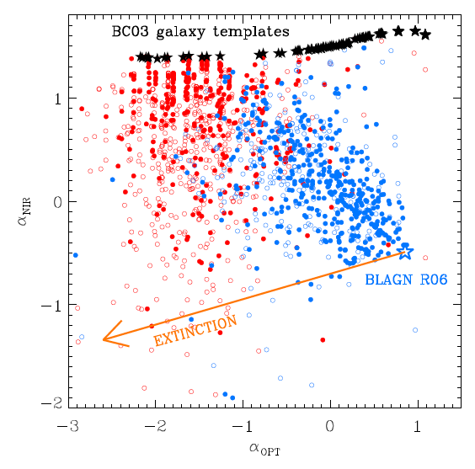
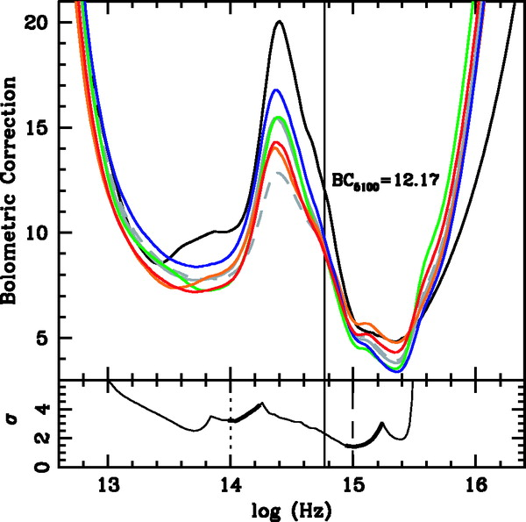
Biases in optical AGN surveys: Obscuration and galaxy dilution
Most of the optical/NIR SEDs of XMM-COSMOS AGN can be explained as a combination of a pure AGN extinguished and/or contaminated by the host galaxy.

Slide 11
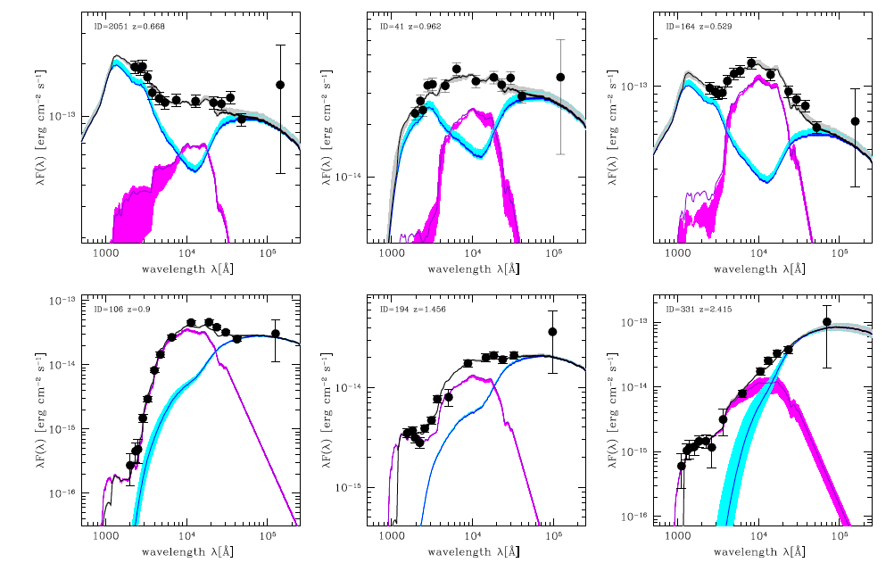
Nuclear vs. stellar light
Bongiorno et al. 2012

Slide 12
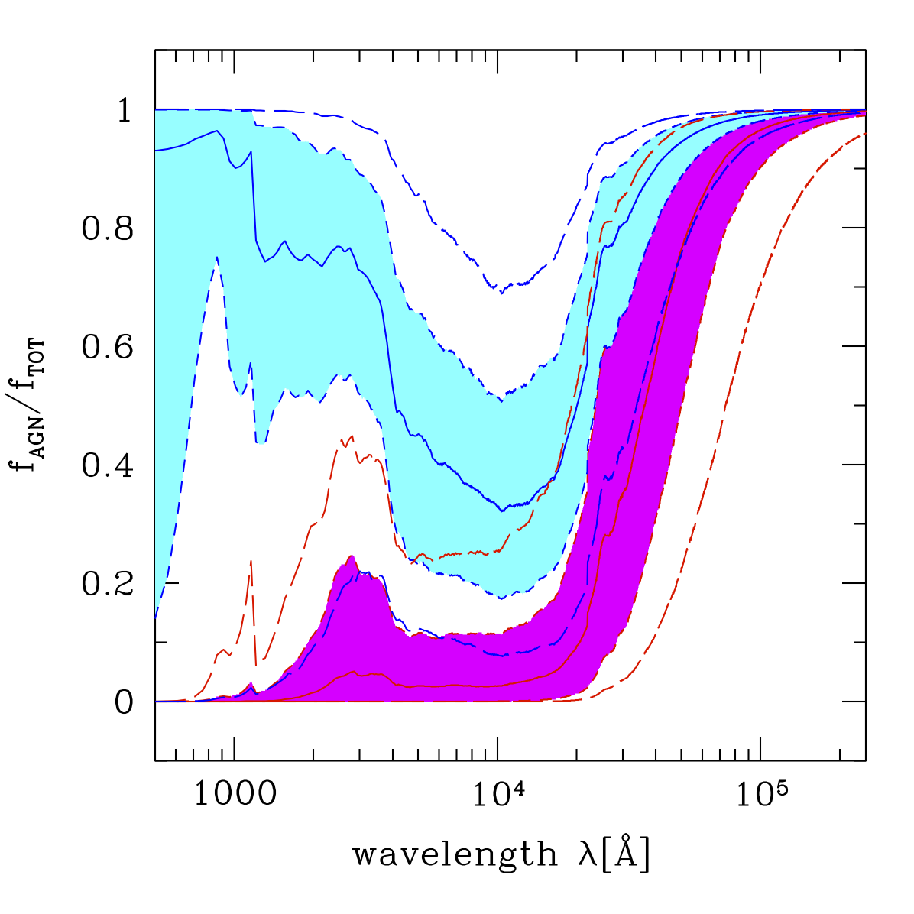
Median AGN fraction vs. λ
At about 1 micron, 75% of type–1 AGN have AGN fractions smaller than ~50% (small errors on stellar masses; Merloni et al. 2010)
For obscured AGN, ~75% of the objects have AGN contribution in the optical bands smaller than 20% (small error on colors)
Bongiorno et al. 2012

Slide 13
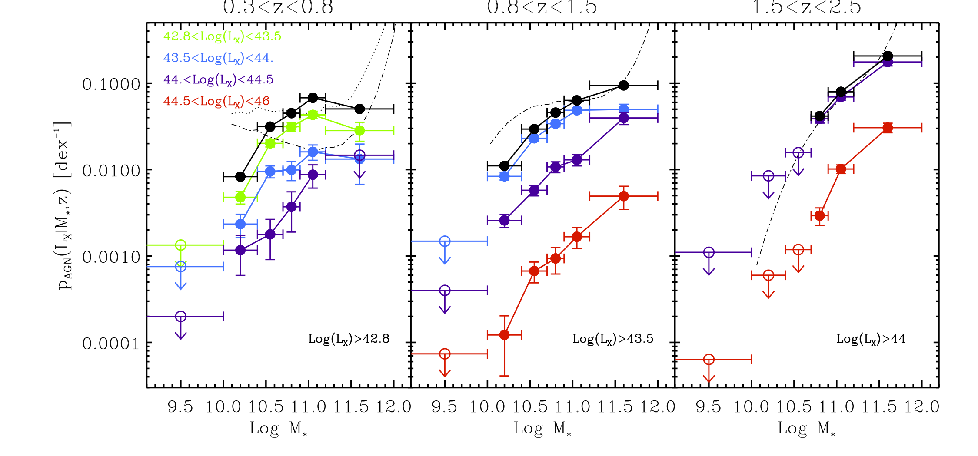
AGN fractions (M*, L_{X})
Bongiorno et al. 2012
1: The probability of a galaxy to host an AGN growing at a given L_{X} strongly depends on stellar mass. Similar at all luminosities! Narrow range of L_{X}/M* clearly ruled out (Merloni & Heinz 2008)

Slide 14
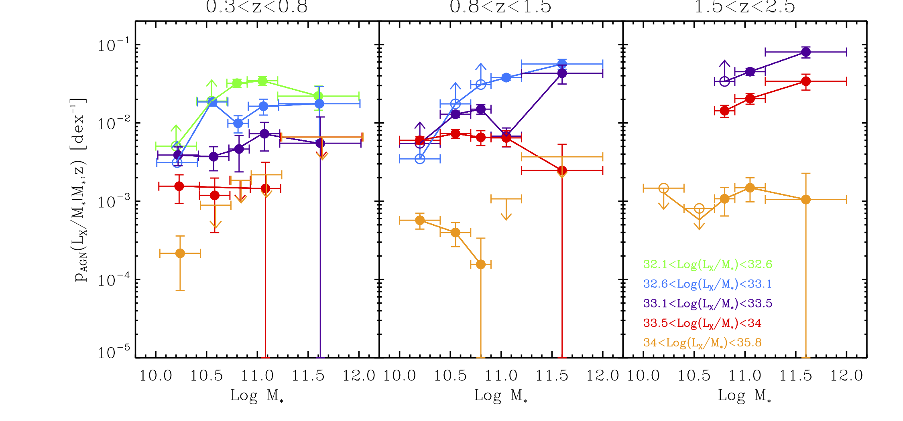
AGN fractions (M*, L_{X})
Bongiorno et al. 2012
2: AGN fraction at fixed L/M ~independent on galaxy mass!

Slide 15
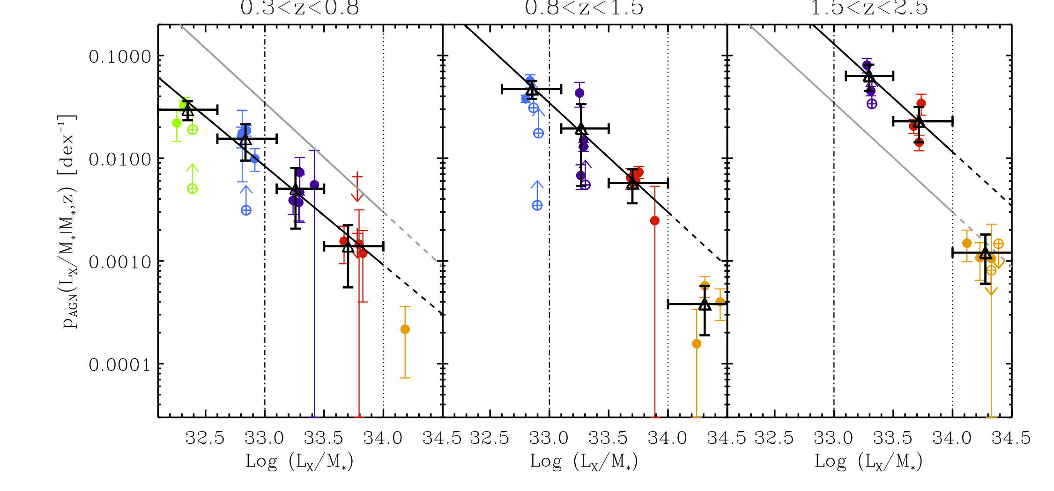
AGN fraction
SLOPES ~ -1
Bongiorno et al. 2012
“Specific Accretion rate” (Aird et al. 2012)
2: AGN fraction at fixed L/M ~independent on galaxy mass!
3: Its normalization increases as ~(1+z)⁴ [cfr. sSFR density]
4: There appears to be a break consistent with ~Eddington limit

Slide 16
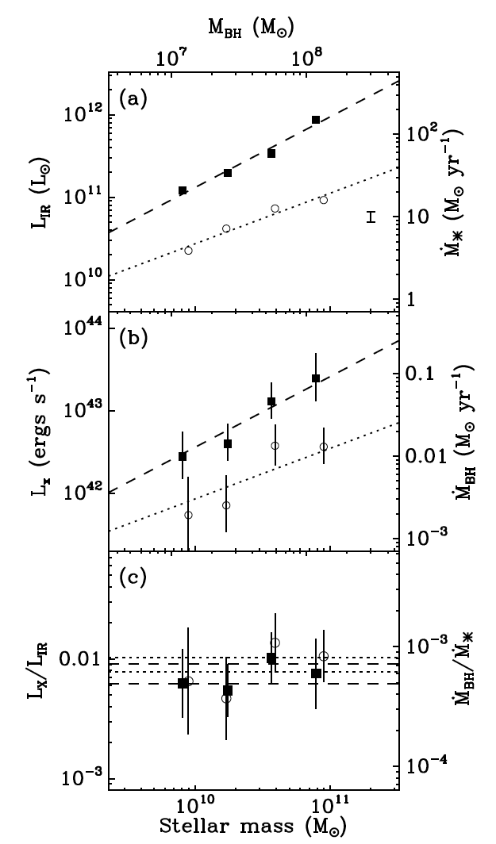
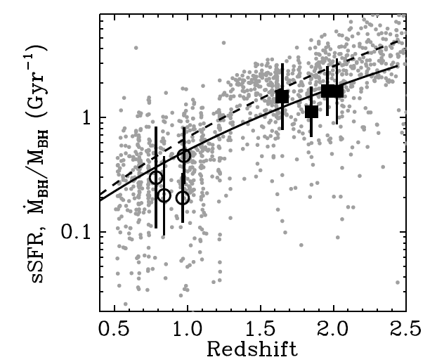
Black Holes growth traces galaxies’ growth
“The ensemble growth rate of SMBHs increases
with both increasing M∗ and redshift in a remarkably
similar manner to the average levels of star-formation taking place in SFGs.”
Mullaney et al. 2012

Slide 17
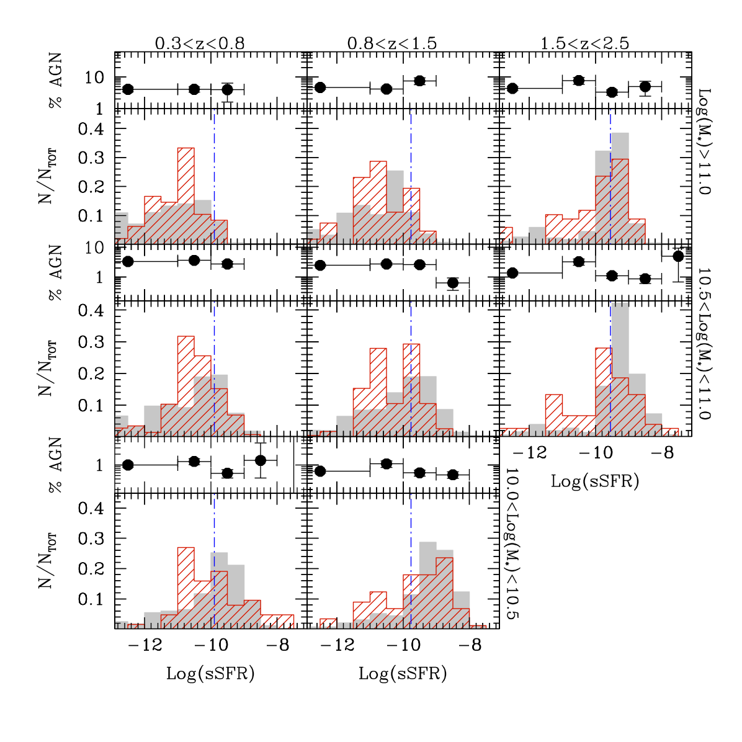
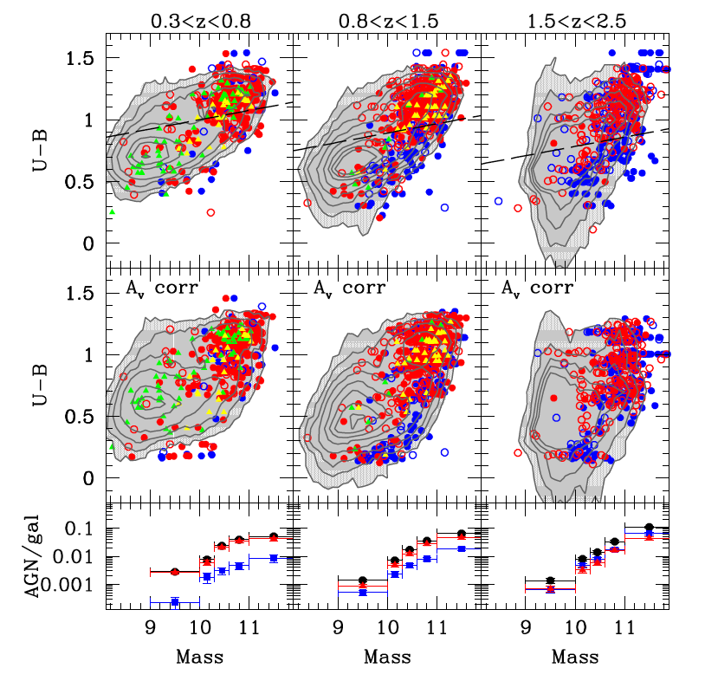
Obscured AGN in sSFR-Mass plane
Bongiorno et al. 2012
4: Very little difference between (type 2) AGN hosts and parent sample in sSFR (once z and M* factored out)

Slide 18
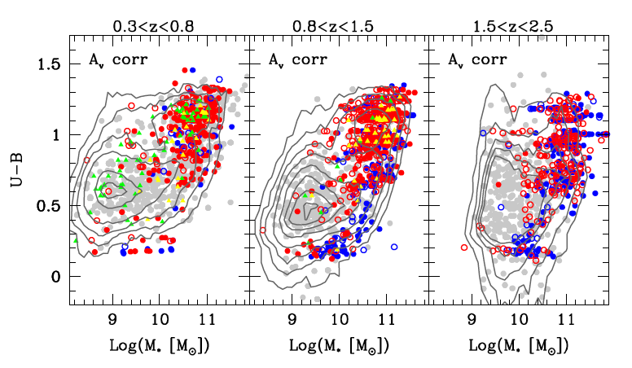
AGN hosts and galaxy ‘colors’
Bongiorno et al. 2012
See also: Nandra et al. 2007; Silverman et al. 2009; Xue et al. 2010; Cardamone et al. 2010;
Rosario et al. 2012

Slide 19
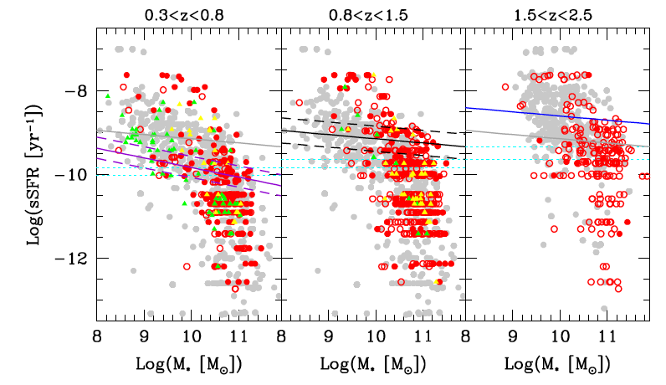
AGN hosts and galaxy star formation properties
Is there anything SPECIAL about galaxies that hosts AGN?
Bongiorno et al. 2012

Slide 20
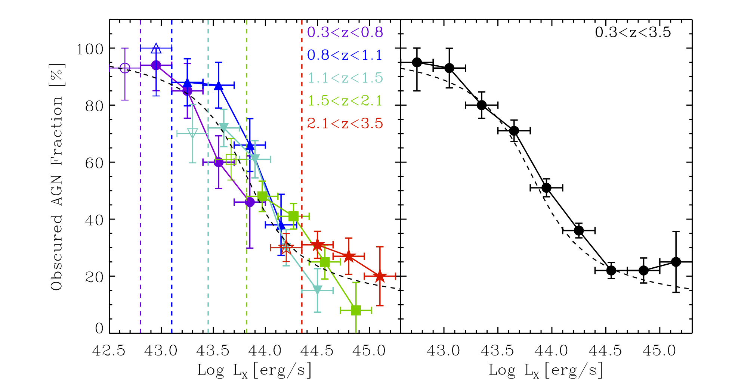
Optical Obscuration
Merloni et al. in prep.
5: The fraction of Optically obscured AGN depends on the nuclear luminosity, but NOT on redshift
Ueda+’03; Simpson’05; Maioliono’07

Slide 21
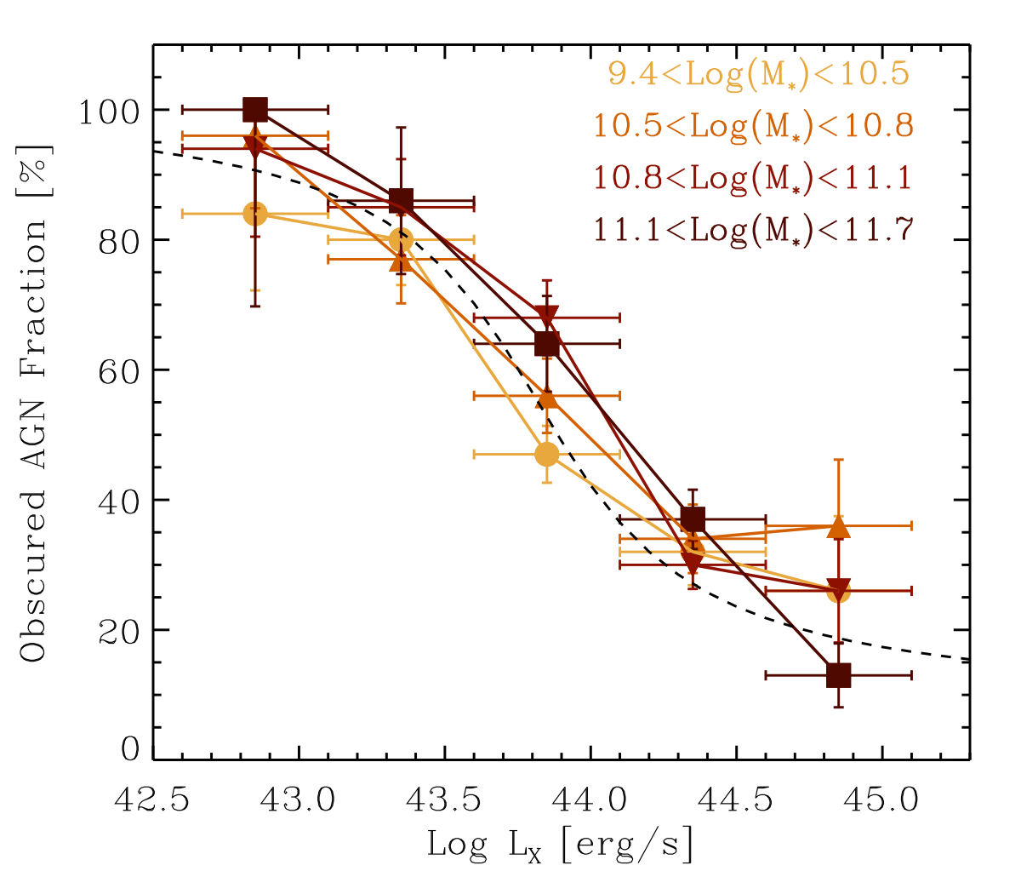
Optical Obscuration: no M*-dependence
Merloni et al. in prep.
6: The fraction of Optically obscured AGN does NOT depend on the host stellar mass

Slide 22
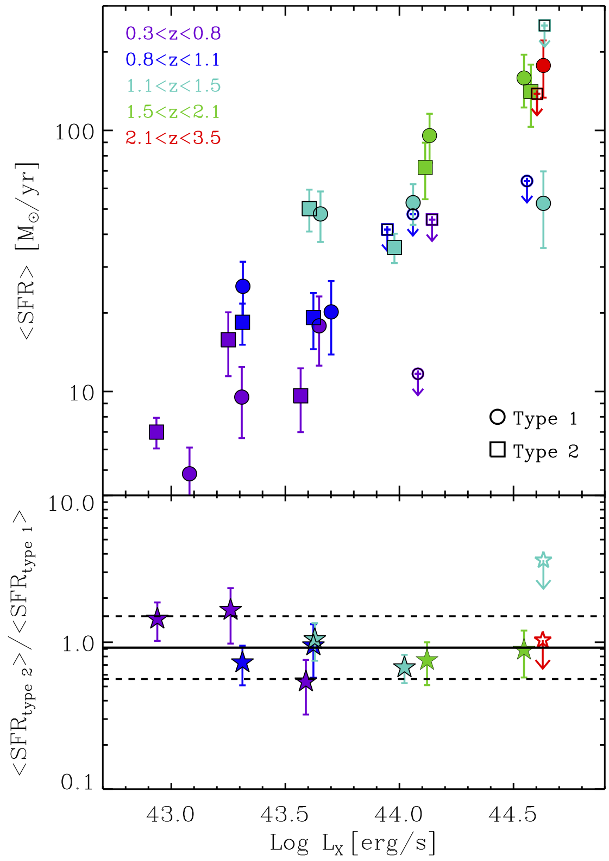
No link with SFR
7: The Galaxy-wide SFR of AGN hosts do not correlate with the properties of the obscuring medium
Merloni et al. in prep.

Slide 23
Lessons learned
Large extragalactic surveys should always include a strategy for reliable census of AGN population (IR multiband, optical spectroscopy, Radio, X-rays) over volumes comparable to that of the galaxy population
SED decomposition to separate nuclear AGN component is cheap (compared to uniform high spatial resolution) but requires very many coordinated observation across the electromagnetic spectrum
In the best cases today (e.g. COSMOS with X-ray selected AGN) we are limited by statistics. Need more complete AGN samples. To sample well LX, z, M*, NH, SFR we need > 10,000 objects (eROSITA!)

Slide 24
Looking into the Future

Slide 25
Big Questions … [CAASTRO, Australia]
20th century : we discovered our place in the Universe
21st century : we seek to understand the Universe we inhabit
THE EVOLVING UNIVERSE
When did the first galaxies form, and how have they then evolved?
THE DYNAMIC UNIVERSE
What is the extreme physics that drives change in the Universe?
THE DARK UNIVERSE
What are the Dark Energy and Dark Matter that dominate the cosmos?
NASA / ESA / S. Beckwith / STScI
oneroundtable.com
(Australian Astronomy Decadal Plan 2006-2010;
European Science Vision for Astronomy 2010;
US Decadal Review 2001-2010)

Slide 26
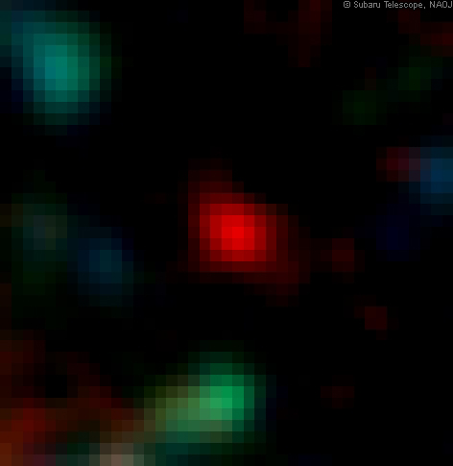
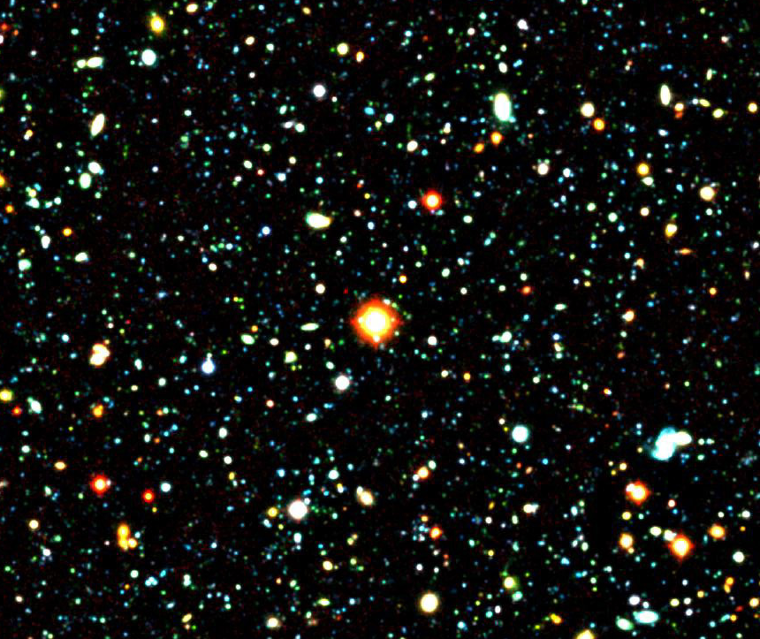
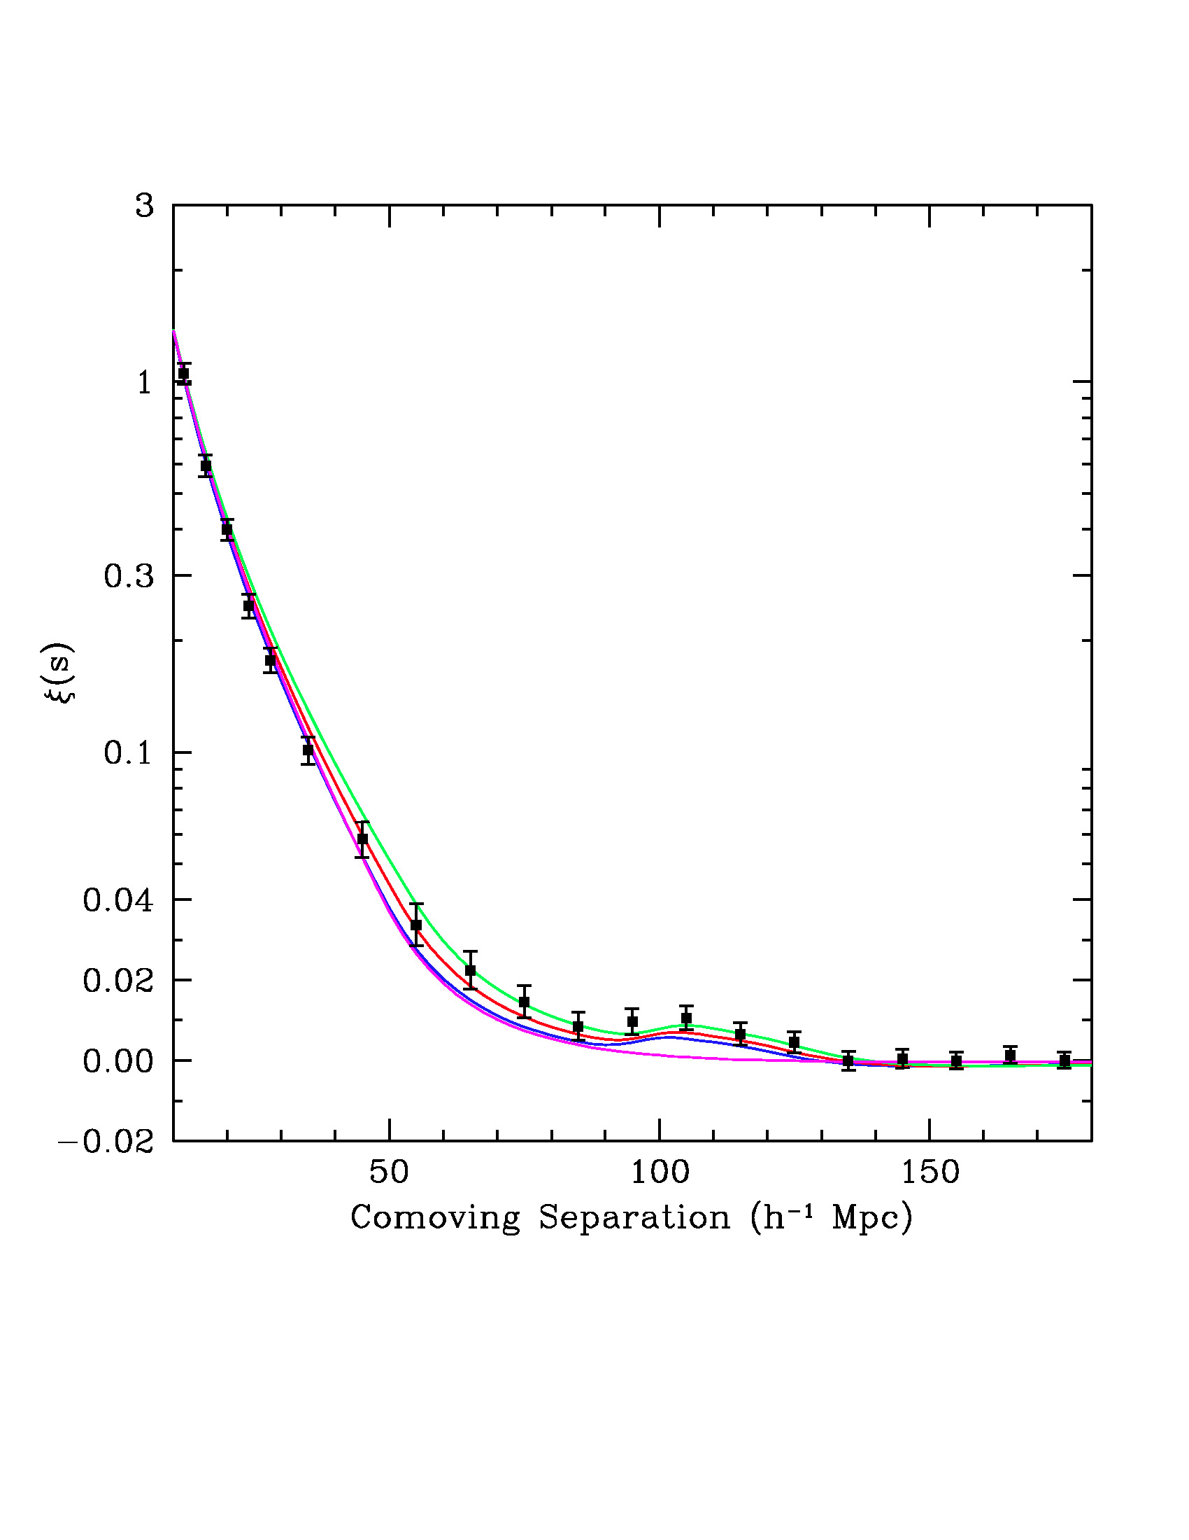
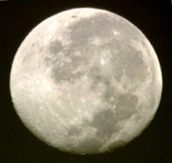
… and Big Challenges
EVOLVING DYNAMIC DARK
ASKAP/
Radio (GHz)
© Subaru Telescope / NAOJ
Barbary et al. (2009)
Eisenstein et al. (2005)
Rare populations, only discoverable in huge surveys
Brief signals, requiring constant monitoring of the sky
Weak statistical signatures, needing enormous samples
Further progress demands a new approach
→ wide-field astronomy
telescopes and detectors with enormous fields of view
data rates of ~40 Gb/sec & CPU speeds of >1 petaflop/sec
algorithms to extract information from this torrent of data
Hubble
Space
Telescope
eROSITA/
Xrays
MWA/
Radio MHz
SkyMapper/
Optical

Slide 27
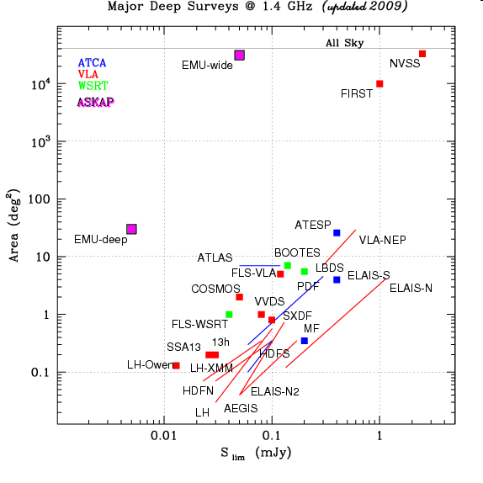
Major radio (1.4 GHz) surveys
LOFAR tier 1 (for α=-0.7)
SKA pathfinders
LOFAR tier 2 (for α=-0.7)
Limit of conventional radio-telescopes
LOFAR tier 3 (for α=-0.7)
Diagram courtesy of Isabella Prandoni
Notes:
27

Slide 28
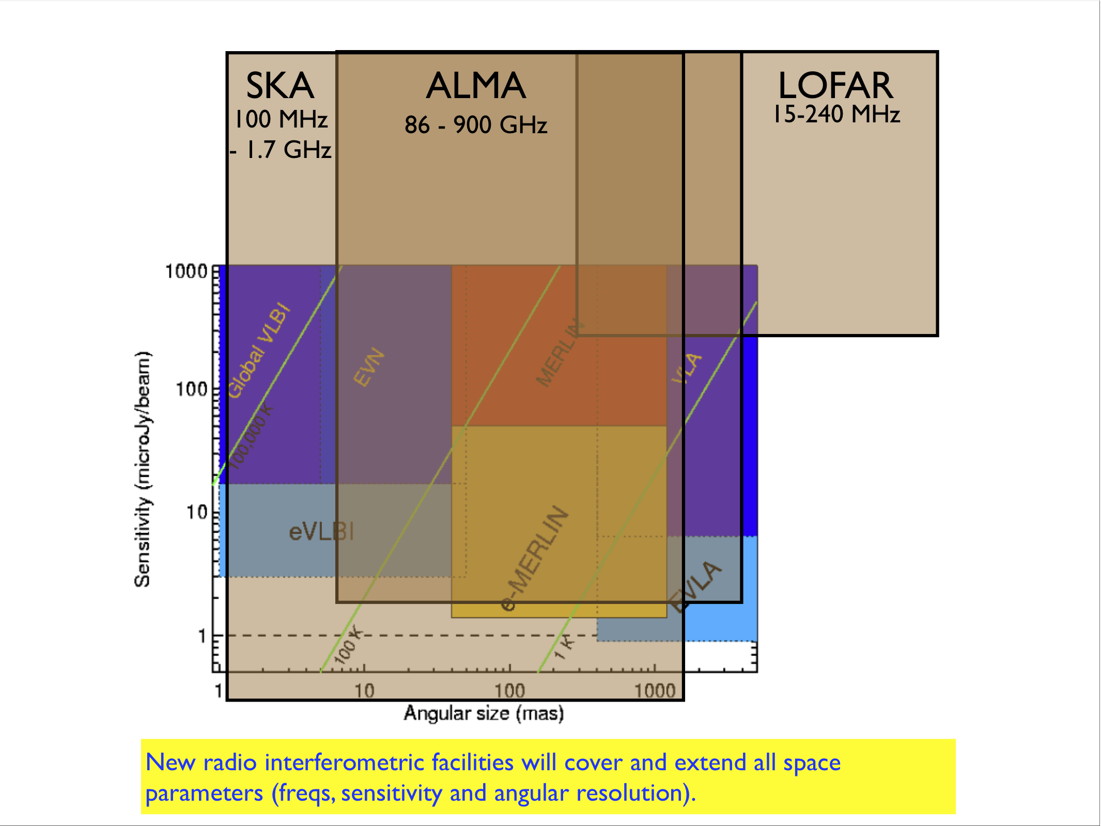

Slide 29
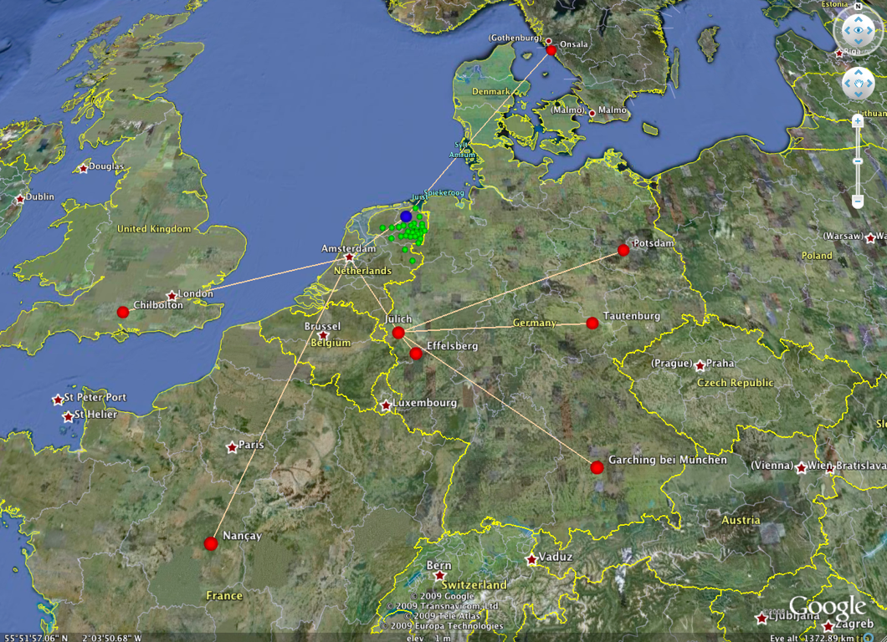
The LOFAR Telescope

Slide 30
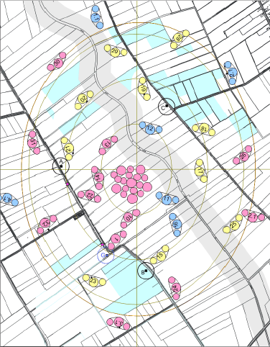
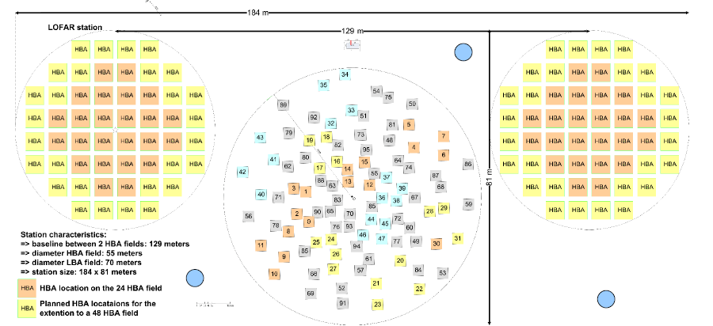
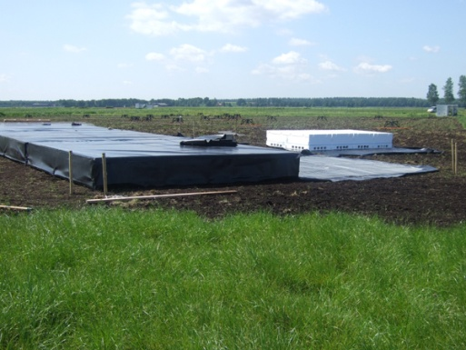
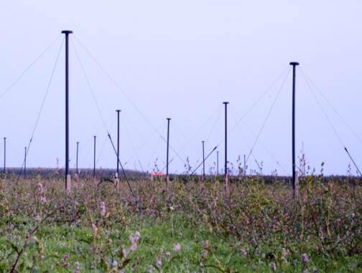
LOFAR configuration
Many (~36) Stations:
Core (3 km), remote (<100 km), international (~1000 km)
HBA: 115-240 MHz
LBA: 30-80 MHz
Notes:
30
This is the configuration of the core stations, then there are more remote ones for which the exact configuration hasn't been decided yet. Each stations is made of a central group of LBAs and two outer groups of HBA. This is the layout of one single station.

Slide 31
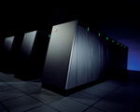
tens of Tflops
Tbytes/s
LOFAR as an IT telescope
Notes:
31
How to explain this…it is as if each of this smaller, cheaper receivers were The challenge for this kind of telescopes is not anymore the telescope itself, but how to transport the data and analize it. The electronic signals from the antennas are digitalized, transported to a central digital processor and combined in software to emulate a conventional antenna. Here the cost is dominated by the cost of electronics rather than in steel and moving structure. These costs then are likely to go down with time, allowing increasingly large telescopes. The data transport requirements are in the range of many Tera-bits/s and the processing power needed is tens of Tera-FLOPS.

Slide 32
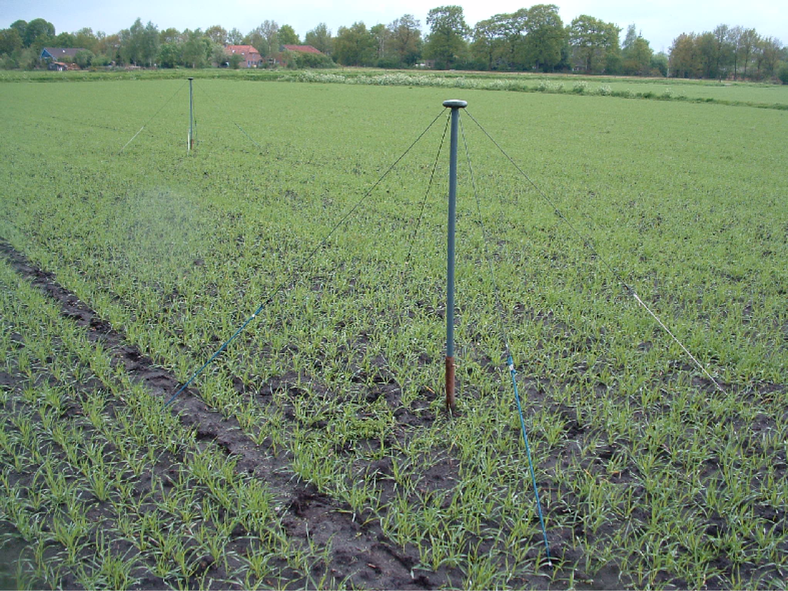
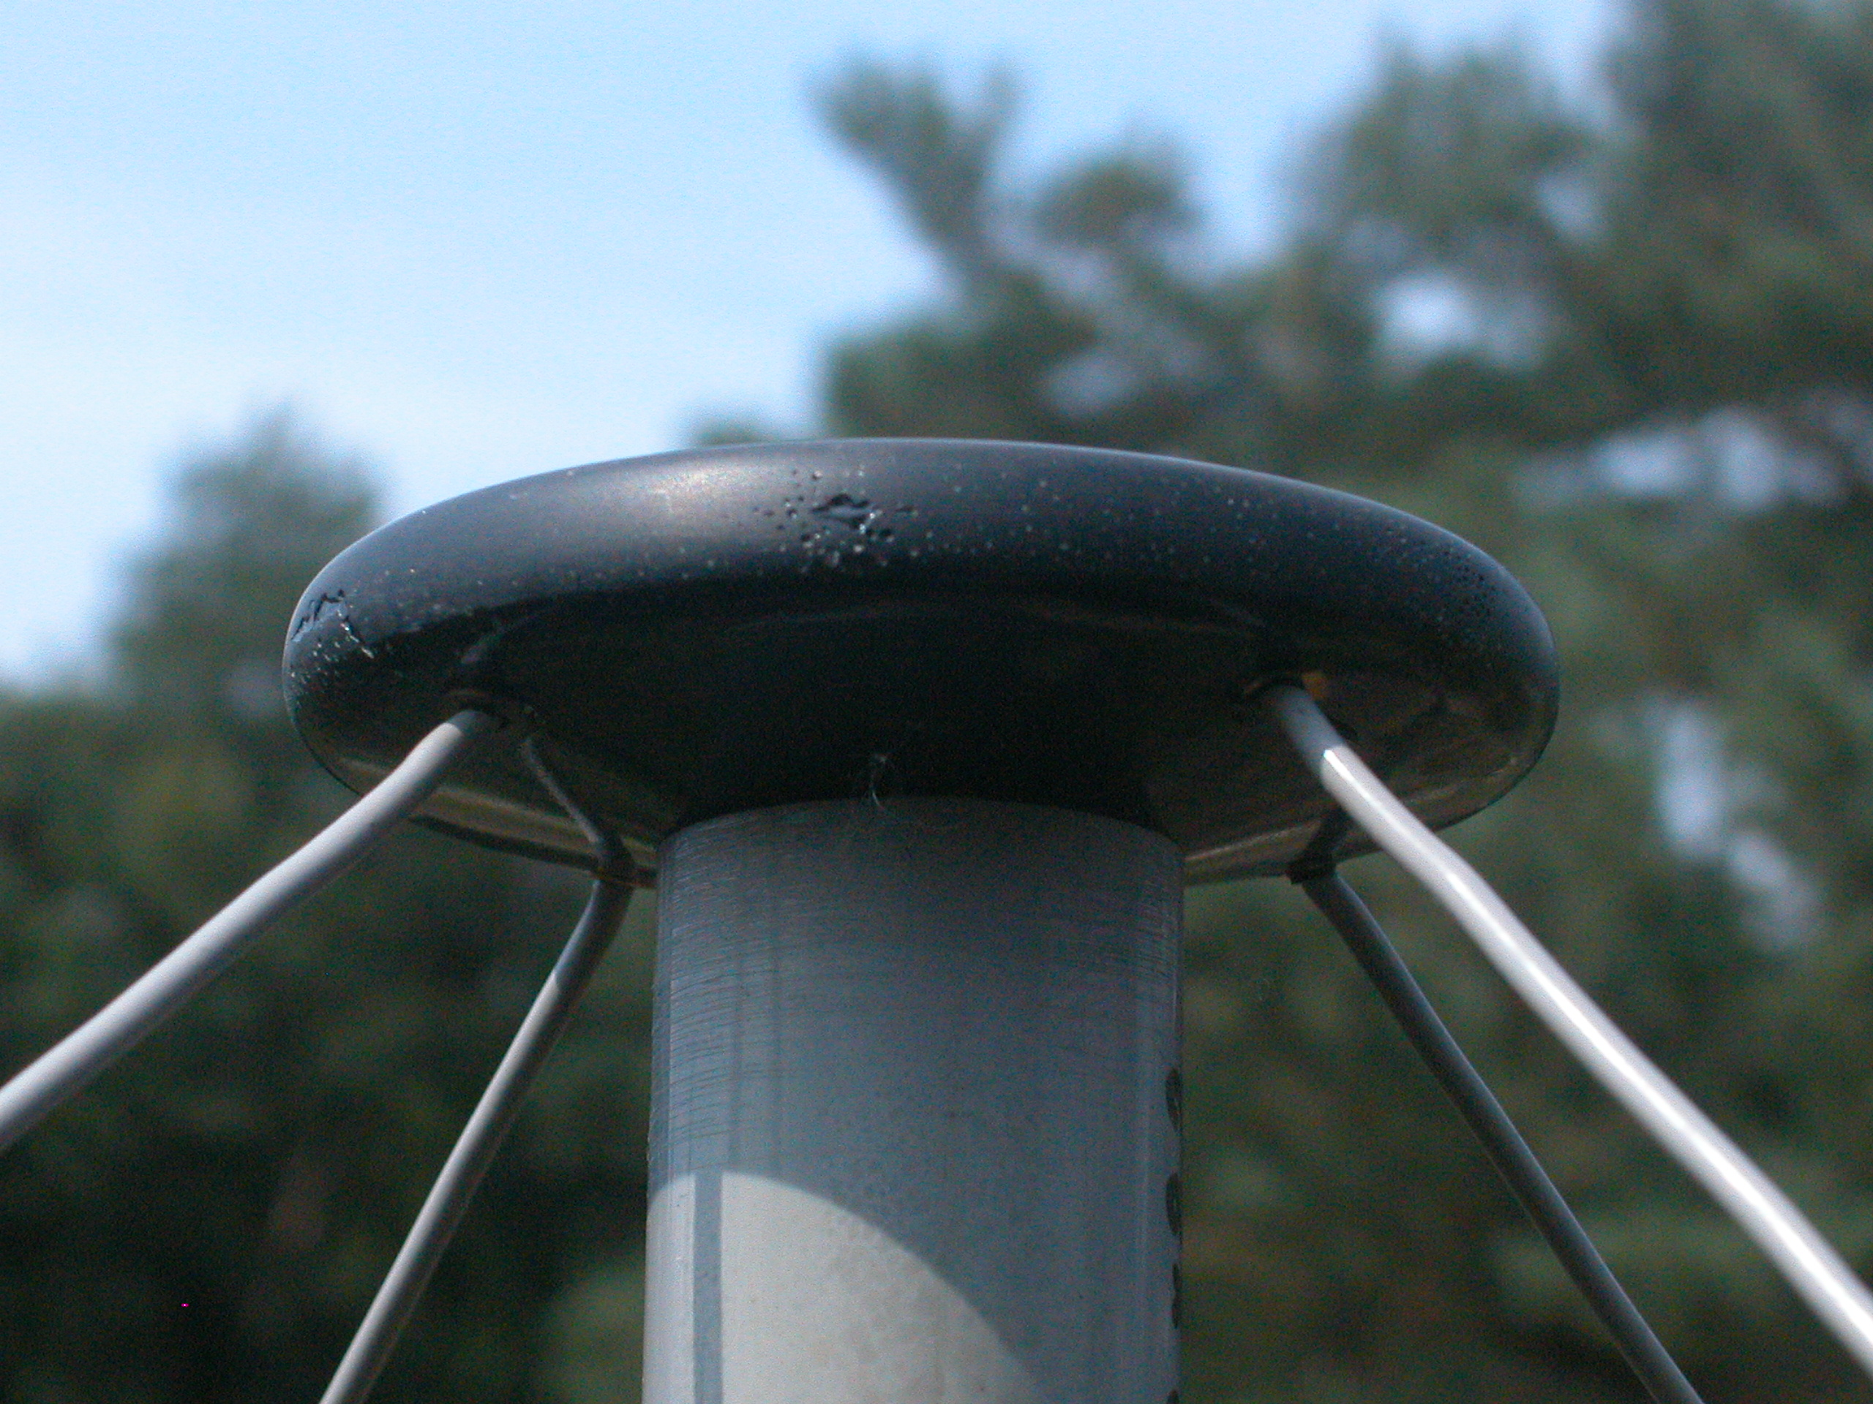
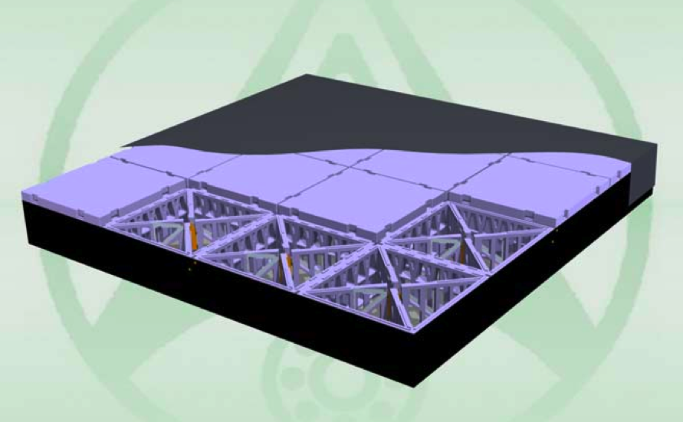
LOFAR Antennas
High band tiles:120 – 240 MHz
96 tiles/station, 4x4 antennas/tile
Low band antenna: 30 – 80 MHz
48/96 antennas per station
36 NL + 8 EU stations of dipoles
Replace big dishes by many cheap dipoles
No moving parts: electronic beam steering
Flexible digital beam forming

Slide 33
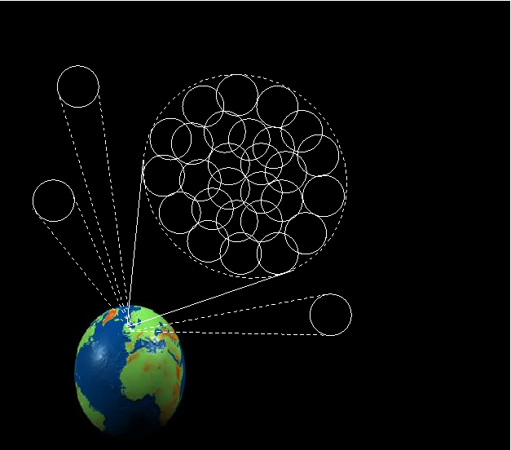
Radio Sky Monitor: Multiple station beams tile out a significant fraction of the sky and detect transients sources on timescales down to 1 second
Multiple beams used to watch for new transients
Single beam(s) monitor known sources
Only data transport and processing power prevent us monitoring the entire visible sky continuously at full sensitivity and resolution!

Slide 34
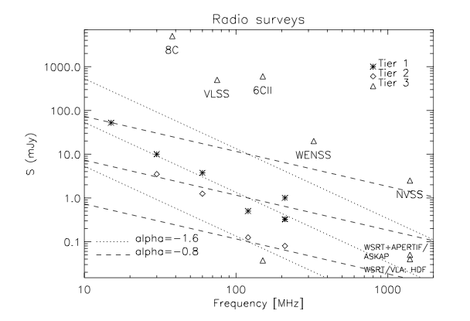
LOFAR Survey plans

Slide 36
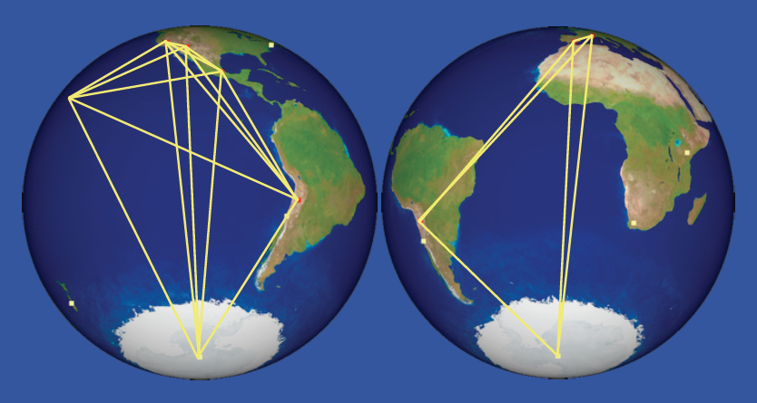
The Event Horizon Telescope
Very Long-baseline Interferometry with the largest mm-waveband antennas in the world. Coming online soon (Doleman et al. 2009)

Slide 38
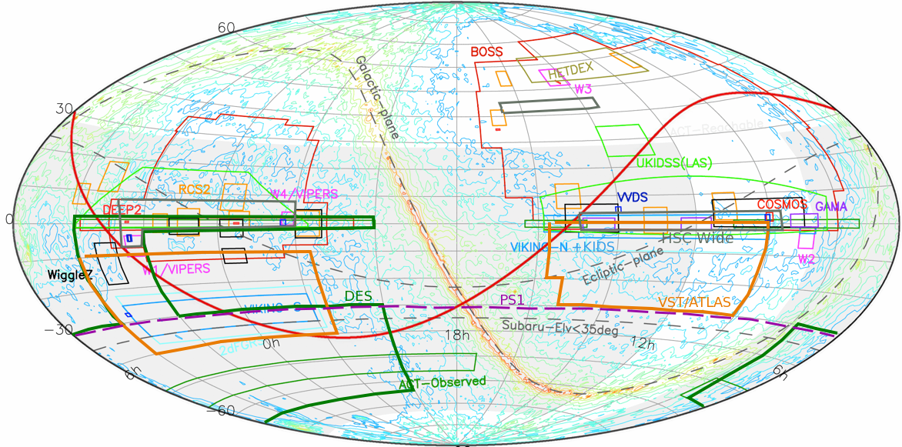
The landscape of O/IR wide area surveys
D/R split
4MOST
Image A. Nishizawa (IPMU), AM

Slide 39
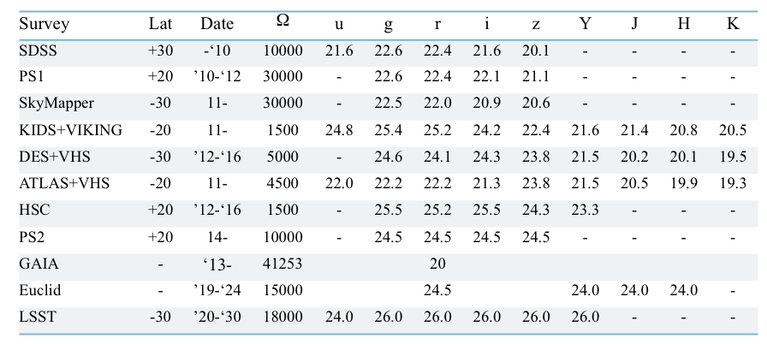
The landscape of O/IR wide area surveys

Slide 40
LSST
SDSS
Blanton

Slide 41
LSST
SDSS
Blanton

Slide 42
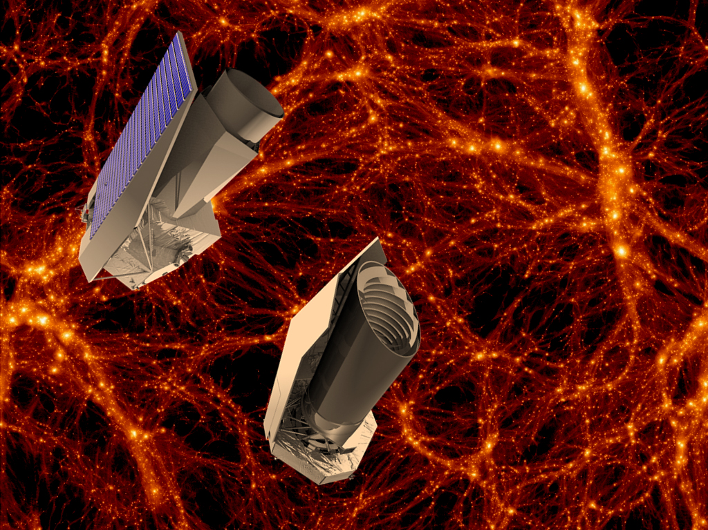
IR surveys for cosmology: Euclid

Slide 43
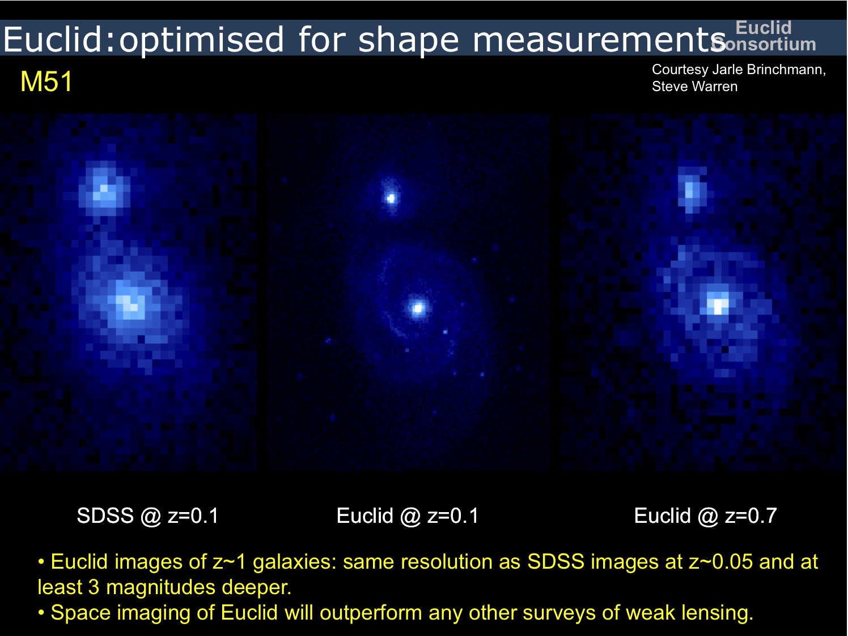

Slide 44
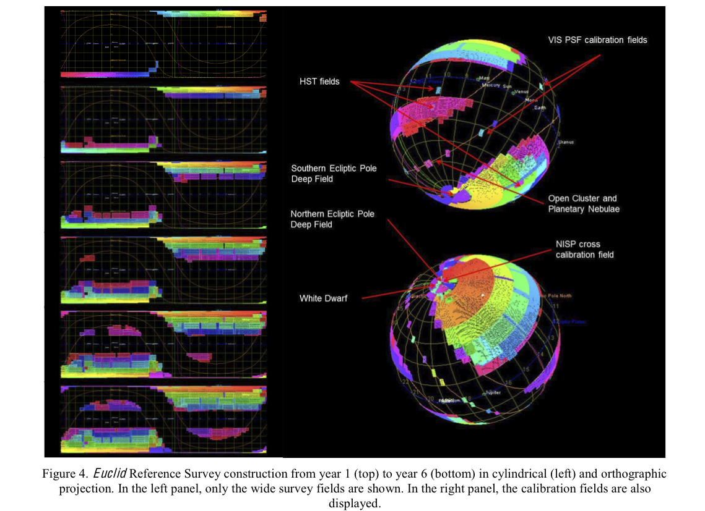
IR surveys for cosmology: Euclid

Slide 46
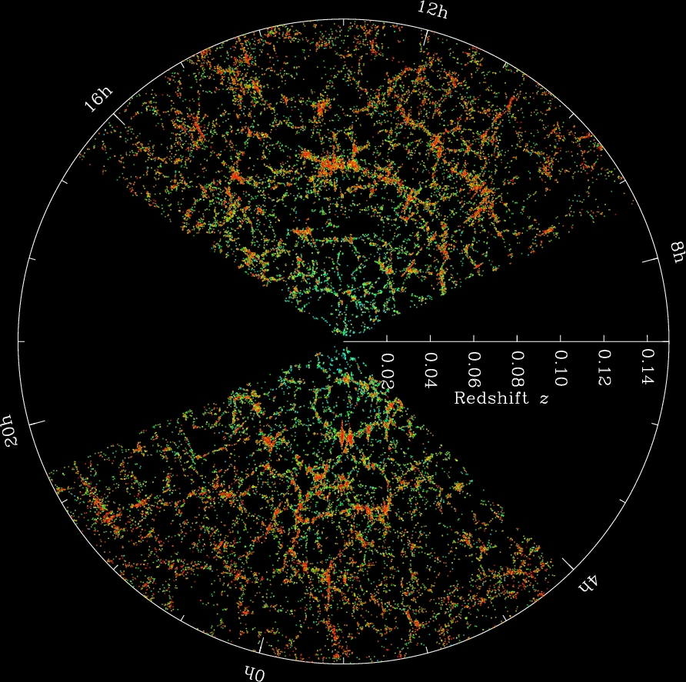
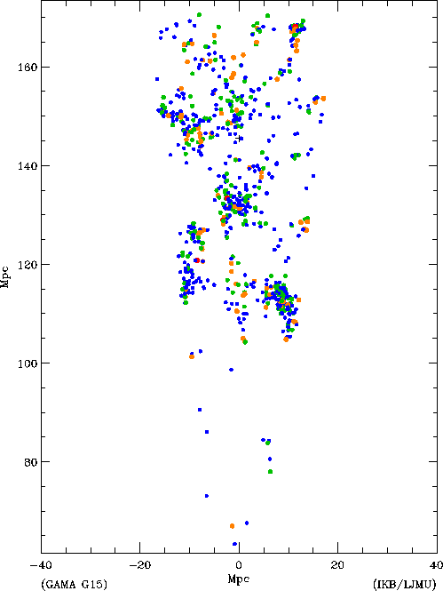
Wide-area optical spectroscopic surveys
Cosmology: 3-D mapping the cosmos
Structure formation/galaxy evolution
GAMA
Baldry
SDSS
Blanton

Slide 47
Wide-area optical spectroscopic surveys
Cosmology: 3-D mapping the cosmos
Structure formation/
galaxy evolution
NEED COMPLETE SAMPLES down to “typical” (L* luminosities:
Higher density over smaller areas (Larger telescopes)
Baryon Acoustic Oscillations are powerful Cosmological probes.
NEED LARGE VOLUMES AND LARGE NUMBERS of GALAXIES
SDSS
Blanton

Slide 48
Wide-area optical spectroscopic surveys
SDSS
Blanton
Courtesy of R. de Jong

Slide 49
Wide-area optical spectroscopic surveys
SDSS
Blanton

Slide 50
Big Observatories
SDSS
Blanton

Slide 52
X-ray Imaging Spectroscopy

Slide 53
Thank you!
Andrea Merloni
MPE, Garching
PhD School, Bologna, 04/2013

