Slide 1


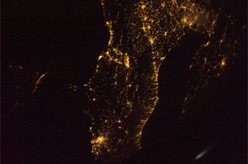

Formation and cosmic evolution of massive black holes
Andrea Merloni
MPE, Garching
PhD School, Bologna, 04/2013

Slide 2
Syllabus
Monday:
  Observational evidence of Supermassive Black Holes
  AGN surveys
Tuesday:
  The evolution of SMBH mass function and spin distributions
  The first black holes
Thursday:
  Accretion in a cosmological context: AGN feedback models
  The fundamental plane of active black holes
Friday:
  AGN-galaxy co-evolution: theoretical issues and observational evidences
  Shedding light onto AGN/galaxy evolution issues with next-generation of multi-wavelength facilities

Slide 3
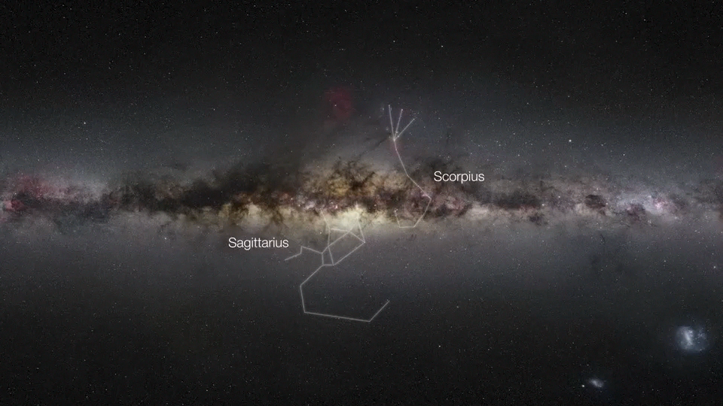
Journey towards a Black Hole
Credit: ESO/MPE/Nick Risinger (skysurvey.org)/VISTA/J. Emerson/Digitized Sky Survey 2

Slide 4
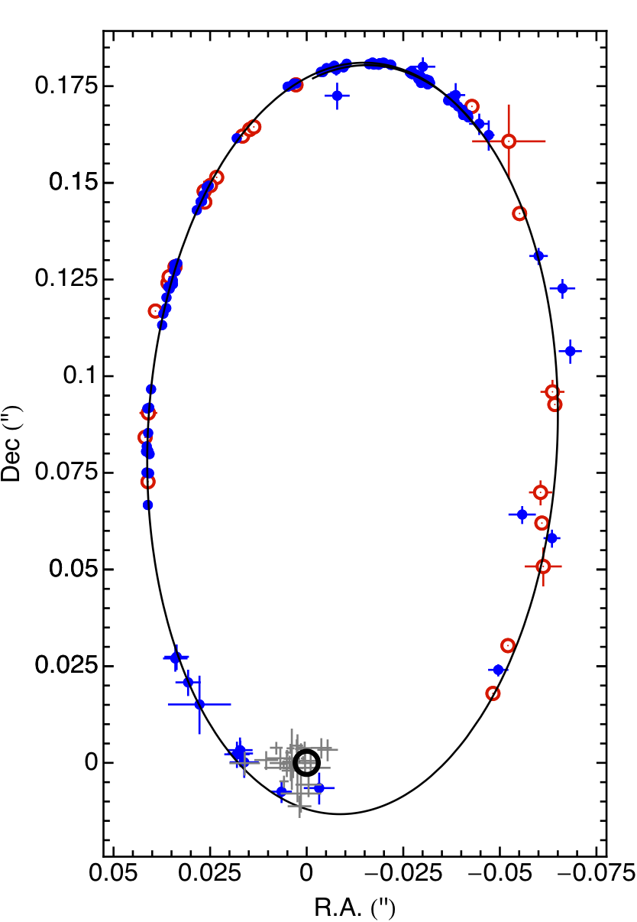
S2: the showcase star
VLT & Keck data suitably combined
2008
1995
1995
1992
2011
(Gillessen et al. 2009)
Speckle
3.5m
pos err:
2 mas
period: 15.9 years
semi major axis: 125 mas *
eccentricity 0.88
AO, 8/10m
pose err:
< 500µas
M = 4.30 ± 0.06 ± 0.35 x 10⁶ M
R₀ = 8.28 ± 0.15 ± 0.30 kpc
Speckle
10m
pos err:
1 mas
*125 mas is equivalent to the diameter of a ping-pong ball seen from ~70 kilometers;
**at the distance of the galactic center, the closest passage of S2 to the BH corresponds to just ~120 times the Earth-Sun distance (~20 Billions km)
THz source!
2002
Notes:
100 mas is equivalent of the diameter of a ping-pong ball seen from 50 miles (80 km)
Peribothron = 2x10^{10}km

Slide 5
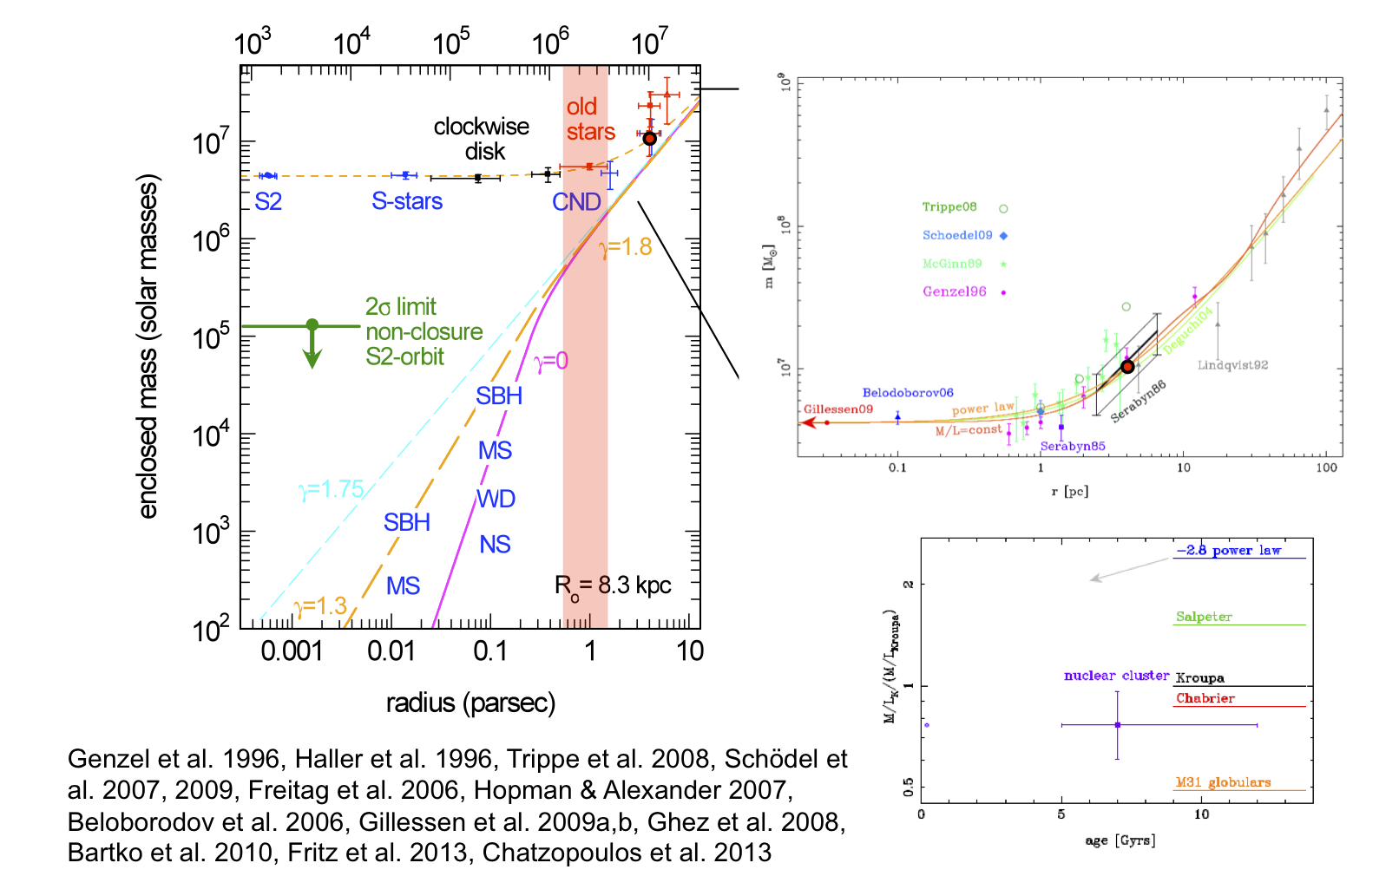
Central mass concentration

Slide 6
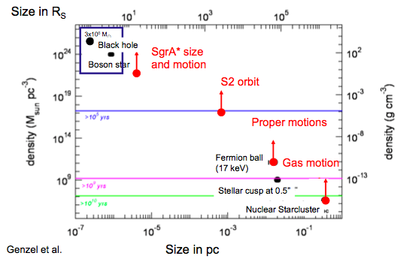
Alternatives to a black hole?
N4258
Courtesy of R. Genzel (MPE)

Slide 7
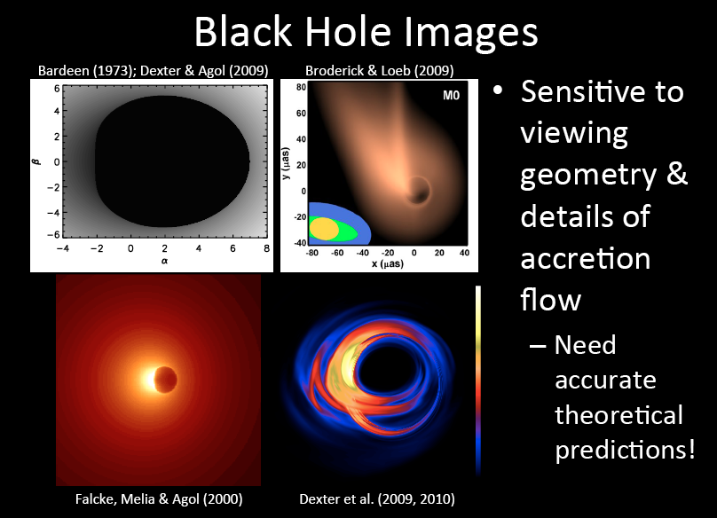
Given a precise Mass measurement we can predict the observational appearance of Sgr A* for different accretion models
The event horizon should appear in silhouette a few tens of micro-arcseconds across (~a tennis ball on the surface of the moon!)

Slide 8
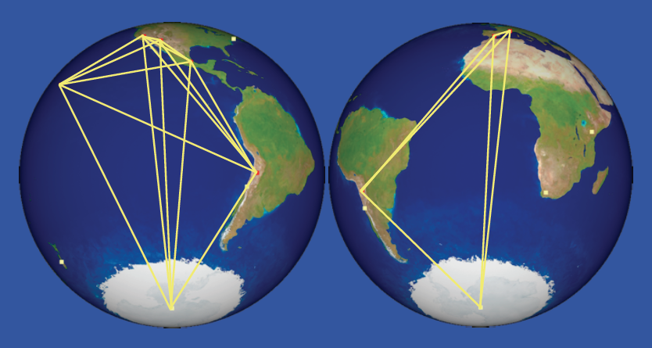
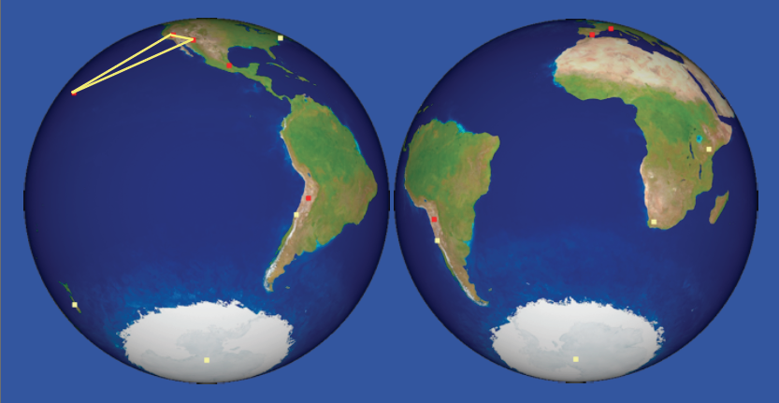
Very Long baseline Interferometry
Very Long-baseline Interferometry with widely separated mm-waveband antennas (Doleman et al. 2008)

Slide 9
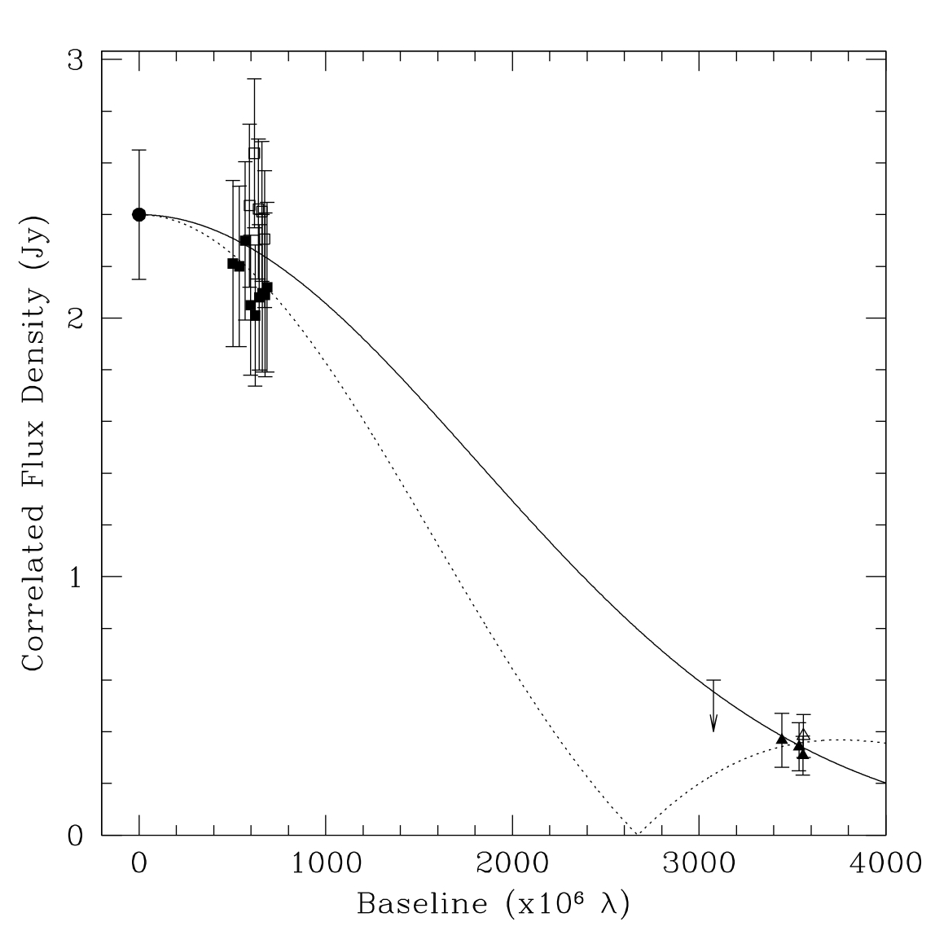
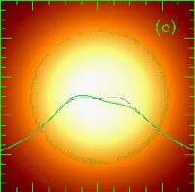

mmVLBI State of the art:
Not yet real imaging yet, but a size measurement
SMT-CARMA
- Model size ~40 μarcsec (~0.3 times the Earth-Sun distance)
- Size=4 Schwarzschild radii!
- The ~20 minutes variability in Sgr A* occurs near the BH
JCMT-CARMA
SMT-JCMT
Falcke et al. (2000), Gammie et al. (2009), Broderick et al. (2011)

Slide 10
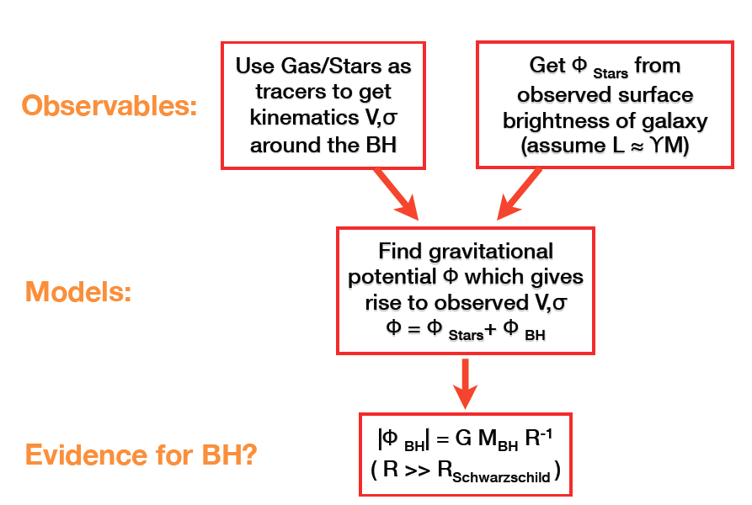
Dynamical evidence of SMBH in nearby galaxies
Courtesy of A. Marconi

Slide 11
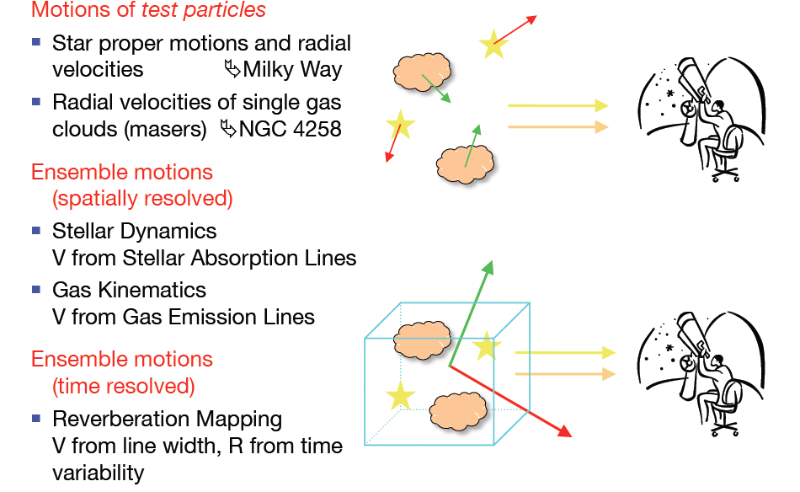
Dynamical evidence for SMBH
Courtesy of A. Marconi

Slide 12
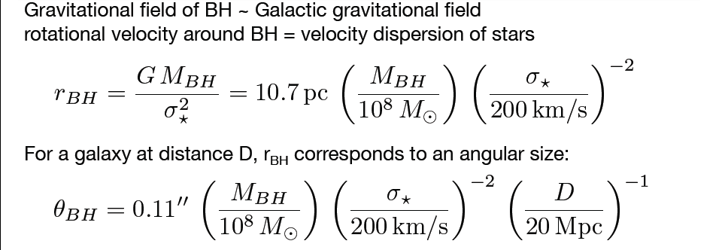
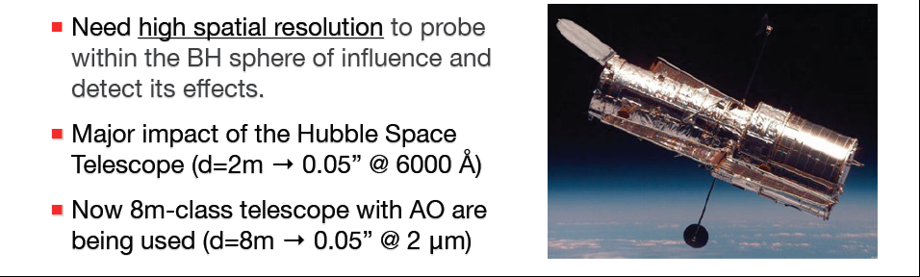
Resolving the BH sphere of influence
Courtesy of A. Marconi

Slide 13
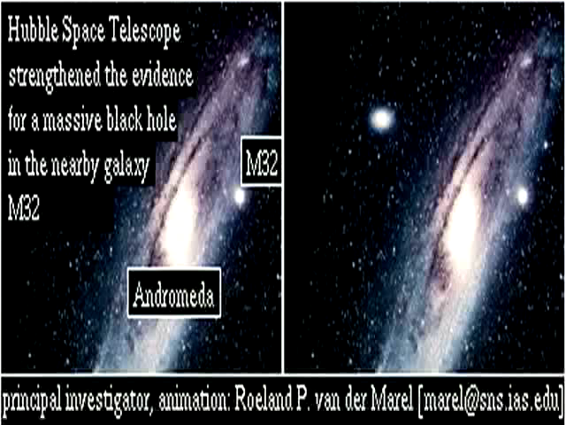
Dynamical masses of BH in nearby galaxies

Slide 14
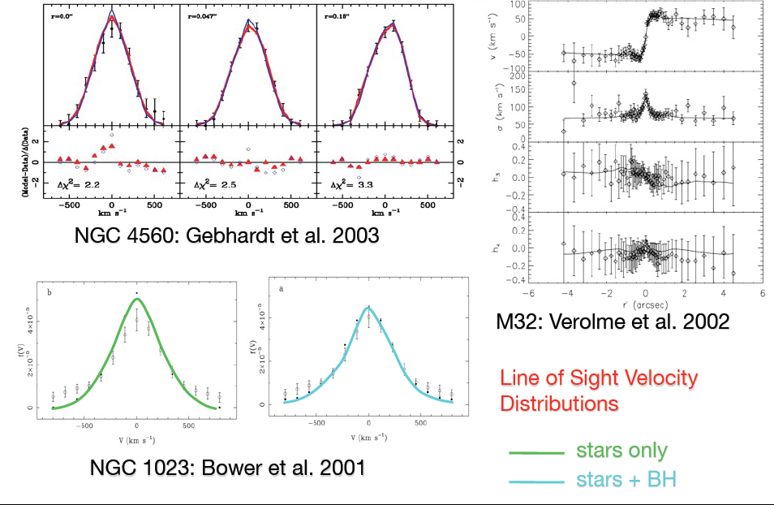
Stellar dynamics HST/STIS

Slide 15
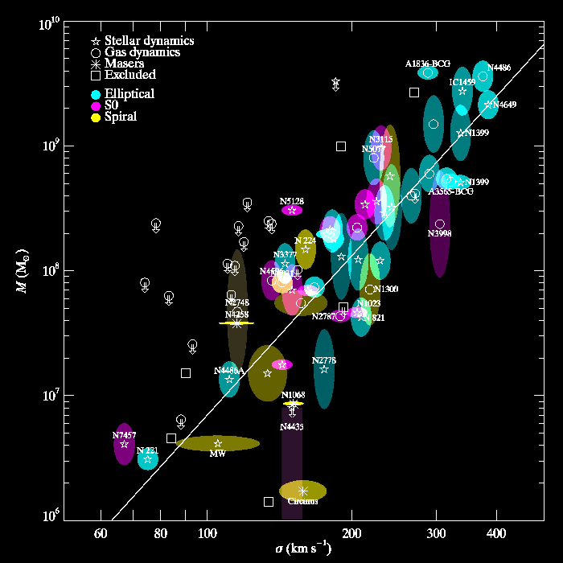
Black Hole – galaxy scaling relations
Correlation between BH mass and galaxy velocity dispersion σ
σ measured well outside gravitational sphere of influence of BH
No causal connection (now)
Either coincidence (!) or the result of common evolution
Gultekin et al. 2009
Kormendy and Richstone 1995; Magorrian et al. 1998; Gebhardt et al. 2000; Ferrarese et al. 2000; Tremaine et al. 2002;
Gultekin et al. 2009; Kormendy & Bender 2012

Slide 16
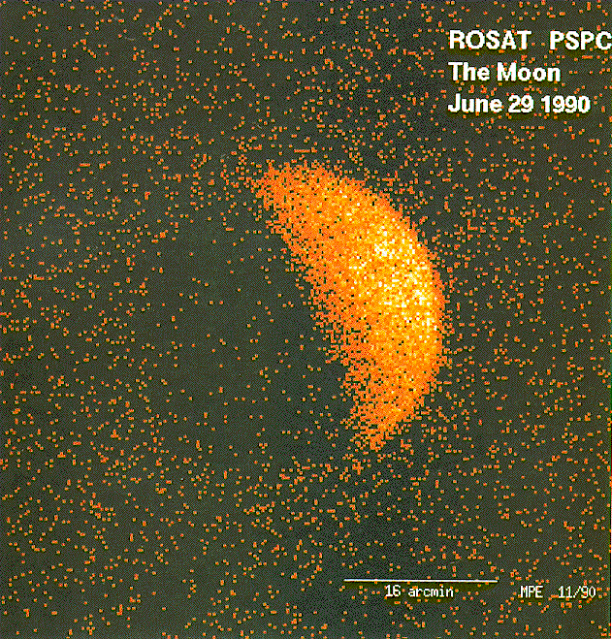
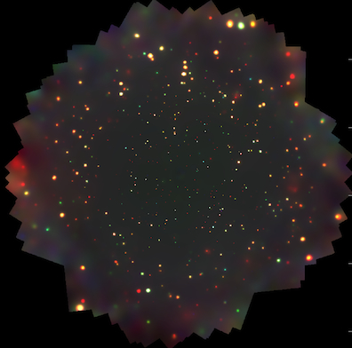
Accreting black holes
Chandra Deep Field South:
The deepest X-ray image of the sky ever taken (Xue et al. 2011)
Every dot is a (supermassive) black hole!

Slide 17
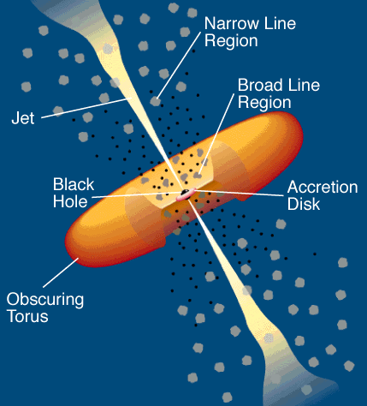

The complexity of galactic nuclei
Urry and Padovani 1995

Slide 18
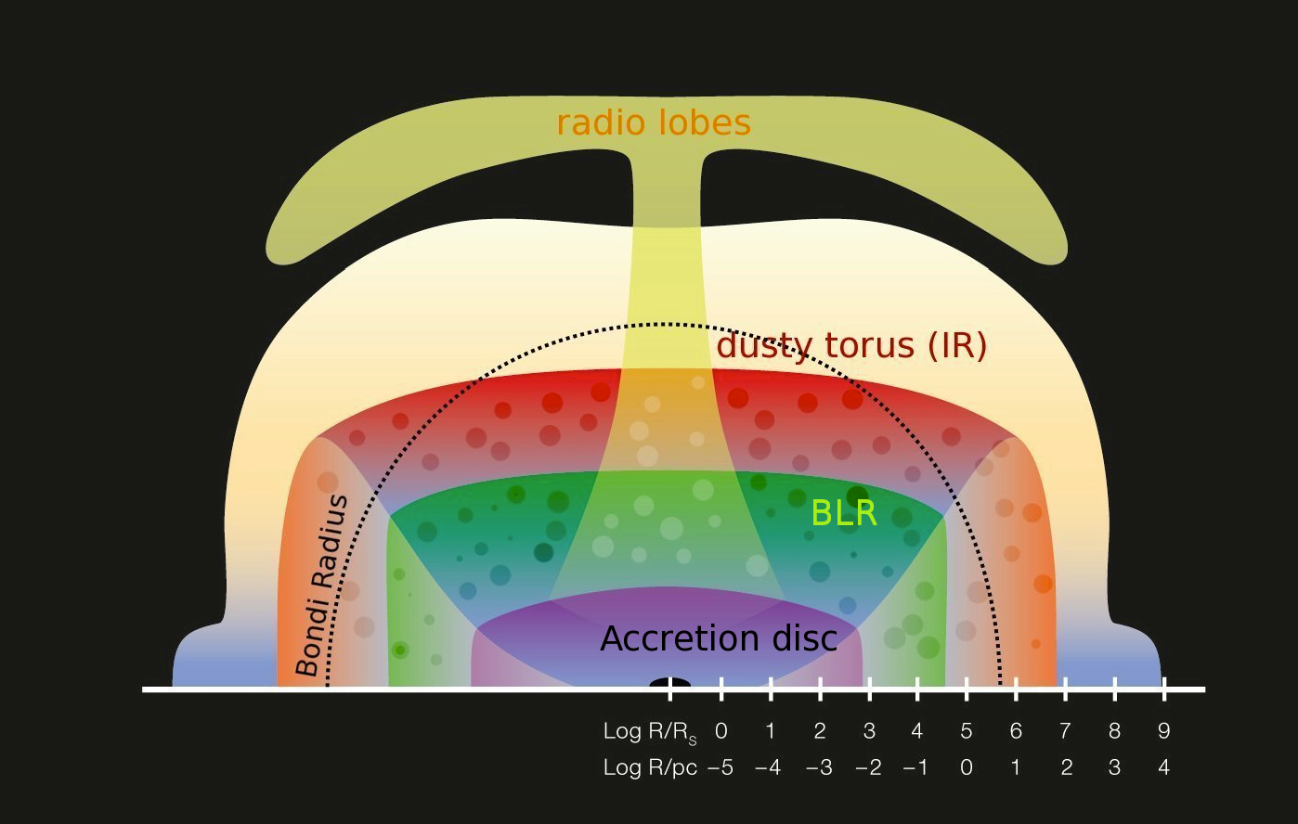
A logarithmic view of an AGN
Binding Energies
E_{b,}≈4 × 10⁴⁸ ergs
E_{b,BH,8}≈10⁶¹ ergs
E_{b,gal,11}≈10⁵⁹ ergs
E_{b,Coma}≈10⁶⁴ ergs
A. Merloni, ESO graphics, 2010
Notes:
I do not have time now to enter into a detail discussion of the various physical processes taking place at different scales, but I just want to emphasize that there are about 8 orders of magnitude difference between the scale where most of the gravitational energy of the accretion matter is released (either as radiation or as bulk motion of powerful relativistic jets) and the size of a galaxy.
Right in the middle, is the scale where the gravitational pull of the black on the surrounding gas begins to be felt, here represented by a black dashed line, is where both fuelling rate and obscuration level are fixed, crucially determining the observational appearance of a growing black hole.
Although this may sound as a nightmare for a purely numerical approach, observations at different wavelengths do offer the chance to resolve different scales, and to achieve a high-dynamic range view of the AGN phenomenon.

Slide 19
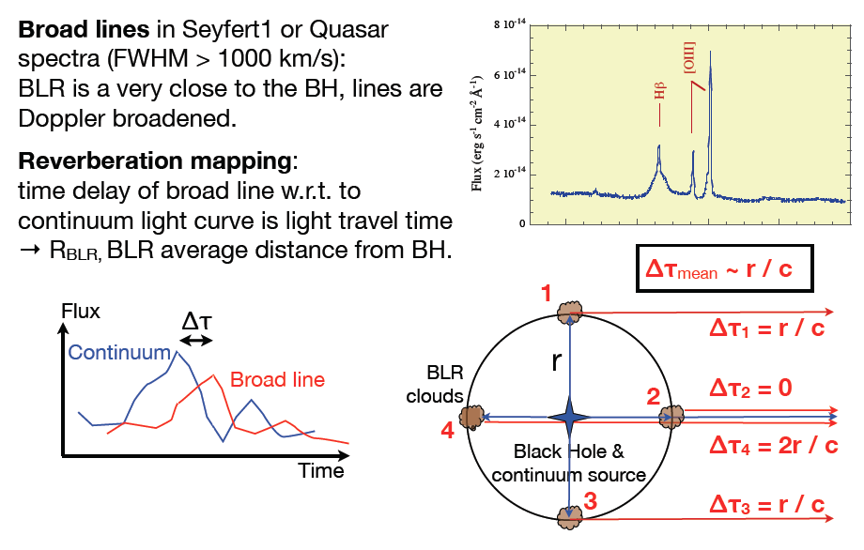
Reverberation mapping
Courtesy of A. Marconi

Slide 20
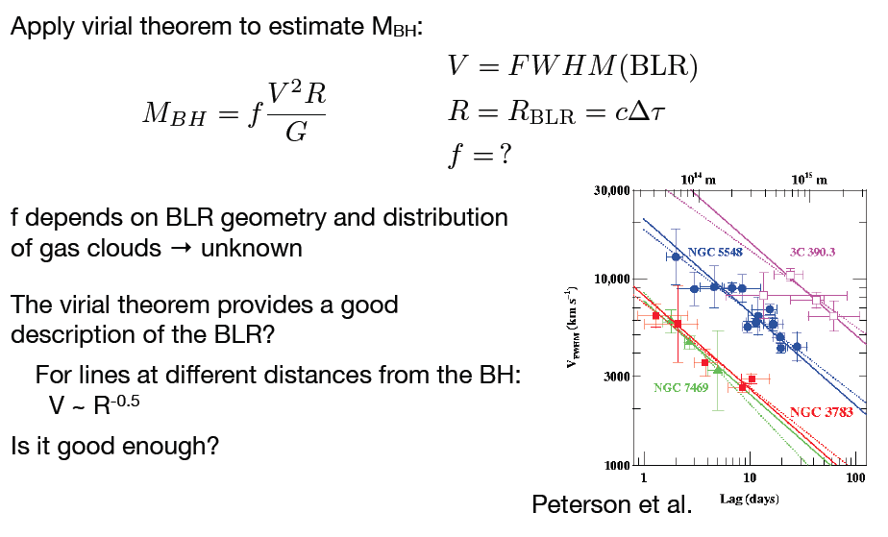
“Virial” masses
Courtesy of A. Marconi

Slide 21
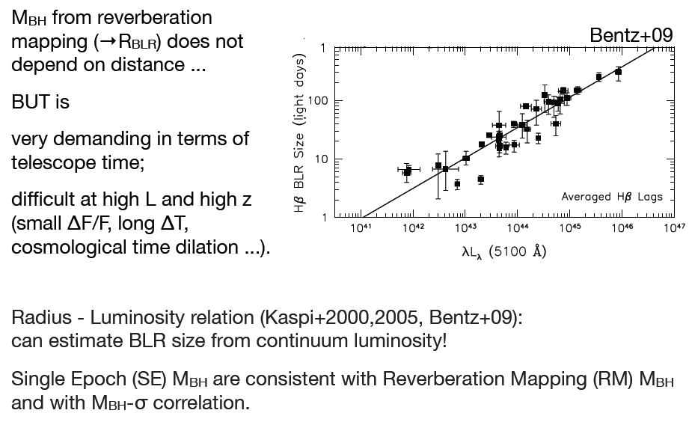
“Radius-luminosity” relation

Slide 22
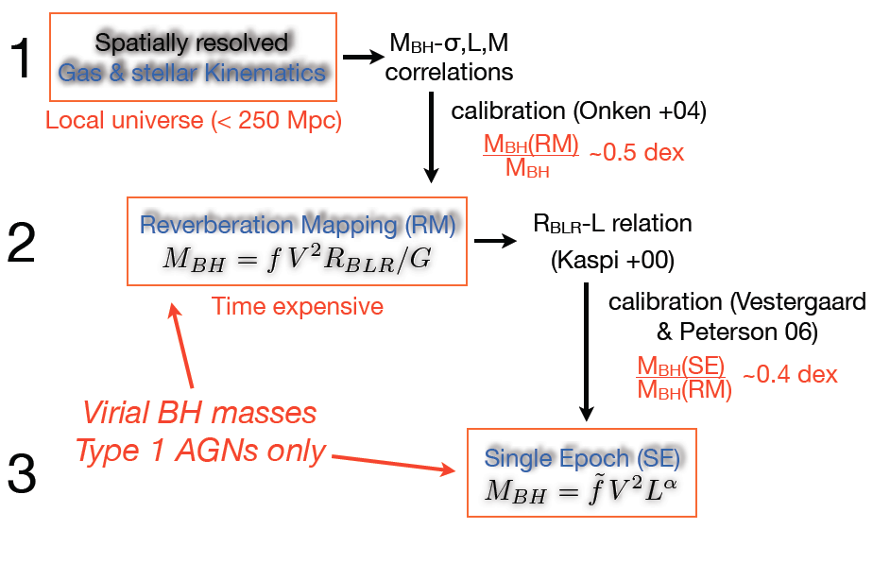
The BH mass ladder [Peterson, Marconi]
Courtesy of A. Marconi

Slide 23
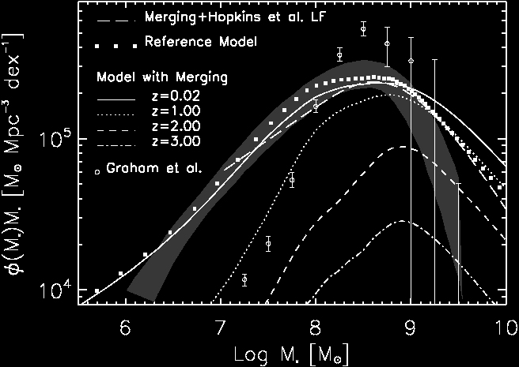
Every galaxy hosts a nuclear Black Hole
Gultekin et al. 2009
Shankar et al. 2007
n_{SMBH}(Log M>5.5) ≈ 1.3 x 10⁻² Mpc⁻³

Slide 24
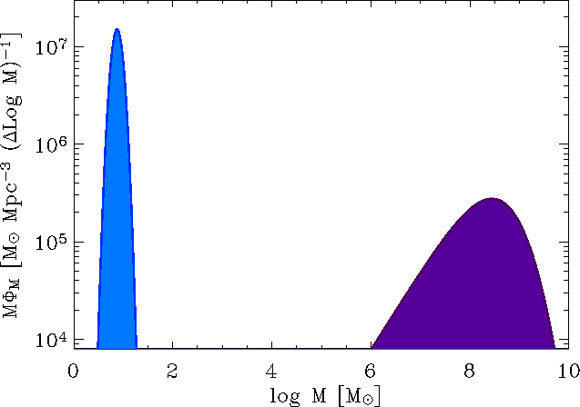

Black Holes in the local Universe
Ω_{*BH}≈7×10⁻⁵ [Fukugita & Peebles (2007)]
Ω_{SMBH}≈2.7×10⁻⁶
Accretion over cosmological times,
Active Galactic Nuclei, galaxy evolution
Stellar physics, SN explosions, GRB
Sgr A*
M87
Ω_{baryon}≈4.5×10⁻² ; Ω_{stars}≈2.5×10⁻³

Slide 25
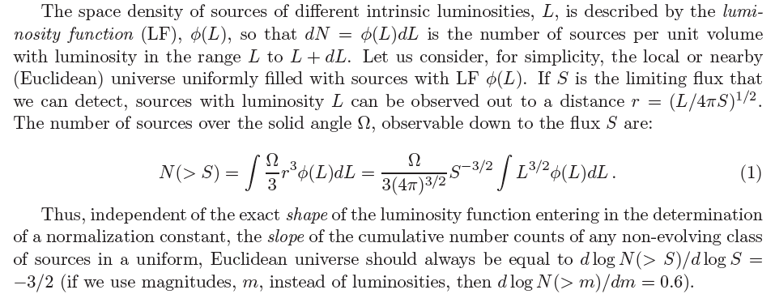
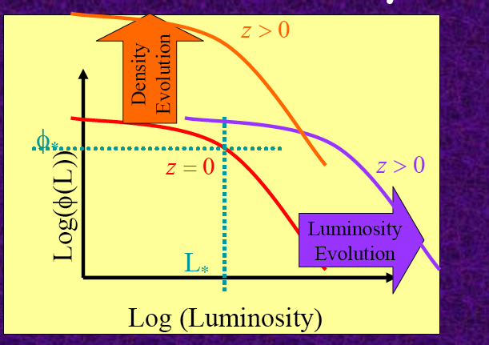
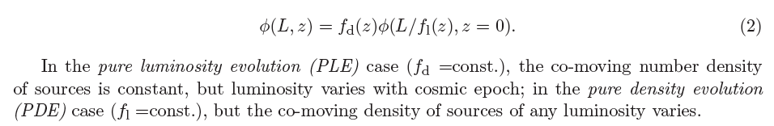
AGN surveys, basic definitions
In the most general case, we can write:

Slide 26
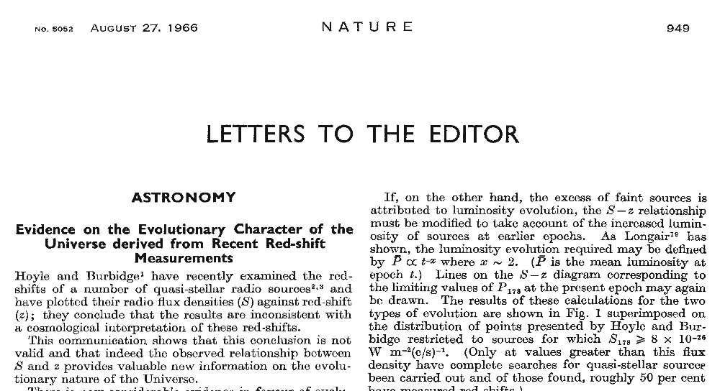
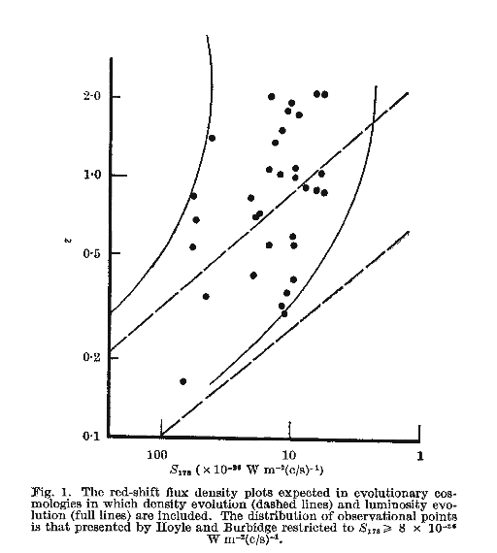
AGN and Cosmology: early developments
Longair 1966

Slide 27

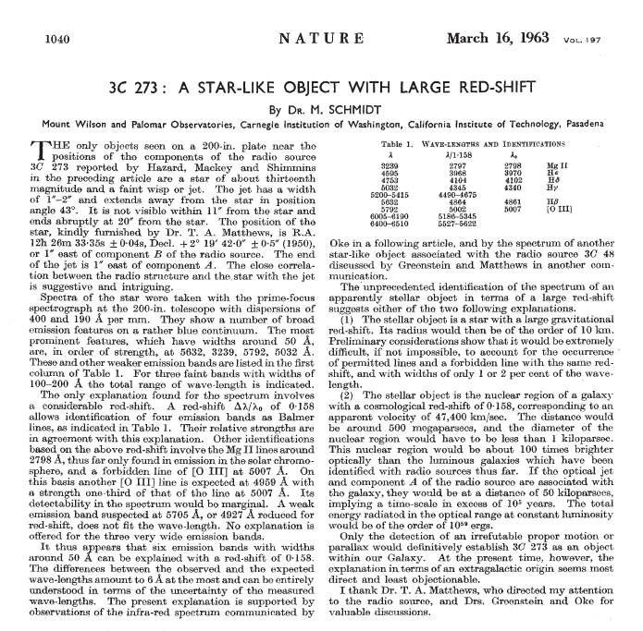
Supermassive Black Holes in Quasars Historical Notes

Slide 28

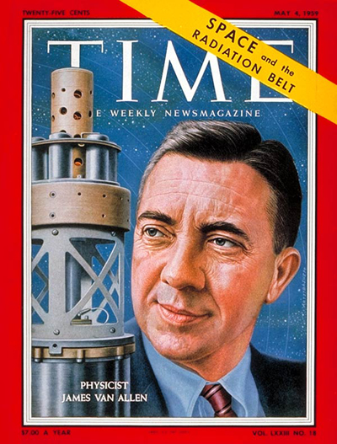


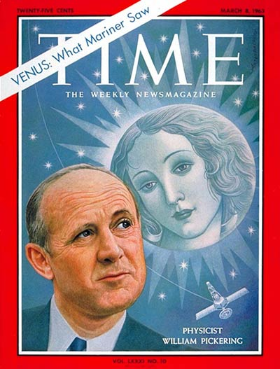
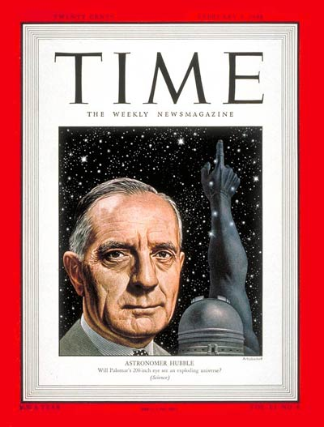
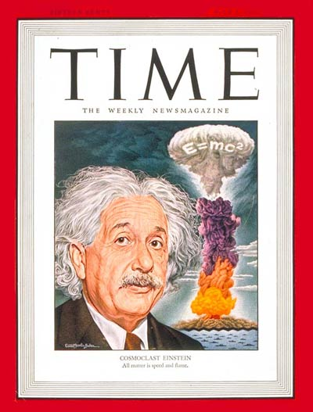
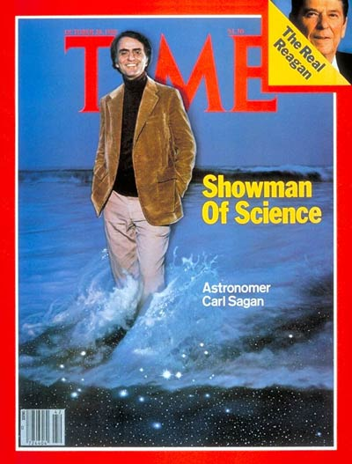

Slide 29
Shapley
Van Allen
Eddington
Schmidt
Pickering
Hubble
Einstein
Sagan

Slide 30
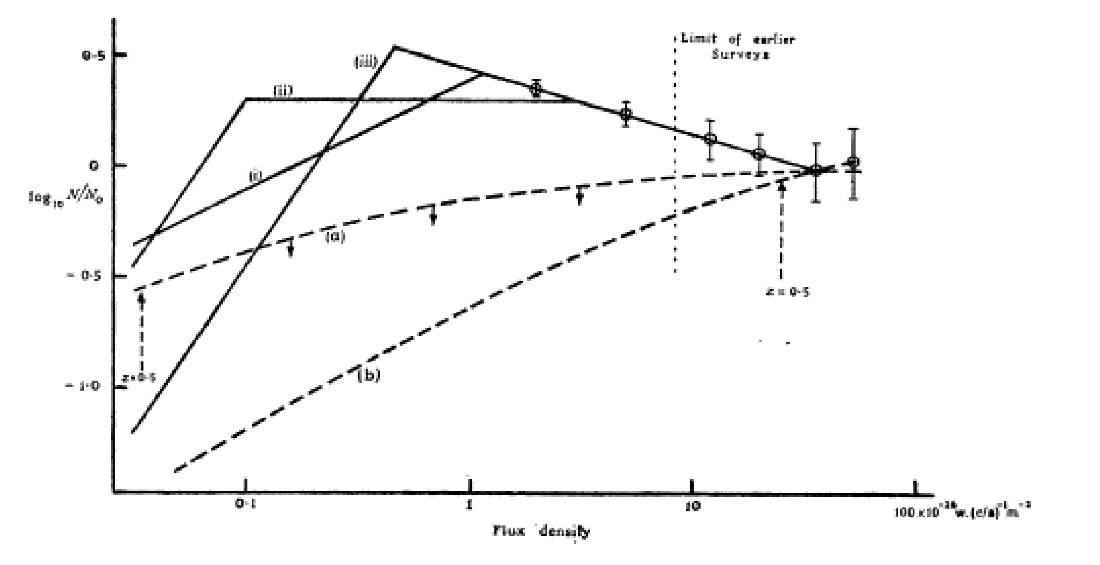
AGN and Cosmology: early developments
Ryle and Clarke (1961)
Radio counts are incompatible with steady state cosmologies

Slide 31
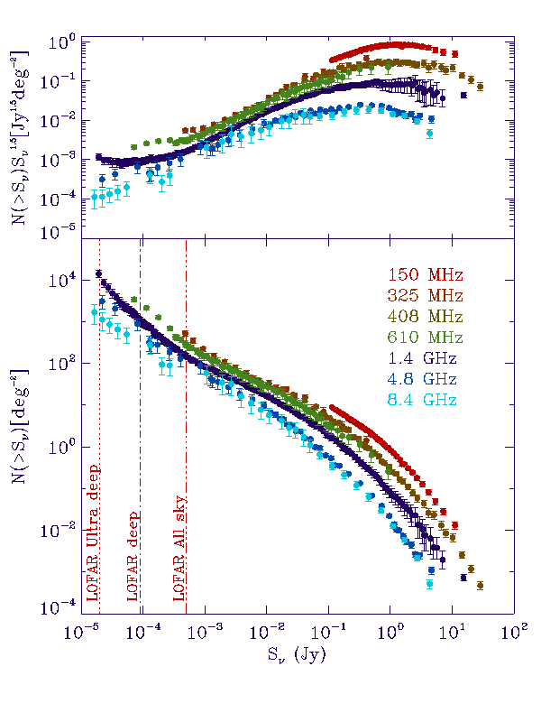
Radio counts
Brightest fluxes: Only radio loud AGN
N(S) increase faster than S^{1.5}: cosmological evolution
“Narrowness” of the ~1Jy peak: differential evolution of high- and low-luminosity radio sources (Longair 1966)
Flattening below ~1Jy: high-redshift sources, cosmological volumes
Sub-mJy steepening: appearance of star-forming galaxies and/or radio-quiet AGN
“Simple” Power-law synchrotron spectrum

Slide 32
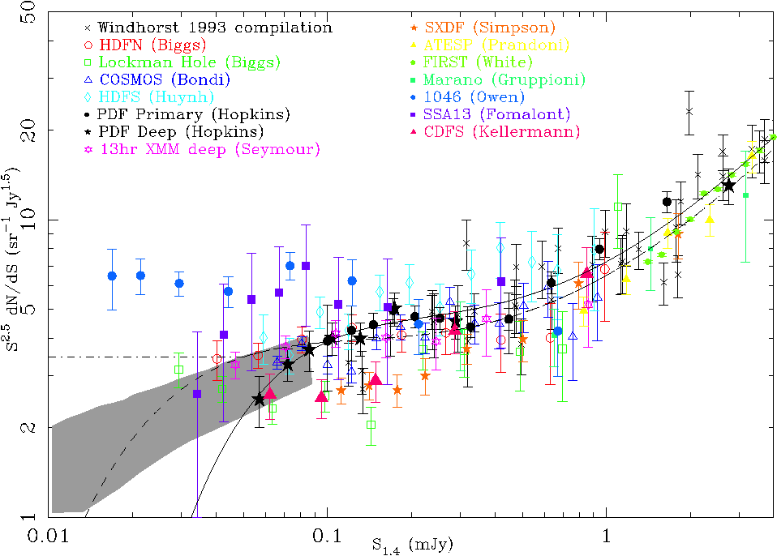
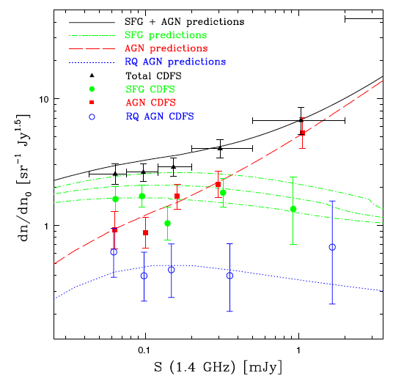
Radio counts: the sub-mJy population
Padovani et al. (2009)
Norris et al. (2011)

Slide 33
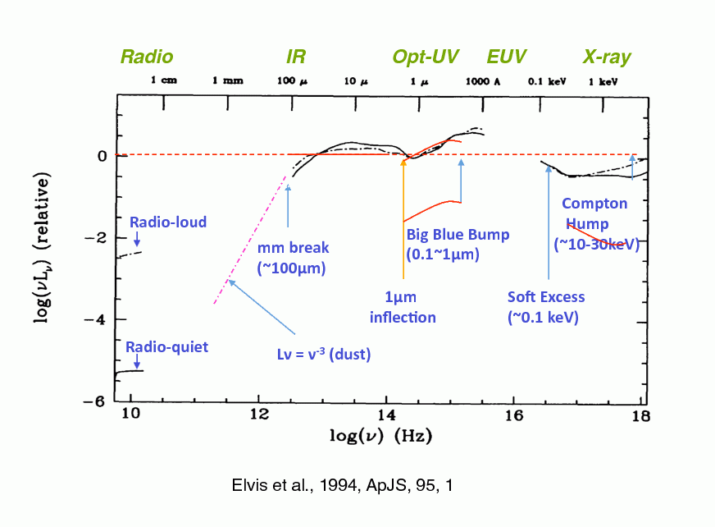
Spectral Energy Distribution (SED)
Elvis et al. 1994

Slide 34
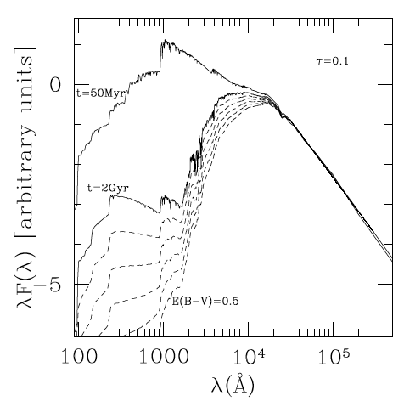
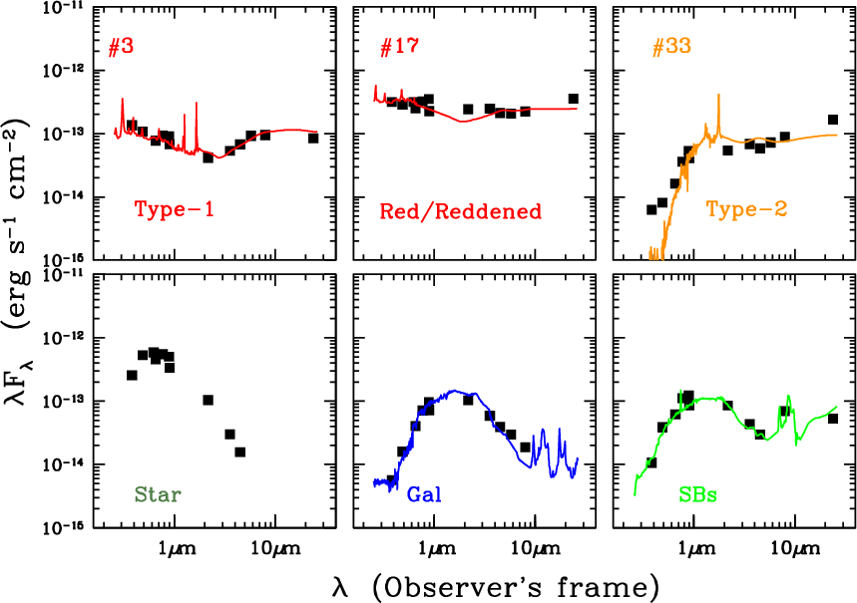
Differences between QSOs and galaxies
Nakos et al. 2009
Bruzual and Charlot 2003

Slide 35
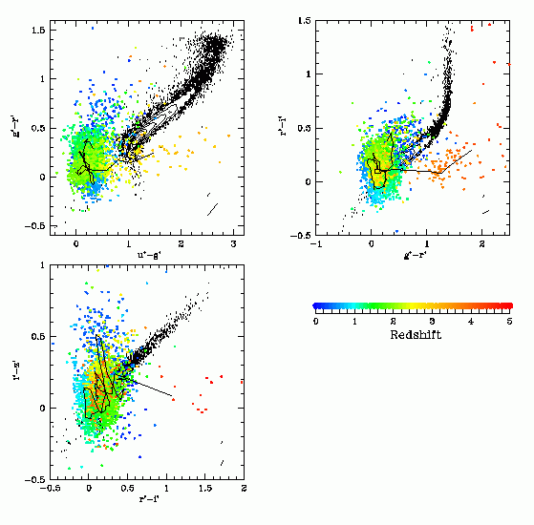
SDSS Color Selection
Color selection
  Type-1 quasars
  Low-z
    UV-excess (UVX), Palomar-Green (PG), 2dF etc.
    Contaminants: brown dwarfs
  High-z
    Lyman break, SDSS, DPOSS, APM
    Contaminants: late type stars, brown dwarfs
>90% of known AGNs are color-selected
Stellar locus
quasar
Z=3
Z=4
Richards et al. 2002
Z=5

Slide 36
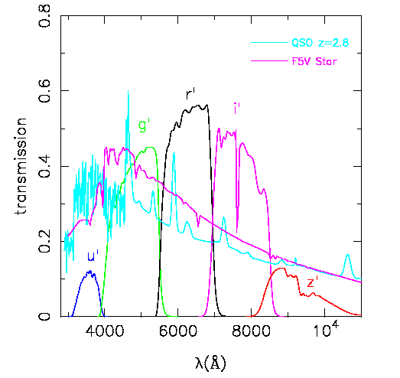
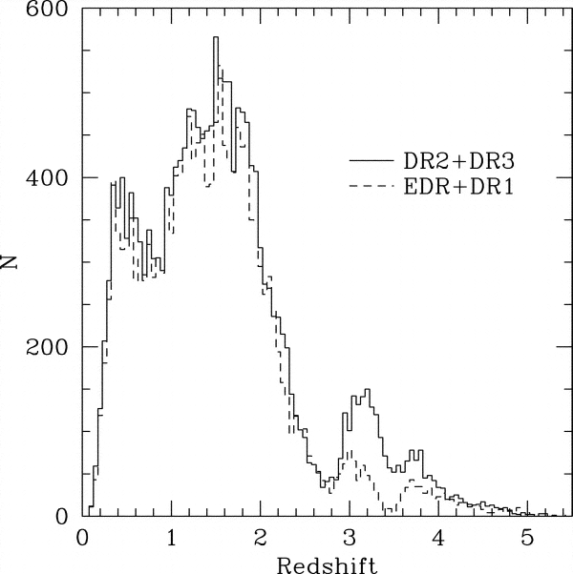
Biases of color selection
z=2.5-3.0 gap
  Quasars have similar colors to F stars
Missing redder or reddened quasars
Missing obscured/type-2 objects
Only sensitive to high level of activity, high AGN/host contrast

Slide 37
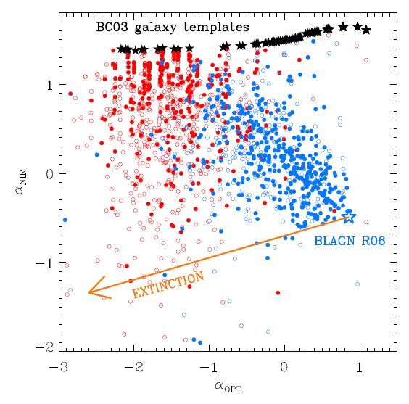
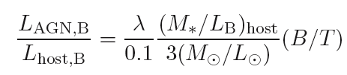

Biases in optical AGN surveys: Obscuration and galaxy dilution
Most of the optical/NIR SEDs of XMM-COSMOS AGN can be explained as a combination of a pure AGN extinguished and/or contaminated by the host galaxy.

Slide 38



Optical QSO surveys

Slide 39


Cosmic Background radiation
Treister et al. 2009
AGN dominate XRB, but contribute only to ~10% of IRB
XRB itself is dominated by obscured (and heavily obscured) AGN

Slide 40




The deep X-ray sky
COSMOS field, 2 deg² (Scoville+07)
XMM 1.55 Ms ~1e-15 cgs
(Hasinger+07, Cappelluti+07,09)
Chandra 1.8 Ms ~2e-16 cgs
(Elvis+09, Puccetti+09)
CDFS 1-2-4Ms ~0.1 deg², ~4e-17 cgs
(Giacconi+ 2002, Luo+ 2008, Xue+2011)
XMM/CDFS 3Ms (Comastri+2011)
soft 0.5-2.0 keV
medium 2.0-4.5 keV
hard 4.5-10.0 keV
Notes:
Public fields, resource for community

Slide 41

X-ray number counts
X-ray background almost fully resolved in the soft X-ray band
Marginal contribution of SFG
Density of sources at “knee” ~100/sqdeg
Some degree of spectral evolution/complexity
Merloni & Heinz 2013
(Soft/Hard) X-ray number counts

Slide 42

Luminosity-dependent obscuration?
- Type 2 AGN fraction, strong function of luminosity: less luminous, most obscured
- Same results in DIFFERENT bands (Simpson+05, Maiolino+08, Hasinger 2008, Bongiorno+10, Burlon+11, Brightman+11)
- Receding torus scenario: most luminous more efficient in cleaning the environment (see also clumpy models, e.g. Nenkova et al. 2008)
- Relative contribution of AGN and host: “extra” obscuration from host galaxy at low-L (optical and X-ray classification do not agree)
Brusa et al. 2010
Optical-class
Gilli+07
X-ray-class
Treister+07

Slide 43
Infrared spectra of AGN
AGN (unobs and obs) are expected to have warm power-law sed at >1micron (≠ from elliptical/starburst)
Blue (unobs)
Red
AGN
Red (obs)
AGN (both type 1 and 2) can be isolated
in NIR/MIR diagrams and they are ~ same order of magnitude of X-ray selected obscured AGN
(Lacy et al. 2004, Hatziminaouglou et al. 2005, Stern et al. 2005, Donley et al.2008, Pope et al. 2008, Fiore et al. 2008, Luo et al. 2011)
Red
Blue
Elliptical
Flat/Blue
Red
Starburst
Main issues:
reliability (are only AGN selected?)
completeness (are all AGN selected?)
Optical NIR IRAC
3.6 4.5 5.8 8.0
Courtesy of M. Brusa

Slide 44

Infrared surveys and AGN
WISE IR all-sky survey jpl.nasa.gov
Thanks to their distinctive IR colors, WISE can reliably identify ~100 luminous QSOs per square degree, irrespective of nuclear obscuration.
Stern et al.2012; Wu et al. 2012; Assef et al. 2013

Slide 45
Useful references (1)
Thorne: “Black Holes and Time Warps: Einstein’s Outrageous Legacy”, W.W. Norton, New York, 1994
Begelman & Rees, “Gravity’s Fatal Attraction: Black Holes in the Universe”, Scientific American Library, New York, 1995
Shapiro & Teukolsky: “Black Holes, White Dwarfs and Neutron Stars”, JohnWiley & Sons Inc., New York, 1983
Longair: “High Energy Astrophysics”, Cambridge Univ. Press, Cambridge, 2011
Krolik: “Active galactic nuclei: from the central black hole to the galactic environment”, Princeton University Press, Princeton, 1998
Melia: “The galactic supermassive black hole”, Princeton University Press, Princeton, 2007
Peterson: “The variability of AGN”, in “Advanced Lectures on the Starburst-AGN Connection”, edited by Aretxaga, Kunth and Mujica, World Scientific, Singapore, 2001
Ferrarese & Holland: “Supermassive Black Holes in Galactic Nuclei: Past, Present and Future Research”, Space Sciences Rev., 116, 523-624, 2005
Merloni and Heinz: “Evolution of AGN”, to appear in “Planets, Stars, Stellar systems”, Springer. arXiv:1204.4265
Brandt and Hasinger: “Deep extragalactic X-ray surveys”, 2005, ARA&A, 43, 827, 2005

