Slide 1
Formation and cosmic evolution of massive black holes
Andrea Merloni
MPE, Garching
PhD School, Bologna, 04/2013

Slide 2
Syllabus
Monday:
Observational evidence of Supermassive Black Holes
AGN surveys
Tuesday:
The evolution of SMBH mass function and spin distributions
The first black holes
Thursday:
Accretion in a cosmological context: AGN feedback models
The fundamental plane of active black holes
Friday:
AGN-galaxy co-evolution: theoretical issues and observational evidences
Shedding light onto AGN/galaxy evolution issues with next-generation of multi-wavelength facilities

Slide 3
The necessity of AGN feedback for galaxy evolution
Maintain the observed close connection between the growth of SMBH and the growth of galaxies
Ensure a tight relation between black hole mass and galaxy mass/velocity dispersion
Help establishing the color-bimodality of galaxies
Prevent too massive galaxies from forming
Solve the cooling flow problem in clusters of galaxies

Slide 4
AGN energy output: feedback flavors
Radiative:
Winds/outflows from luminous accretion discs [QSOs/Seyfert]
BAL QSOs
UV absorbers
Warm absorbers
UFO (X-ray Ultra-Fast Outflows)
Kinetic
Powerful radio galaxies [RLQ, FRII]
LLAGN (cfr. XRB Hard state compact jets

Slide 5
Feedback flavors
We need to classify them based on:
Global energetics (mechanical power in Eddington units)
Covering factor/duty cycle
Impact on the gaseous phase of their host galaxies
Redshift and mass distribution of the liberated energy

Slide 6
Observational issues
Feedback on cluster scales is more easily observable (larger physical scales, denser atmospheres, brighter diffuse emission from the hot gas in the X-rays)
Feedback on galactic scale is hard to resolve
Galaxies experience most of their growth at earlier times than clusters (in a hierarchical Universe)
Dust extinction in the region of interest cloak both AGN and star-formation

Slide 7
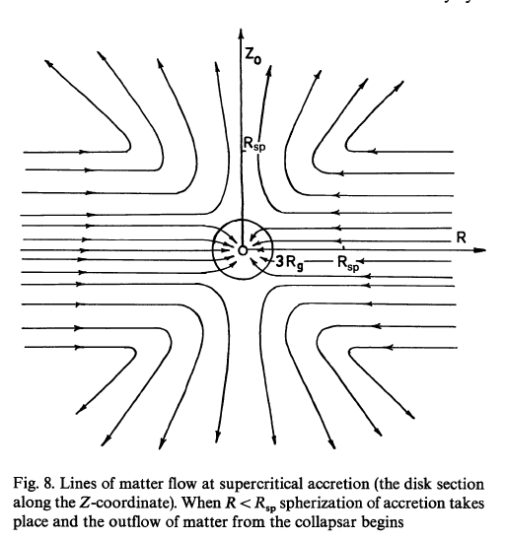
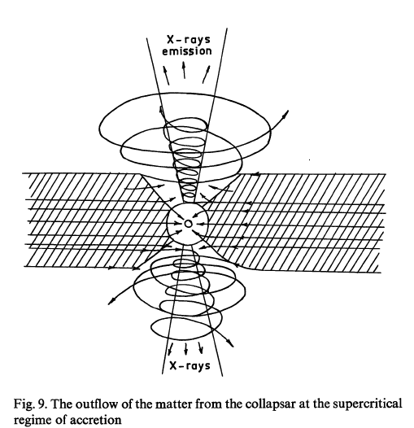
Super-Eddington accretion and disk winds
Shakura and Sunyaev (1973); King and Pounds (2003); King (2005)

Slide 8
Winds from Super-Eddington flows

Slide 9
How fast should the outflows be?
=L/L_{edd}=η(dM/dt)c²/L_{Edd}

Slide 10
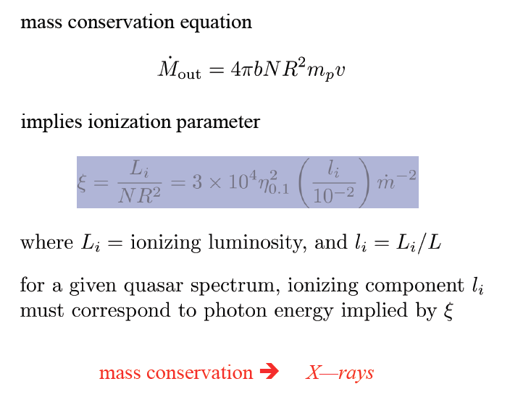
Ionization state of the gas

Slide 11
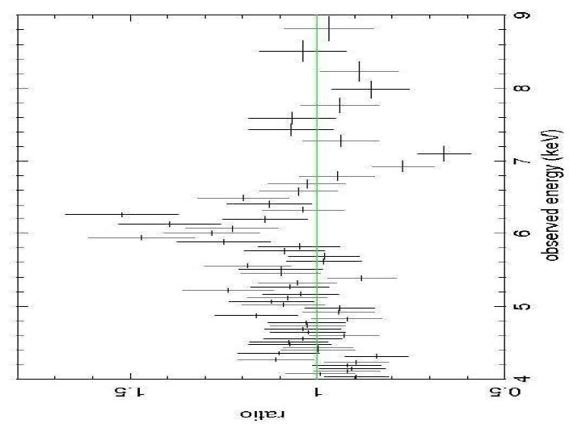
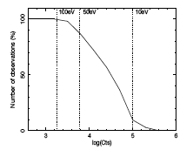
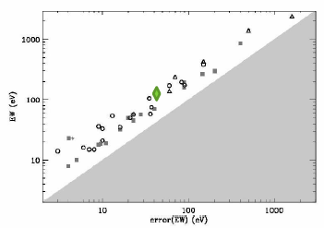
(Ultra-)Fast X-ray outflows
PG 1211+143; Pounds & Reeves 2009
L_{kin}~0.1 L_{bol} !
The physical implications are very appealing. However:
• Often only one line is detected: unsure identification, ionization/column density
• Region strongly influenced by: background subtraction, continuum modelling, lower effective area/resolution
Tombesi et al. 2010
Uttley & Vaughan 2008

Slide 12
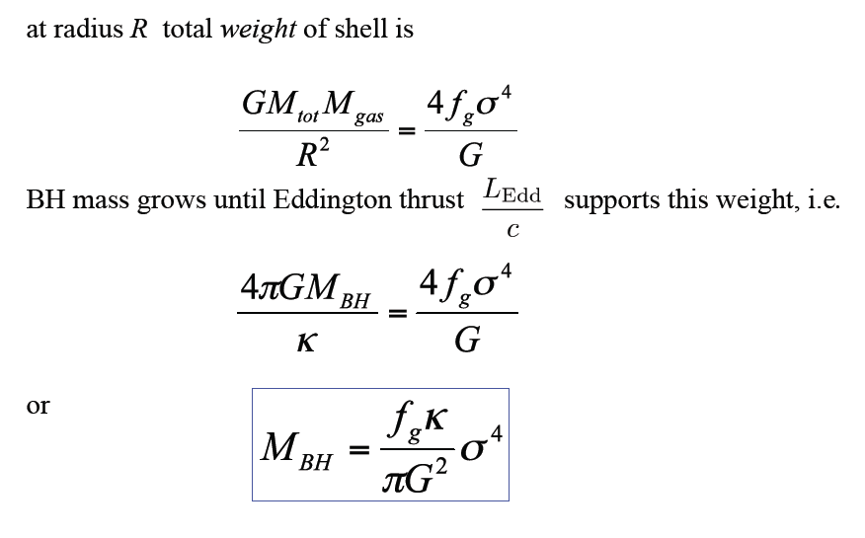
A simple model for QSO feedback (A. King)

Slide 13
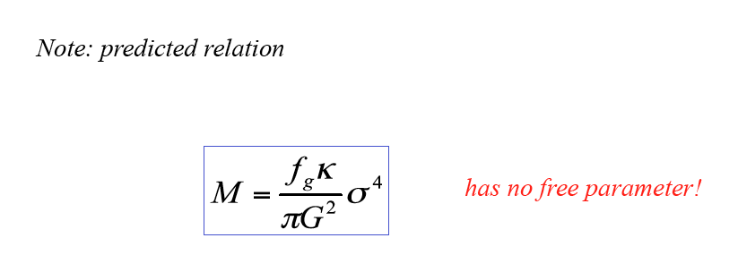
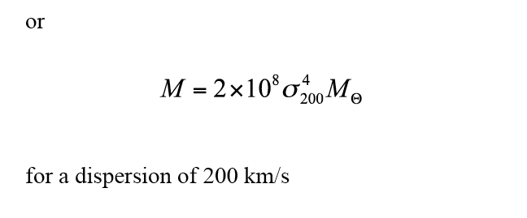
A simple model for QSO feedback (A. King)
See King (2005) for a more thorough calculation

Slide 14
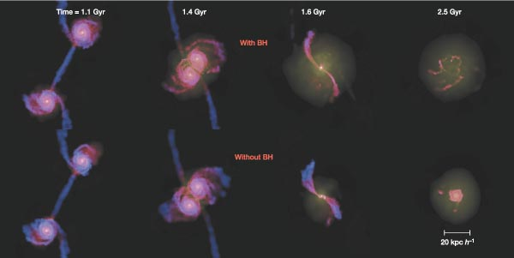
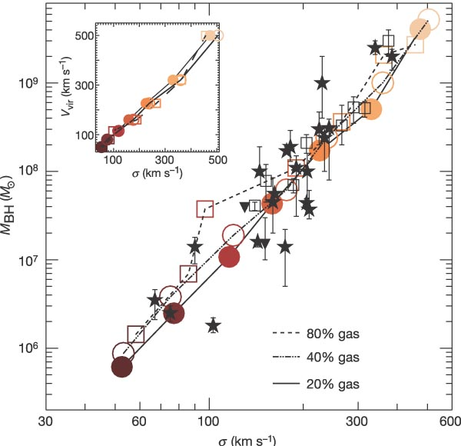
Numerical simulations of QSO feedback
Violent feedback from AGN quickly establishes M-sigma relation
Indeed NEED 0.5% of accreted energy
Di Matteo et al. 2005

Slide 15
Caveat!
To reproduce M-sigma relation need SMBH feedback to stop its own growth at the right time [BH self-regulate: see Hopkins et al. 2009]
Indeed NEED 0.5% of accreted energy

Slide 16
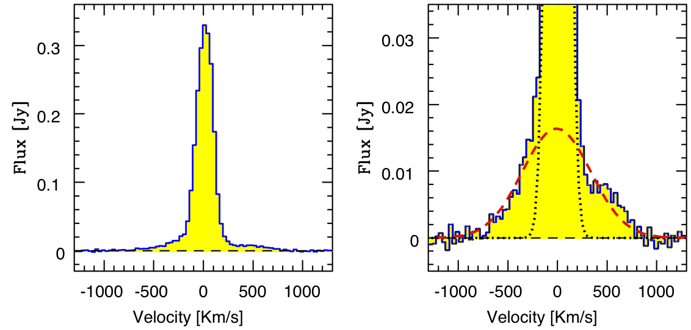
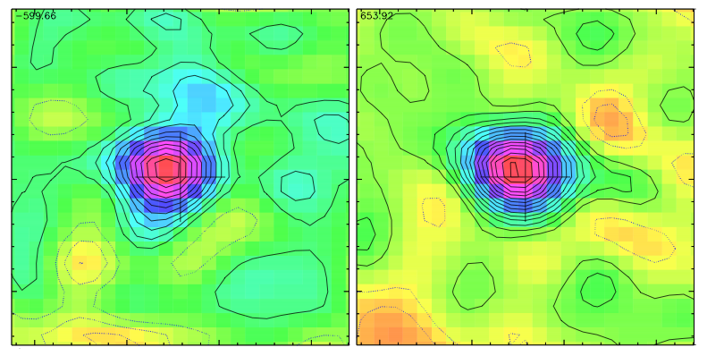
QSO feedback revealed in Mrk 231
(Feruglio et al. 2010)
IRAM-PdBI detection of broad CO(1-0)
CO(1-0)
CO(1-0)
Broad
CO(1-0) @115.2712 GHz
Narrow component +
low surface brightness broad component with wings extending out to +-800 km/s
(FWZI = 1500 km/s).
Wings are spatially resolved and extended on 1.2 kpc scales.
OUTFLOW RATE
dM(H₂)/dt = 700 M ⊙ /yr
SFR ~ 200M⊙ /yr
Kinetic energy of outflowing gas: E =1.2 10⁴⁴ erg/s =
~1% L_{Bol} (2 10⁴⁶ erg/s)
Map of Blue wing
Map of Red wing
expected for AGN radiation driven shock-wave
expanding in the ISM (Lapi+05)

Slide 17
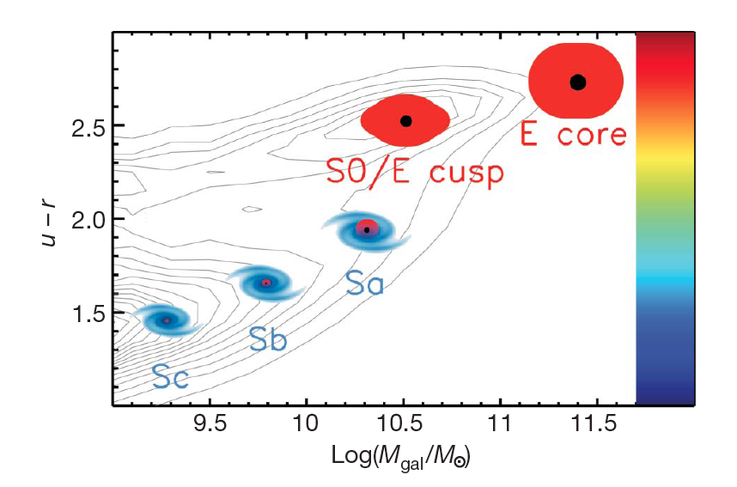
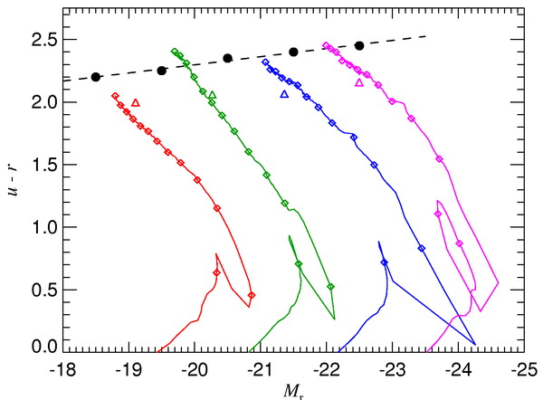
QSO feedback and galaxy bimodality
Cattaneo et al. 2009
Color-magnitude evolution of merging galaxies with QSO feedback
(Springel et al. 2005)

Slide 18
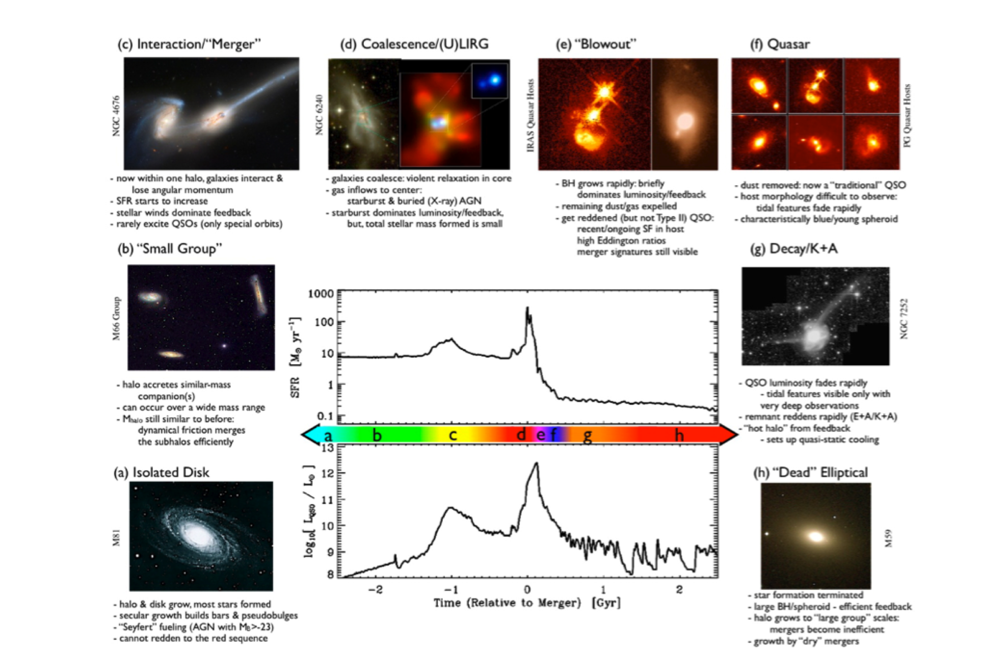
Is AGN activity triggered by galaxy-galaxy mergers?
P. Hopkins et al. (2006+)

Slide 19
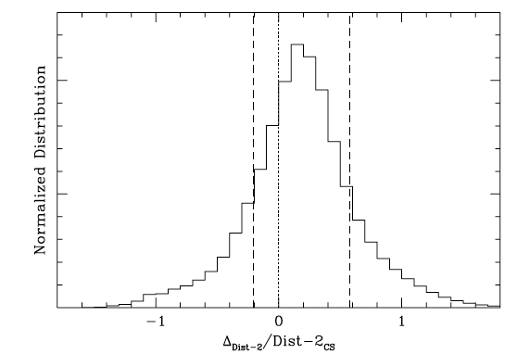
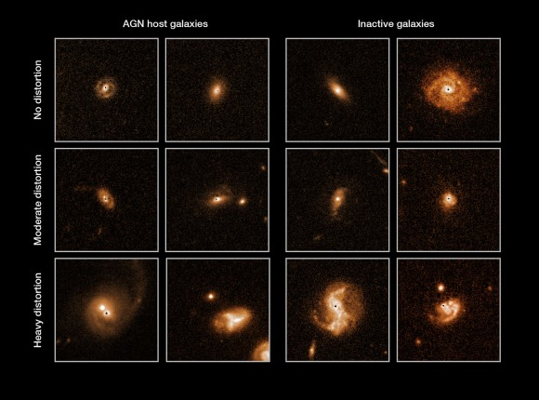
Is AGN activity triggered by galaxy-galaxy mergers?
Probably not. (at z<1)
The observed HST morphologies of AGN hosts are indistinguishable from those of a “inactive” galaxies sample
Cisternas et al. (2011)

Slide 20
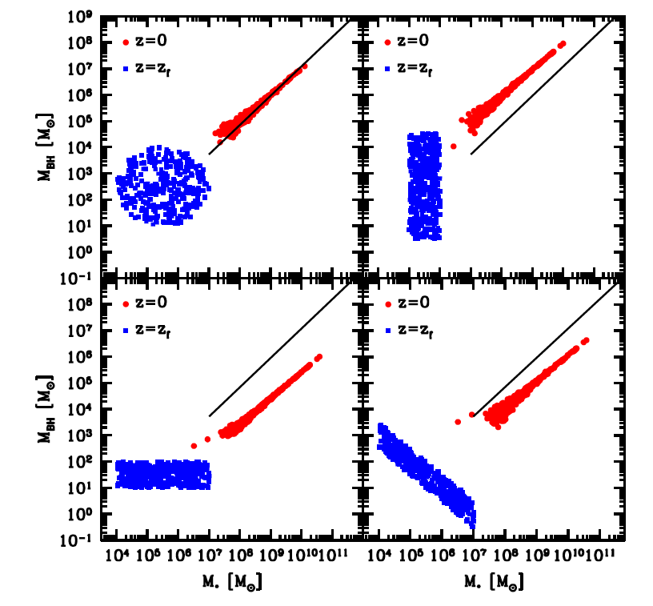
Caveat: Jahnke and Maccio’ 2011

Slide 21
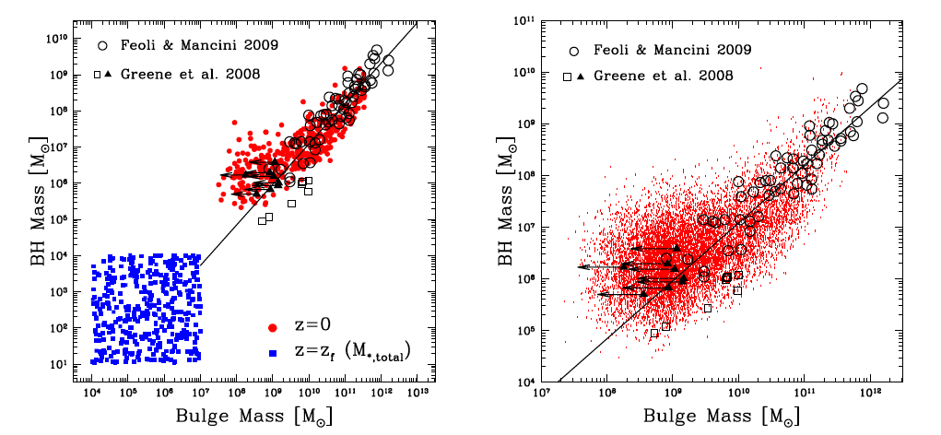
Caveat: Jahnke and Maccio’ 2011
M_{BH}-M_{galaxy} relation arise from the stochastic nature of the merging process, provided that there are enough mergers after the major mass build-up

Slide 22
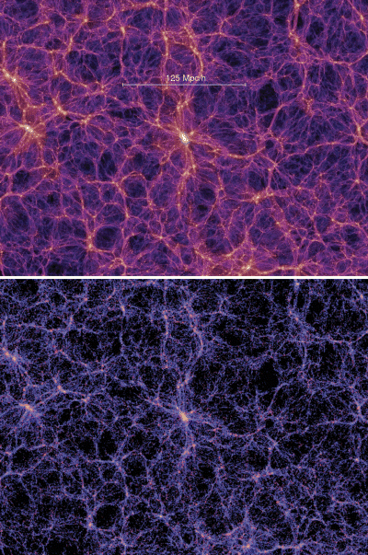
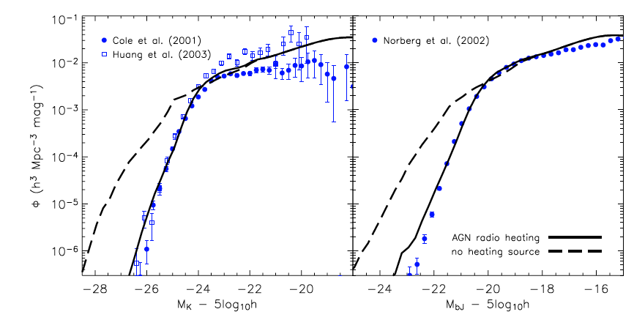
AGN feedback in clusters and groups
Main problem #1: Galaxy mass function
Croton et al. 2006

Slide 23
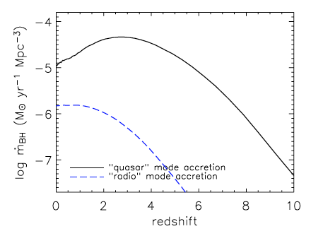
AGN feedback in clusters and groups
Main problem #1: Galaxy mass function
Croton et al. 2006

Slide 24
X-ray surface brightness of typical clusters of galaxies
Main problem #2: The Cooling flow problem

Slide 25
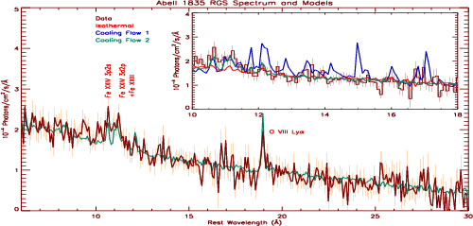
The cooling flow problem
Cooling gas is not observed!
High-res. X-ray spectrum of a cooling core cluster (Peterson et al. 2001)

Slide 26
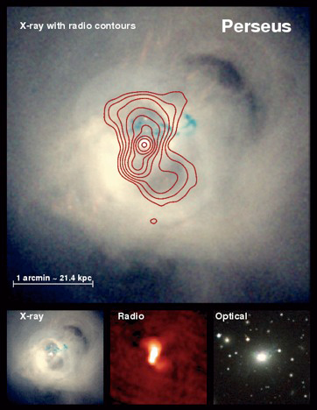
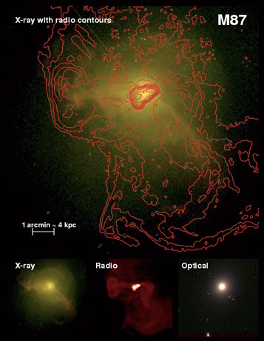
Low-luminosity AGN: jet-disc connection
Fabian, Forman

Slide 27
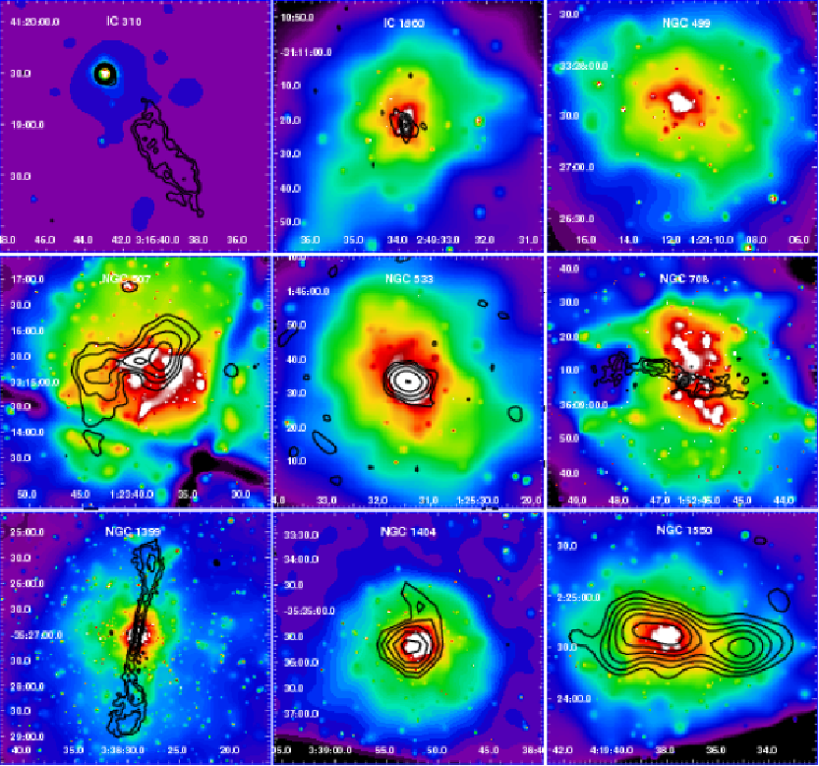
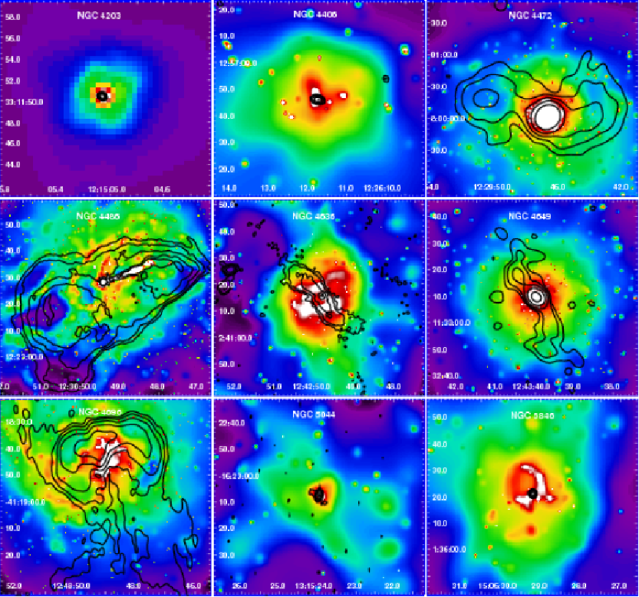
LL radio AGN: ubiquitous in cluster/group cores
A complete, X-ray selected sample of nearby, massive elliptical galaxies
Dunn et al. 2010

Slide 28
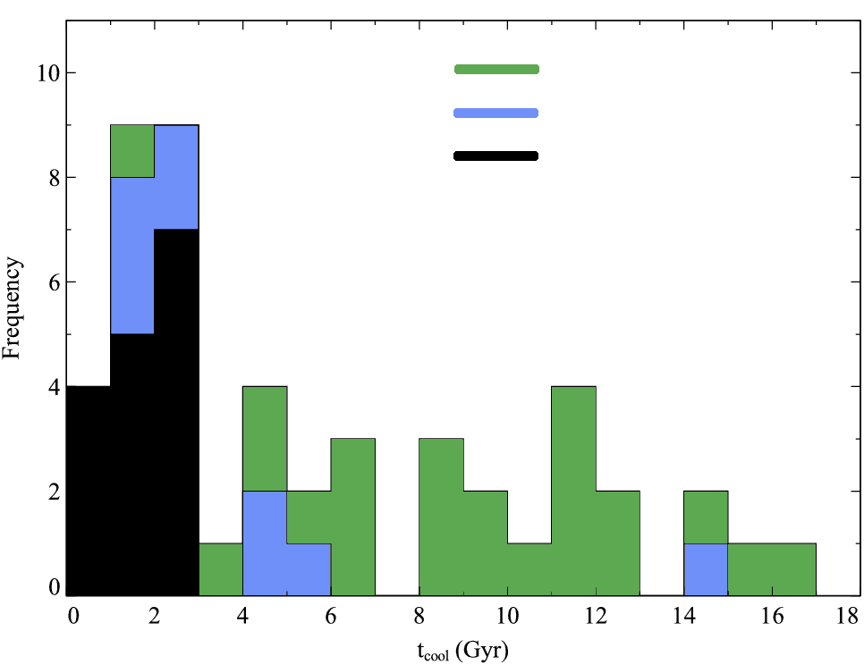
Duty cycle is ~100%
Dunn & Fabian (2006)
Brightest 55 clusters
No bubbles or radio
Central radio source
Clear bubbles
Number
of
clusters
Cooling time (Gyr)
See also Birzan+04, Rafferty+06+08, Dunn+F07

Slide 29
Issues
Total Energy not an issue.
How does energy get distributed?
How close is the heating/cooling balance?
Observations suggest better than 10% for many Gyr in some objects.
HOW DOES THE AGN DO THIS?
Moreover, (how) is coolest X-ray gas
(ie T<5.10⁶K with radiative cooling time ~10⁷yr) prevented from cooling?

Slide 30
A note on the physics of radio jets feedback
We can distinguish three phases
Supersonic (like a wind-blown bubble, Castor et al. 1975): R~(P_{jet} t³/ρ_{ICM})^{1/5}
Subsonic, pressure confined bubble: R~(P_{jet} t/P_{e})^{1/3}
Buoyant detachment of cavity (filled with relativistic particles)
1
2
3
Reynolds et al. 2001; Merloni and Heinz 2012

Slide 31
Estimating the kinetic power of jets
γ=4/3

Slide 32
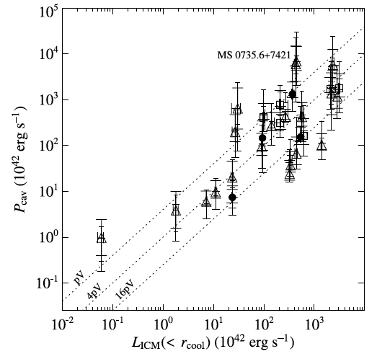
PdV work vs. cooling luminosity
Relatively tight balance between heating and cooling
High “efficiency” of AGN heating might require (for extreme objects) spin powering of Jets
(McNamara et al. 2011)
Rafferty+06

Slide 33
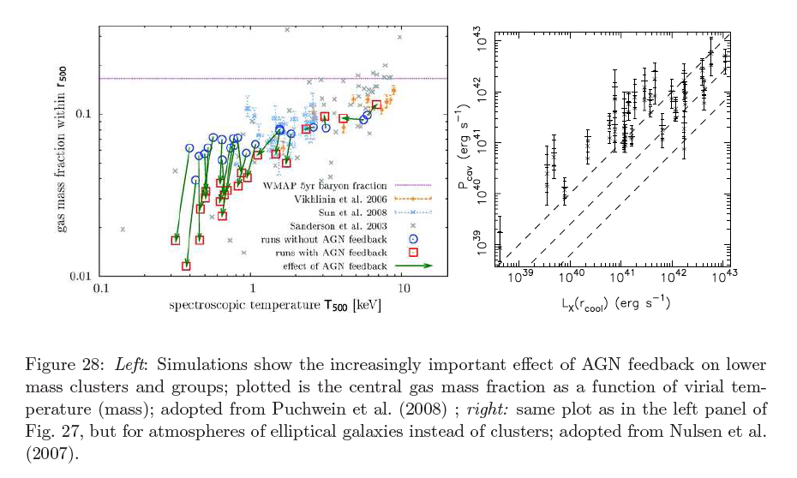
Feedback in groups and ellipticals
Kinetic powers lie mostly above the heating=cooling line

Slide 34
What is the right proxy for Jet power?
Measuring PdV work done by the jets in carving the bubbles in the Intra-Cluster Medium is very hard (need lots of X-ray photons)
It would be nice to have a cheaper way to estimate kinetic jet powers: can radio luminosity help?

Slide 35
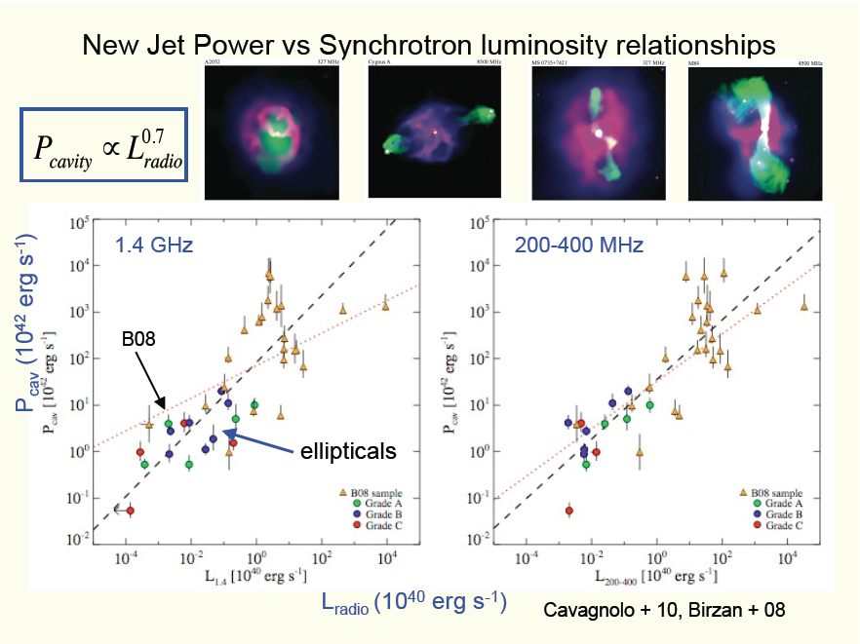
Extended Radio/L_{Kin} relation

Slide 36
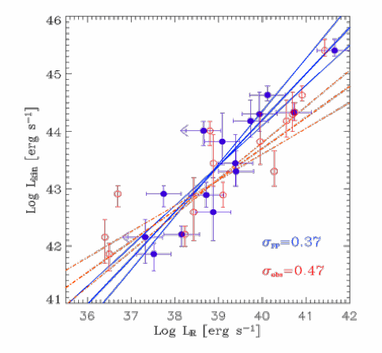
Core Radio/L_{Kin} relation
Log L_{kin}=0.81 Log L_{5GHz} +11.9
Observed L_{R} (beaming)
Derived from FP relation
Monte Carlo simulation:
Statistical estimates of
mean Lorentz Factor Γ~7
Merloni and Heinz (2007)

Slide 37
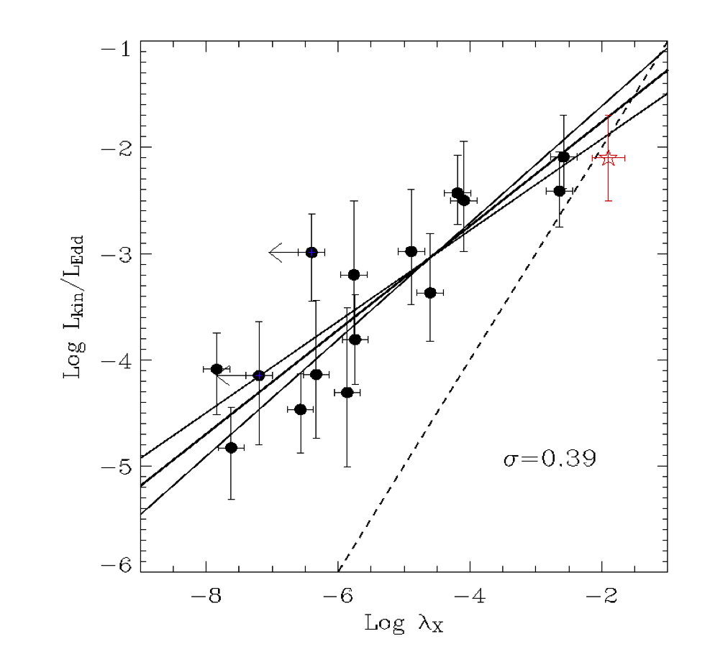
How do AGN work? Low Power ones are jet dominated
Kinetic power
dominates output
Radiative power
Dominates output
By studying the nuclear properties of the AGN we can establish a link between jet power and accretion power
The observed slope (0.49±0.045) is perfectly consistent with radiatively inefficient “jet dominated” models
L_{kin}/L_{edd}=0.16*(L_{bol}/L_{edd})^{0.49}
Jet kinetic power
Radiative (bolometric) power
Merloni et al. 2003
Merloni & Heinz 2007
Log
Notes:
As discussed at the beginning, phenomenological studies of joint evolution of BH and galaxies need to be supplemented by efforts towards a better understanding of how AGN work, namely of the way in which they are able to release energy in different forms.
The fundamental plane of active black holes was born from the attempt of testing the scale invariance hypothesis of black holes astrophysics. In this plot, I show one of the most important findings in this area: when comparing the jet mechanical power, either measured directly (red points), or inferred from the thoery of synchrotron jets (grey points), with the nuclear bolometric luminosity of AGN, a common characteristics of low power black holes, either of stellar mass, in XRB, or supermassive, to have their energy output dominated by the kinetic power of relativistic jets

Slide 38
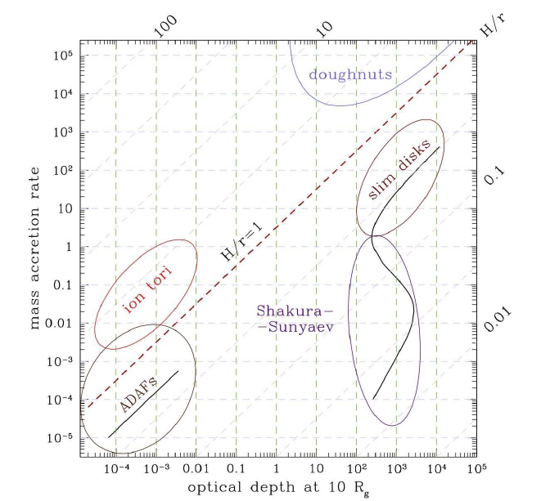
Accretion diagram

Slide 39
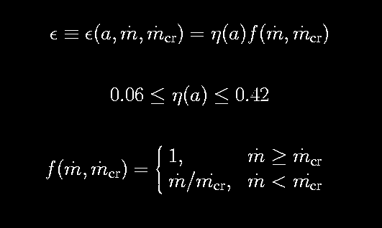
Radiative efficiency vs. accretion efficiency
radiative efficiency
accretion efficiency (BH spin)
In General Relativity, accretion efficiency is just a function of BH spin
^{Non Spinning BH}
^{Maximally Spinning BH}
Complications of accretion physics (gas MHD, viscosity etc.) enters here

Slide 40
Transient BHXRB: the current paradigm

Slide 41
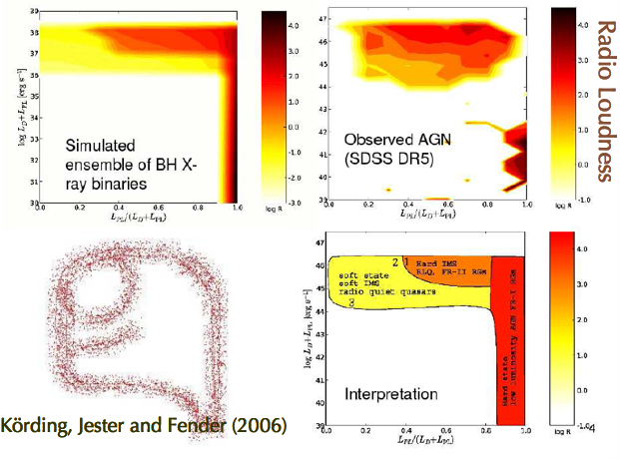
The AGN/XRB analogy: spectra

Slide 42
The scale invariance paradigm
Stellar mass Black holes and their supermassive counterparts share the same basic physical ingredients
The nature and conditions of the inner disc, where most of the accretion energy is released, are governed by only a few parameters (mass & accretion rate in primis)
Jet formation occurs in the innermost accretion disc region (see e.g. M87) and is also mainly governed by the same parameters
The structure and dynamics of the coupled disc-jet system is invariant under change of mass and/or Eddington scaled accretion rate (= L_{bol}/ L_{Edd}); unless a global accretion mode change takes place.

Slide 43
Properties of scale invariant jets [Heinz & Sunyaev 2003]
Any quantity f needed to calculate synchrotron emission from the jet can be decomposed
Normalization (set by boundary conditions at the jet base => accretion)
Structure function (set by jet geometry and structure)
Unknowns are: normalization of the magnetic field strength φ_{B}(M,dm/dt,a), jet cross section φ_{A}(M,d/mdt,a), normalization of the electron power-law distribution φ_{C}(M,dm/dt,a).

Slide 44
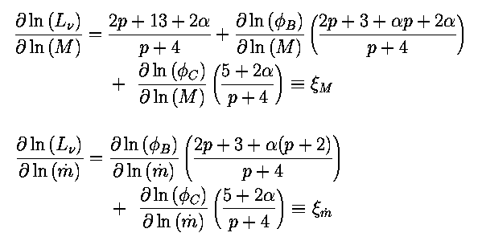
Properties of scale invariant jets [Heinz & Sunyaev 2003]
The radio luminosity at a given frequency, then scales with mass and accretion rate independently on the structure functions (), and therefore on the jet model
The scaling depends on the radio spectral index α = ∂ log L_{ν} / ∂ log ν , on the electron distribution power-law index p and on the normalization functions (φ), and therefore on accretion physics
Correlation coefficients (theoretical)

Slide 45
Properties of scale invariant jets
Measurements of the correlation coefficients  cannot be used to constrain the structure functions, and therefore to distinguish between different jet models
Measurements of the correlation coefficients  can be used to put constraints on the boundary conditions at the base of the jets, i.e. on accretion models

Slide 46
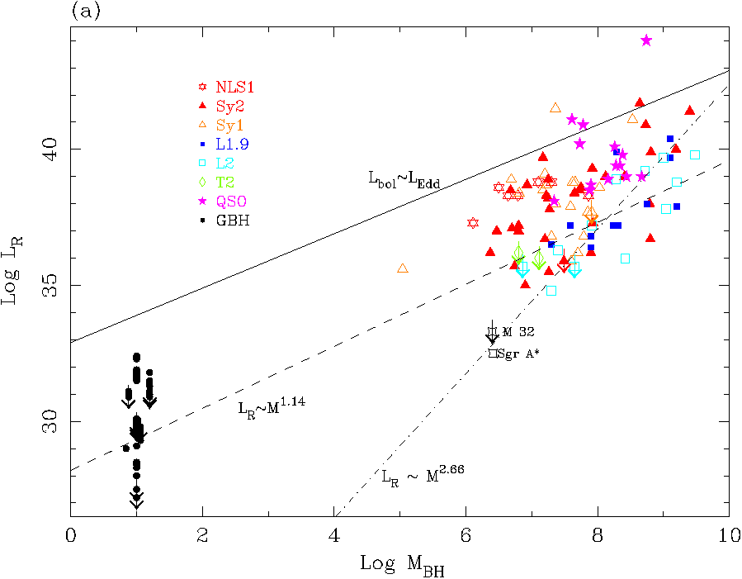
Core radio luminosity vs. BH mass
Nagar et al. (2002)
Franceschini, Vercellone & Fabian (1998)

Slide 47
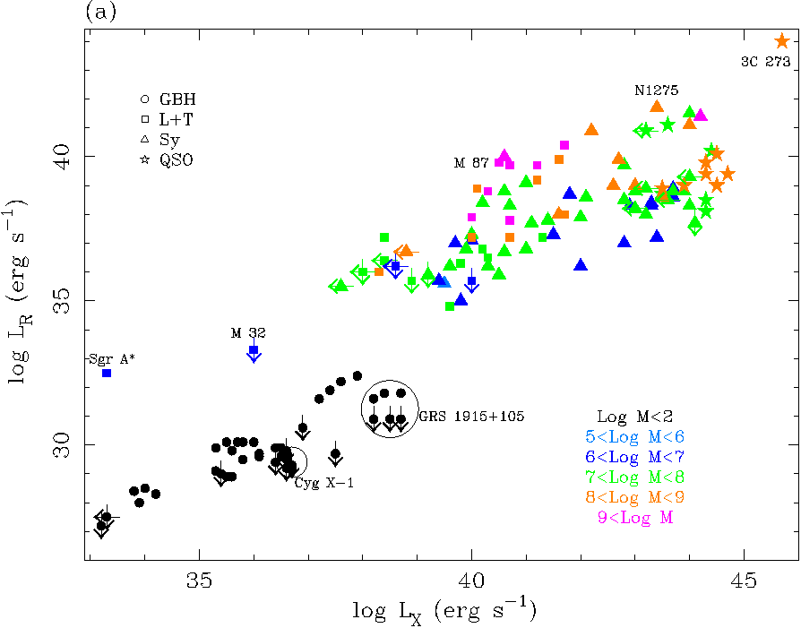
Core radio luminosity vs. X-ray luminosity

Slide 48
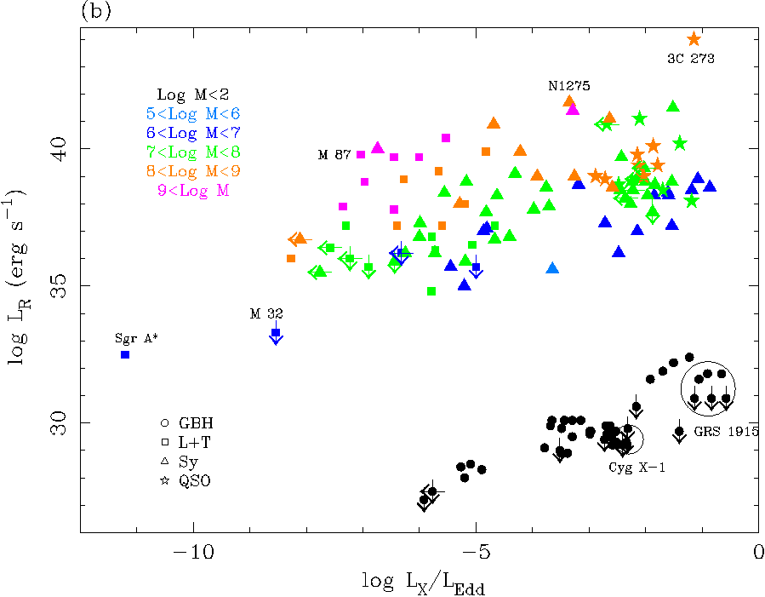
Core radio luminosity vs. Eddington ratio

Slide 49
A fundamental plane of black hole activity
Define the instantaneous state of activity of a black hole of mass M by its core radio luminosity at 5 GHz and by its X-ray luminosity in the 2-10 keV band;
Represent such an object as a point in the 3D space (log L_{R}, log L_{X}, log M)
Then all the points representing different black holes will lie preferentially on a plane (although with substantial scatter: σ_{R}=0.88 dex)
The equation that defines the plane is the following

Slide 50
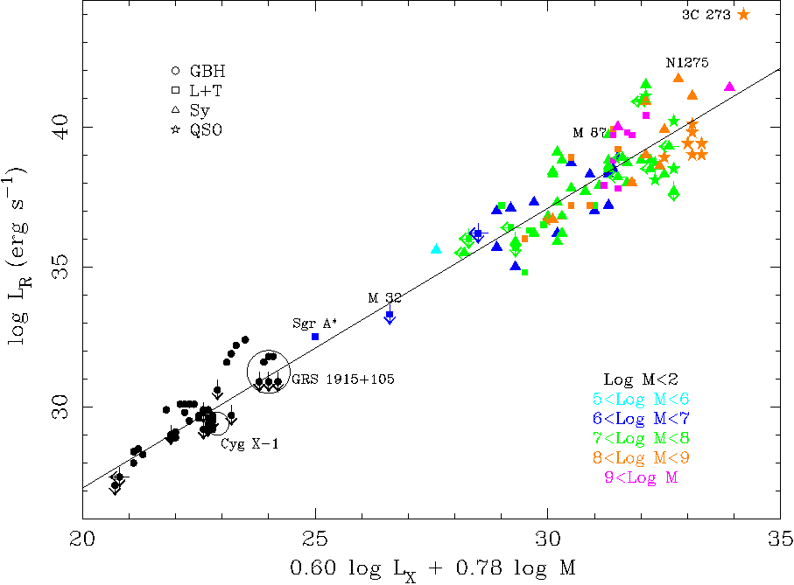
A “fundamental plane” of BH activity

Slide 51
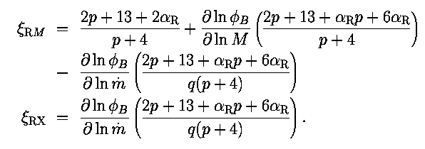
The relationship between observed correlation coefficents and theory: testing accretion modes
Need the link between the observed correlation coefficients (ξ_{RM}=0.78; ξ_{RX}=0.60) and the theoretical ones
Let us define:
Then, the properties of scale invariant jets imply:
q=2 => rad. inefficient
q=1 => rad. efficient
(We have assumed that the pressure of relativistic particles is a fixed fraction of the total pressure at injection

Slide 52
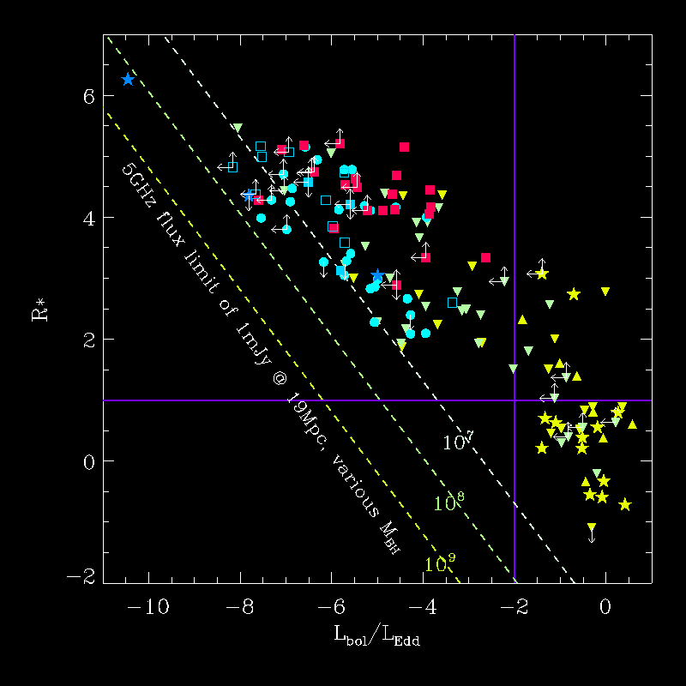
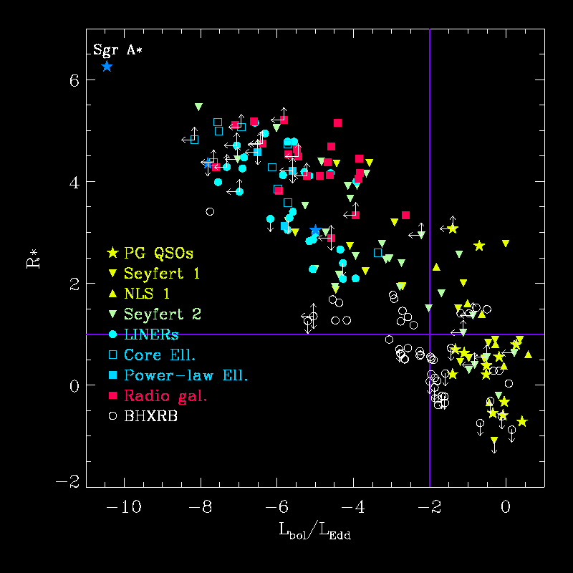
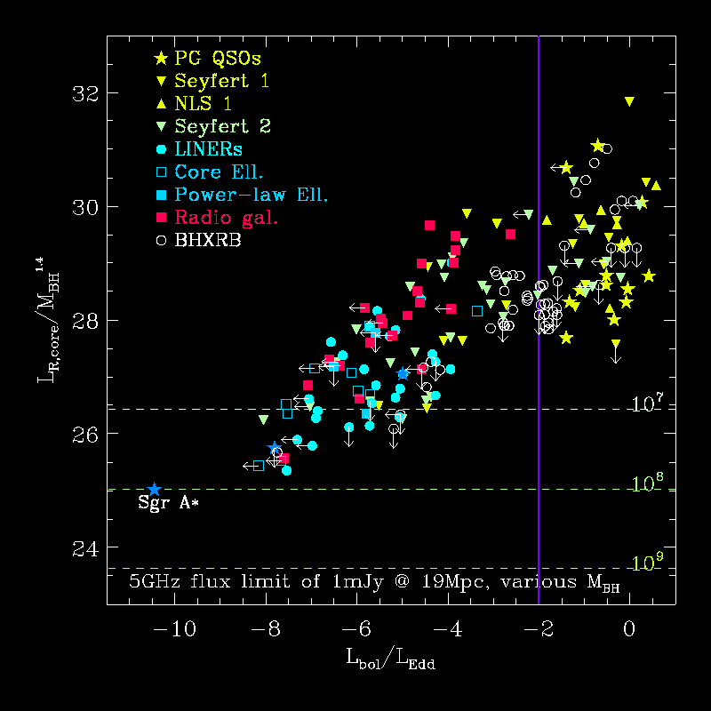
Radio cores scaling with M and mdot
A “fundamental plane” of active BHs
[Merloni et al. 2003; Falcke et al. 2004; Guterlkin et al. 2009]
See also Ho 2002; Greene, Ho and Ulvestad 2003
R*=(F_{R}/F_{bol})(ν_{max}/ν_{5GHz})
Log
Log
Log
Log

Slide 53
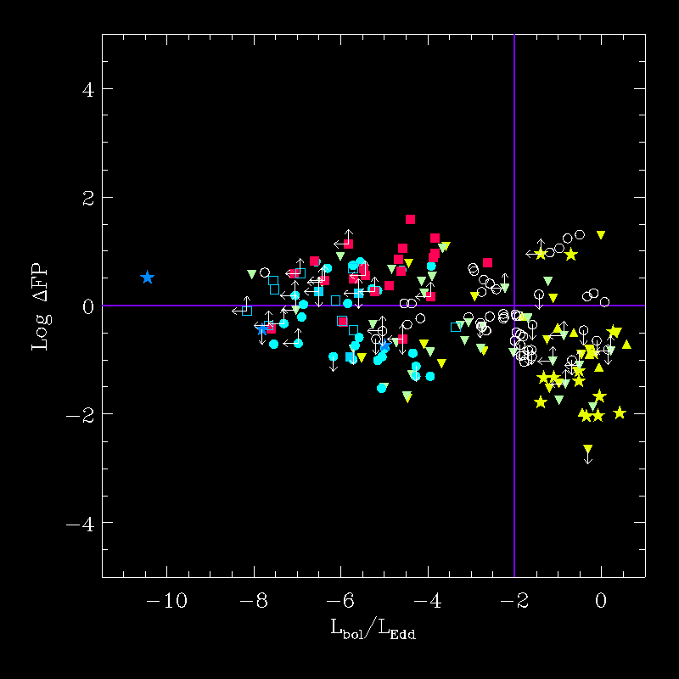
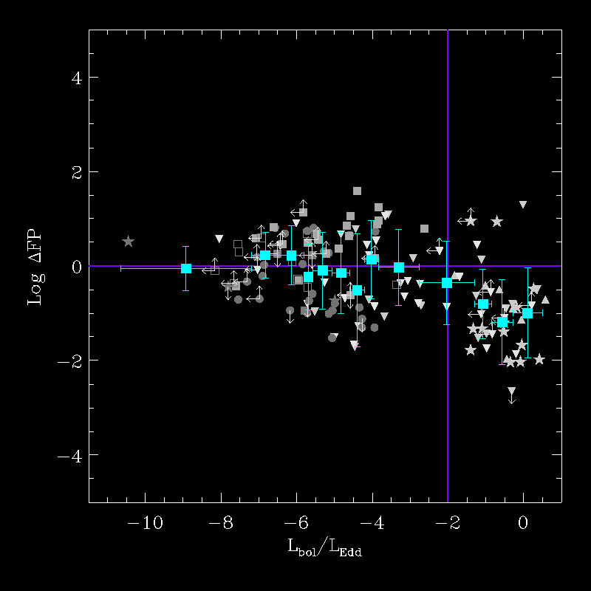
Using the FP to search for mode changes
RLQ,FRII
RQQ

Slide 54
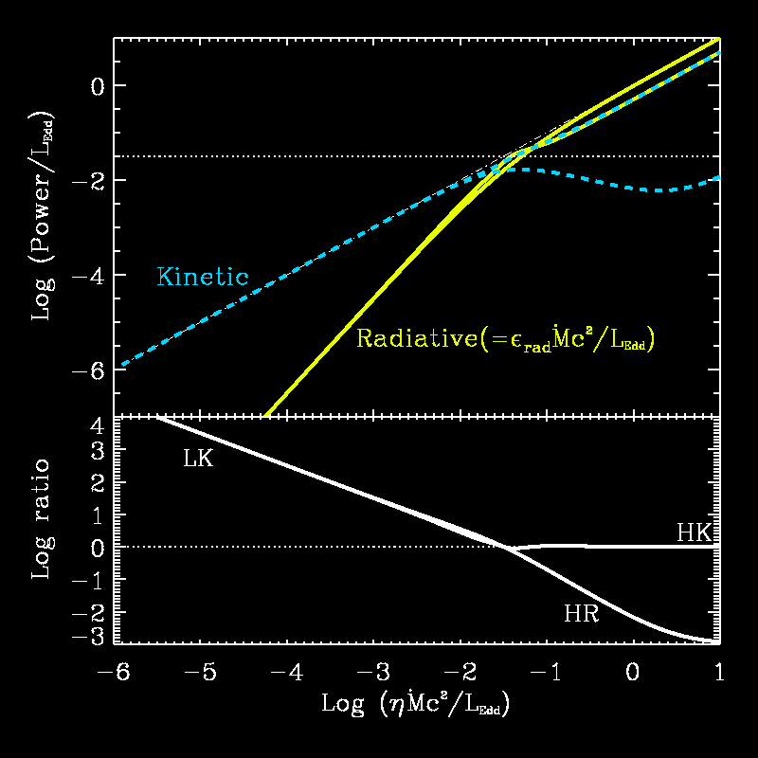
Accretion diagram for LMXB & AGN
Model parameter
LK (low-kinetic; LLAGN, FRI)
HK (high-kinetic; RLQ, FRII)
HR (high-radiative; RQQ)
(Blandford & Begelman 1999, Körding et al. 2007, Merloni and Heinz 2008)

Slide 55
Basic scaling laws for the Jet Kinetic power
LLAGN (L/L_{edd}<0.01); No BLR
L_{R} ∝ L_{X}^{0.6-0.7} M^{0.7-0.8}
L_{KIN} ∝ L_{R}^{0.7-0.8}
L_{KIN} /L_{EDD} ∝ L_{X}/L_{EDD}^{0.5}
Powerful Jets (L/L_{edd}>0.01)
L_{KIN,JEt} ~ L_{bol}

Slide 56
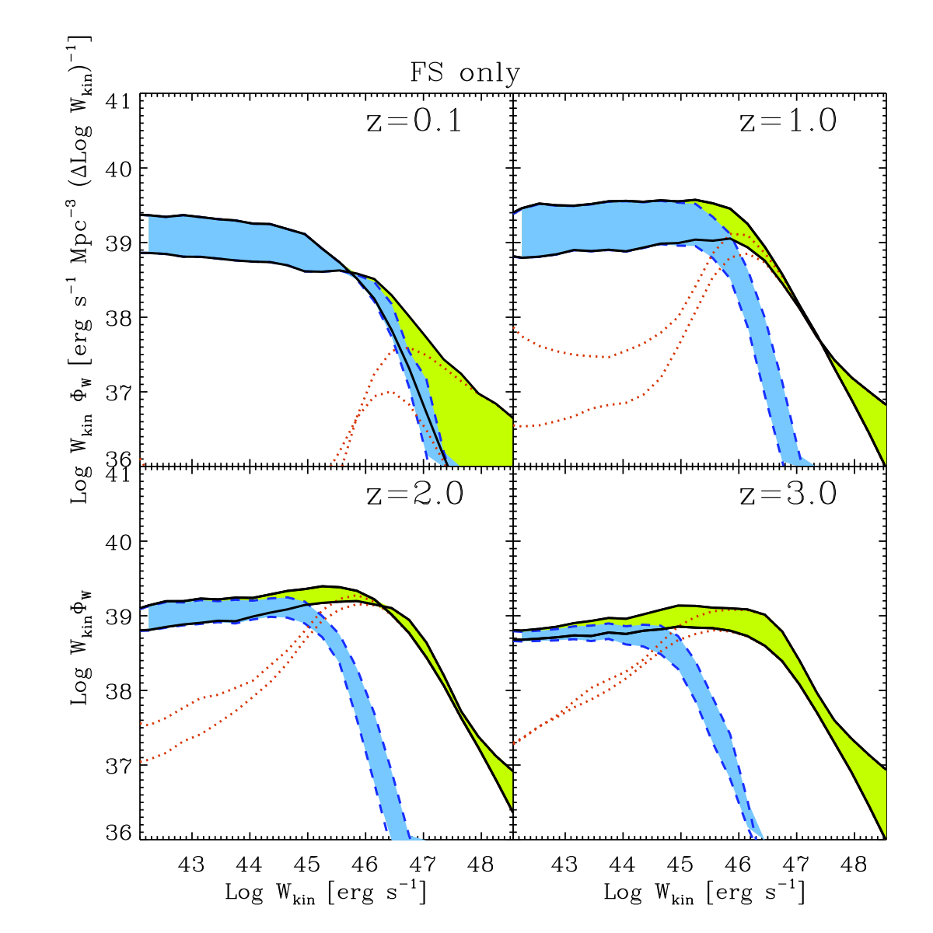
The “kinetic” luminosity function of radio AGN
Low power jets (FRI) dominate at low redshift
Powerful jets (FRII) dominate at high redshift
Merloni & Heinz 2008

Slide 57
SMBH growth: weighting modes
Kinetic to radiative
energy density ratio
Log L_{kin}= 45.2 x 0.81 Log (P_{1.4,core} /10²⁵)
(Merloni & Heinz 2007)
Log L_{kin}= 44.6 x 0.7 Log (P_{1.4} /10²⁵)
(Cavagnolo 2010, “cavity power”)
Heinz, Merloni and Schwaab (2007); Körding, Jester and Fender (2007); Cattaneo and Best (2009)

Slide 58
SMBH growth: weighting modes
Kinetic to radiative
energy density ratio
log L_{kin}= 45.2 x 0.8 log (P_{1.4,core} /10²⁵)
log L_{kin}= 44.6 x 0.7 log (P_{1.4} /10²⁵)
Heinz, Merloni and Schwaab (2007); Körding, Jester and Fender (2007); Cattaneo and Best (2009)
Energy efficiency of winds in ~Eddington accretion
Kurosawa et al. 2009
L/L_{Edd}

Slide 59
Useful references (3)
Fabian: “Black Holes at work”, Astronomy & Geophysics, 50, 3.18, 2009
Cattaneo et al.: “The role of black holes in galaxy formation and evolution”, Nature, 460, 213, 2009
Croton et al.: “The many lives of active galactic nuclei: cooling flows, black holes and the luminoisities and colors of galaxies”, MNRAS, 365, 11, 2006
Done: “Observational characteristics of accretion onto black holes”, XXI Canary Islands Winter School of Astrophysics. Ed. T Shahbaz, CUP, Cambridge, 2010. arXiv:1008.2287
Maccarone, Fender, Ho (editors): “From X-ray binaries to Quasars: black holes on all mass scales”, Springer, Dordrecht, 2005
Merloni, Heinz, Di Matteo: “A fundamental plane of accreting black holes”, MNRAS, 345, 1057, 2003
McNamara & Nulsen: “Mechanical feedback from active galactic nuclei in galaxies, groups and clusters”, NJPh, 14e5023M, 2012

