Slide 1
Formation and cosmic evolution of massive black holes
Andrea Merloni
MPE, Garching
PhD School, Bologna, 04/2013

Slide 2
Syllabus
Monday:
Observational evidence of Supermassive Black Holes
AGN surveys
Tuesday:
The evolution of SMBH mass function and spin distributions
The first black holes
Thursday:
The fundamental plane of active black holes
Accretion in a cosmological context: AGN feedback models
Friday:
AGN-galaxy co-evolution: theoretical issues and observational evidences
Shedding light onto AGN/galaxy evolution issues with next-generation of multi-wavelength facilities

Slide 3
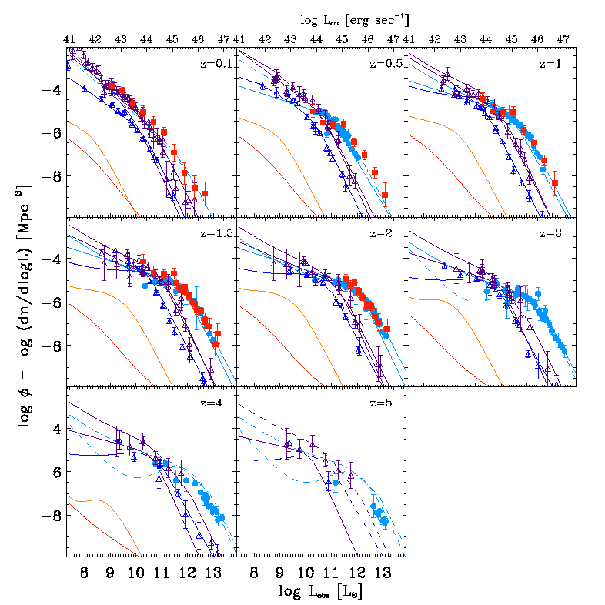
Panchromatic Luminosity Functions
B-band QSOs
IR-selected AGN
0.5-2 keV AGN
2-10 keV AGN
Steep Spectrum radio AGN
Flat Spectrum radio AGN
Hopkins et al. (2007)

Slide 4
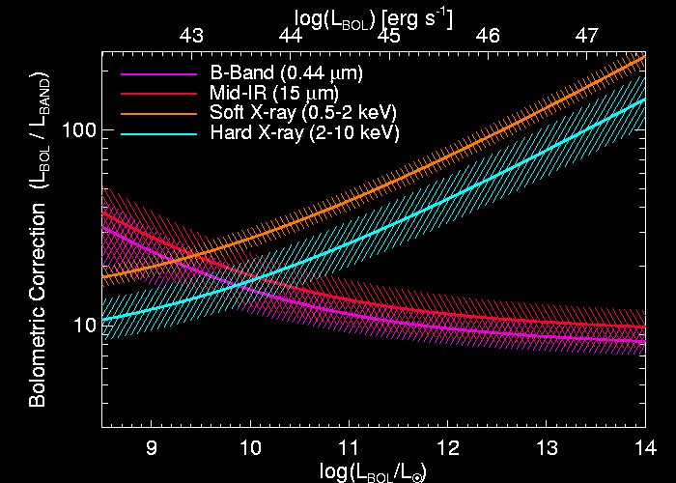
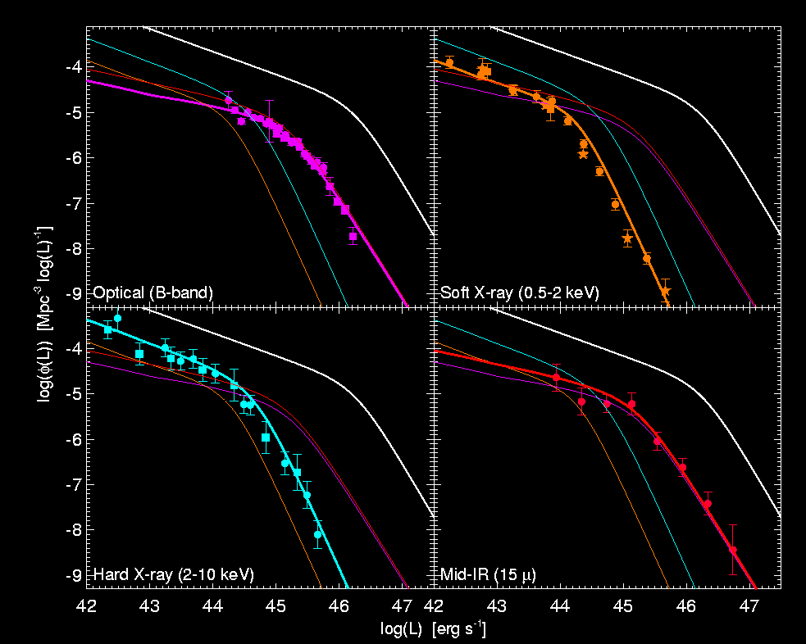
Bolometric corrections robustness
Crucial: varying X-ray bolometric
correction with luminosity (Marconi et al 2004)
Hopkins et al 2007
Radiative efficiency
Accretion rate
BH growth rate

Slide 5
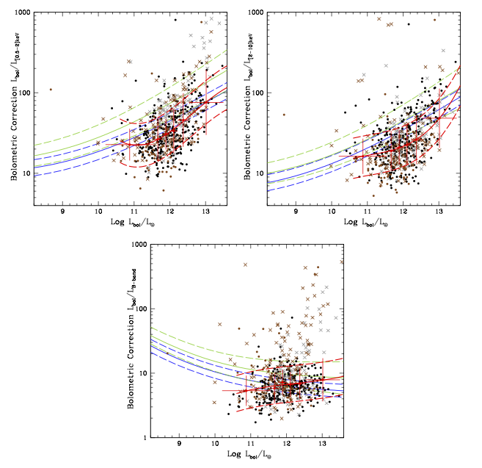
Observed bolometric corrections
X-ray selected AGN in COSMOS survey
Lusso et al. 2012

Slide 6
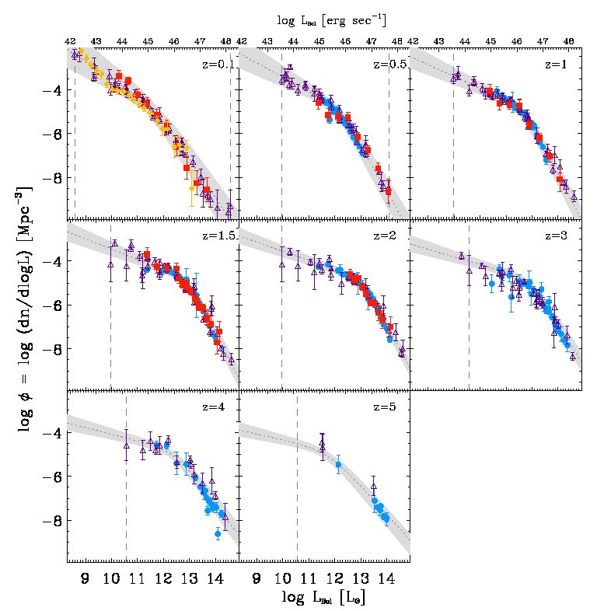
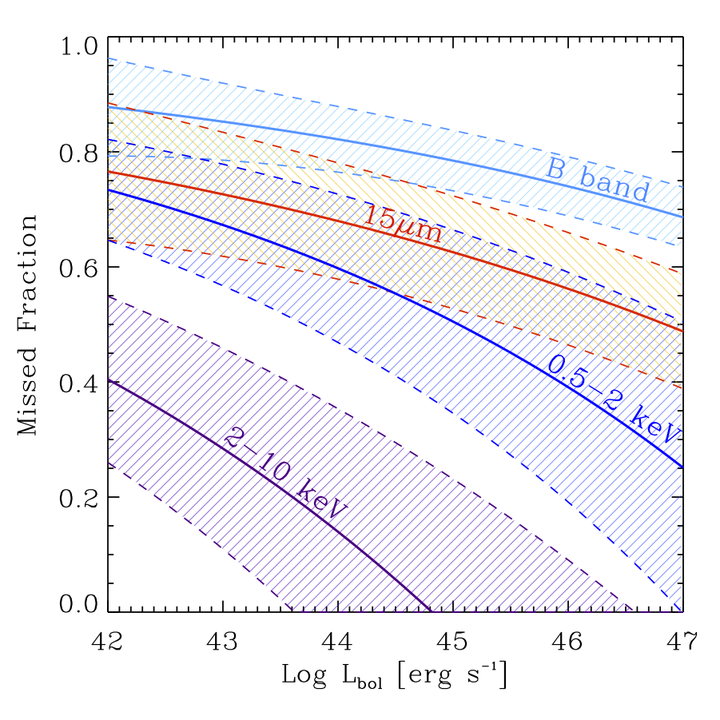
Panchromatic Luminosity Functions
Hard X-rays provide by far the most
complete census of AGN activity
See Hopkins et al. (2007);
Marconi et al. (2004)

Slide 7
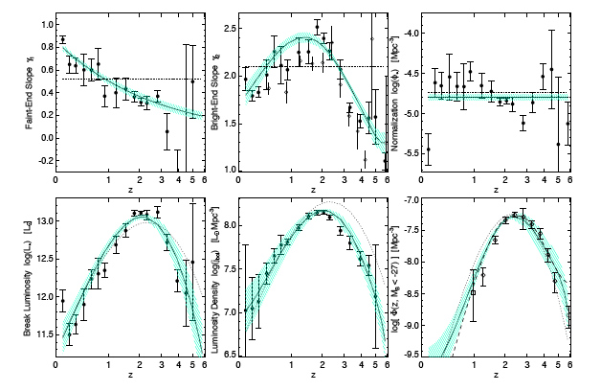
Panchromatic Luminosity Functions
“Downsizing”
Hopkins et al. (2007)

Slide 8
AGN as accreting BH: the Soltan argument
Soltan (1982) first proposed that the mass in black holes today is simply related to the AGN population integrated over luminosity and redshift
Fabian and Iwasawa (1999) ε~0.1; Elvis, Risaliti and Zamorani (2002) ε >0.15;
Yu and Tremaine (2002) ε>0.1; Marconi et al. (2004) 0.16> ε >0.04;
Merloni, Rudnick, Di Matteo (2004) 0.12> ε >0.04; Shankar et al. (2007) ε ~0.07

Slide 9
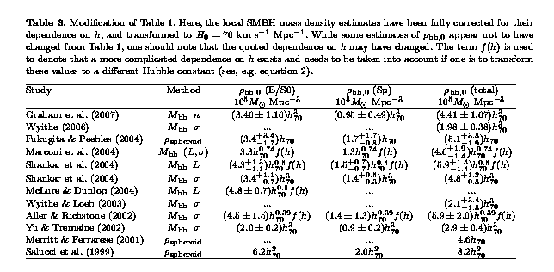
Convergence in local mass density estimates






Graham and Driver (2007)

Slide 10
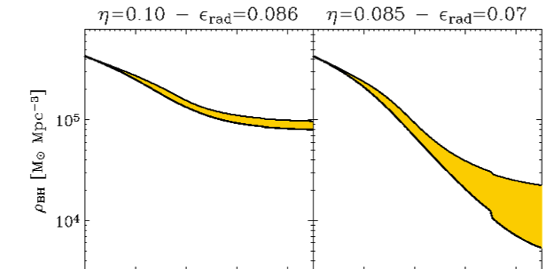
Constraints on radiative efficiency ⟨ε_{rad}⟩
ξ₀=ρ_{BH,0}/(4.2x10⁵)
ξ_{i}=ρ_{BH}(z=z_{i})/ρ_{BH,0}
(Input from seed BH formation
models needed!)
1
2
3
4
1
2
3
4
redshift
ξ_{CT}=ρ_{BH,CT}/ρ_{BH,0}
(Fractional Mass density of SMBH grown in a Compton Thick, heavily obscured phase)
ξ_{lost}=ρ_{BH,lost}/ρ_{BH,0}
(Mass density of SMBH ejected from galactic nuclei due to GW recoil after mergers)
⟨ε_{rad}⟩ ≈ 0.07/[ξ₀ (1-ξ_{CT}-ξ_{i} +ξ_{lost})]
Merloni and Heinz 2008

Slide 11
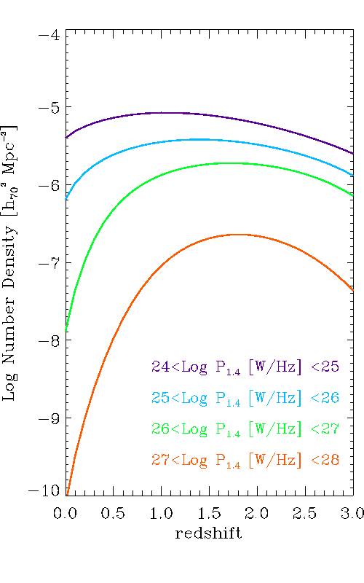
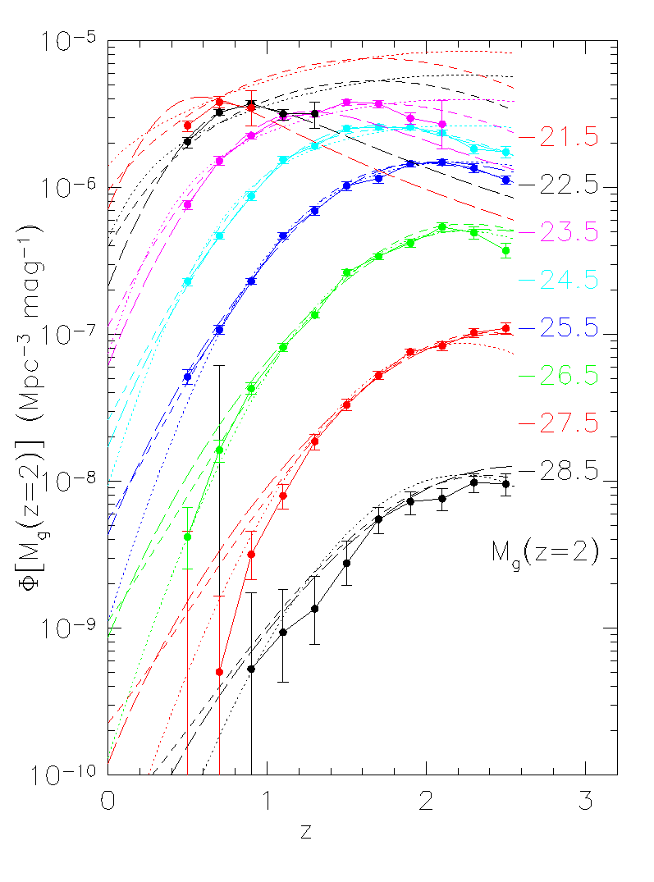
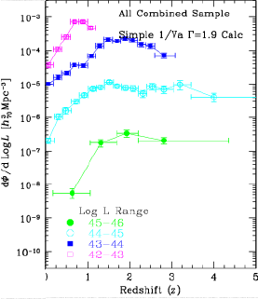
AGN downsizing: multicolor view
Radio (1.4 GHz)
from Massardi et al. 2010
X-rays (2-10 keV)
Miyaji et al. in prep.
Optical (g-band) 2DF-SDSS
Croom et al. (2009)
Qualitatively similar evolution (“downsizing”)
Brightest objects at z<1 and z>3 still very uncertain (Area is KEY)

Slide 12
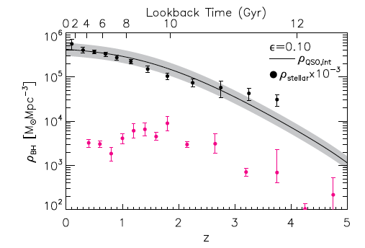
Mass density of active SMBH
Optically selected, broad line QSOs (SDSS DR7).
SMBH mass is estimated using the “virial” method (see Lesson 1).
Q: How can we get an estimate of the TOTAL SMBH mass function?
Shen and Kelly 2012

Slide 13
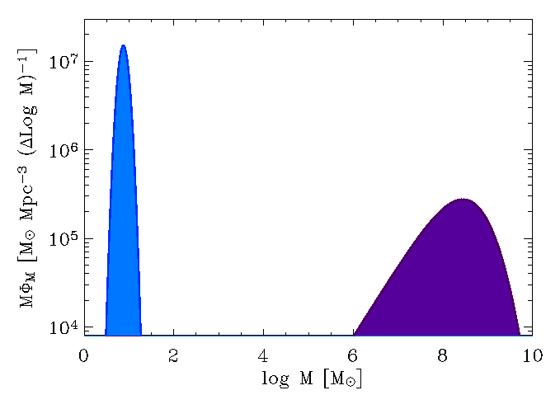
Understanding the mass function evolution
BH mass can only increase*
As opposed to galaxies, BHs do not transform into something else as they grow**
BHs are like teenagers: they let us know very clearly when they grow up (AGN)
*Kicked BH after mergers can introduce a loss term in the continuity equation
**Merging BH alter the Mass function

Slide 14
Continuity equation for SMBH growth
Need to know simultaneously mass function Ψ(M,t₀)
and accretion rate distribution F(dM/dt,M,t) [“Fueling function”]
Cavaliere et al. (1973); Small & Blandford (1992); Merloni+ (2004; 2008; 2010)

Slide 15
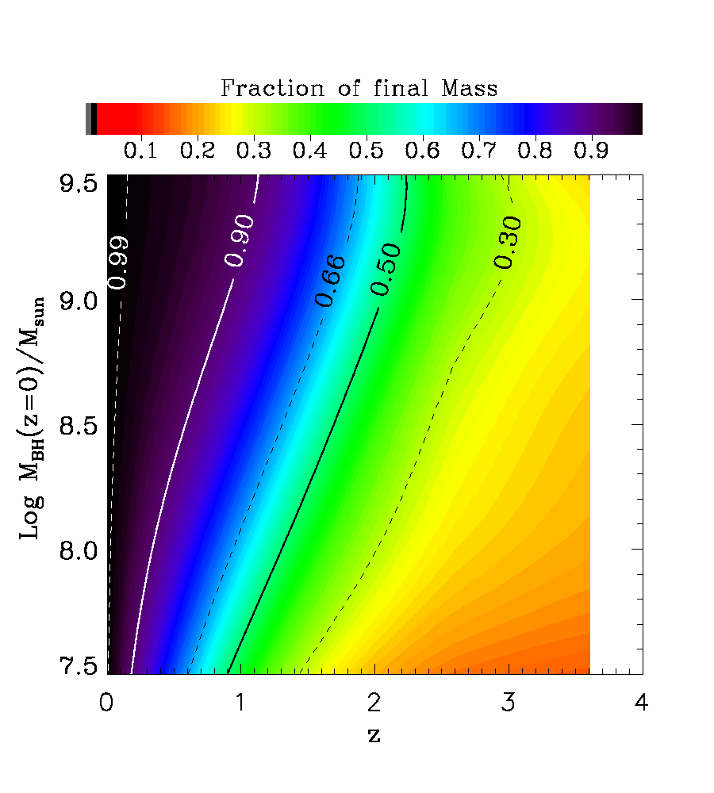
Fractional Mass evolution: Downsizing
Merloni+ 2010; Lamastra et al. 2010

Slide 16
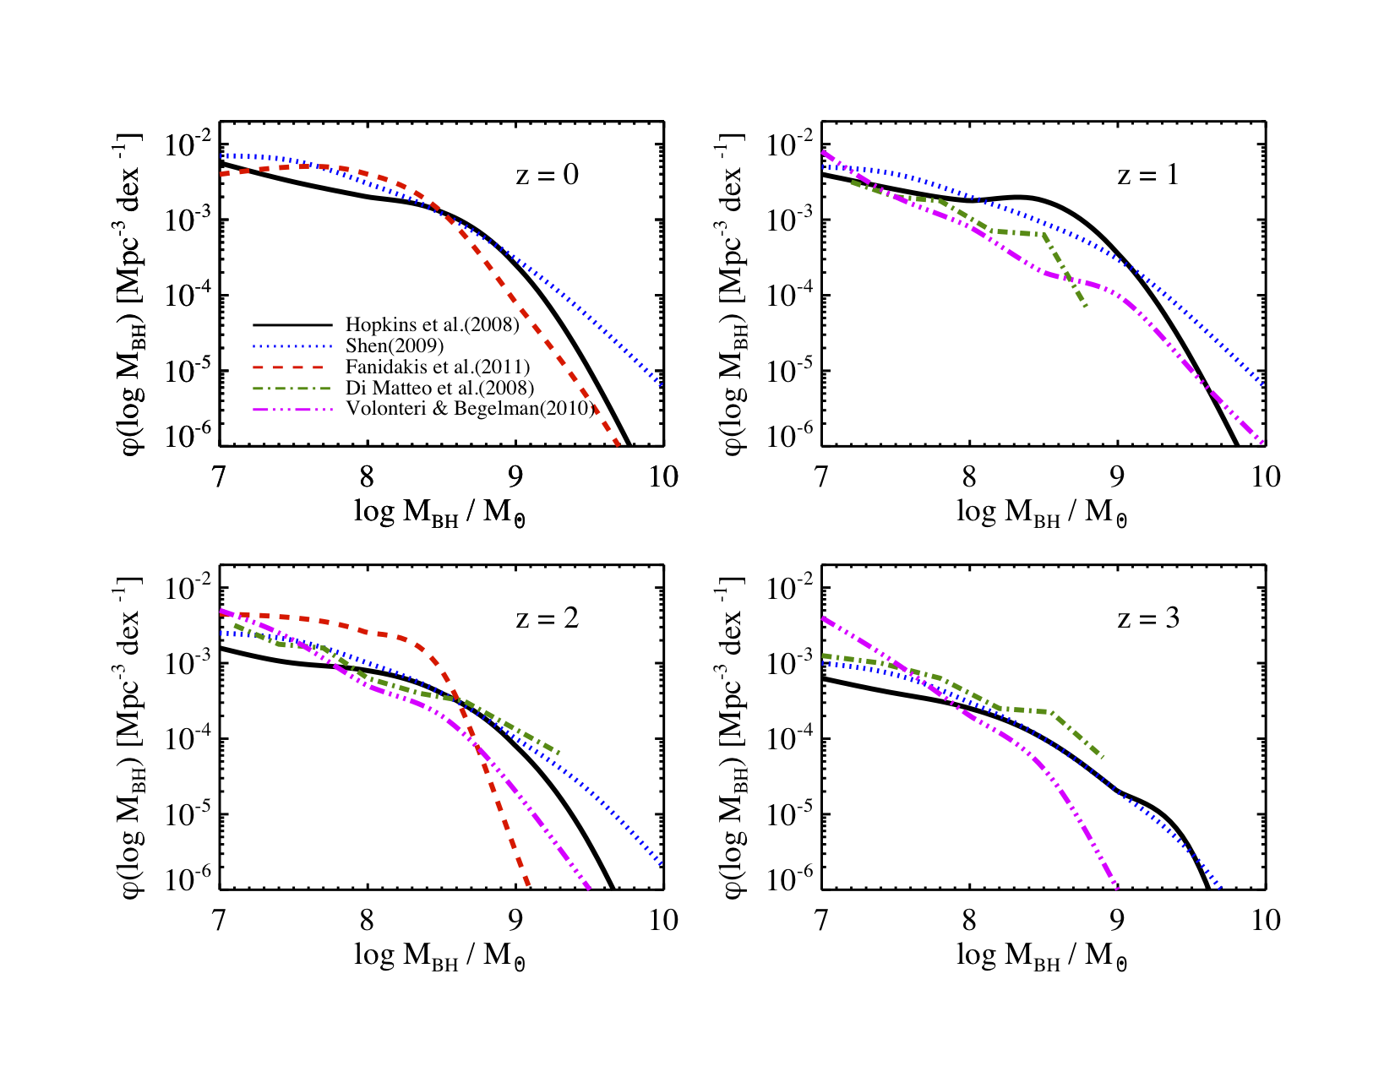
Mass function evolution: models
Kelly & Merloni 2012

Slide 17
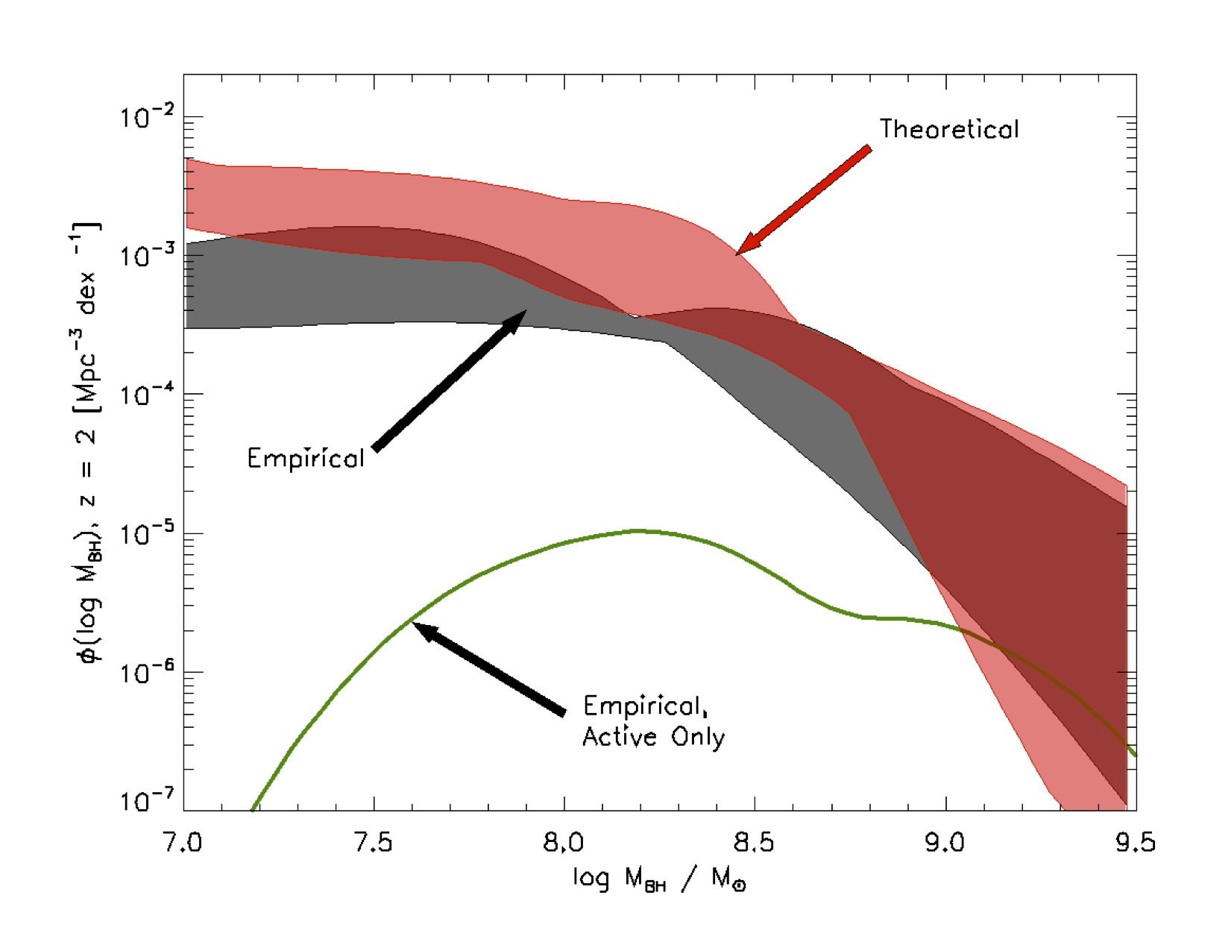
Mass functions of SMBH
z=0
z=2
Kelly and Merloni 2012

Slide 18
So far, I have assumed that the average radiative efficiency is constant (does not depend on mass, redshift, etc.), and tried to infer the distribution of accretion rates
What if we assume a shape for the accretion rate distribution?

Slide 19
Continuity equation for SMBH growth II.

Slide 20
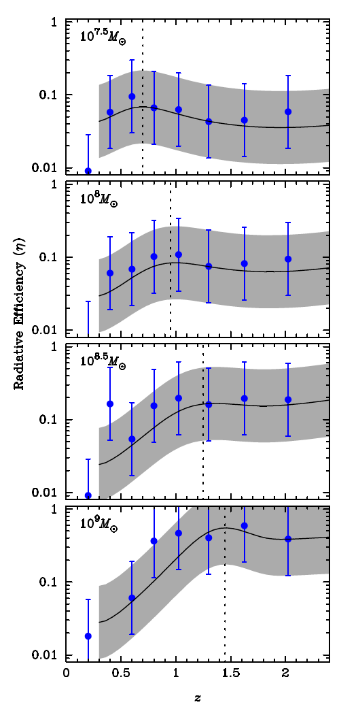
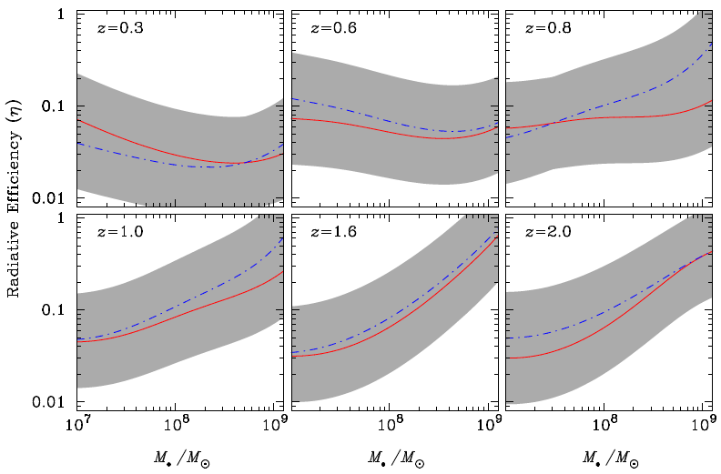
Constraints on variations of radiative efficiency
Li et al. 2011

Slide 21
Excursus: mergers
Credit: NASA, ESA, and F. Summers (STScI)
Simulation Data: Chris Mihos (Case Western Reserve University) and Lars Hernquist (Harvard University)

Slide 22
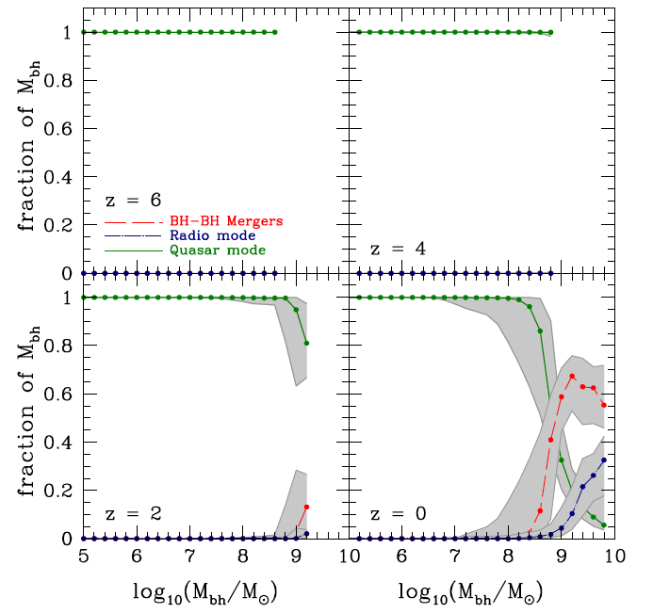
The effect of Mergers
Fanidakis et al. 2011

Slide 23
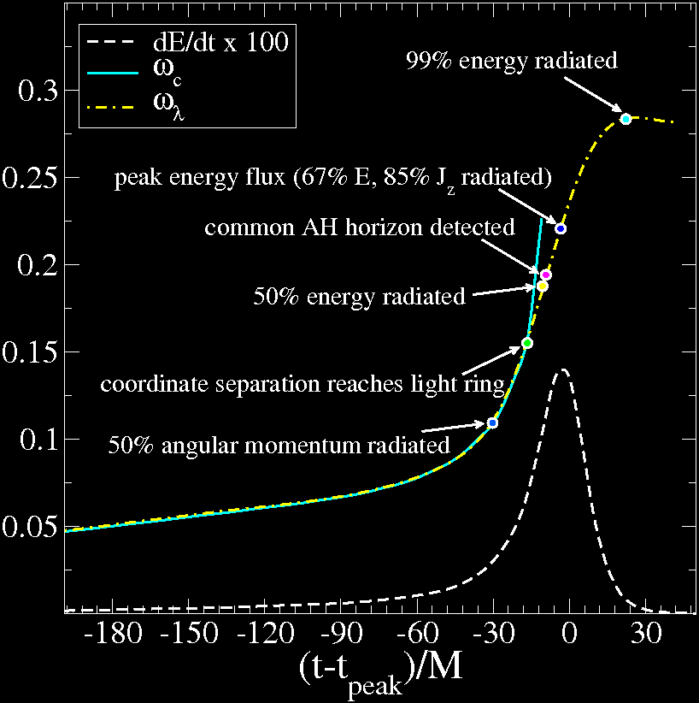
Excursus: SMBH mergers and spin evolution
Recently, great progress in the general relativistic simulations of coalescing Black Holes (Pretorius 2007)
Boyle et al. 2007
(Pretorius 2007)

Slide 24
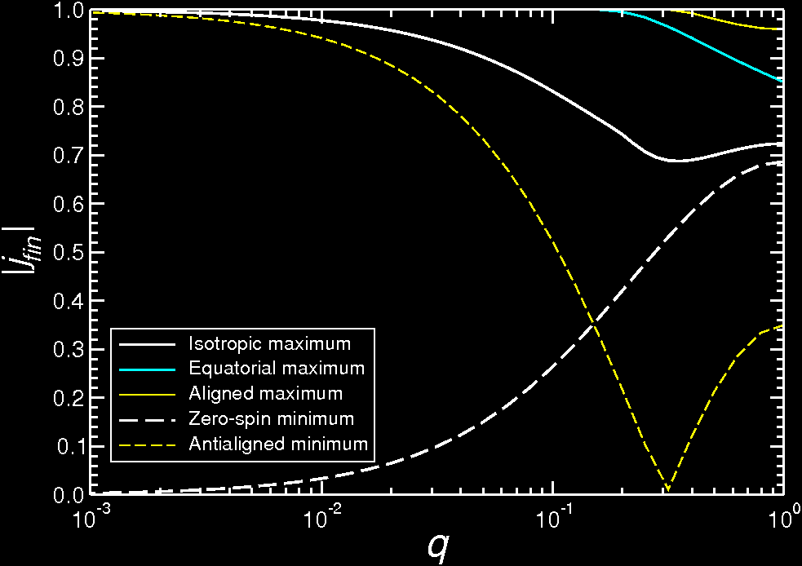
Excursus: final spin and GW recoil
Zero spin, equal mass merger case
Final spin = 0.69
Berti and Volonteri (2008)
Spin in the equatorial plane:
maximum kick (>2000km/s)
(Pretorius et al., Buonanno et al)

Slide 25
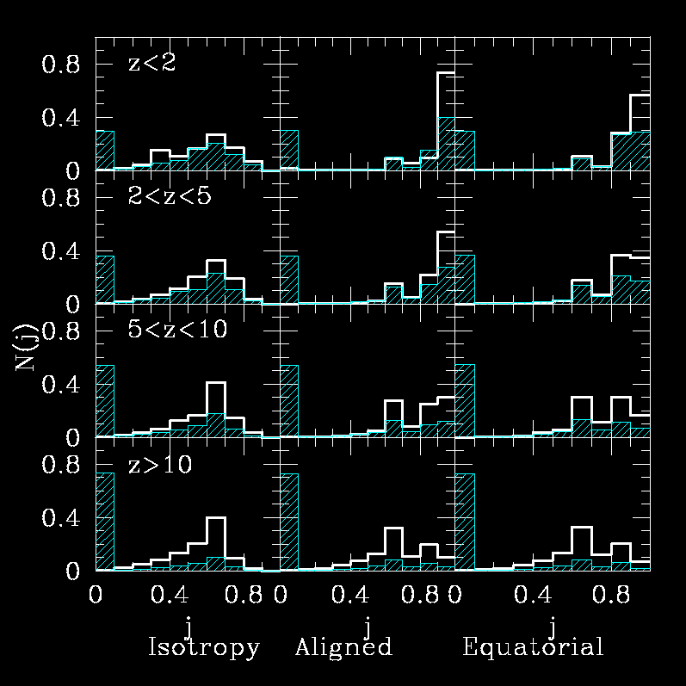
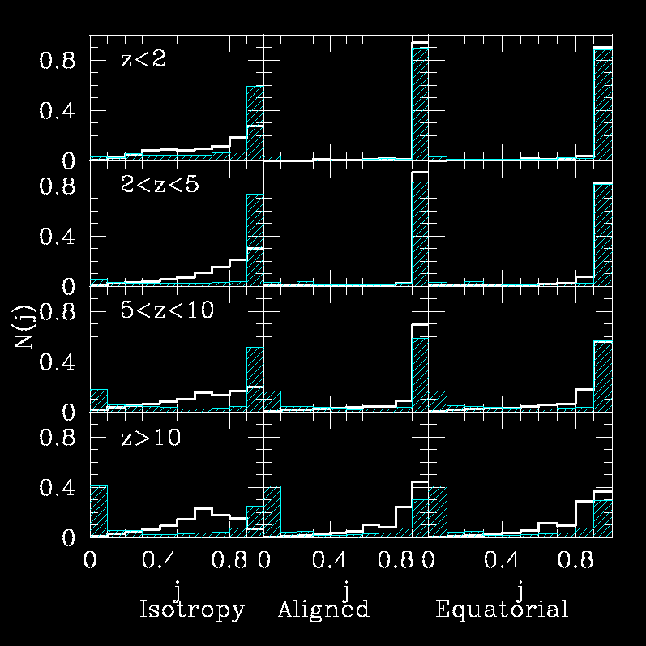
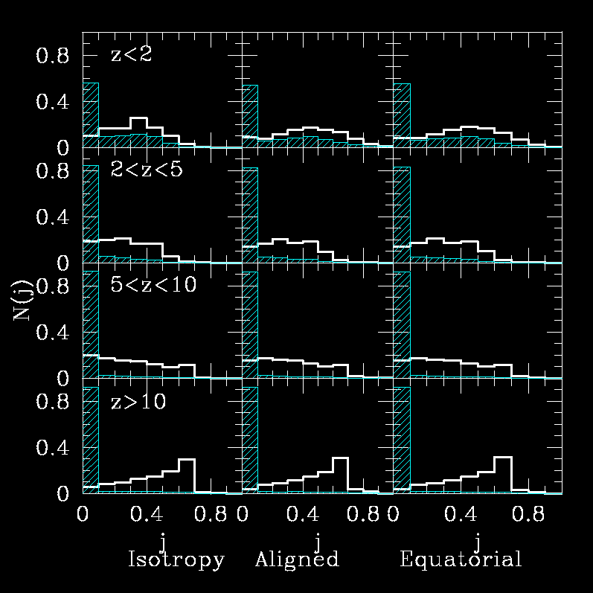
SMBH spin evolution: accretion vs. mergers
Mergers+disc accretion
Mergers+chaotic accretion
Mergers Only
Berti and Volonteri (2008)

Slide 26
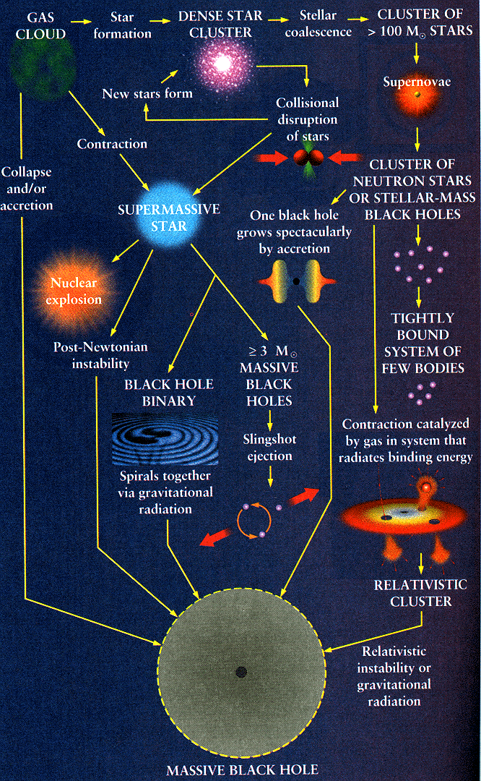
The first black holes
Begelman & Rees: Gravitiy’s fatal attraction

Slide 27
The highest redshift QSOs
Very Large Masses (M_{bh}>10⁹ M_{sun})
Very Large metallicities
Fan et al. (2004)

Slide 28
The highest redshift QSOs: the time problem
Available time from z=30 till z=6 is about 0.8 Gyr.
Assume SMBH growth at the Eddington limit:
dM/dt=(1- η) L_{edd}/(ε_{rad} c²)
Assuming, for simplicity, η=ε_{rad}
M(t)=M(0) exp [(1- η)/η * t/t_{edd}]
With t_{edd}=0.45 Gyr
⬇
Upper limit on η !

Slide 29
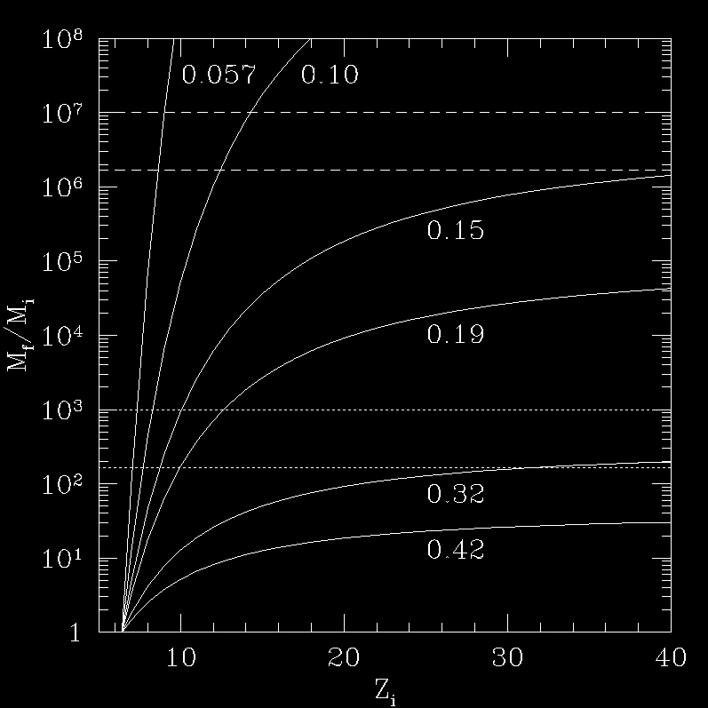
The highest redshift QSOs: the time problem
PopIII remnants seeds
(100<M/M_{sun}<600)
Massive seeds
(10⁶<M/M_{sun}<6x10⁶)
Shapiro (2005)

Slide 30
The highest redshift QSOs: efficiency problem
BH growth by accretion via standard thin disc from an initial state with M=M_{i} and spin a=a_{i}
Spin evolves according to:
a_{f}=(r_{ISCO,i}^{1/2}/3) *χ*[4-(3r_{ISCO,I}* χ² -2 )^{1/2}]
Where χ=M_{i}/M_{f}
➔An initially non-rotating BH is spun up to a_{f}=1 if χ=M_{i}/M_{f}=6 ^{1/2}≈2.45
⬇
Prolonged coherent accretion episodes imply high efficiency!

Slide 31
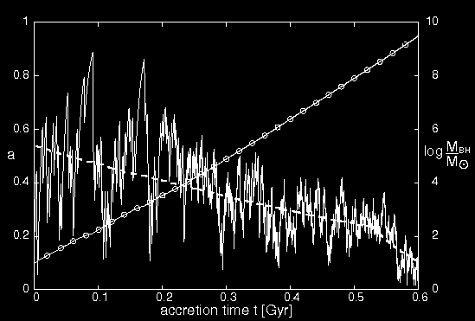
Keeping the spin low: chaotic accretion
Accretion proceeds via a succession of small episodes in which
the disc angular momentum is always smaller than the hole’s one
a≈(M_{disc}/M)r_{d}^{-1/2}
For r_{d} ~ self-gravitating radius,
M_{disc} ~ 0.1% M
King and Pringle (2006)
King et al. (2008)

Slide 32
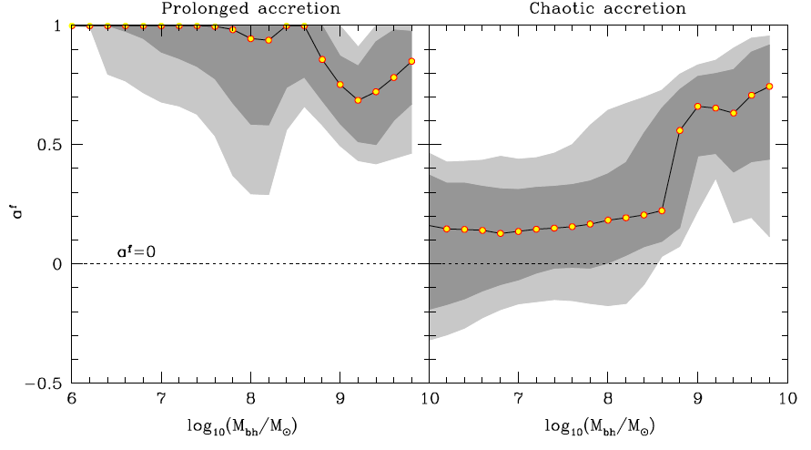
Spin distributions (z=0)
Fanidakis et al. 2011

Slide 33
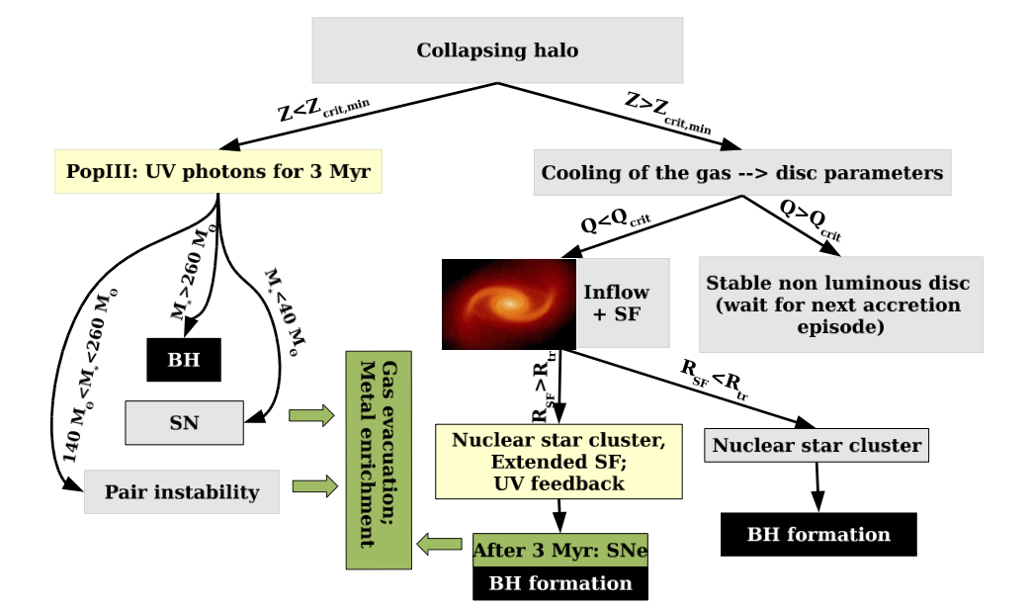
Seed black holes formation
Devecchi et al. 2012

Slide 34
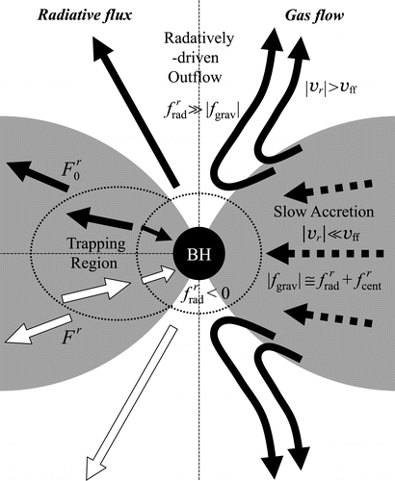
Supercritical Accretion and Quasistars
Begelman et al. (2006;2008)
In a supercritical accretion disc (left) BH growth rate can be super-Eddington, as the photons are trapped in the flow
In a Quasistar, a BH sits in the center of a convective envelope and grows at the Eddington rate of a supermassive star
Begelman et al. ‘82; Ohsuga et al. (2007)

Slide 35
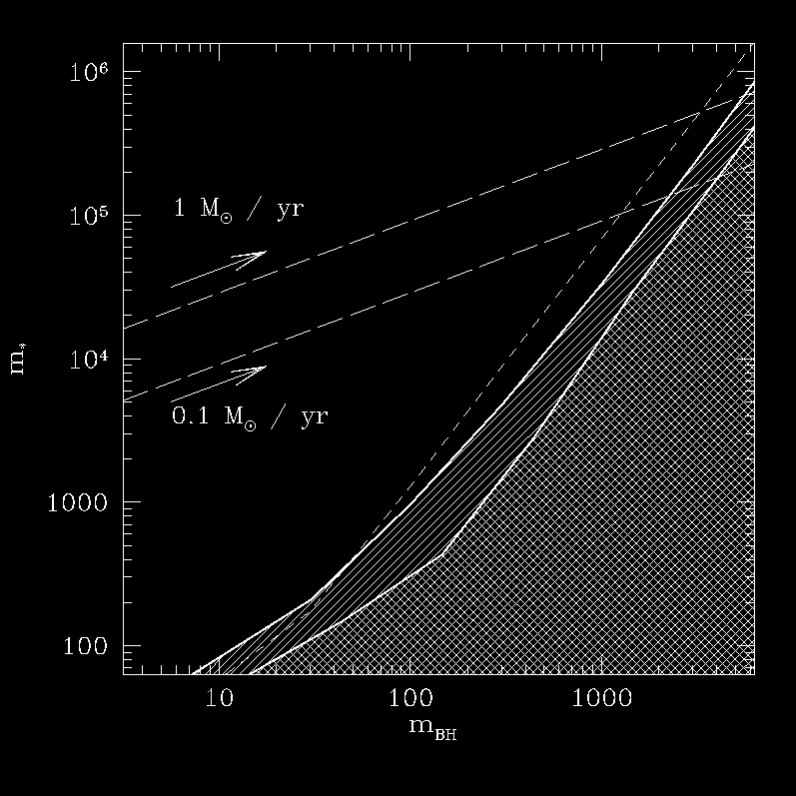
Growth and death of a Quasistar
Infall rates >100 times larger
than for Pop III star formation
(“bars in bars” instability)
A PopIII Quasistar may form by direct collapse in the core a pristine pre-galactic halos where atomic hydrogen cooling is efficient
In less than a million years a 10⁴ BH may be born
forbidden
photospheric temp.
EVAPORATION
Begelman et al. (2008)

Slide 36
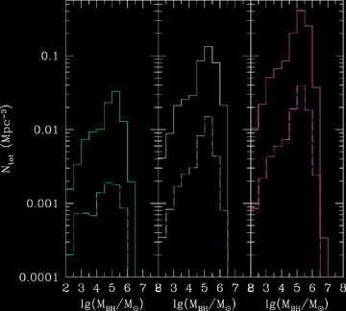
Predictions: early (seed) BH mass functions
Using a model for gas collapse in pre-galactic halos that ccounts for gravitational stability and fragmentation
Q is a stability parameter: lower Q implies more stable discs
Solid lines: z=15; dashed z=18
Q=1.5
Q=2
Q=3
Volonteri et al. (2008)

Slide 37
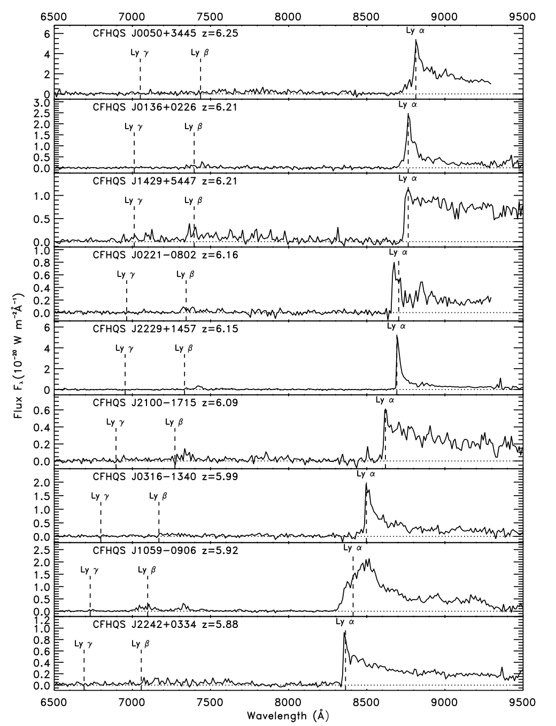
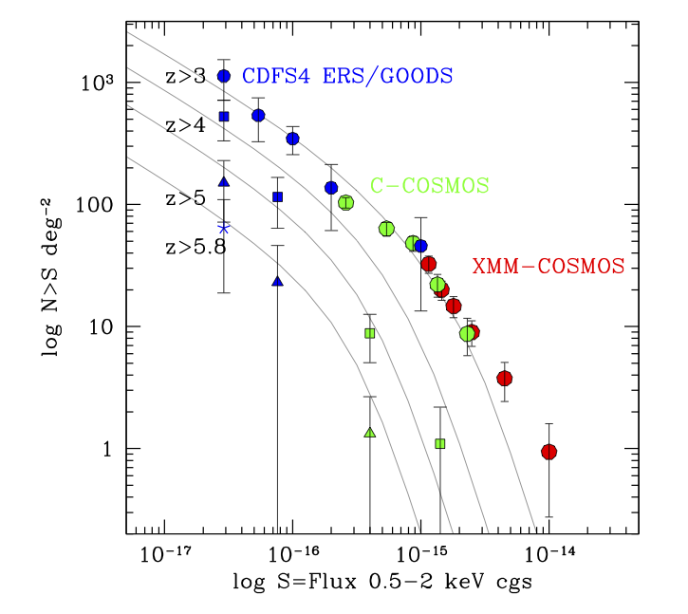
High-z constraints on BH density
Optical QSOs
X-ray QSOs
Fan et al. 2006; Willott et al. 2009; Brusa+10; Civano+11; Fiore+12

Slide 38
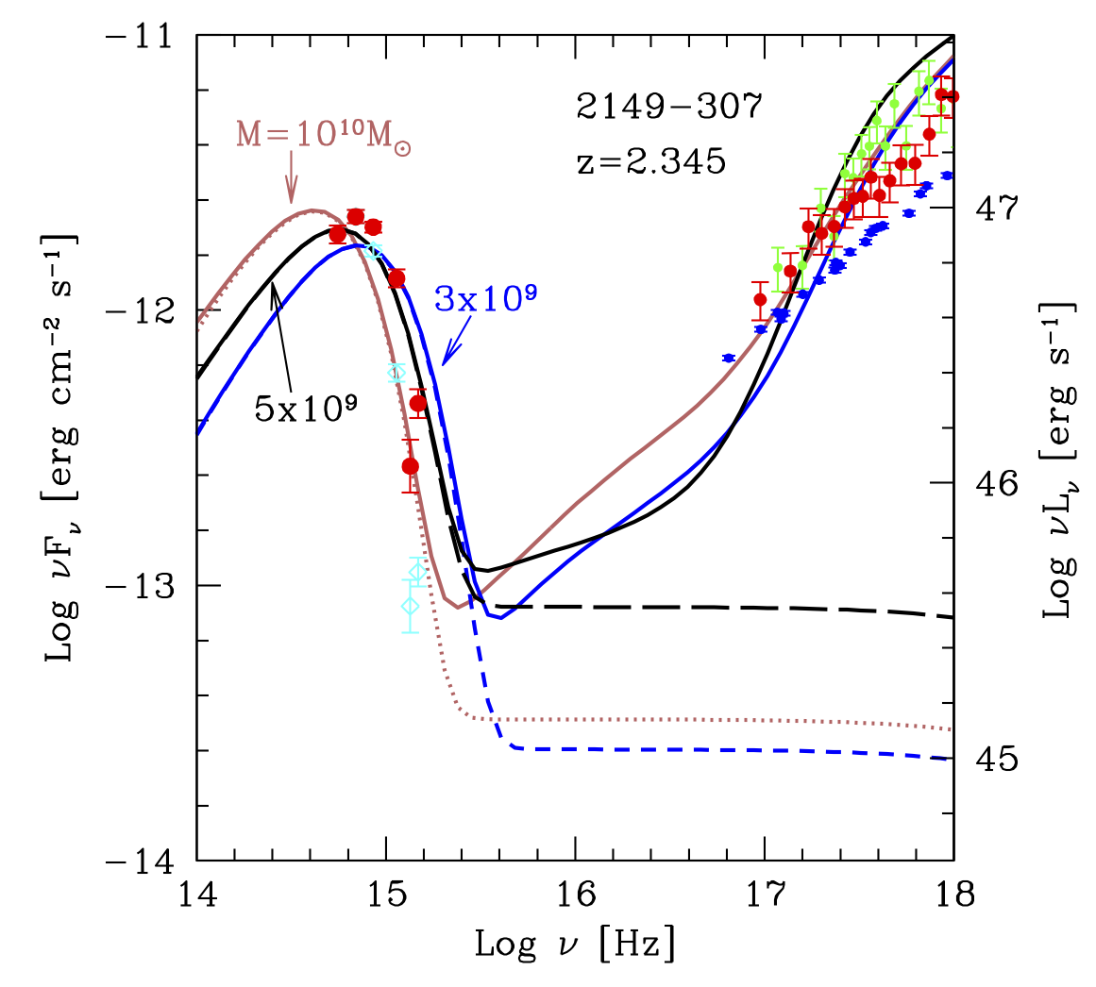
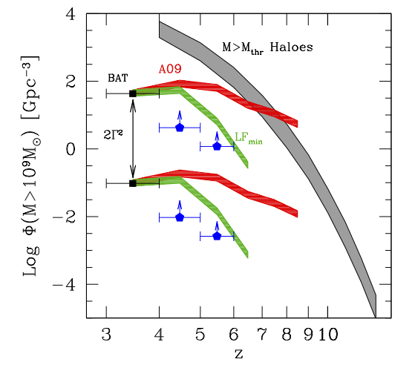
High-z constraints on BH density
High redshift Blazars
Ghisellini et al. 2012

Slide 39
Useful references (2)
Hopkins et al.: “An observational determination of the bolometric quasar luminosity function”, 2007, ApJ, 654, 731
Marconi et al.: “Local supermassive black holes, relics of active galactic nuclei and the X-ray background”, 2004, MNRAS, 351, 169
Colpi and Dotti: “Massive binary black holes in the cosmic landscape”, 2010, arXiv:0906.4339
Pretorius: “Binary black hole coalescence”, Astrophysics and Space Science Library, Volume 359. Springer Netherlands, 2009, p. 305
Ripamonti and Abel: “The formation of primordial luminous objects”, in “Joint evolution of black holes and galaxies”, Eds. Colpi, Gorini, Haardt, Moschella, Taylor and Francis, New York, 2006
Volonteri: “Formation of Supermassive black holes”, ARA&A, 18, 279
Tanaka & Haiman: “The assembly of Supermassive Black Holes at high redshift”, ApJ, 696, 1798

