Slide 1
Black Hole Binaries and Active Galactic Nuclei
Chris Done
University of Durham

Slide 2
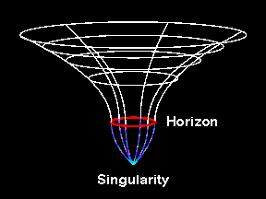
Black holes
Black holes – the ultimate triumph of gravity
Completely determined by mass and spin in Einstein GR
(any charge is quickly neutralised)
Space so warped that not even light escapes from below the event horizon
The thing about black holes, is their black. And the thing about space, your basic space colour is…its black. So how are you meant to see them?

Slide 3
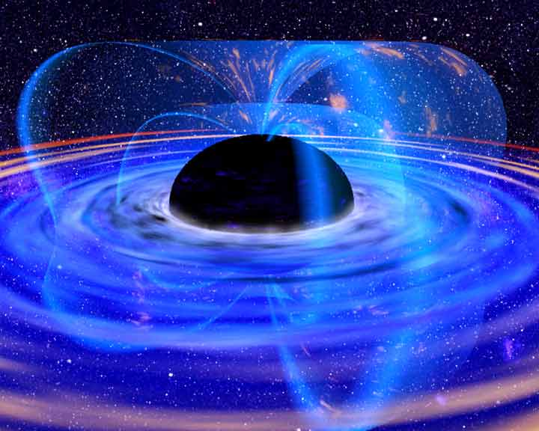
Accretion
Accreting BH: huge X-ray luminosity close to event horizon R_{s}
Emission from region of strong spacetime curvature
Observational constraints on strong gravity if we can understand accretion!
GR predictions - event horizon, last stable orbit (spin), Lense-Thirring precession (spin)

Slide 4
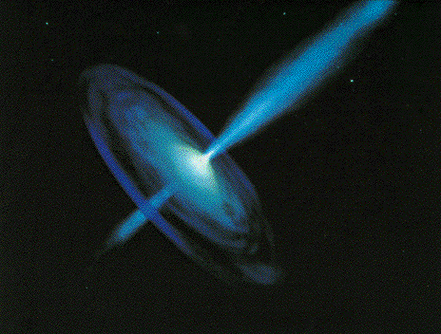
Black holes
Black hole binaries – quasars for the impatient!
Observational template of how accretion flows (spectra and variability) and their associated jet behave
Build a working physical model of accretion flows

Slide 5
Black holes
Scale up to AGN – what works and what doesn’t
Need to understand accretion flow and jet feedback in order to understand galaxy formation
Does jet depend on spin?

Slide 6
BHB – Quasars for the impatient
BRIGHT! Huge amounts of data, long term variability (days –years) in mass accretion rate (due to H ionisation instability in disc)
Observational template of accretion flow as a function of L/L_{Edd} onto ~10 M BH (very homogeneous!)
2 years
DGK07

Slide 7
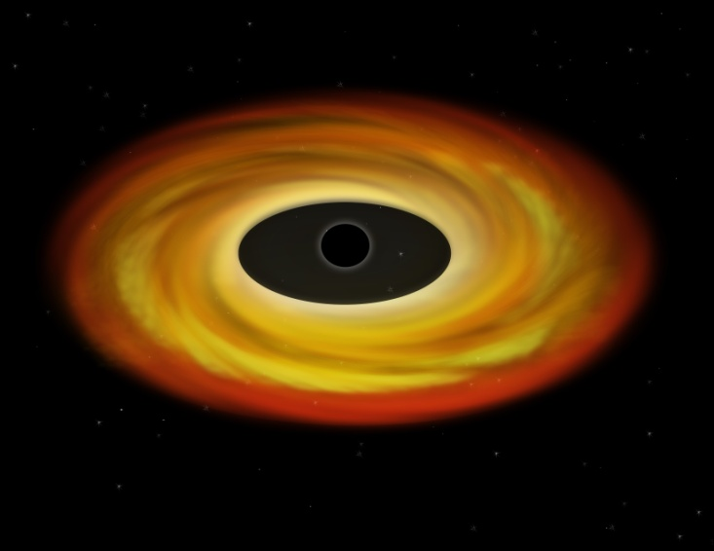
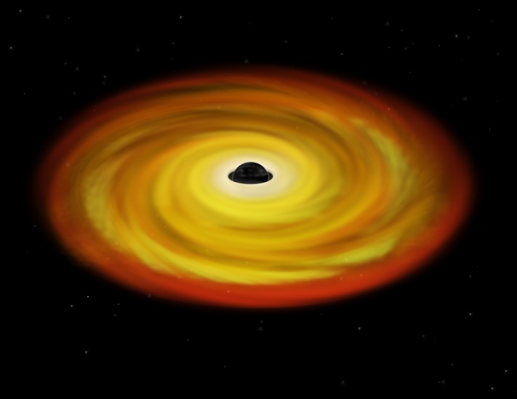
Spectra of accretion flow: disc
Differential Keplerian rotation
Viscosity B: gravity → heat
Thermal emission: L = AσT⁴
Temperature increases inwards until minimum radius R_{lso}(a*) For a*=0 and L~L_{Edd} T_{max} is
1 keV (10⁷ K) for 10 M
10 eV (10⁵ K) for 10⁸ M
Maximum spin T_{max} is 3x higher
Log ν f(ν)
Log ν
Notes:
Accretion discs are the most well known form of the accretion flow. Inner radii rotate faster so there is viscous friction (a magnetic dynamo) which converts gravitational energy to heat. If this thermalises then at large radii there is not much gravitational energy and a lot of area, so producing low temperature, while at small radii there is lots of energy and not much area, so high temperature. There is a minimum radius – the last stable orbit which is a GR prediction – so there is a maximum temperature. At LEdd this is of order 1keV, or 10 million degrees for GBH, or 10eV, a hundred thousand degrees for a supermassive BH.

Slide 8
Spectral states
Disc dominated - look like a disc but small tail to high energies
Very high/intermediate states at least know something about a disc
Low/hard state look really different, not at all like a disc!
When not dominated by disc don’t get consistent results for radius so can’t get spin
very high
disk dominated
high/soft
Gierlinski & Done 2003

Slide 9
BHB – Quasars for the impatient
BRIGHT! Huge amounts of data, long term variability (days –years) in mass accretion rate (due to H ionisation instability in disc)
Observational template of accretion flow as a function of L/L_{Edd} onto ~10 M BH (very homogeneous!)
2 years
DGK07

Slide 10
Variability of disc:long timescale
L/L_{Edd} ∝AT⁴_{max} (Ebisawa et al 1993; Kubota et al 1999; 2001)
Constant size scale – last stable orbit!! BH spin

Slide 11
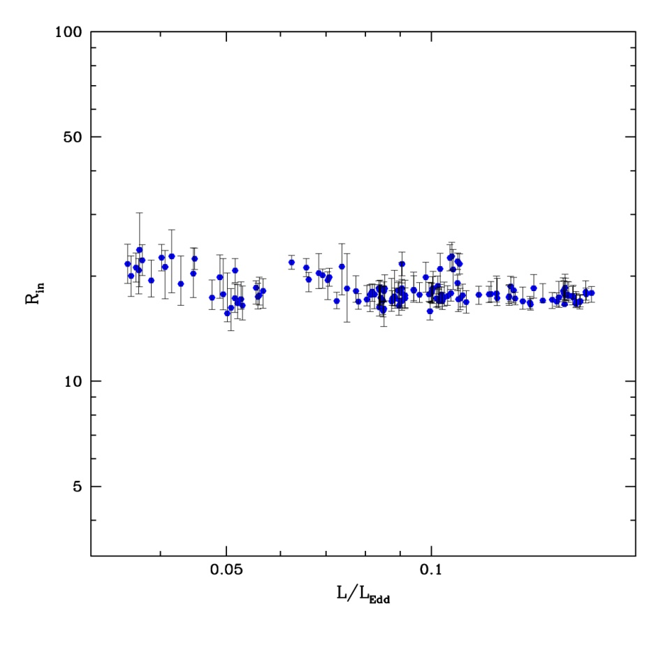
Disc spectra: last stable orbit
Bewildering variety
Pick ONLY ones that look like a disc!
L/L_{Edd} ∝T⁴_{max} (Ebisawa et al 1993; Kubota et al 1999; 2001)
Constant size scale – last stable orbit!!
Proportionality constant gives a measure R_{lso} i.e. spin as L=σ R² T⁴
Not quite as simple as this – need to fold in some corrections. But clear evidence for last stable orbit
Kolehmainen & Done 2010

Slide 12
Spectral states
very high
Disc dominated look like a disc and vary like a disc
Very high/intermediate states at least know something about a disc
Low/hard state look really different, not at all like a disc!
disk dominated
high/soft
Gierlinski & Done 2003

Slide 13
Variability of disc:short timescale
Accretion rate through disc changes on timescales of days
tvisc= α⁻¹ (H/R)⁻² torb
=5 α⁻¹ (H/R)⁻² (r/6) ^{-3/2} ms ~ 500s
~ 500s at last stable orbit for 10M
No rapid variability of disc in disc dominated states!
0.5 1.0 2.0

Slide 14
Low/hard state variability
Hard X-rays show much more dramatic change on short timescales down to few 10s of ms
tvisc= α⁻¹ (H/R)⁻² tdyn = 5 α⁻¹ (H/R)⁻² (r/6) ^{-3/2} ms
IF viscous timescale then H/R~1
0.5 1.0 2.0

Slide 15
Accretion flows without discs
Disc models assumed thermal plasma – not true at low L/L_{Edd}
Instead: hot, optically thin, geometrically thick inner flow replacing the inner disc (Shapiro et al. 1976; Narayan & Yi 1995)
Hot electrons Compton upscatter photons from outer cool disc
Few seed photons, so spectrum is hard
Log ν f(ν)
Log ν
Notes:
The disc models assumed that the emission thermalised. That’s not necessarily true at low L/Ledd where the flow is not very dense. If its not thermalising then its not cooling as efficiently so the flow heats up. This can lead to a hot, optically thin, geometrically thick inner flow replacing the inner disc. The hot electrons in this flow can compton upscatter any low energy photons from a residual outer disc, but there are not many of these, so the spectrum is hard

Slide 16
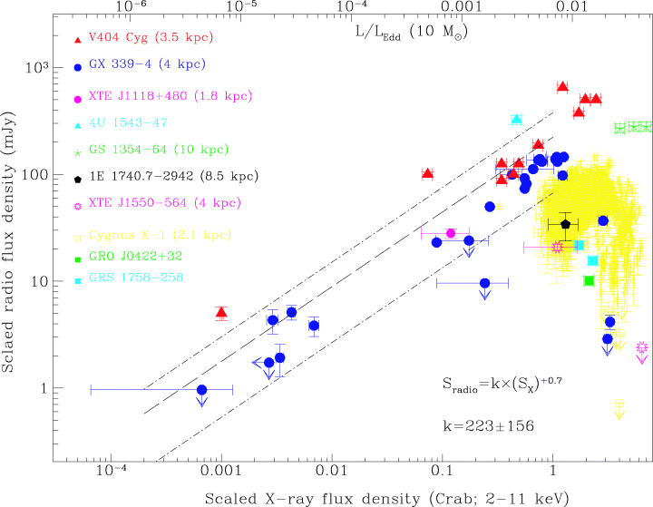
And the radio jet… link to spin?
No special μQSO class – they ALL produce jets, consistent with same radio/X ray evolution
Jet links to spectral state – hard state has steady radio jet which gets brighter as the hard X-rays get brighter
Then collapses as make transition to disc (Fender et al 2005)
0.01L_{edd}
L(radio) jet
L(X-ray) accretion flow
Gallo et al 2003 Corbel et al 2013
Notes:
Scaling these models up to the supermassive black holes in quasars, the only change should be that the disc emission is in the UV rather than X-ray region. The problem is knowing how far to scale them for an individual qso, knowing the BH mass. This has only recently become possible with the discovery of the relationships between the BH mass and the properties of the galaxy as a whole. Big BH live in big galaxies, little BH live in small ones. Also, only recently that enough high s/n data has become available to test these models – xmm-newton database

Slide 17
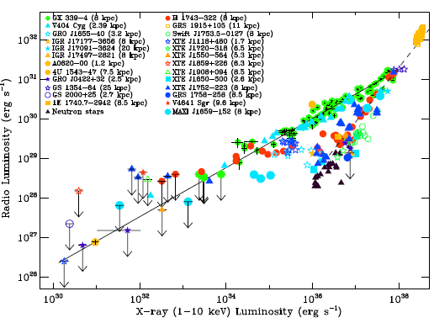
Accretion flows – Jet
Low/hard
High/soft
Very high
Corbel et al 2012
Notes:
The disc models assumed that the emission thermalised. That’s not necessarily true at low L/Ledd where the flow is not very dense. If its not thermalising then its not cooling as efficiently so the flow heats up. This can lead to a hot, optically thin, geometrically thick inner flow replacing the inner disc. The hot electrons in this flow can compton upscatter any low energy photons from a residual outer disc, but there are not many of these, so the spectrum is hard

Slide 18
No inner disc
Disc models assumed thermal plasma – not true at low L/L_{Edd}
Instead: hot, optically thin, geometrically thick inner flow replacing the inner disc (Shapiro et al. 1976; Narayan & Yi 1995)
Hot electrons Compton upscatter photons from outer cool disc
Few seed photons, so spectrum is hard
Jet from large scale height flow
Log ν f(ν)
Log ν
Notes:
The disc models assumed that the emission thermalised. That’s not necessarily true at low L/Ledd where the flow is not very dense. If its not thermalising then its not cooling as efficiently so the flow heats up. This can lead to a hot, optically thin, geometrically thick inner flow replacing the inner disc. The hot electrons in this flow can compton upscatter any low energy photons from a residual outer disc, but there are not many of these, so the spectrum is hard

Slide 19
No inner disc
Disc models assumed thermal plasma – not true at low L/L_{Edd}
Instead: hot, optically thin, geometrically thick inner flow replacing the inner disc (Shapiro et al. 1976; Narayan & Yi 1995)
Hot electrons Compton upscatter photons from outer cool disc
Few seed photons, so spectrum is hard
Jet from large scale height flow
Log ν f(ν)
Log ν
Notes:
The disc models assumed that the emission thermalised. That’s not necessarily true at low L/Ledd where the flow is not very dense. If its not thermalising then its not cooling as efficiently so the flow heats up. This can lead to a hot, optically thin, geometrically thick inner flow replacing the inner disc. The hot electrons in this flow can compton upscatter any low energy photons from a residual outer disc, but there are not many of these, so the spectrum is hard

Slide 20
Collapse of hot inner flow
Disc models assumed thermal plasma – not true at low L/L_{Edd}
Instead: hot, optically thin, geometrically thick inner flow replacing the inner disc (Shapiro et al. 1976; Narayan & Yi 1995)
Hot electrons Compton upscatter photons from outer cool disc
Few seed photons, so spectrum is hard
Jet from large scale height flow collapse of flow=collapse of jet
Log ν f(ν)
Log ν
Notes:
The disc models assumed that the emission thermalised. That’s not necessarily true at low L/Ledd where the flow is not very dense. If its not thermalising then its not cooling as efficiently so the flow heats up. This can lead to a hot, optically thin, geometrically thick inner flow replacing the inner disc. The hot electrons in this flow can compton upscatter any low energy photons from a residual outer disc, but there are not many of these, so the spectrum is hard

Slide 21
Moving disc – moving QPO
Disc closer in, more soft photons from disc so softer spectra
Especially when overlaps with hot flow. Decrease radius, increase overlap, increases seed photons dramatically
Disc down to last stable orbit and collapse of hot flow gives physical mechanism for hard/soft transition
DGK07

Slide 22
Low/hard state variability
Hard X-rays show much more dramatic change on short timescales down to few ms
tvisc= α⁻¹ (H/R)⁻² tdyn = 5 α⁻¹ (H/R)⁻² (r/6) ^{-3/2} ms
IF viscous timescale then H/R~1
0.5 1.0 2.0

Slide 23
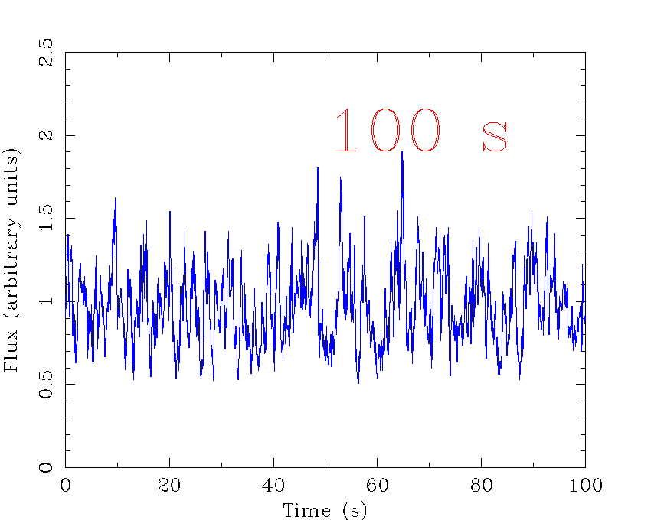
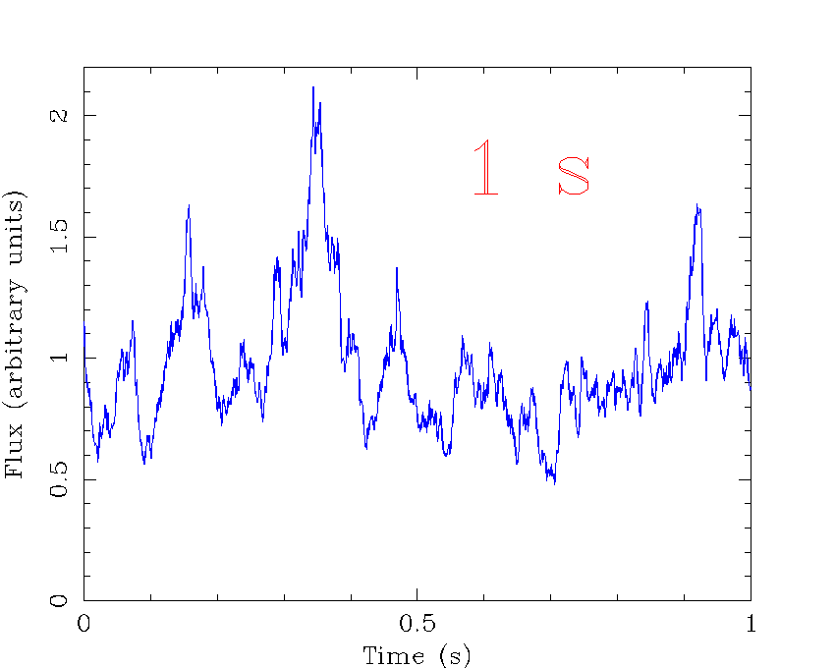
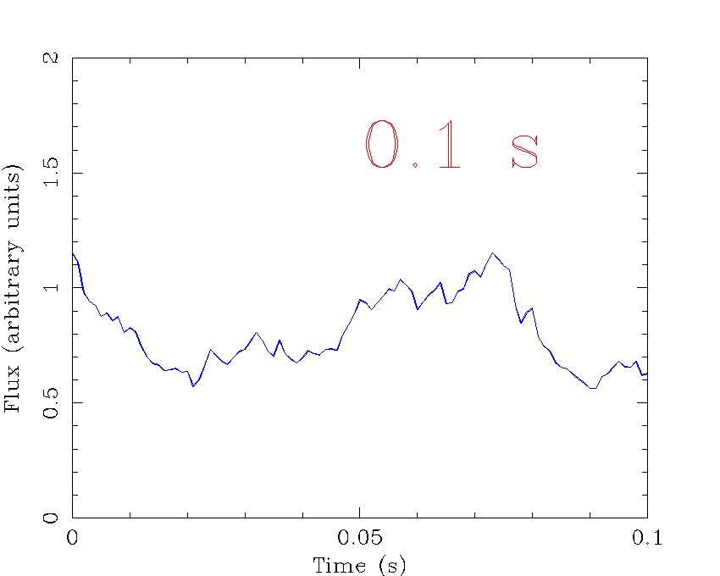
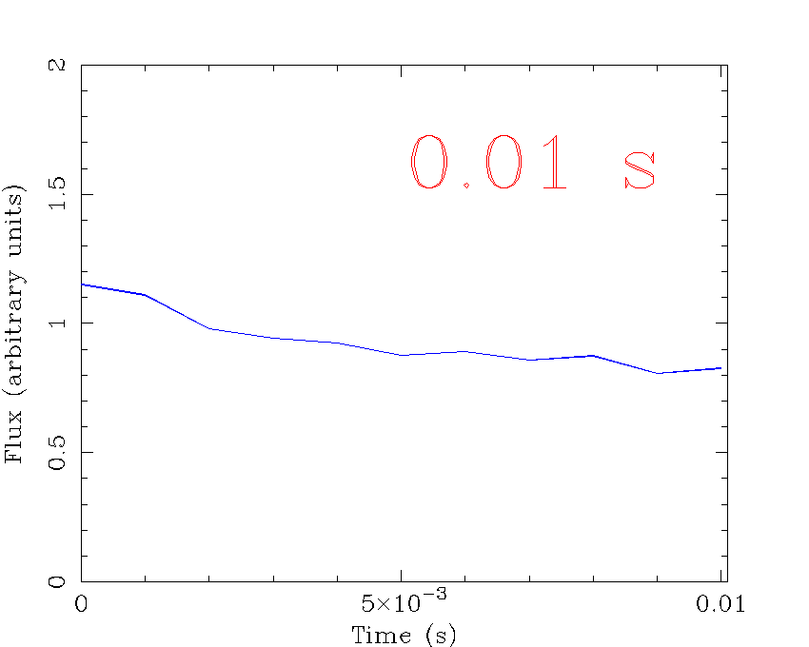
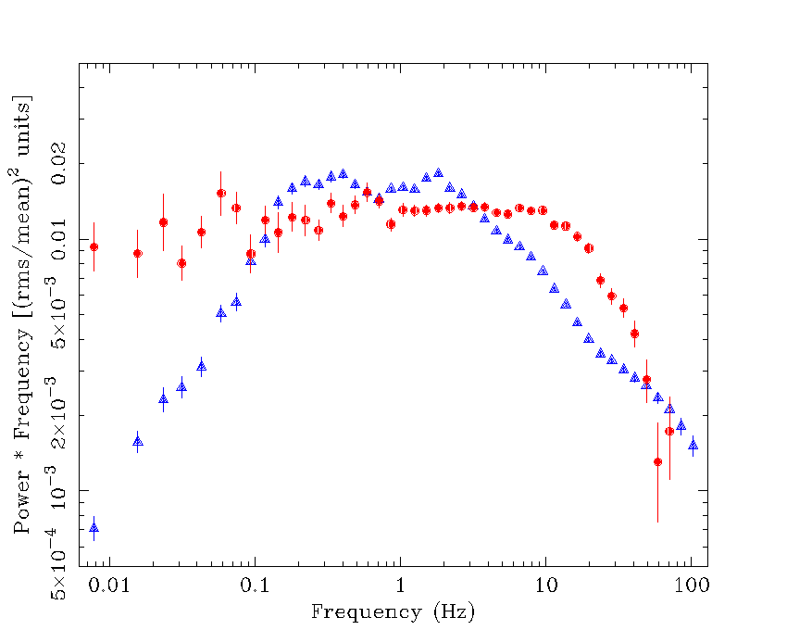
Quantifying variability: the power spectral density (PSD) of Cyg X-1
P(f)∝f⁻¹
P(f)∝f⁰
P(f)∝f⁻²
Phil Uttley

Slide 24
XTE J1550-564

Slide 25
f_{b}
f_{h}
XTE J1550-564

Slide 26
f_{QPO}
XTE J1550-564

Slide 27
Moving disc – moving QPO
Energy spectra need disc to move from 50-6ish Rg as make transition
Power spectra: low frequency break moves, high frequency power more or less constant! Large radius moves, Small radii constant
Low frequency QPO moves with low frequency break
QPO big, must be fundamental
DGK07

Slide 28
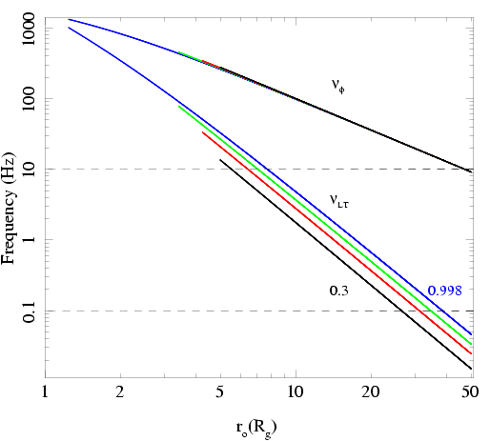
Low frequency QPO
Spectra need disc to move from R_{tr} = 50-6ish R_{g} as make transition
Observed QPO frequencies go from ~0.1-10 Hz
See similar range in ALL BHB – so either all BHB have same spin or not much spin dependence on QPO
Not ν(ϕ) as too fast!
Ingram, Done & Fragile 2009

Slide 29
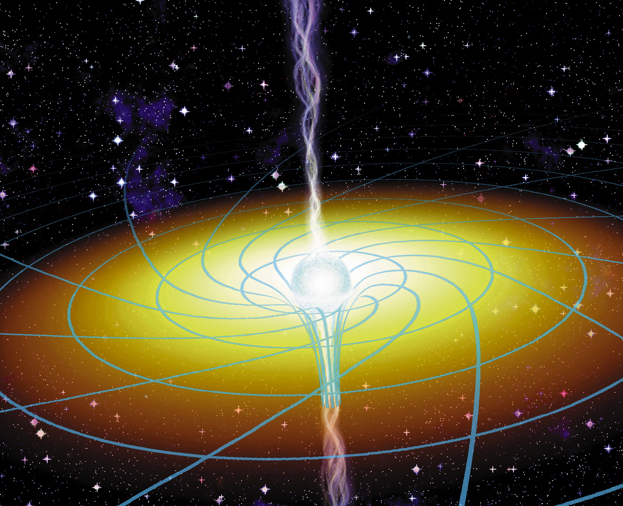
Frame dragging
Spacetime rotating
Asymmetric potential
Orbits get dragged around
So any orbit which crosses the equatorial plane will precess
Lense-Thirring precession
www.phys.ncku.edu.tw/.../ apod/ap971107.html

Slide 30
Low frequency QPO
Stella & Vietri 1998 – GR potential not spherically symmetric so vertically offset circular orbit has ν(θ) ≠ ν(ϕ)
Lense-Thirring precession ν_{LT} = ν(θ) - ν(ϕ)
Lamb & Markovic

Slide 31
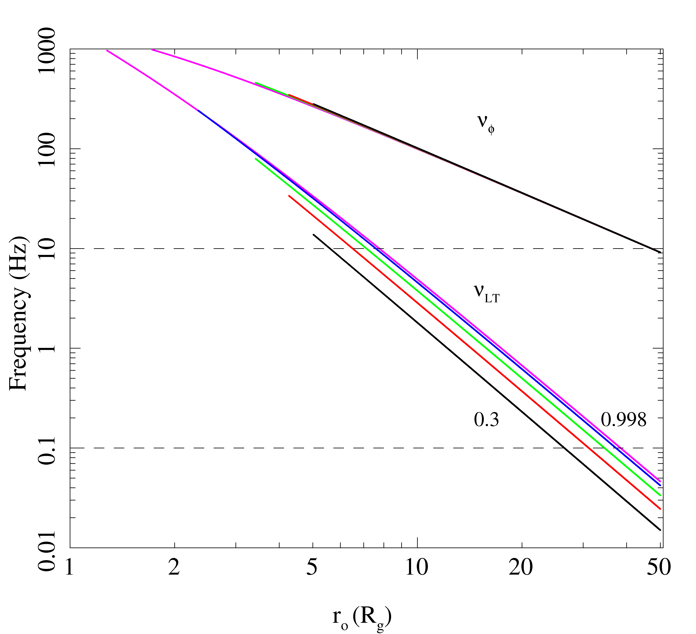
Does it work ?
Not really
Any moderate spin gives QPO much faster than observed as r → lso
And edge of disc would have blackbody spectrum. QPO has spectrum of hot inner flow
Ingram, Done & Fragile 2009

Slide 32
How does it modulate?
Spectrum of LF QPO is same as Comptonisation to zeroth order
NOT the disc - most obvious close to transition
Zycki & Sobolewska 2005; 2006
DGK07
Ingram, Done & Fragile 2009

Slide 33
< H/R
precession
> H/R
Warped disc
Ingram, Done & Fragile 2009

Slide 34
Chris Fragile 2007

Slide 35
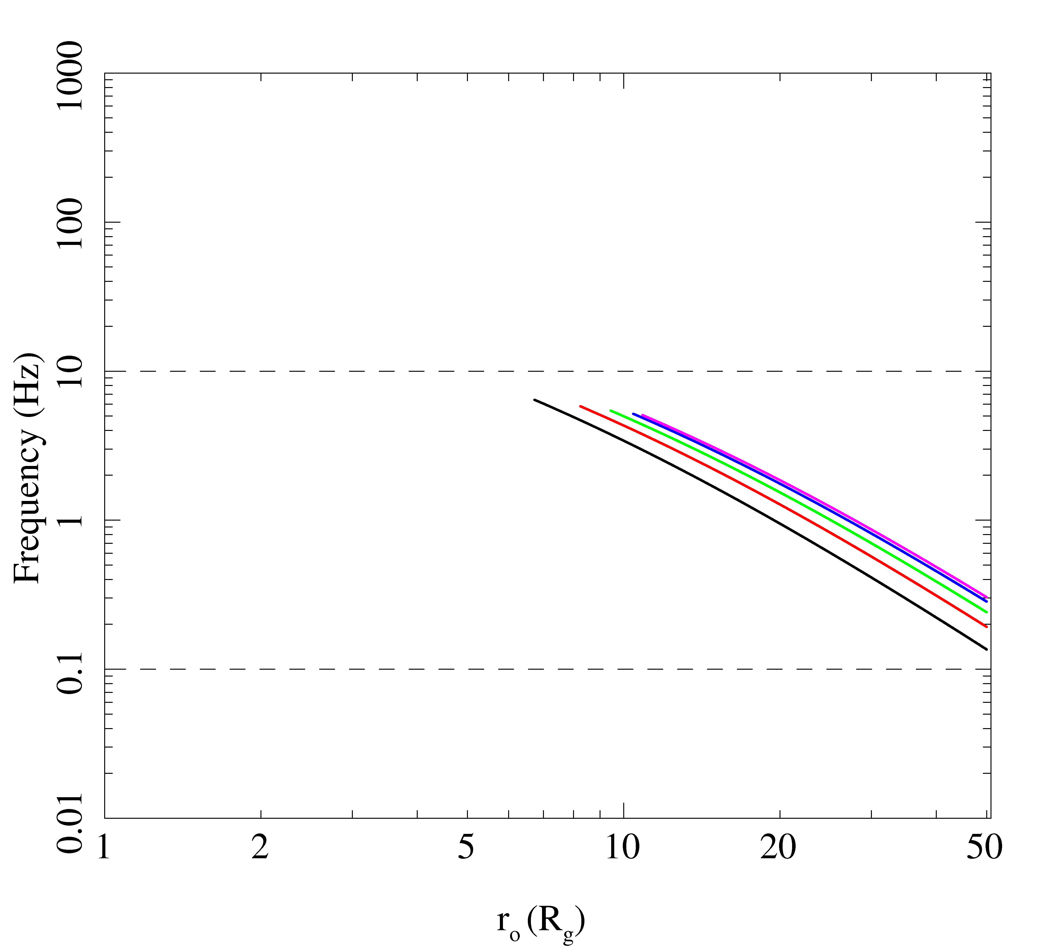
LT precession of hot flow?
Truncates at ~ bending wave radius
QPO frequency given by weighted average of LT precession frequency over all radii in hot flow
Gets the frequencies correct!!
Modulates Compton region so gets spectrum
Ingram, Done & Fragile 2009

Slide 36
Black holes
Black hole binaries –
Observational template of how accretion flows (spectra and variability) and their associated jet behave
Build a working physical model of accretion flows
GR tests – last stable orbit, Lense-Thirring precession (also compare to disc accreting NS to get evidence for event horizon!)

Slide 37
Black holes
Scale up to AGN
Bigger mass! L =AT⁴ -L goes with M but A goes with R² so M² so area wins and disc temp lower!
Larger RANGE in mass – all BHB within factor 2 of 10M whereas AGN from 10⁵-10¹⁰M disc in UV

Slide 38
UV disc seen in Quasars!
Bright, blue/UV continuum from disc.
Gas close to nucleus irradiated and photo-ionised – lines!
Broad permitted lines ~ 5000 km/s (BLR)
Narrow forbidden lines ~ 200 km/s (NLR)
Forbidden lines suppressed if collisions so NLR is less dense than BLR
Francis et al 1991
Notes:
Scaling these models up to the supermassive black holes in quasars, the only change should be that the disc emission is in the UV rather than X-ray region. The problem is knowing how far to scale them for an individual qso, knowing the BH mass. This has only recently become possible with the discovery of the relationships between the BH mass and the properties of the galaxy as a whole. Big BH live in big galaxies, little BH live in small ones. Also, only recently that enough high s/n data has become available to test these models – xmm-newton database

Slide 39
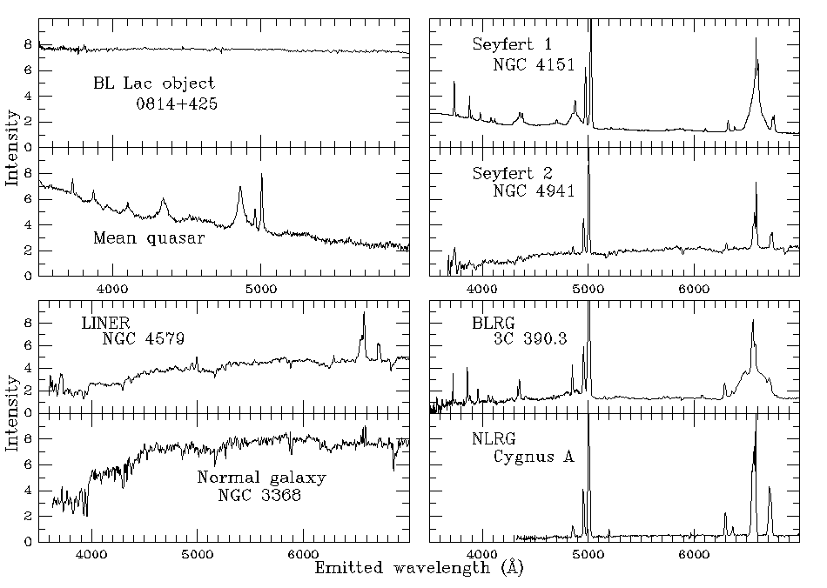
AGN/QSO Zoo!!! Optical

Slide 40
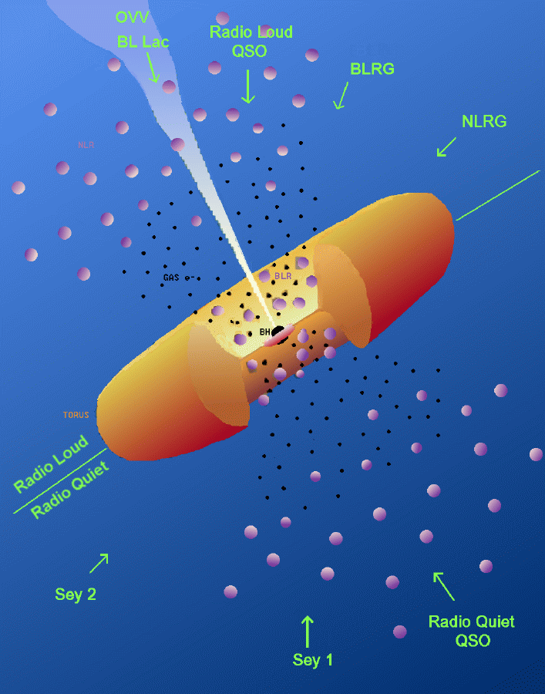
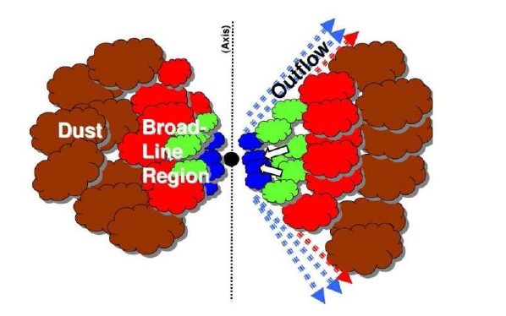
Seyfert 1 – Seyfert 2
Intrinsically same except for obscuration ?
So now take only unobscured objects!

Slide 41
Seyfert 1 - Quasars
Similar spectra and line ratios,
strong UV flux to excite lines,
probably similar L/L_{Edd} ~ 0.1-0.3
Increasing L
Increasing M

Slide 42
Spectral states - BHB
Dramatic changes in continuum – single object, different days
Underlying pattern in all systems
High L/L_{Edd}: soft spectrum, peaks at kT_{max} often disc-like, plus tail
Lower L/L_{Edd}: hard spectrum, peaks at high energies, not like a disc (McClintock & Remillard 2006)
very high
high/soft
Gierlinski & Done 2003

Slide 43
‘Spectral states in AGN’
Disc BELOW X-ray bandpass. Only see tail
0.01
0.1
1
10
100
Any evidence for this? L(2-10 keV) / Lbol bigger at low L/LEdd

Slide 44
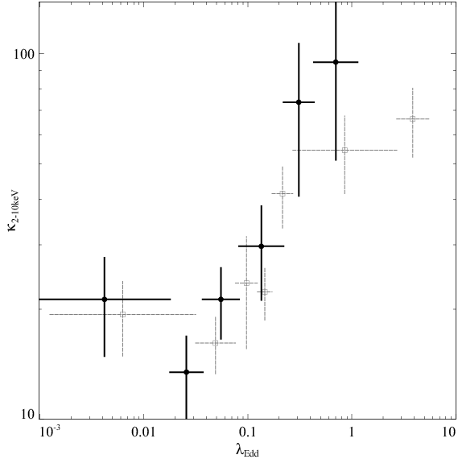
AGN spectral states
Vasuvaden & Fabian 2008
Big change in ratio of Lbol/L(2-10 keV) with Eddington ratio L/LEdd
Looks good!!
Lbol/L(2-10 keV)
Lbol/LEdd

Slide 45
LINERS-S1-NLS1 ?
Similar mass.
Different L/L_{Edd}
Different ionisation
NLS1
Increasing L/L_{Edd}
S1/QSO
disc
Hot inner flow, no UV bright disc – true type 2 Seyferts
LINER

Slide 46
LINERS-S1-NLS1 - radio???
Similar mass.
Different L/L_{Edd}
Different ionisation
NLS1
Increasing L/L_{Edd}
S1/QSO
disc
Hot inner flow, no UV bright disc – true type 2 Seyferts
LINER

Slide 47
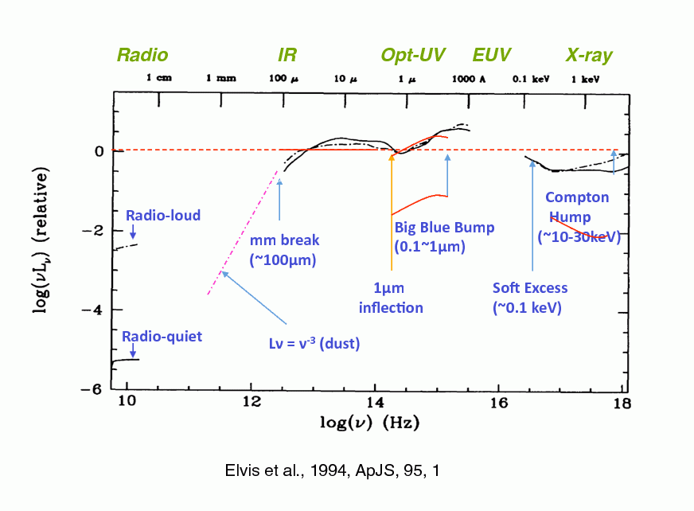
What do AGN look like?
Mass not well known 10 years ago…
Big! So disc peak somewhere in unobservable UV/EUV !!
Spectra generally not dominated by the disc – hard tail often carries a large fraction of Lbol and puzzling soft excess also can carry large fraction of Lbol
Richards et al 2006, Elvis et al 2004

Slide 48
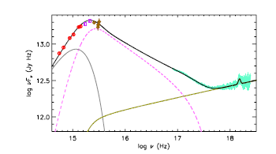
Classic QSO?
Mkn 509 XMM-Newton OM + FUSE +EPIC
10⁸M L/LEdd~0.1
Not low/hard as no jet and too bright! AGN are (should be!) high soft state. But disc turnover far too soon. Plus strange soft X-ray excess….What is this????
Medhipour et al 2011

Slide 49
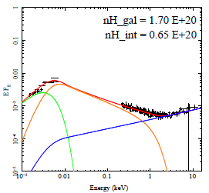
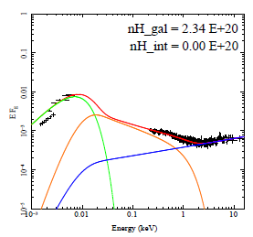
So what do AGN look like?
51 objects with SDSS-2XMM with high s/n and low absorption
High M, low L/LEdd, disc far from SX
Jin et al 2011

Slide 50
Classic QSO?
Mkn 509 XMM-Newton OM + FUSE +EPIC
10⁸M L/LEdd~0.1
Not low/hard as no jet and too bright! AGN are (should be!) high soft state. But disc turnover far too soon. Plus strange soft X-ray excess….What is this????
Medhipour et al 2011

Slide 51
Classic QSO?
Mkn 509 XMM-Newton OM + FUSE +EPIC
10⁸M L/LEdd~0.1
Not low/hard as no jet and too bright! AGN are (should be!) high soft state. But disc turnover far too soon. Plus strange soft X-ray excess….What is this????
Medhipour et al 2011

Slide 52
Classic QSO?
Mkn 509 XMM-Newton OM + FUSE +EPIC
10⁸M L/LEdd~0.1
Not low/hard as no jet and too bright! Plus strange soft X-ray excess….What is this????
Medhipour et al 2011

Slide 53
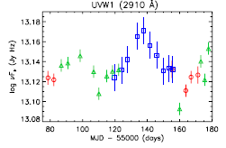
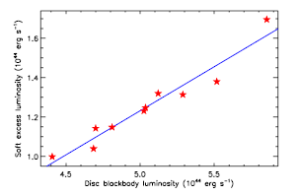
Variability on ~month
Mkn 509 XMM-Newton OM + FUSE +EPIC
Soft excess correlates with UV NOT X-ray on long timescales
Medhipour et al 2011

Slide 54
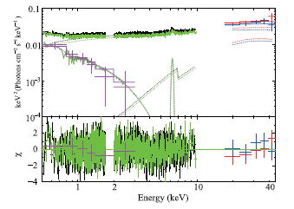
Variability on < day
Short timescale. Soft excess does NOT vary, hard power law does
It’s a separate component!!!! Noda et al 2011; 2012
Noda et al 2011

Slide 55
So what do AGN look like?
51 objects with SDSS-2XMM with high s/n and low absorption
High M, low L/LEdd, disc far from SX
Jin et al 2011

Slide 56
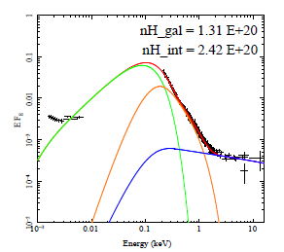
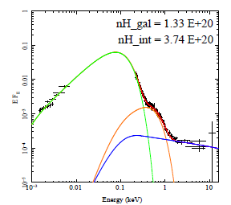
So what do AGN look like?
51 objects with SDSS-2XMM with HIGH S/N AND LOW NH
Low M, high L/LEdd disc makes most of Soft Xrays
Jin et al 2011

Slide 57
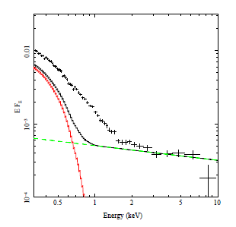
Disc spectra from 10⁶ M L/L_{Edd} ~1
Done, Davis, Jin, Blaes Ward 2011
Enormous soft excess in REJ1034
But actually a lot of it should be the bare disc!
Plus a little bit of soft comptonisation !
Again variability says it’s a separate component to the power law (Middleton et al 2010)
More like disc dominated black holes

Slide 58
Disc spectra from 10⁶ M L/L_{Edd} ~1
Done, Davis, Jin, Blaes Ward 2011
Enormous soft excess in REJ1034
But actually a lot of it should be the bare disc!
Plus a little bit of soft comptonisation !
Again variability says it’s a separate component to the power law (Middleton et al 2010)
More like disc dominated black holes

Slide 59
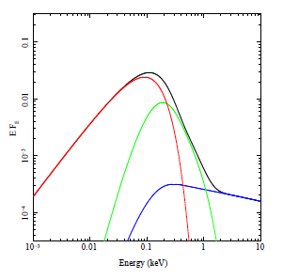
Models conserving energy!!
Lopt ∝M Mdot
Know M from optical and Hβ
Measure Mdot from L opt. Lbol = η Mdot c²
Schwarzchild a=0 η=0.0572
If powered by accretion of material through the outer disc then this also makes soft excess and power law tail
Thermal down to R_{corona} with colour temp correction
Comptonised/power law after this – XSPEC optxagn Done et al 2011 cf dkbbfth Done & Kubota 2006
R_{corona}
Mdot
M
Done et al 2011

Slide 60
So what do AGN look like?
51 objects with SDSS-2XMM with HIGH S/N AND LOW NH
Low M, high L/LEdd
Jin et al 2011

Slide 61
So what do AGN look like?
51 objects with SDSS-2XMM with high s/n and low absorption
High M, low L/LEdd, disc far from SX
Jin et al 2011

Slide 62
AGN spectral states
Jine, Ward, Done Gelbord 2011

Slide 63
AGN spectral states
Jine, Ward, Done Gelbord 2011

Slide 64
AGN spectral states
Jine, Ward, Done Gelbord 2011

Slide 65
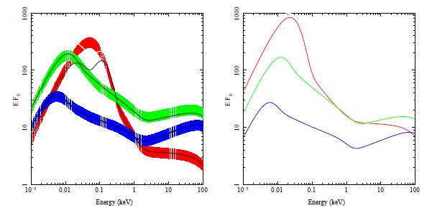
INTRINSIC changes in SED
Co-add models in 3 bins of L/L_{Edd}
Correlates with M due to galaxy formation. high mass objects have low L/L_{Edd} in local Universe – downsizing
Physical model so shift to same mass M=10⁸ to compare with BHB
M=10⁷ L/L_{Edd}~1
L/L_{Edd}~1
M=10⁸
L/L_{Edd}~0.2
L/L_{Edd}~0.2
L/L_{Edd}~0.06
M=2x10⁸ L/L_{Edd}~0.06
Done et al 2011

Slide 66
AGN spectral states
Jine, Ward, Done Gelbord 2011

Slide 67
AGN spectral states
Jine, Ward, Done Gelbord 2011

Slide 68
AGN spectral states
Jine, Ward, Done Gelbord 2011

Slide 69
AGN spectral states
L/L_{Edd}~10⁻⁵
M/M_{Edd}~10^{-2.5}
Nemmen et al 2012
M=2x10⁸

Slide 70
INTRINSIC changes in SED
Co-add models in 3 bins of L/L_{Edd}
Correlates with M due to galaxy formation. high mass objects have low L/L_{Edd} in local Universe – downsizing
Physical model so shift to same mass M=10⁸ to compare with BHB
M=10⁷ L/L_{Edd}~1
L/L_{Edd}~1
M=10⁸
L/L_{Edd}~0.2
L/L_{Edd}~0.2
L/L_{Edd}~0.06
M=2x10⁸ L/L_{Edd}~0.06
Done et al 2012

Slide 71
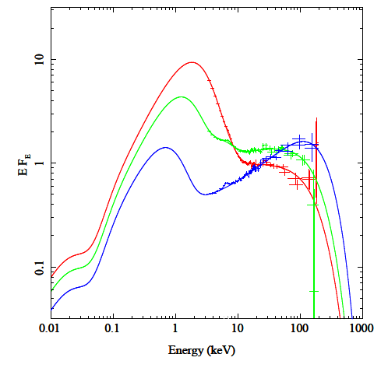
Low/hard to high/soft ?
Looks good to zeroth order… but….
Transition at L/LEdd=0.02 in steady state accretion - 0.2 in AGN
LINERS are low/hard state (strong radio)
Green/blue are classic QSO – not low/hard state – what are they?
M=10⁷ L/L_{Edd}~1
BHB 10 M
L/L_{Edd}~1
M=10⁸
L/L_{Edd}~0.2
L/L_{Edd}~0.2
AGN 10⁸ M
L/L_{Edd}~0.06
M=2x10⁸ L/L_{Edd}~0.06
Done et al 2012

Slide 72
Scale up to AGN
UV line driven discwind (origin of BLR/torus?) - BAL QSOs
Can this change the disc structure in AGN from BHB? Mass loss rate can be large so disc no longer constant mass accretion rate at all radii. Lose mass predominantly from UV emitting zone
Throws material above disc so maybe more mass in corona
Proga et al

Slide 73
Low/hard to high/soft ?
LINERS are low/hard state (strong radio)
Green/blue are classic QSO – not low/hard state – winds?
NLS1 – look disc dominated!!
M=10⁷ L/L_{Edd}~1
BHB 10 M
L/L_{Edd}~1
M=10⁸
L/L_{Edd}~0.2
L/L_{Edd}~0.2
AGN 10⁸ M
L/L_{Edd}~0.06
M=2x10⁸ L/L_{Edd}~0.06
Done et al 2012

Slide 74
NLS1 as disc dominated ?
Surprising as might expect stronger winds at Eddington – but maybe higher temperature (from lower mass) supresses wind
Jin et al 2011

Slide 75
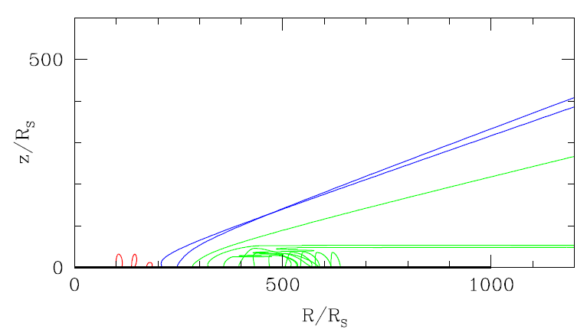
Scale up to AGN
UV line driven discwind as function of BH mass and L/LEdd
UV line driven wind – rises and is overionised by central source and falls back down (shocks produce soft X-ray excess?)
shields UV line driven discwind further out so its not overionised and keeps on acceleration and can escape
Then run out of UV photons for driving as disc temperature too low
Risaliti & Elvis 2010

Slide 76
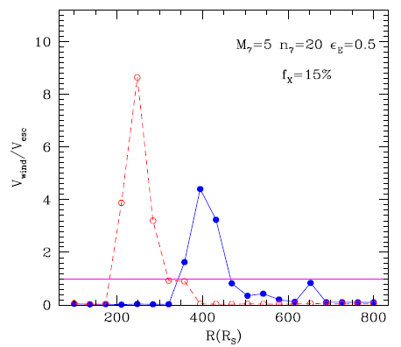
Scale up to AGN
UV comes from further out for lower mass for same L/LEdd as disc is hotter
If BLR is wind from disc then wind is further away – narrower lines…
Is the BLR a UV line driven disc wind ? Chiang & Murray 1997, Elvis 2000; Risaliti & Elvis 2010
Risaliti & Elvis 2010

Slide 77
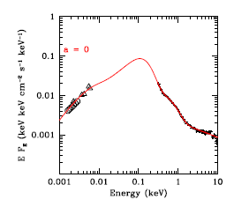
Black Hole spin!
PG1244
M from Hb
0.8 - 8.0×10⁶M
Correct for P_{rad}
2.5×10⁷M
M from Lx variability compared to reverberation mapped sample 0.2 - 2.0×10⁷M
Best fit 0.8L_{edd} 1.7×10⁷M
Done,, Jin, Middleton Ward 2012

Slide 78
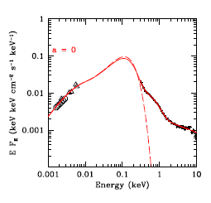
Black Hole spin!
PG1244
Pure disc at this mass and mass accretion rate - a=0
Already goes VERY close to soft X-rays – constrains SPIN
Done,, Jin, Middleton Ward 2012

Slide 79
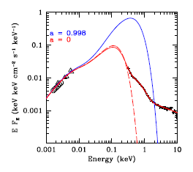
Black Hole spin!
To put maximum spinn need lower disc T ie higher M lower mass accretion rate
Need M>10⁸M
Withing mass limits get a<0.6
Done,, Jin, Middleton Ward 2012

Slide 80
Conclusions: BHB-AGN
Use BHB to understand (characterize) accretion
See disc down to last stable orbit at high L/Ledd !!
Disc progressively recedes below L/Ledd<0.01
moving radius, moving QPO Lense-Thirring precession?
Scale to AGN: different BHB spectral states mean different ionising spectra so different optical line ratios
Unabsorbed LINERS-S1-NLS1 increasing L/L_{Edd} and decreasing M (downsizing) so L often SAME!
DON’T assume Lopt/Lbol or Lx/Lbol constant or L
LINERS – low/hard state
NLS1 – disc dominated with SMALL SX – can get spin!
S1/QSO don’t look like any BHB state – wind??

Slide 81
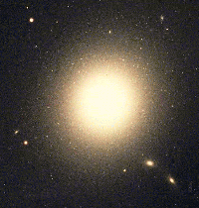
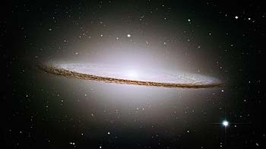
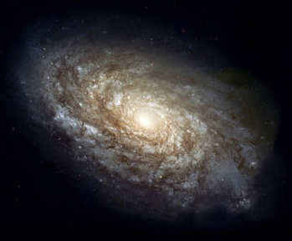
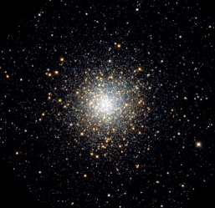
Mass of AGN??
Magorrian-Gebhardt relation gives BH mass!! Big black holes live in host galaxies with big bulges! Either measured by bulge luminosity or bulge mass (stellar velocity dispersion) or BLR
10⁵⁻¹⁰M
10⁹
Black hole mass
10³
10⁶
Stellar system mass
10¹²
Notes:
Scaling these models up to the supermassive black holes in quasars, the only change should be that the disc emission is in the UV rather than X-ray region. The problem is knowing how far to scale them for an individual qso, knowing the BH mass. This has only recently become possible with the discovery of the relationships between the BH mass and the properties of the galaxy as a whole. Big BH live in big galaxies, little BH live in small ones. Also, only recently that enough high s/n data has become available to test these models – xmm-newton database

Slide 82
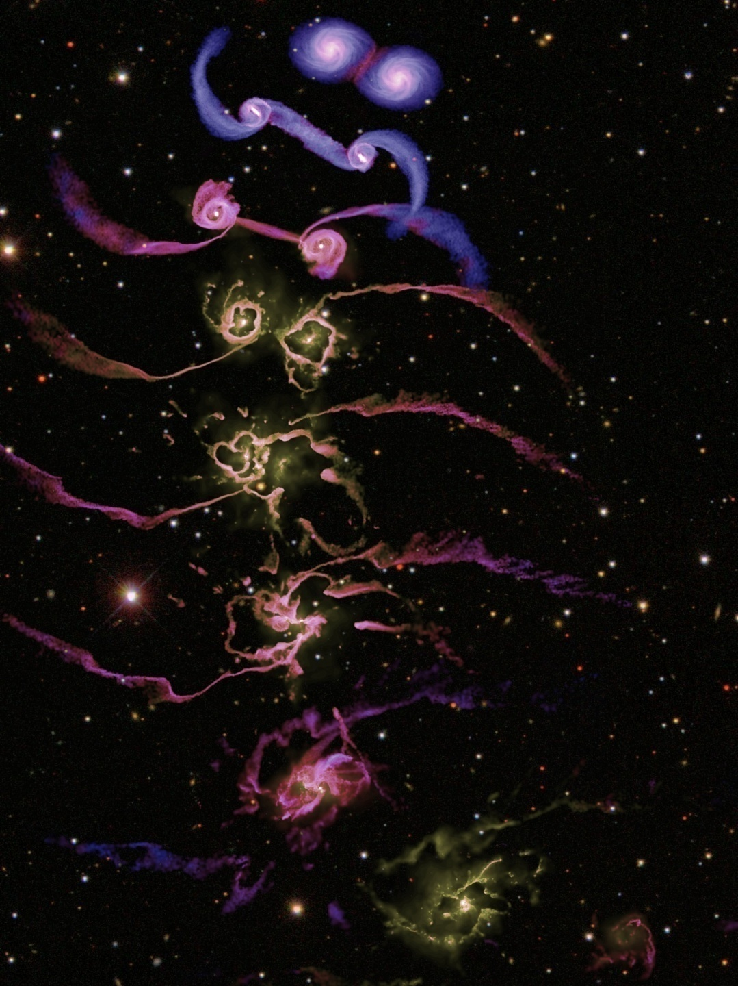
Black holes in AGN grow by accretion
Gas supply to nucleus
Galaxy disc instabilities
Major mergers
Minor mergers
Cooling flow of hot gas from halo
Regulated by feedback
Supernovae
Kinetic energy from jet
Momentum from wind and/or radiation
Need to understand accretion to understand feedback
Di Matteo et al 2005

Slide 83
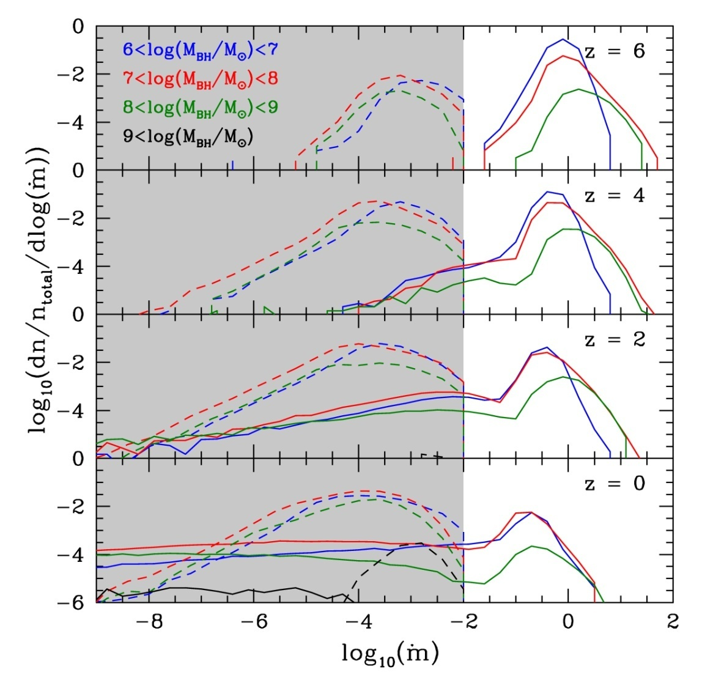
Black hole mass accretion rate
Fanidakis et al 2010
Now need a prescription to link M and L/Ledd to the jet kinetic power
And another prescrition to link jet power to radio power (also depends on M and L/Ledd)
Does it also depend on spin??

Slide 84
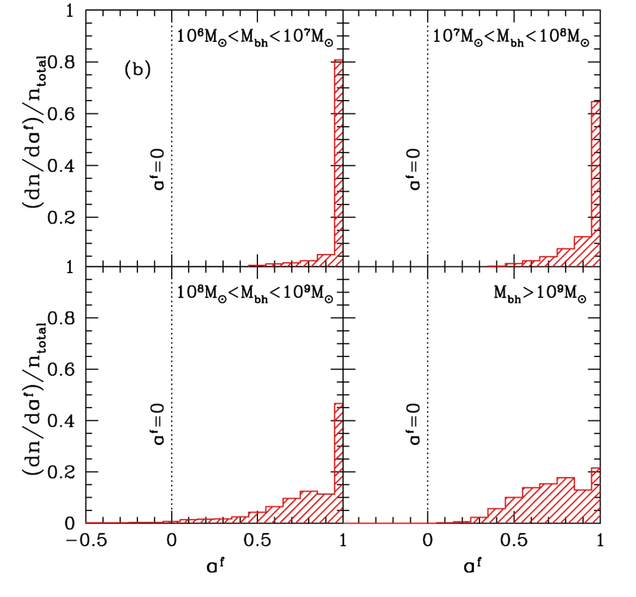
Black hole mass and spin
Fanidakis et al 2010
Prolonged accretion?
Typical mass available in each accretion episode is > M_{BH} so spin BH up to maximal a ~ 1
BH – BH mergers spin DOWN the most massive BH to 0.7

Slide 85
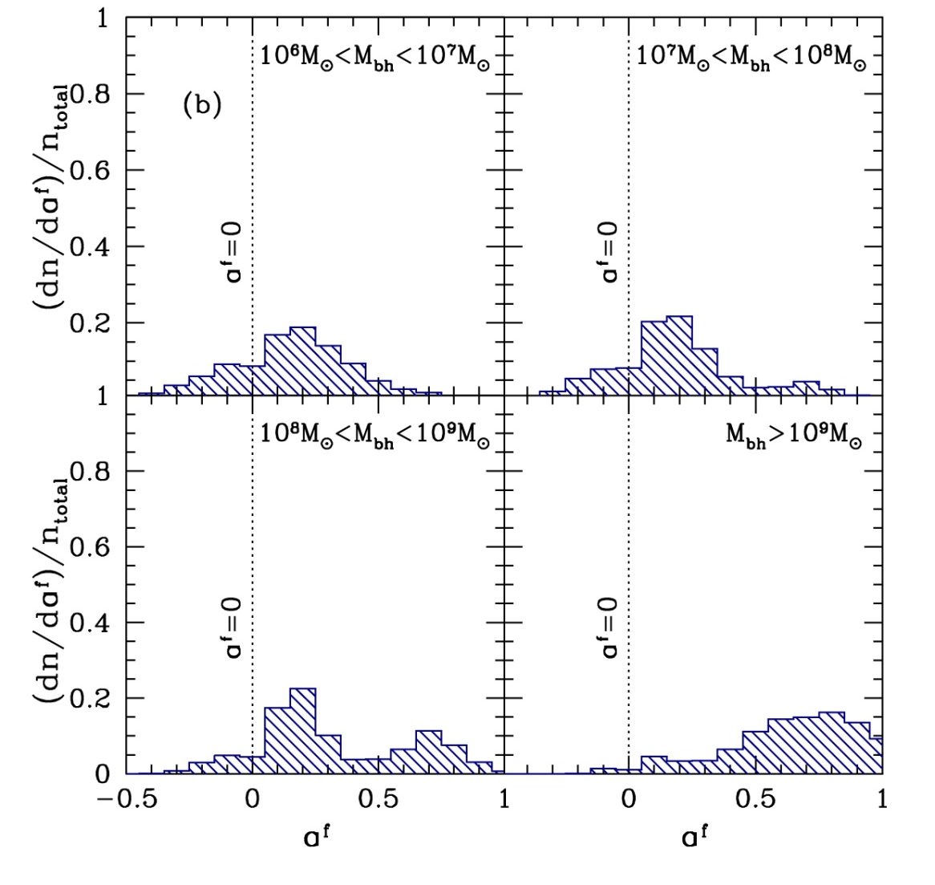
Black hole mass and spin
Fanidakis et al 2010
Chaotic accretion?
Mass of thin disc limited by self gravity to ~ (H/R) M_{BH} (King et al 2008)
Each accretion episode splits up into multiple events with randomised direction
Low spin except for most massive BH where mergers spin UP

Slide 86
Conclusions: BHB-AGN
BHB - disc down to last stable orbit at high L/Ledd !!
Test of GR in strong field limit
Disc progressively recedes below L/Ledd~0.01
Moving disc explains moving characteristic frequencies in power spectrum – QPO as Lense-Thirring precession ?
AGN

Slide 87
AGN/QSO Zoo!!! Radio loud
Some have enormous, powerful jets on Mpc scales
How QSO first found. But now most known to be radio quiet
FRI (fuzzy lobes, 2 sided jet) FRII (bright hot spot, 1sided jet)
Notes:
Scaling these models up to the supermassive black holes in quasars, the only change should be that the disc emission is in the UV rather than X-ray region. The problem is knowing how far to scale them for an individual qso, knowing the BH mass. This has only recently become possible with the discovery of the relationships between the BH mass and the properties of the galaxy as a whole. Big BH live in big galaxies, little BH live in small ones. Also, only recently that enough high s/n data has become available to test these models – xmm-newton database

Slide 88
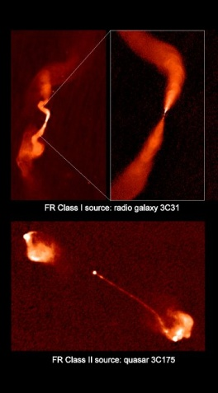
FRI is top of ADAF branch
Ghisellini et al 2010

Slide 89
L/Ledd < 0.01 ADAF FRI,
weak disk, low excitation
Broader, slower
L/Ledd~1 Disc+tail FRII
strong disk, high excitation
Faster, narrower (Krause et al 2011)
Log ν f(ν)
Log ν f(ν)
Log ν
Log ν
Notes:
The disc models assumed that the emission thermalised. That’s not necessarily true at low L/Ledd where the flow is not very dense. If its not thermalising then its not cooling as efficiently so the flow heats up. This can lead to a hot, optically thin, geometrically thick inner flow replacing the inner disc. The hot electrons in this flow can compton upscatter any low energy photons from a residual outer disc, but there are not many of these, so the spectrum is hard

Slide 90
An additional component
Gierlinski & Done 2004
ALL PG QSO need soft excess! This is very gradual and smooth, not steep, though strength varies
Generally too hot to be the disc – we know mass and L/LEdd from optical and Hβ

Slide 91
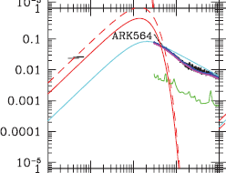
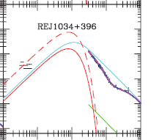
But some discs do get close…
Low mass, high L/L_{Edd} – NLS1 !!
Typically the objects with the biggest SX if just fit X-ray ….
Middleton et al 2007

Slide 92
So what do AGN look like?
Co-add models in 3 bins of L/L_{Edd}
Correlates with M due to galaxy formation. high mass objects have low L/L_{Edd} in local Universe – downsizing
Physical model so shift to same mass M=10⁸ to compare with BHB
M=10⁷ L/L_{Edd}~1
L/L_{Edd}~1
M=10⁸
L/L_{Edd}~0.2
L/L_{Edd}~0.2
L/L_{Edd}~0.06
M=2x10⁸ L/L_{Edd}~0.06
Done et al 2011

Slide 93
Low/hard to high/soft ?
Looks good to zeroth order… but….
Transition at L/LEdd=0.02 in steady state accretion - 0.2 in AGN
Green/blue are classic QSO NOT LINERS – not low/hard state as no jet! Disc shape very strange, soft X-ray excess….
M=10⁷ L/L_{Edd}~1
BHB 10 M
L/L_{Edd}~1
M=10⁸
L/L_{Edd}~0.2
L/L_{Edd}~0.2
AGN 10⁸ M
L/L_{Edd}~0.06
M=2x10⁸ L/L_{Edd}~0.06
Done et al 2011

Slide 94
Classic QSO?
It’s the classic QSO shape which is strange. Not low/hard as no jet, and strange soft excess…. WHICH IS REAL
Mkn 509 (Suzaku SX constant, PL varies Noda et al 2011) !
Different disc structure due to wind mass loss ???????
Medhipour et al 2011

Slide 95
Classic QSO?
It’s the classic QSO shape which is strange. Not low/hard as no jet, and strange soft excess…. WHICH IS REAL
Mkn 509 (Suzaku SX constant, PL varies Noda et al 2011) !
Different disc structure due to wind mass loss ???????
Noda et al 2011

Slide 96
And at lower energies…
RXTE misses peak of disc..
XMM-Newton can see it directly still get good fits to constant radius disc models, though some residuals at the 5% level even with BHSPEC.
Best disc models are not quite up to describing real data at the <5% level
And still a few dirty things in the calibration
Kolehmainen et al 2012

Slide 97
Moving disc
Kolehmainen Done & Diaz Trigo 2012
Iron line should be very small and narrow for low L/LEdd
Gets bigger and broader as disc moves in
XMM-Newton timing mode - Kolehmainen Done & Diaz Trigo 2011 cf Tomsick et al 2010

Slide 98
QPO and broadband noise
Low frequency QPO moves with low frequency break
Wijnands & van der Klis 1989

Slide 99
Origin of variability: MRI
Krolik, de Villiers, Hawley

Slide 100
f_{b}
f_{h}
log[fP(v)]
log[f]
Notes:
100

Slide 101
f_{b}
f_{h}
log[fP(v)]
log[f]
Notes:
101

Slide 102
f_{b}
f_{h}
log[fP(v)]
log[f]
Notes:
102

Slide 103
Propagating fluctuations
This gives the noise spectrum EMMITED at each annulus
Lyubarskii 1997; Arevalo & Uttley 2006, Kotov et al 2001

Slide 104
Fitting to XTE J1550-564
r_{o}=68.0

Slide 105
Fitting to XTE J1550-564
r_{o}=45.7

Slide 106
Fitting to XTE J1550-564
r_{o}=25.0

Slide 107
Fitting to XTE J1550-564
r_{o}=16.3

Slide 108
Fitting to XTE J1550-564
r_{o}=12.8
Ingram & Done 2011

