Slide 1












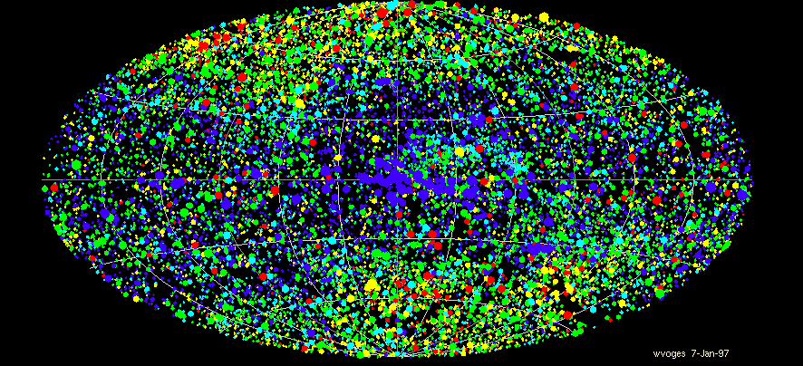


Science with eROSITA all-sky surveys: an outlook
Andrea Merloni (MPE)
on behalf of the eROSITA team

Slide 2

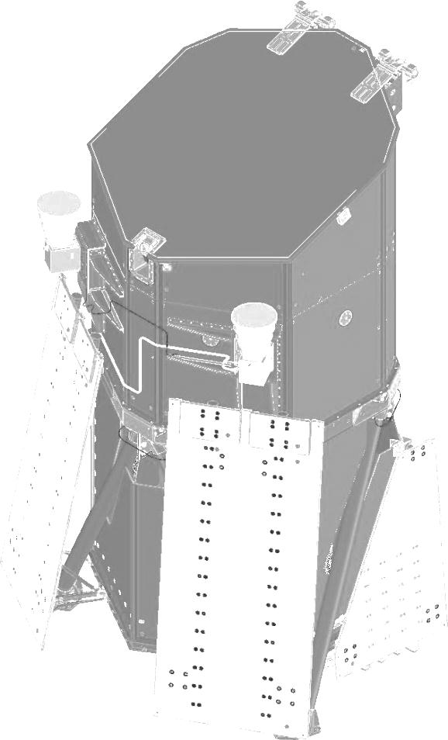

eROSITA Collaboration
PI: Peter Predehl; PS: A. Merloni (MPE)
Core Institutes (DLR funding):
MPE, Garching/D
Universität Erlangen-Nürnberg/D
IAAT (Universät Tübingen)/D
SB (Universität Hamburg)/D
Astrophysikalisches Institut Potsdam/D
Associated Institutes:
MPA, Garching/D
IKI, Moscow/Ru
USM (Universität München)/D
AIA (Universität Bonn)/D
Industry:
Media Lario/I Mirrors, Mandrels
Kayser-Threde/D Mirror Structures
Carl Zeiss/D ABRIXAS-Mandrels
Invent/D Telescope Structure
pnSensor/D CCDs
IberEspacio/E Heatpipes
RUAG/A Mechanisms
HPS/D,P MLI
+ many small companies
MPE: Scientific Lead Institute, Project Managment
Instrument Design, Manufacturing, Integration & Test
Data Handling & Processing, Archive etc.
A. Merloni – AEI - 11/2012

Slide 3
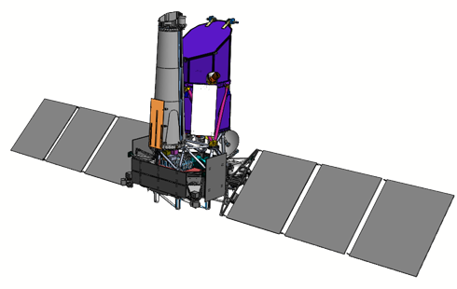
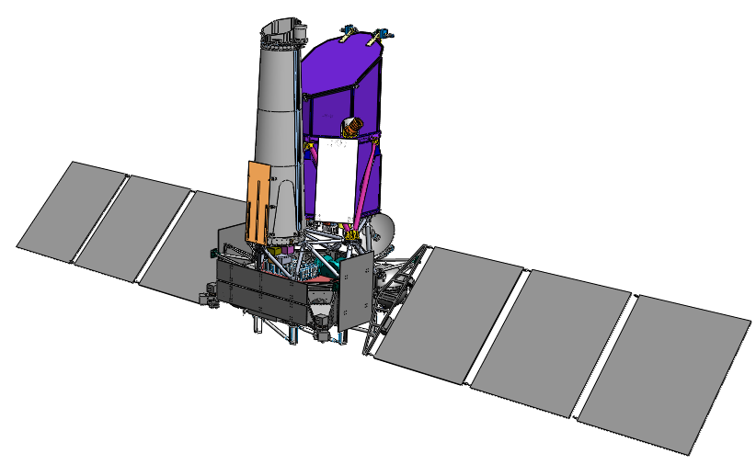
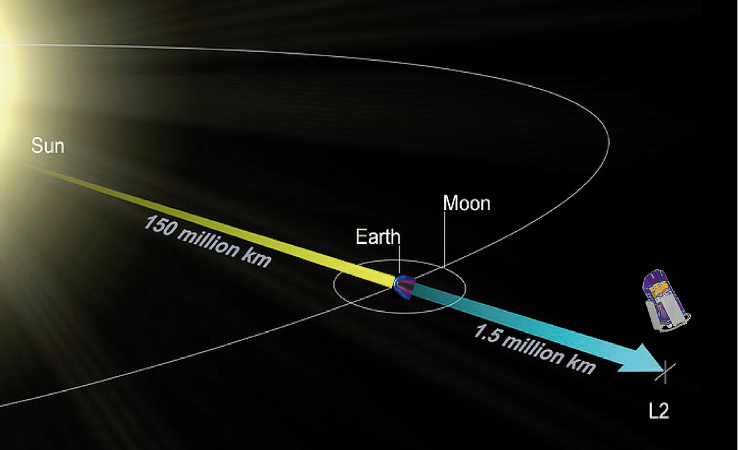
eROSITA on SRG: the Mission
ART-XC
IKI
eROSITA
MPE
Navigator
NPO Lavochkin
Launch: Q4 2014 from Baykonour
3 Months: flight to L2, verification and calibration phase
4 years: 8 all sky surveys (scanning mode: 6 rotations/day, 1 degree advance per day)
3.5 years: pointed observation phase, including ~20% of GTO. 1 AO per year
Proprietary data rights shared 50/50 between MPE (Germany) and IKI (Russia)
German (MPE) half: proprietary period 2 yrs
Public Release of all-sky scan data ~ every year

Slide 4
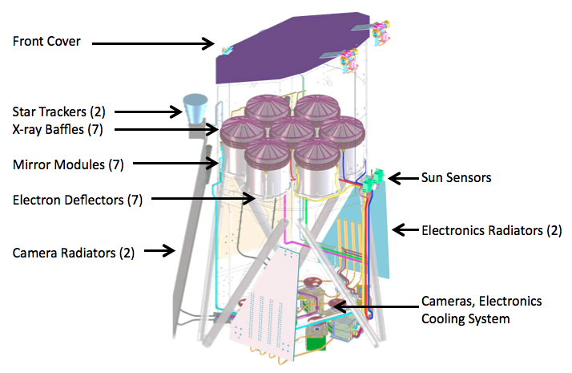
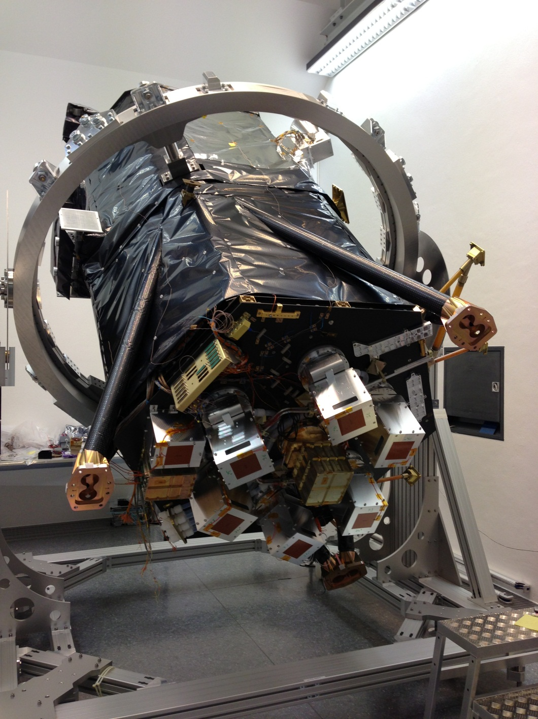
eROSITA Telescope
www.mpe.mpg.de/eROSITA
7 identical telescopes (Wolter-I/ pnCCD-cameras)
Energy range: 0.5-10 keV
Energy resolution: 138 eV @ 6 keV
Effective Area: ~1400 cm2 (@1keV)
Focal length 1.6 m
F.o.V. = 0.81 sqdeg
54 nested mirror shells
Total weight ~800 kg

Slide 5
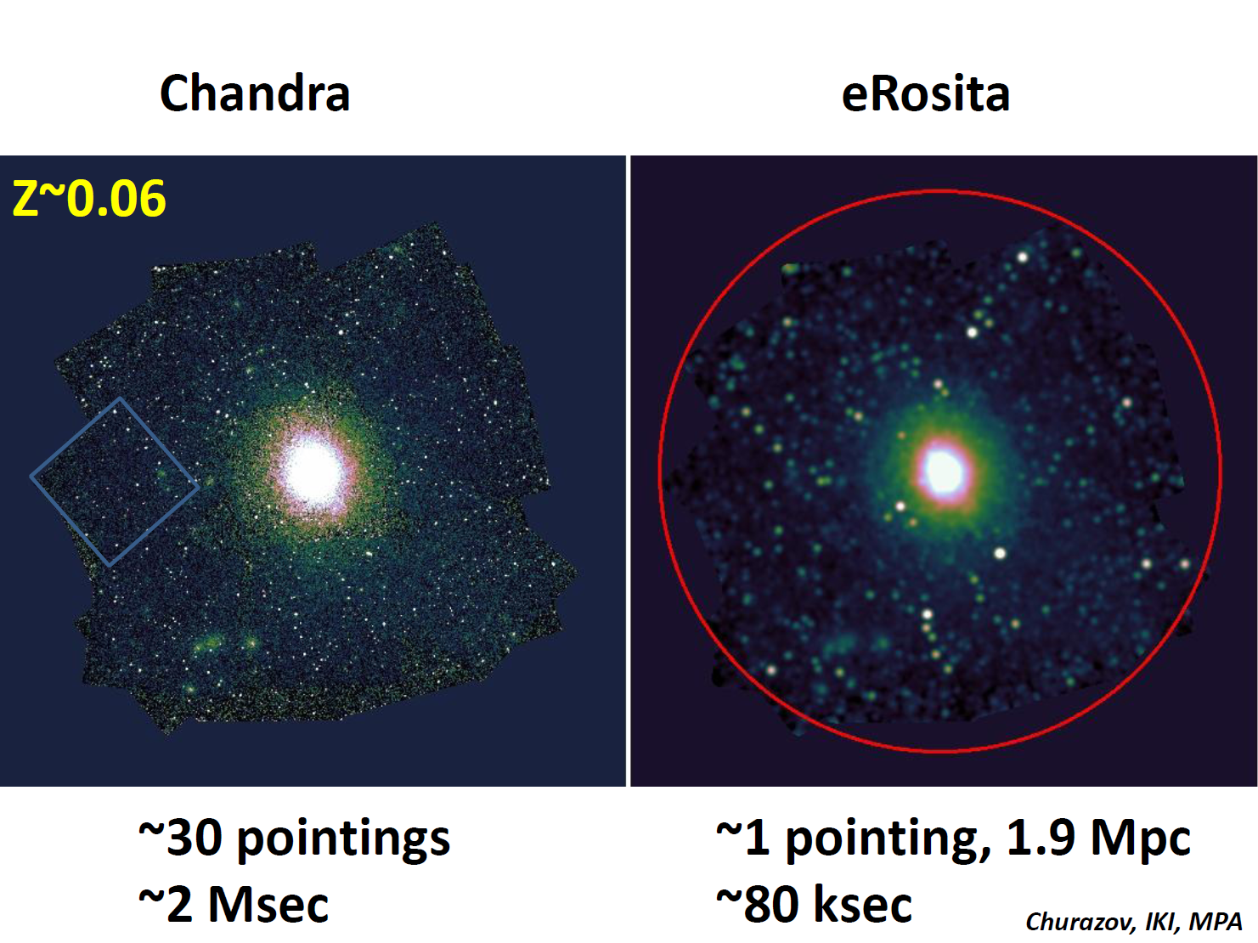
Grasp

Slide 6
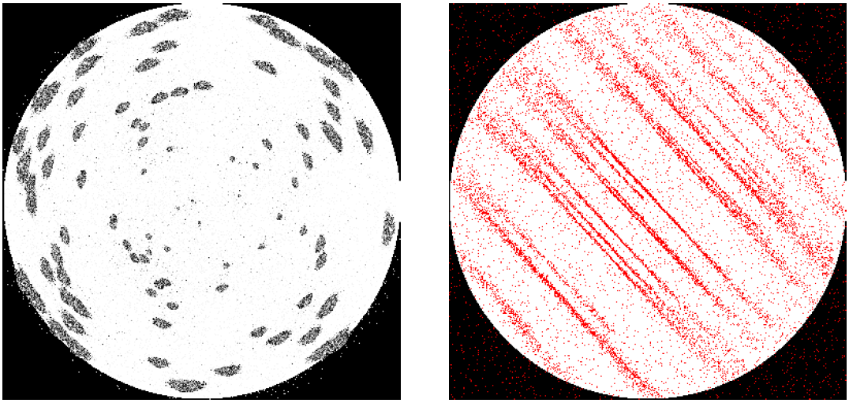
eROSITA PSF
Pointing Survey
Off-axis blurring of a Wolter-I telescope:
PSF has to be averaged over the FoV
15-17 arcsec on-axis ➔ 28-25 arcsec averaged

Slide 7
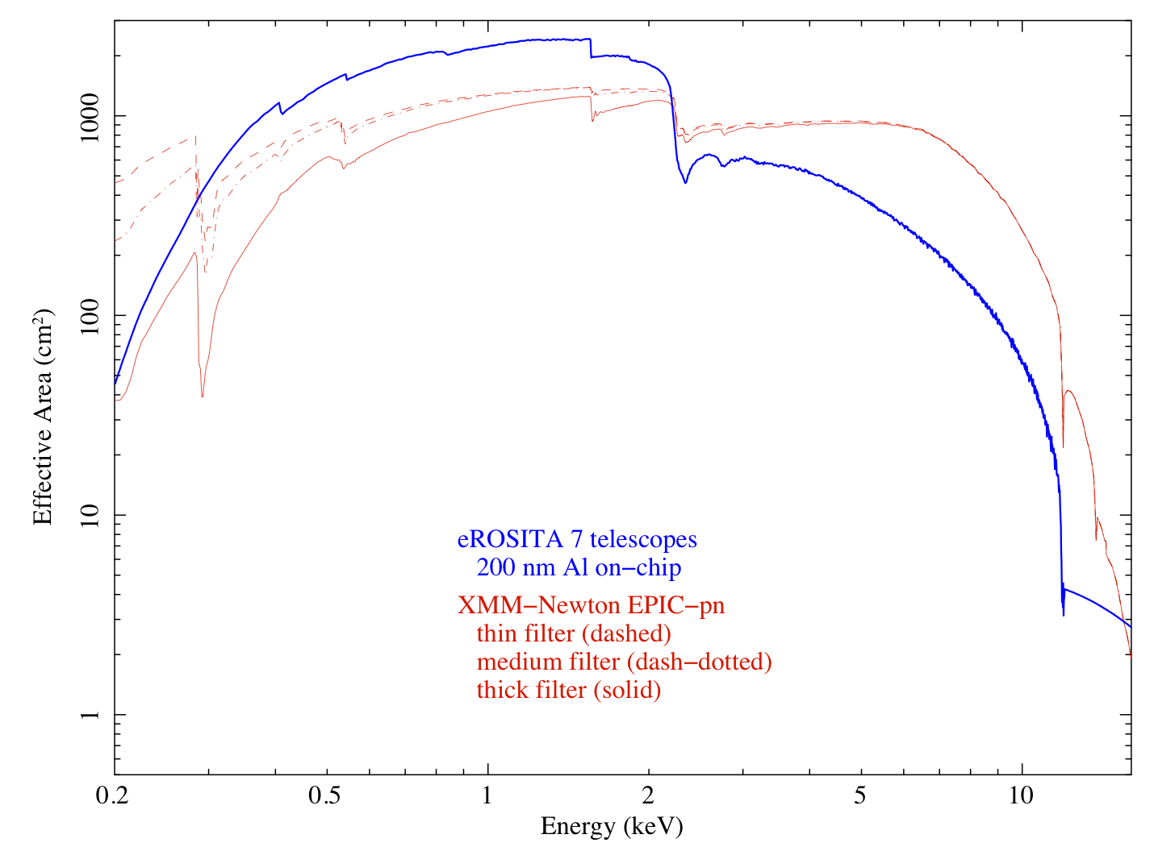
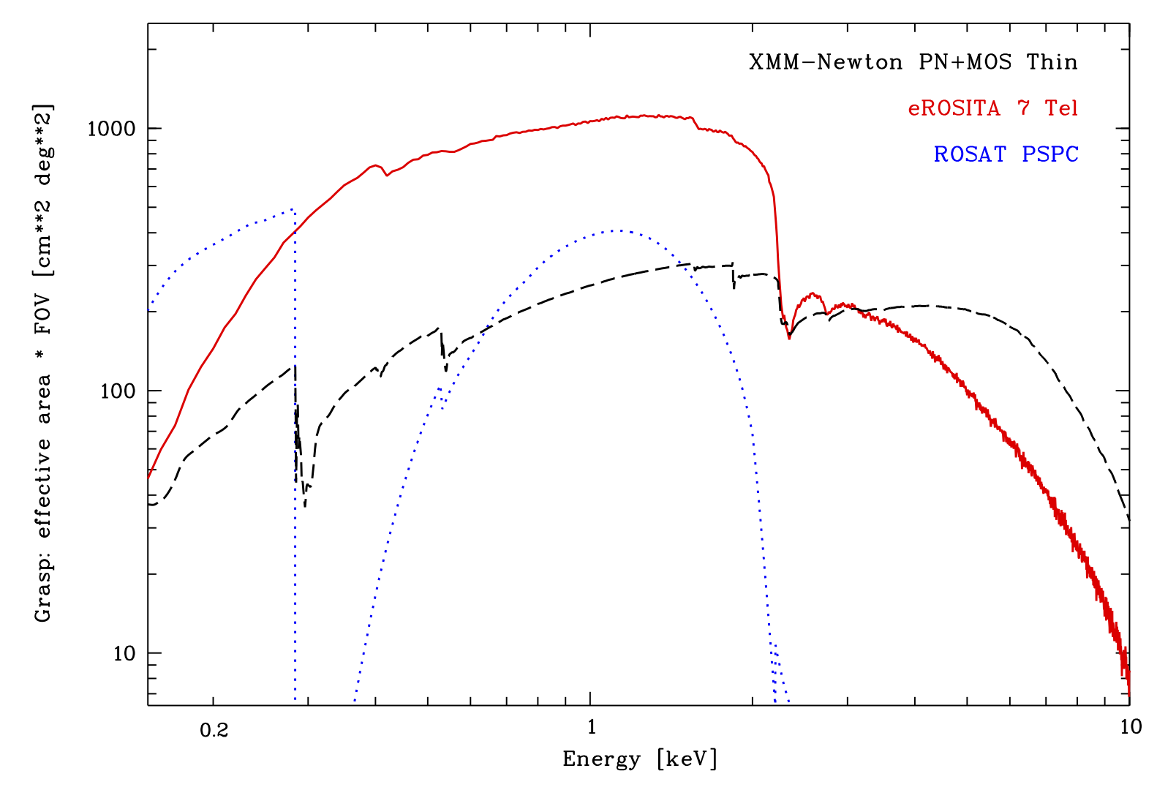
Effective area and grasp
Effective Area
Grasp

Slide 8
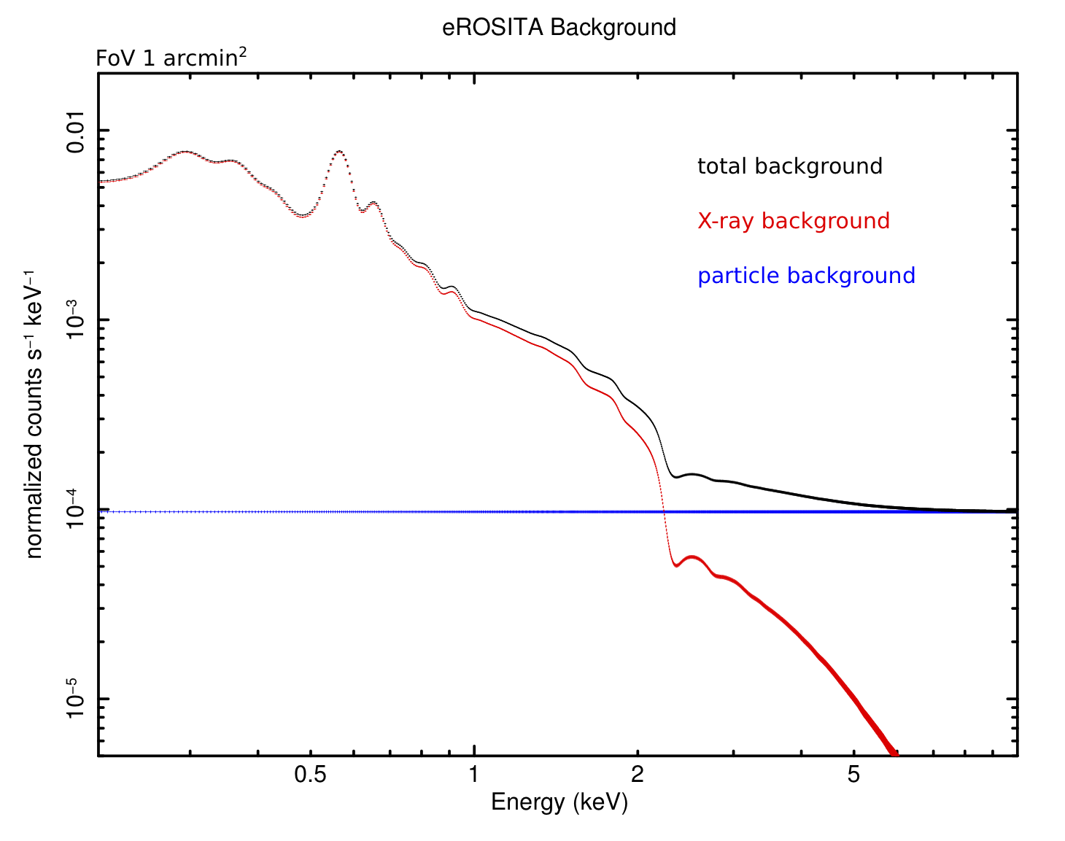
Background

Slide 9
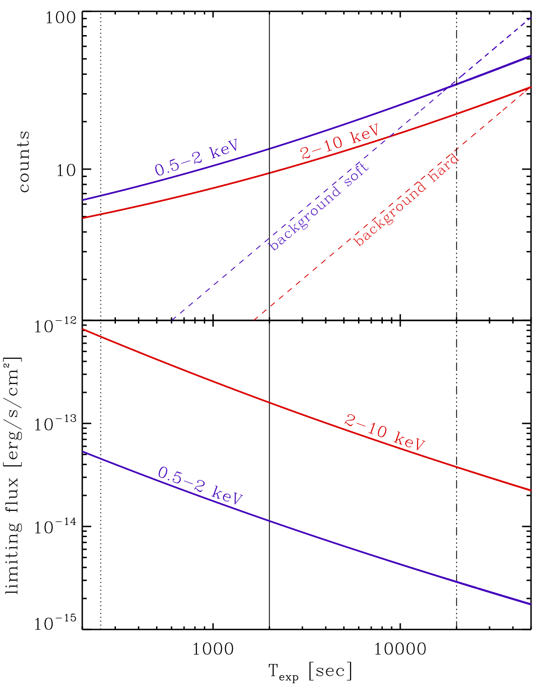
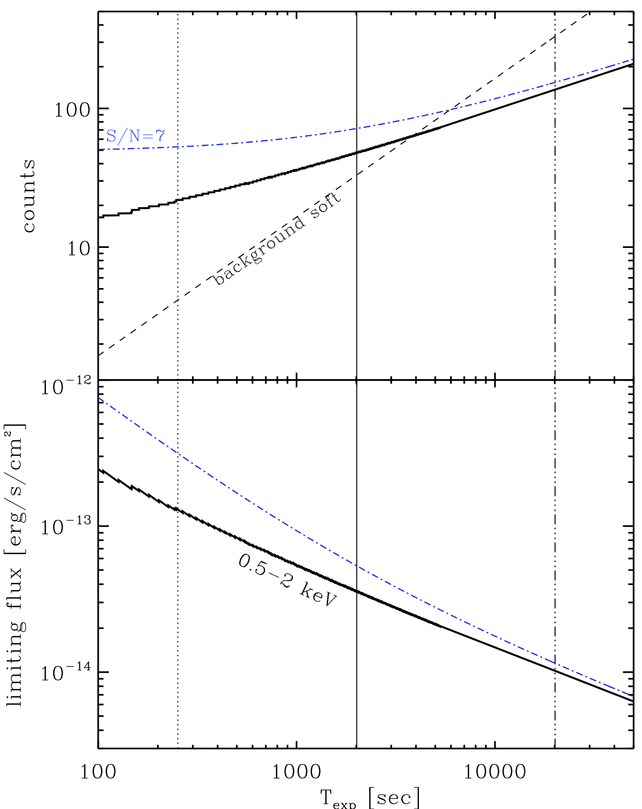
eROSITA sensitivity estimates
Point sources (AGN)
Extended sources (Clusters)
Deep area
Deep area
6 months
6 months
4 yrs
4 yrs

Slide 10
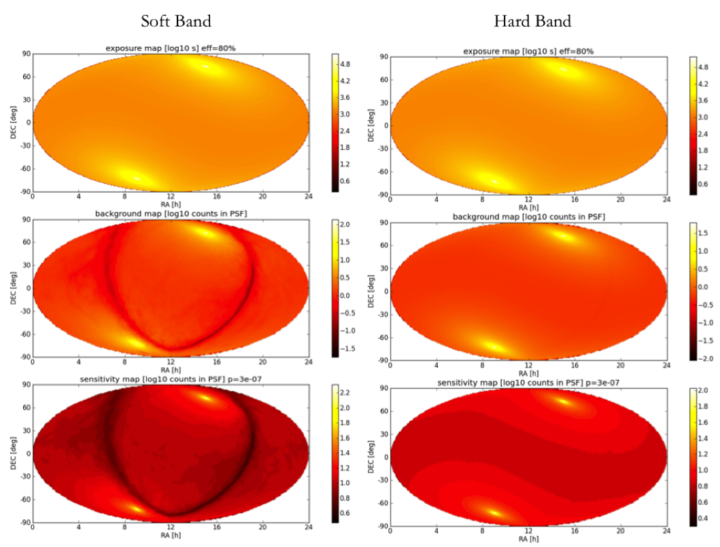
The eROSITA All-Sky Survey
~ 2 ks
~ 20 ks
exposure
background
sensitivity
Merloni et al. 2012

Slide 11
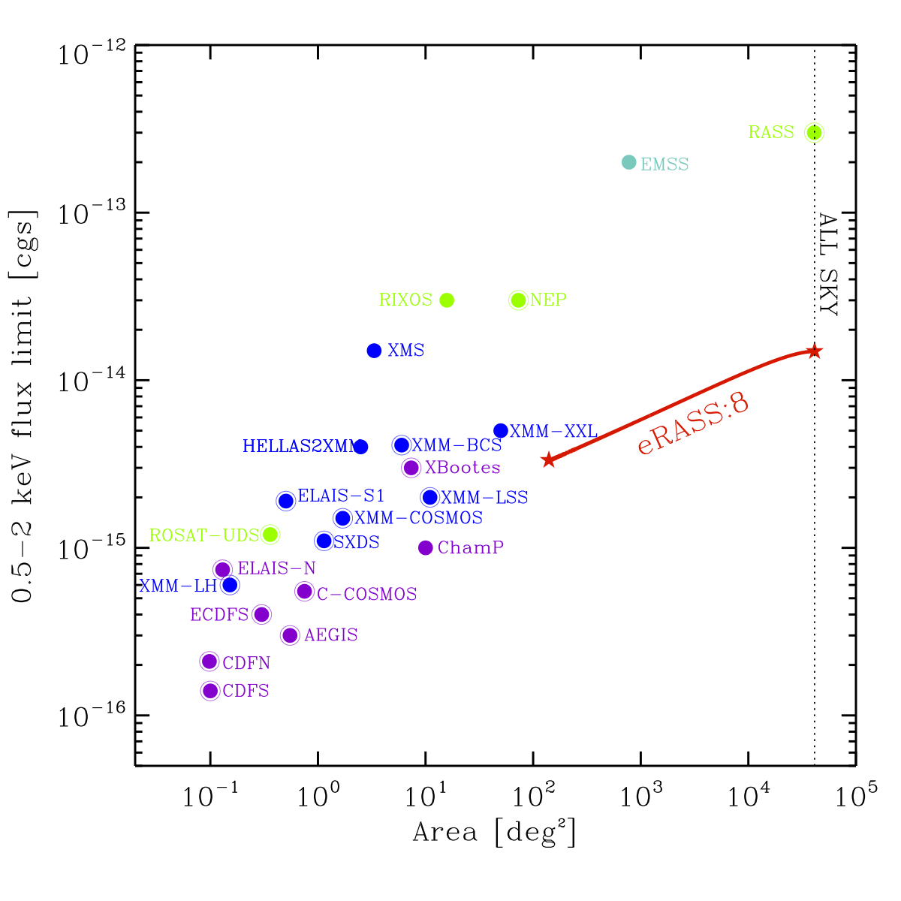
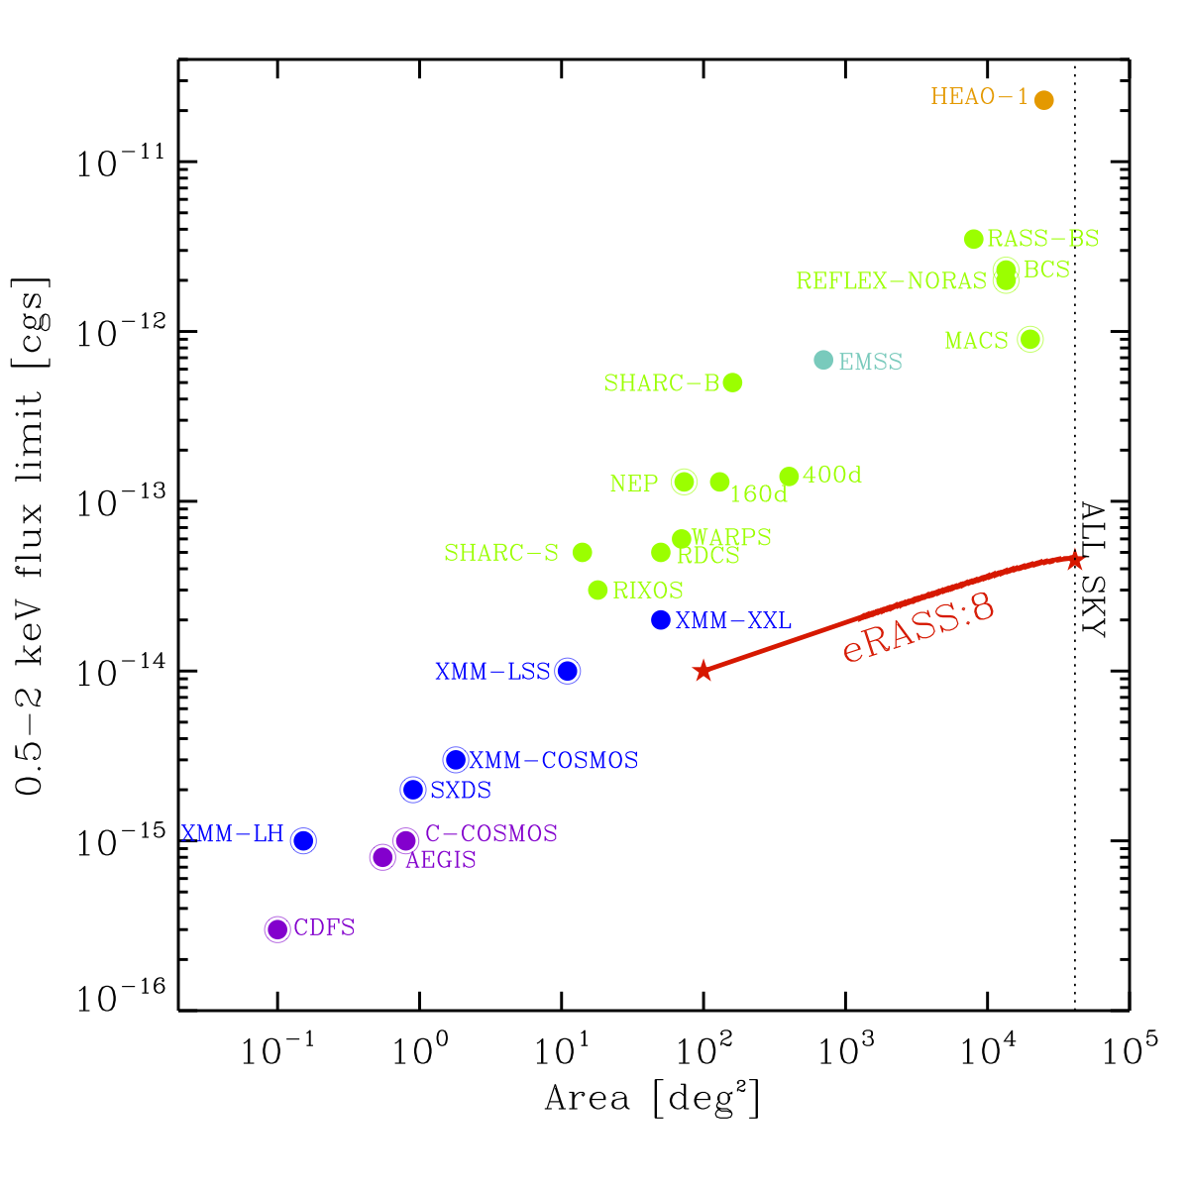
eROSITA surveys in context
Point sources (AGN)
Extended sources (Clusters)
All sky: 10⁻¹⁴ (0.5-2 keV)
2×10⁻¹³ (2-10 keV) [erg/cm²/s]
All sky: 3.4 x 10⁻¹⁴ (0.5-2 keV)
Merloni et al. 2012

Slide 12
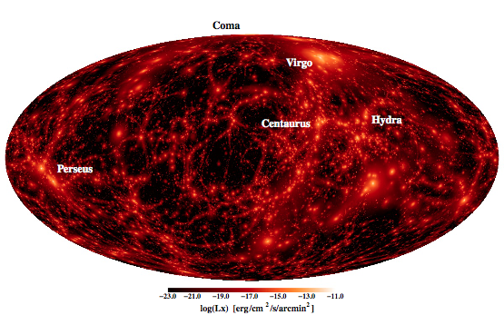
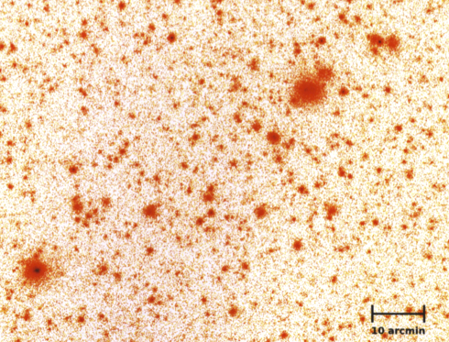
X-rays map “hot-spots” in evolving Large Scale Structure
Diffuse X-ray emitting gas traces the massive knots of the cosmic web (Clusters)
Point sources (Quasars) signpost the growth of black holes
Survey of such highly biased population over large volumes can be done at very high completeness levels!

Slide 13
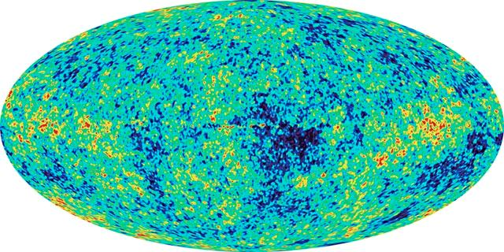
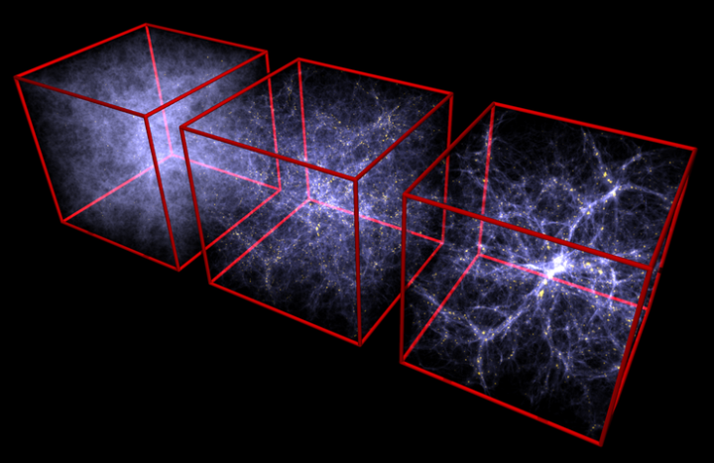
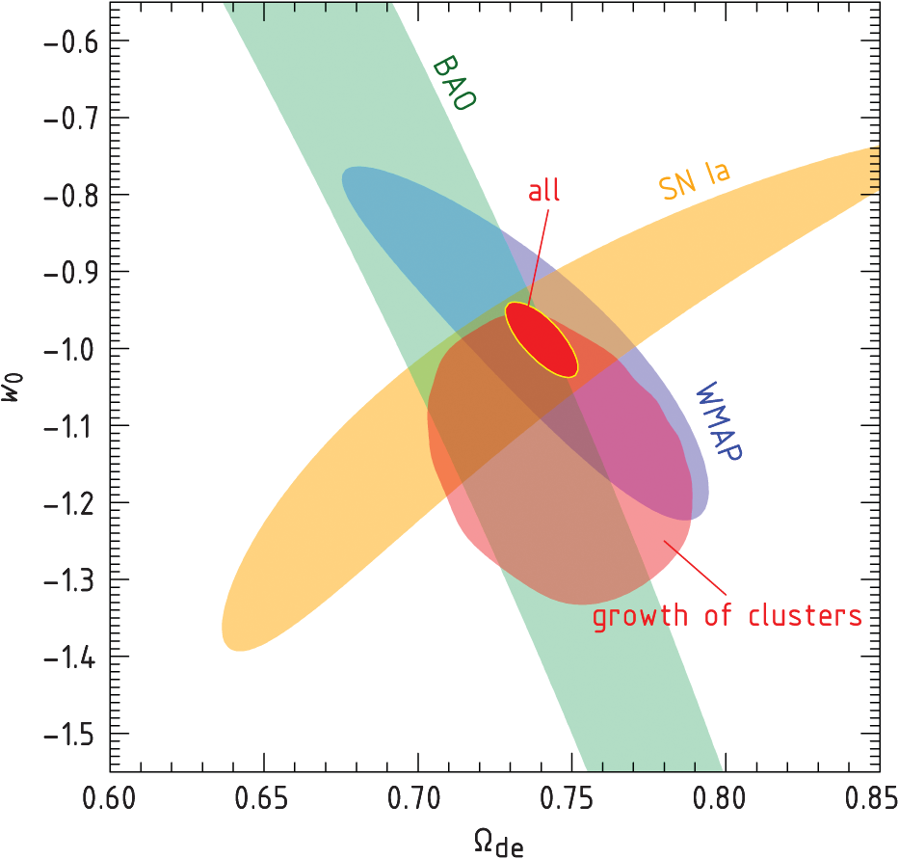
Main science driver:
Cluster Cosmology and the growth of LSS
WMAP, z = 1100
Millennium Simulation
Vikhlinin et al. 2009
ROSAT, z < 0.1
time
Clusters of galaxies are the largest gravitational bound structures
They are exponentially sensitive tracers of LSS
A signature of clusters is the existence of hot, X-ray emitting baryons
Cosmological constraints with (well calibrated) ROSAT samples of <100 obj.

Slide 14
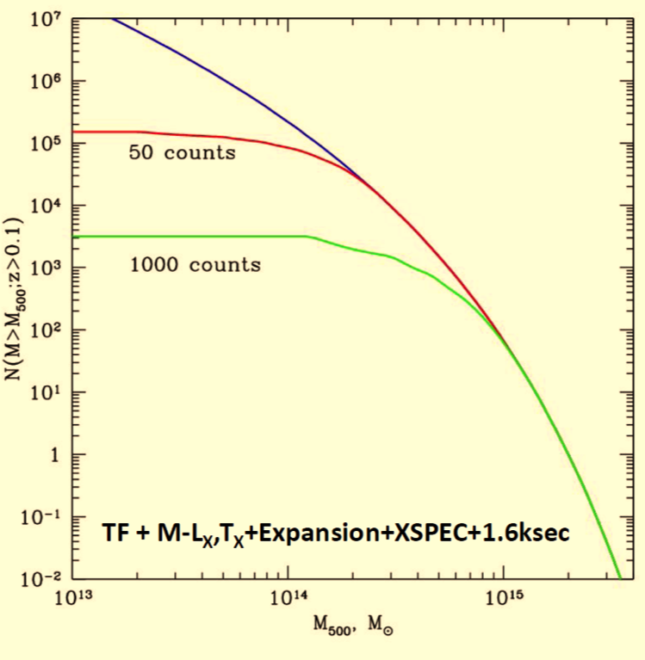
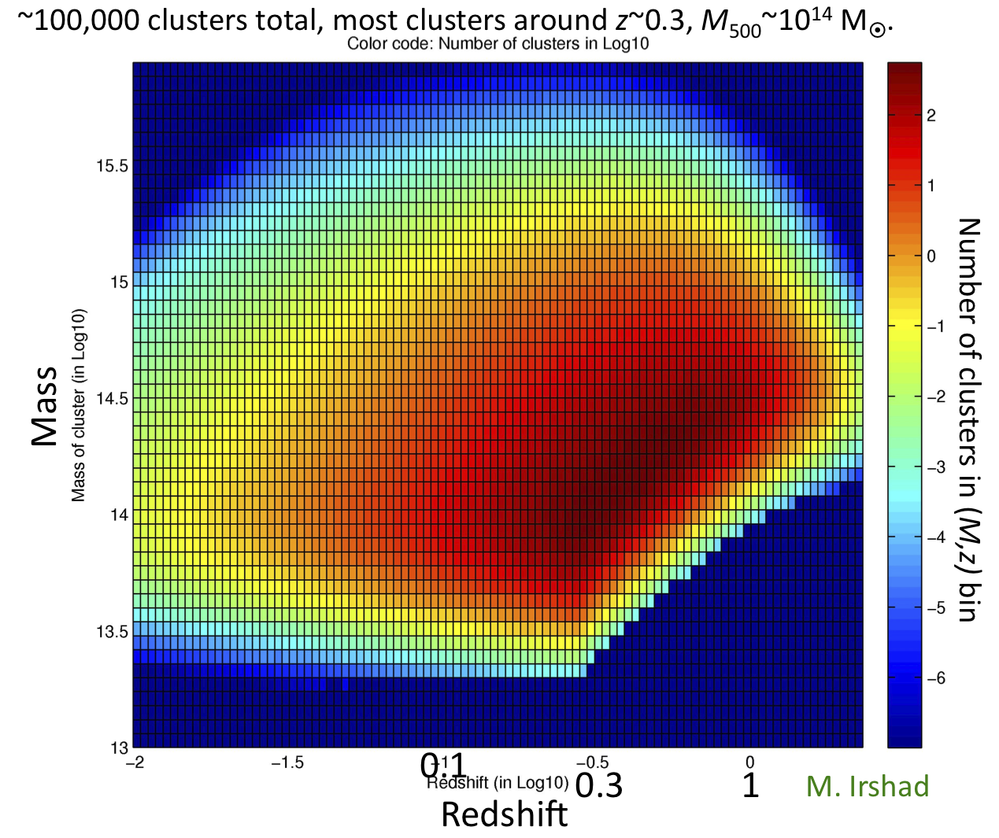
Detect ALL massive clusters
Courtesy of E. Churazov (MPA)

Slide 15
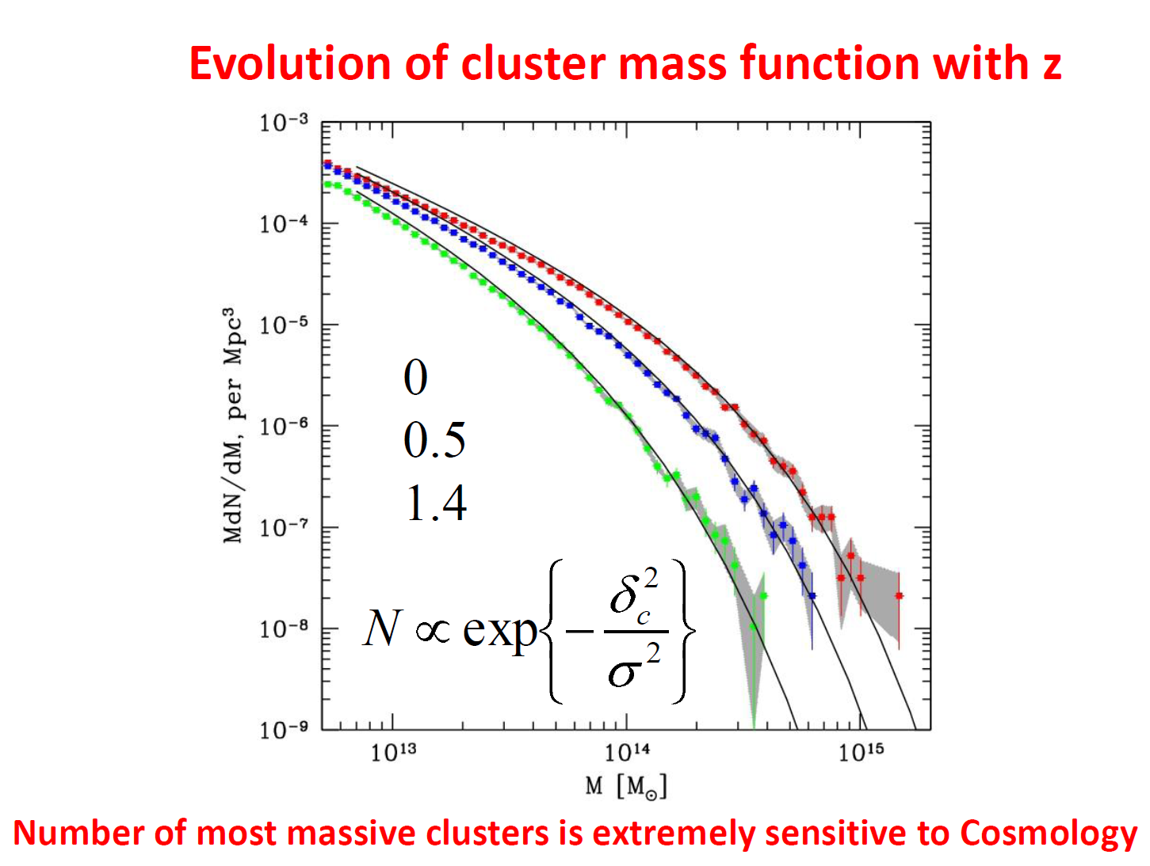
Evolution of Cluster Mass Function
court. Churazov/MPA
z = 0
z = 0.5
z = 1.4
Number of most massive clusters is extremely sensitive to cosmology
Merloni - eROSITA - AEI 11/2012

Slide 16
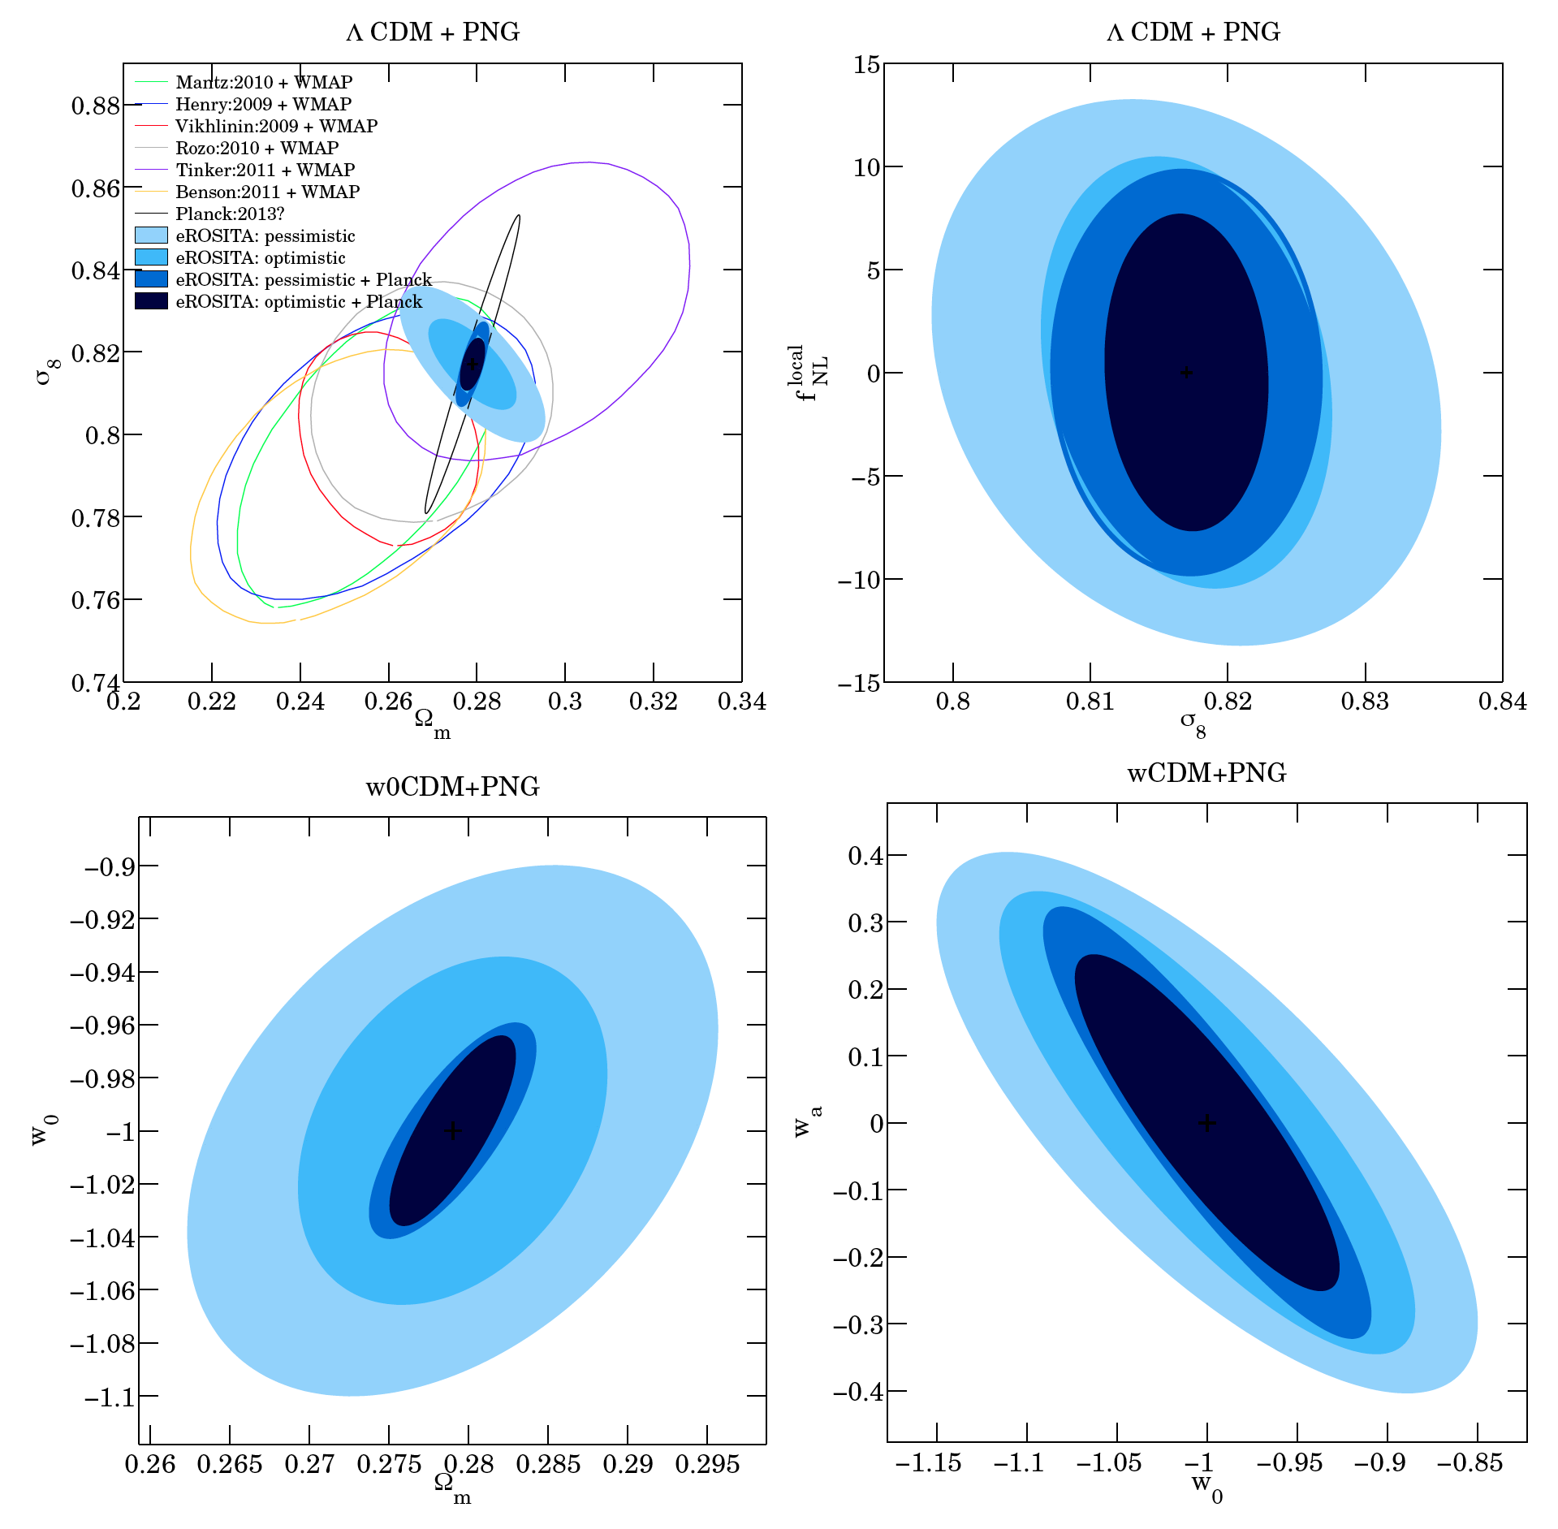
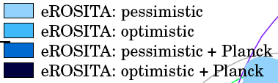
A Stage IV DE experiment
X-ray (eROSITA) selection
Redshift determination
Mass calibration (dedicated follow up)
Cluster Mass function vs. z
Cluster Power Spectrum vs. z
DETF
FoM
(photo-z)
57
103
174
263
(spec-z)
Merloni et al. 2012
Pillepich et al. 2012

Slide 17
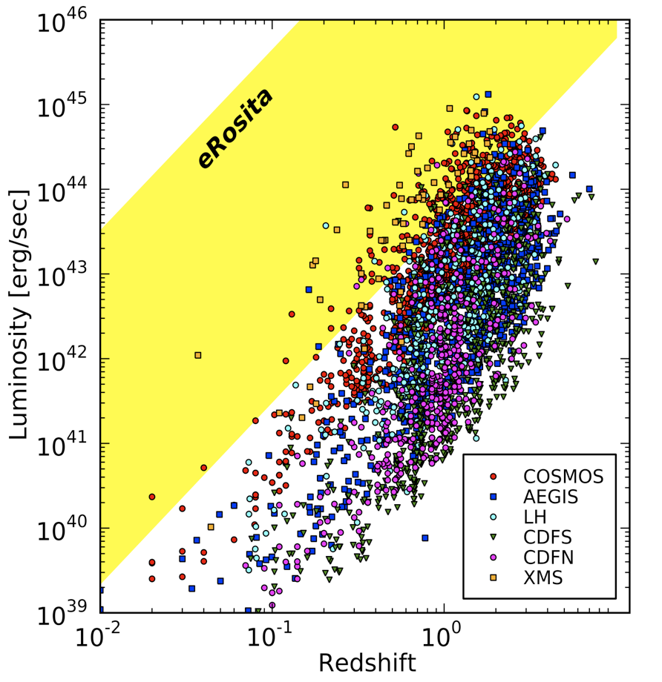
3 Millions eROSITA AGN
L*

Slide 18
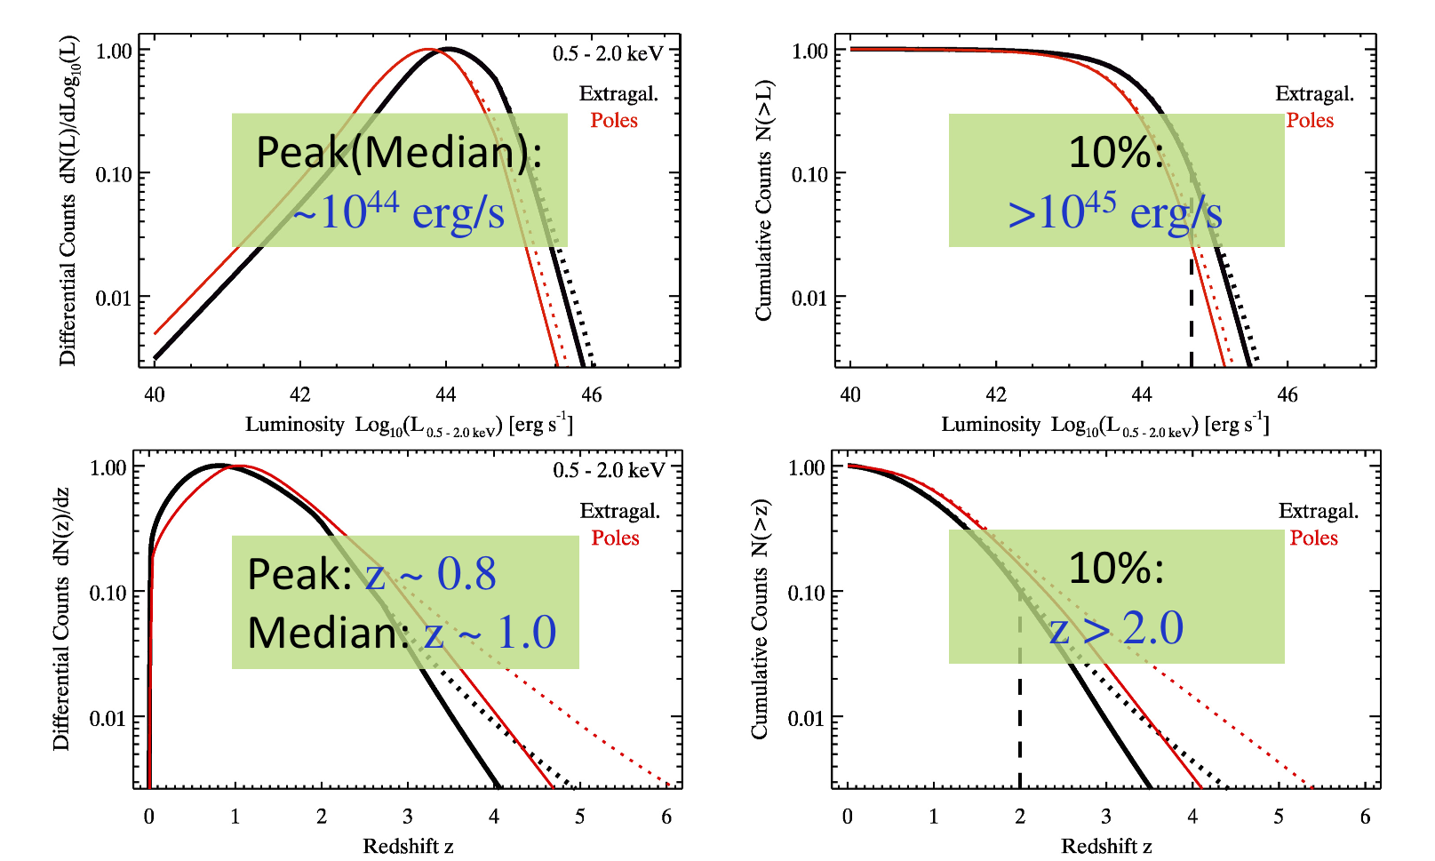
3 Millions eROSITA AGN
Kolodzig et al. 2012
eROSITA will cover uniformly the redshift range 0<z<3
A 3-D map of the “active Universe”

Slide 19
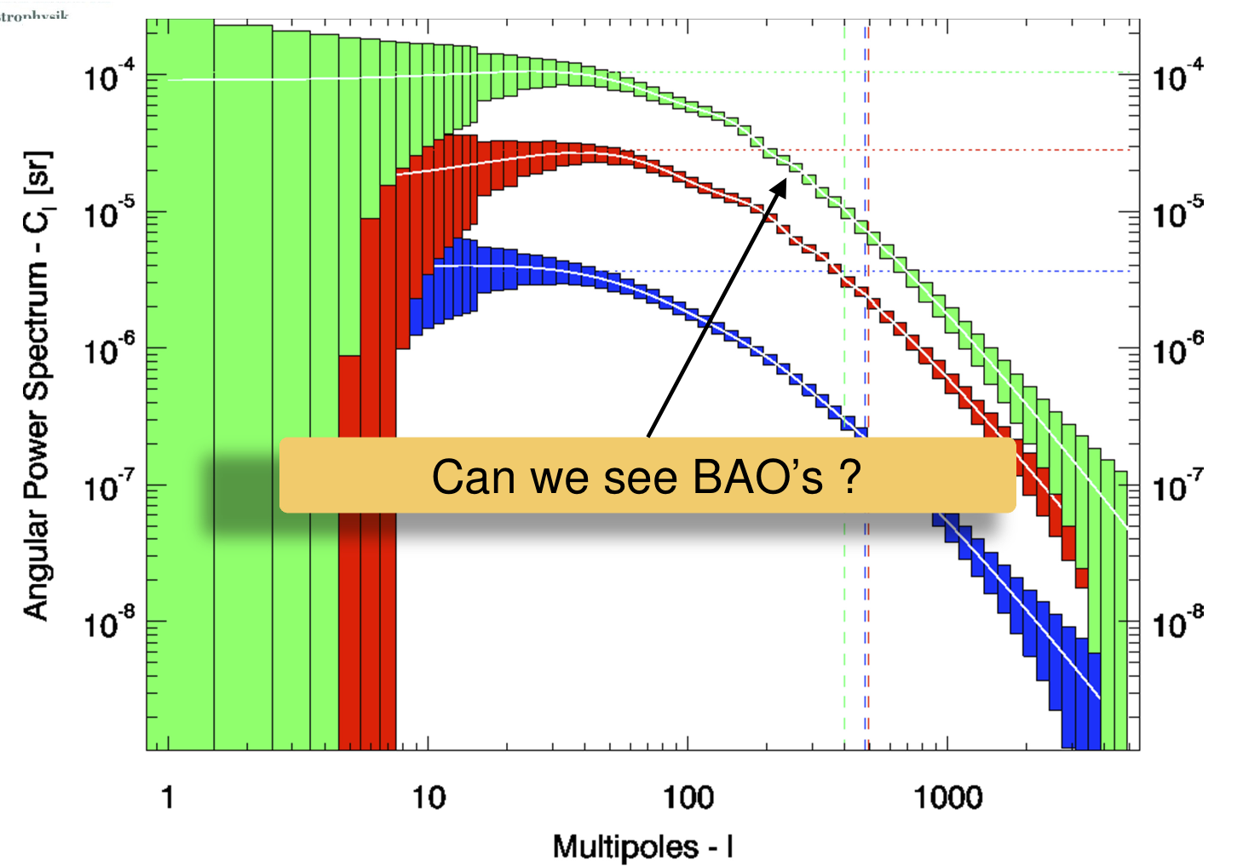
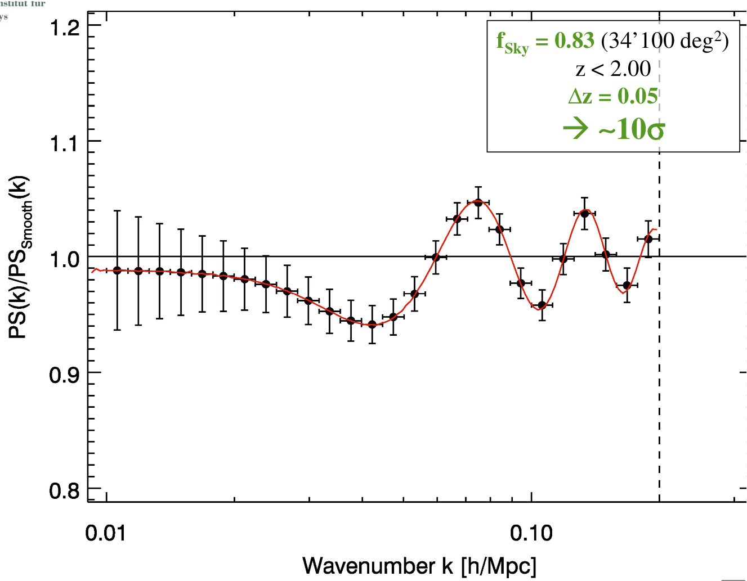
AGN in Large Scale Structure
0.8<z<0.85
0.8<z<1
all
Kolodzig et al. 2012

Slide 20
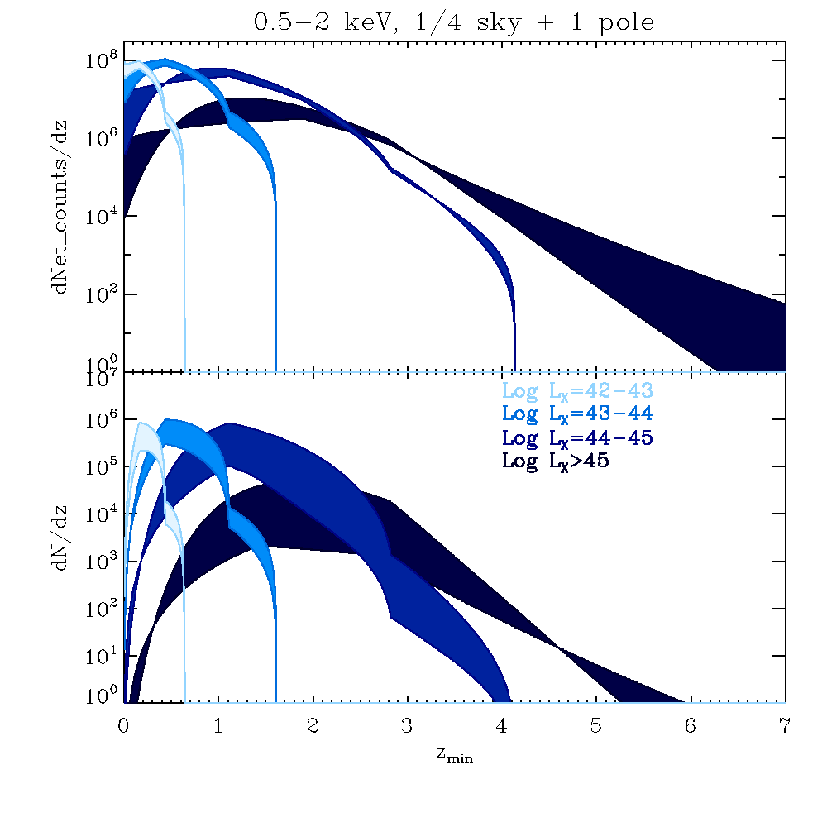
eROSITA power for AGN physics
Stacked AGN “templates” vs. L-z
X-ray Baldwin effect: Narrow/Broad Iron Kα emission line vs. L_{X}
High L/L_{edd}; QSO feedback via disk winds:
    For log L_{X}>45 @z~1 >10⁶ counts in 4-20 keV (rest frame)
    For log L_{X}>45 @z~3 >10⁶ counts in 2-8 keV (rest frame)
Make every X-ray photon count!

Slide 21
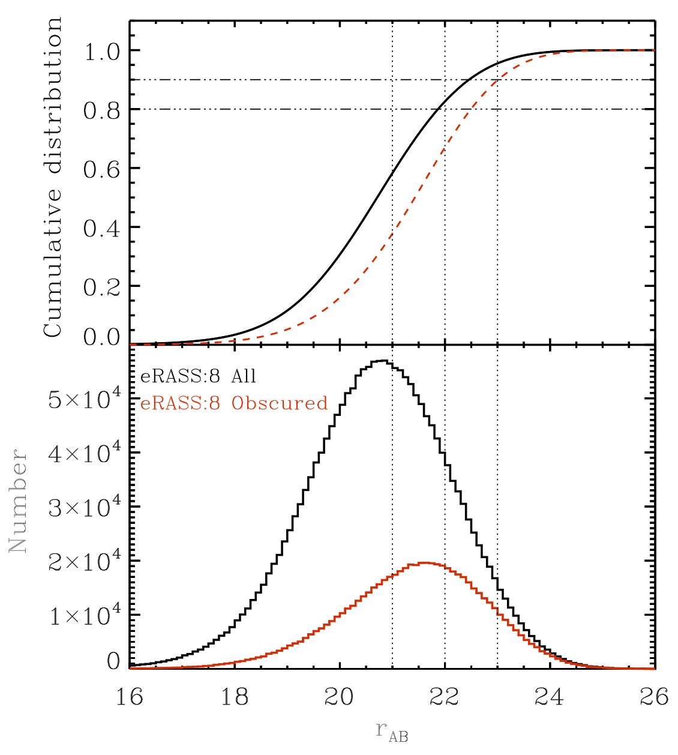
AGN: Can we follow them up?
At these relatively bright X-ray flux levels, X-ray posItional uncertainty is an issue: test with (degraded XMMCOSMOS) = ~87 (+5)% secure ID at i=24 [~60-70% in VHS]
Expected r_{AB} magnitude distribution of 0.5-2 keV selected AGN in eROSITA surveys
Latest 4MOST simulation: close to 90% completeness over the extragal. accessible sky
Looking forward to a highly complete spectroscopic sample of >800k X-ray selected AGN
CALIBRATED ON XMM-COSMOS
Merloni et al. 2012

Slide 22
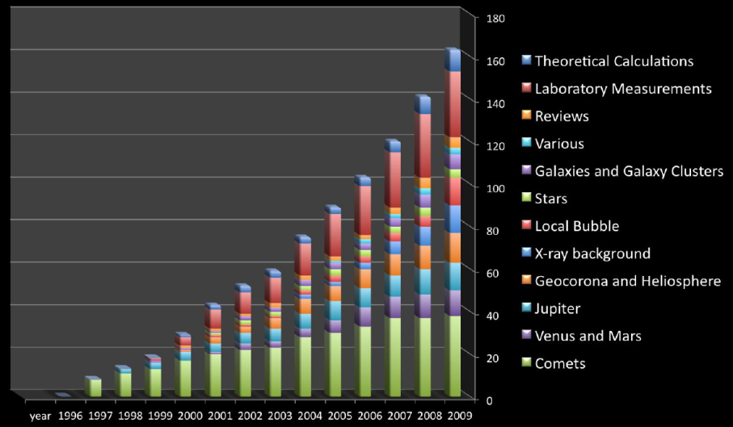
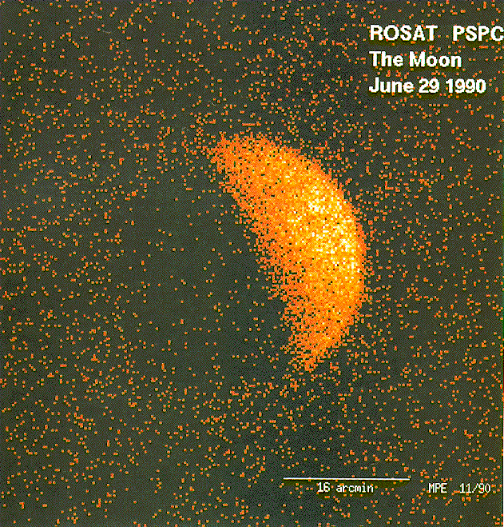
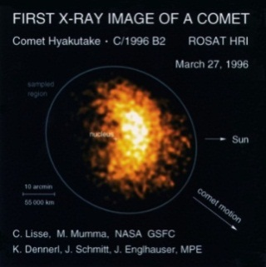
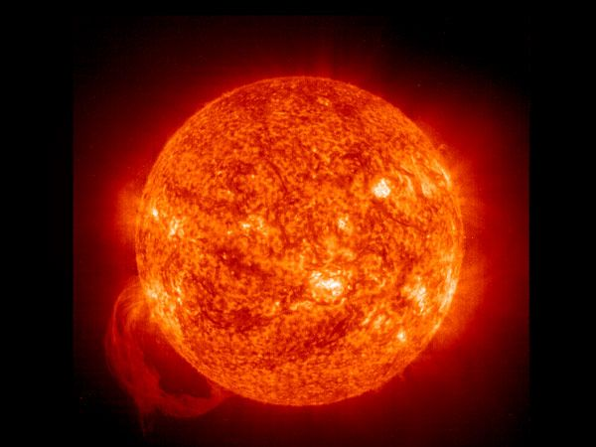
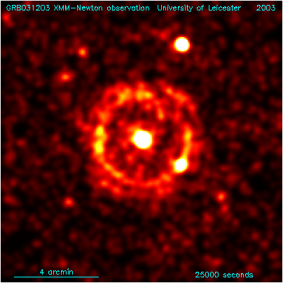
Other Science: Cold Universe
Charge Exchange
Schmitt et al. 1990
court. K. Dennerl
Interstellar Dust
scattering
spectroscopy
chemistry
Cool Stars
magnetic activity
coronae
Costantini et al., 2005
Vaughan et al., 2003
Merloni - eROSITA - AEI 11/2012

Slide 23
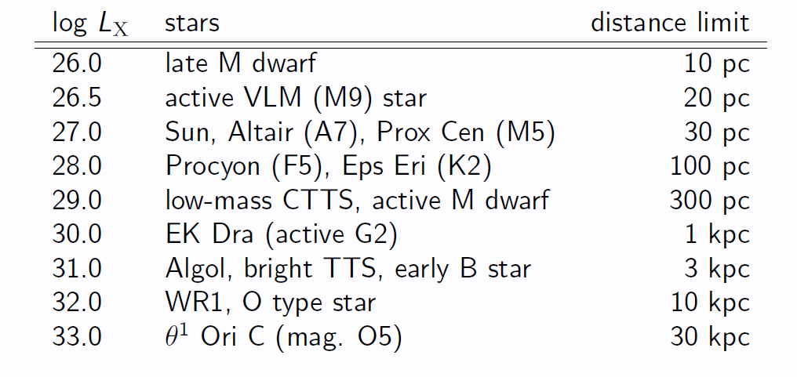
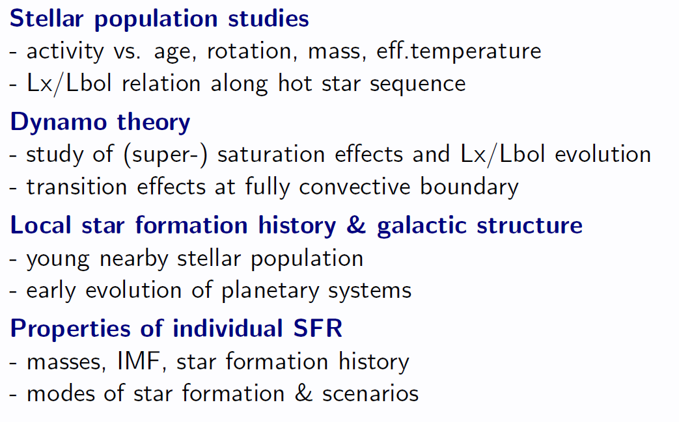
½ Million X-ray Stars
Cool Stars (late A to late M-type, magnetic activity, coronae)
Hot Stars (O to early B-type incl. WR Stars, wind shocks)
Variables
court. J. Robrade, J. Schmitt

Slide 24
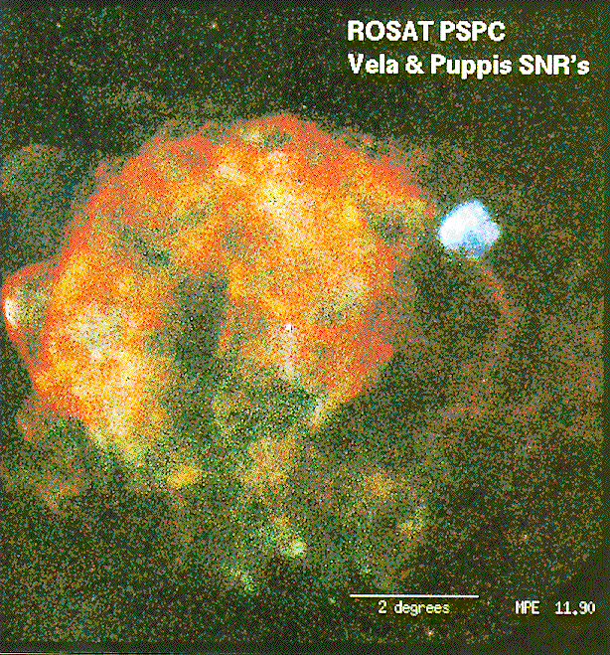
SNR + ISM
SNRs:
  Search for new SNR candidates (radio quiet / X-ray bright)
  Large SNRs in Milky Way
Hot Interstellar Medium:
  Globally (LMC, SMC)
  Particular Sources (superbubbles, SNR)
  Strong shocks, T, densitities, ionization stages, chem. abund., NE effects
  XMM-Newton and Chandra spectra show inconsistencies with collisional ionizing equilibrium
  and common non-equilibrium ionizing models
  Background:
    Local Hot Bubble (origin? state? CEI or NEI?, cooling curves?, etc.)
    Loop I (CE relevant?)
    Galactic Halo (by shadowing → 3d picture of contribution and properties)
Merloni - eROSITA - AEI 11/2012

Slide 25
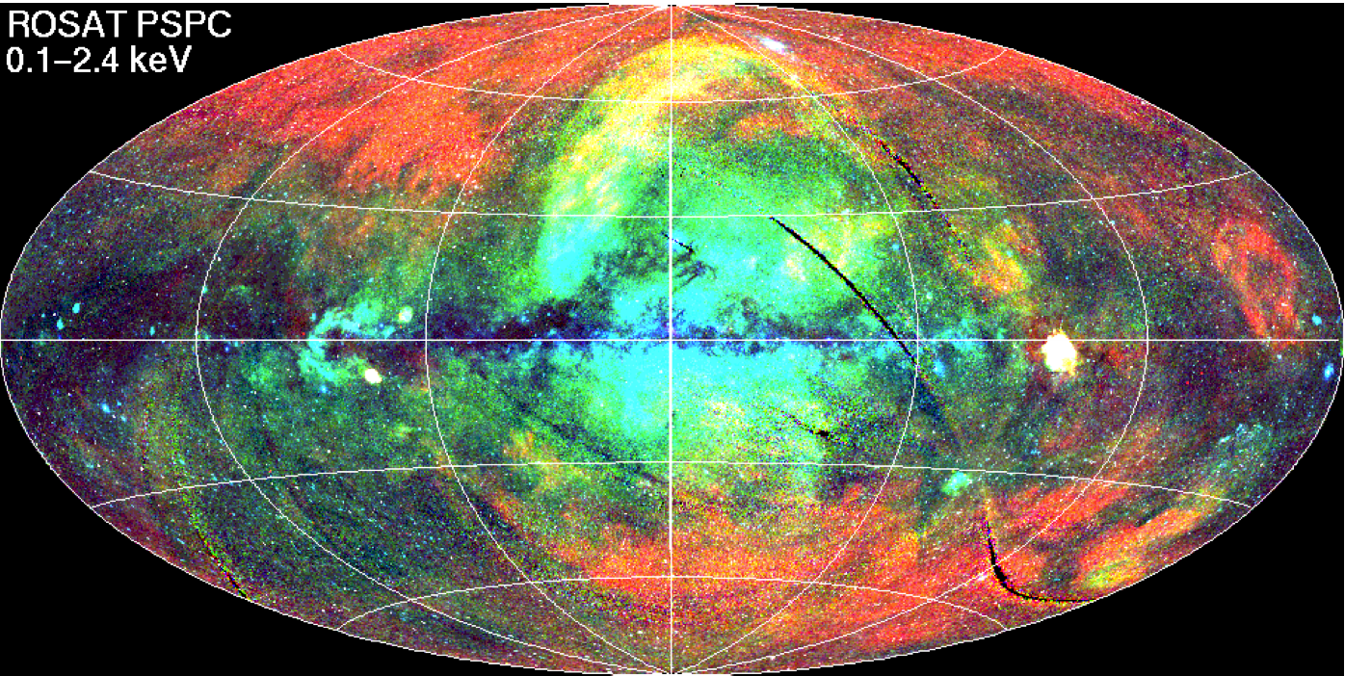
Diffuse emission
M. Freyberg, MPE
The complex physics of the hot ISM
Local Bubble, Loop-I, Galactic halo
Our understanding of it hasn’t changed much since ROSAT!

Slide 26
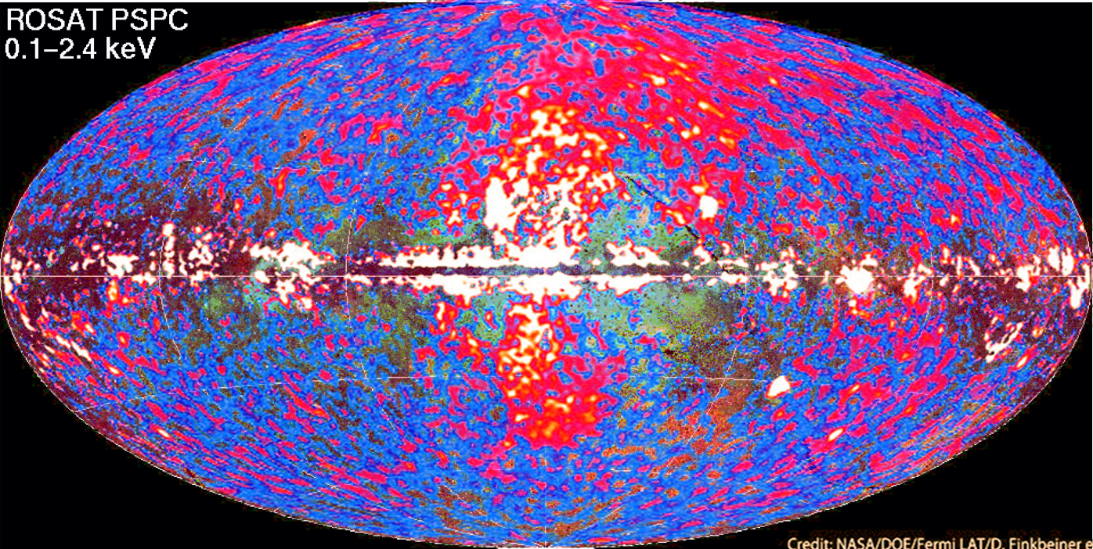
Diffuse emission
Fermi-LAT detects Loop-I @ 10-100 GeV
Past activity of SgrA*? Starburst Superwind?

Slide 27
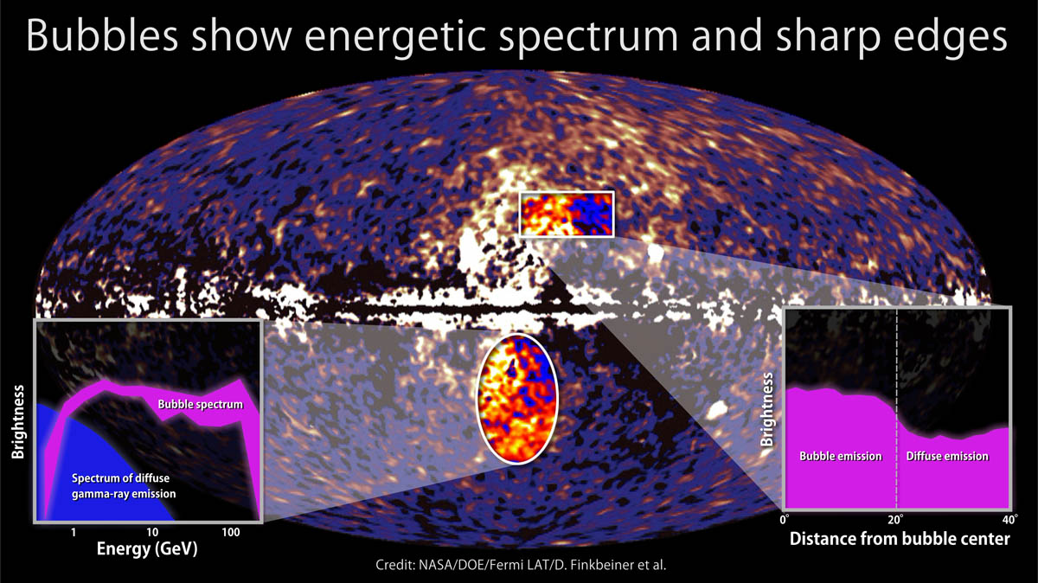
Diffuse emission
Fermi-LAT detects Loop-I @ 10-100 GeV
Past activity of SgrA*? Starburst Superwind?

Slide 28
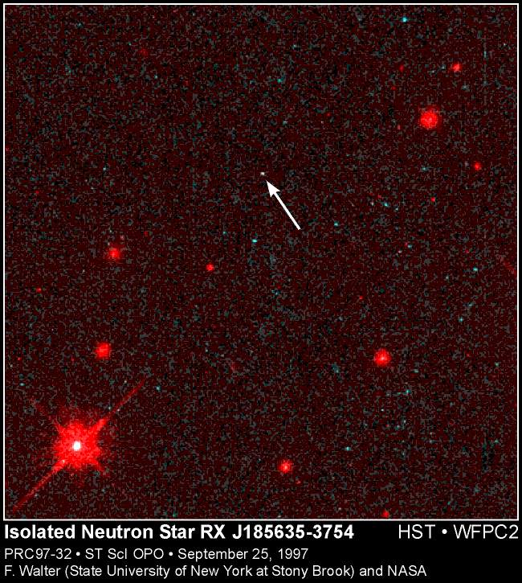

Compact Objects
Accretion
  via RLOF (CVs, LMXBs, BHs…)
  via stellar wind (HMXBs)
  via disk (BE)
  from ISM (INS, IBH)
  Cyclotron line features
  Heavily obscured binary systems
Thermonuclear
  Novae, Bursts
Cooling, remnant heat
  WDs, NSs
Magnetic Fields
  AXPs, Magnetars
Spin-down
  Pulsars
Other
Merloni - eROSITA - AEI 11/2012
>100 INS?

Slide 29
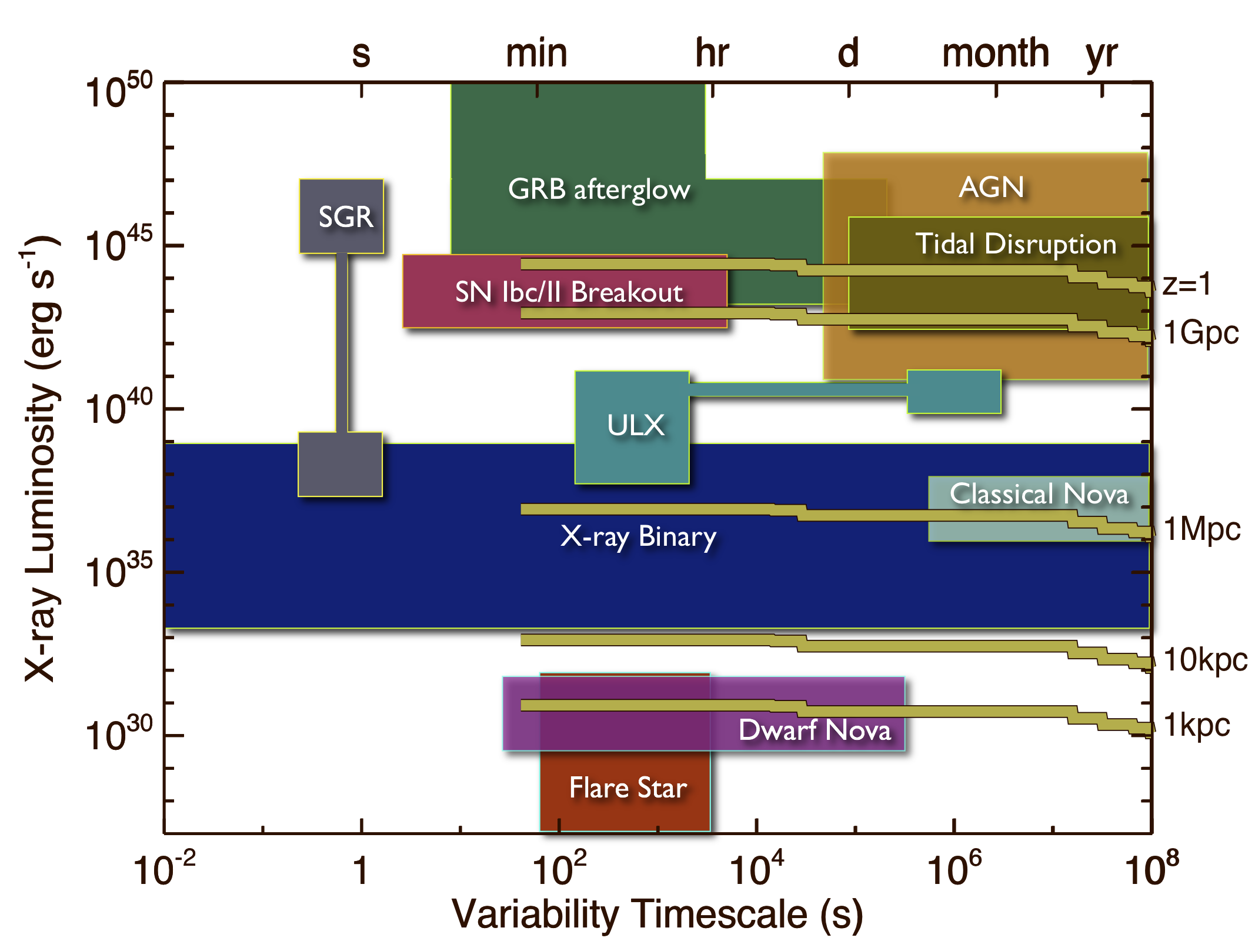
eROSITA sensitivity to variables
Merloni et al. 2012

Slide 30
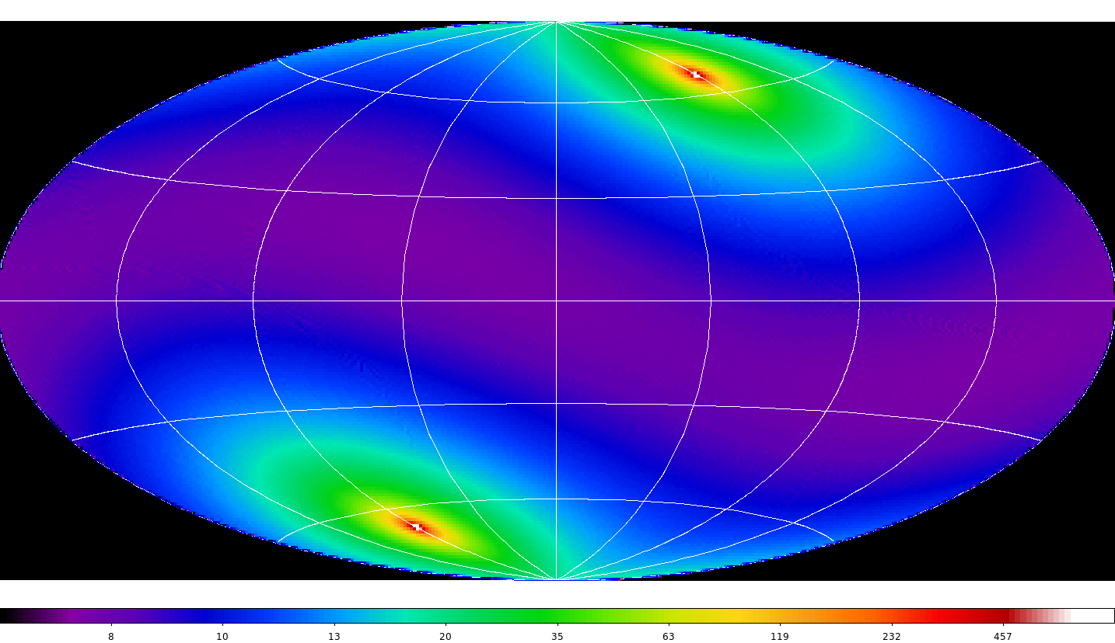
Cadence Map
Merloni et al. 2012

Slide 31
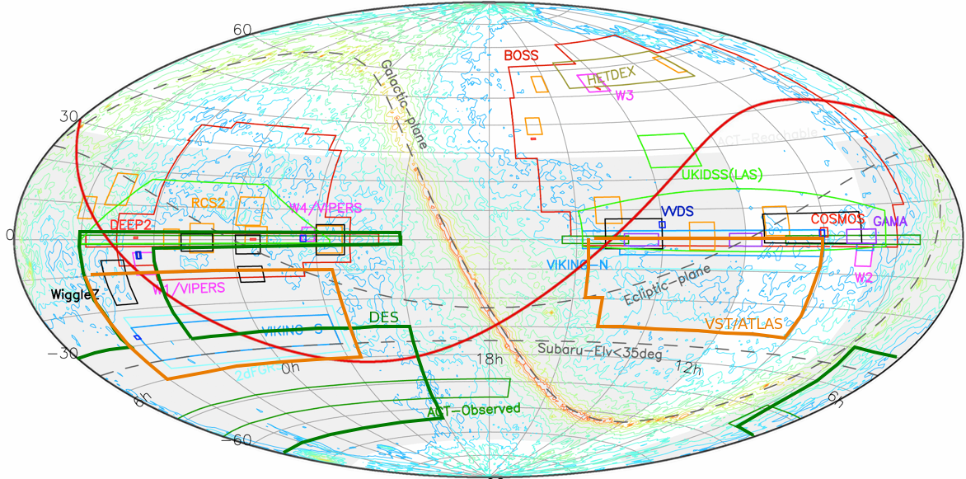
The landscape of O/IR
wide area surveys
IKI(R)
D/R split
MPE(D)
Image A. Nishizawa (IPMU), AM

Slide 32














(German) eROSITA spectroscopic follow-up plan
  Southern hemisphere: 4MOST (2019-2024)
    Complete, systematic follow-up of both Clusters and AGN from eROSITA: reach >80% completeness for eRASS:8
    After Conceptual Design Phase waiting ESO verdict (5/2013)
  Northern hemisphere: SPIDERS (AS3; 2014-2019)
    Early follow-up over a ~7500 deg² area in the NGC: reach >80% completeness for eRASS:4

Slide 33
Status
Telescope Structure: PFM Complete
Mirrors: Qualified, ~85% of all shells integrated, in spec (~15“)
Cameras: Qualified (incl. p-radiation), in spec, CCDs 100%, FM Cooling System: PFM complete
X-ray Baffles, Electron Deflector, Filterwheels etc: qualified, in manuf.
FM-Electronics: Behind schedule
Qualification tests of completer telescope completed (Jan 2013)
Delivery and test of Technological Moldel to Lavochkin (Maech 2013)
FM1 Mirror module completed and tested; FM2 tests underway
Next Steps
FM3-8 Mirror Modules tests and integration Apr-Nov 2013
Delivery to Lavochkin December 2013
SRG Launch Q4 2014
A. Merloni - eROSITA - IASF-BO 04/2013

Slide 34
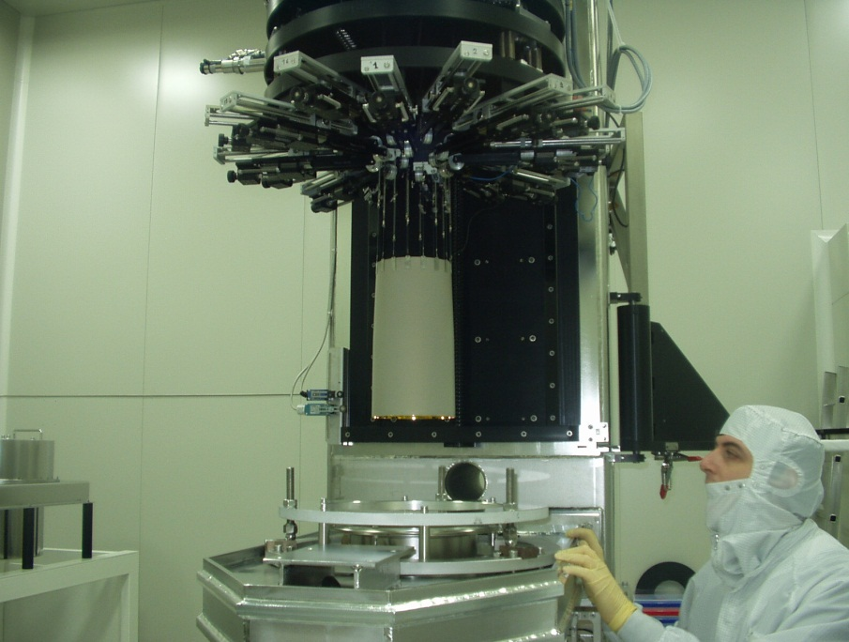
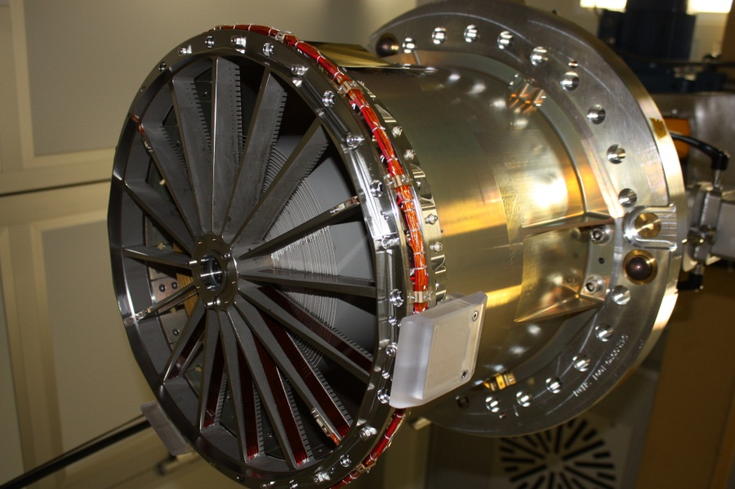

7 Mirrors
Integration of 8 Modules, >400 shells
FM-3, 2/3 of all shells integrated
Preparation of PANTER X-ray test
A. Merloni - eROSITA - IASF-BO 04/2013

Slide 35
eROSITA Mirror shells integration
X-ray Measurements
Spec @ 1.5keV = 15“
FM1, HEW=15.2“
FM2, HEW=xx.x“
Shell #
54 50 40 30 20 10 1
Integration Sequence
FM1 FM2 FM3 FM4 FM5 FM6 FM7 FM8
A. Merloni - eROSITA - IASF-BO 04/2013

Slide 36

FM1 PSF characterization at PANTER
- On-axis HEW 15.2” (1.5 keV)
A. Merloni - eROSITA - IASF-BO 04/2013
N. Clerc, MPE

Slide 37




7 Cameras

Slide 38


Testing the telescope structure
eROSITA at the space testing facility IABG during mass measurement.

Slide 39
Data Rights and Policies
German eROSITA data made public after 2 yr proprietary period
Periodic data releases envisaged (e.g. 6, 18, 48 months)
Proprietary data via German eROSITA Consortium
Projects/Papers regulated by Working Groups
Individual External Collaborations
Group External Collaborations (negotiations/discussions underway with DES, CAASTRO, HSC)
Science Working Groups:
Clusters and Cosmology
AGN, Blazars
Normal Galaxies
Compact objects
Diffuse emission, SNR
Stars, Solar System
Infrastructure Working Groups:
Time Domain Astrophysics
Data analysis, source extraction, catalogs
Multi-wavelength follow-up
Calibration
Background

Slide 40


Slide 41

Thank you! eROSITA Science Book arXiv:1209.3114

